Slide 1
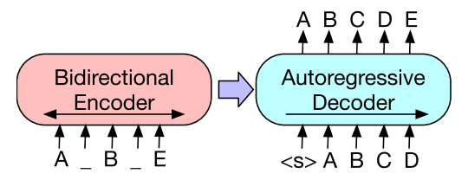
NPL modelling case
Sentiment analysis of Tweets
Technical Interview for:
Machine Learning Engineering Role
BART
Notes:
Thank you for attending.

Slide 2

The data
Message
Basic user information
Time and Date

Slide 3
Due to lack of compute
Message
Basic user information
Time and Date
Small version of dataset

Slide 4



The task: Binary Sentiment Analysis
0: Negative
1: Positive
Message
Basic user information
Time and Date
Small version of dataset
Model

Slide 5

Baseline: BART
Classification
Language Model
Translation
Generation
Comprehention
Large corpus of public internet data
No need for labels (self-supervision)
BART: A Denoising auto-encoder
Learns by reconstructing corrupted patterns
Transformer-based
Weights between all stages of encoder to decoder (attention)

Slide 6
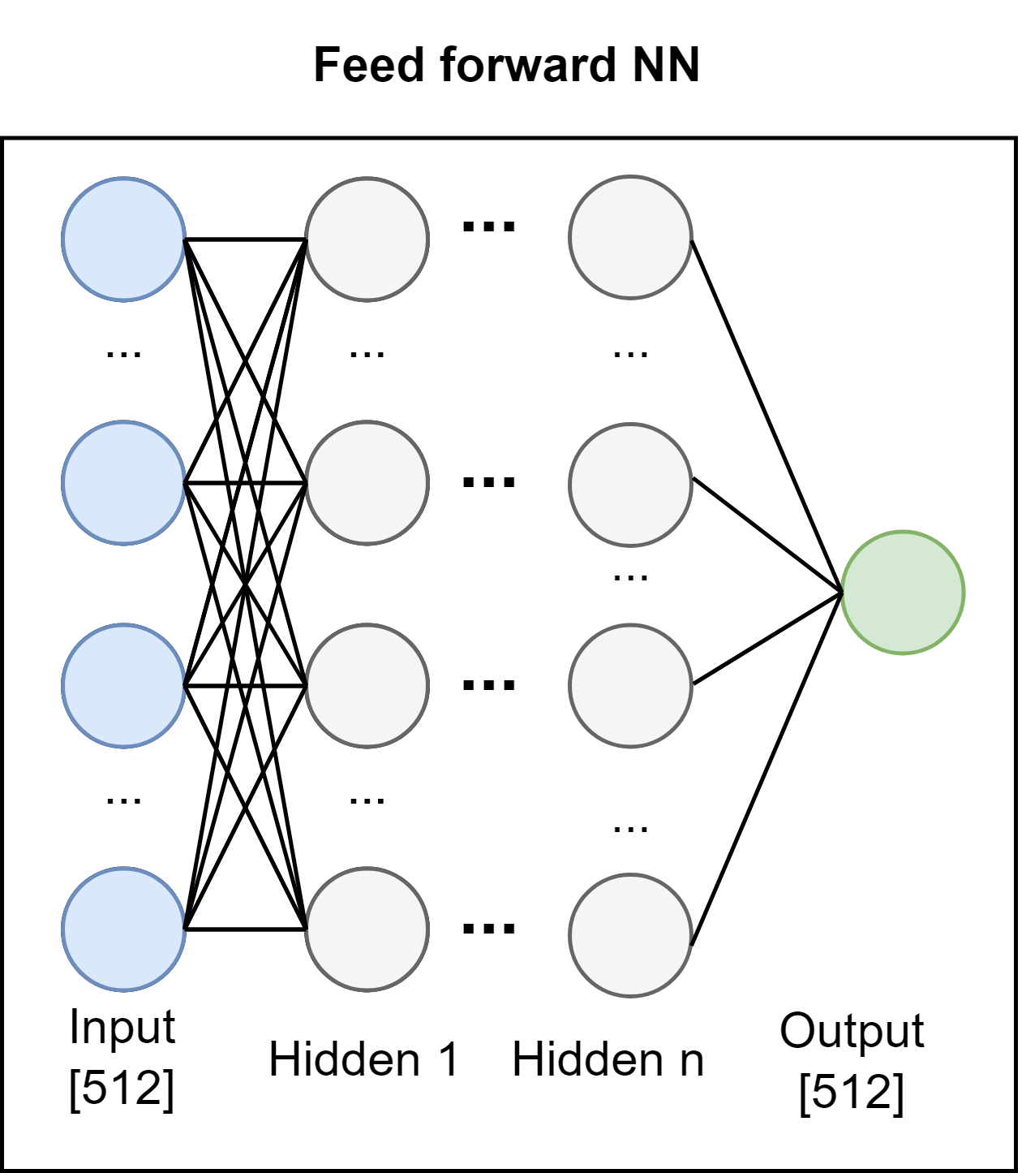
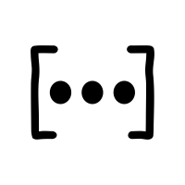
Proposed Solution
Text
Encodings

Slide 7
Proposed Solution
Text
Encodings
Sigmoid activation

Slide 8
Proposed Solution
Text
Encodings
Binary Cross-etropy (BCE) Loss

Slide 9
Proposed Solution
Text
Encodings
Hidden Layers 1-3
Hidden Units 10-200
ReLU/LeakyReLU activation
Dropout layer 0.2 – 0.5

Slide 10
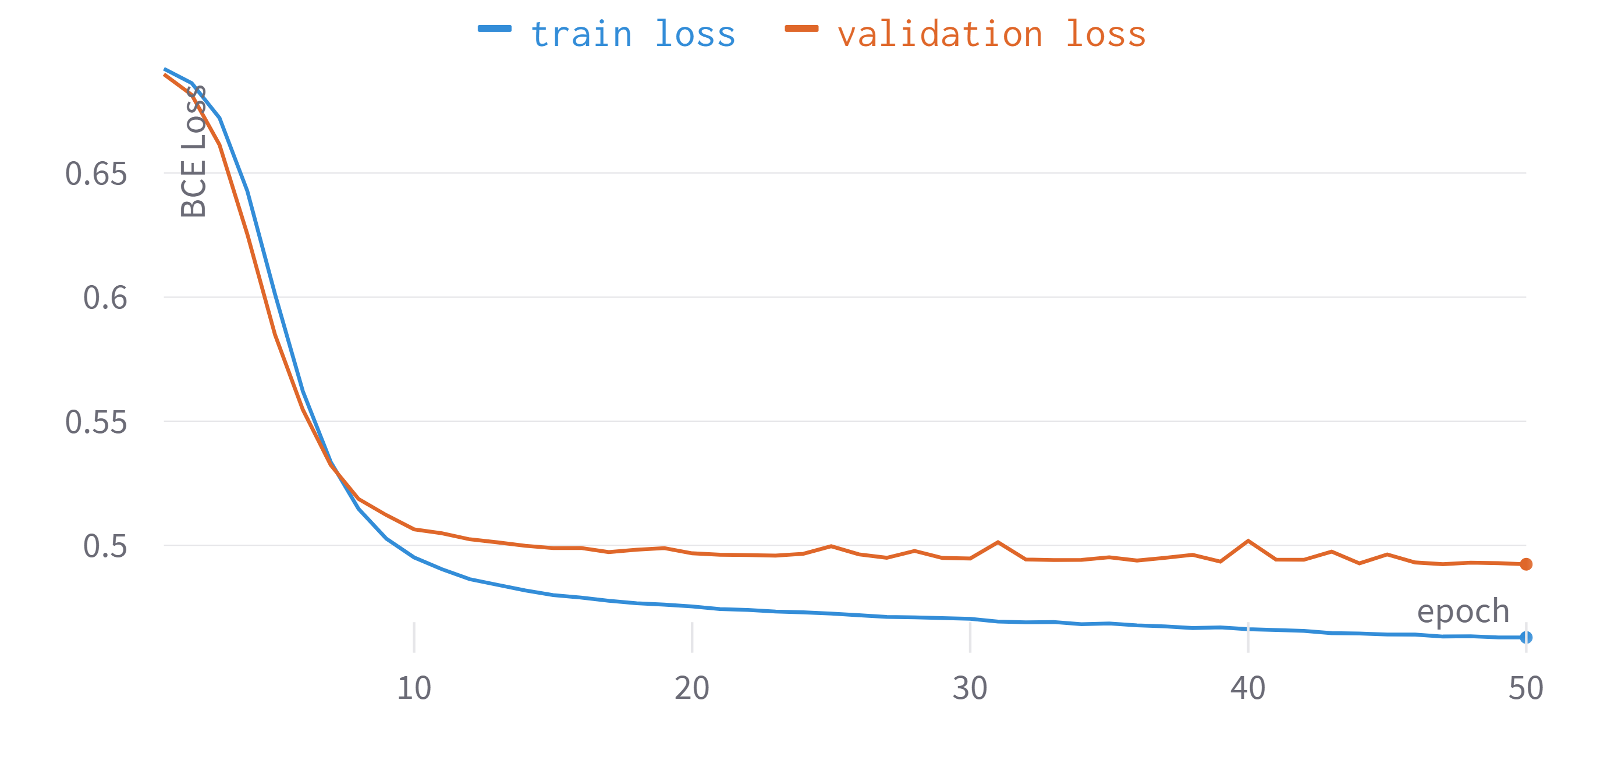
Results
Training of 1-Layered FFNN
Notes:
Rely on large amounts of labelled data, and a high computational error.
Are prone to inexplicable adversarial examples -> overfitting
Each model is tailored to a specific task, and domain.
They use backprop, which is a unlikely model for the plasticity of the brain.

Slide 11
Results
Some overfitting
Training of 1-Layered FFNN
Notes:
Rely on large amounts of labelled data, and a high computational error.
Are prone to inexplicable adversarial examples -> overfitting
Each model is tailored to a specific task, and domain.
They use backprop, which is a unlikely model for the plasticity of the brain.

Slide 12
Results
Some overfitting
Training of 1-Layered FFNN
Add regularization
Notes:
Rely on large amounts of labelled data, and a high computational error.
Are prone to inexplicable adversarial examples -> overfitting
Each model is tailored to a specific task, and domain.
They use backprop, which is a unlikely model for the plasticity of the brain.

Slide 13
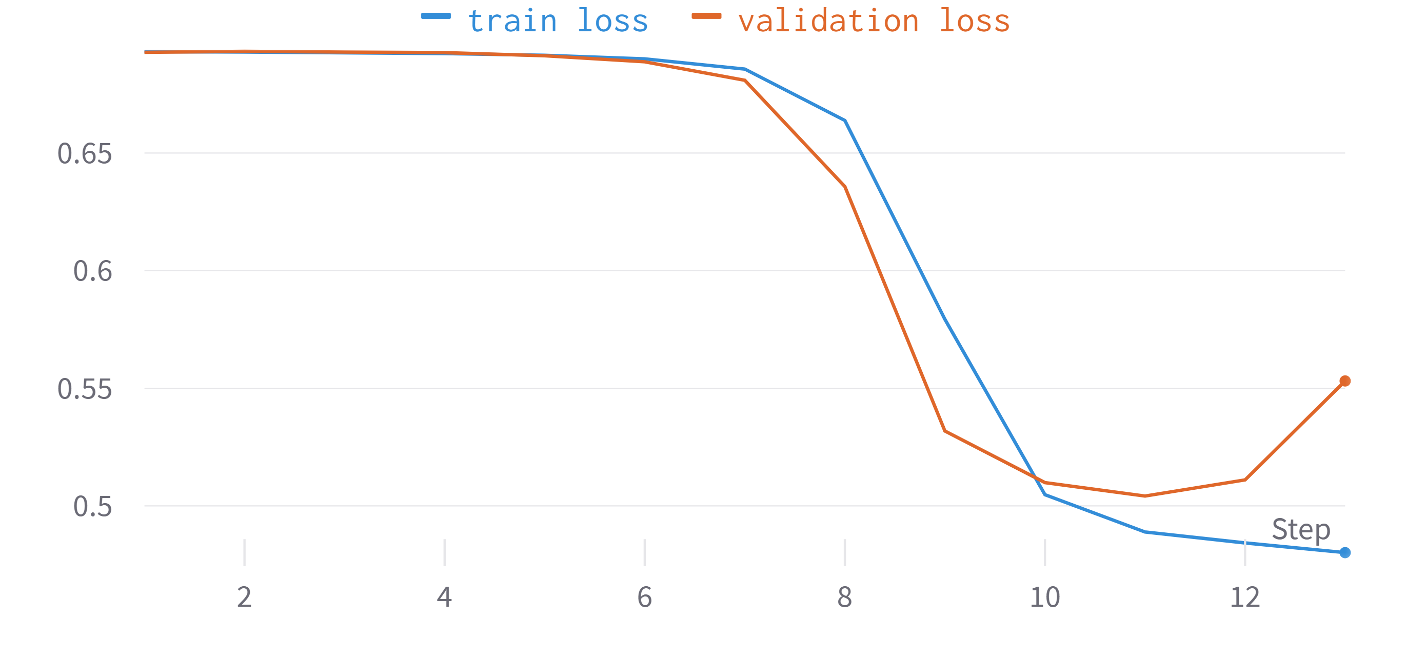
Results
Training of 1-Layered FFNN
Notes:
Rely on large amounts of labelled data, and a high computational error.
Are prone to inexplicable adversarial examples -> overfitting
Each model is tailored to a specific task, and domain.
They use backprop, which is a unlikely model for the plasticity of the brain.

Slide 14
Results
Clear overfit
Training of 1-Layered FFNN
Notes:
Rely on large amounts of labelled data, and a high computational error.
Are prone to inexplicable adversarial examples -> overfitting
Each model is tailored to a specific task, and domain.
They use backprop, which is a unlikely model for the plasticity of the brain.

Slide 15
Results
Clear overfit
Step back complexity
And hyper-tune
Training of 1-Layered FFNN
Notes:
Rely on large amounts of labelled data, and a high computational error.
Are prone to inexplicable adversarial examples -> overfitting
Each model is tailored to a specific task, and domain.
They use backprop, which is a unlikely model for the plasticity of the brain.

Slide 16
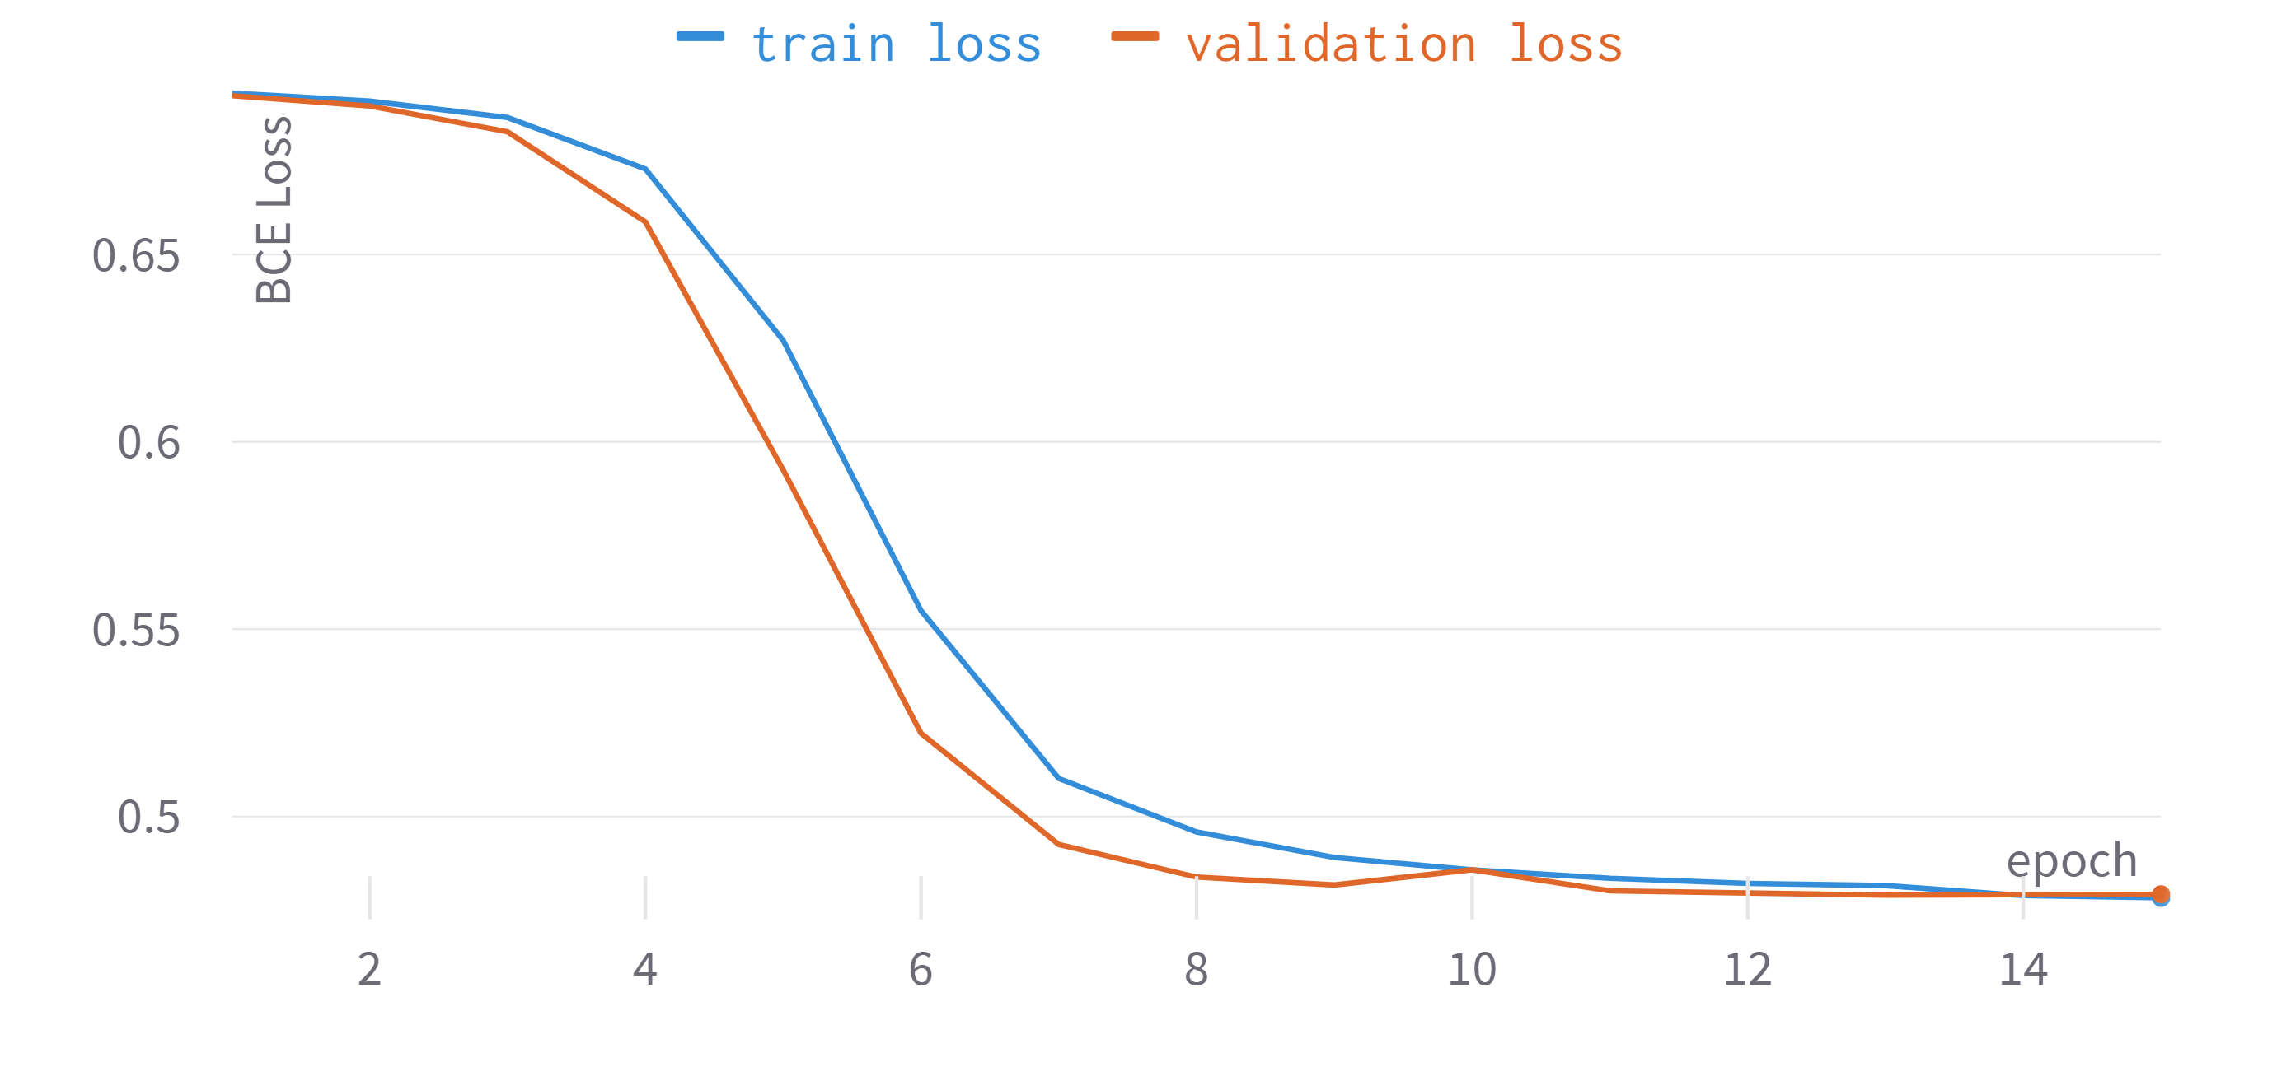
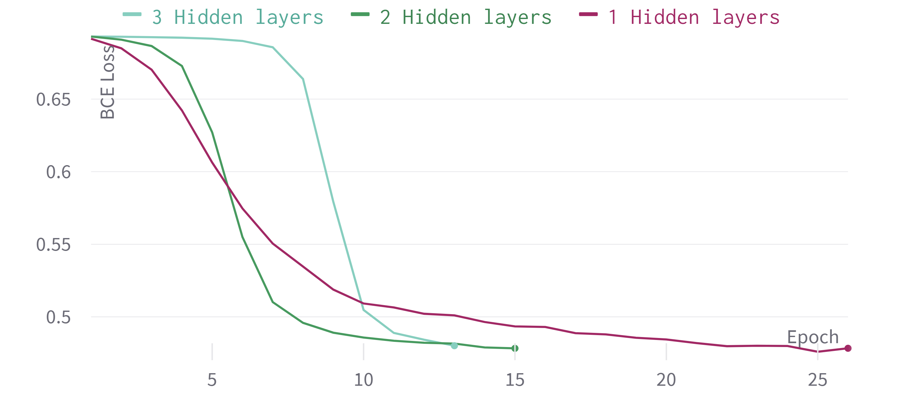
Results – tuned model
Final Model Training
3model comparison
Notes:
Rely on large amounts of labelled data, and a high computational error.
Are prone to inexplicable adversarial examples -> overfitting
Each model is tailored to a specific task, and domain.
They use backprop, which is a unlikely model for the plasticity of the brain.

Slide 17
Results - baseline comparison
Model | BART (baseline) | FFNN (proposed solution)
Notes:
Rely on large amounts of labelled data, and a high computational error.
Are prone to inexplicable adversarial examples -> overfitting
Each model is tailored to a specific task, and domain.
They use backprop, which is a unlikely model for the plasticity of the brain.

Slide 18
Results - baseline comparison
Model | BART (baseline) | FFNN (proposed solution)
Accuracy | 70% | 77%
Notes:
Rely on large amounts of labelled data, and a high computational error.
Are prone to inexplicable adversarial examples -> overfitting
Each model is tailored to a specific task, and domain.
They use backprop, which is a unlikely model for the plasticity of the brain.

Slide 19
Results - baseline comparison
Model | BART (baseline) | FFNN (proposed solution)
Accuracy | 70% | 77%
F1-score | 0.65 | 0.78
Notes:
Rely on large amounts of labelled data, and a high computational error.
Are prone to inexplicable adversarial examples -> overfitting
Each model is tailored to a specific task, and domain.
They use backprop, which is a unlikely model for the plasticity of the brain.

Slide 20
Results - baseline comparison
Model | BART (baseline) | FFNN (proposed solution)
Accuracy | 70% | 77%
F1-score | 0.65 | 0.78
Model size (trainable parameters) | 10.281 | 407.344.131
Notes:
Rely on large amounts of labelled data, and a high computational error.
Are prone to inexplicable adversarial examples -> overfitting
Each model is tailored to a specific task, and domain.
They use backprop, which is a unlikely model for the plasticity of the brain.

Slide 21
Results - baseline comparison
Model | BART (baseline) | FFNN (proposed solution)
Accuracy | 70% | 77%
F1-score | 0.65 | 0.78
Model size (trainable parameters) | 10.281 | 407.344.131
Applicability | Binary Classification | Many NLP Tasks
Notes:
Rely on large amounts of labelled data, and a high computational error.
Are prone to inexplicable adversarial examples -> overfitting
Each model is tailored to a specific task, and domain.
They use backprop, which is a unlikely model for the plasticity of the brain.

Slide 22
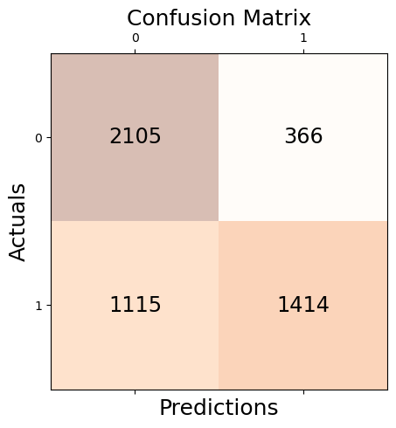
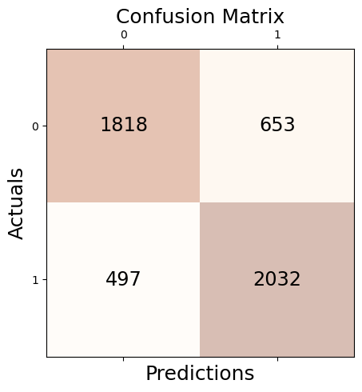
Results - baseline comparison
BART
FFNN
Notes:
Rely on large amounts of labelled data, and a high computational error.
Are prone to inexplicable adversarial examples -> overfitting
Each model is tailored to a specific task, and domain.
They use backprop, which is a unlikely model for the plasticity of the brain.

Slide 23
Results - baseline comparison
BART
FFNN
BART is negative-biased
Notes:
Rely on large amounts of labelled data, and a high computational error.
Are prone to inexplicable adversarial examples -> overfitting
Each model is tailored to a specific task, and domain.
They use backprop, which is a unlikely model for the plasticity of the brain.

Slide 24
Results - baseline comparison
BART
FFNN
Good class-balance
Notes:
Rely on large amounts of labelled data, and a high computational error.
Are prone to inexplicable adversarial examples -> overfitting
Each model is tailored to a specific task, and domain.
They use backprop, which is a unlikely model for the plasticity of the brain.

Slide 25
Conclusions
Notes:
Divide the experimental analysis in two sections
Some final thoughts and FUTURE work

Slide 26
Conclusions
Built a complete solution from data -> sentiment analysis
Notes:
Divide the experimental analysis in two sections
Some final thoughts and FUTURE work

Slide 27
Conclusions
Built a complete solution from data -> sentiment analysis
Simple solution was better than baseline
Notes:
Divide the experimental analysis in two sections
Some final thoughts and FUTURE work

Slide 28
Conclusions
Built a complete solution from data -> sentiment analysis
Simple solution was better than baseline
Hopefully I have shown my ML fundamentals despite lack of NLP experience
Notes:
Divide the experimental analysis in two sections
Some final thoughts and FUTURE work

Slide 29
Conclusions
Built a complete solution from data -> sentiment analysis
Simple solution was better than baseline
Hopefully I have shown my ML fundamentals despite lack of NLP experience
What could be improved:
Notes:
Divide the experimental analysis in two sections
Some final thoughts and FUTURE work

Slide 30
Conclusions
Built a complete solution from data -> sentiment analysis
Simple solution was better than baseline
Hopefully I have shown my ML fundamentals despite lack of NLP experience
What could be improved:
Use of K-folds cross validation
Notes:
Divide the experimental analysis in two sections
Some final thoughts and FUTURE work

Slide 31
Conclusions
Built a complete solution from data -> sentiment analysis
Simple solution was better than baseline
Hopefully I have shown my ML fundamentals despite lack of NLP experience
What could be improved:
Use of K-folds cross validation
Use of more advanced model (1d CNN, RNN, etc…)
Notes:
Divide the experimental analysis in two sections
Some final thoughts and FUTURE work

Slide 32
Conclusions
Built a complete solution from data -> sentiment analysis
Simple solution was better than baseline
Hopefully I have shown my ML fundamentals despite lack of NLP experience
What could be improved:
Use of K-folds cross validation
Use of more advanced model (1d CNN, RNN, etc…)
Better programming practices (config files, automated sweeps)
Notes:
Divide the experimental analysis in two sections
Some final thoughts and FUTURE work

Slide 33
Conclusions
Built a complete solution from data -> sentiment analysis
Simple solution was better than baseline
Hopefully I have shown my ML fundamentals despite lack of NLP experience
What could be improved:
Use of K-folds cross validation
Use user information and datetime information in FF model
Use of more advanced model (1d CNN, RNN, etc…)
Better programming practices (config files, automated sweeps
Notes:
Divide the experimental analysis in two sections
Some final thoughts and FUTURE work

Slide 34
Thank you
Notes:
Divide the experimental analysis in two sections
Some final thoughts and FUTURE work

