Slide 1



relatorio_gerencial_modificado
View in Power BI
Last data refresh:
03/12/2025 10:09:33 UTC
Downloaded at:
03/12/2025 10:12:23 UTC

Slide 2
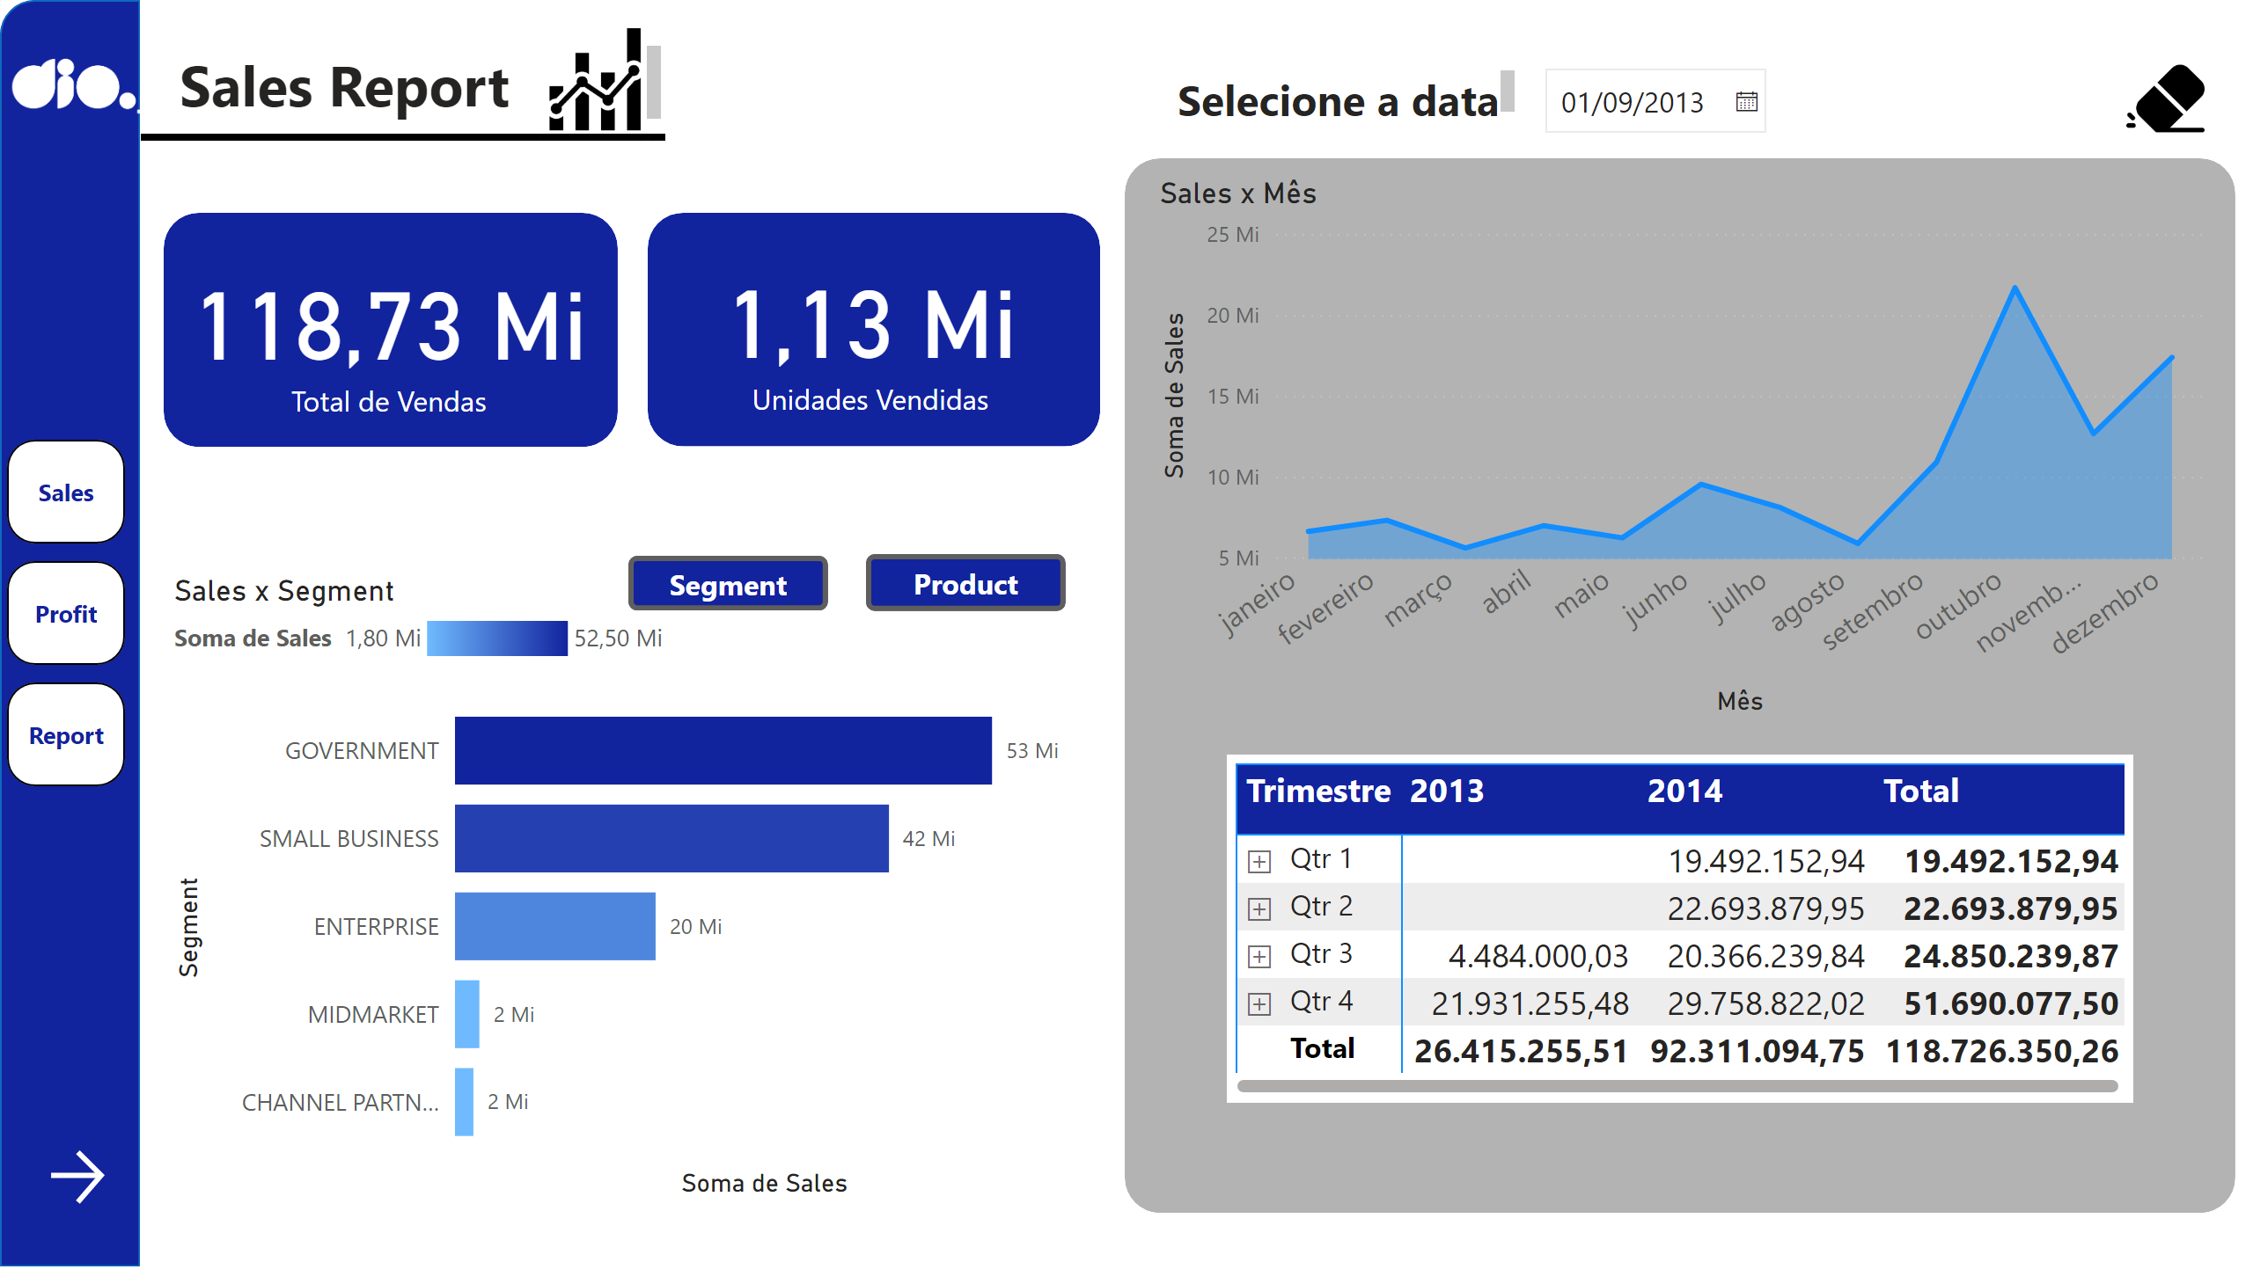
Sales
Notes:
shape
No alt text provided
shape
No alt text provided
logo_dio
No alt text provided
textbox
No alt text provided
image
No alt text provided
shape
No alt text provided
shape
No alt text provided
Sales x Mês
No alt text provided
card
No alt text provided
shape
No alt text provided
card
No alt text provided
shape
No alt text provided
Sales x Segment
No alt text provided
clusteredBarChart
No alt text provided
Botão - Product
No alt text provided
Botão - Segment
No alt text provided
clean
No alt text provided
actionButton
No alt text provided
textbox
No alt text provided
slicer
No alt text provided
actionButton
No alt text provided
pivotTable
No alt text provided
shape
No alt text provided
pageNavigator
No alt text provided

Slide 3
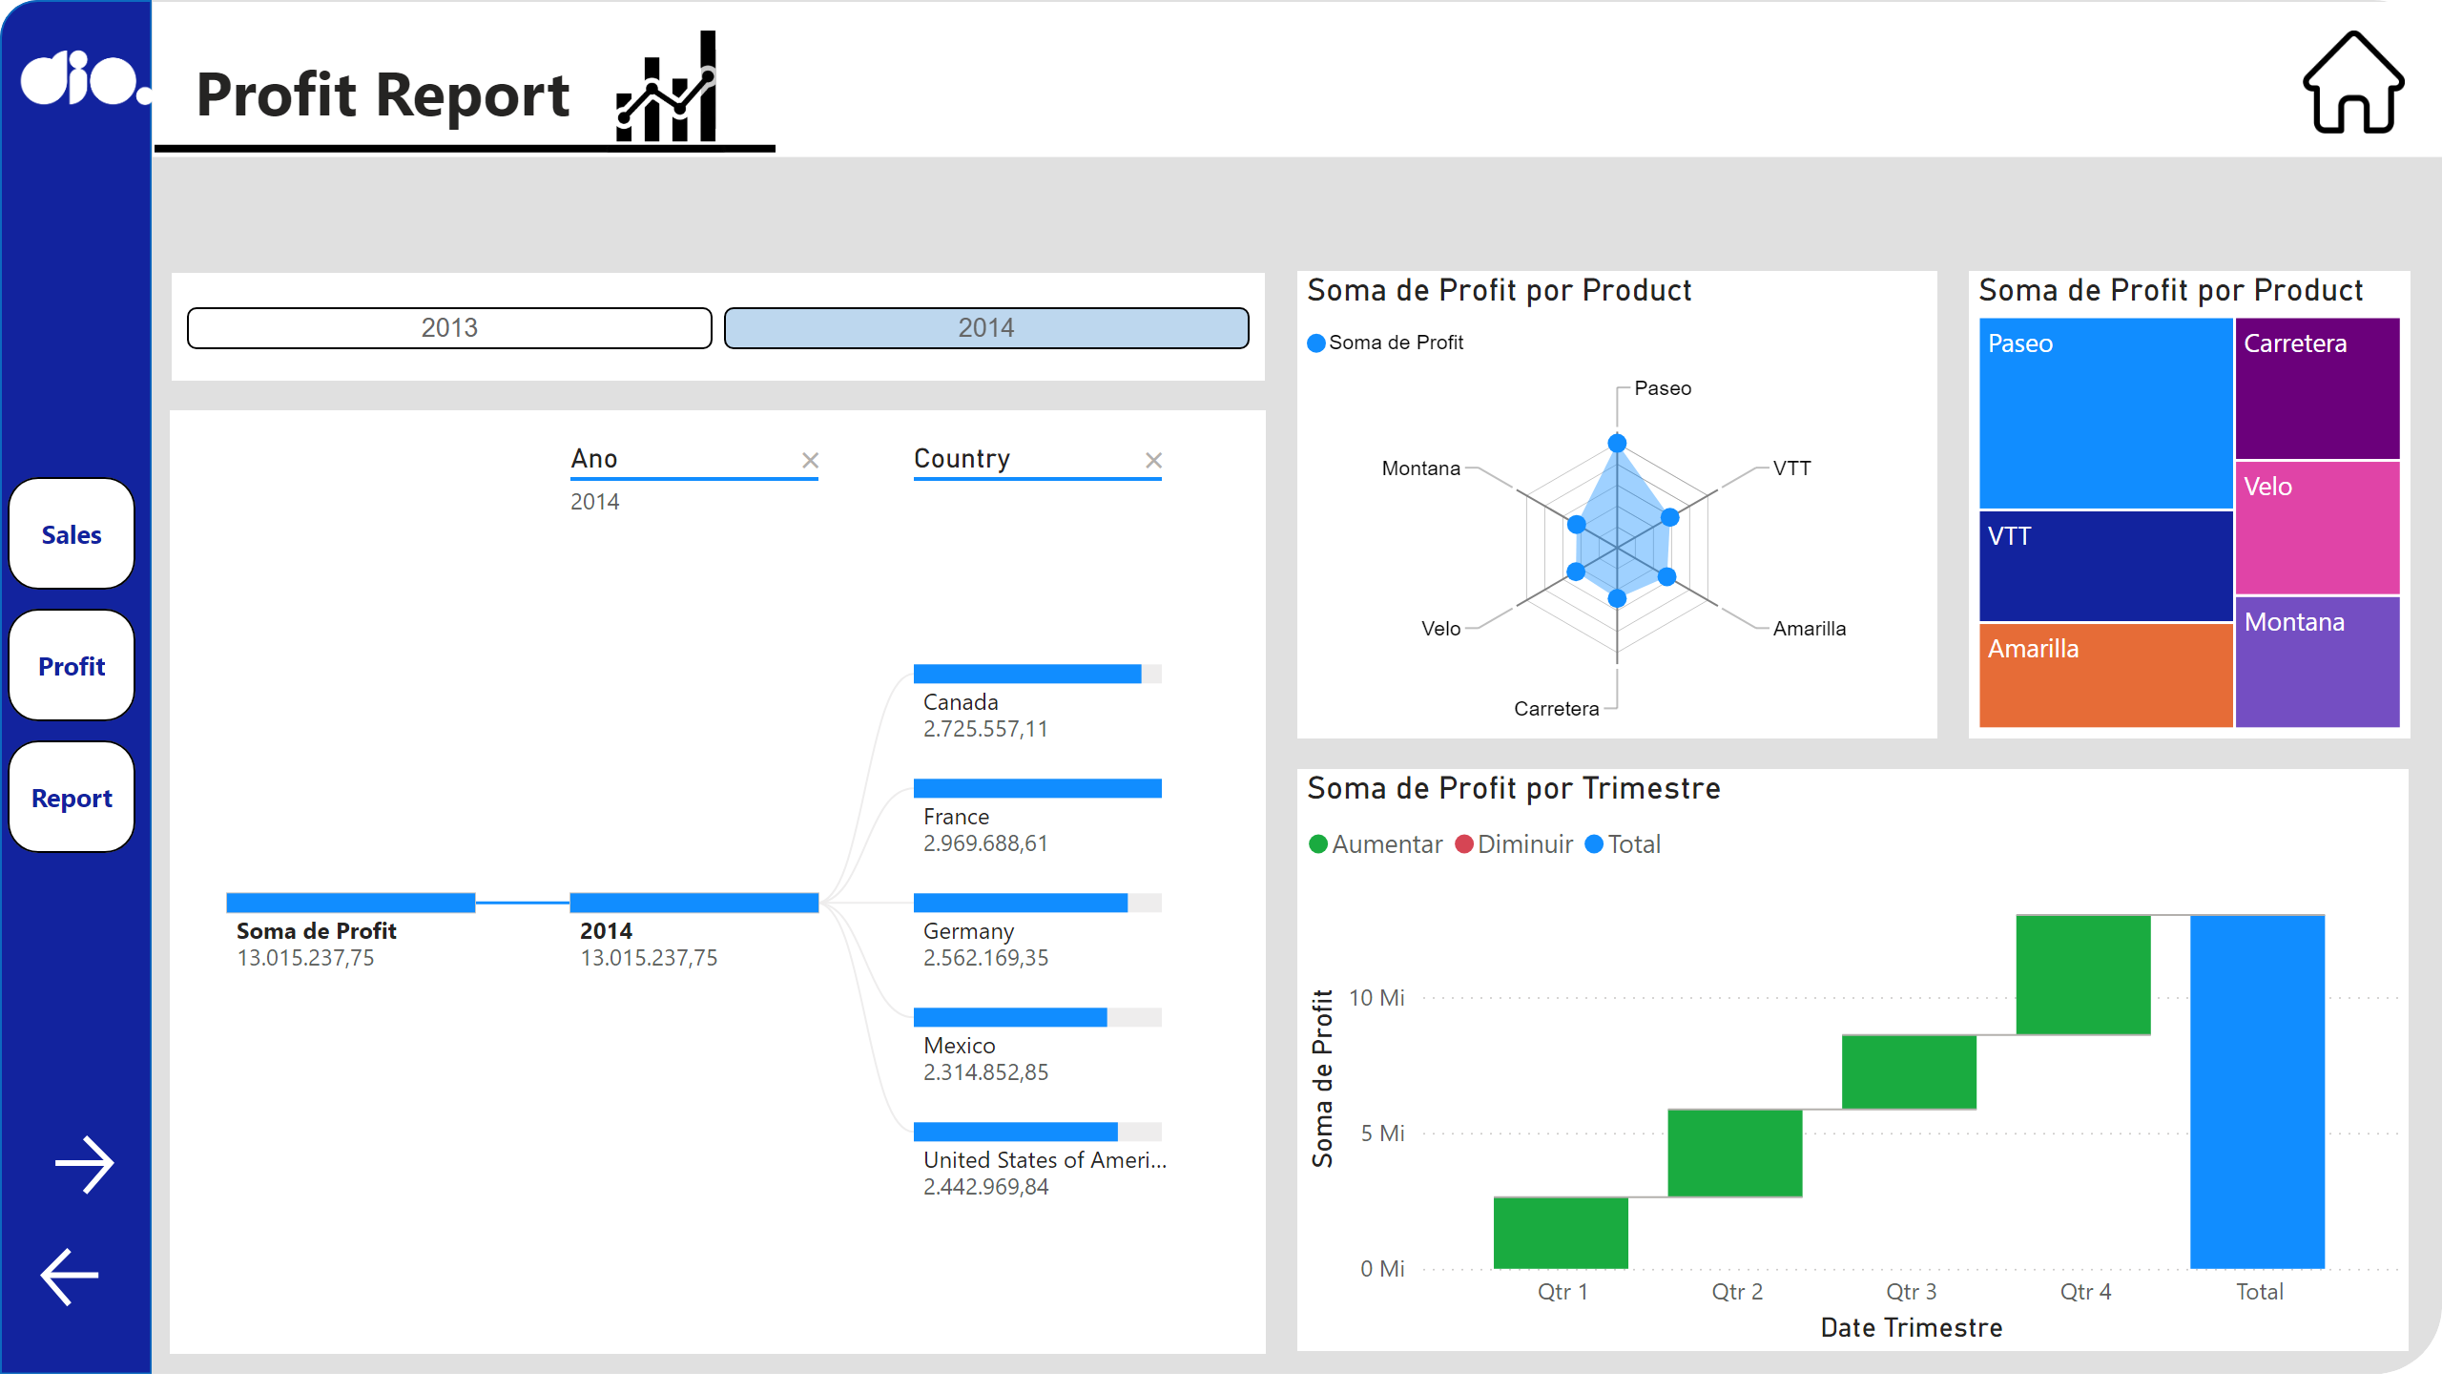
Profit
Notes:
shape
No alt text provided
shape
No alt text provided
shape
No alt text provided
logo_dio
No alt text provided
shape
No alt text provided
shape
No alt text provided
shape
No alt text provided
shape
No alt text provided
treemap
No alt text provided
RadarChart1446119667547
No alt text provided
waterfallChart
No alt text provided
decompositionTreeVisual
No alt text provided
ChicletSlicer1448559807354
No alt text provided
actionButton
No alt text provided
pageNavigator
No alt text provided
image
No alt text provided
textbox
No alt text provided
image
No alt text provided
shape
No alt text provided
actionButton
No alt text provided

Slide 4
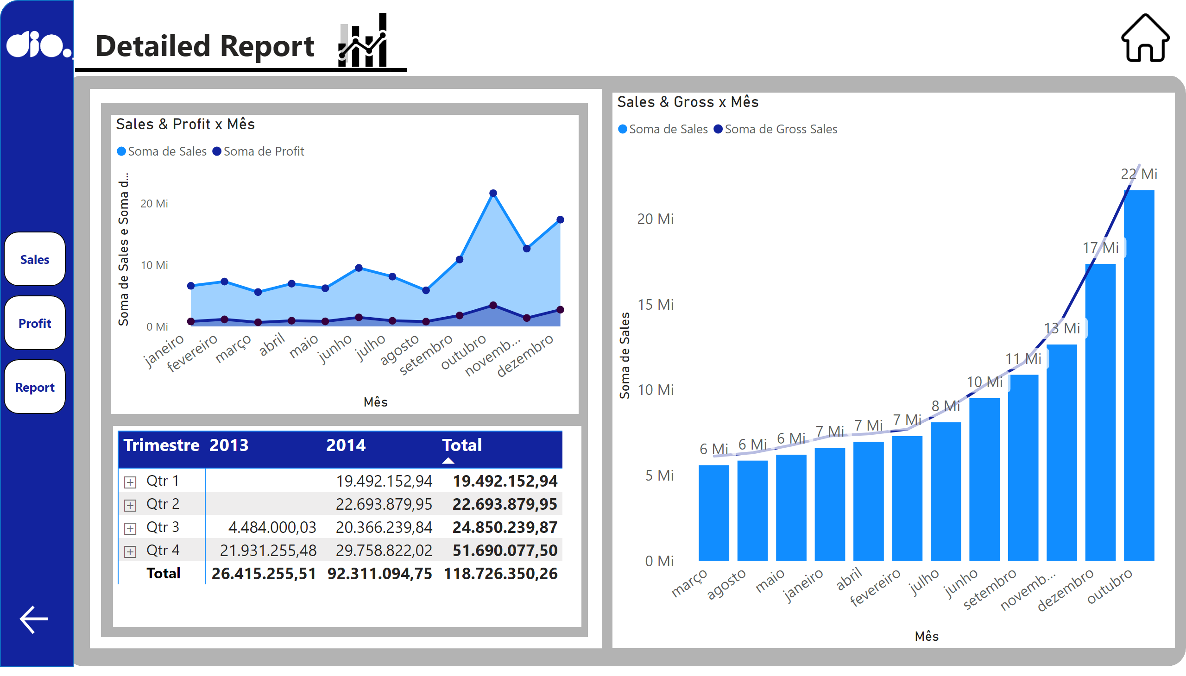
Report
Notes:
shape
No alt text provided
shape
No alt text provided
logo_dio
No alt text provided
Sales & Profit x Mês
No alt text provided
pivotTable
No alt text provided
shape
No alt text provided
pageNavigator
No alt text provided
shape
No alt text provided
shape
No alt text provided
Sales & Gross x Mês
No alt text provided
image
No alt text provided
textbox
No alt text provided
image
No alt text provided
shape
No alt text provided
actionButton
No alt text provided

