Slide 1
The Effect of Crime Perception in Tourism Towards Mexico: Differentiated Impacts
Rodrigo Valdés Ortiz

Slide 2
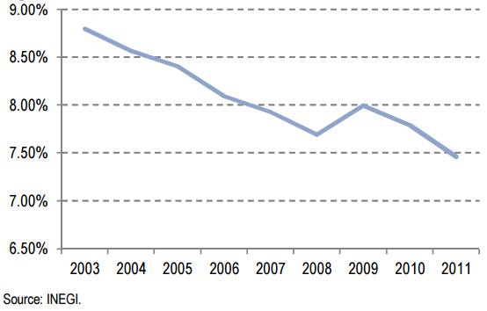
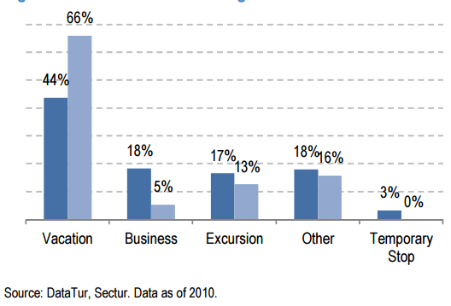
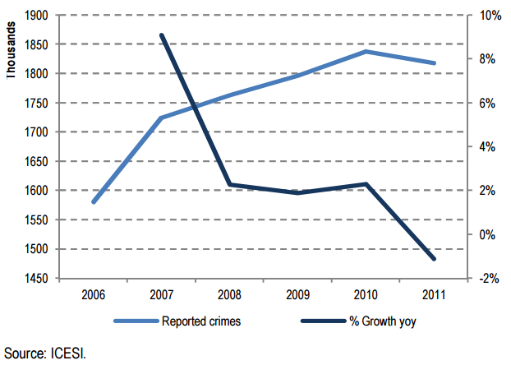
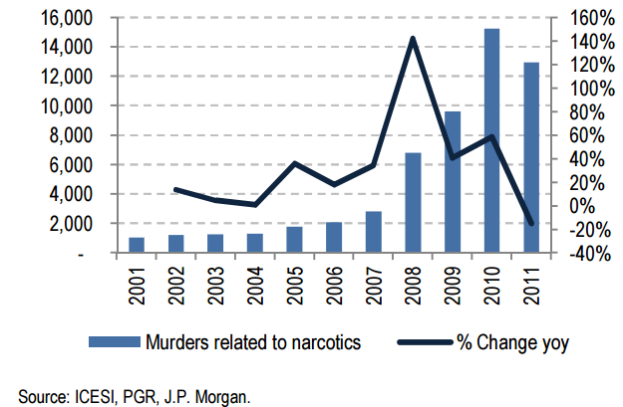
Motivation
GDP Related with Tourism
Reasons to Visit Mexico
Reported Crimes
Source: all graphs from Mexico 101, JP Morgan.

Slide 3
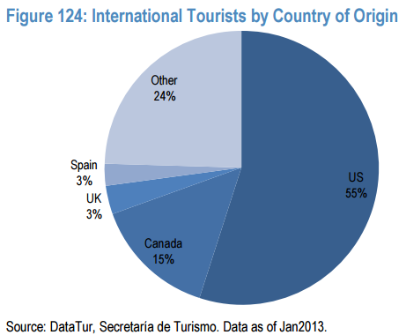
Motivation
Visitors by Region
Source: all graphs from Mexico 101, JP Morgan.

Slide 4
Research Question
What are the effects of perception of crime on the tourism towards Mexico?
How does perception varies by characteristics of the individuals, such as gender, ethnicity, age, or education?

Slide 5
Data
Data: Sentiment Analysis
Infer gender, ethnicity, place in the US, age.
Twitter
Instagram
Tumblr
Social Networks
Newspapers
Data: Sentiment Analysis
Characteristics of the authors
New York Times
Boston Globe

Slide 6
Data
Facts
Decision to Travel
Crime Indicators: homicides, crime reports, others
Number of tourists
Spending by tourist
Total spending
Global Indicators
Exchange rate
Seasonality

Slide 7
Theory and Computational Tools
Statistics and Economics
Decisions to travel (microeconomics)
Web scrapping
Machine learning
Regressions
Content analysis
Sentiment analysis
Infer characteristics
Time series

Slide 8
Possible Findings
Does the perception differ by ethnicity, age, and place of origin?
How the perception changes by social network? Which of them responds more quickly to events?
Does the perception overreacts in the short term?
Is perception in newspapers aligned with perception in social networks?
Is perception more important than the facts?

Slide 9
Thanks!
Criticize welcome.

