Slide 1
The Effect of Crime Perception in Tourism Towards Mexico: Differentiated Impacts
Rodrigo Valdés Ortiz

Slide 2
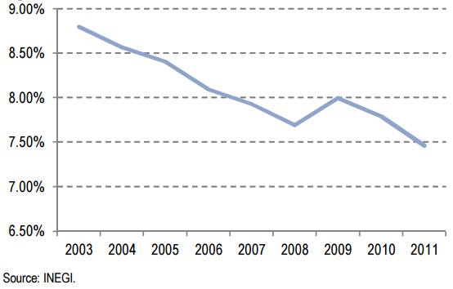
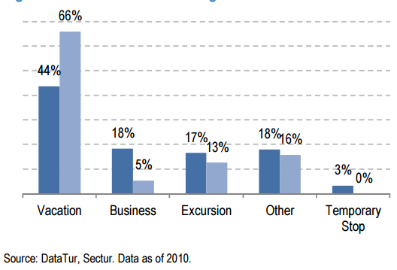
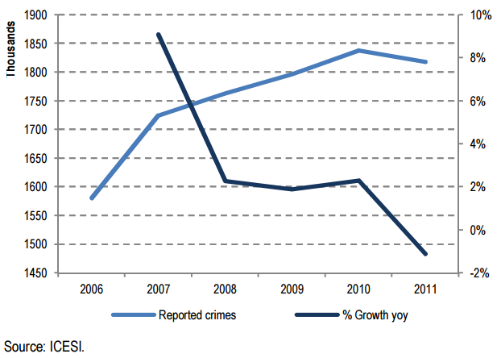
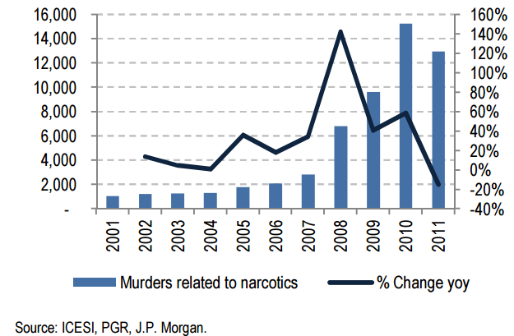
Motivation
GDP Related with Tourism
Reasons to Visit Mexico
Reported Crimes
Source: all graphs from Mexico 101, JP Morgan.

Slide 3
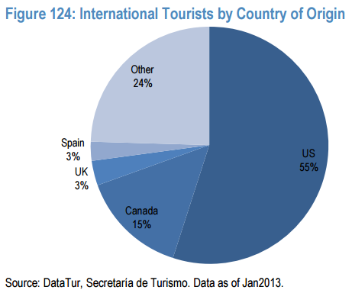
Motivation
Visitors by Region
Source: all graphs from Mexico 101, JP Morgan.

Slide 4
Research Question
What are the effects of perception of crime on the tourism towards Mexico?
Two steps:
1) Perception by characteristics of the individuals (gender, ethnicity, age, others) vs data.
2) How perception affects tourism vs data. Perception and decisions by characteristics of the individuals.

Slide 5
Data for Perception
Data: Sentiment Analysis
Infer gender, ethnicity, place in the US, age.
Twitter
Tumblr
Social Networks
Newspapers
Data: Sentiment Analysis
Characteristics of the authors
New York Times
Boston Globe

Slide 6
Other Data
Facts
Decision to Travel
Crime Indicators: homicides, crime reports, others
Number of tourists
Spending by tourist
Total spending
Indicators
Exchange rate
Seasonality

Slide 7
Theory and Computational Tools
Statistics and Economics
Decisions to travel (microeconomics)
Web scrapping
Machine learning
Regressions
Content analysis
Sentiment analysis
Infer characteristics
Time series

Slide 8
Possible Findings
Does the perception differ by ethnicity, age, and place of origin?
How the perception changes by social network? Which of them responds more quickly to events?
Is perception in newspapers aligned with perception in social networks?
What is the lag between change in ”facts” and change in perception?
What is the elasticity of perception of crime to crime?
Is perception more important than facts to explain tourist’s decisions?

Slide 9
Thanks!
Criticize welcome.

