Slide 1


Slide 2
Rodrigo Yoshima
blog.aspercom.com.br
@rodrigoy
Kanban: The Flow Hour

Slide 3
Kanban Assessment
What do you know about Kanban?
(Mind Map)

Slide 4
Before we start: The Job!
Join groups of 4-7 people.
The deliverables:
UI Sketch (one sheet)
Test Case (one sheet)
CRC Cards or Class Diagram (index card or sheet)
(Domain Classes Only – examples Order, Invoice, Customer, Product)

Slide 5
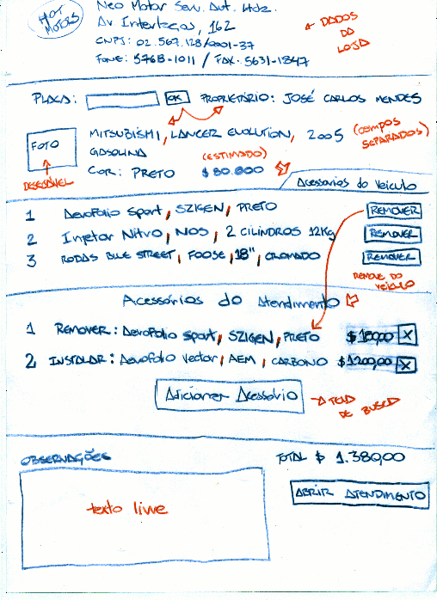
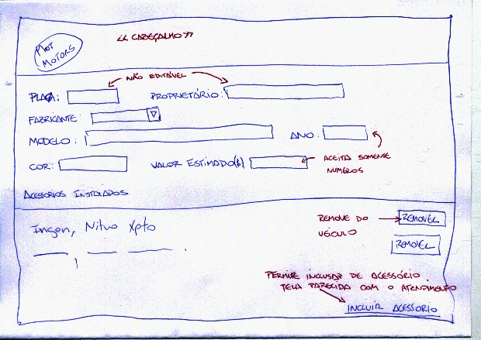
UI Sketch (Paper Prototyping)
All must look like
One per sheet

Slide 6
Test Case Example
Feature: Signin
Success Scenario:
When I type a valid username and password
And click “Submit”
Then I see the User Profile
Fail Scenario:
When I type a invalid username or password
And click “Submit”
I see the error message “Permission Denied”

Slide 7
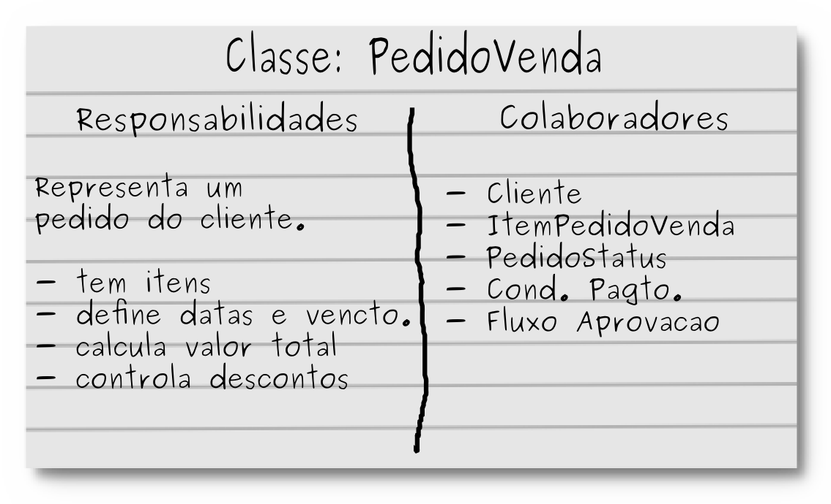
CRC Card / Class Diagram

Slide 8
Case Study:
Corporate Social Network
(Orkut/Facebook Style)
Product Vision: “The system should improve social online interaction inside the company by linking workers profiles as friends, so they can exchange messages and discuss ideas on communities/groups.”

Slide 9
Round 1: In the beginning the caos...
Use paper and index card to create the deliverables for the system. Poor quality will be rejected by the user.
Policy:
Production Delivery ASAP

Slide 10
Retrospective 1
Did you deliver something?
How do you evaluate? (1-5)
    Quality
    Team Focus
    Work Visibility
    Project Predictability
What can we improve?

Slide 11
Using small batches: User Stories
Use Index Cards to write stories:
View Worker Profile
Write a Scrap
Search Profile
Create a Community
Accept / Reject relationship request
Write on the community discussion list
Upload and Remove Photos (Worker Profile)
Create my Profile
Check community discussions

Slide 12
User Stories
Ban worker from the community
Edit my Profile
View Scraps
Show Worker relationships
Write a Testimonial (friend workers only)
Sign in
Send a relationship request to a friend
Search communities

Slide 13
User Stories
Edit community profile
Delete Profile
Accept or Delete a Testimonial
Delete Scraps
Ignore Worker
Remove relationship
Moderate the community
Post a comment (Photos)
Join a community

Slide 14
Round 2: Small Batches
Continue! Create (or change) the deliverables
Policy:
Production Delivery ASAP
Work with small batches (stories)

Slide 15
Retrospective 2
Did you deliver something?
How do you evaluate? (1-5)
    Quality
    Team Focus
    Work Visibility
    Project Predictability
What can we improve?

Slide 16
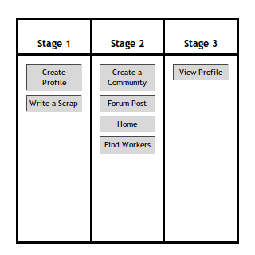
First Kanban
Try your first cards board wall. Make it show the current work status. Improve the workflow visualization.

Slide 17
Round 3: Visualize the Workflow...
Continue! Create (or change) the deliverables
Policy:
Production Delivery ASAP
Work with small batches (stories)
Make the work visible, keep the board up-to-date

Slide 18
Retrospective 3
Did you deliver something?
How do you evaluate? (1-5)
    Quality
    Team Focus
    Work Visibility
    Project Predictability
The card board wall reflects the work?
What can we improve?

Slide 19
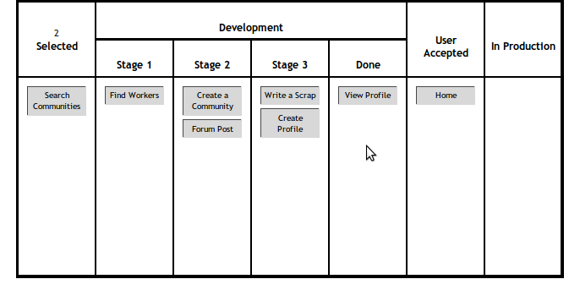
Priorization and User Acceptance
Update your Kanban. Now the work will be prioritized and accepted by the user.

Slide 20
Round 4: Priorization and User Acceptance...
Continue! Create (or change) the deliverables.
The trainer will emulate the user.
If he/she is busy stay in line!
Policy:
Production Delivery ASAP
Work with small batches (stories)
Make the work visible, keep the board up-to-date
The user (trainer) selects next stories to do (limit 2)
The user accepts the stories after development
The user can deploy to production “marketable” story sets

Slide 21
Retrospective 4
Did you deliver something?
How do you evaluate? (1-5)
    Quality
    Team Focus
    Work Visibility
    Project Predictability
The card board wall reflects the work?
What can we improve?

Slide 22

Limit the Work in Progress!
You can develop just ___ stories a time.
Don't fight it. Don't cheat it. Make it flow!
2, 3, ask the trainer...

Slide 23
Round 5: Limit the Work in Progress
Continue! Create (or change) the deliverables.
The trainer will emulate the user.
If he/she is busy stay in line!
Policy:
Production Delivery ASAP
Work with small batches (stories)
Make the work visible, keep the board up-to-date
The user (trainer) selects next stories to do (limit 2)
The user accepts the stories after development
The user can deploy to production “marketable” story sets
Respect the development limit of ____

Slide 24
Retrospective 5
Did you deliver something?
How do you evaluate? (1-5)
    Quality
    Team Focus
    Work Visibility
    Project Predictability
The card board wall reflects the work?
How the limit affected development work?
What can we improve?

Slide 25
Final Round: Deliver it!
Continue! Create (or change) the deliverables.
The trainer will emulate the user.
If he/she is busy stay in line!
Policy:
Production Delivery ASAP
Work with small batches (stories)
Make the work visible, keep the board up-to-date
The user (trainer) selects next stories to do (limit 2)
The user accepts the stories after development
The user can deploy to production “marketable” story sets
Respect the development limit of ____

Slide 26
Final Retrospective
Closing Thoughts
Chaos to Kanban System: What is your team story?
How did the team behavior evolve?
Is process and workflow visibility important?
Do the practices improve predictability?
Does the card board wall help?
What do the limits impact on the system?
What is a bottleneck?

