Slide 1
EFE · CONCEPTS · 2026-07-14
Inter-agent information exchange
Eight concepts — nano-robots, swarm, meta-swarm, frontier panel (Claude · Gemini · GPT)
1. Getting several AI agents to cooperate — Claude (Anthropic), Gemini, but also swarms of “nano-robots” (tiny latent agents) — means having them exchange information and converge on a shared decision, without any one of them dominating.
2. EFE organizes that exchange across scales: nano-robots fold into a swarm's answer; whole swarms become operators coupled into a meta-swarm; and, in parallel, a frontier panel (Claude, Gemini, GPT) exchanges text under a re-verifiable receipt.
3. At every scale the same discipline holds: aggregate by folding toward a consensus, project onto safety limits, and refuse to serve (fail-closed) rather than return an unverified answer.
4. The cardinal rule: describe each mechanism at its real maturity — served by default, real-but-opt-in, or a stub — never as more than what ships.
Confidential — internal draft (EFE → Kovant) · the maturities shown are the real default state

Slide 2
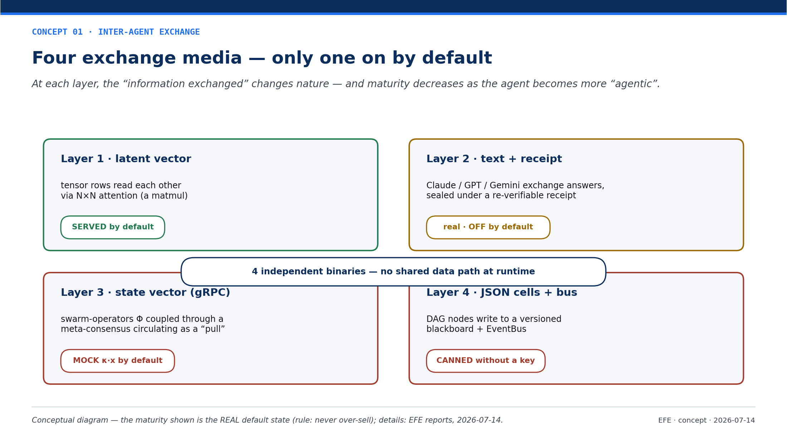
Notes:
Four exchange media — at each layer the information changes nature, and maturity decreases as the agent becomes more “agentic”. The maturity shown is the REAL default state: only one layer (the latent fusion) is on. Rule: never over-sell.

Slide 3
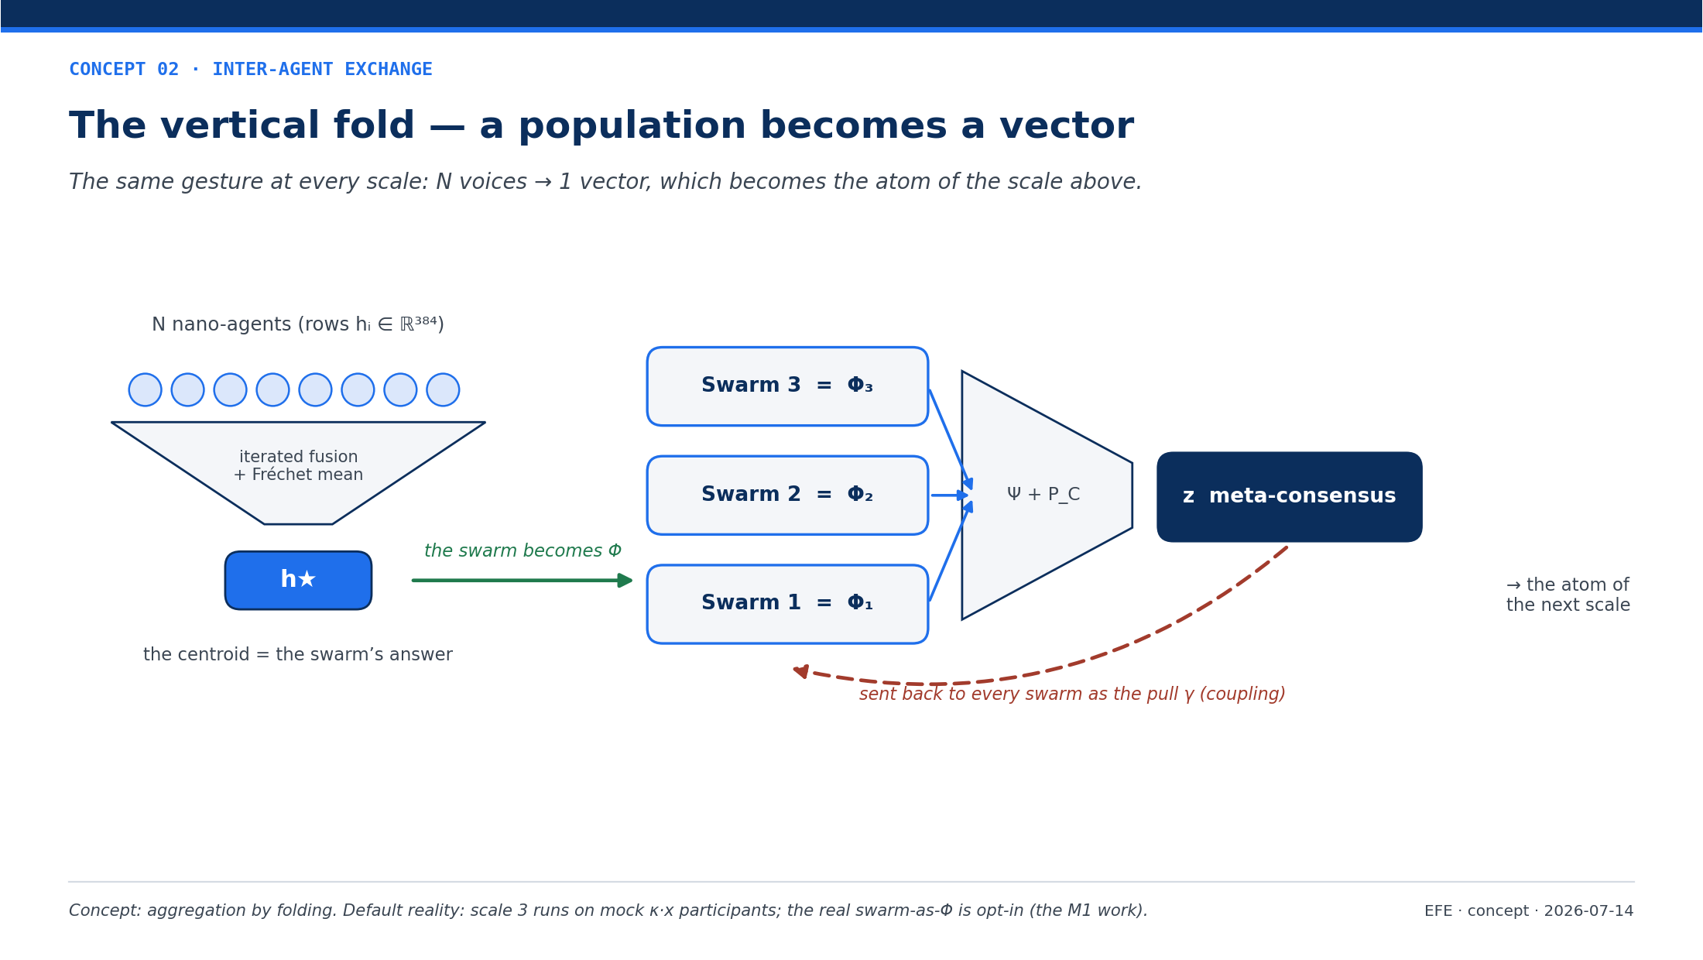
Notes:
The vertical fold — the same gesture at every scale: N voices → 1 vector, which becomes the atom of the scale above. Default reality: scale 3 (meta-swarm) runs on mock κ·x participants; the real swarm-as-Φ is opt-in (the M1 work).

Slide 4
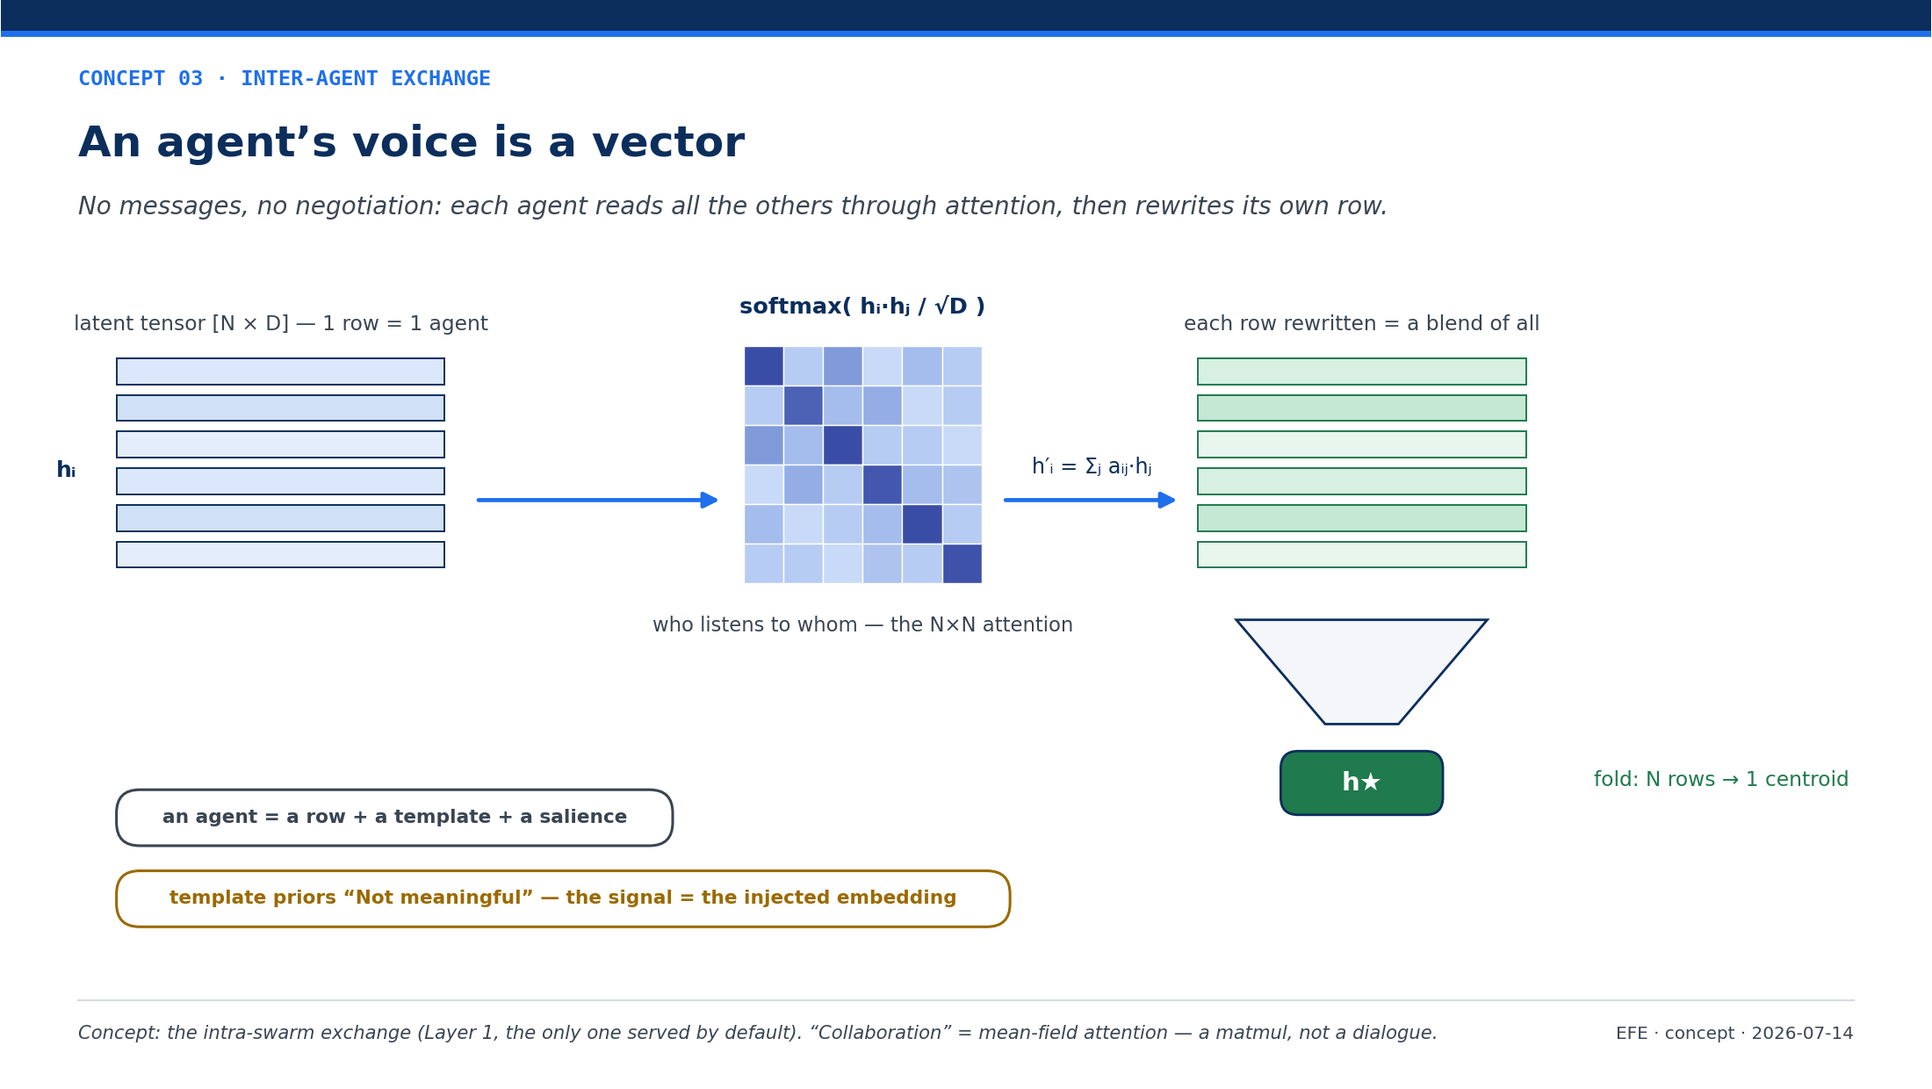
Notes:
An agent's voice is a vector — each agent reads all the others through N×N softmax attention, then rewrites its own row; the population folds into a centroid. “Collaboration” = mean-field attention (a matmul), not a dialogue. Template priors are “Not meaningful”: the signal is the injected embedding.

Slide 5
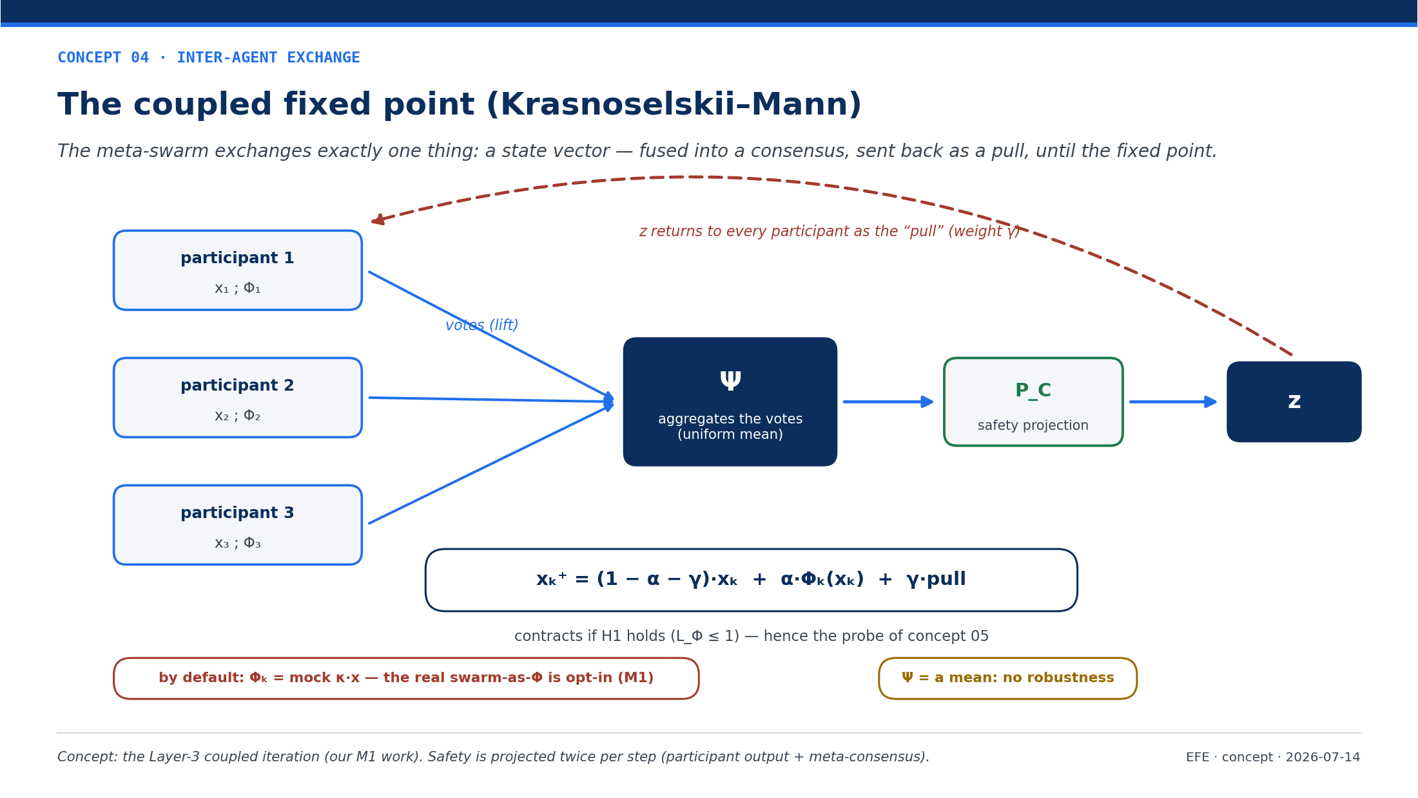
Notes:
The coupled fixed point (Krasnoselskii–Mann) — the meta-swarm exchanges only a state vector: fused into a consensus (uniform mean Ψ), projected onto safety (P_C), sent back as the pull γ, until the fixed point. By default Φ = mock κ·x; Ψ = a mean, no robustness.

Slide 6
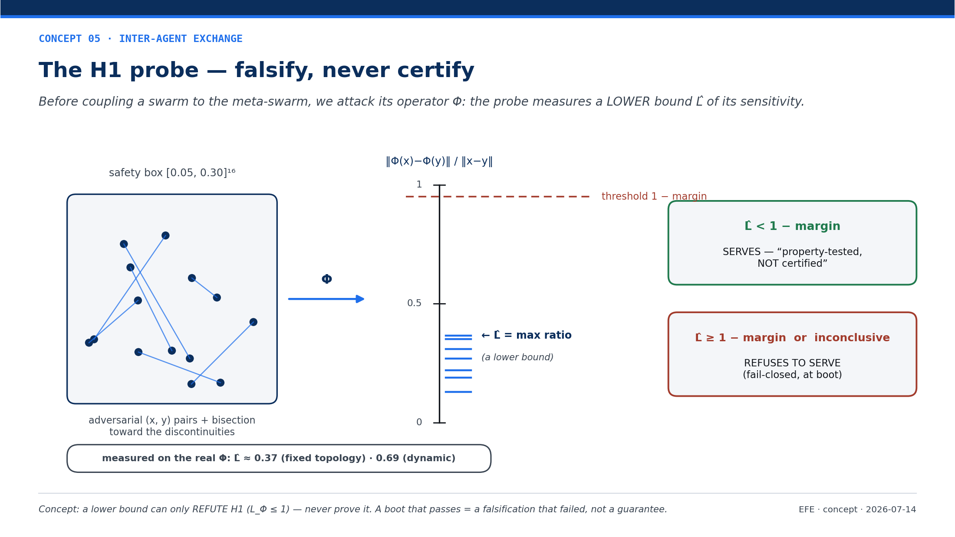
Notes:
The H1 probe — before coupling a swarm, we attack its operator Φ with adversarial pairs: the probe measures a LOWER bound L̂. It can only REFUTE H1 (refuse to serve, fail-closed), never prove it. Measured: L̂ ≈ 0.37 (fixed) / 0.69 (dynamic).

Slide 7
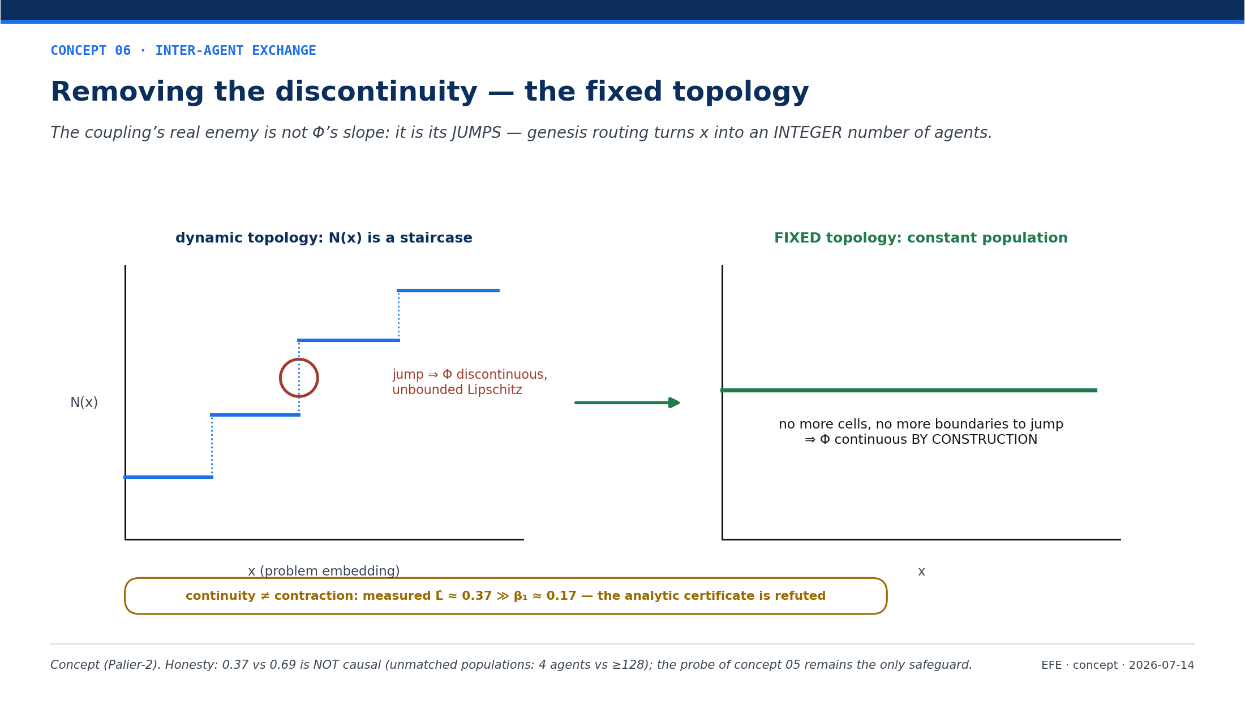
Notes:
Removing the discontinuity — the coupling's real enemy is not Φ's slope but its JUMPS (routing → an integer number of agents). A fixed topology makes Φ continuous by construction. Honesty: 0.37 vs 0.69 is NOT causal (unmatched populations, 4 vs ≥128).

Slide 8
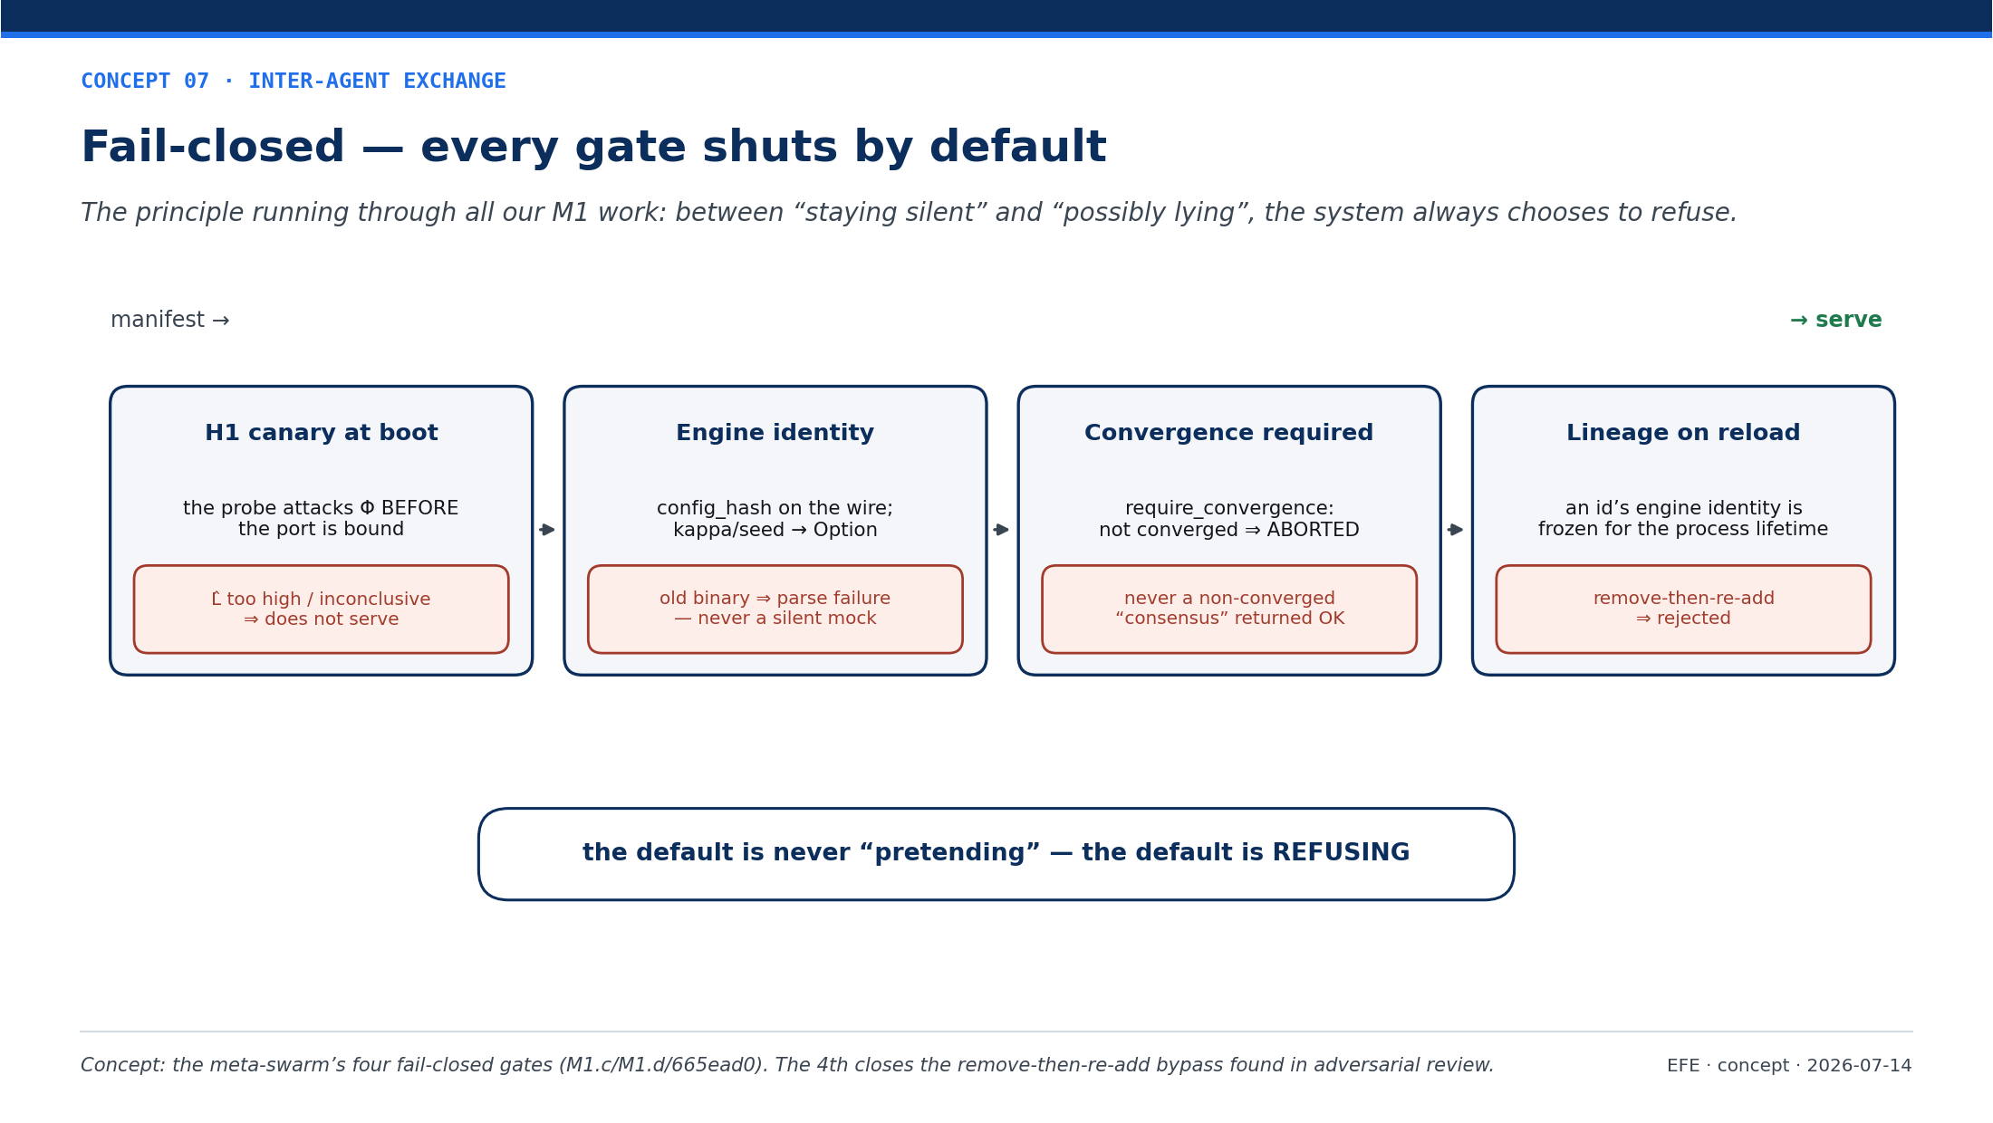
Notes:
Fail-closed — the meta-swarm's four gates (H1 canary, engine identity, convergence required, reload lineage). Between “staying silent” and “possibly lying”, the default is always to REFUSE, never to pretend.

Slide 9
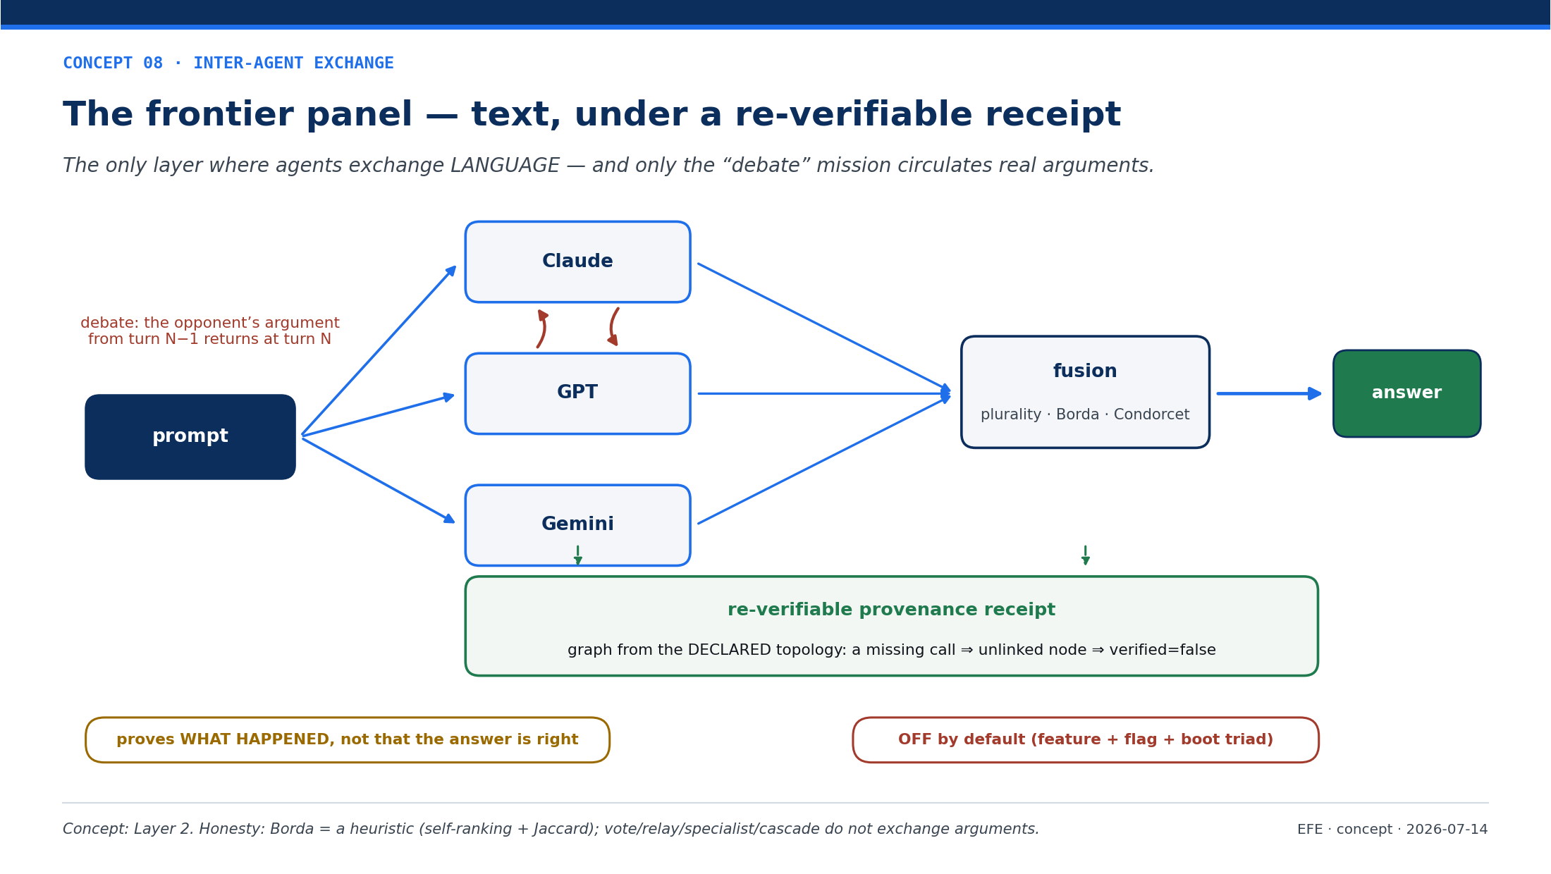
Notes:
The frontier panel — the only layer where agents exchange LANGUAGE: a prompt fans out to Claude, GPT, Gemini; only the “debate” mission circulates real arguments; all under a re-verifiable provenance receipt. OFF by default; Borda = a heuristic.

