Slide 1


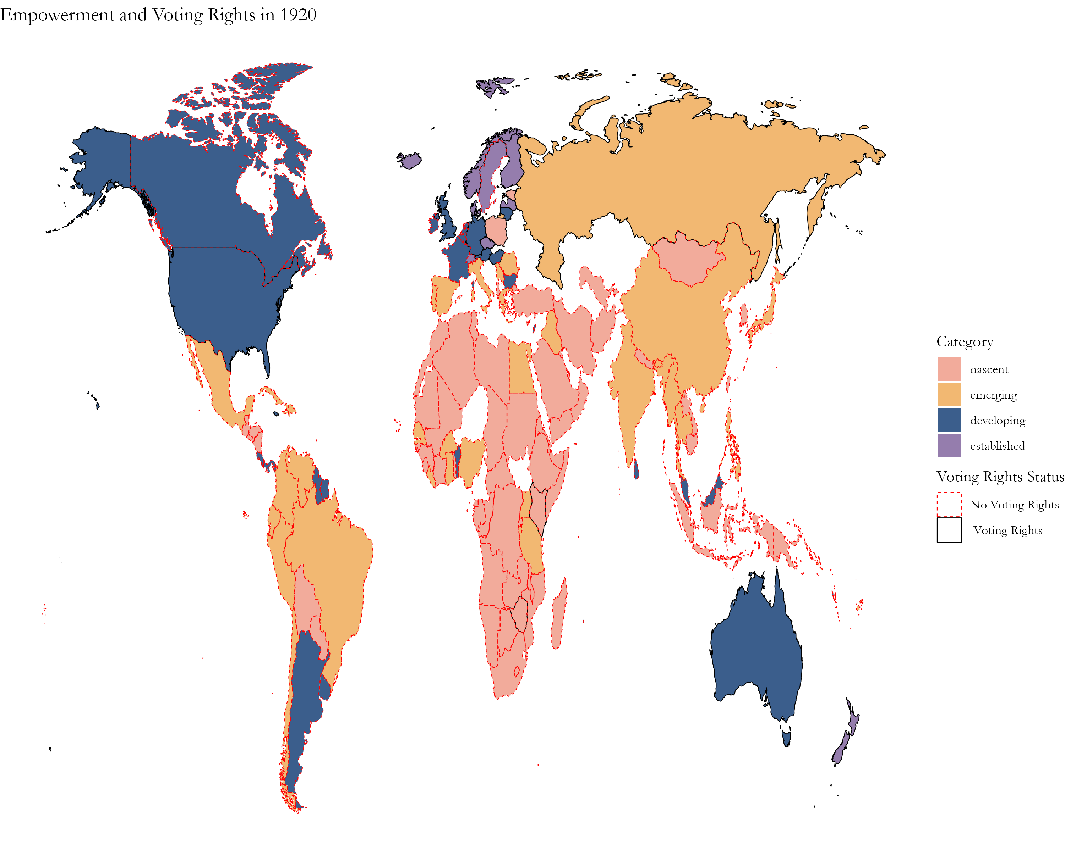
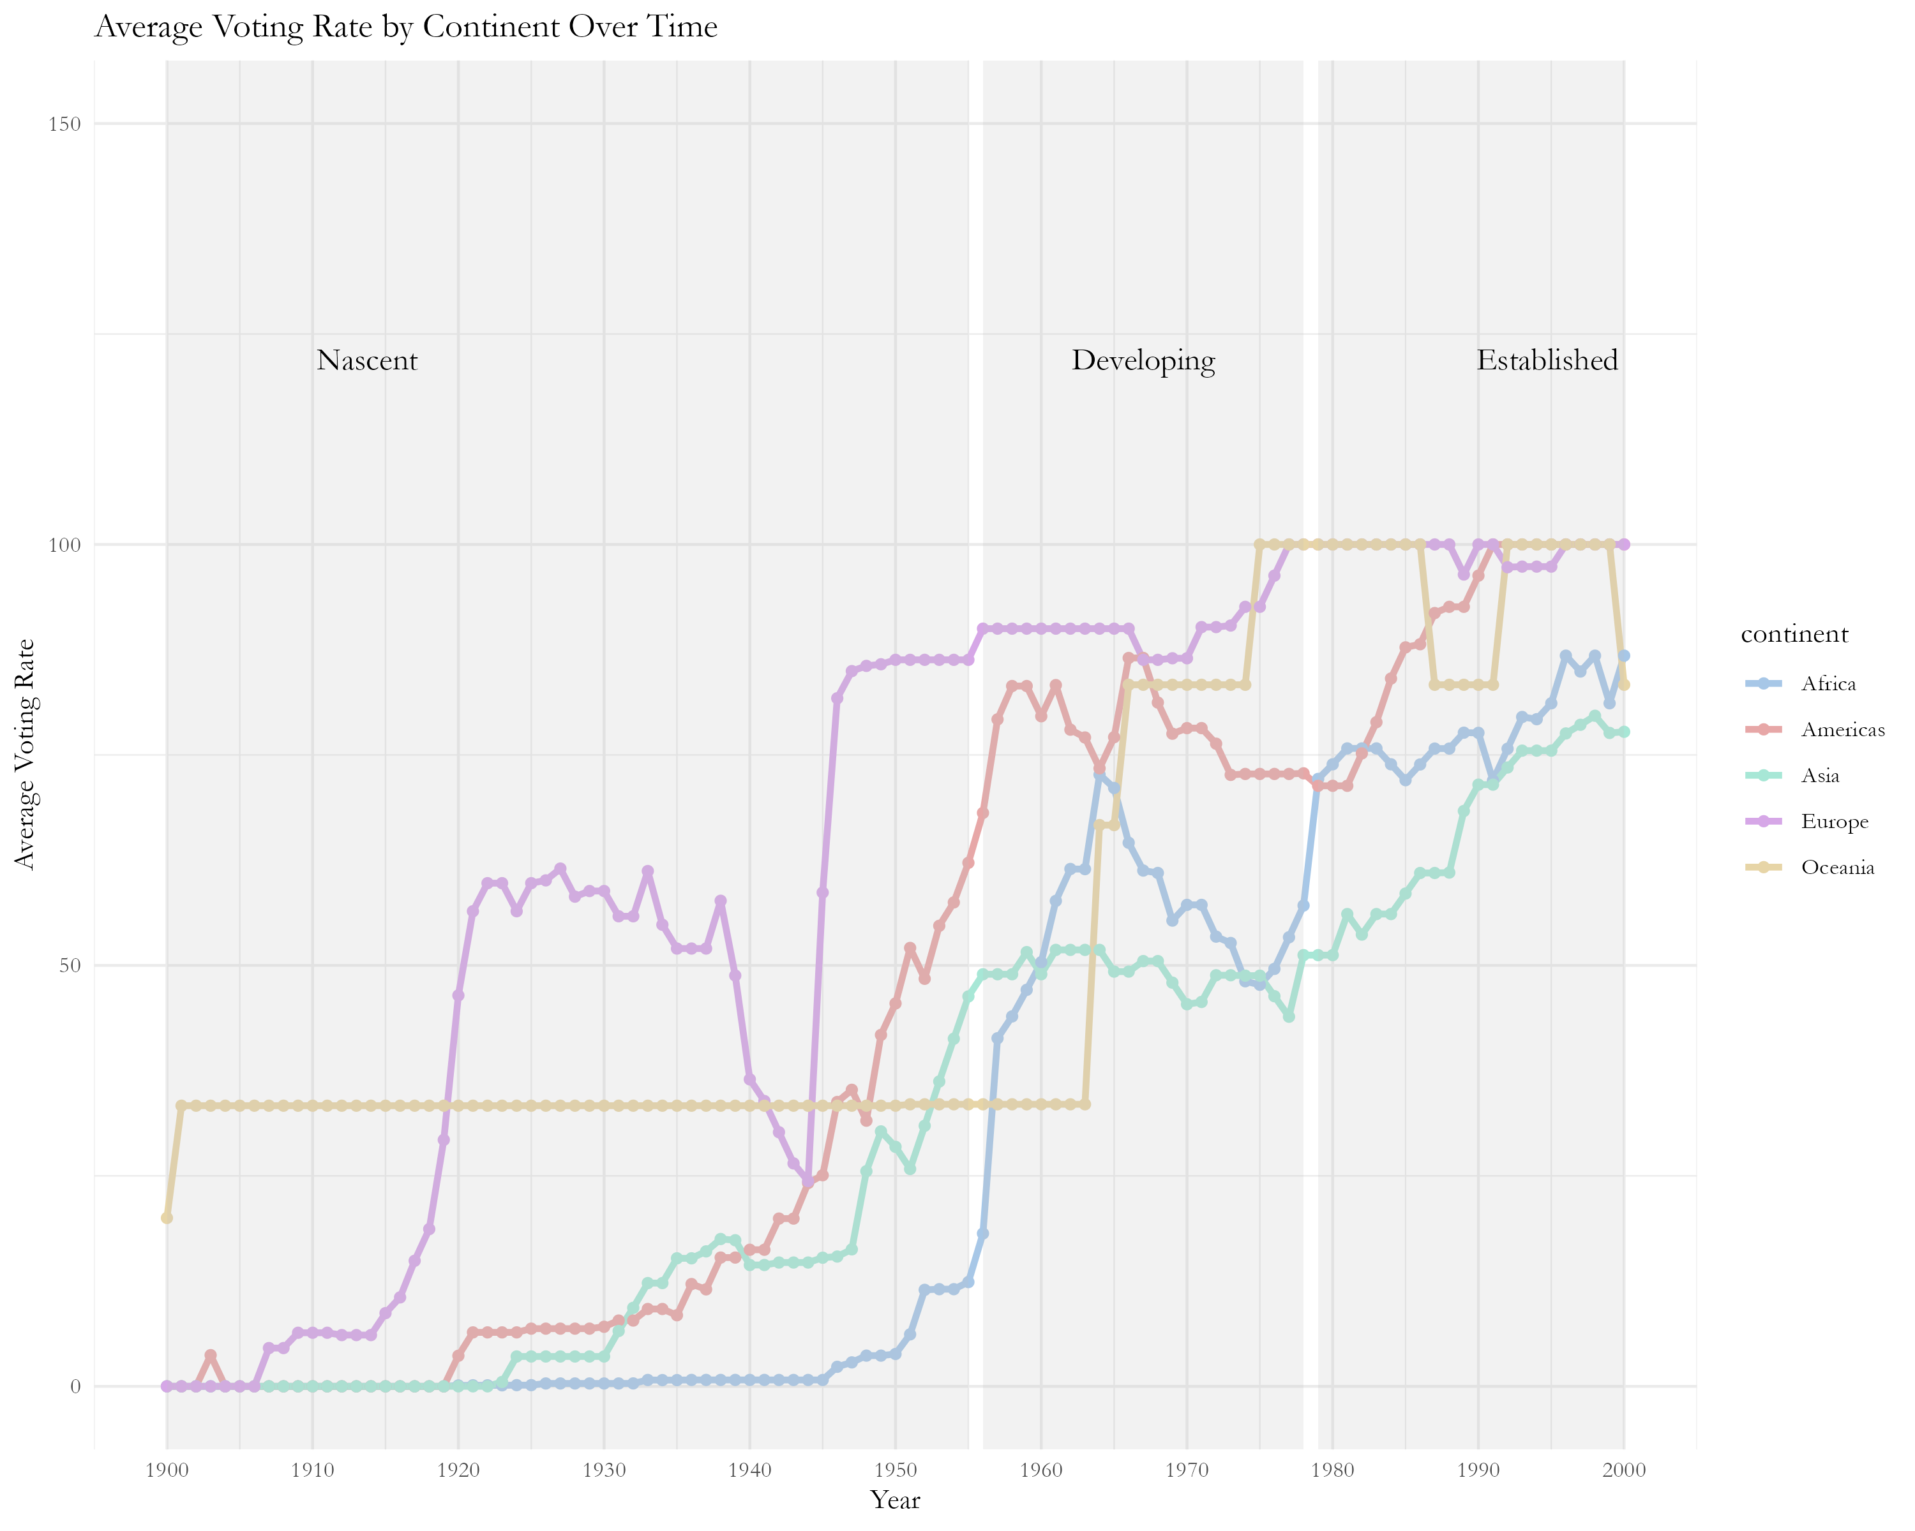

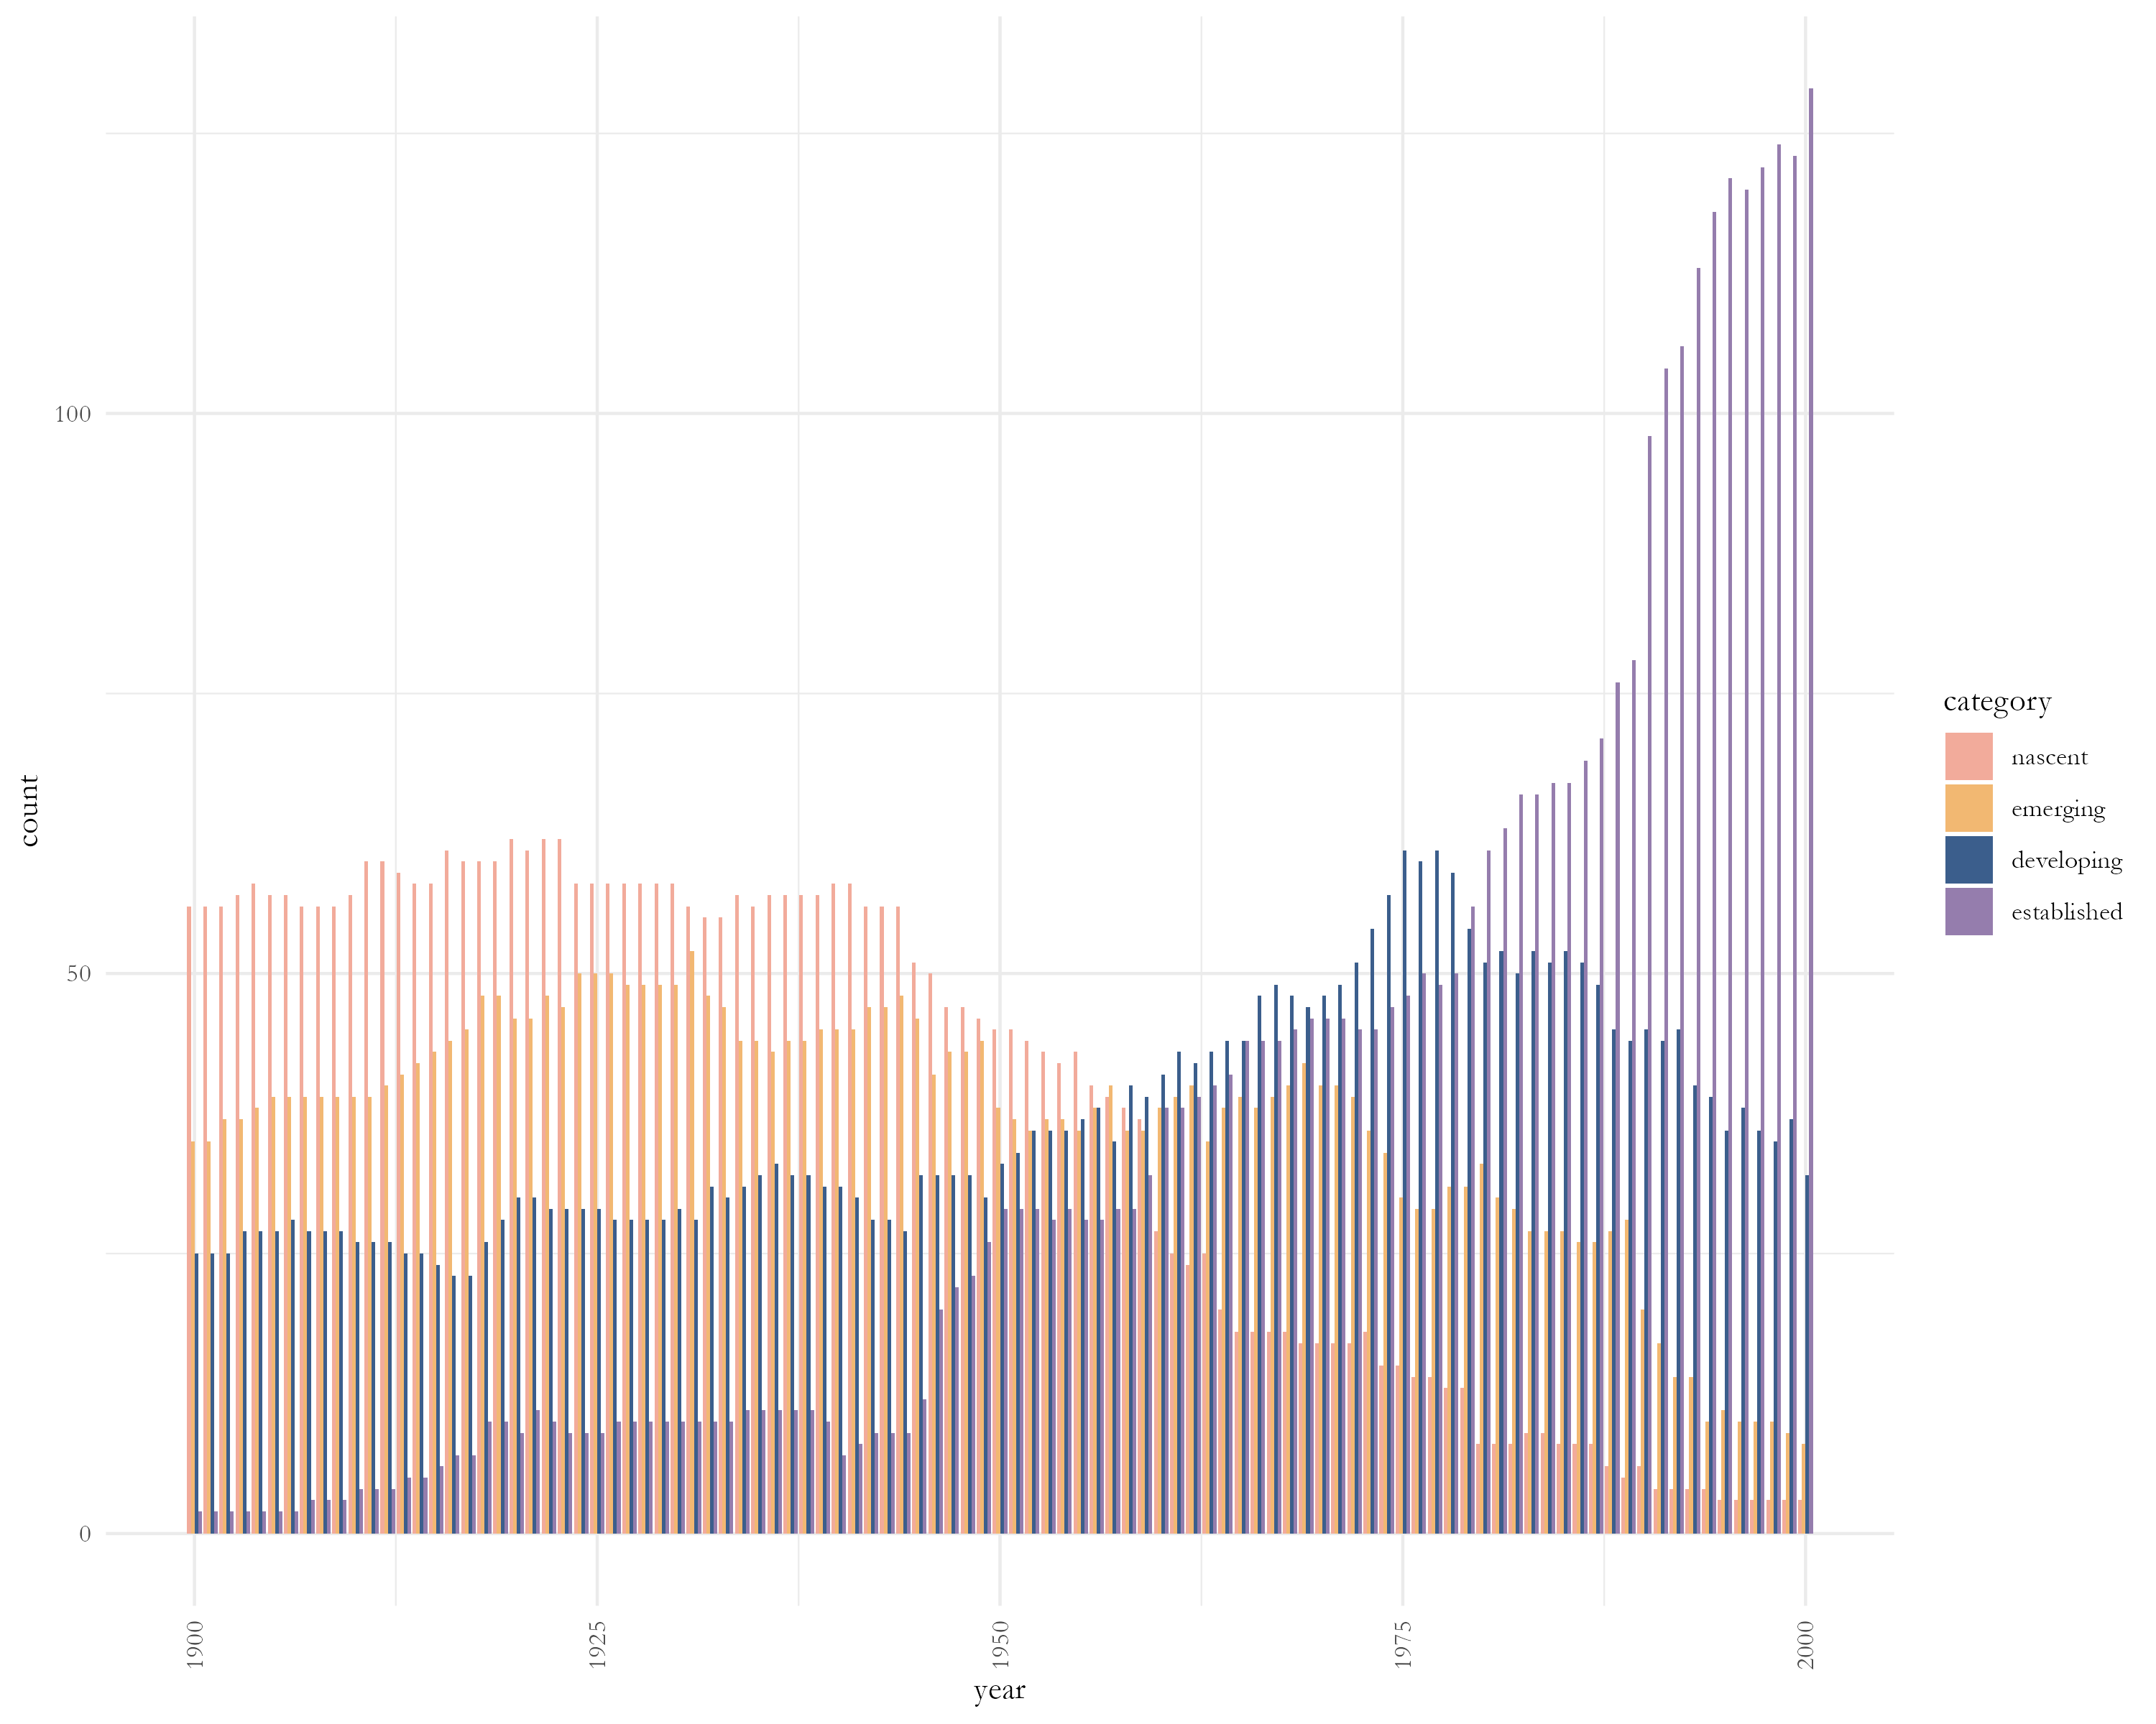
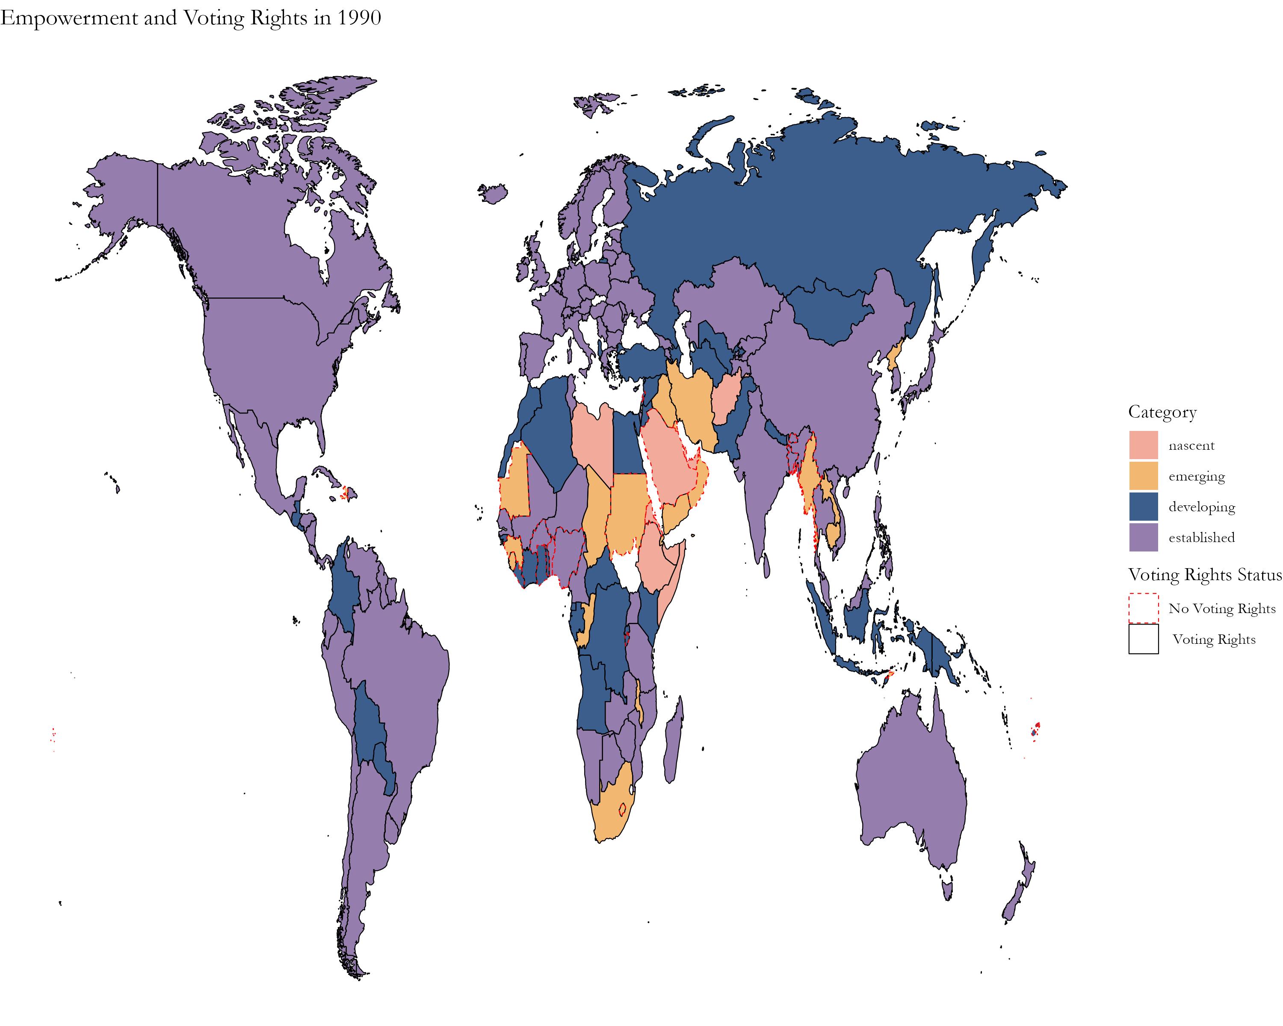
Tracking Women’s Political Empowerment and Suffrage (1900 -2000)
Athena B. Rodrigues
Undergraduate Capstone Spring 2024
Background
Map 1. Empowerment and Voting in 1920
Methodology
Women’s
Civil Liberties
Index
Freedom of domestic movement
Freedom from forced labor
Property rights
Access to justice
Empowerment Categories
Category | Range
Nascent | WPEI ≤ 0.188
Emerging | 0.188 ≤ WPEI ≤ 0.336
Developing | 0.336 ≤ WPEI ≤ 0.546
Established | WPEI ≥ 0.546
Women’s
Civil Society
Participation
Index
Freedom of discussion
Participation in Civil Service Organizations
Percentage of female journalists
Empowerment Periods
Women’s
Political Participation
Index
Power distribution by gender
Political position representation
Presence in Legislature
Period | Years
Nascent | 1900 – 1955
Developing | 1956 – 1978
Established | 1979 - 2000
Empowerment
through the Decades
Decolonization
End of Cold War
Women’s
Political Empowerment
Index
A measurement which…
considers new countries
adjusts with central concepts of women’s rights
gives a better representation of the Global South.
Research Questions
1.
Can Empowerment be Categorized and Reflect the Development of the 20th Century?
2.
How does Suffrage Impact Empowerment?
Empowerment Thresholds
3.
Are there Regional Patterns in Empowerment or Suffrage?
Start
90%
End
Start
80%
End
Start
75%
End
Nascent | 1900 | 1944 | 1900 | 1946 | 1900 | 1948
Emerging | 1918 | 1944 | 1914 | 1969 | 1905 | 1972
Developing | 1974 | 1978 | 1967 | 1987 | 1966 | 1987
Established | 1994 | 2000 | 1991 | 2000 | 1990 | 2000
Reference
Sundström, A., Paxton, P., Wang, Y. T., & Lindberg, S. I. (2017). Women’s political empowerment: A new global index, 1900–2012. World Development, 94, 321-335.
Map 2. Empowerment and Voting in 1990
*Emerging Period condensed due to overlap

