Slide 1
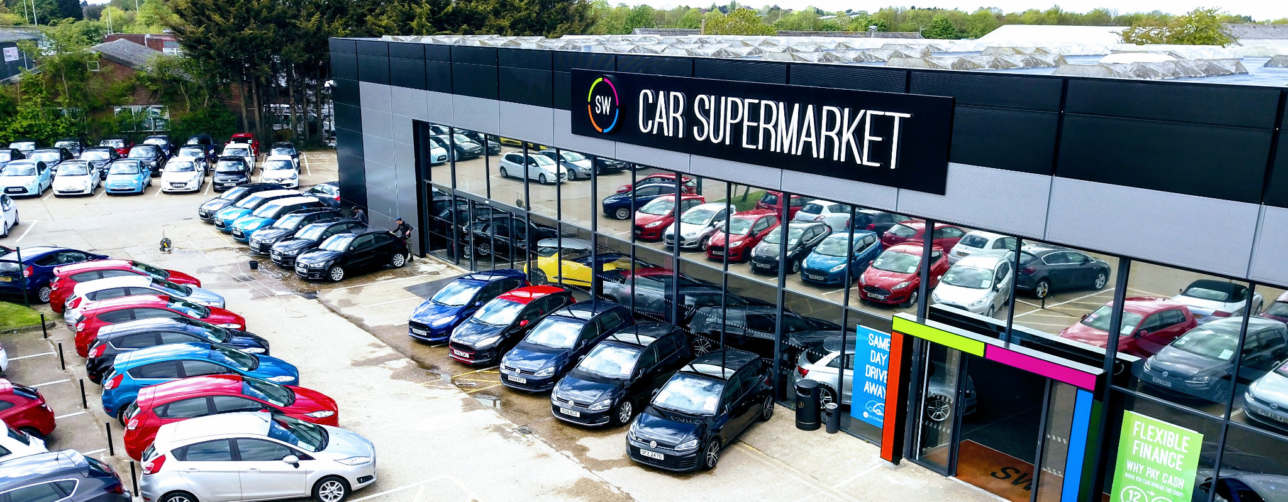
Exploratory Data Analysis of Car Sales

Slide 2
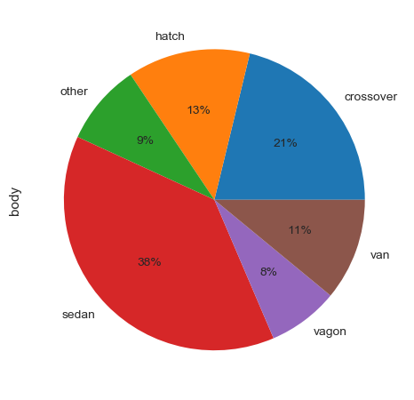
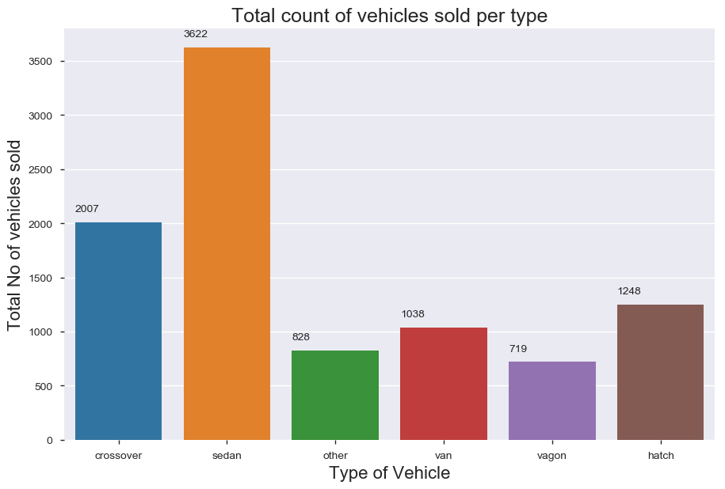
What are the different car body types and their count?
Car Types
Number of sold cars

Slide 3
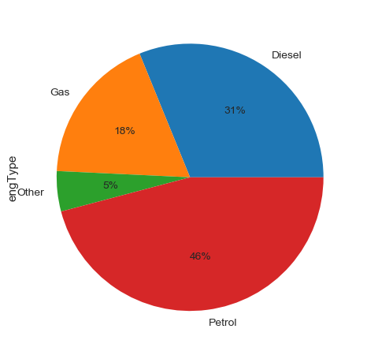
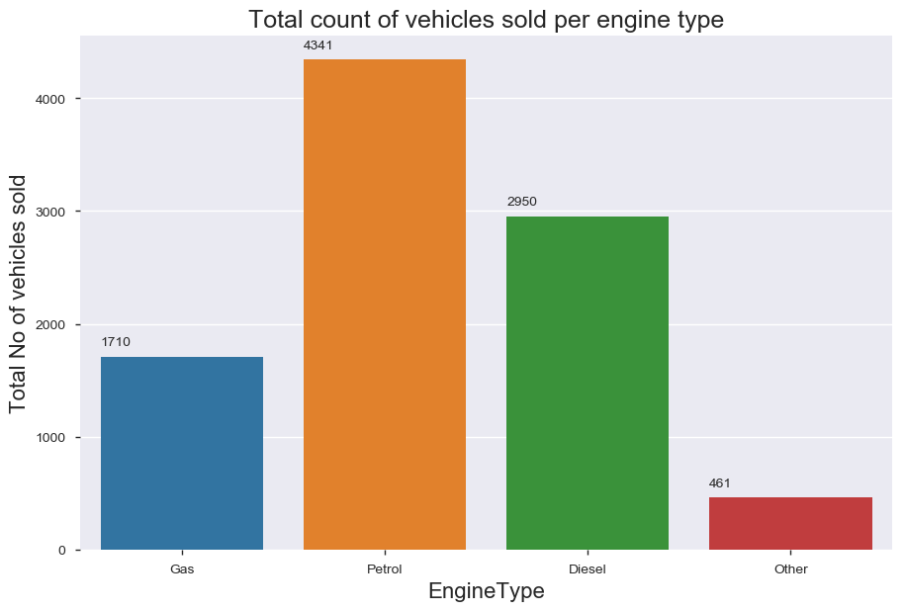
How many kinds of engine types were available? Which engine type had maximum sale?
Engine Types
Number of cars sold

Slide 4
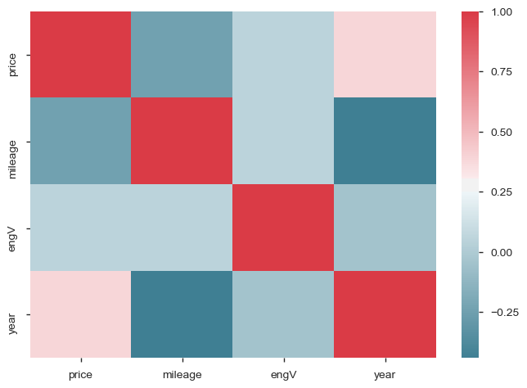
Correlation between different aspects

Slide 5
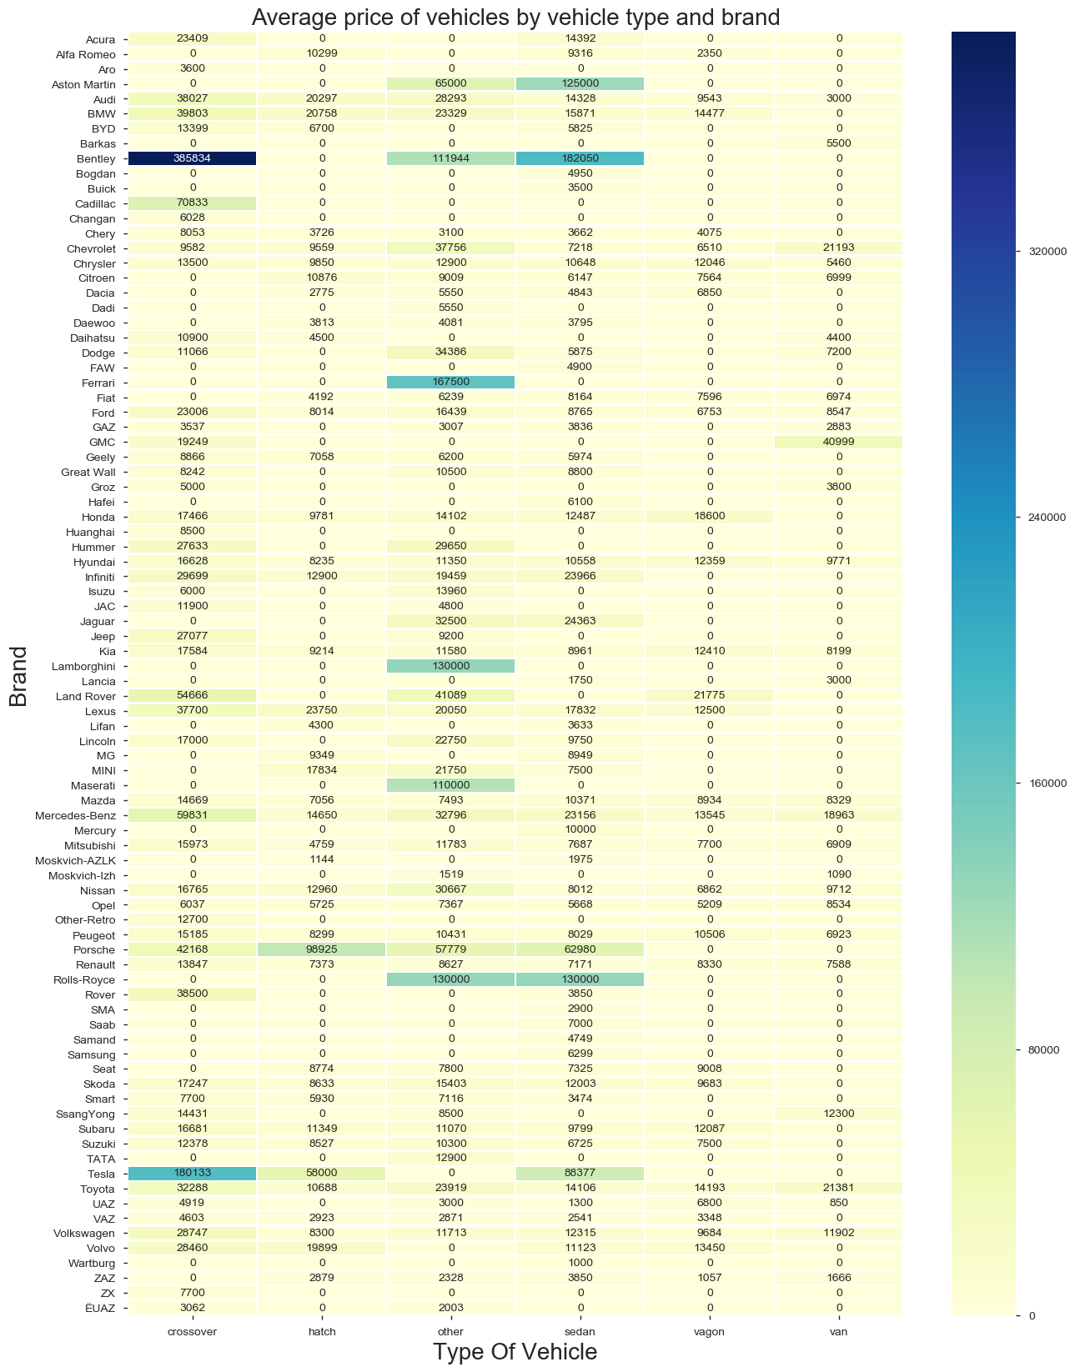
What were the average prices of cars with body type, year of make, engine power and engine type?

Slide 6
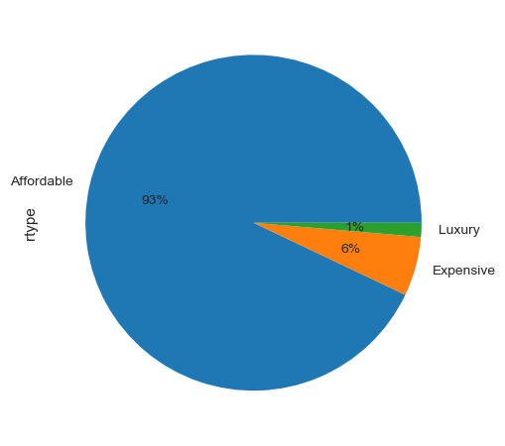
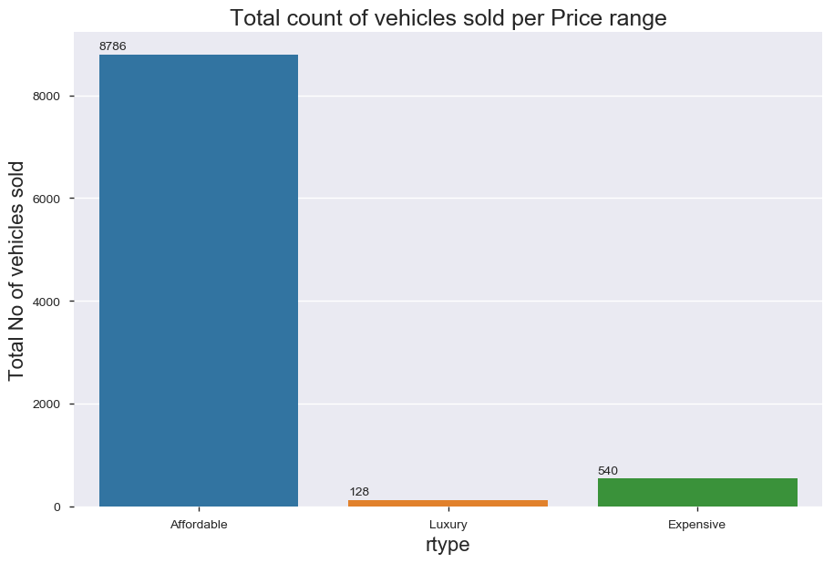
What are the different the Price range categories ?

Slide 7
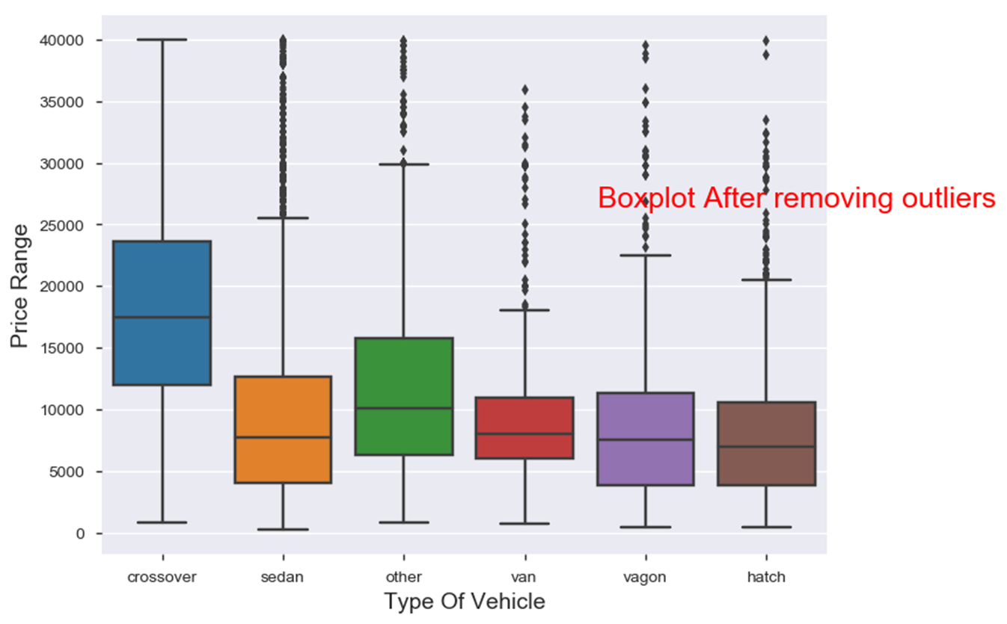
Affordable cars What were the prices for different car body types in Affordable cars category?

Slide 8
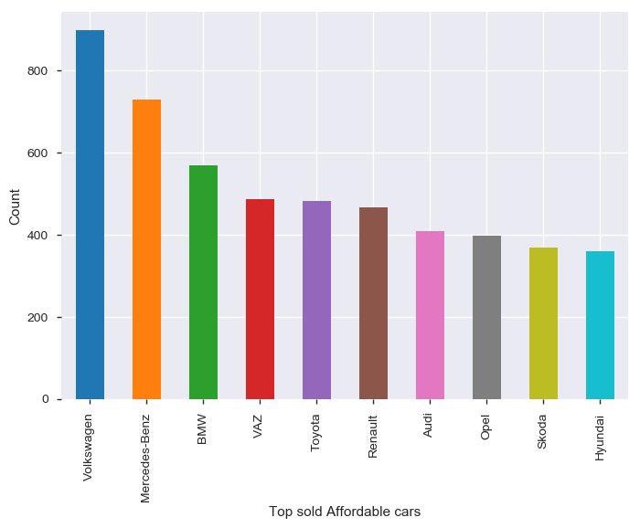
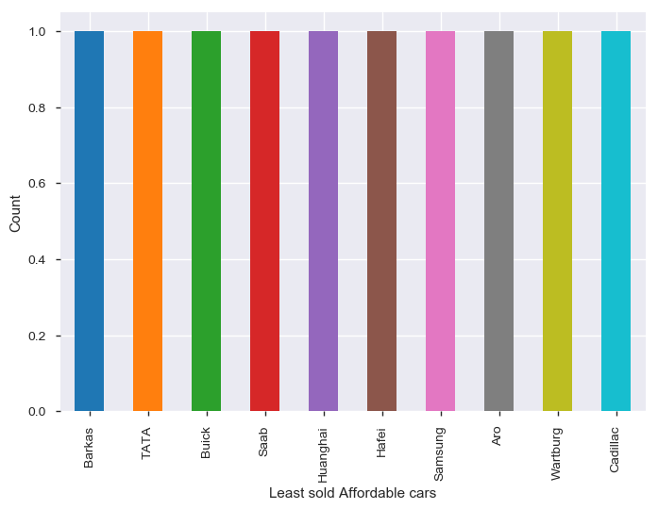
Affordable cars
Top sold Affordable car brands
Least sold car brands

Slide 9
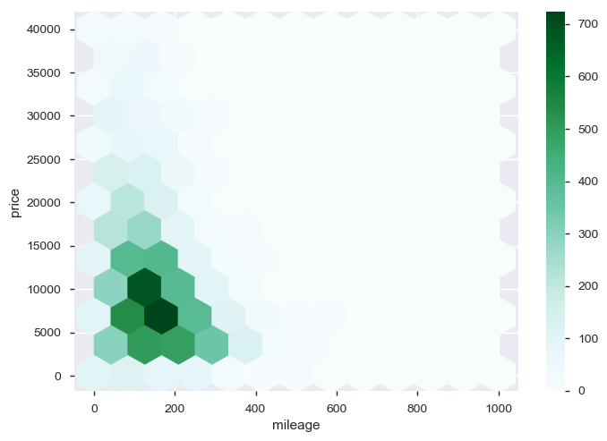
Affordable cars Price –Mileage density

Slide 10
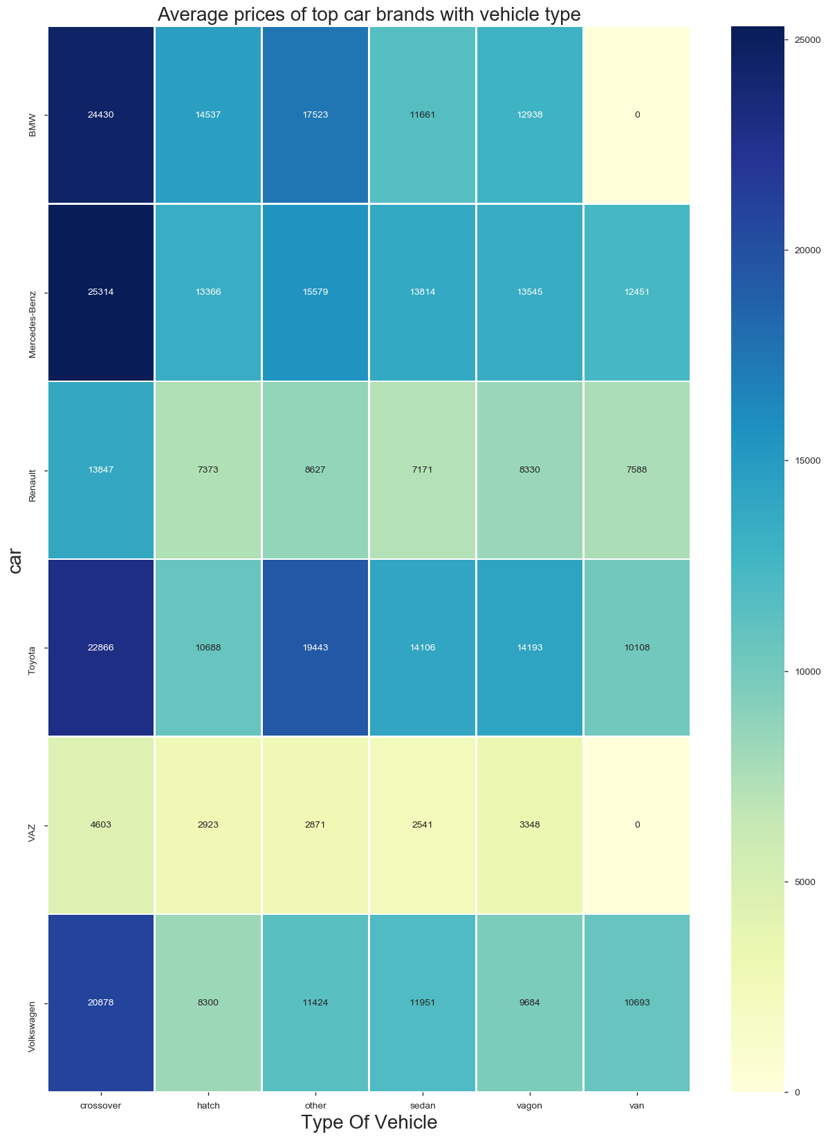
Affordable cars Average prices of top brands with body types

Slide 11
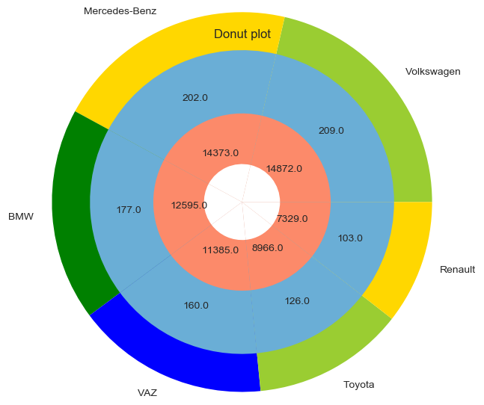
Affordable cars Top selling brands with mean mileage and mean price

Slide 12
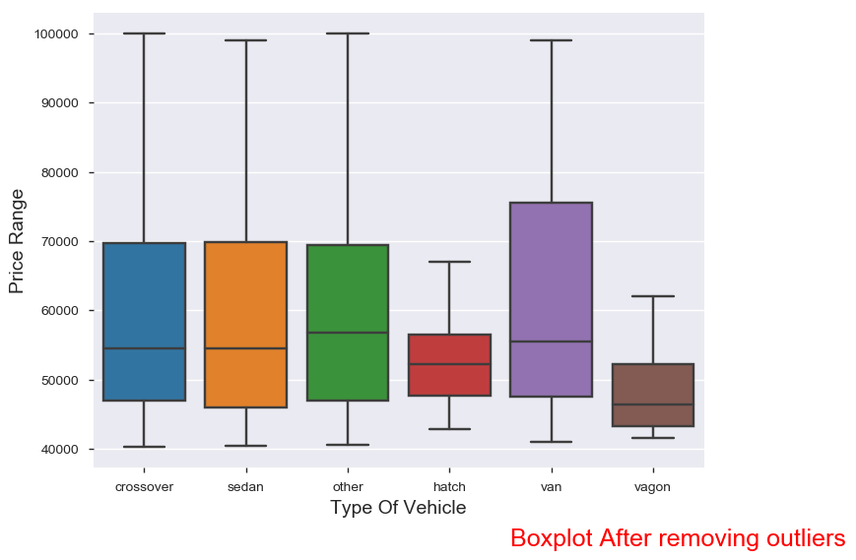
Expensive Cars What are the prices for different car body types in Expensive cars?

Slide 13
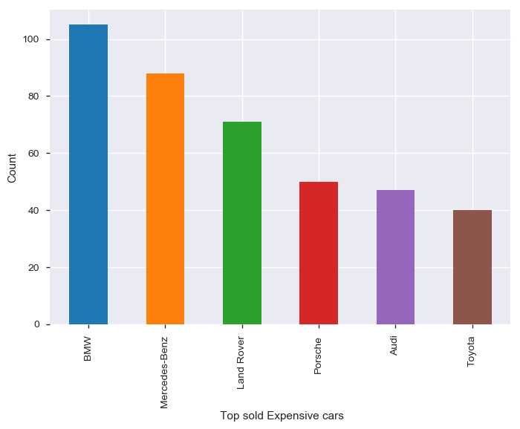
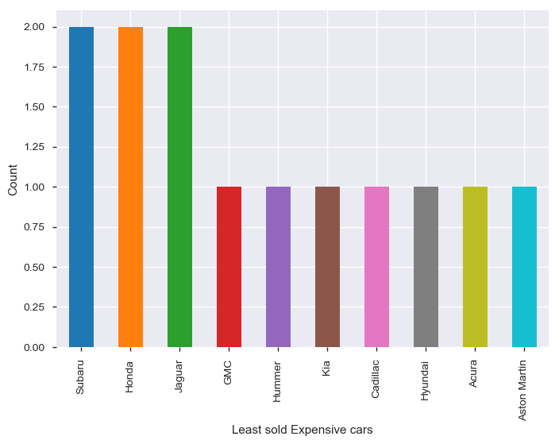
Expensive Cars
Top Sold Expensive car brands
Least Sold Expensive car brands

Slide 14
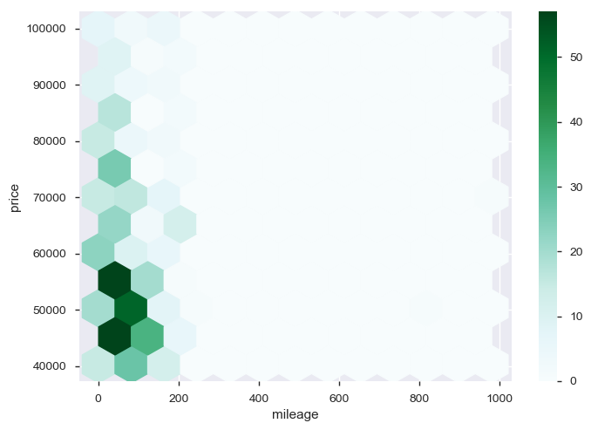
Expensive cars Price –Mileage density

Slide 15
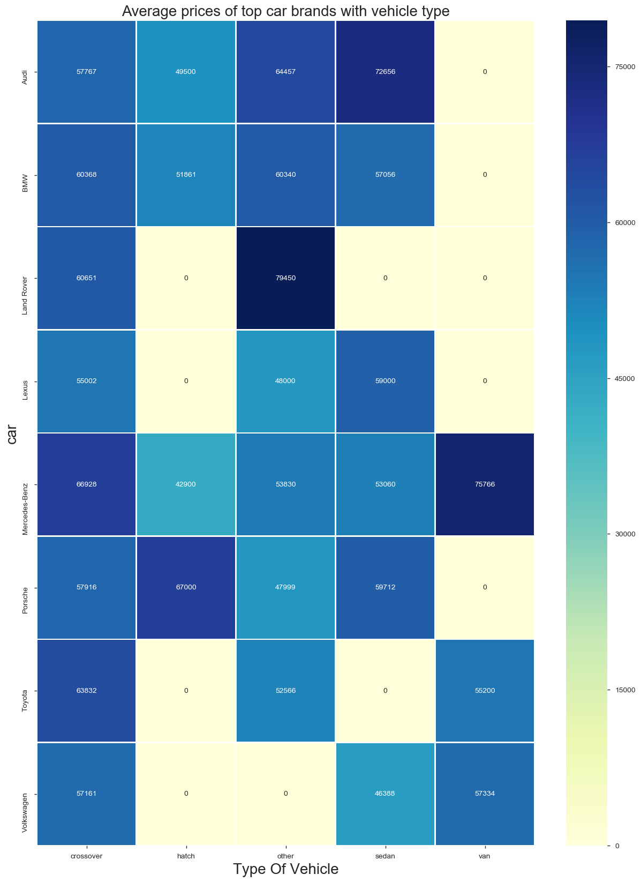
Expensive Cars Average prices of top brands with body types

Slide 16
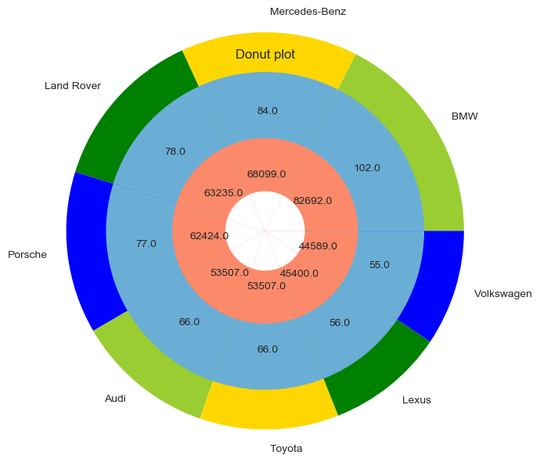
Expensive cars Top selling brands with mean mileage and mean price

Slide 17
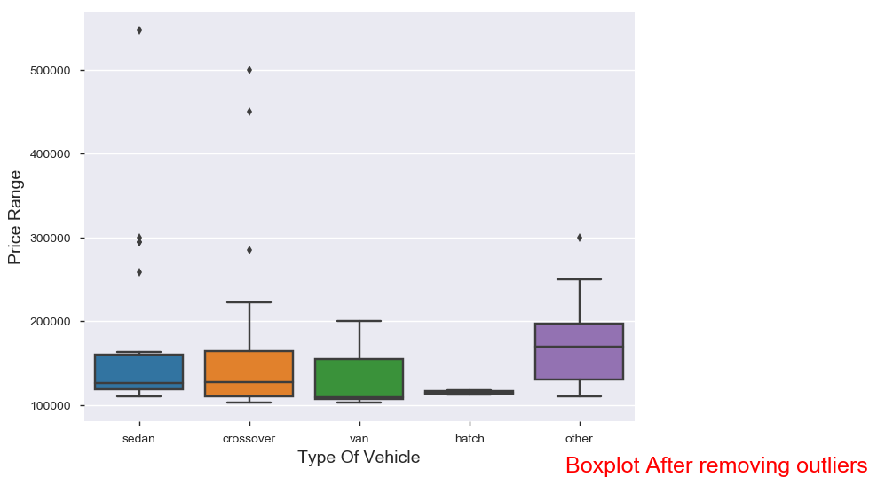
Luxury Cars What are the prices for different car body types in Luxury cars?

Slide 18
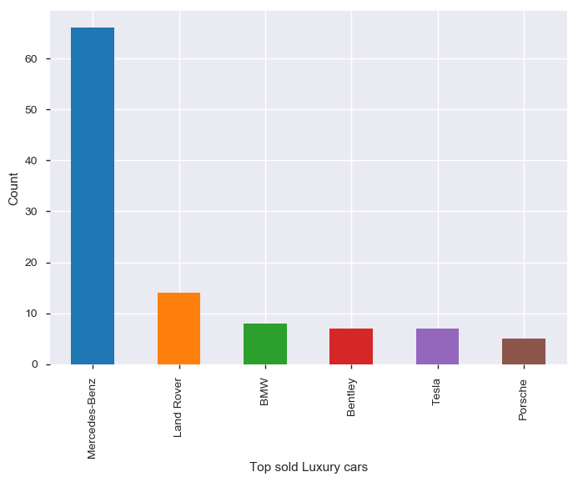
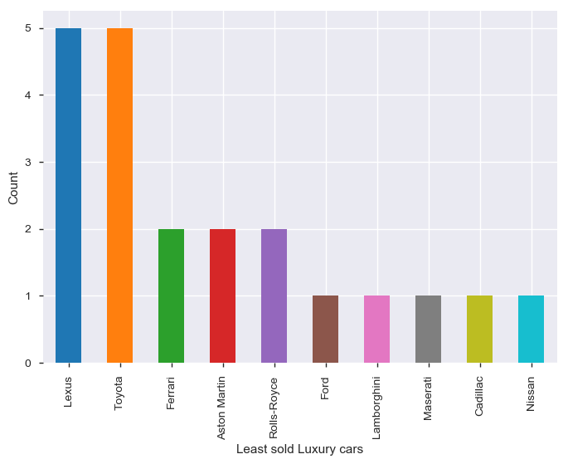
Luxury cars
Top Sold Luxury car brands
Top Sold Luxury car brands

Slide 19
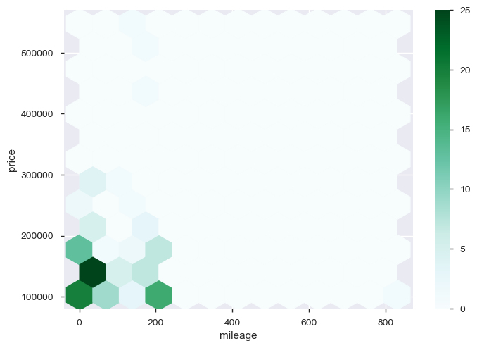
Luxury cars Price –Mileage density

Slide 20
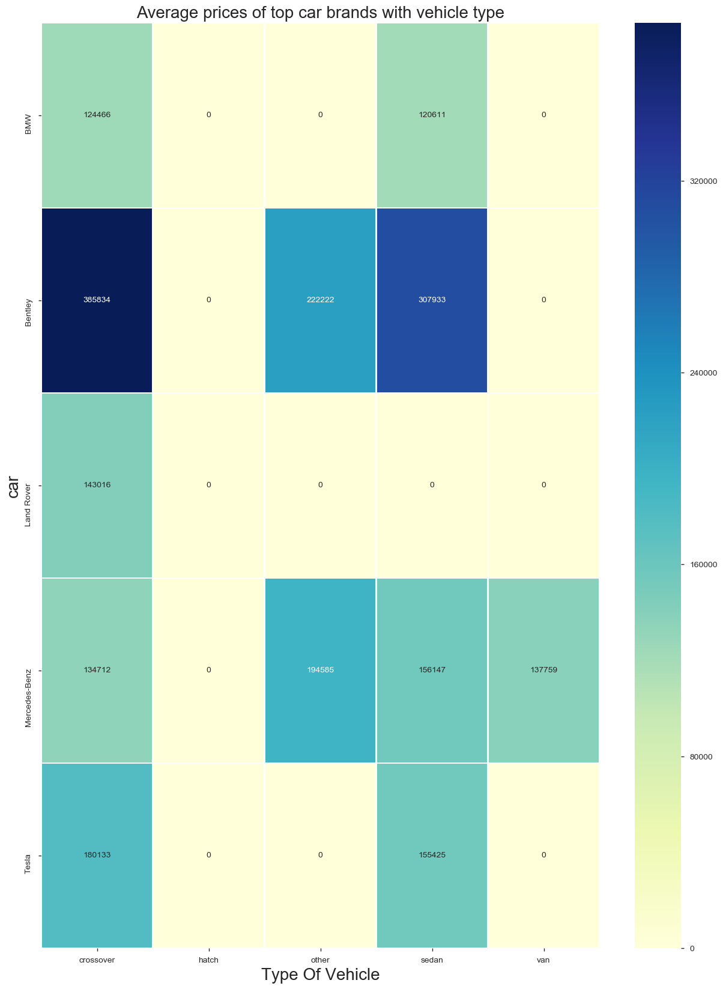
Luxury Cars Average prices of top brands with body types

Slide 21
Conclusion
Price has positive correlation with engine volume and production year which indicates newer models and high engine volume cost more.
Price-Mileage are negatively correlated with each other .i.e. as mileage increases price decreases
Production year 2008 and 2012 cars were sold the most
Data has been categorized in three different classes based on the price ranges it has been sold i.e. Affordable cars, Expensive cars and Luxury cars. All the categories are further analyzed to find out correlations between data.
Affordable cars Expensive cars Luxury cars
Top sold brand Volkswagen Mercedes-Benz Mercedes-Benz
Least sold brand Cadillac Aston Martin Lamborghini
Price density 5000-12000 USD 42000-58000 USD 120000 - 150000 USD
Mileage density 150-200km 0-150km 0 km
(probably brand new cars)

