Slide 2
Main Window
UC – Search
UC – Home
Load

Slide 3
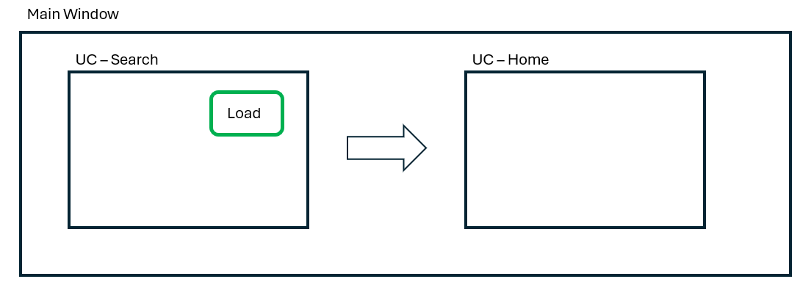
AppViewModel
UC1 ViewModel
LoadButton
Listener
LoadButton
Click Event
SwitchView
Event
UC2 ViewModel

