Slide 1
Vision Based Indoor Environment Ontology
Rodney

Slide 2
Summary
Research Domain / Problem
Related Work
Computer Vision
Ontologies
Proposed Ontology
Conclusion

Slide 3
Research Domain / Problem
Using Computer Vision to build assistive indoor navigation tecnologies
Too many variables, and ways to achieve similar results
Combine algorithms to achieve obstacle detection and landmark identification

Slide 4
Indoor Navigation Related Work
Ref classify the indoor navigation problem as: navigation, and obstacle detection;
Serrão2012 proposed the navigation based on obstacle detection and landmark detection, the landmarks are mateched to any room prior to a Geographical Information System;
Also Costa2012, Tapu2013 proposed obstacle detection solutions for indoor navigation;
Jose2011, Asad2012, and Moreno2012 proposed a navigation based on the pathways and corridors.

Slide 5
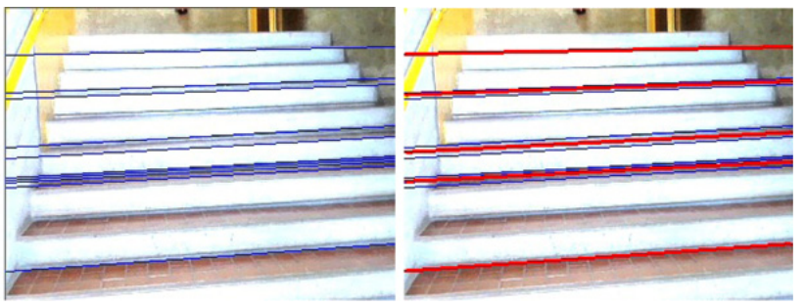
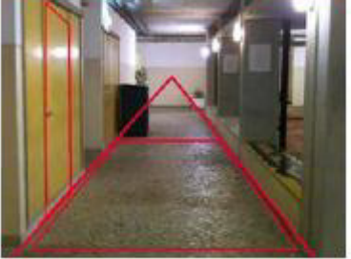
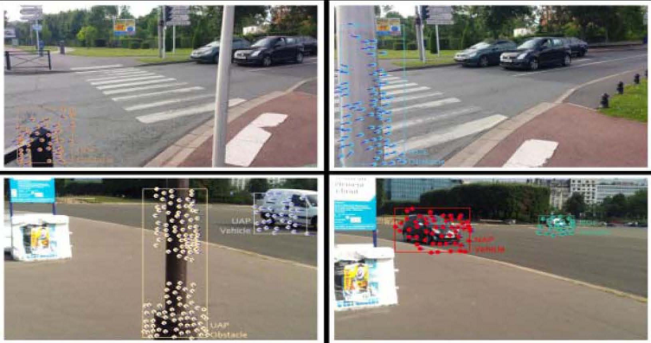
Computer Vision - Examples

Slide 6
Ontologies Related Work
Romero Et Al 2011 proposed a computer vision framework that relies on an ontology based scene representation model for tracking objects in video
Sriharee 2015 proposed a method for capturing and creating symbolic information of spatial objects for indoor navigation

Slide 7
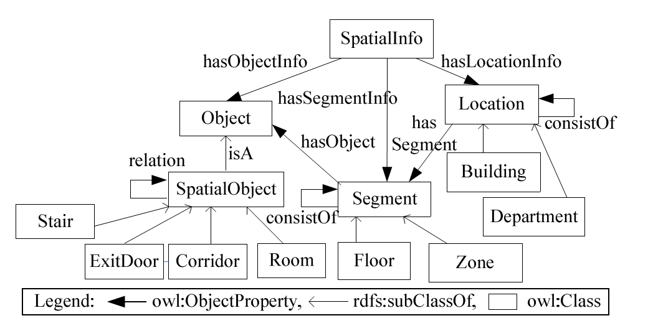
Sriharee 2015 – Spatial Information Ontology

Slide 8
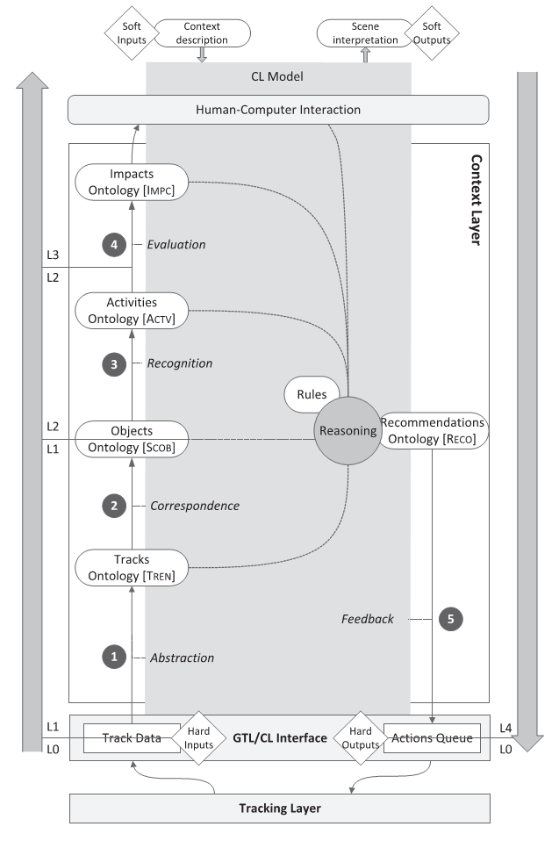
Romero Et Al 2011
Several Ontologies for tracking the objects in the videos;
Generally object knowledge is represented by TREN and SCOB ontologies;
Algo object representation there’s a specific domain ontology called SURV which is a specialization of the SCOB ontology
It defines a Mirror class which is specialized from StaticObject

Slide 9
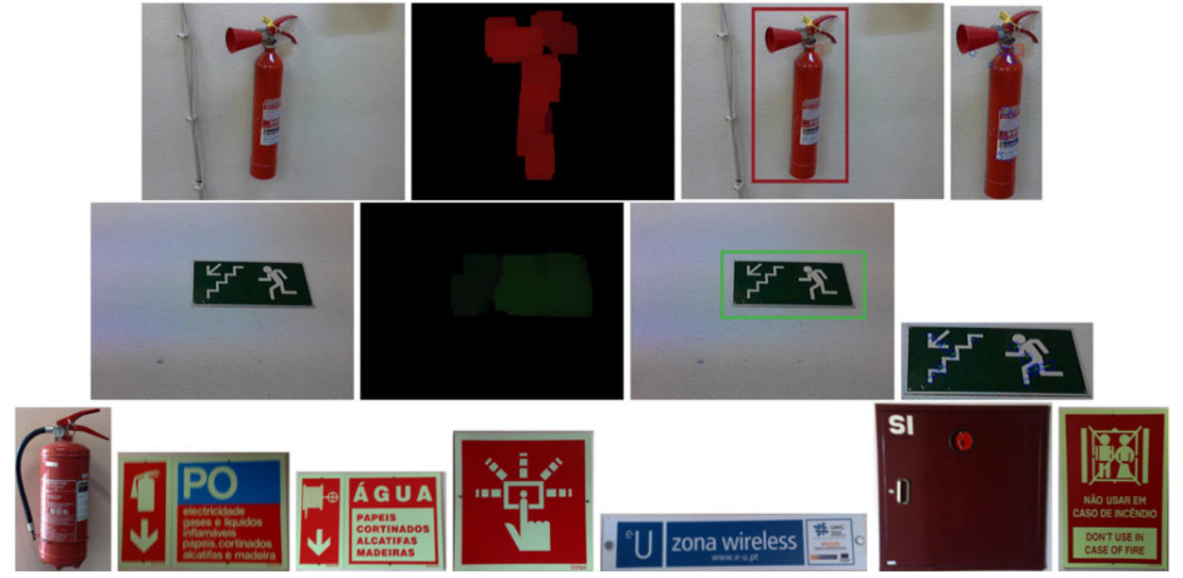
Overview
Object Representation as Features
Colors
Shapes
Edges
Object Hierarchy:
Landmarks
Obstacles
Computer Vision Algorithms
Extraction
Detection
Recognition

Slide 10
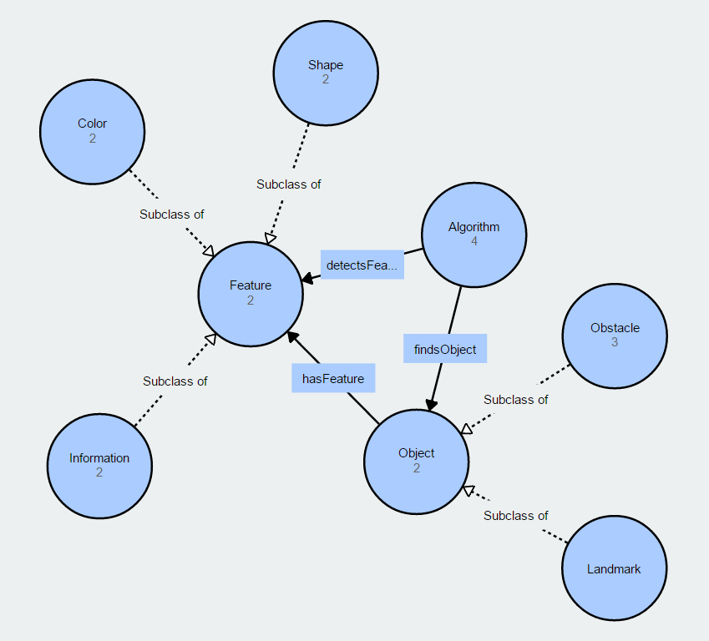
Proposed Ontology

Slide 11
Object Properties and Rules
Object Properties
detectFeature (Detect – Feature)
hasFeature (Object – Feature)
findObject(Algorithm – Object)
Rules
Algorithm(?a), Feature(?f), Object(?o), detectsFeature(?a, ?f), hasFeature(?o, ?f) -> findsObject(?a, ?o)
Object(?o), hasFeature(?o, ?f), Information(?f) -> Landmark(?o)

Slide 12
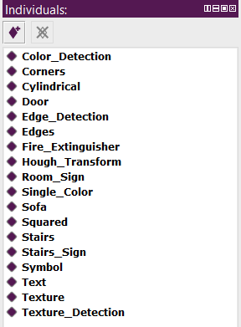
Individuals
Known computer vision / image processing algorithms
Canny Edge Detection
Hough transforms
Color or texture detectors
Features
Edges, corners
Color styles, textures
Shapes, rectangular, squared
Objects
Signs, like warning, or room names
Doors, stairs

Slide 13
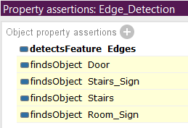
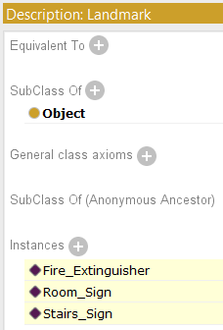
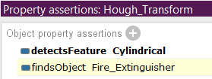
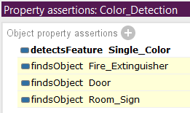
Questions / Ontology Inferred
What objects may be detected by each algorithm
What objects might be considered landmarks?

Slide 14
Conclusion
Overview of computer vision practices for obstacle and landmark detection and recognition
Different solutions for the same problems encountered, and different results
Computer vision tasks are often hard because of different solutions to the same problem which might seem a little confusing
Computer vision field of research is huge, a complete knowledge base about each thing might be impossible to do
More general algorithms can simply be used to several different cases of detection

Slide 15
References
Romero Et Al 2011
Sriharee 2015
Serrão Et Al 2012
Costa Et Al 2012
Tapu Et Al 2013
Jose Et Al 2011
Asad Et Al 2012
Moreno Et Al 2012

