Slide 1
Vision Based Indoor Environment Ontology
Rodney

Slide 2
Summary
Research Domain / Problem
Related Work
Computer Vision
Ontologies
Proposed Ontology
Conclusion

Slide 3
Research Domain / Problem
Using Computer Vision to build assistive indoor navigation tecnologies
Too many variables, and ways to achieve similar results
Combine algorithms to achieve obstacle detection and landmark identification

Slide 4
Indoor Navigation Related Work
Ref classify the indoor navigation problem as: navigation, and obstacle detection;
Serrão2012 proposed the navigation based on obstacle detection and landmark detection, the landmarks are mateched to any room prior to a Geographical Information System;
Also Costa2012, Tapu2013 proposed obstacle detection solutions for indoor navigation;
Jose2011, Asad2012, and Moreno2012 proposed a navigation based on the pathways and corridors.

Slide 5
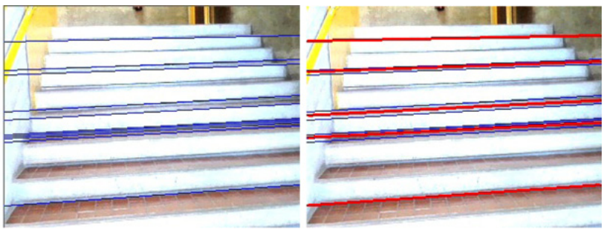
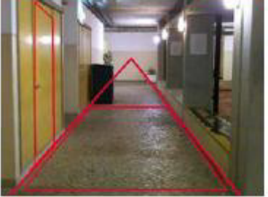
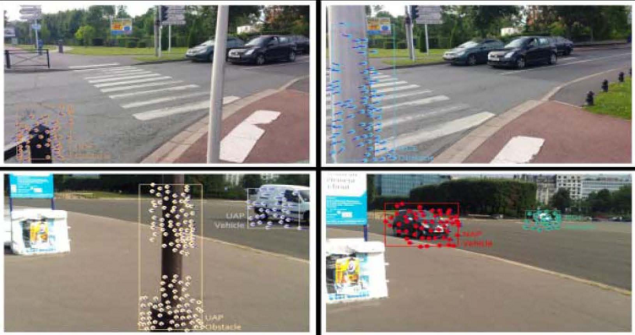
Computer Vision - Examples

Slide 6
Ontologies Related Work
Romero Et Al 2011 proposed a computer vision framework that relies on an ontology based scene representation model for tracking objects in video
Sriharee 2015 proposed a method for capturing and creating symbolic information of spatial objects for indoor navigation

Slide 7
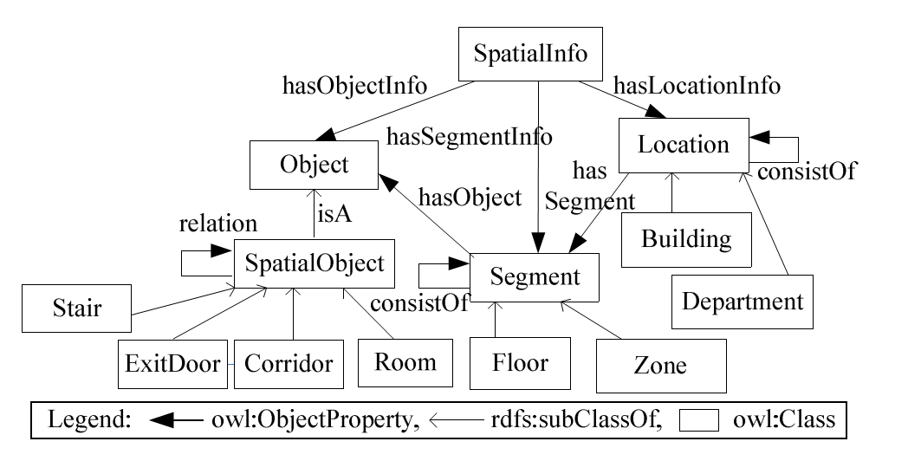
Sriharee 2015 – Spatial Information Ontology

Slide 8
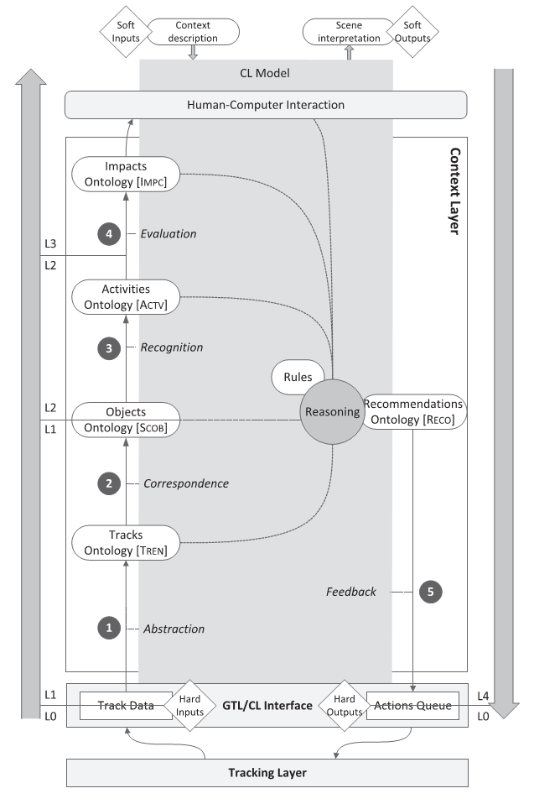
Romero Et Al 2011
Several Ontologies for tracking the objects in the videos;
Generally object knowledge is represented by TREN and SCOB ontologies;
Algo object representation there’s a specific domain ontology called SURV which is a specialization of the SCOB ontology
It defines a Mirror class which is specialized from StaticObject

Slide 9
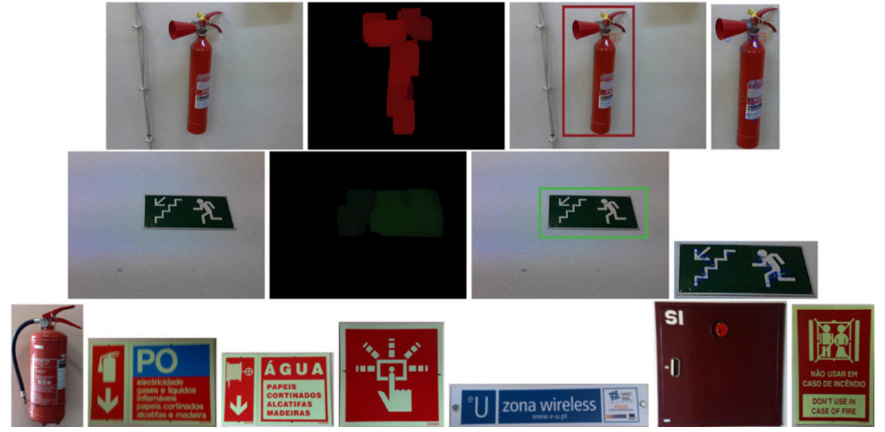
Overview
Object Representation as Features
Colors
Shapes
Edges
Object Hierarchy:
Landmarks
Obstacles
Computer Vision Algorithms
Extraction
Detection
Recognition

Slide 10
Proposed Ontology

Slide 11
Object Properties
detectFeature (Detect – Feature)
detectColor
detectShapes
hasFeature (Object – Feature)
hasColor
hasShape
reconigzes (Recognition – Object)

Slide 12
Individuals
Algoritmos conhecidos / utilizados nos trabalhos relacionados
Canny Edge Detection
Bag of Visual Words
Speed up robust features
Tipos de características distintas
Bordas
Uma única cor, várias cores, texturas
Formatos, oval, triangular, retangular, etc
Objetos
Placas de direção, ou nomes de sala
Portas, entre outros

Slide 13
Conclusion
Overview of computer vision practices for obstacle and landmark detection and recognition
Different solutions for the same problems encountered, and different results
Computer vision tasks are often hard because of different solutions to the same problem which might seem a little confusing

Slide 14
References
Romero Et Al 2011
Sriharee 2015
Serrão Et Al 2012
Costa Et Al 2012
Tapu Et Al 2013
Jose Et Al 2011
Asad Et Al 2012
Moreno Et Al 2012

