Slide 1
Vision Based Indoor Environment Ontology
Rodney

Slide 2
Summary
Research Domain / Problem
Indoor Navigation Related Work
Overview
Ontologies as Related Work
Proposed Ontology
Conclusion

Slide 3
Research Domain / Problem
Using Computer Vision to build assistive indoor navigation tecnologies
Too many variables, and ways to achieve similar results
Combine algorithms to achieve obstacle detection and landmark identification

Slide 4
Indoor Navigation Related Work
Ref classify the indoor navigation problem as: navigation, and obstacle detection;
Serrão2012 proposed the navigation based on obstacle detection and landmark detection, the landmarks are mateched to any room prior to a Geographical Information System;
Also Costa2012, Tapu2013 proposed obstacle detection solutions for indoor navigation;
Jose2011, Asad2012, and Moreno2012 proposed a navigation based on the pathways and corridors.

Slide 5
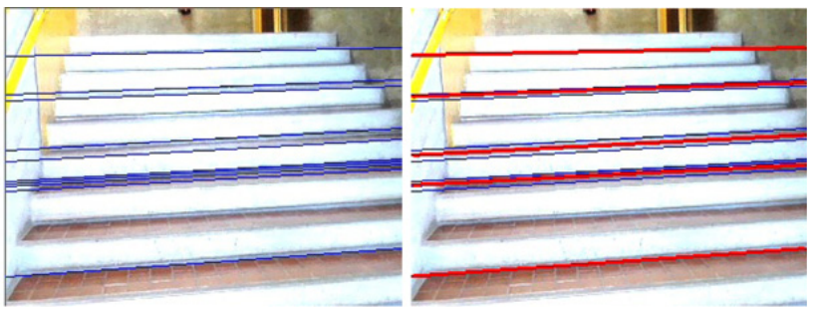
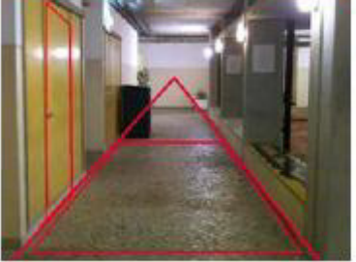
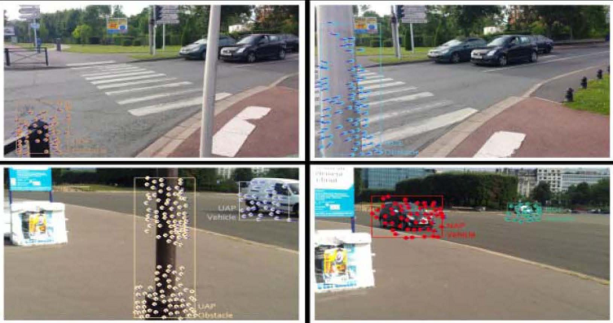
Computer Vision - Examples

Slide 6
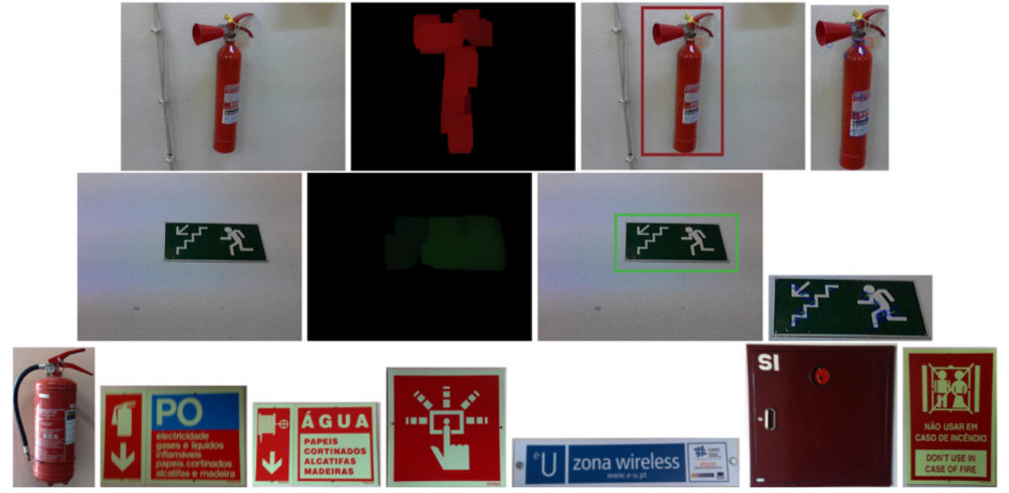
Overview
Object Representation as Features
Object Hierarchy:
Landmarks
Obstacles
Computer Vision Algorithms
Extraction
Detection
Recognition

Slide 7
Ontologies as Related Work

Slide 8
Proposed Ontology

Slide 9
Conclusion

Slide 10
References

