Slide 1

Project Wildfire
CSPB 4502 – Group 3

Slide 2

Team
Natalie Dreher
Ronald Durham
Grant Fairbairn

Slide 3
Questions Sought to Answer
Have wildfires become more or less frequent over time?
There was no significant correlation between the number of fires and years between 1992 and 2015.
In this dataset, what is the most common cause of fires?
The “Debris Burning” category was the most common cause in this dataset (by a long shot). But that category is quite vague.
Which cause of fire most commonly leads to the largest fire size?
From 1992 to 2015, the data shows that lightning strikes were the identified cause of the largest wildfires.

Slide 4
Data Preparation Work
We utilized the data set “1.88 Million US Wildfires” for wildfires occurring in the United States between 1992 and 2015.
Short, Karen C. 2017. Spatial wildfire occurrence data for the United States, 1992-2015 [FPAFOD20170508]. 4th Edition. Fort Collins, CO: Forest Service Research Data Archive. https://doi.org/10.2737/RDS-2013-0009.4.
The dataset was massive, with 1.88 million rows of tabulated data, requiring that it be broken into four CSV segments before importing.
We needed to do some data cleaning as some of the rows were incomplete. We utilized the attributes that were useful in answering our questions and removed excess or ones not applicable to this project.

Slide 5
Tools Used
Coding:
Visualization tools:
Jupyter Notebook
Python
Matplotlib
Pyplot
Seaborn
Plotly
Colorcet
Holoviews
Data processing and regression:
Pandas
Numpy
Sklearn
Statsmodels

Slide 6
Techniques Applied
We utilized visualization tools (Matplotlib and Seaborn) to analyze the data and look for interesting patterns to analyze, and we created a “heatmap” showing the prevalence of fires from the dataset.
Once we had an idea of what we were looking for, we set out to look for significance in correlations.
For example, we used the linear regression tools from the Python statsmodel library to analyze whether wildfires were becoming more or less common over time.

Slide 7
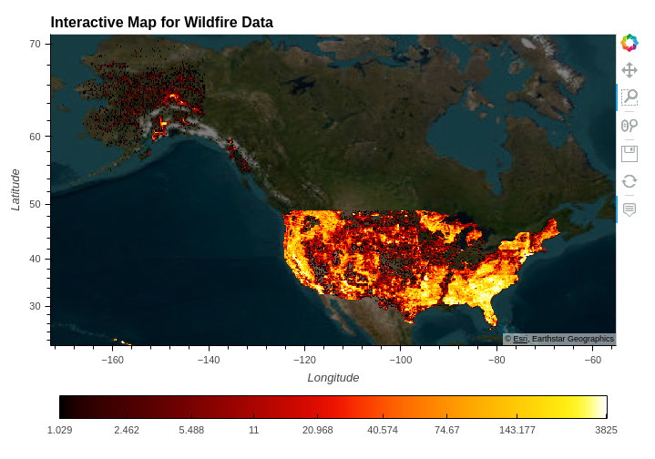
Heatmap Visualization

Slide 8
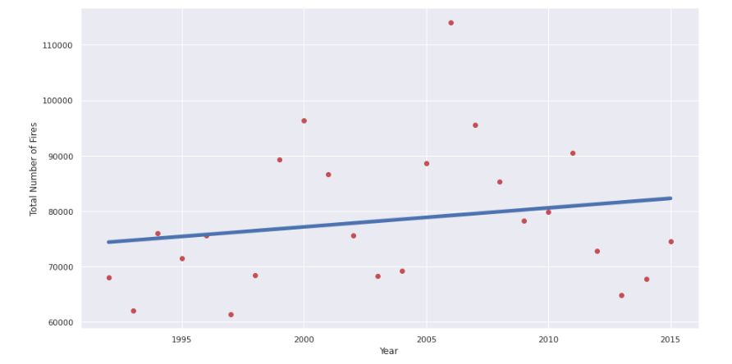
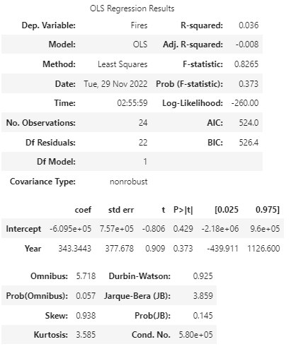
Knowledge Gained
We did not find a significant trend in the growth or reduction of fires over time. The R-squared value of “Fires” against “Years” was low at 0.036:

Slide 9
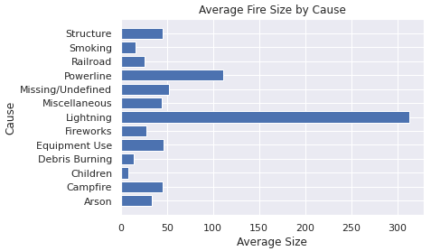
Knowledge Gained
But we did find an interesting result in comparing fire size by cause. Lightning strikes accounted for the largest average fire (by a wide margin):

Slide 10
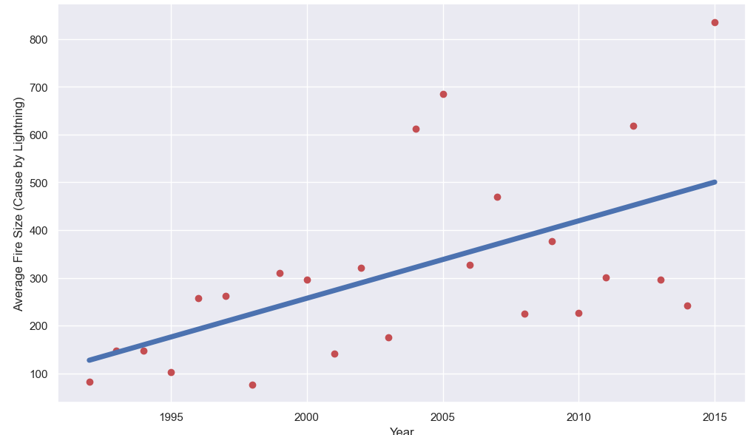
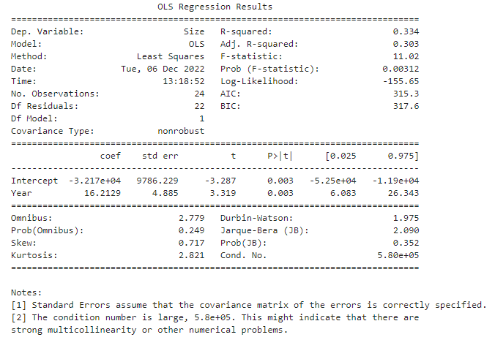
Knowledge Gained
That led us to analyze the average fire size caused by lightning over time, revealing a positive correlation:

Slide 11
Applications
The largest area of application from studying wildfire data is the potential for learning about prevention and containment.
Wildfires are a necessary part of the global ecosystem, and lightning strikes are natural causes.
While lightning strikes cannot be prevented, early detection of strikes in forested areas prone to the largest fires (e.g., the western portion of the United States) could reduce the burn area.

Slide 12


Thank You
https://github.com/rodu4835/CSPB4502_ProjectWildfire

