Slide 1
Politics and Industries

Slide 2
What Did We Want To Accomplish?
Data Source: Census Bureau’s County Business Patterns Data Set (www.census.gov/programs-surveys/cbp.html)
Sample: A variety of industries selected by their North American Industry Classification System (NAICS) codes
End Goal 1: Choropleth map (with filters mind you) to display the concentration of businesses in different industries across all 50 states
End Goal 2: Zoomable Sunburst to visualize the concentrations of business in a particular industry, in a geographical area, and the political affiliations of the states in that area
https://bl.ocks.org/mbostock/4348373

Slide 3
Did We Accomplish It?
Simply put…no
However, we got decently far *applause*
Hold tight while we discuss our approach and results

Slide 4
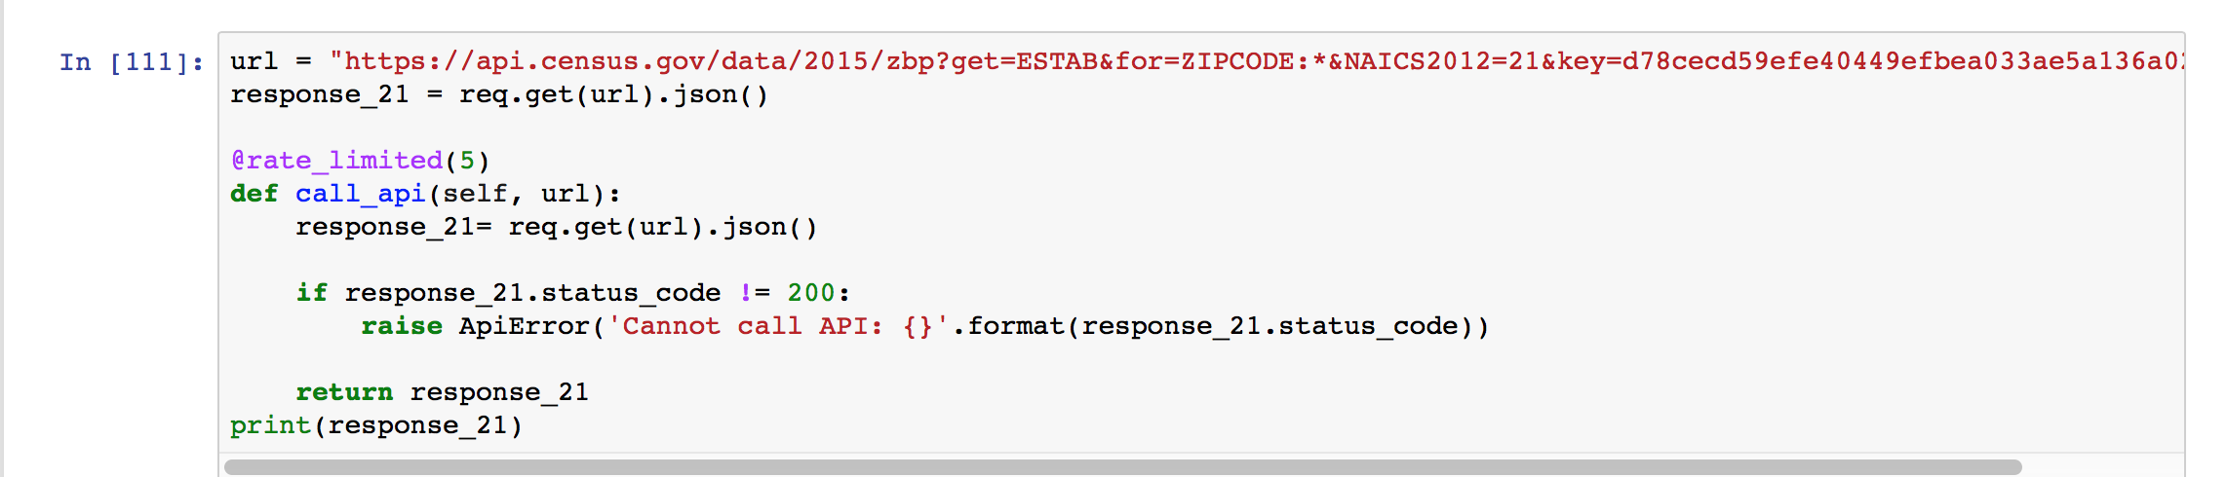
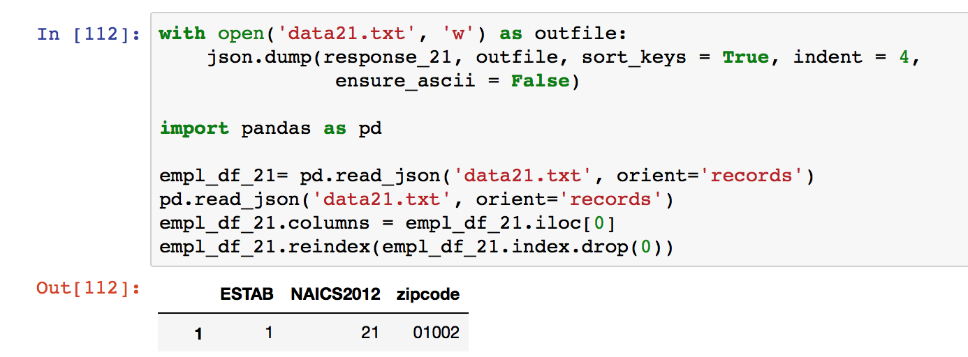
Our Approach
Started with a Jupyter Notebook to compile the data

Slide 5
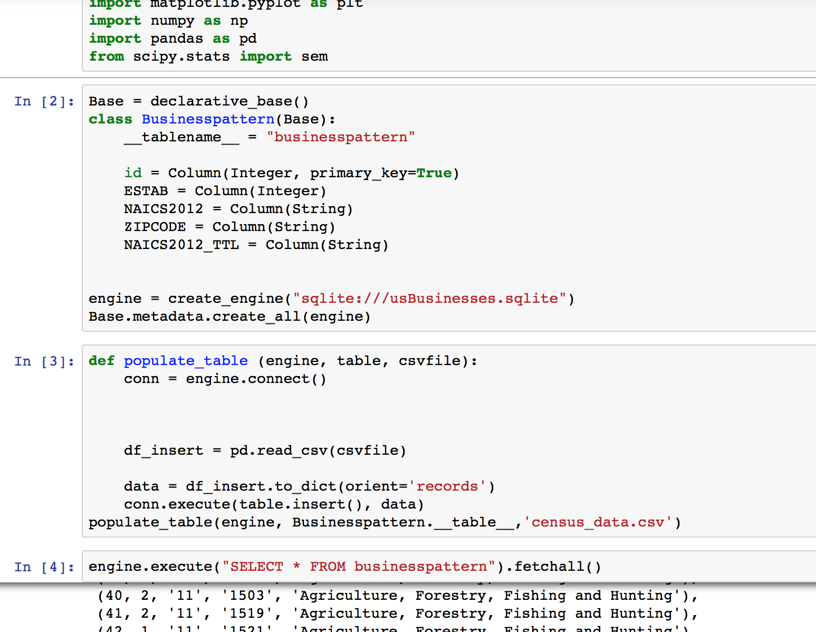
Our Approach
We then deployed our flask app and SQL Alchemy db
This is where our success ended

Slide 6
Our Approach
Used python, javascript, html, css, etc.
We got a website up and running and plotted the data, but realized too late that it wasn’t what we needed
Problem traced back to the GeoJson file (needed borders, had points instead)
This is why the choropleth map wasn’t working

Slide 7
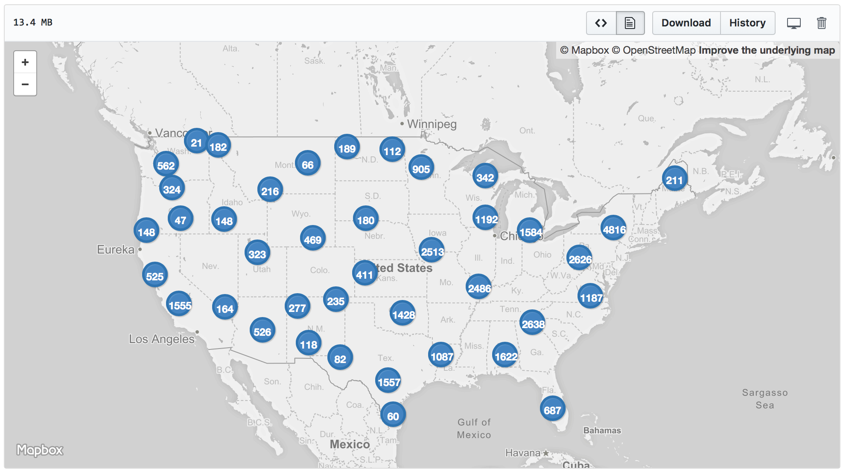
Map (Using GeoJson Data)
https://github.com/roduok/Prjoect-2-Story-Visualtization/blob/master/zipcodedata.geojson

Slide 8
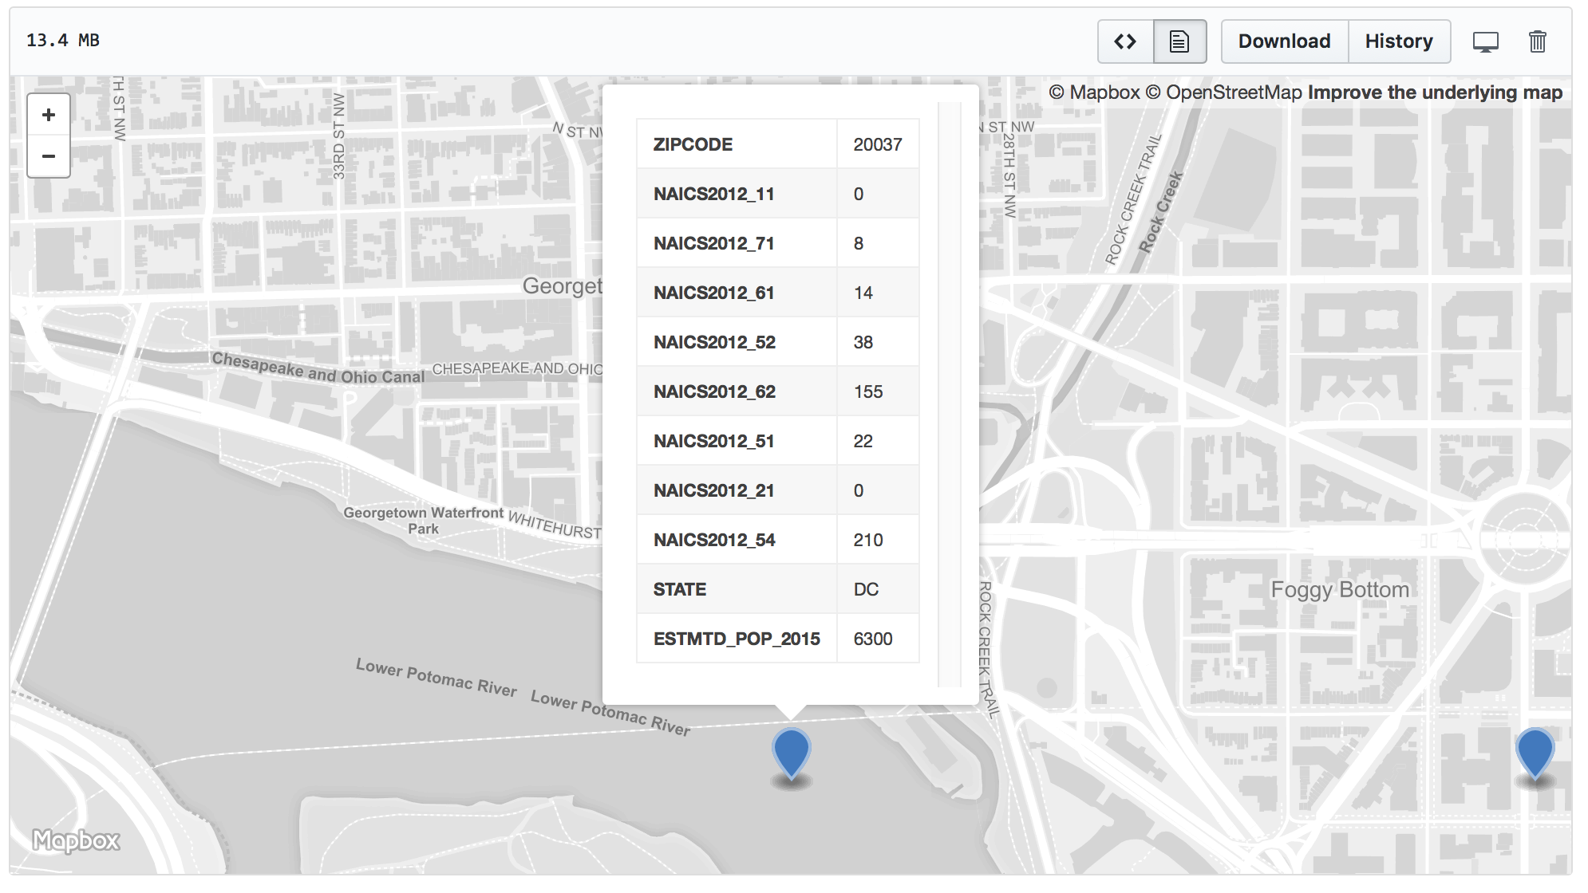

Slide 9
NAICS Codes
NAICS Code | Industry
11 | Agriculture, Forestry, Fishing & Hunting
21 | Mining, Quarrying, & Oil & Gas Extraction
51 | Information
52 | Finance & Insurance
54 | Professional, Scientific, & Technical Services
61 | Educational Services
62 | Health Care & Social Assistance
71 | Arts, Entertainment, & Recreation

Slide 10
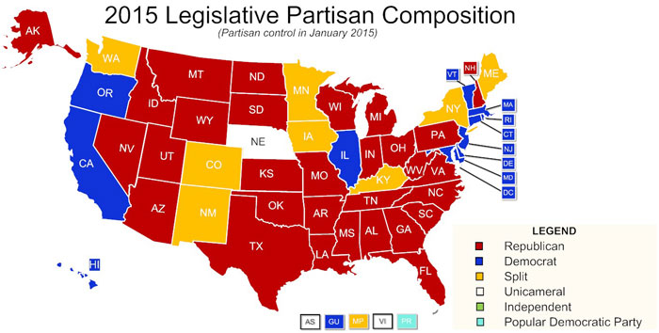
Political Affiliations of States

Slide 11
Questions?

