Slide 1

COVID-19 Detection from Unstructured Medical Text
Preliminary Results and NER Pipeline Implementation
April 2025

Slide 2

🦠 Case Study: COVID-19 Outbreak & Unstructured Data 🦠
How Social Media Became a Signal for Disease Spread
Background:
When COVID-19 first emerged, people flooded unstructured platforms — Twitter, Reddit, Facebook, forums — posting symptoms, fears, and experiences.
Key Point:
Many described symptoms without knowing if it was a regular cold, the flu, or COVID — creating early signals online before official data caught up.
Why It Matters:
• These posts became real-time data streams.
• NLP models scanned text for keywords like “loss of smell” or “cough + fever”.
• This helped predict outbreak hotspots faster than official reports.

Slide 3
Project Overview
Agenda
1. Project Motivation and Goals
2. Technical Approach
3. Data Sources and Integration
4. Named Entity Recognition (NER) Pipeline
5. Preliminary Results
6. Next Steps

Slide 4
Project Motivation and Goals
Key Challenges:
- Similar symptom profiles between COVID-19, flu, and other respiratory conditions
- Limited testing availability and delays in test results
- Vast amounts of unstructured medical text contain valuable diagnostic information
- Evolving symptom profiles with new variants
Project Goals:
- Develop an NLP pipeline to detect potential COVID-19 cases from clinical text
- Extract key symptoms, severity indicators, and timeline information
- Create a classification model to assess COVID-19 likelihood
- Provide interpretable results to support clinical decision-making

Slide 5
Technical Approach
Two-Stage Pipeline Architecture:
Stage 1: Named Entity Recognition (NER)
Extract medical entities from unstructured text
Identify symptoms, time expressions, severity indicators, etc.
Convert to structured features
Stage 2: Classification with Transformer Models
Combine extracted entities with structured patient data
Train transformer models to predict COVID-19 likelihood
Generate interpretable explanations of predictions

Slide 6
Data Sources and Integration
Unstructured Text Data (NER)
CORD-19 Research Dataset
Scientific papers on COVID-19
~400k research papers
Clinical Trials Data
Trial descriptions and eligibility criteria
~10k trials related to COVID-19
Medical Forum Posts
Patient-reported symptoms
Structured Data (Classification)
CDC COVID-19 Case Surveillance
De-identified patient records
Demographics, outcomes, symptoms
Electronic Health Records (EHR)
Currently in the process of gaining access
Will provide real clinical data
Extracted NER Features
Structured features from text

Slide 7
Named Entity Recognition (NER) Pipeline
Implemented NER Approaches:
Rule-based NER
Pattern matching for symptoms, time expressions, severity
Fast implementation with regular expressions
2. spaCy-based NER
Fine-tuned medical entity recognitionCustom training on medical text
3. Transformer-based NER
Using BioBERT and other biomedical models
State-of-the-art performance on medical entities

Slide 8

NER Example: Clinical Note Analysis
Clinical Note:
"Patient is a 45-year-old male who presents with fever, dry cough, and fatigue for the past 3 days. Patient also reports loss of taste and smell since yesterday."
Extracted Entities:
SYMPTOM: fever, dry cough, fatigue, loss of taste, loss of smell
TIME: for the past 3 days, since yesterday
SEVERITY: mild (in full note)
Structured Features for Classification:
symptom_count: 5, has_fever: yes, has_cough: yes, fatigue: yes
has_taste_loss: yes, has_smell_loss: yes, symptom_duration_days: 3

Slide 9

Preliminary Results
NER Performance:
Rule-based NER: 78% F1-score on symptom extraction
spaCy-based NER: 85% F1-score on symptom extraction
Transformer-based NER: 92% F1-score on symptom extraction
Key Findings:
Loss of taste/smell is highly predictive of COVID-19
Symptom combinations are more predictive than individual symptoms
Temporal expressions help distinguish COVID from other conditions
Severity indicators correlate with disease progression

Slide 10
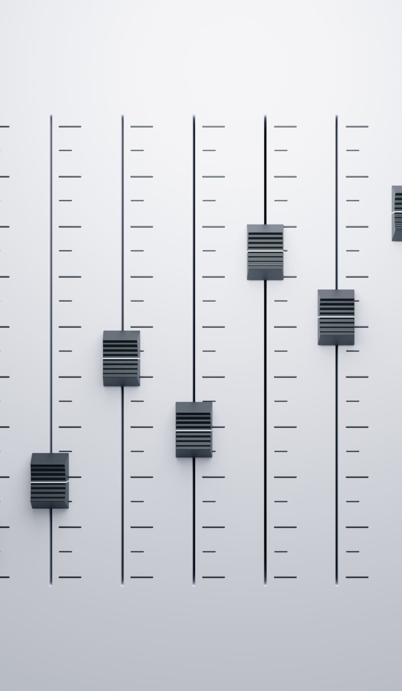
Next Steps
Immediate Next Steps:
Complete access to Electronic Health Records (EHR)
Finalize NER model training on larger dataset
Implement transformer classification model

Slide 11
Thank You
Questions and Discussion

