Slide 1
CEFPython
Developing applications using Chromium
Jason Jones
@JasonProgrammer
simpletutorials.com/cef

Slide 2
What is Chromium?
The code behind Google’s Chrome browser.
*Google has Chromium OS, but we’re talking about the browser
http://www.chromium.org/Home

Slide 3
What is CEF?
What is CEF?

Slide 4
Chromium Embedded Framework
C/C++ wrapper around Chromium.
Helps embed Chromium into applications.

Slide 5
What is CEF?
What is CEFPython?

Slide 6

...a Python wrapper for CEF.
CEFPython
c++, cython
CEF
c++
Chromium
c++

Slide 7
Why use it?
You’re familiar with web design.
You want a reponsive, cross-platform UI.
You want custom UI controls.
You want to provide a client with a custom browser.

Slide 8
What’s something I’d like to do with it?

Slide 9
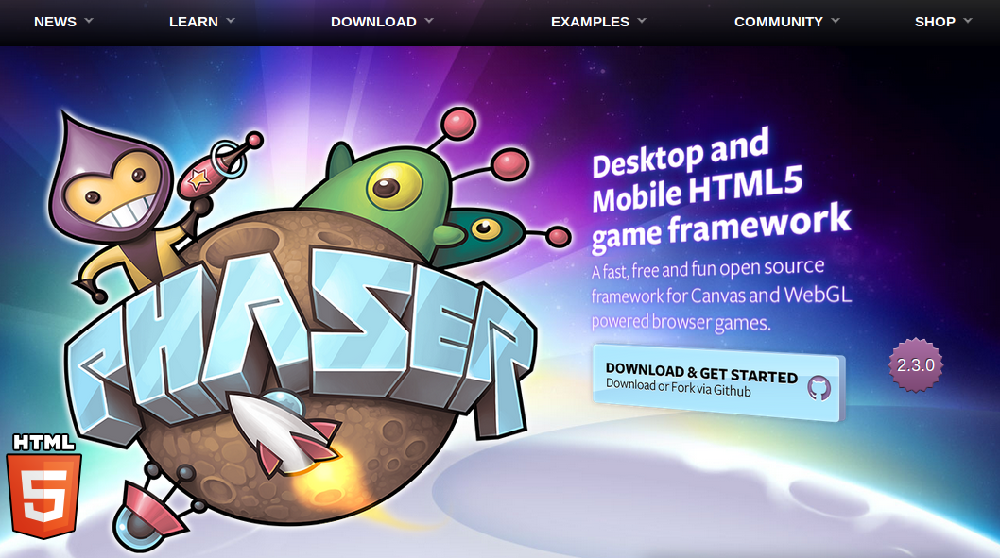

Slide 10
What is CEF?
Who uses CEF?

Slide 11
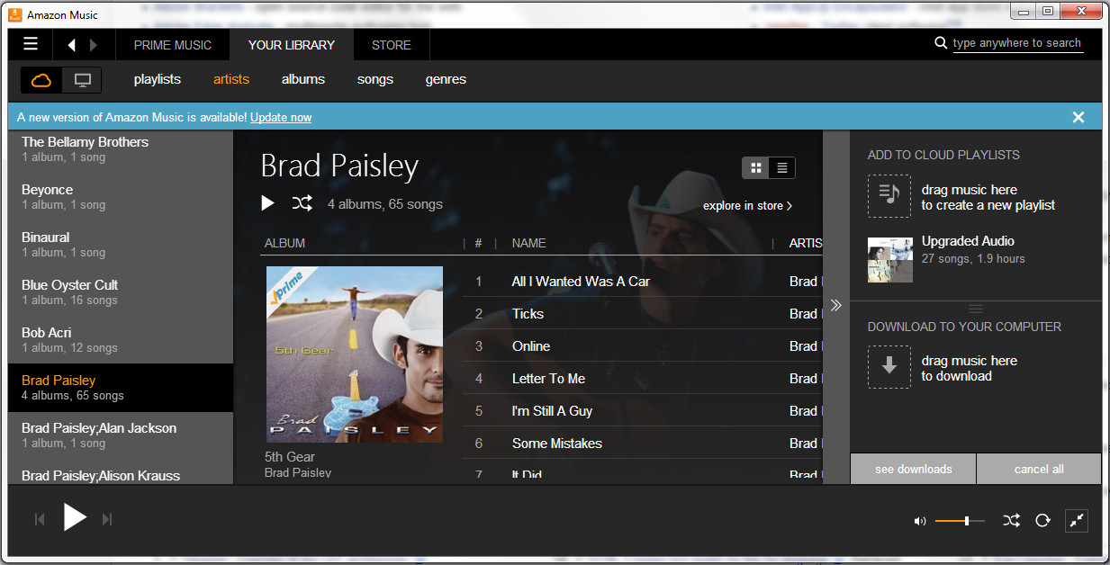

Amazon
Note the responsive design (resize-friendly)

Slide 12
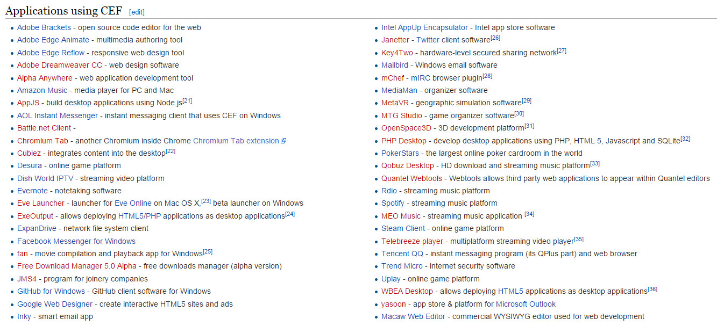
https://en.wikipedia.org/wiki/Chromium_Embedded_Framework

Slide 13
CEFPython Requirements
Windows XP SP3+
Python 2.7 (no Python 3 packages yet)
http://www.magpcss.net/cef_downloads/

Slide 14
What is CEF?
What UI frameworks work with CEFPython?

Slide 15
Quite a few...
Kivy - MIT License
PyWin32 - Python Software Foundation license
Panda3D - Modified BSD - 3D game engine (Disney)
wxPython - based on wxWidgets C++ library
PyGTK - LGPL
PySide - LGPL
PyQt - GPL, Fee for commercial use
*No CEFPython examples provided for Tkinter

Slide 16
I chose wxPython.
Open source
Free for commercial use
Cross-platform
Based on wxWidgets (C++ library)

Slide 17
A great wxPython example comes with cefpython.

Slide 18
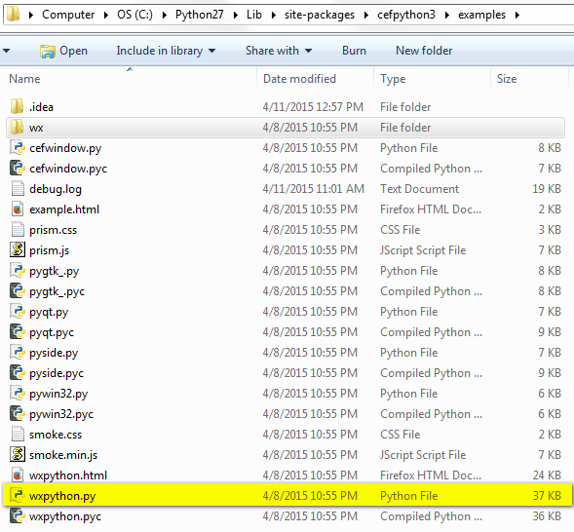

Slide 19
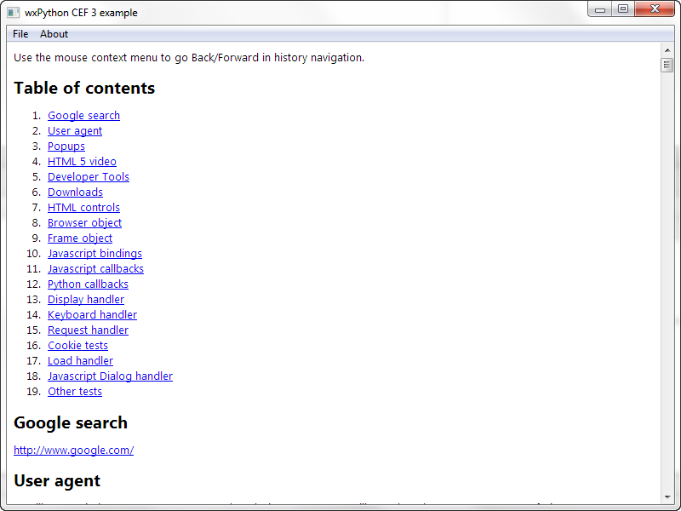

Slide 20
So does everyone who runs my application need to install Python?

Slide 21
py2exe
We can create an executable from Python code.
http://www.py2exe.org/

Slide 22
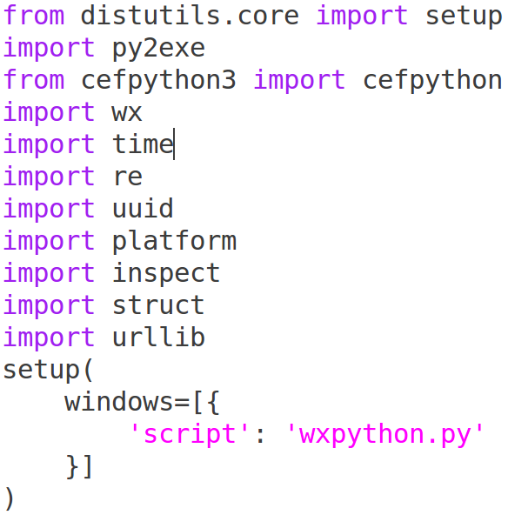
py2exe build script

Slide 23
set PYTHONPATH=C:\Python27;C:\Python27\Lib;C:\Python27\DLLs
C:\Python27\python.exe build_exe.py py2exe
wxpython.exe
(no Python interpreter needed to run this)

Slide 24
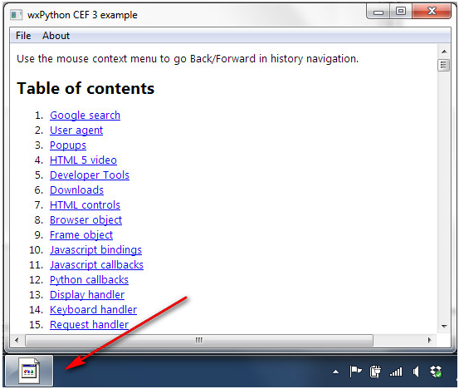

Slide 25
What does task manager look like?

Slide 26
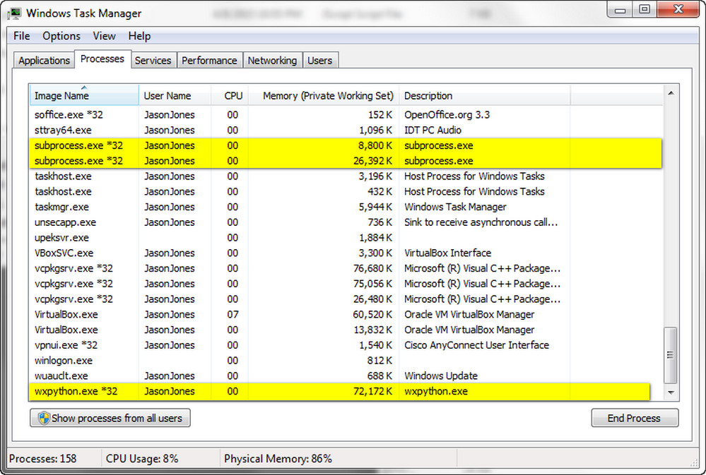

Slide 27
Multiple Processes
Chromium uses multiple processes and talks between those processes (IPC).

Slide 28
What processes are involved?

Slide 29
Browser Process
wxpython.exe
Render process
Blink - Layout (parse HTML, CSS)
V8 - Run JavaScript
subprocess.exe
Render process
Plugin process (e.g. Flash)

Slide 30
When debugging, keep in mind there are multiple processes.
If your breakpoint isn’t being hit, you might need to use a __debugbreak().

Slide 31

browser_subprocess_path
A separate (lightweight)
process to be used as each render process.

Slide 32
Message Loop
Chromium uses multiple threads. Each thread has a message loop.
User Interface
IO
File
DB
Safe Browsing
History
Proxy
http://www.chromium.org/developers/design-documents/threading

Slide 33
To run the message loop...
Call a blocking function that runs the message loops
-OR-
Call DoMessageLoopWork on a timer or on an idle event.

Slide 34

Don’t starve the message loop.

Slide 35

Sandbox
The render process can only access:
CPU
Memory
http://dev.chromium.org/developers/design-documents/sandbox/Sandbox-FAQ

Slide 36
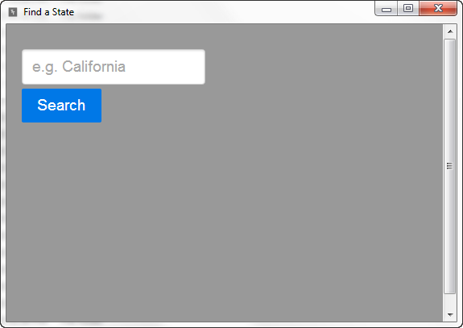
A simple application to search the 50 states by name.

Slide 37
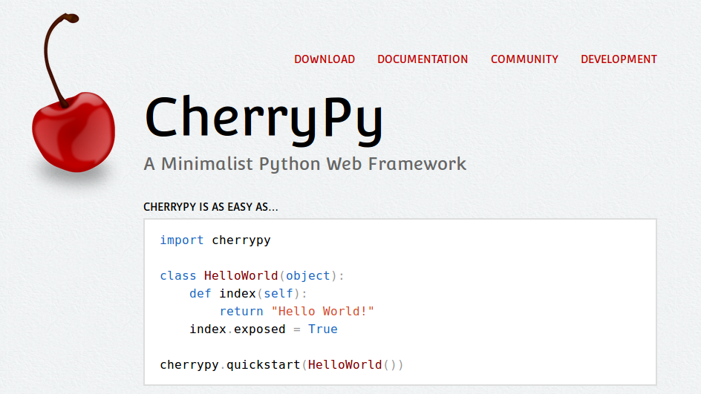
Multithreaded, production ready web server and framework (WSGI)

Slide 38
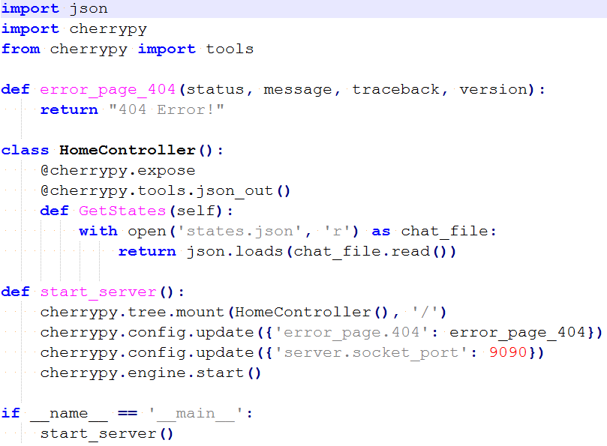

Slide 39
states.json
[
"Alabama",
"Alaska",
"Arizona",
"Arkansas",
"California",
"Colorado",
"Connecticut",
"Delaware",
"District Of Columbia",
"Florida",
"Georgia",
…(more)...
]

Slide 40
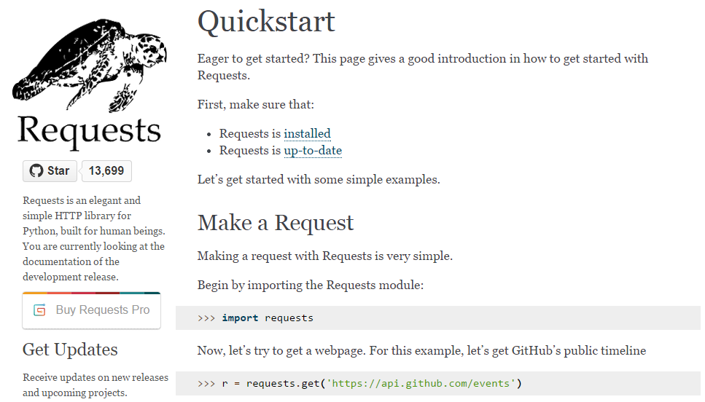

Slide 41
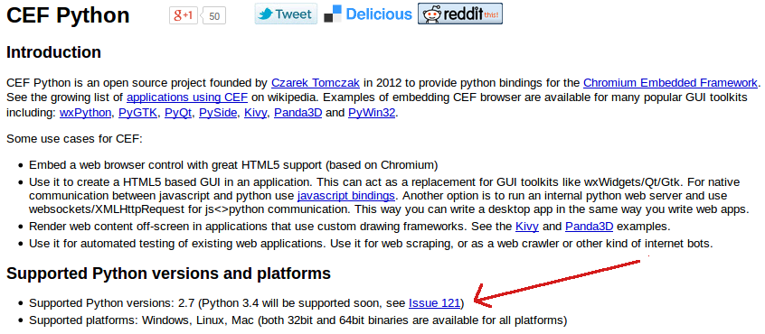
What about Python 3?
https://code.google.com/p/cefpython/

Slide 42
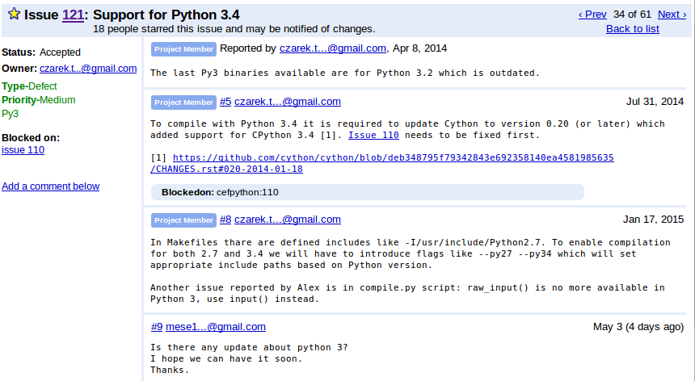

Slide 43
What is Cython?
Python + C data types
It’s a language (superset of Python) that compiles to C++.
It’s used for optimization and interfacing to C/C++ code.

Slide 44
Can I update CEF?
What if I want the latest version of CEF/Chromium?

Slide 45
CEF Builds
Latest nightly - Rev. 2378
Requires Visual Studio 2013
https://cefbuilds.com/

Slide 46
Python extensions for Windows need to be built with the same version of VC++ used to build Python.

Slide 47
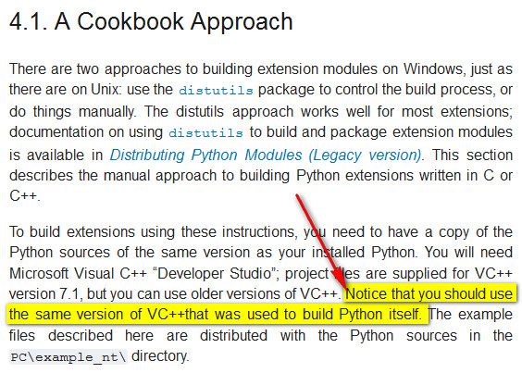
https://docs.python.org/3/extending/windows.html

Slide 48
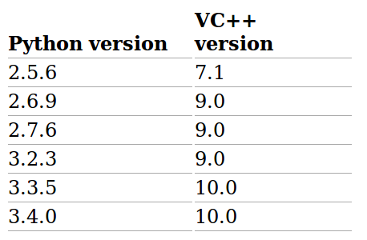
http://matthew-brett.github.io/pydagogue/python_msvc.html

Slide 49
Visual C++ for VS2013 is version 18
http://en.wikipedia.org/wiki/Visual_C%2B%2B

Slide 50
Are there Python binaries built with VS2013?

Slide 51
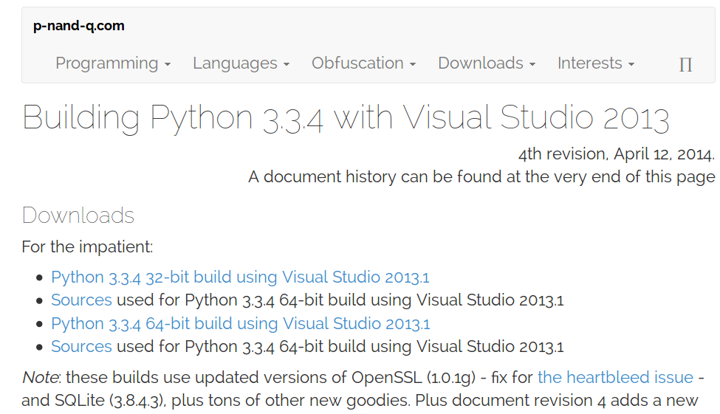
http://p-nand-q.com/python/building-python-33-with-vs2013.html

Slide 52
Alternatives
Is it possible to use Python 3 and the CEF Nightly build?

Slide 53
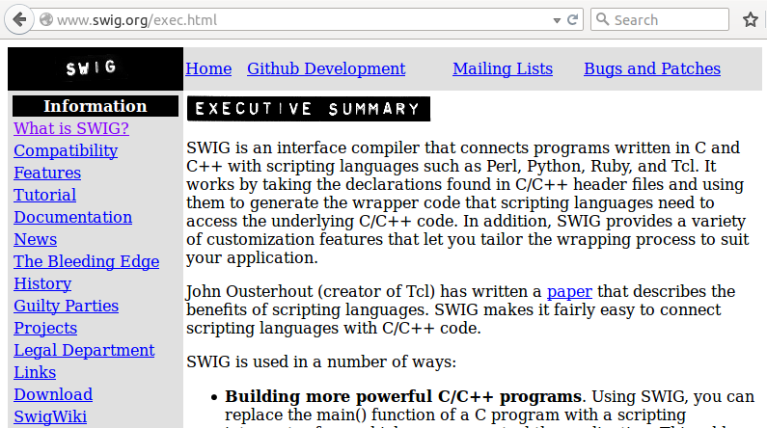
Yes. You can write Python-C++ bindings with SWIG.

Slide 54
Simplified Wrapper and Interface Generator
http://en.wikipedia.org/wiki/SWIG
http://www.swig.org/tutorial.html
http://www.wxpython.org/OSCON2008/Python%20C++%20and%20SWIG.pdf

Slide 55
SWIG can generate wrapper code for 23 languages:
Allegro CL
C#
CFFI
CLISP
Chicken
D
Go
Guile
Java
Javascript
Lua
Modula-3
Mzscheme
OCAML
Octave
Perl
PHP
Python
R
Ruby
Scilab
Tcl
UFFI

Slide 56
Install SWIG
Download
Extract
Add directory to your PATH

Slide 57
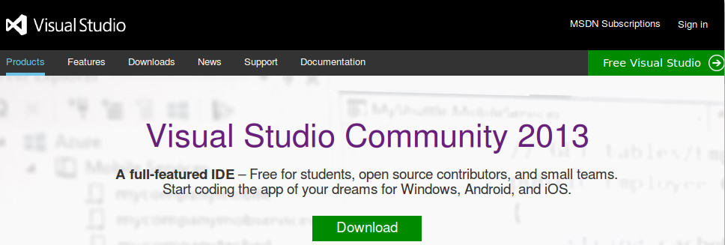
Install VS

Slide 58
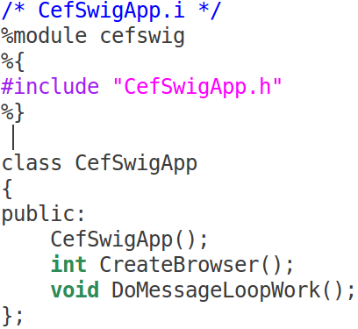
Interface File
Helps SWIG know what to wrap

Slide 59
swig -c++ -python CefSwigApp.i
cefswig.py
CefSwigApp_wrap.cxx
Our Python module:
import cefswig
C++ wrapper we will build with our source to produce a pyd (DLL) file

Slide 60
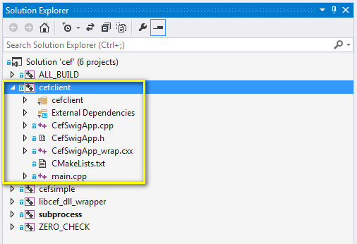
CEF C++ Solution

Slide 61
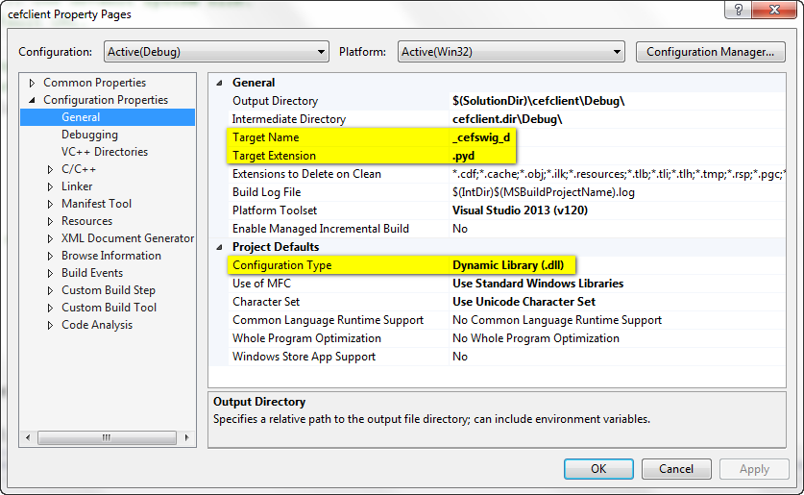

Slide 62
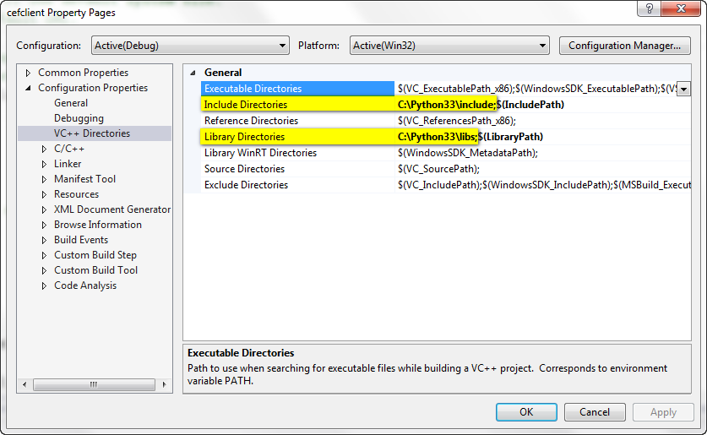

Slide 63
Thanks!
Questions? @jasonprogrammer

