Slide 1
Group Project 1 BAN 5763, Spring 2024
Customer Lifetime Value Analysis
SFRR Analytics Shreyan Datta Chakraborty
Roe Djer Tan
Frankle Muchahary
Ritwik Roy Chowdhury

Slide 2




Why do we need to understand Customer Lifetime Value?
10%-25%
5x – 7x
2x
?
Average Churn Rate for B&M Retailers^{[1]}
Cost of Acquiring New Customers vs Retaining Existing Customers^{[2]}
Value generated in 2-5 Years timeframe vs Year 1^{[3]}
Can we estimate Potential Future Customer Value???
[1] https://www.zendesk.com/blog/customer-churn-rate/#:~:text=According%20to%20the%20Zendesk%20Customer,all%20resulting%20in%20customer%20churn
[2] https://www.forbes.com/sites/forbesbusinesscouncil/2022/12/12/customer-retention-versus-customer-acquisition/?sh=67b707a91c7d
[3] https://www.forbes.com/sites/sap/2019/09/12/why-and-how-companies-should-calculate-customer-lifetime-value/?sh=49937efd459d
Notes:
Brick and Mortar retailers have an average yearly churn rate of around 10-25% based on external market research
HBR research estimates that it costs almost 5 to 7 times more to acquire new customers compared to retaining old customers
BCG research estimates that customers generate more value as the length of relationship with the company increases. They generate almost 2 times more value per year in years 2-5 of the relationship as compared to year 1

Slide 3





Objective: What are we trying to solve?
26%
Targeted Strategies
for Customer Groups
Large proportion of the customers churn within the first one year of association
Calculate Customer Lifetime Value
Estimate Margin Value
Identify Churn Risk
Understand Customer Behavior
Notes:
The dataset has 26% churn rate

Slide 4



Executive Summary
Retail customer engagement is multifaceted & exhibit diverse behaviors - influencing their loyalty and spending
Retaining customers is crucial for creating long term engagement & value
Complication
Customers are concentrated in the lower tiers and have highest rates of churn.
Different demographic groups have varying preferences and rate of churn
Segmenting customers into groups can help design targeted strategies
Varying Problems
Immediate focus required for disengaged customers.
Tailored loyalty campaigns for high-value customer groups – long term value.
Higher Tier offerings need revamping to offer better value for money.
Recommendations

Slide 5
EXPLORATORY DATA ANALYSIS

Slide 6
Year 1 Churn Rate – A look across the different subscription tiers
Customers from lower subscription tiers are at a much higher risk of churning. Customers are concentrated in these tiers
Churn
Not Churn
73.6%
100%
26.4%
Churn
Not Churn
Bronze
Silver
Gold
Platinum
Diamond
% Customers | 64.2% | 20.2% | 11.3% | 2.3% | 2.0%

Slide 7
Retained customers generate up to 2.5 times more revenue across 3 years
RFM Metrics will be crucial in determining Churn Risk. Significantly different b/c Churn and Not Churn
-34.5%
2.5x
-71.0%
Churn
Not Churn
Churn
Not Churn
Churn
Not Churn
Average Purchase Amount – 3 Years
Average Interval B/W Purchases
Average Recency Months

Slide 8
Customers generate more value on average in the corresponding years of association compared to the first year
Average Margin ($) Generated Per Customer
+17%
Average value increases across the years
Creating loyal customers can generate 17% more margin in the long run
Loyalty and Retention Campaigns are crucial
Year 1
Year 2
Year 3
Year of Association
Note: Same set of customers were used across all three years for a fair comparison. Newly acquired customers in year 2 and year 3 were ignored.

Slide 9
Older Age Groups: Higher Average Margin $ and Higher Retention Rates
Average Margin $ Across Age Groups
Older aged customers are more satisfied with the services
Crucial to understand why younger aged customers are leaving
Customized service offerings fine-tuned towards different age buckets might be helpful
18-24 years old
25-34 years old
35-44 years old
45-54 years old
55-64 years old
65-74 years old
75+ years old
Churn Rate Across Age Groups
42%
40%
34%
29%
25%
21%
17%
18-24 years old
25-34 years old
35-44 years old
45-54 years old
55-64 years old
65-74 years old
75+ years old

Slide 10
Older Age Groups: Higher proportion of upper tier customers
Diamond Customers vs Age Groups
27%
21%
22%
16%
11%
3%
0%
18-24 years old
25-34 years old
35-44 years old
45-54 years old
55-64 years old
65-74 years old
75+ years old
Larger proportion of Diamond Customers are older aged
Lower Tier (Bronze, Silver) customers tend to be on the younger spectrum
Bronze Customers vs Age Groups
21%
23%
18%
16%
14%
7%
1%
18-24 years old
25-34 years old
35-44 years old
45-54 years old
55-64 years old
65-74 years old
75+ years old

Slide 11
PREDICTING CHURN RATE

Slide 12

Churn Model – Performance Metrics
Model/Approach | Misclassification Rate | AUC
Logistic Regression | 10.0% | 0.91
Gradient Boosted Decision Trees | 8.6% | 0.94
GBDT - additional 1.4% customers identified correctly
Can lead to better retention and cost savings during retention campaigns
Recency is the most important metric for identifying risk of churn
Automated Purchase Schedule also helps identify churn
Mode of Payment also seems to have an impact on churn rate (CK, ET)
Approach for modeling detailed out in Appendix

Slide 13
Churn Probability Scores – Group Breakdown

Slide 14
PREDICTING MARGIN VALUE

Slide 15
Margin Estimation Model – Performance Metrics
Model/Approach | R Squared | Test MSE
Logistic Regression | 59.8% | 1.4 x 10⁻⁴
Random Forest | 72.12% | 1.0 x 10⁻⁴
Gradient Boosted Decision Trees | 53.12% | 1.1 x 10⁻⁴
RF model provides a good tradeoff between training time and model performance
GBDT will likely require extensive parameter tuning for performance
Historical Customer Monetary Values are the best indicators for future margin estimates
Approach for modeling detailed out in Appendix

Slide 16
Estimated Margin – Group Breakdown
*M = Margin

Slide 17
ESTIMATING FUTURE CLV

Slide 18
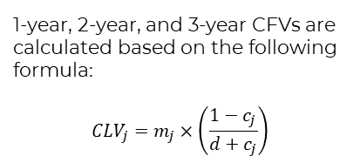
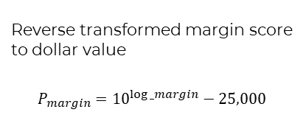
Approach for estimating Customer Future Value (CFV)
Reverse Transformation
Reverse transformed margin score to dollar value
$$P_{margin}={10}^{log⁡_margin}−25,000$$
Step 1
Step 2
Step 3
Churn Modeling &
Margin Modeling
Calculate CFV
1-year, 2-year, and 3-year CFVs are calculated based on the following formula:
$${CLV}_{j}=m_{j}×\left(\frac{1−c_{j}}{d+c_{j}}\right)$$
Obtained churn score and margin score

Slide 19
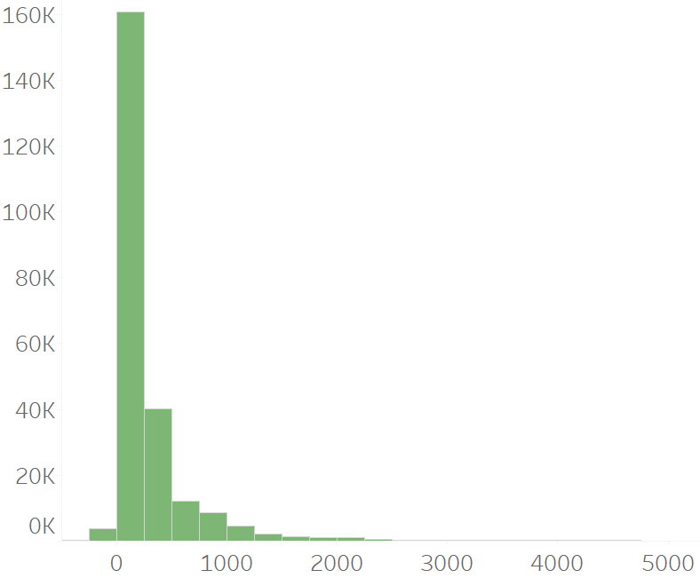
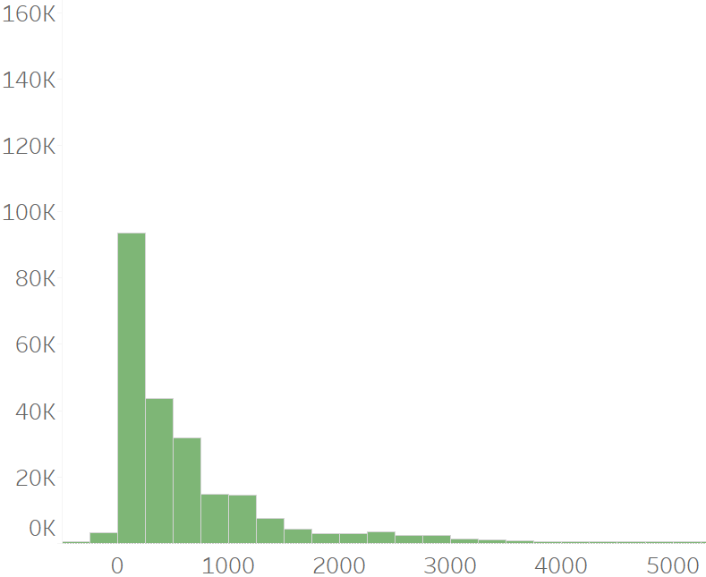
Customer Future Value: 1-Year Value vs 3-Year Value
Customer value increases as the length of relationship with the company increases. Increasing customer loyalty can help generate long-term value.
CFV Distribution – 1 Year
CFV Distribution – 3 Year

Slide 20
CUSTOMER SEGMENTATION

Slide 21
Customers can be segmented and prioritized based on Margin and Retention
Loyal Low Spenders
45% Customers
$ 450 Avg 3-Year CFV
Loyal Big Spenders
22% Customers
$2200 Avg 3-Year CFV
Retention Likelihood
Disengaged Low Value Customers
23% Customers
$47 Avg 3-Year CFV
Unhappy High Value Customers
10% Customers
$1100 Avg 3-Year CFV
Margin

Slide 22
Loyal Big Spenders: High Margin – High Retention (Group 1)
Loyal Low Spenders
45%
Customers
Loyal Big Spenders
22%
Customers
Lowest Churn Rate (5%)
Highest 3-Year CFV ($ 2200)
High Income Group
75% Customers in Silver + Gold Tiers
Retention Likelihood
Disengaged Low Value Customers
23%
Customers
Unhappy High Value Customers
10%
Customers
Margin

Slide 23
Loyal Low Spenders: High Retention & Low Margin (Group 2)
Loyal Low Spenders
45%
Customers
Loyal Big Spenders
22%
Customers
Low Churn Rate (9%)
Second Lowest 3-Year CFV ($ 450)
Low Income Group
80% Customers in Bronze Tier
Retention Likelihood
Disengaged Low Value Customers
23%
Customers
Unhappy High Value Customers
10%
Customers
Margin

Slide 24
Unhappy High Value Customers: High Margin – Low Retention Rate (Group 3)
Loyal Low Spenders
45%
Customers
Loyal Big Spenders
22%
Customers
Retention Likelihood
Disengaged Low Value Customers
23%
Customers
Unhappy High Value Customers
10%
Customers
High Churn Rate (38%)
High Spenders. $1100 3-Year CFV
Mostly middle-aged customers
Highest % of Platinum + Diamond Customers
Margin

Slide 25
High-Risk Low Value Customers: Low Margin – Low Retention Rate (Group 4)
Loyal Low Spenders
45%
Customers
Loyal Big Spenders
22%
Customers
Retention Likelihood
Disengaged Low Value Customers
23%
Customers
Unhappy High Value Customers
10%
Customers
Highest Churn Rate (76%)
Mostly younger aged customers
Similar Avg Purchase Amount to Loyal Low Spenders
Last purchase was 7 months back on average
Margin

Slide 26
Customer Segments vs Subscription Tiers
Opportunity for moving these customers to Platinum and Diamond
Identify issues with Platinum and Diamond before running up-selling campaigns
Opportunity for up-selling
Move these customers to Silver & Gold Tiers through up-selling and cross-selling
Unhappy High Value customers have the highest proportion of Platinum and Diamond Customers.
Group has high churn rate
Higher tiers might have lower value for money

Slide 27
RECOMMENDATIONS

Slide 28
Recommended Actions – Estimated Immediate Impact vs. Implementation Effort
Estimated Immediate Impact
Immediate Focus Targeted Promotion/Coupon Campaigns – Focused on Retaining At Risk Groups | Medium Term Initiatives Identify Issues & Product/Service Development Cross-Selling and Up-Selling
Major Projects Loyalty Program Implementation focused on High Value Groups | Long Term Strategies Customer Feedback Loop & Continuous Improvement Plan
Implementation Effort

Slide 29
Phased Implementation Strategy & Groups to Focus for Each Phase
Medium Term Initiatives
Long Term Initiatives
Action:
Cross-Selling and Up-Selling
Identify Issues & Product/Service Development
Target Groups: High Value (Groups 1 and 2)
Action: Feedback & Continuous Improvement Loop Target Groups: All Groups
Phase 1
Phase 2
Phase 3
Phase 4
Immediate Focus
Major Projects
Action: Targeted Promotion and Coupon Campaigns Target Groups: Low Value (Groups 3 and 4)
Action: Loyalty Program targeted at High Value Groups
Target Groups: High Value Groups
(Groups 3 and 4)

Slide 30
APPENDIX

Slide 31
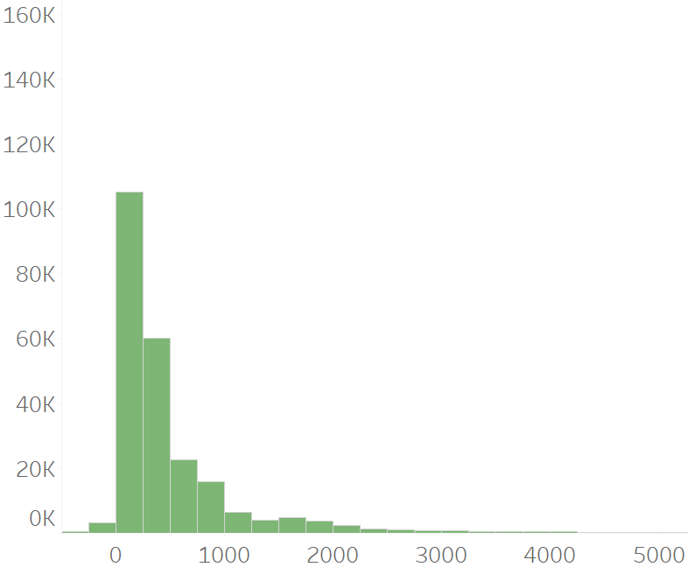
CFV Distribution Histogram
Year 3 CFV
Year 2 CFV
Year 1 CFV

Slide 32
Hyperparameters – Margin Model and Churn Model
Margin Model
1. Random Forest
n_estimators: 120,
min_samples_split: 6,
min_samples_leaf: 2,
max_features: 'sqrt',
max_samples: 0.5,
max_depth: 40
2. Gradient Boosted DT
n_estimators: 70,
min_samples_split: 2,
max_depth: 5,
learning_rate: 0.01,
loss: squared_error}
Churn Model
1. Gradient Boosting
n_estimators: 200,
min_samples_split: 2,
max_depth: 5,
Learning_rate: 0.05

Slide 33
Segmentation Profiling
Cluster | Proportion of Client | Average Margin | Average Churn Rate | Average 3-Year CFV | Average Purchase Intervals | Average Purchase Amount in 36 Months | Average Months Since Last Transaction
Loyal Big Spender | 21.54% | 984.09 | 5% | $2,209.82 | 1.4 | $3,030.66 | 1.31
Disengaged Low Value Customer | 22.72% | 131.05 | 76% | $47.84 | 2.71 | $418.46 | 7.36
Unhappy High Value Customer | 10.29% | 573.83 | 38% | $1,136.63 | 30.1 | $1,492.12 | 3.2
Loyal Low Spender | 45.45% | 207.41 | 9% | $453.3 | 1.99 | $478.26 | 1.39

Slide 34
Segmentation Profiling
 | Demog Inc Crs (group) | Demog Inc Crs (group) | Demog Inc Crs (group)
Cluster | $ 15000 - $ 29999, $ 30000 - $ 39999, Less than $15000 | $ 40000 - $ 49999, $ 50000 - $ 74999, $ 75000 - $ 99999 | $ 100000 - $149999, $ 150000 - $199999, $ 200000 or more
Loyal Big Spender | 46.17% | 42.90% | 10.93%
Disengaged Low Value Customer | 55.66% | 36.98% | 7.36%
Unhappy High Value Customer | 55.06% | 36.40% | 8.54%
Loyal Low Spender | 54.16% | 38.50% | 7.35%

Slide 35
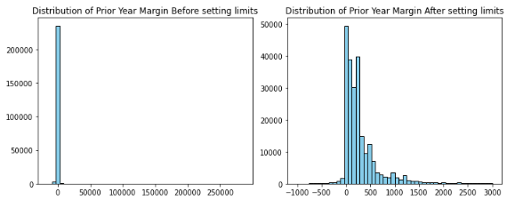
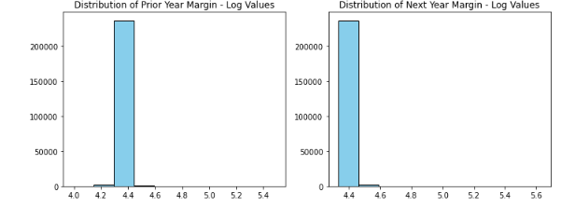
Churn Model: Sample Untransformed vs Transformed Variables
Original Variables (Untransformed)
Transformed Target
Transformed Independent Variables (Prior Year)

Slide 36
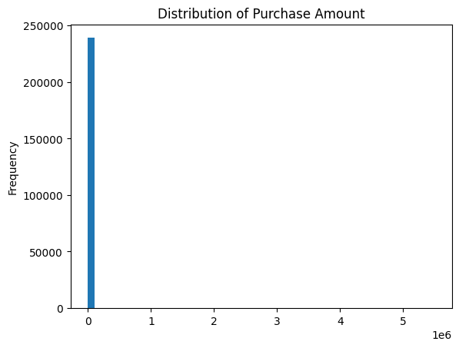
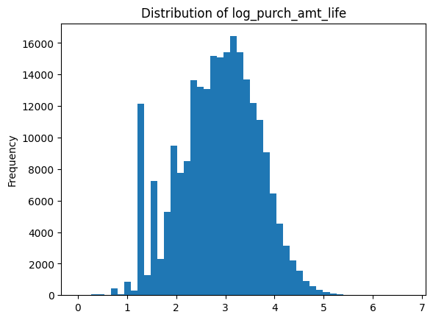
Margin Model: Sample Untransformed vs Transformed Variables
Original Variables (Untransformed)
Transformed Variables

Slide 37





Approach for Estimating Churn/Retention Rate
Data Cleaning
Feature Engineering
Train-Test Split
Feature Selection
Classification Modeling
Remove Duplicate Account IDs
Remove high cardinality variables
Reduce cardinality (Recategorization)
Power Transformation
Standardization
30% Holdout Set
Logistic Regression with L1 Regularization
VIF Feature Reduction
Logistic Regression
Gradient Boosting

Slide 38
Approach for Estimating Margin
Data Cleaning
Feature Engineering
Train-Test Split
Feature Selection
Regression Modeling
Remove Duplicate Account IDs
Remove high cardinality variables
Margin Calculation
Average Rolling Margins
Power Transformation
30% Holdout Set
VIF Feature Reduction
Linear Regression
Random Forest
Gradient Boosting

Slide 39
Approach for segmenting customers into actionable groups
Churn Risk
Margin Value
Lifetime Value
Segmentation
Profiling
Estimate Churn Risk using Churn Classification Model
Estimate Future Margin Value using Margin Regression Model
Calculate Customer Lifetime Value (CFV)
K-Means clustering based on Churn Risk, Estimated Margin, and CFV Value
Profile using sales and demographic metrics

