Slide 1
Supernove Gray Opacity modeling

Slide 2
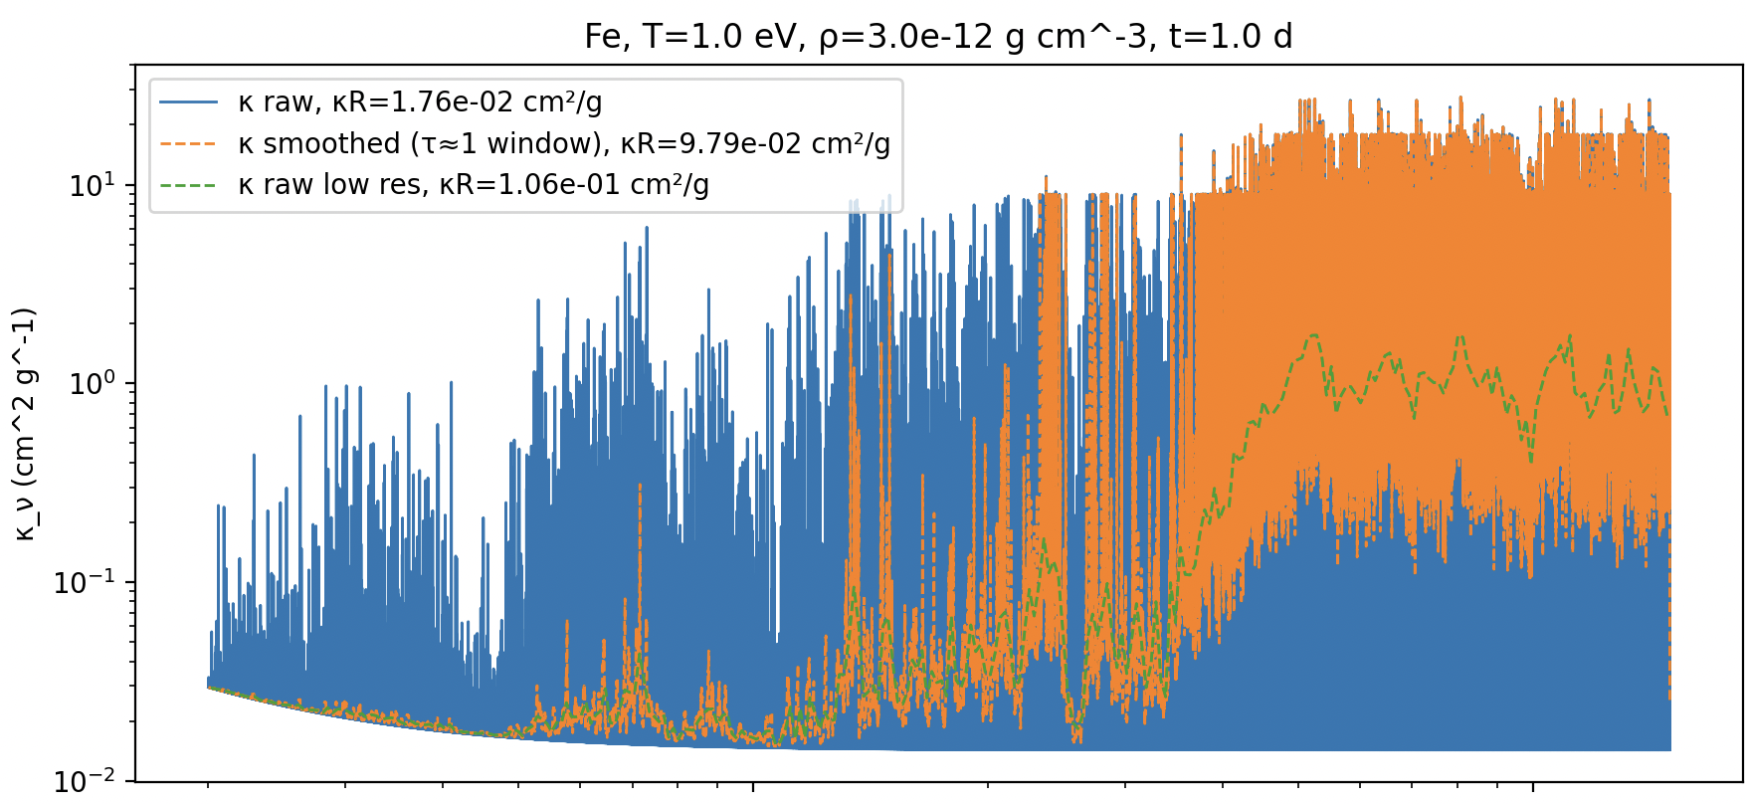
Summery of previous times:
Expansion opacity can be estimated to one number of rosseland mean opacity by practically smoothing with tau=1 window.

Slide 3
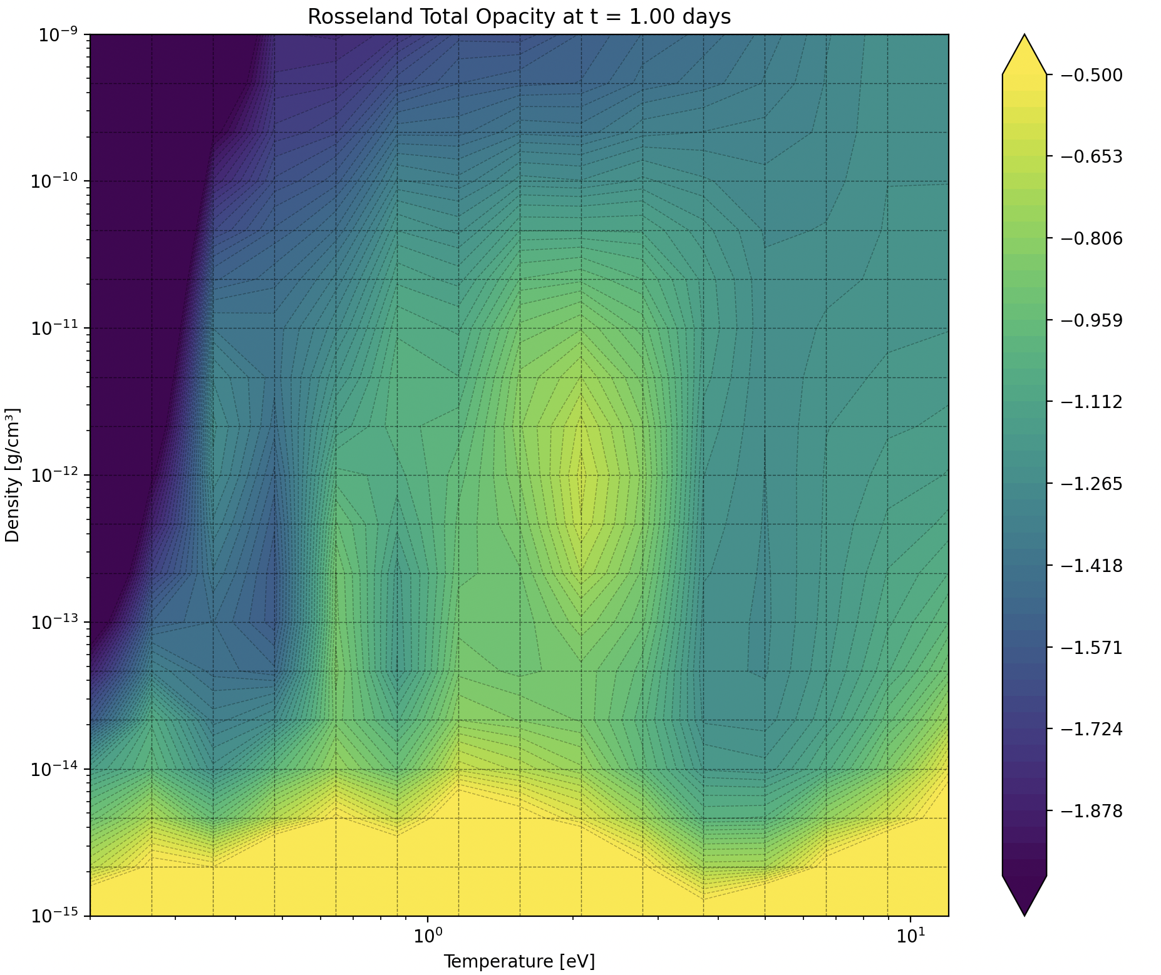
The opacity itself

Slide 4
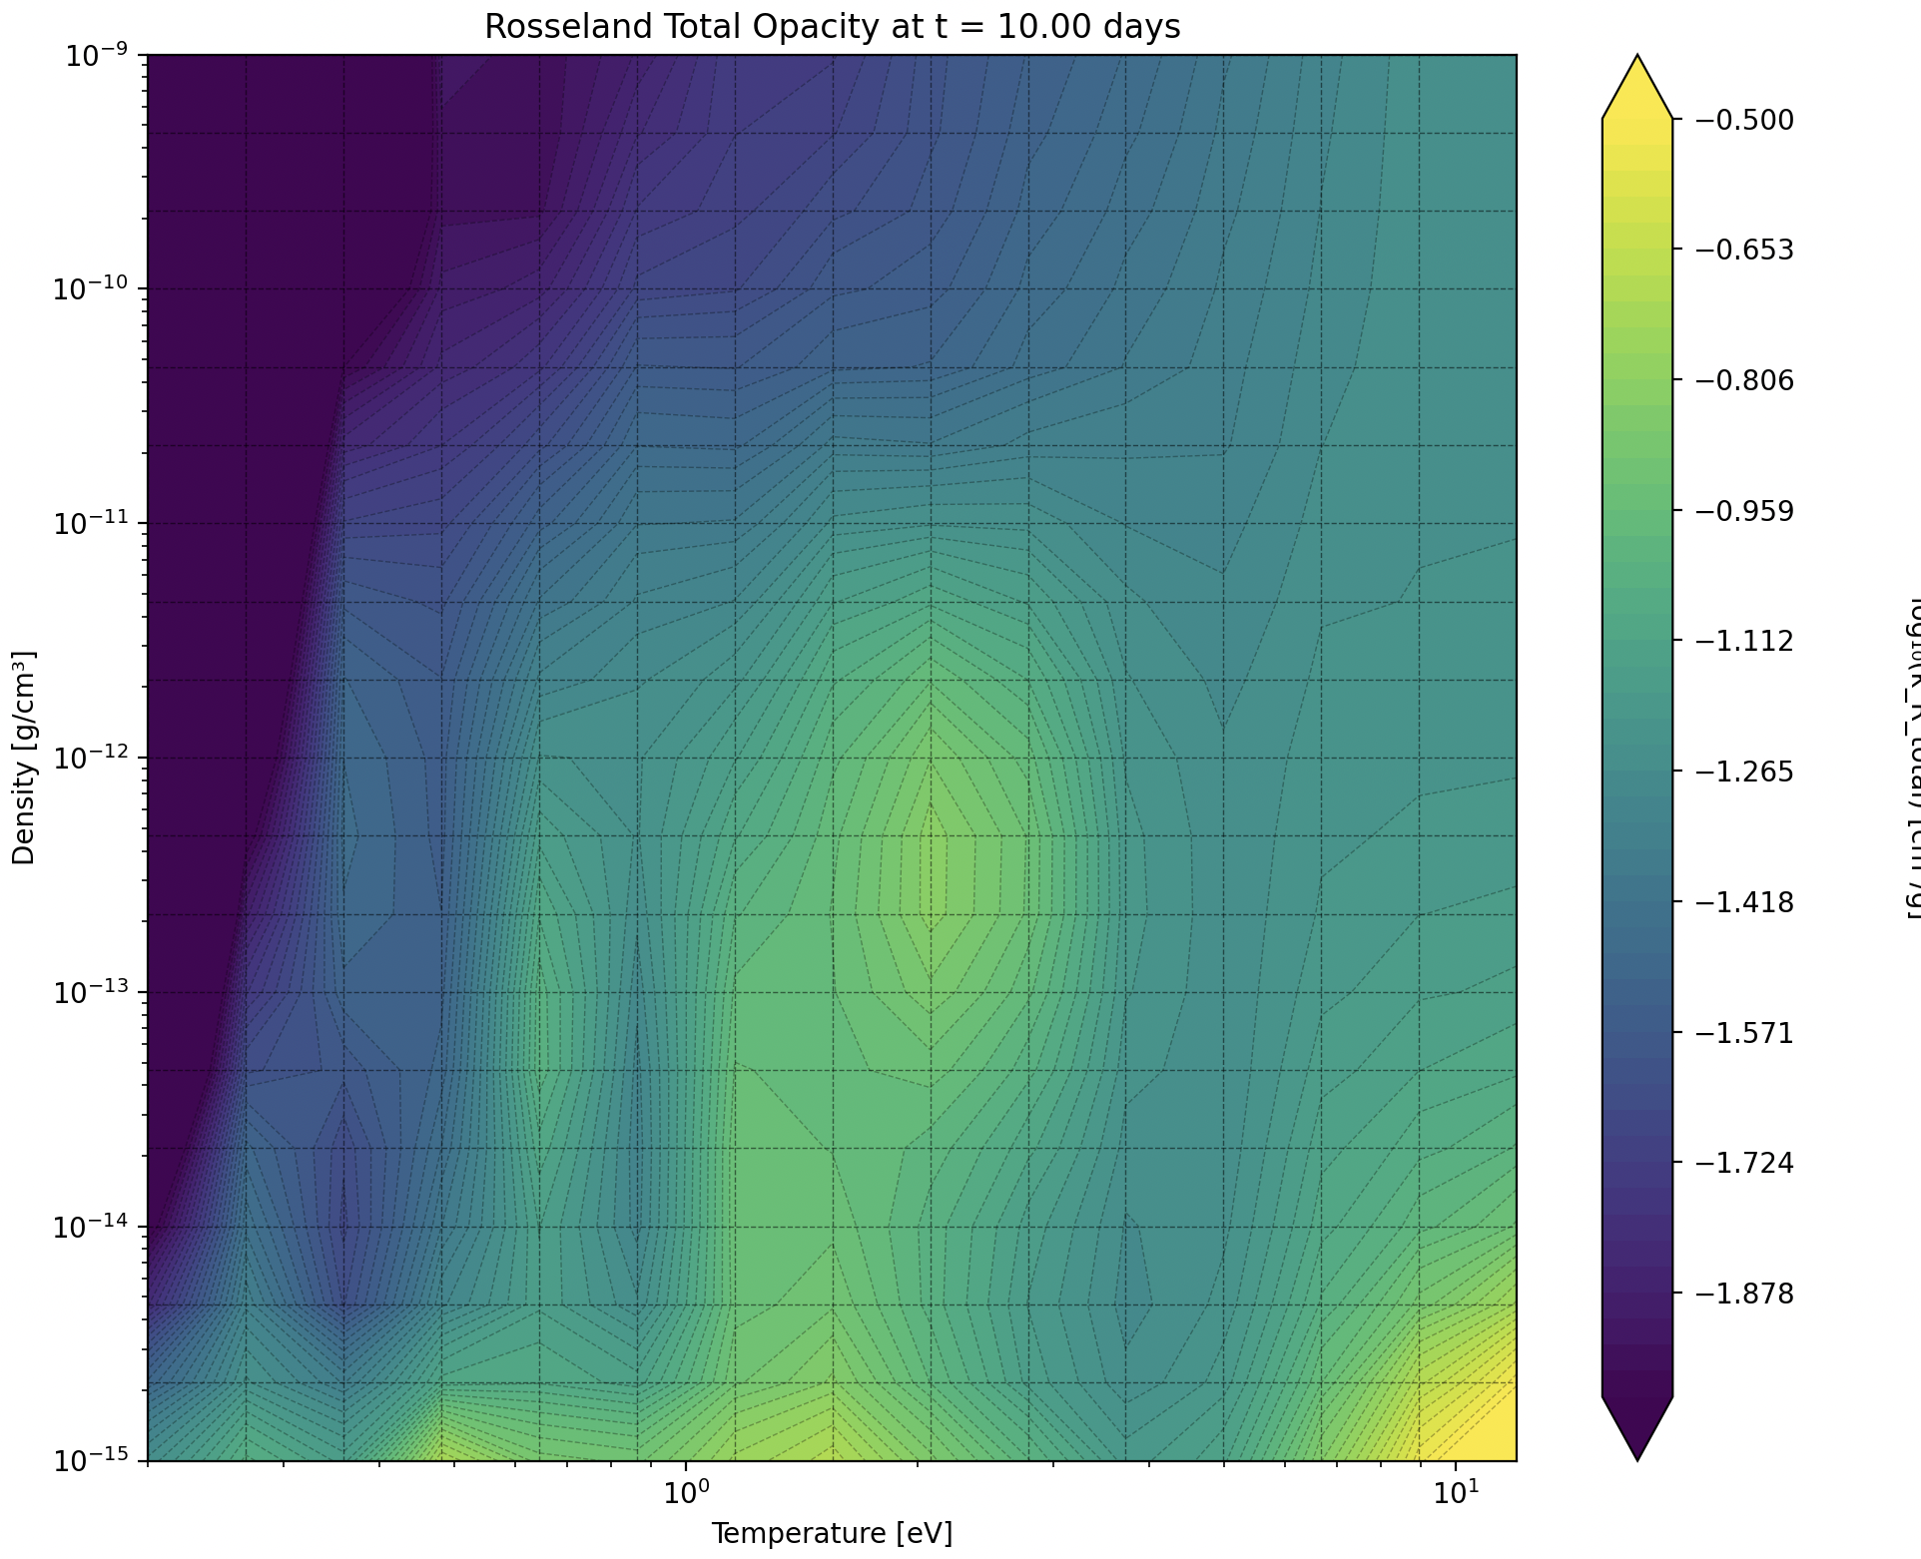
The opacity itself

Slide 5
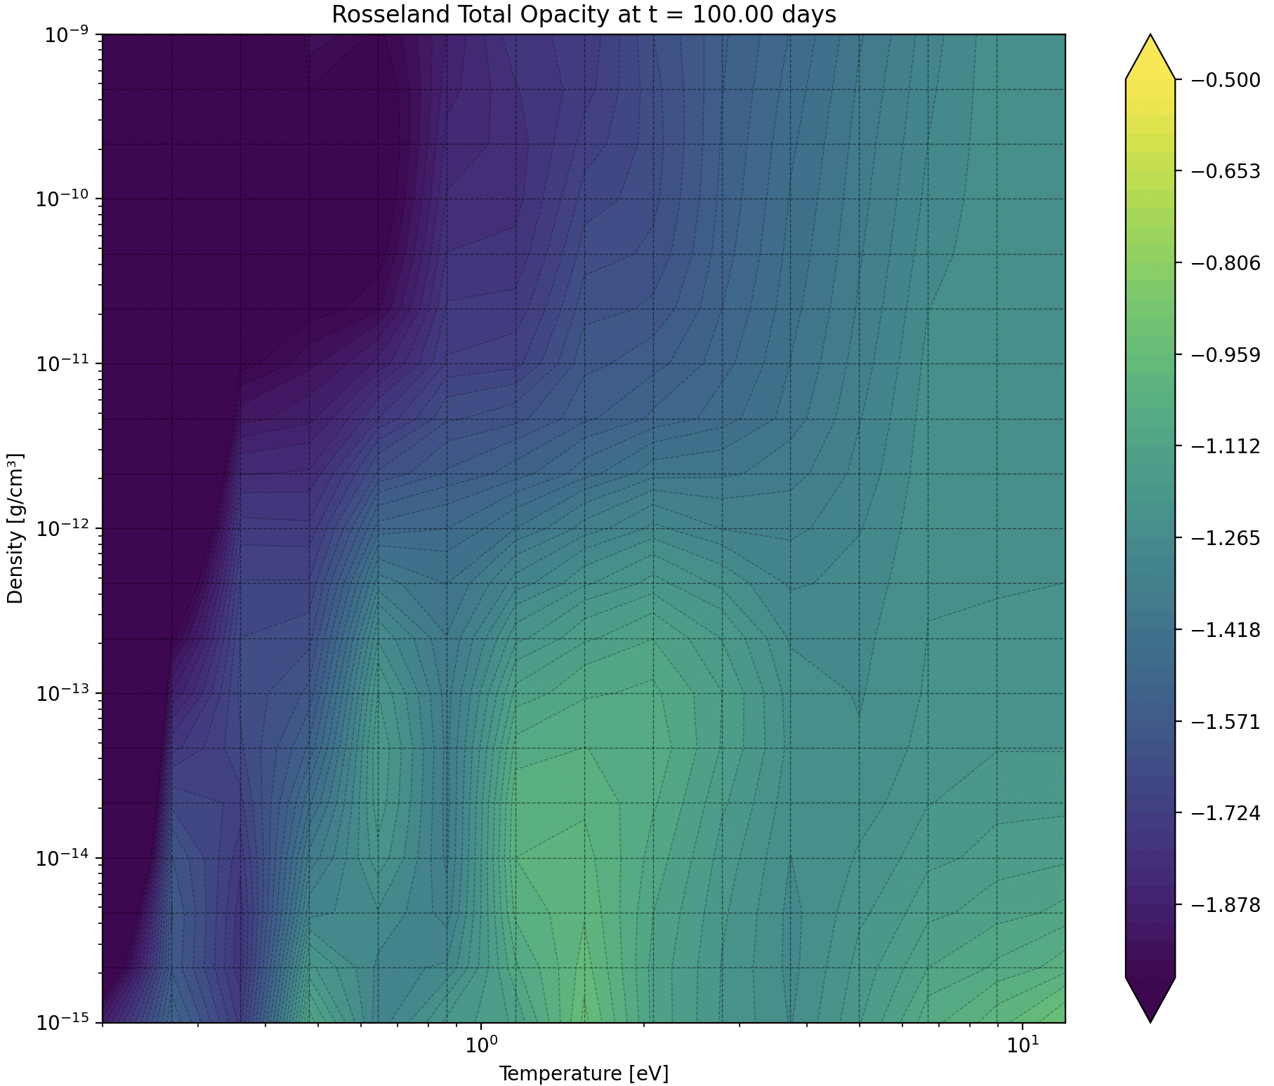
The opacity itself

Slide 7
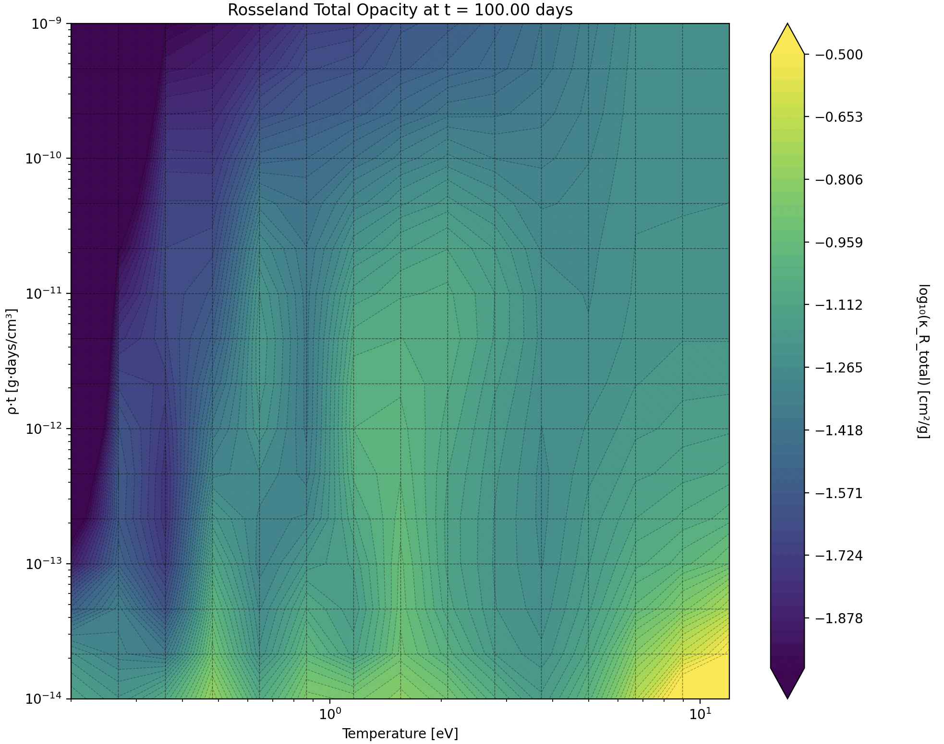
The opacity as a function of (rho*t ,T)

Slide 8
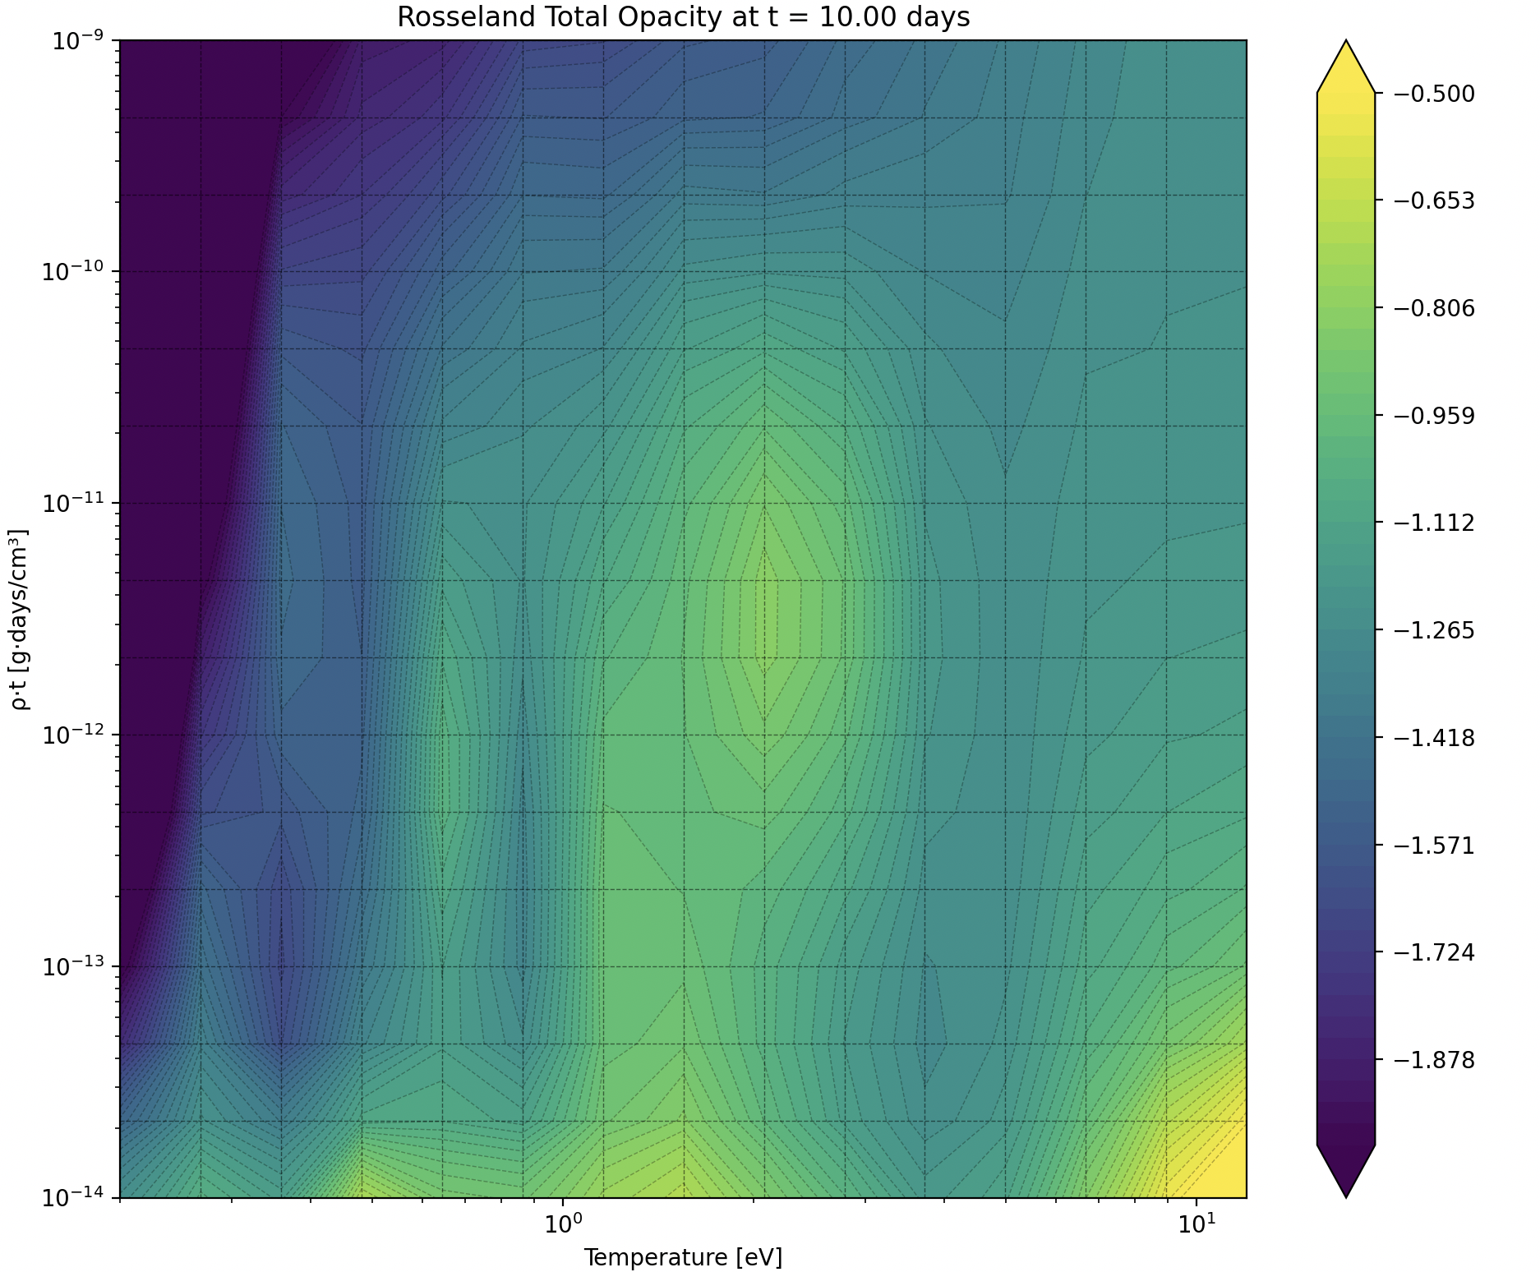
The opacity as a function of (rho*t ,T)

Slide 9
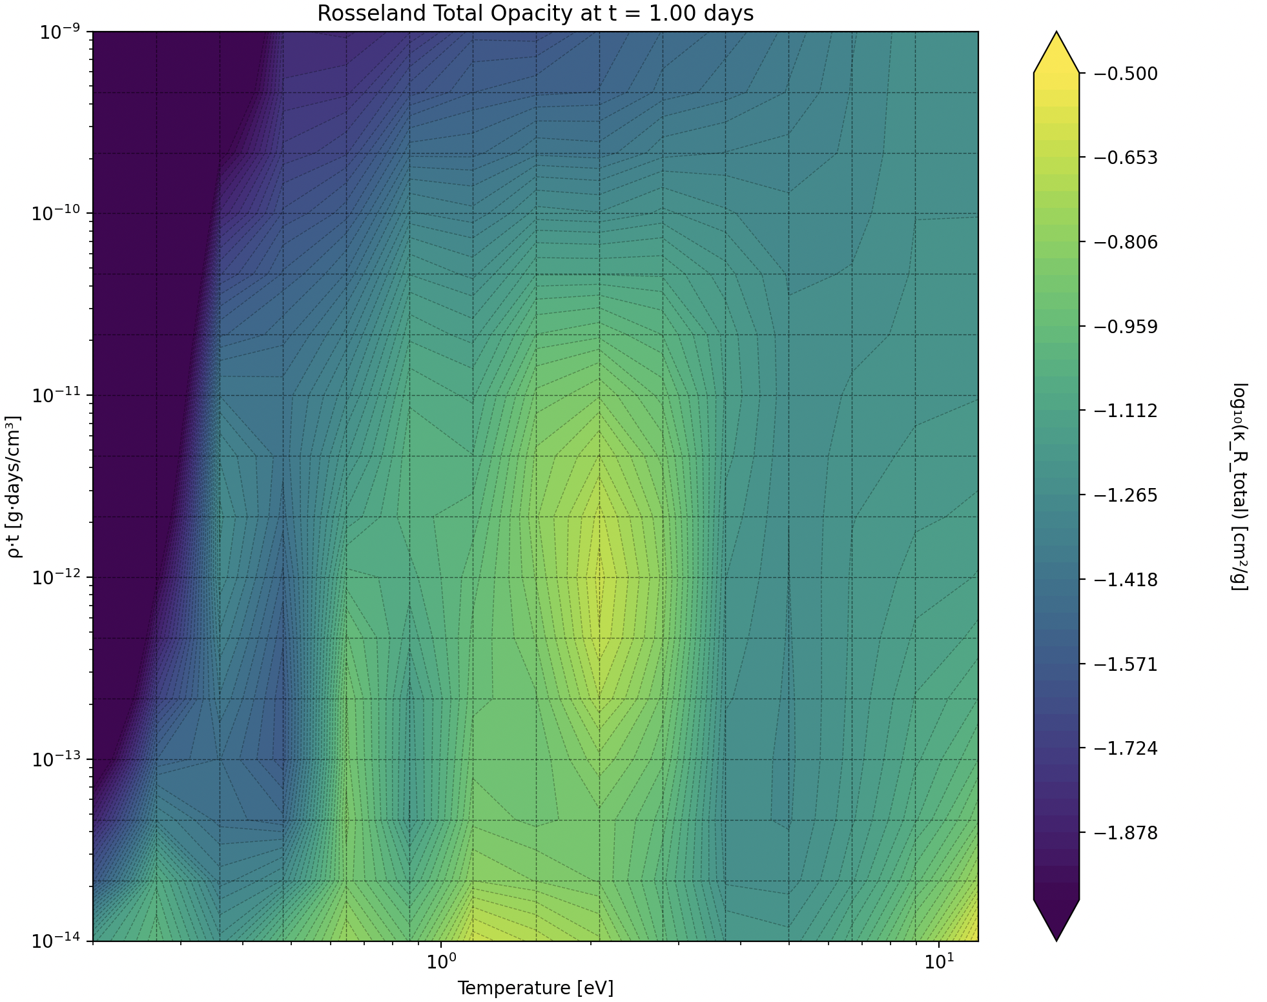
The opacity as a function of (rho*t ,T)

Slide 10
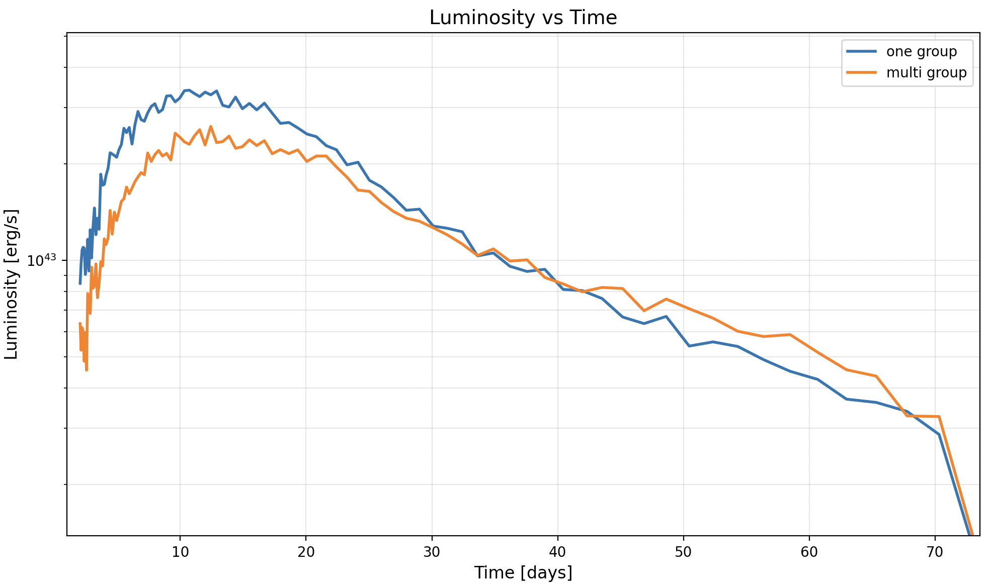
Results

Slide 11
Gap source:
In OG Opacity:
When a photon gets to a new cell with lower temperture he has a lower chanse to be absorbed because its frequency gets lower.
In MG Opacity:
When a photon gets to a new cell with lower temperture he has a similar chanse to be absorbed.
To test this, an experiment with singel cell and singel Temperture was done

Slide 12
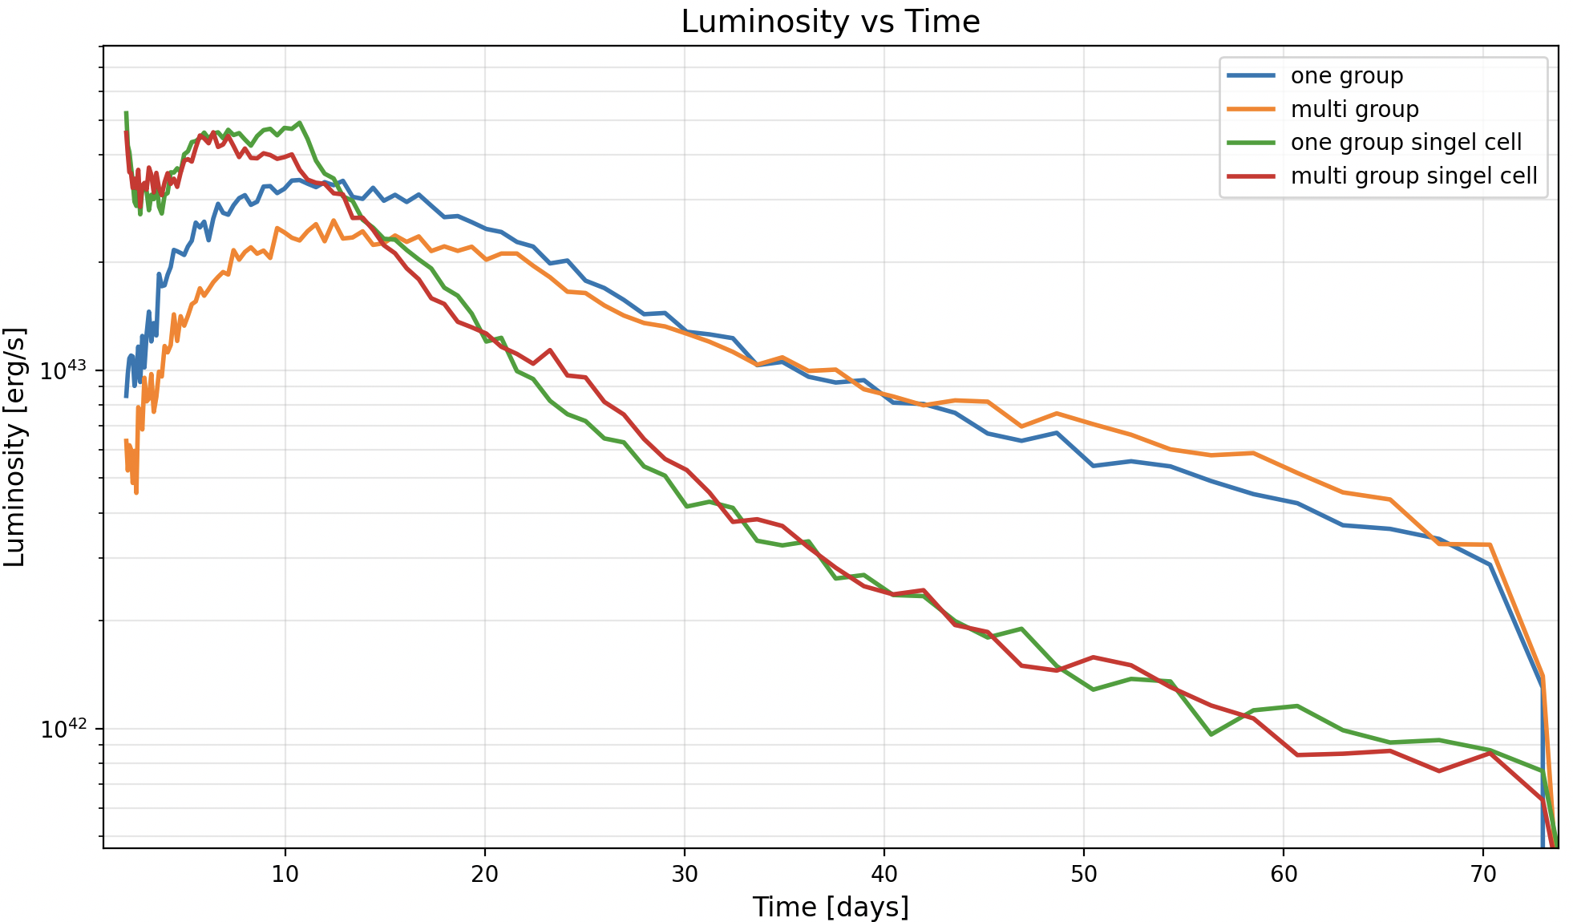
Results

