Slide 1
SimilarWeb Test
Ro’ee Orland

Slide 2
Goal
Comparison of 3 test data sets to a learning set, to ascertain which of the 3 is best suited for internet activity research

Slide 3
Methods
Test sets were joined to portions of the learning set according to websites
K-means clustering was used to discard disproportionately influential data points
Resulting data frames were analyzed via linear regression with a single iteration of outlier-removal (to avoid overfitting)
Results are presented in the following slides

Slide 4
Parameters of Interest
Slope of number of visits (in the learning set) vs. number of visits (in each set) – the steeper the slope the more data points in the external sets (We look for the largest slope)
Slope of number of visits versus percent unique – a measure of people’s inclination to return to a site previously visited (we look for the slope most similar to the learning set)

Slide 5
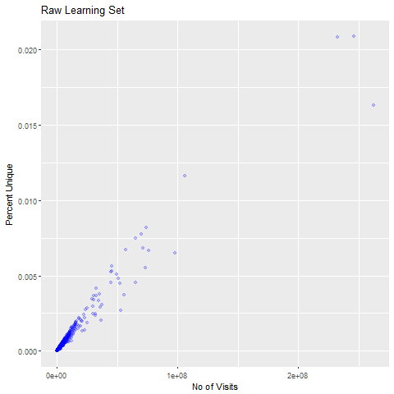
Learning Set

Slide 6
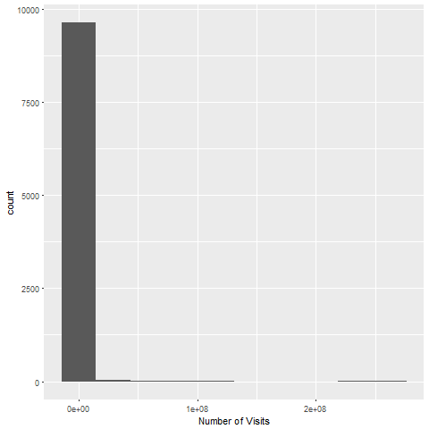
Skewed by small number of large-value points

Slide 7
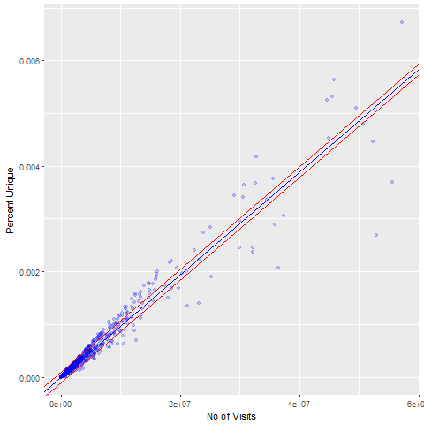
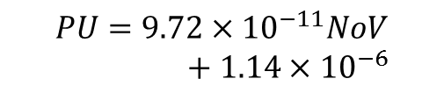
K-means clustering, regression with 95% confidence interval
$$PU=9.72×{10}^{−11}NoV+1.14×{10}^{−6}$$

Slide 8
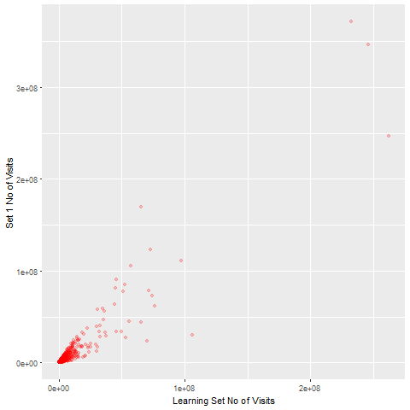
Set 1

Slide 9
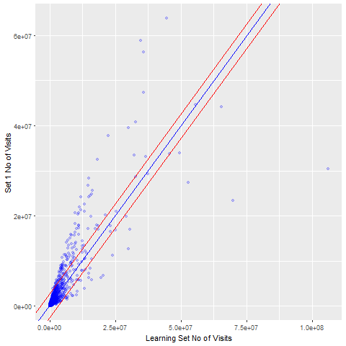
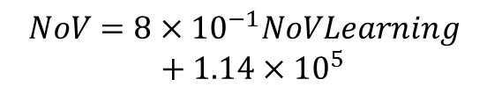
K-means clustering, regression with 95% confidence interval
$$NoV=8×{10}^{−1}NoVLearning+1.14×{10}^{5}$$

Slide 10
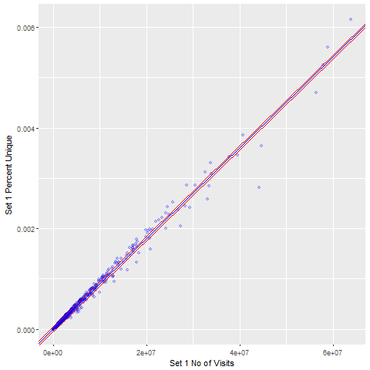
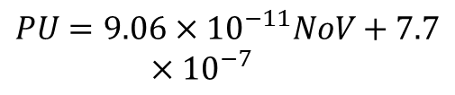
$$PU=9.06×{10}^{−11}NoV+7.7×{10}^{−7}$$

Slide 11

Set 2

Slide 12
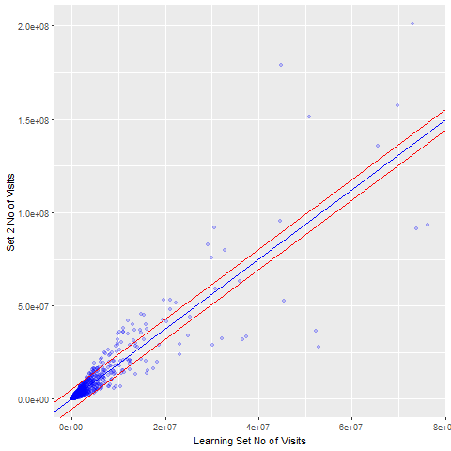

K-means clustering, regression with 95% confidence interval
$$NoV=1.8NoVLearning+8.7×{10}^{4}$$

Slide 13
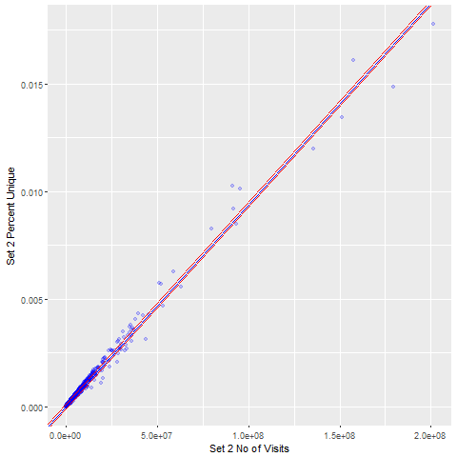
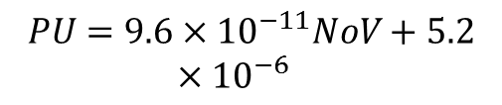
$$PU=9.6×{10}^{−11}NoV+5.2×{10}^{−6}$$

Slide 14
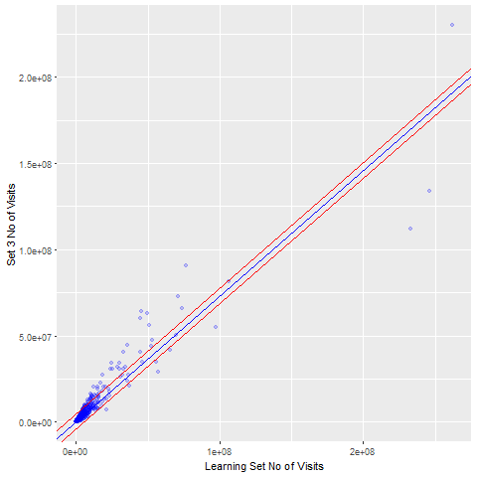
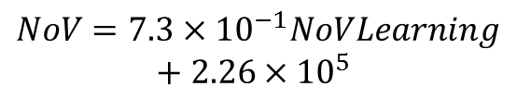
K-means clustering, regression with 95% confidence interval
$$NoV=7.3×{10}^{−1}NoVLearning+2.26×{10}^{5}$$

Slide 15
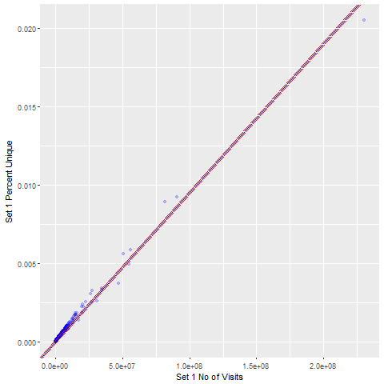
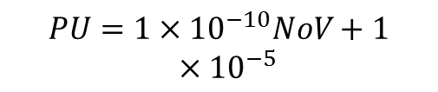
$$PU=1×{10}^{−10}NoV+1×{10}^{−5}$$

Slide 16
Conclusions
Set 2 gives the best results according to the analysis, both in terms of proportion of learning-set visits registered and consistent visits-to-unique proportion (most similar to learning set results, which give an indication of users’ tendency to go back to the site after initial visit)

