Slide 2
ML Tasks
Client-Similarity-Based Recommendations
Process-Based Recommendations
Process (Risk Level) Classifier

Slide 3
Client Similarity
Survey of Client Preferences (Netflix-Style “Cold Start”)
Embedding in Finite Vector Space
  Client Description May Be Embedded in BERT-Style Embedding Space
  Cosine Distance From Category-Specific Vectors
  Resulting Features Used for Nearest-Neighbor Evaluation

Slide 4
Process Classification
Among Processes with Same Features – Random Forest Models to Assess Feature Importance
Classification Algorithms to Assess Risk – TBD
Process Similarity Metrics -
  % Shared Features?
  Editing Distance?
  Pearson Correlation?

Slide 7
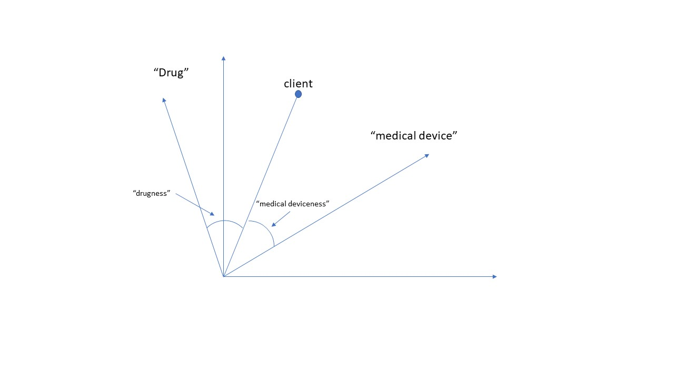

Slide 8
