Slide 1
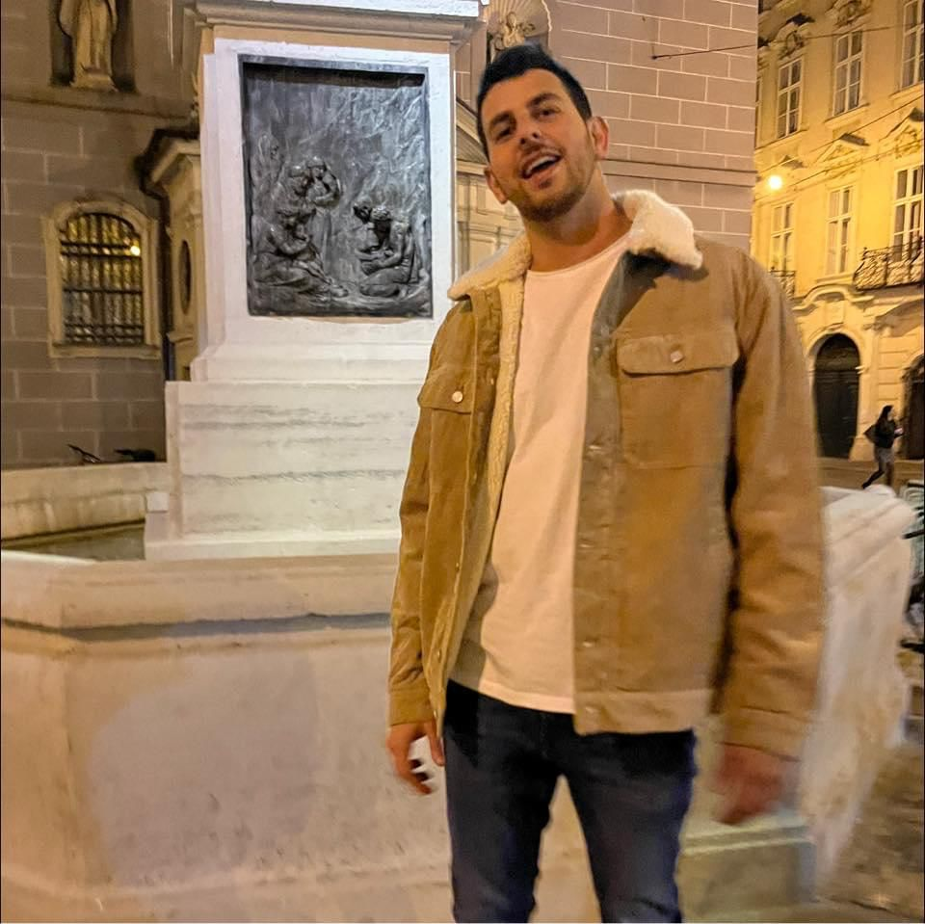
Roee Shahmoon
Computer Engineering
Occupation
Contact
2023 Aug - present
Python Backend Developer at Circles AI - Part Time Job
ADDRESS
Israel, Tel Aviv Israel, Be’er Sheva
• I developed and maintained backend services using Python, TypeScript, JavaScript contributing to the successful launch of Relationship Type Clients repo. • Proficient in database management, specialize in MySQL, optimized database queries and data access patterns, resulting improvement in system performance.
• I have experience implementing GraphQL to enhance API, contribute to success of Startup.
PHONE
052 - 5999 - 370
Education
2020 Oct – present
EMAIL
shmoonroey@gmail.com
B.Sc. Computer Engineering, Ben Gurion University, GPA 80.
Courses:
• Digital Design and Logic – Front End processes in chip design, covering hardware design in Verilog, using HDL and Modelsim, verification in SystemVerilog. Grade: not given yet
• Structure of Digital Computers - Microprocessor MSP430: DMA, ADC, DAC, Timers, Watchdog, Interrupts, Cache, Memory Management, Virtual Memory, UART. Grade: 88
• CPU Architecture & Laboratory design utilizing VHDL and SOC with Intel DE10-standard. Proficient in MIPS and RISC-V processor architectures, specializing in designing pipelined thread processor cores. Understanding of deep learning principles and their application in processor design. Grade: 86
• Systems programming : Linux work environment, C/C++ memory management and data storage, develop and test software , top-down design and high-level abstraction, and design patterns. Grade: 84
• Data Structures & Graph Theory & Algorithm Design: Sorting, BST, linked lists, hashtable, applying mathematical models of graphs and network using DFS, Dijkstra etc. Grade: 85
Links
Roee – Protfolio
Projects - Overiew
LinkedIn
Github
Skills
• Python
• C and C++
• Linux
• Assembly
• Verilog
• System Verilog
• VHDL
• HDL
• ModelSim
• Quartus
• TypeScript
• JavaScript
• MySQL
• GraphQL
• Git
• Github
Projects:
• Hardware Acelerator of Matrix Multiplication written in Verilog & System Verilog: The Design use a Systolic Array Architecture, which enables highly Parallel and Pipelined computational structure, to achieve high throughput, reduced latency compared to sequential methods.
• Light Sources & Objects Detector System – RT Embedded:
PC side at Python & MCU Side at C, working with Texas Instruments MSP430 using Servo Motor, ADC12, Ultrasonic sensor, UART, PWM, Timers, GPIO, LCD, DMA.
• MIPS based MCU Architecture and Design: Building Single Cycle Mips, upgrade to a processor with a Pipeline core become Microcontroller burn to FPGA intel DE-10 using Quartus and Modelsim.
2011 - 2016
Alliance Tel Aviv High School
Language
• Participation in a medical Physics program for outstanding students with visit Blinson Hospital.
• Engaged in school's volleyball team, instructor in scout movement. GPA 109.
Military Service
• Hebrew: Native
• English: Fluent
• French: Proficient
2016 – 2019
Fighter and Commander in the 'Kfir' infantry brigade
• Graduated from the commander's course led a team of 15 soldiers trained them to be fighters.
• Complex operations in challenging environments, training commander certificate of excellence.

