Slide 1
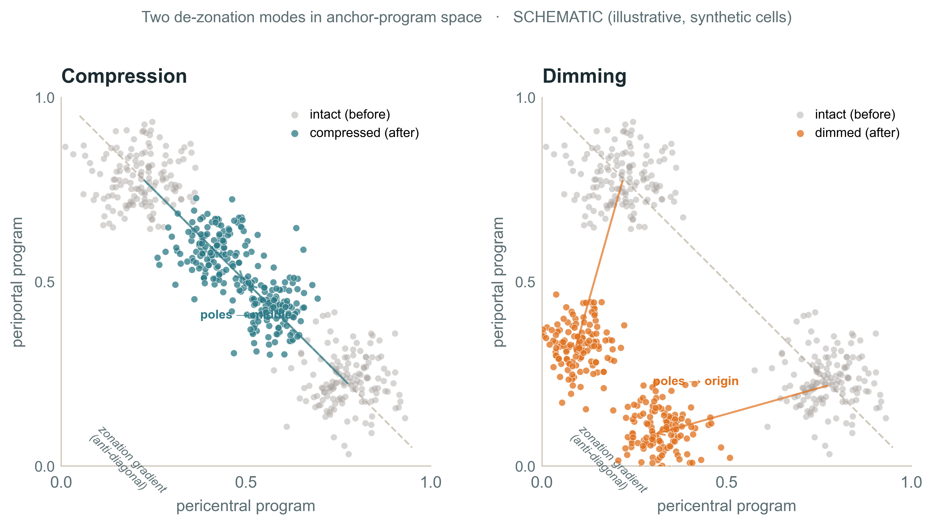
THE GRADIENT AXIS
METHOD
Beyond the boxes — zonation is a gradient
Zonation is a continuous gradient — cells strung on an anti-diagonal. It can weaken two ways without any cell changing class:
Compression — shape
Balance drifts to the middle; the poles’ contrast shrinks.
Mild, non-monotone → gradient present.
Dimming — level
The pericentral detox program declines in level — same balance, lower volume.
Real coordinated decline → a finding (Results).
Matched biopsies: shape holds (no compression); level dims (detox — confirmed next). Only the explant collapses to one pole.
Computational Genomics 76553 · HUJI · MASLD snRNA-seq hackathon

Slide 2
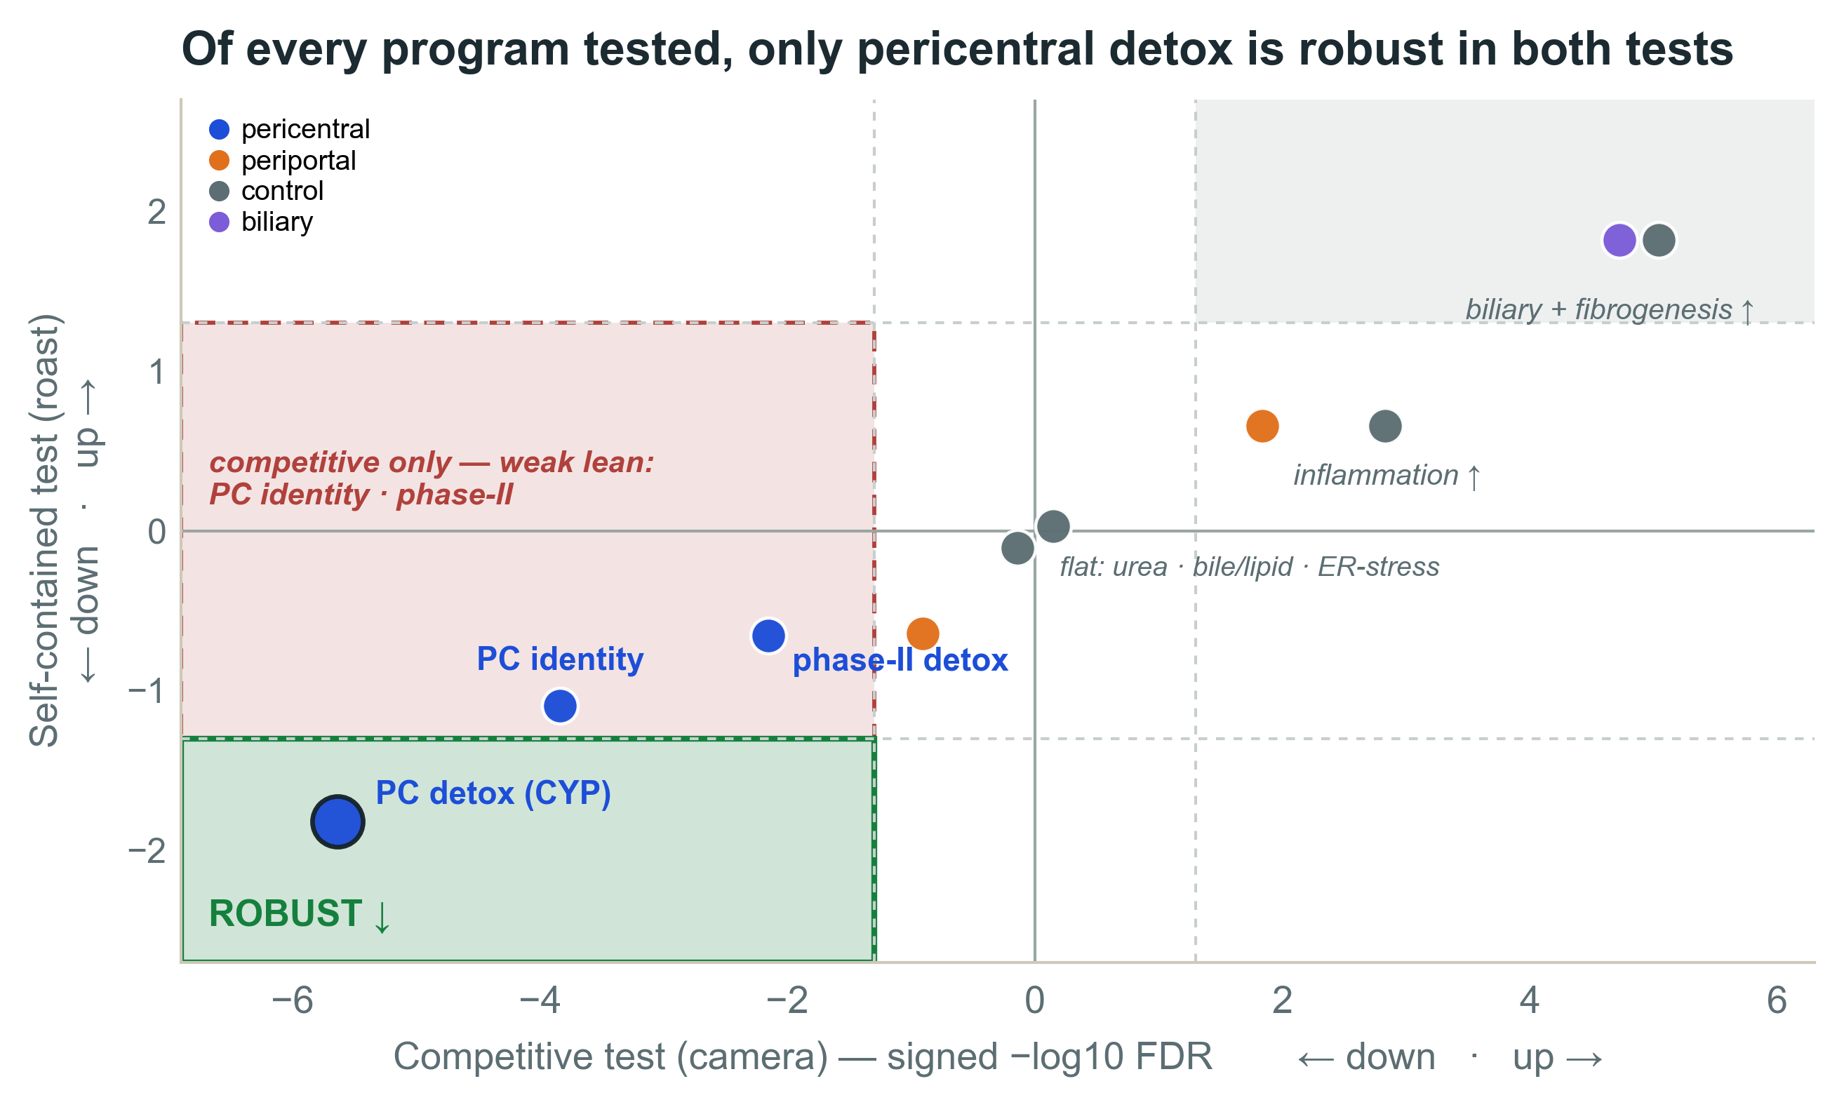
RESULTS · THE LANDSCAPE
RESULTS
Only one program robustly changes — pericentral detox
Each dot is one pre-specified program. Right = it moves more than the genome (competitive); up/down = it moves on its own (self-contained). Only a dot in a far corner is robust.
Pericentral detox (CYP)
falls coherently and hard enough → clears both tests + the per-cell trend (ρ=−0.48). The one robust change.
WHY THE OTHERS AREN’T ROBUST
The landmark & phase-II sets only lean down faintly — far too weakly to clear the self-contained test (no single gene moves). A shift this faint isn’t a real turn-off; only the CYP detox core moves hard enough to count as a robust change.
Controls behaved ↑ — the test reads real biology.
Computational Genomics 76553 · HUJI · MASLD snRNA-seq hackathon

Slide 3
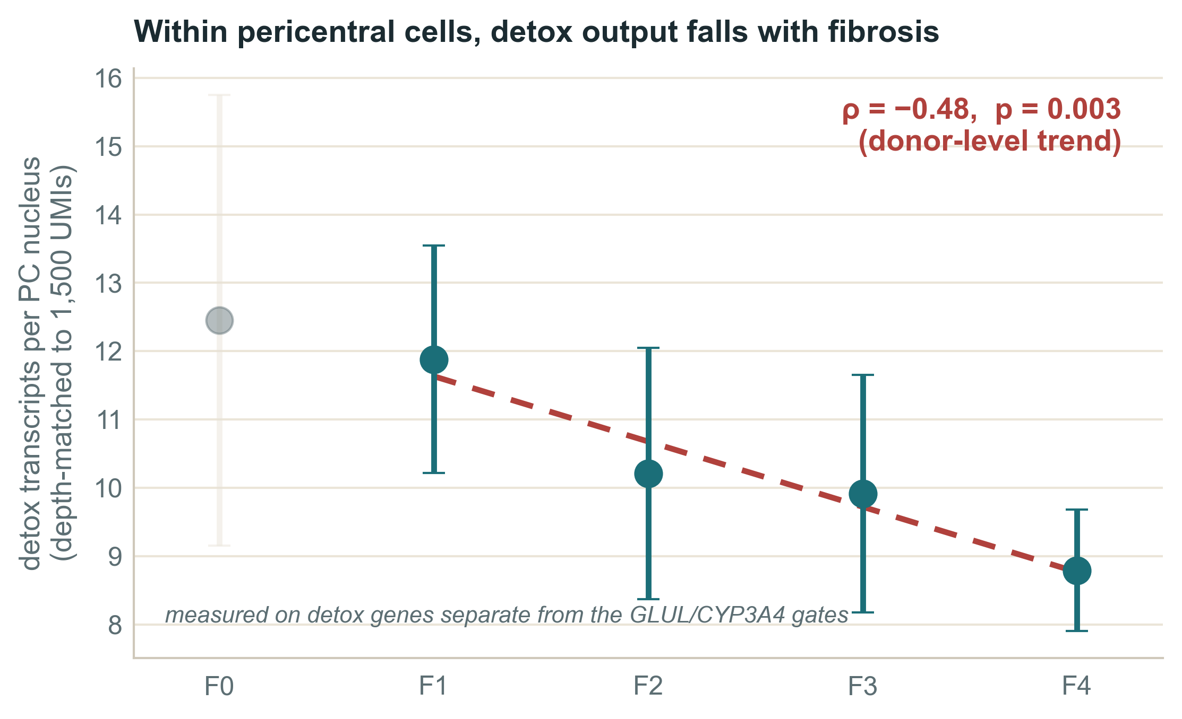
THE ONE REAL CHANGE
RESULTS
Pericentral detox dims — dimming, not de-zonation
Per-cell, depth-matched
composition can’t fake it — the decisive evidence (ρ=−0.48).
Cells keep their class
the pericentral anchor fractions stay flat — no de-zonation; no identity gene is individually lost.
Coordinated, not a switch
no single gene clears FDR — many genes each shift a little, same direction.
Like a radio: same genre (cells stay pericentral), lower volume (the detox channel dims).
A relative decline within a fixed budget, not proven absolute molecule loss; a donor-level trend; could partly reflect a shift among PC subzones.
Computational Genomics 76553 · HUJI · MASLD snRNA-seq hackathon

Slide 4
CONCLUSION
No de-zonation signal — the pericentral detox program dims
01
No transcriptional de-zonation signal — cells keep their zonal class (large shift excluded)
02
The one real change: the pericentral detox program dims (gates held)
03
Much of the dramatic trajectory may track acquisition, not disease
We correct one evidence leg — the snRNA marker-correlation; the paper’s imaging and protein staining are untouched. The biliary signal is a separate compositional lead.
Scope — a “PC-like program,” not lobular location; a weak coordinated gene-set program is not excluded; F4 is only 4 donors.
Computational Genomics 76553 · HUJI · MASLD snRNA-seq hackathon

