Slide 1
DONOR VARIANCE
BACKUP
Why a flat result is readable despite huge donor spread
Within each fibrosis stage the per-donor pericentral-anchor fraction spans ~25–35 pp (SD ≈ 12 pp). Could that scatter be hiding a real trend? No — four reasons:
1
The donor is the replicate — not the cell
2
The spread is the same at every stage
Inference is donor-level (F1–F4 = 8 / 12 / 12 / 4). A stage MEAN has standard error SE ≈ SD/√n ≈ 12/√10 ≈ 4 pp — we compare stage means (± 4 pp), not individual donors (± 12 pp).
Variance is homoscedastic — as wide at F1 as at F4. A real progression would shift the mean monotonically beyond ± 4 pp; it doesn’t. This is noise around a flat line, not a trend buried in noise.
3
We bound what is excluded (TOST)
4
Stable across marker sets & thresholds
Not merely “no trend found”: a shift > ± 19 pp between F1 and F4 is positively rejected at the donor level. Only a subtle drift (≤ 10 pp) remains possible — limited by F4’s n = 4.
The flat result holds on 6 marker sets (2–1,637 genes, incl. Paper 2’s own) and the full ≥1 / ≥2 / ≥3-UMI grid — no setting-dependent signal hiding in the variance.
Bottom line: large person-to-person variance ≠ an undetectable signal. With donor-level inference and an equivalence bound, a large progressive de-zonation is excluded (a subtle ≤10-pp drift is not).
Computational Genomics 76553 · HUJI · MASLD snRNA-seq hackathon

Slide 2
METHODS & SOFTWARE
METHOD
The analysis stack, end to end
Every quantitative claim runs at the donor level on raw molecule counts. The methods, grouped by step:
COUNTS & DEPTH
PER-GENE DGE
• Raw UMI extraction (not SCT) — absolute detection needs molecules, not normalized residuals — Seurat / Matrix (R)
• Pseudobulk, donor-level — sum each donor’s hepatocyte counts → one profile per donor (Squair 2021)
• Binomial down-sampling → 1,500 UMIs / nucleus — removes sequencing depth as a confound (the depth-match)
• edgeR — TMM + NB quasi-likelihood GLM — composition-robust normalization + per-gene fibrosis trend (filterByExpr gene filter)
GENE-SET TESTS
SOURCE & STATISTICS
• GSEA pre-rank — gseapy — is a set enriched at one end of the ranked genome?
• decontX — ambient-RNA removal — models native + ambient mixture, subtracts the estimate (celda; Yang 2020)
• CAMERA — competitive (limma) — set shifted more than the rest of the transcriptome? (Wu & Smyth 2012)
• TOST equivalence · Cramér’s V · Spearman / partial corr. — bound the null · test batch confounding · trend & covariate control
• ROAST / mroast — self-contained (limma) — does the set move against zero? rotation p-value (Wu 2010)
Stack: R (edgeR, limma, decontX/celda, Seurat) · Python (numpy, scipy, pandas, gseapy). Refs: edgeR / TMM — Robinson, McCarthy & Smyth 2010; Robinson & Oshlack 2010 · CAMERA — Wu & Smyth 2012 · ROAST — Wu et al. 2010 · decontX — Yang et al. 2020 · pseudobulk — Squair et al. 2021 · GSEA — Subramanian et al. 2005.
Computational Genomics 76553 · HUJI · MASLD snRNA-seq hackathon

Slide 3
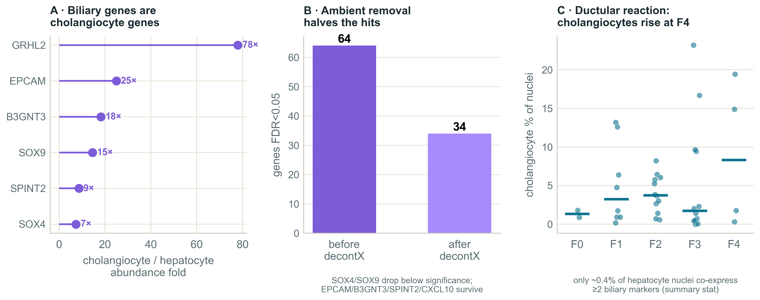
SOURCE
RESULTS
The biliary signal: most likely compositional — a lead
What we see: biliary / ductular genes (EPCAM, SOX9, GRHL2, B3GNT3, SPINT2) rise at F4 — exactly where cirrhosis’s ductular reaction floods the tissue with cholangiocytes.
Figure. Source attribution — cross-lineage abundance, decontX ambient-RNA removal, and the F4 ductular reaction.
COMPOSITIONAL (the lead)
These are cholangiocyte genes. At F4 there are more cholangiocytes → more of their RNA in the ambient “soup” (plus the odd doublet) enters hepatocyte droplets → hepatocytes look biliary without transdifferentiating.
RARE PER CELL (read it carefully)
Only ~0.4% of hepatocyte nuclei co-detect biliary markers at ≥2 UMI — not population-wide. But that is prevalence over ALL hepatocytes: it argues against MASS transdifferentiation, not against a rare sub-population (class imbalance).
OPEN (a residual survives)
decontX removes about half the hits (64 → 34), but EPCAM / SPINT2 / B3GNT3 survive decontamination — ambient can’t explain all of it, so a rare intrinsic state is not excluded.
Verdict: most consistent with composition / ambient (the ductular reaction) — a lead, not a closed verdict.
Computational Genomics 76553 · HUJI · MASLD snRNA-seq hackathon

