Slide 1
COMPUTATIONAL GENOMICS 76553 · FINAL HACKATHON
Spatial Degradation of
Hepatocyte Zonation
Using a healthy spatial liver atlas to recover — and watch the collapse of — the lost spatial identity of diseased liver cells
PORTAL
CENTRAL
Combining a healthy spatial atlas (Yakubovsky et al., Nature 2026)
with a single-nucleus disease cohort (Gribben et al., Nature 2024)
Team: [names]

Slide 2
The question, in one breath
A healthy liver is spatially organised: each hepatocyte sits at a position along a blood-flow gradient and does the job that suits its position. One paper measured that map with positions kept (spatial). Another profiled the whole disease course but with a method that throws positions away (single-nucleus). We use the healthy map to put a position back on each diseased cell, then measure how that organisation falls apart as disease worsens.
Healthy lobule
sharp portal-central gradient
Diseased lobule
blurred - identity lost
We turn that blurring into a number per stage.

Slide 3
Liver zonation - and how disease erases it
Zonation. Hepatocytes specialise by position along the porto-central axis: oxygen-rich periportal cells run the urea cycle (ASS1, HAL); oxygen-poor pericentral cells run detox (CYP2E1) and glutamine synthesis (GLUL).
De-zonation a hepatocyte forgets where on the axis it belongs - it co-expresses opposite-end genes.
ASS1 · HAL
GLUL · CYP2E1
Epithelial plasticity a hepatocyte forgets that it is a hepatocyte at all - drifting toward a bile-duct (cholangiocyte) identity; biphenotypic cells express both ALB and KRT7/KRT19.
We measure the first quantitatively, and test whether it travels with the second.

Slide 4
Two papers, mirror-image gaps
Paper 1 - the cells (Vallier 2024)
Paper 2 - the ruler (Itzkovitz 2026)
47 biopsies, healthy to end-stage
69,426 single-nucleus hepatocytes
Notes zonation loss - only qualitatively
Weakness: snRNA destroyed the spatial map
Healthy human liver, spatial transcriptomics
Quantitative porto-central zonation map
1,724 zonated genes - our signatures
Weakness: healthy only, no disease stages
The gap: one has the map but no disease; the other has the disease but no map. Nobody has used the healthy ruler to decode the disease cohort - that is our project.

Slide 5
Use the healthy map to decode the diseased cells
1
2
3
4
Paper 2 ruler
>
Score each cell
>
Zonation coordinate
>
Collapse across stages
pericentral & periportal signatures
every Paper 1 hepatocyte vs both signatures
pericentral - periportal (per cell)
how sharp is the axis at each stage?
Honest framing: the reference is a 1-D axis, so we recover a pseudo-zonation coordinate - not a physical (x, y) position.

Slide 6
Three hypotheses, three tests
H1 - erosion
H2 - what fails first
H3 - plasticity link
Claim. A de-zonation score rises Healthy to end-stage.
Claim. Specific programs (e.g. pericentral CYP detox) collapse earliest.
Claim. The most de-zonated cells are the ones turning duct-like.
Test. Ordered-trend test (Jonckheere-Terpstra / Spearman on stage rank): does it climb step by step?
Test. Per-gene differential expression within zones + Benjamini-Hochberg FDR to control false positives.
Test. Compare plasticity (KRT7/19) in de-zonated vs zonated cells - Mann-Whitney U.

Slide 7
The pipeline - course methods, end to end
1
>
2
>
3
>
4
>
5
>
6
>
7
QC (inherited)
Normalize
Score + classify
Validate (5/5b)
Collapse curve (H1)
Zone DE + FDR (H2)
Plasticity link (H3)
All in scope: single-cell processing & clustering (Lec 15-16), differential expression, ordered-trend testing, and Benjamini-Hochberg FDR (Lec 5); counts & complexity from Ex 1-2.
Two-person split: one drives the reference + statistics, the other the disease data + modelling; safe baseline by end of Day 1, rich analysis on Day 2.

Slide 8
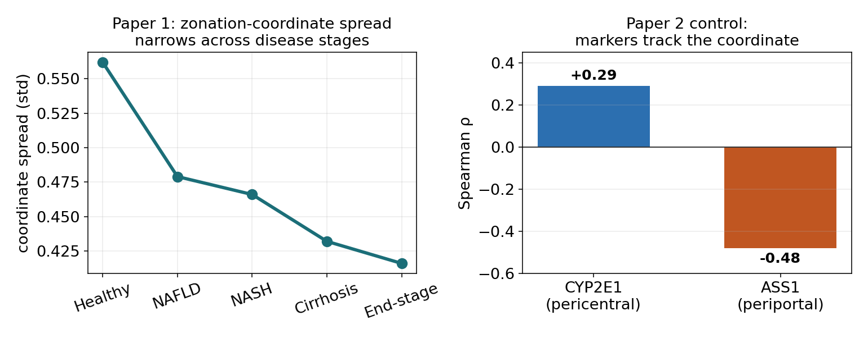
Feasibility - the engine already starts
69,426
hepatocytes extracted, all 5 stages
rho +0.29 / -0.48
Paper 2 control: CYP2E1 / ASS1 track the axis
loads & runs
Real Paper 1 hepatocytes: the coordinate's spread narrows monotonically across stages (feasibility run).
both datasets public; pipeline validated
Sanity-check only - the full analysis is the hackathon.

Slide 9
Why it matters - not 'we filled a gap'
1
A reusable decoder
once validated, it reads zonal identity out of the many existing dissociated disease atlases that have no spatial data.
2
What fails first
which zonal programs lose legibility earliest (H2) predicts the order in which liver functions fail.
3
How identity breaks
when/how the program becomes unreadable (silenced vs identity-mixed), tied to the plasticity linked to disease severity (H3).
Not a reproduction: Paper 1 showed zonation loss by eye (2 markers, 2 extremes); we make it quantitative, continuous, transcriptome-wide and stage-resolved.

Slide 10
The ask
A rough green-light on this direction -
so we can start prep now, not lose the runway.
Question locked · data downloaded & extracted · pipeline validated on real data · primer written.
Thank you - [team names]

