Slide 1
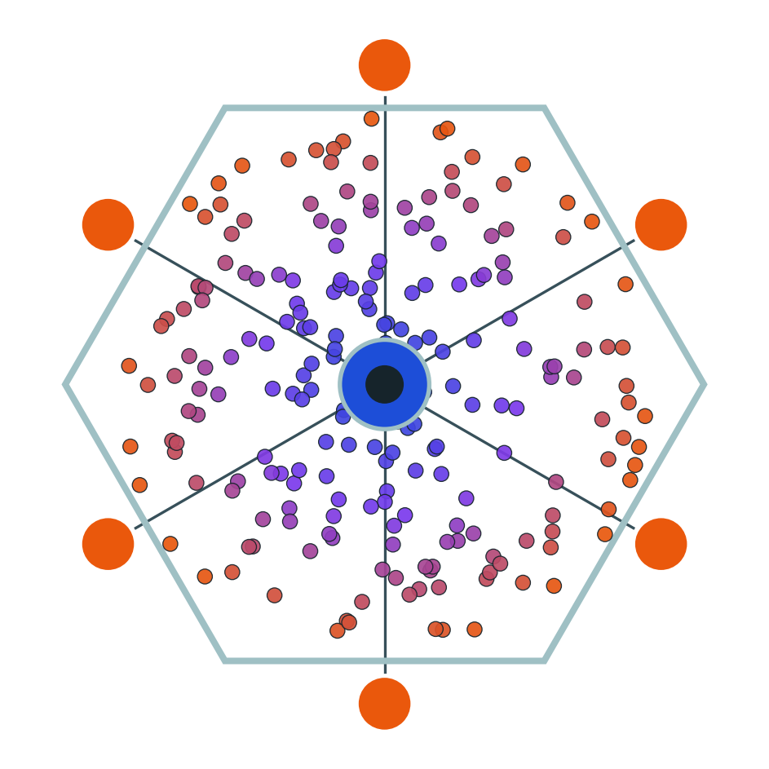
Thank you
now — QA: your questions
No hepatocytes lost their identity in the making of this talk.
Roee Tekoah · Shira Gelbstein · Computational Genomics 76553 · HUJI

