Slide 1
BACKGROUND
BACKGROUND
The liver is zoned — and a paper says disease un-zones it
PERICENTRAL zone
PERIPORTAL zone
detox / drug metabolism
urea cycle
WHAT WAS KNOWN · zonation atlas
THE CLAIM · Gribben et al., Nature 2024
A healthy-liver atlas mapped the marker genes that say which zone a cell belongs to. That is our ruler for “what zonation is.”
In fatty-liver disease (MASLD), hepatocytes:
1. lose their zonation (the two groups blur together), and
2. turn into bile-duct cells (transdifferentiation).
OUR IDEA
Take the atlas’s healthy-zonation ruler, and measure the “gap” across the MASLD disease stages — does it really shrink?
Computational Genomics 76553 · HUJI · MASLD snRNA-seq hackathon

Slide 2
THE QUESTION
BACKGROUND
Our question
Does hepatocyte zonation really degrade across MASLD — and is it linked to the hepatocyte→bile-duct transdifferentiation the paper describes?
We re-checked both claims in the raw data — and ran into two catches: first our ruler, then the experiment itself.
Computational Genomics 76553 · HUJI · MASLD snRNA-seq hackathon

Slide 3
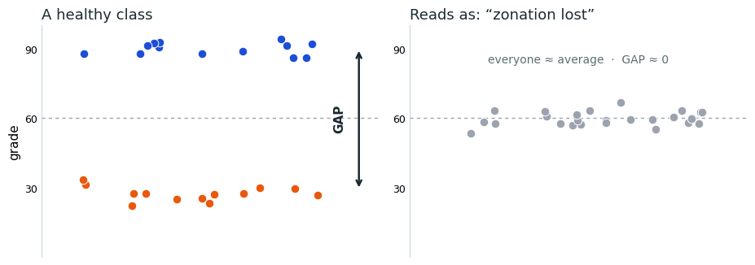
OUR FIRST RULER
THE CATCH
The first ruler — a school-class analogy
Imagine a make-believe school where — by design — every student is clearly one of two kinds: top (≥ 90) or failing (≤ 30), nobody in between. (A thought experiment — real grades vary, but the two-bin picture makes the idea clear.)
In this imagined class, two clear groups (top = pericentral cells, failing = periportal). The first method measures only the GAP between them.
The naive reading: if the gap collapses to zero — everyone looks average — it reads as “zonation lost.”
Computational Genomics 76553 · HUJI · MASLD snRNA-seq hackathon

Slide 4
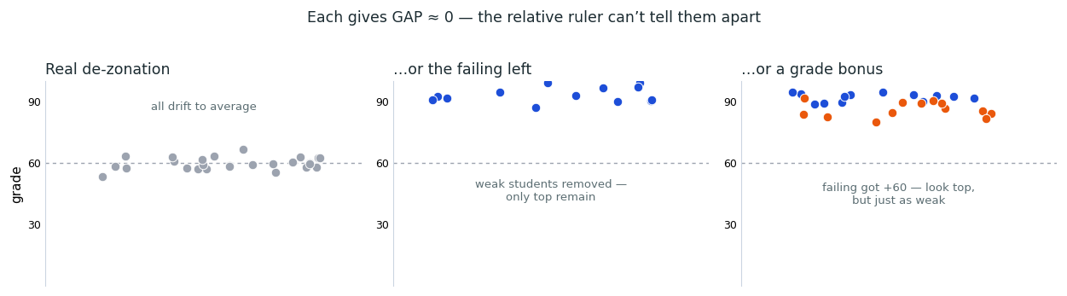
WHY THE RULER MISLEADS
THE CATCH
A zero gap can mean very different things
Three classes that all read GAP ≈ 0 — yet only the first is real de-zonation.
It hides who moved
It’s bent by tweaks
One number, re-graded data
Real de-zonation? A top↔failing swap? Or did the failing students simply leave? The gap reads the same.
Give the failing a grade bonus and they “look” top: gap = 0, yet nothing real changed. Any across-the-board shift fools a relative ruler.
A single relative score crams all of these together — and it’s built on normalized grades tuned for the original question, not ours.
→ So we drop the gap and count the raw work each cell does — actual molecules, not a relative score — which can tell these apart.
Computational Genomics 76553 · HUJI · MASLD snRNA-seq hackathon

Slide 5
THE SECOND CATCH
THE CATCH
Could the setup itself fake the signal?
Healthy
F0
F1
F2
F3
F4
End-stage
quick needle biopsies
invasive whole-organ surgery
cut tissue
invasively
→
STRESS programs
switch ON
→
expression
changes
So the two ends carry an extra stress signal.
Is it coming from how they were collected — and could it be faking the “de-zonation”?
We ran two checks →
Computational Genomics 76553 · HUJI · MASLD snRNA-seq hackathon

Slide 6
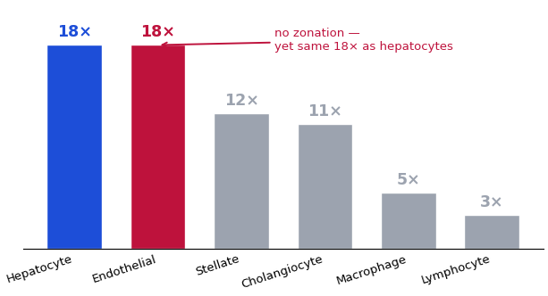
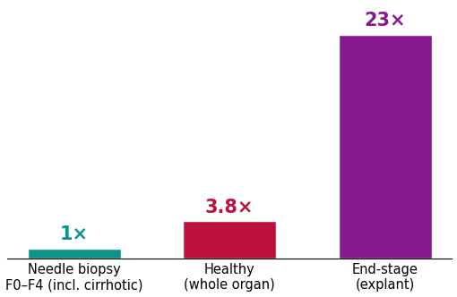
THE SECOND CATCH
THE CATCH
Could the stress be the real signal? Two reasons to doubt it
① Can’t be pinned on zonation
② Doesn’t behave like disease
Even if the stress is a zonation change, we can’t separate it from handling — cells with no zonation program at all (e.g. endothelium) show the same spike. So it’s at least confounded.
If it were the disease, this pattern is odd: loud in HEALTHY tissue and silent in cirrhosis. A disease signal should rise with severity — so the pattern leans to procurement.
→ so we look at every group — healthy · F0 · F1–F4 · end-stage — but the two ends are procurement-confounded; disease is read from the matched biopsies (F1–F4).
Computational Genomics 76553 · HUJI · MASLD snRNA-seq hackathon

Slide 7
HOW WE MEASURE
METHOD
Our fix: count, control, look finer
The two catches told us what to fix. So we changed three things — same data, read more honestly:
①
②
③
Count real molecules
Control the grading
Look finer than two bins
We stop measuring the relative gap and count the actual molecules in each cell — so we can see who moved and how many.
We pin down the normalization ourselves, so an across-the-board tweak — an artifact — can’t quietly shift the answer.
Not just top vs failing. For every cell: clearly pericentral? periportal? both? neither? — and how loud is its program?
fixes: the gap hid who moved
fixes: the gap was bent by tweaks
fixes: the coarse top / failing split
Same data — raw, normalization-controlled, and read at a finer grain. Now the ruler can’t fool us.
Computational Genomics 76553 · HUJI · MASLD snRNA-seq hackathon

