Slide 1
Spatial Degradation of Hepatocyte Zonation
Decoding the collapse of liver cell identity across the fatty-liver disease course
portal
central
Roee · Shira | Computational Genomics 76553 — Final Hackathon

Slide 2
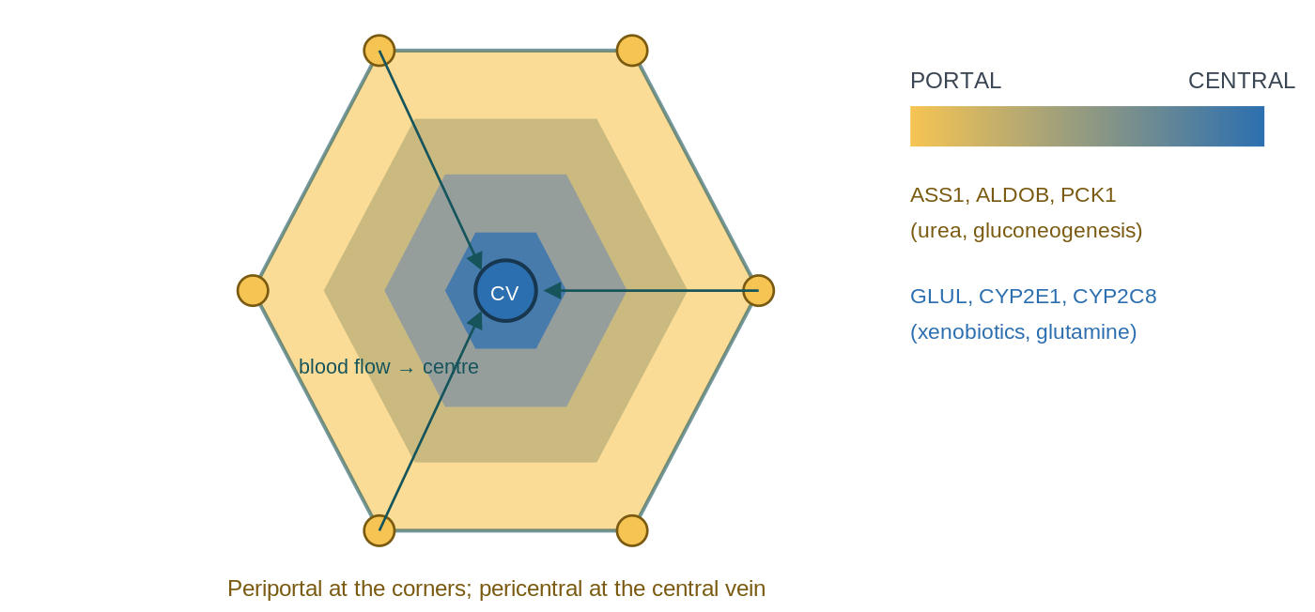
THE BIOLOGY
What the liver does — and the zonation gradient
The liver is a metabolic factory:
buffers blood sugar
detoxifies drugs,
nitrogen waste → urea
produces bile acids
make plasma proteins
Two epithelial cells:
hepatocytes (the bulk factory)
cholangiocytes (bile-duct lining)
Blood flows portal → central
The gene a cell in the liver expresses depends on where it sits: • Periportal: urea cycle, gluconeogenesis (ASS1, PCK1). • Pericentral: drug metabolism, glutamine (CYP2E1, GLUL).
The hinge: position is encoded in expression, so it can be decoded back out.

Slide 3
WHAT WE MEASURE
Two ways identity breaks: de-zonation vs plasticity
Both look like 'a cell expressing two opposite things at once' — the difference is WHICH boundary is crossed.
De-zonation
Plasticity
Loses its POSITION
on the (portal ↔ central) axis – still a hepatocyte
Co-expresses opposite zonal programs (CYP2E1 + ASS1)
Signature: the pericentral / periportal zonation genes.
Loses its CELL-TYPE identity
hepatocyte → bile-duct Co-expresses hepatocyte + duct programs (ALB + KRT7).
Signature: KRT7, KRT19, SOX9 … (from Paper 1).
Analogy: a worker who forgets which station they man (de-zonation) is still a factory worker; one who forgets they work in the factory at all (plasticity) is something else. H3 asks whether these are the same cells — does losing your address predict losing your job?

Slide 4
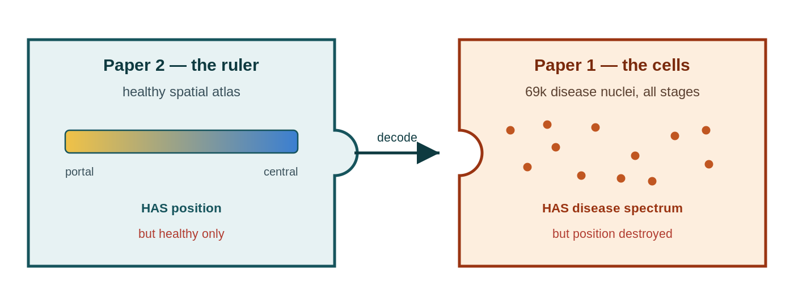
THE OPPORTUNITY
Two datasets, one gap
Paper 2 — the ruler
Paper 1 — the cells
Healthy human liver with spatial coordinates KEPT → a quantitative porto-central zone index.
69k disease nuclei across all stages —
but snRNA-seq THREW AWAY position.
Our move: use the healthy ruler to assign each diseased cell a pseudo-zonal coordinate. Neither paper did this.

Slide 5
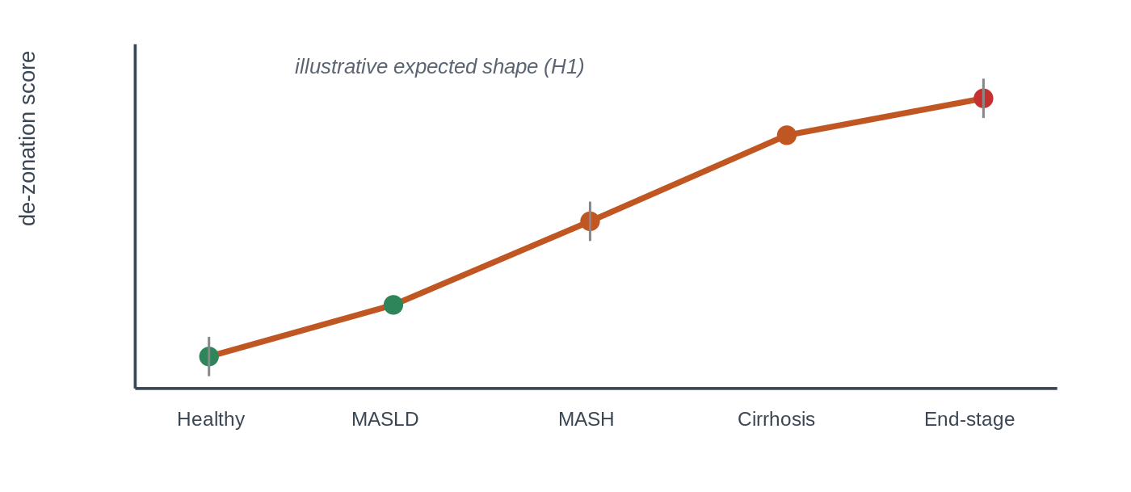
WHAT WE TEST
Research question & hypotheses
Q Using the healthy zonation ruler, can we measure how — and how much — hepatocyte zonation degrades as MASLD advances from healthy to end-stage, and is that degradation linked to plasticity?
H1 — Erosion
H2 — Which programs
H3 — Plasticity link
A de-zonation score rises monotonically Healthy → end-stage. Test: ordered trend on per-donor values.
Specific programs (e.g. pericentral CYP detox) collapse earliest. Test: pseudobulk donor×zone DE + FDR.
The most de-zonated cells are the ones gaining bile-duct identity. Test: within-donor correlation.
Why it matters: drug dosing (pericentral CYP) · ammonia / encephalopathy (periportal urea) · finer-than-histology staging · cancer / de-differentiation link · a reusable decoder for spatially-blind atlases.
illustrative — the H1 collapse curve we're after

Slide 6
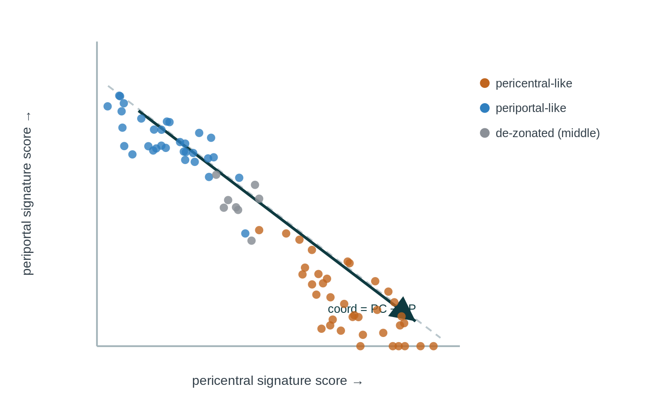
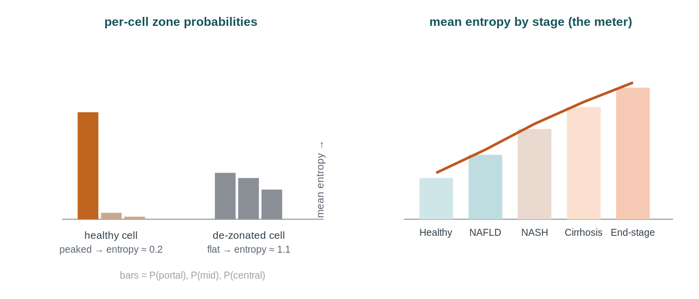
THE METHOD
How we decode position
1
Signatures
2
Coordinate
3
Classifier
4
Collapse
▶
▶
▶
pericentral & periportal gene sets — landmark & full, compared
score =
mean_z(PC) − mean_z(PP)
zone probabilities → entropy = confusion = de-zonation
one metric per donor, tested across stages

Slide 7
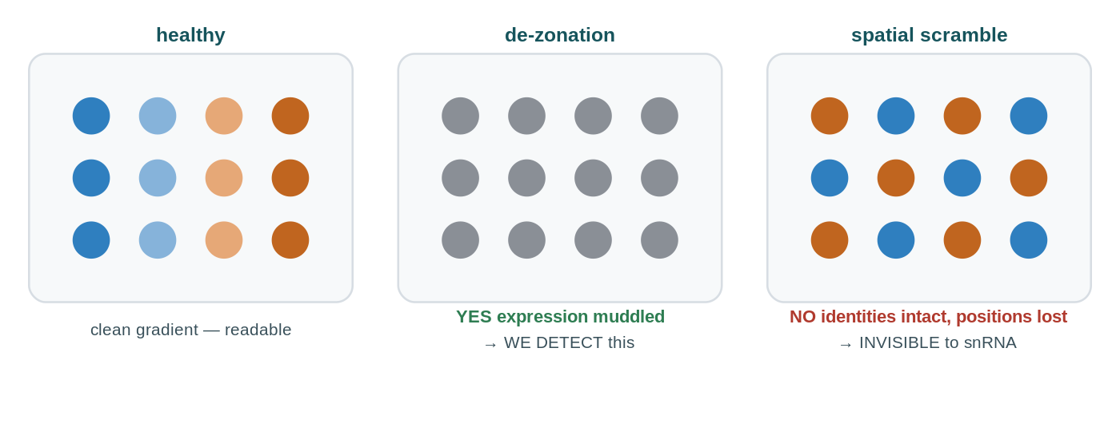
WHY IT HOLDS UP
Doing it honestly
Negative control. Shuffle the disease-stage labels and re-run: the collapse trend must VANISH. A 'signal' that survives shuffling was an artefact. (The positive control — recovering zonation in healthy liver — is the next slide.)
What de-zonation is — and isn't
IS — loss of the expression program: pericentral–periportal mutual exclusivity weakens and the coordinate spread narrows.
ISN'T — physical spatial scrambling with intact expression: dissociated data couldn't see it, and it's very unlikely here.
Donor-level inference (no pseudoreplication) and held-out-gene / circularity guards underpin every test — details in backup.

Slide 8
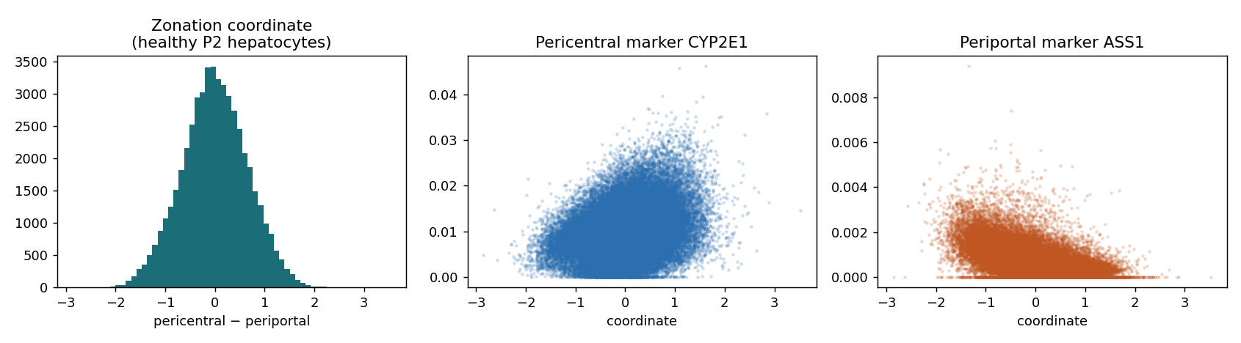
VALIDATION
Controls — does the result hold up?
✓ Positive control — on healthy liver the coordinate recovers zonation: pericentral CYP2E1 rises with it, periportal ASS1 falls (real data, above).
✗ Negative control — shuffle the disease-stage labels and re-run: the collapse trend must VANISH. A 'signal' that survives shuffling is an artefact, not biology.

Slide 9
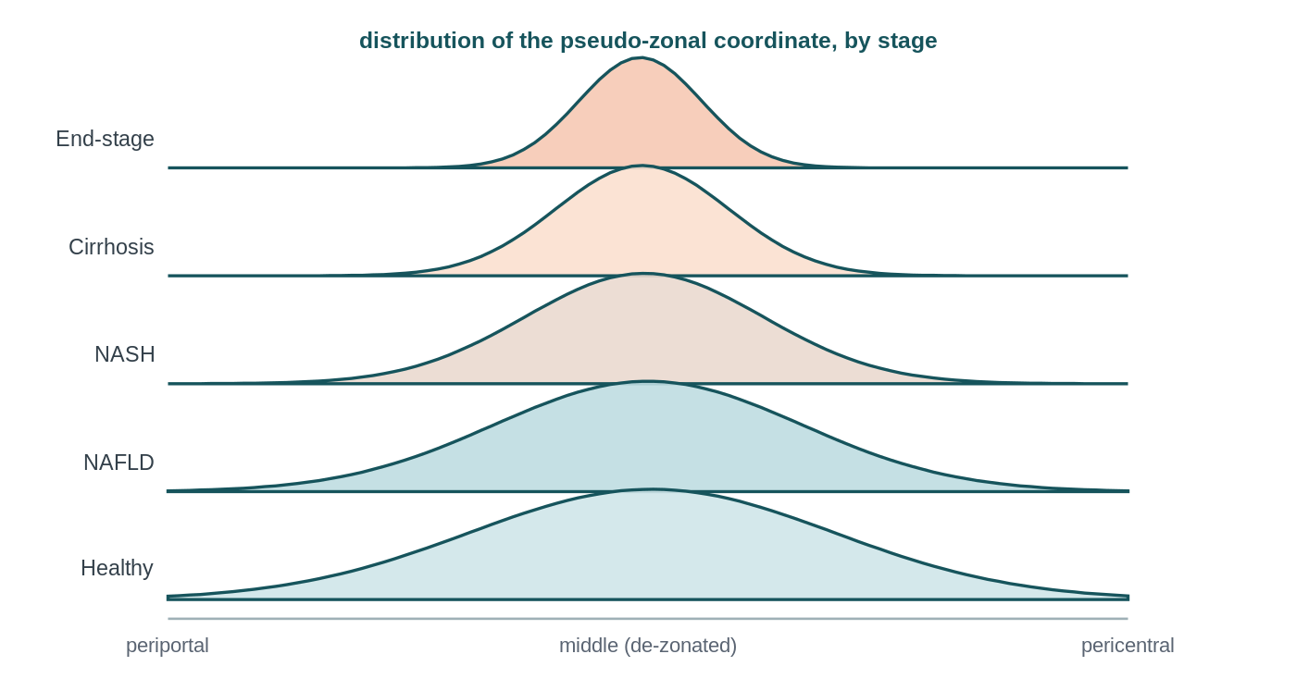
RESULT
TO FILL AFTER HACKATHON
H1 — Does zonation collapse across stages?
What to look for
Coordinate spread NARROWS and pericentral–periportal anti-correlation weakens toward 0 across stages.
We found: ___
[fill: ρ, donor-bootstrap 95% CI, permutation p] plot_a6_collapse · pipeline.py:collapse
EXPECTED SHAPE — swap for real A6

Slide 10
RESULT
TO FILL AFTER HACKATHON
H2 — Which programs collapse, and where?
FIGURE GOES HERE Volcano per zone (portal / central): effect vs −log10 q plot_a7_volcano · signature genes flagged
What to look for
A coherent set of genes at q<0.05 — surviving EXCLUSION of the signature genes — concentrated in one zone first.
We found: ___
[fill: # genes q<0.05 per zone; name the 3–5 earliest-collapsing programs] pipeline.py:de

Slide 11
RESULT
TO FILL AFTER HACKATHON
H3 — Are de-zonated cells the plastic ones?
FIGURE GOES HERE Stage-stratified scatter: de-zonation vs plasticity score plot_a8_plasticity · WITHIN donor/stage
What to look for
A positive within-donor link — not a pooled one (late disease trivially has more of both).
We found: ___
[fill: mean per-donor ρ; OLS dez coefficient controlling stage+donor] pipeline.py:plasticity

Slide 12
HONEST SCOPE
Limitations
Ruler-validity. Disease may corrupt the very marker genes the coordinate relies on, so a 'collapse' could be the ruler falling apart rather than true de-zonation. Step 5b diagnostics (internal coherence, PC–PP anti-correlation, split-half reproducibility) tell these apart before we make any claim.
Few patients at the extremes. The cohort thins at the ends — cirrhosis (n = 4) and end-stage (n = 5) — so the donor-level trend rests on a handful of people there; the tails of the curve carry the widest confidence intervals.
Cross-dataset transfer. The ruler is learned on a different healthy cohort and platform; residual batch effects could tilt the coordinate. We mitigate with rank/z features, a same-platform (snRNA) classifier, and the healthy positive control — but it remains a caveat.
Minor caveat — spatial scrambling. If cells kept their expression identity but were physically rearranged, dissociated data couldn't see it. We judge this biologically very unlikely in MASLD, and note it only for completeness.

Slide 13
TO FILL AFTER HACKATHON
Conclusions
H1 — [did zonation collapse, and how monotonically? ___]
H2 — [which programs eroded first, and in which zone? ___]
H3 — [did de-zonation track plasticity, within donors? ___]
One-line takeaway: a reference-decoder turns the many spatially-blind disease atlases into a quantitative readout of how liver identity disintegrates. [refine with results]

Slide 14
Thank you — questions?
Roee · Shira | Computational Genomics 76553 (backup slides follow)

Slide 15
BACKUP
TO FILL AFTER HACKATHON
Is the ruler still a ruler? (validity battery)
FIGURE GOES HERE Per-stage: internal coherence · cross-program anti-corr · split-half · program-off vs restriction-lost plot_a5b_ruler (Step 5b)

Slide 16
BACKUP
TO FILL AFTER HACKATHON
Classifier — held-out confusion matrix (Paper 2)
FIGURE GOES HERE Confusion matrix + held-out accuracy on Paper 2 before applying to Paper 1 Step 4b · calibrated multinomial logistic regression

Slide 17
BACKUP
Statistical rigor — the checklist
BH-FDR q<0.05, never raw p
Ordered trend test, not pairwise only
Donor-level resampling (never 69k cells as independent)
Pseudobulk donor×zone DE; H2 via coordinate×stage interaction on held-out genes (repeated random splits)
Positive + negative controls
Effect sizes beside p/q

Slide 18
BACKUP
OPTIONAL — IF IT RAN
Bonus — collapse vs inherited risk (Paper 3)
FIGURE GOES HERE Hypergeometric overlap: Step-7 collapse drivers vs Paper-3 risk-variant targets, expression-matched background step9_bonus_enrichment.py · report fold + BH q

