Slide 1
LIVER GENOMICS · SINGLE-NUCLEUS RE-ANALYSIS
No detectable hepatocyte de-zonation
across biopsy-stage MASLD
The reported collapse is inseparable from tissue-source / procurement confounding.
Raw-count, donor-level re-analysis of Gribben et al., Nature 2024 (GSE202379) · 47 donors · 69,426 hepatocyte nuclei

Slide 2
THE QUESTION
Is liver zonation lost in fatty-liver disease?
The healthy lobule is ZONATED
THE PUBLISHED CLAIM
PERIPORTAL (zone 1)
PERICENTRAL (zone 3)
“Hepatocytes lose their zonation”
Periportal: ASS1, CPS1, PCK1 — urea cycle, gluconeogenesis
Pericentral: GLUL, CYP3A4, drug-metabolizing enzymes (Wnt-driven)
Two opposing programs along the portal→central axis.
Gribben et al., Nature 2024 — end-stage hepatocytes co-express pericentral + periportal markers.
H1 Does hepatocyte zonation collapse across disease stage?
2

Slide 3
THE FORMAL QUESTION
Our research question — and the answer
“Using Paper 2’s healthy zonation ruler, can we assign a pseudo-zonation coordinate to every spatially-blind Paper-1 hepatocyte — and measure how, and how much, hepatocyte zonation degrades from healthy to end-stage, and is that linked to the transdifferentiation Paper 1 reported?”
Answer, clause by clause:
Assign a coordinate?
Measure degradation?
Linked to transdifferentiation?
Yes — but it’s the wrong instrument. The fitted ruler + marker-correlation turn depth and tissue differences into a fake collapse. We count molecules instead.
No detectable biopsy-stage change (F1→cirrhotic F4). The “healthy → end-stage” drop is the biopsy-vs-explant tissue axis — not identifiable as disease.
Can’t establish. Biliary markers (KRT7/19, EPCAM, SOX4) stay ~0 across biopsy disease and rise only in explants — the same confound.
3

Slide 4
THE LEGACY APPROACH
How we first read the data — and the claim it produced
The metrics we used at first
The claim it produced
z-scored zonation coordinate — z(PC) − z(PP) per cell
PC–PP marker anti-correlation
coordinate spread / IQR per stage
zonation heatmaps & slope-loss plots
“Hepatocytes lose their zonation;
the pericentral program turns off,
strongest at end-stage.”
Every metric is a relative summary — z-scored, correlation-based, pooled across all samples. It hides who moved, how many, and from where.
The trap: these statistics pool healthy, biopsy and end-stage samples together — across a hidden sampling discontinuity. The next slides show what that discontinuity is, and why it fakes a collapse.
4

Slide 5
THE CATCH
Disease stage is confounded with how the tissue was collected
Disease stage | Donors | Tissue source | Lobes
Healthy | 4 | surgical / atlas (mixed) | mixed
NAFLD | 7 | needle biopsy | right
NASH (no cirrhosis) | 27 | needle biopsy | right
NASH cirrhosis | 4 | needle biopsy | right
End-stage | 5 | transplant EXPLANT | left + right + caudate
Perfect collinearity.
Every end-stage sample is a transplant explant; every milder disease sample is a needle biopsy.
So disease and acquisition cannot be separated.
Verified directly from the paper's Methods + the dataset metadata.
5

Slide 6
WHY IT MATTERS
The end-stage “collapse” rides on organ-wide procurement stress
Endothelial cells
— irrelevant to hepatocyte zonation — are as stressed as hepatocytes.
⇒ organ-level ischemia / handling, not a hepatocyte disease program. End-stage excluded as a disease endpoint.
raw stress UMIs per 10⁴ by lineage (donor-median); explant/biopsy ≈ 5–21× across lineages
6

Slide 7
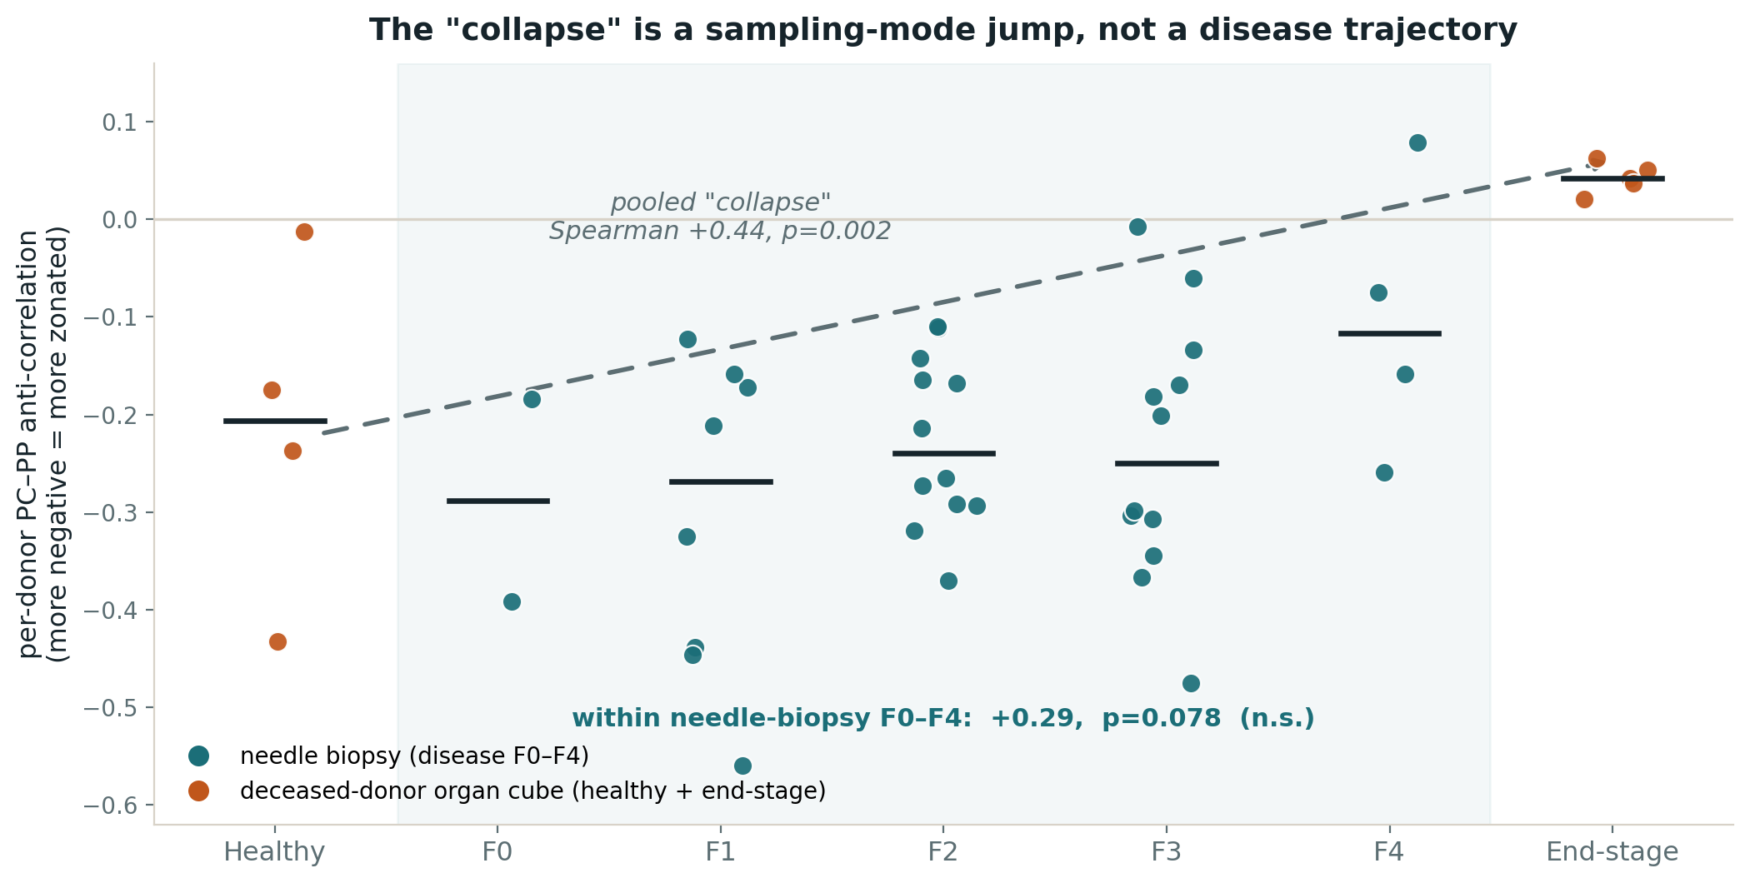
THE PARADOX
Simpson's paradox: the collapse is between groups, not within them
The collapse dissolves
pooled (legacy): +0.44, p=.002
biopsy F0–F4 only: +0.29, p=.078 n.s.
depth-matched counts: flat
Lurking variable: procurement stress, maximal in end-stage organ cubes — collinear with disease stage.
Textbook reversal: each healthy donor is individually zonated (anti-corr −0.21), yet pooling the four flips the sign to +0.01 — “de-zonation” manufactured purely by aggregation.
7

Slide 8
HOW WE MEASURED
We changed the measurement, not just the plot
Raw UMI counts
Depth-matched
The shipped matrix is an SCT model output (depth squeezed to ~5k). We extracted real molecule counts from the RNA assay.
Downsample every nucleus to a common budget so detection differences reflect biology, not sequencing depth. Averaged over draws.
Donor is the unit
Counts, not summaries
Inference at the donor level (~47), never the cell — no pseudoreplication of tens of thousands of nuclei.
Cell counts, fractions, molecule burdens — never marker correlations / spreads / z-scores that hide who moved.
8

Slide 9
THE TEST
Six snRNA marker-count signatures expected under zonation collapse
Mechanism | Count signature | Biopsy F0–F4 & NAS
Pericentral-cell depletion | PC-anchor nuclei fall | no change
Within-cell program dimming | detox in PC nuclei falls | no change
De-zonation: co-expression | dual PC⁺ PP⁺ nuclei rise | no change
De-zonation: gradient compression | per-nucleus balance → middle | no change
Identity turn-off | double-negative nuclei rise | no change
Compositional shift | PP : PC anchor ratio shifts | no change
9

Slide 10
RESULT
None detected — within biopsy-stage power (F1→cirrhotic F4)
Robust to everything that could fake a null:
depth budget 1,000 / 1,500 / 3,000 UMIs
anchor = GLUL-only / CYP3A4-only / both
8 thinning draws (noise SD 0.006–0.010)
every UMI threshold
real co-expression (≥2 UMI): ~0 in biopsy vs 7× in explants
ambient, contamination, ploidy: tested in counts — none drives it
Pericentral-anchor fraction of hepatocyte nuclei vs fibrosis stage (flat, non-monotone)
10

Slide 11
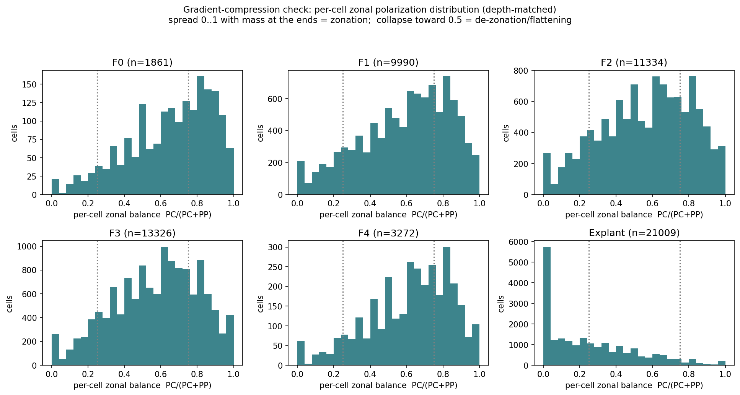
THE PICTURE
The gradient stays broad through cirrhosis — collapses only in explants
Each panel = per-nucleus zonal balance, PC ↔ PP.
F0–F4: broad, spread — zonation intact.
Explant: abnormal only here, and heterogeneous across donors (one even retains PC).
11

Slide 12
A BOUNDED ANSWER — HONEST ABOUT POWER
WHAT WE CAN SAY
WHAT WE DO NOT CLAIM
No detectable hepatocyte de-zonation across acquisition-matched biopsy MASLD (F0–F4 + NAS), by any mechanism.
A broad PC↔PP gradient is present at every stage, including cirrhotic F4.
Near-total collapse is excluded.
Not “zonation preserved” — the design is underpowered (smallest detectable change ≈ 85% of the mean; F0, F4 each ~one donor).
Single-nucleus counts cannot see lobular spatial position — “PC-like program,” not location.
Single cohort; no protein / spatial validation.
12

Slide 13
THE CORRECTION
We correct one evidence leg — not the whole claim
snRNA marker-correlation
A relative statistic, on procurement-confounded explant tissue. No progressive drift toward co-expression in biopsy (dual ≥2 UMI: 0.003 → 0.0, F1→F4).
CORRECTED
Immunofluorescence (GLUL+ASS1)
Protein co-localization — different molecule and timescale than the acute RNA stress we measure.
NOT ADDRESSED
FLASH 3D whole-organ imaging
Architecture of end-stage explants; cirrhosis genuinely remodels the lobule. We cannot call it artifact.
NOT ADDRESSED
13

Slide 14
THE GENOME-WIDE CHECK
Genome-wide, the biopsy hepatocyte transcriptome is broadly stable
Transcriptome-wide donor-level DE — pseudobulk, 38 biopsy donors, 17,572 genes, Spearman vs fibrosis, BH-FDR — tested with no curated panel:
Zonation & detox genes: all flat
CYP2E1 FDR .98 · CYP1A2 .91 · ADH4 .97 · SLCO1B3 .80 · GLUL .85 · all periportal > .79. The null holds far beyond the panel.
23 genes do trend — but not zonation
15/23 are stromal/immune ambient (stellate, cholangiocyte, endothelial). The one clear hepatocyte-intrinsic signal: A2M acute-phase, CPM 219→718.
Correction: the earlier within-pericentral xenobiotic dip (12.7→8.9 molecules/nucleus) does not survive this genome-wide test, so it is no longer reported as a finding. Net: a stable hepatocyte transcriptome with a modest acute-phase response — not de-zonation.
14

Slide 15
LIMITATIONS
What this dataset cannot settle
Power
End-stage disease
A bounded null: near-total loss excluded, moderate graded change not.
Unrecoverable here — no end-stage biopsies, no non-end-stage explants exist.
No spatial ground truth
Markers
snRNA gives a PC-like program, not lobule position; focal / architectural de-zonation is invisible.
GLUL is dropout-prone; CYP3A4 covaries with detox — so no independent “identity preserved” claim.
No clinical covariates
Single cohort
No etiology / alcohol / medication / fasting — fatal for any disease-specific gene claim.
No independent biopsy series or protein validation.
15

Slide 16
CONCLUSION
Across acquisition-matched biopsy MASLD, raw-count donor-level snRNA shows no detectable marker-count de-zonation — excluding near-total collapse, but underpowered for moderate/focal change. The end-stage signal is confined to heterogeneous explants and is inseparable from organ-wide procurement stress — not identifiable as progressive disease.
The transferable lesson
Relative summary statistics — marker correlations, spreads, z-scores — on cohorts where disease stage tracks tissue acquisition can manufacture biology. Count-based, depth-matched, donor-level analysis with an explicit confound audit is the more conservative standard.
16

Slide 17
APPENDIX · METHODS
Methods, in brief
Raw molecule counts
Depth-matched
Extracted the RNA-assay counts from the Seurat object — the shipped matrix is an SCT model output, not molecules. 45-gene panel + full library size per nucleus.
Downsample every nucleus to a common budget (1,000 / 1,500 / 3,000 UMIs) by binomial thinning, averaged over 8 draws — the standard count-preserving depth control.
Anchor census
Donor-level inference
Classify each nucleus PC / PP / dual / null on the canonical landmarks (GLUL, CYP3A4 vs ASS1, CPS1, PCK1, HAL, ALDOB); sweep thresholds, anchor genes, and programs.
Donor is the unit (~47): per-donor medians + ranges by stage. Two axes — fibrosis F0–F4 and NAS. Minimum detectable effect estimated at donor level.
GSE202379 (Gribben et al., Nature 2024) · 47 donors · 69,426 hepatocyte nuclei · full numeric record in FINDINGS.md
17

