Slide 1
LIVER GENOMICS · SINGLE-NUCLEUS RE-ANALYSIS
No transcriptional de-zonation signal in matched MASLD biopsies
— but the pericentral detox program dims
A critical re-analysis of the single-nucleus RNA-seq in Gribben et al., Nature 2024 (GSE202379)
Roee Tekoah · Shira Gelbstein
Computational Genomics (76553) · Hebrew University of Jerusalem · Hackathon
47 donors · ~99,809 nuclei · 69,426 hepatocytes · raw-count, donor-level analysis
Notes:
Title slide. We are Roee Tekoah and Shira Gelbstein; this is our hackathon re-analysis of the single-nucleus RNA-seq in Gribben et al., Nature 2024, asking whether the evidence for progressive hepatocyte de-zonation in MASLD survives once tissue acquisition is controlled. One-line answer: in matched biopsies we find no detectable progressive de-zonation — a large collapse is excluded, subtle drift is not. We are not claiming zonation is 'preserved' in any positive sense, and we do not touch the paper's imaging/protein evidence.

Slide 2
BACKGROUND
BACKGROUND
Hepatocytes are transcriptionally zonated
Pericentral (zone 3)
Periportal (zone 1)
Central vein
Portal tract
GLUL, CYP3A4, CYP2E1 — drug metabolism (Wnt-driven)
ASS1, CPS1, PCK1, HAL, ALDOB — urea cycle
THE PUBLISHED CLAIM — Gribben 2024
OUR QUESTION
“Hepatocytes lose their zonation.”
Does hepatocyte zonation degrade across MASLD?
End-stage hepatocytes co-express pericentral + periportal markers — validated by imaging + protein.
Hepatocyte↔cholangiocyte transdifferentiation, “prominent in end-stage.”
— and is it linked to the hepatocyte → cholangiocyte transdifferentiation they describe?
Computational Genomics 76553 · HUJI · MASLD snRNA-seq hackathon
2
Notes:
Minimal background: the liver lobule is zonated — pericentral hepatocytes (near the central vein) run one program (GLUL, CYP3A4, the CYP/detox genes), periportal hepatocytes (near the portal tract) run another (ASS1, CPS1, PCK1, urea cycle). Gribben et al.'s claim is that in MASLD hepatocytes lose this zonation and acquire cholangiocyte-like identity. That is what we test.

Slide 3
The catch
our first approach is misleading — and the tissue itself is confounded

Slide 4
THE FIRST APPROACH
THE CATCH
Catch 1: A relative ruler — and what it hides
THE OLD RULER
THE TRAP
We first read it with a z-scored zonation coordinate and marker–marker correlations, pooled across all samples.
Hides who moved
no counts — which cells? how many? and from where?
WHAT IT SHOWED
“Hepatocytes lose their zonation; the pericentral program turns off, strongest at end-stage.”
Bent by artifacts
depth, cell number and tissue source all tilt a z-score or correlation.
→ so we count molecules instead.
Pivoting back to the paper’s raw data.
Computational Genomics 76553 · HUJI · MASLD snRNA-seq hackathon
3
Notes:
The first catch: the metric. We first read it with a relative ruler — a z-scored zonation coordinate + marker correlations pooled over all samples — which produced 'hepatocytes lose zonation; pericentral turns off, strongest at end-stage.' But a relative summary hides who moved, pools healthy+biopsy+end-stage across a hidden sampling break, and is bent by depth/cell-number/tissue-source; and even biopsy-only it stays depth-sensitive and conflates turn-off vs de-zonation vs noise. So we switched to raw molecule counts. The second catch is the tissue itself (next slide).

Slide 5
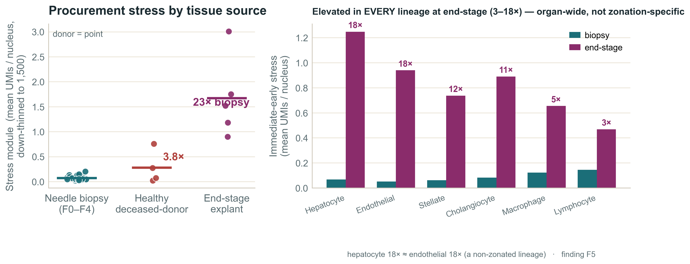
THE TISSUE — A CONFOUND
THE CATCH
Catch 2: Stage is entangled with tissue procurement
① The two extremities are rouge - acquisition isn’t needle biopsy
Healthy
F0
F1
F2
F3
F4
End-stage
deceased-donor
16-gauge needle biopsies
explants
The ends aren’t acquisition-matched to the biopsies (2/8/12/12/4) → we use biopsy-only F1–F4.
② And they also carry organ-wide stress
Stress spikes even where there’s no zonation.
Immediate-early / heat-shock genes jump 18× in the ends — but endothelium, which has no zonation program, jumps 18× too; hypoxia (HIF) stays flat. So it’s not necessary zonation change affect – but rather, at least as probable - acute handling¹.
Figure 1. Procurement-stress module by tissue source (donor-level).
¹ Dissociation / handling artifact: van den Brink et al. 2017; O’Flanagan et al. 2019; Denisenko et al. 2020. Provenance: paper Methods + GSE202379 metadata.
Computational Genomics 76553 · HUJI · MASLD snRNA-seq hackathon
4
Notes:
The tissue catch, both halves on one slide. (1) Stage is collinear with acquisition: healthy and end-stage are deceased-donor cubes/explants, F0-F4 are needle biopsies (2/8/12/12/4) — the ends are not acquisition-matched, so a 'progressive' trajectory can be manufactured by procurement/ischemia/dissociation/batch. (2) The ends also carry organ-wide stress: IEG+HSP spike ~18x in explants, but endothelium (no zonation program) spikes the same ~18x, and hypoxia (HIF) stays flat (1.7-2.6x) — acute handling, not a zonation program. Both reasons → exclude the deceased-donor/explant ends, use biopsy-only F1-F4. Verified from the paper's Methods + dataset metadata.

Slide 6
Method – corrected
how we re-test it, in counts

Slide 7
HOW WE MEASURE
METHOD
Raw-count anchor classification
raw UMI counts
down-thin to 1,500
marker ON if ≥ 2 UMI
classify nucleus (e.g. PC)
fraction per donor
Raw counts, not Single Cell Transformation (SCT)
Depth-matched¹
A single molecule may be ambient — absolute detection is what matters.
Down-thin every nucleus to 1,500 UMIs so depth can’t drive detection (stable at 1k / 1.5k / 3k).
≥2 UMI, not ≥1
Donor is the unit (~47)
Kills ambient soup — apparent co-expression 7–10% → 0.2–0.5%.
No pseudoreplication. Robust on 6 marker sets (2–1,637 genes, incl. Paper 2’s own).
¹ Depth-matched down-sampling: Amezquita et al., Nat. Methods 2020. · Raw-extraction integrity: 9/9 sanity checks pass (integer UMIs; 69,426 hepatocytes match the paper).
Computational Genomics 76553 · HUJI · MASLD snRNA-seq hackathon
7
Notes:
Why raw counts: a single marker molecule may be ambient, so absolute detection matters and SCT-normalized values are the wrong object. Down-thin every nucleus to a common 1,500-UMI budget, call a marker on at >=2 UMIs, classify each hepatocyte PC/PP/dual/null, infer at the donor level (~47). The >=2 cut matters: at >=1 UMI apparent co-expression is ~7-10% (ambient soup), collapsing ~40x to ~0.2-0.5% at >=2. Robust on 6 marker sets spanning 2 to 1,637 genes (incl. Paper 2's own) and the full threshold grid. Raw-extraction integrity: 9/9 sanity checks pass (integer UMIs, library 920-49,854 not the SCT band, hepatocyte count = the paper's 69,426).

Slide 8
WHAT WE MEASURE –THE FOUR CLASSES VOCABULARY
METHOD
Four classes – and how they can move
Every hepatocyte is one of four classes (left).
“Losing zonation” = cells redistribute across them — four distinct moves (right), each with its own count signature.
THE FOUR CLASSES
THE FOUR MOVES
periportal program →
Depletion
an anchor box ↓
Co-expression
the dual box ↑
PP −
PP +
PC-anchor
Dual
PC +
pericentral
program ↓
pericentral only
both — co-expression
Turn-off
the null box ↑
Composition shift
PP : PC ratio moves
Null
PP-anchor
PC −
neither
periportal only
The moves are dissociable — an emptying anchor box (depletion) and a filling null box (turn-off) are opposite directions; neither implies the other.
A single z-score or correlation collapses all four into one number — only counting molecules tells them apart.
Computational Genomics 76553 · HUJI · MASLD snRNA-seq hackathon
5
Notes:
Vocabulary + moves on one slide. LEFT — the 2x2: every hepatocyte is sorted into exactly one of four classes by which program it runs (pericentral detected? x periportal detected?): PC-anchor (PC only), PP-anchor (PP only), Dual (both — co-expression), Null (neither — double-negative). RIGHT — 'losing zonation' is not one event but four distinct moves among these boxes, each with its own count signature: Depletion (an anchor box shrinks), Co-expression (the dual box fills), Turn-off (the null box fills), Composition shift (the PP:PC ratio tilts); chip colours match the box each move touches. They are dissociable — a pole can convert to the opposite pole (depletion, null untouched) and cells can go double-negative without any pole shrinking (turn-off, no depletion). A single relative summary (z-score, correlation, UMAP axis) is scale-free — it divides out the level and reads only the gradient's shape, collapsing all four into one number; absolute counts keep them separate. We track all four, not just the pericentral depletion we expected.

Slide 9
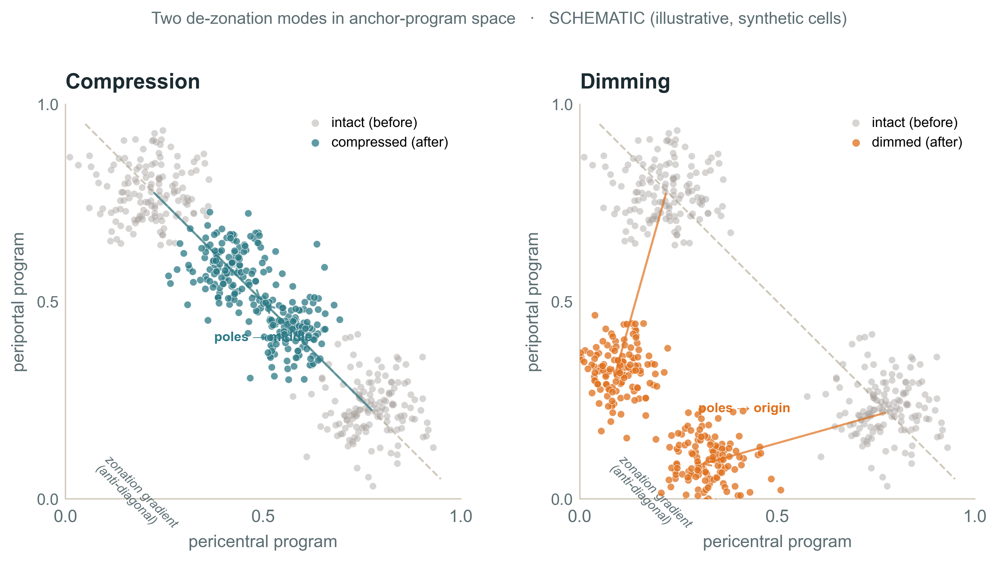
WHAT WE MEASURE - THE GRADIENT AXIS
METHOD
Beyond the classes — zonation is a gradient
Zonation is a continuous gradient — cells strung on an anti-diagonal. It can weaken two ways without any cell changing class:
Compression — shape
Balance drifts to the middle; the poles’ contrast shrinks.
Dimming — level
The pericentral detox program declines in level — same balance, lower volume.
Computational Genomics 76553 · HUJI · MASLD snRNA-seq hackathon
6
Notes:
The continuous-gradient axis, which the discrete box-counts cannot capture. Compression = loss of SHAPE (per-cell PC/(PC+PP) balance drifts to the middle); dimming = loss of LEVEL (the program's relative magnitude falls while the balance is unchanged). Compression: mild non-monotone middle drift peaking at F3, both poles populated — gradient present; only the explant collapses. Dimming: the pericentral detox program declines in relative level — a real coordinated finding, confirmed in Results by gene-set + per-cell tests. Cells keep their identity.

Slide 10
METHODS & SOFTWARE
METHOD
The analysis stack, end to end
Every quantitative claim runs at the donor level on raw molecule counts. The methods, grouped by step:
COUNTS & DEPTH
PER-GENE DGE
• Raw UMI extraction (not SCT) — absolute detection needs molecules, not normalized residuals — Seurat / Matrix (R)
• Pseudobulk, donor-level — sum each donor’s hepatocyte counts → one profile per donor (Squair 2021)
• Binomial down-sampling → 1,500 UMIs / nucleus — removes sequencing depth as a confound (the depth-match)
• edgeR — TMM + NB quasi-likelihood GLM — composition-robust normalization + per-gene fibrosis trend (filterByExpr gene filter)
GENE-SET TESTS
SOURCE & STATISTICS
• GSEA pre-rank — gseapy — is a set enriched at one end of the ranked genome?
• decontX — ambient-RNA removal — models native + ambient mixture, subtracts the estimate (celda; Yang 2020)
• CAMERA — competitive (limma) — set shifted more than the rest of the transcriptome? (Wu & Smyth 2012)
• TOST equivalence · Cramér’s V · Spearman / partial corr. — bound the null · test batch confounding · trend & covariate control
• ROAST / mroast — self-contained (limma) — does the set move against zero? rotation p-value (Wu 2010)
Stack: R (edgeR, limma, decontX/celda, Seurat) · Python (numpy, scipy, pandas, gseapy). Refs: edgeR / TMM — Robinson, McCarthy & Smyth 2010; Robinson & Oshlack 2010 · CAMERA — Wu & Smyth 2012 · ROAST — Wu et al. 2010 · decontX — Yang et al. 2020 · pseudobulk — Squair et al. 2021 · GSEA — Subramanian et al. 2005.
Computational Genomics 76553 · HUJI · MASLD snRNA-seq hackathon

Slide 11
Results
what the counts actually say – and a meaningful differential gene expression analysis

Slide 12
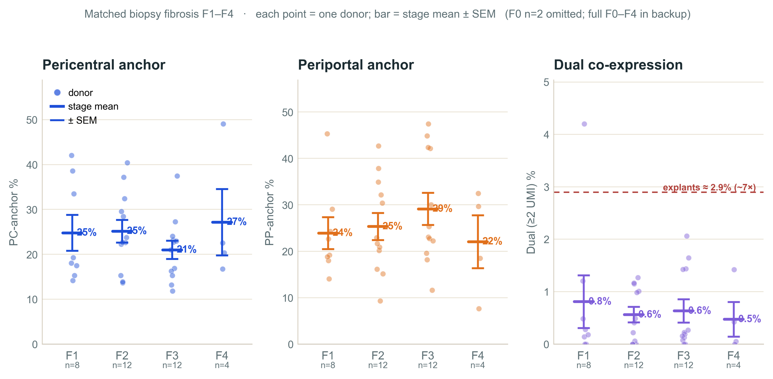
THE CLASSES RESULTS
RESULTS
No depletion signal across matched biopsies
No depletion.
PC & PP anchors flat across F1–F4.
No co-expression.
Dual stays ~0.4% per cell (vs 2.9% in explants).
Null & PP:PC flat too.
40/40/40/41%; ratio ≈ 1.1–1.7.
→ no transcriptional de-zonation signal.
Figure 2. Pericentral / periportal anchor and dual co-expression across matched biopsy F1–F4
(each point = one donor; bar = stage mean ± SEM; F0 n=2 omitted — in QA).
Equivalence (TOST): a > ±19 pp F4–F1 shift is excluded; a ≤10 pp drift is not (F4 n=4). Spread + 10-confounder audit in QA.
Computational Genomics 76553 · HUJI · MASLD snRNA-seq hackathon
8
Notes:
The core result. PC and PP anchor fractions are flat/non-monotone across F1-F4 — no depletion. Dual co-expression at the ambient-robust >=2-UMI cut stays ~0.4% and does not trend (vs ~2.9% in confounded explants). Null (44/36/39/39%) and PP:PC (~1.1) are flat too. WHY READABLE DESPITE THE SPREAD: donors scatter ~25-35 pp within each stage (SD ~12 pp), but the donor is the replicate, so each stage average has SE ~ SD/sqrt(n) ~ 4 pp; the spread is the same at every stage — noise around a flat line, not a hidden trend. EQUIVALENCE (TOST): a shift > ±19 pp is excluded; a <=10 pp drift is not (F4 n=4). F0 OMITTED: its 2 donors disagree 16.6 pp on the PC anchor (44% vs 28%), too unstable to anchor a trend, and it carries the highest PC fraction of any stage so dropping it doesn't flatter the result. QA: 10 confounders audited (source, stress, batch, depth, ambient, ploidy, cholangiocyte, discard, covariates, lobe) — none manufactures the result. All in backup.

Slide 13
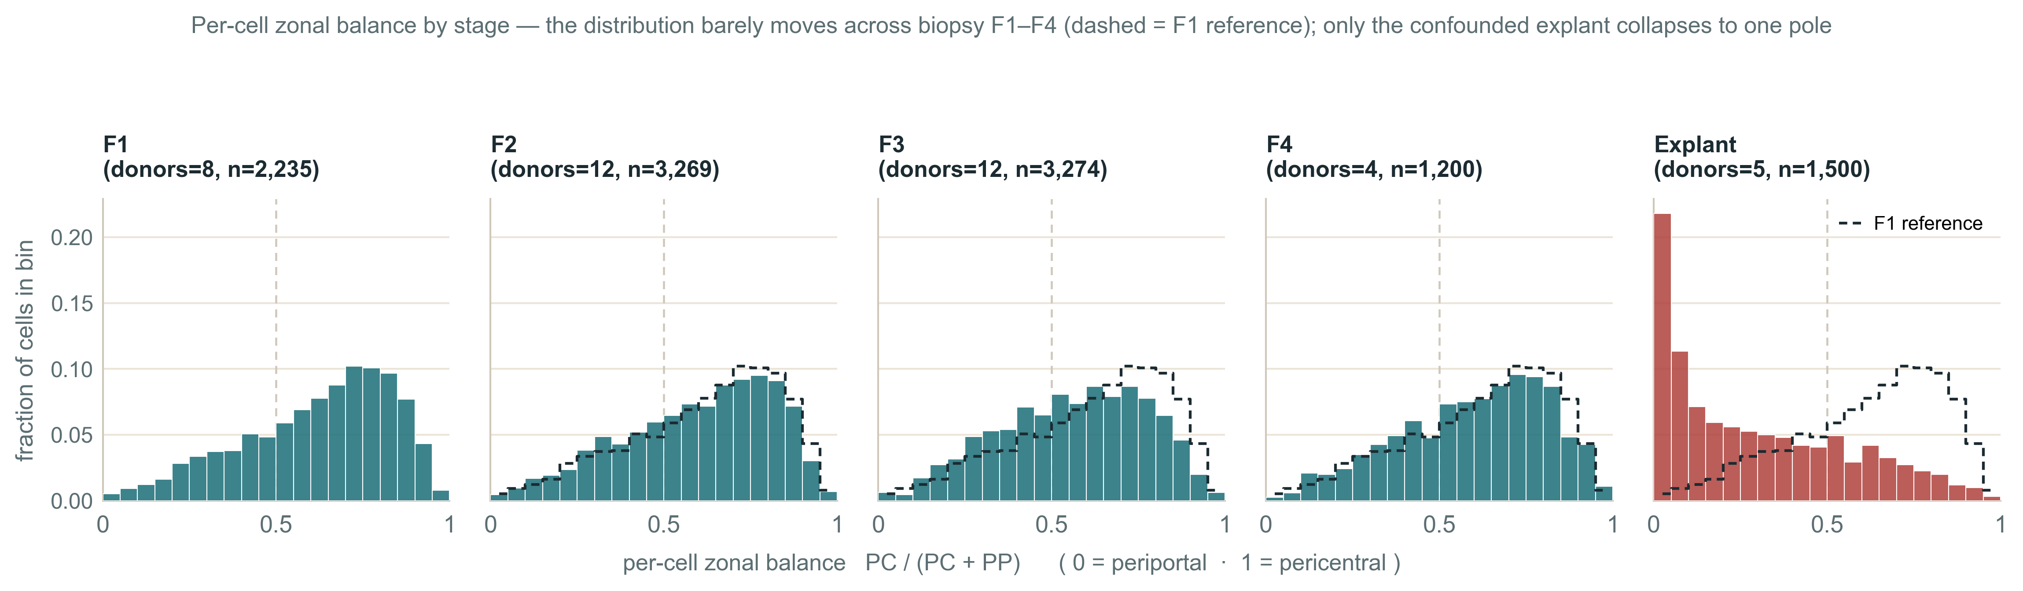
THE GRADIENT, IN DATA
RESULTS
Cells stay spread across the zones — no apparent collapse
Each panel: where hepatocytes fall on the pericentral ↔ periportal axis. PC / (PC + PP) directly from counts. A zonal gradient histogram.
A spread of positions = zonation present; cells bunched into one pile = collapse.
Figure 3. Per-cell zonal balance by stage (down-thinned to 1,500 UMIs, ≤300 nuclei/donor).
Dashed outline = the F1 distribution, repeated on each panel: biopsy F1–F4 barely move; only the explant collapses to the periportal pole.
Across biopsy F1–F4 the mass stays spread — the share of cells landing across [0.4–0.6) drifts only 22 → 24 → 28 → 26% (peak F3, then reverts), non-monotone and mild. Only the confounded explant collapses to a single (periportal) pole.
Computational Genomics 76553 · HUJI · MASLD snRNA-seq hackathon
9
Notes:
The per-cell gradient view — the most direct test of compression. x-axis is each cell's pericentral share PC/(PC+PP): 0 = all periportal, 1 = all pericentral; a spread of positions means zonation is intact, cells bunching into one pile means collapse. Across biopsy F1-F4 the distribution stays spread, with only a mild non-monotone middle drift peaking at F3 (it reverts at F4) — gradient present, not collapsed. The explant collapses onto the periportal pole — the same acquisition confound. On the rightward lean: the histograms center above 0.5 because the pericentral program is summed over 7 broadly/highly expressed CYP/detox genes vs 6 periportal genes — a marker-set asymmetry, not biology, and irrelevant to the claim, which is the CHANGE across stages (the lean is constant and cancels out). The dashed reference line marks the F1 centre, repeated across panels, to show it does not move.

Slide 14
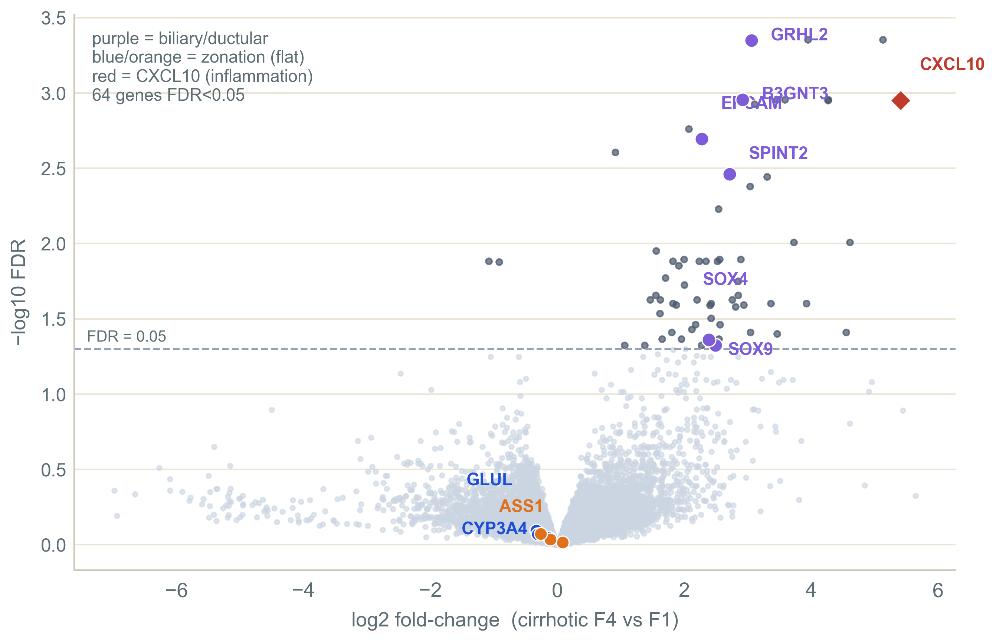
GENOME-WIDE
RESULTS
Per gene, nothing usable moves
64 of ~21,000 genes pass FDR¹
— mostly biliary / ductular. Zonation genes flat (GLUL FDR 0.80).
No large single-gene program.
But a weak program, spread thinly across many genes, hides from per-gene FDR
Figure 4. Genome-wide pseudobulk differential expression, cirrhotic F4 vs F1 (edgeR).
¹ Pseudobulk: Squair et al. 2021; edgeR / TMM: Robinson, McCarthy & Smyth 2010; Robinson & Oshlack 2010.
Computational Genomics 76553 · HUJI · MASLD snRNA-seq hackathon
10
Notes:
Per-gene pseudobulk: nothing usable moves (64/21,000 significant, mostly biliary/ductular; zonation flat, GLUL FDR 0.80). No large single-gene program. But per-gene FDR catches a big change in any ONE gene; a weak coordinated program (many genes each drifting a little, same direction) slips past — that is the pericentral-detox decline shown on the next slide.

Slide 15
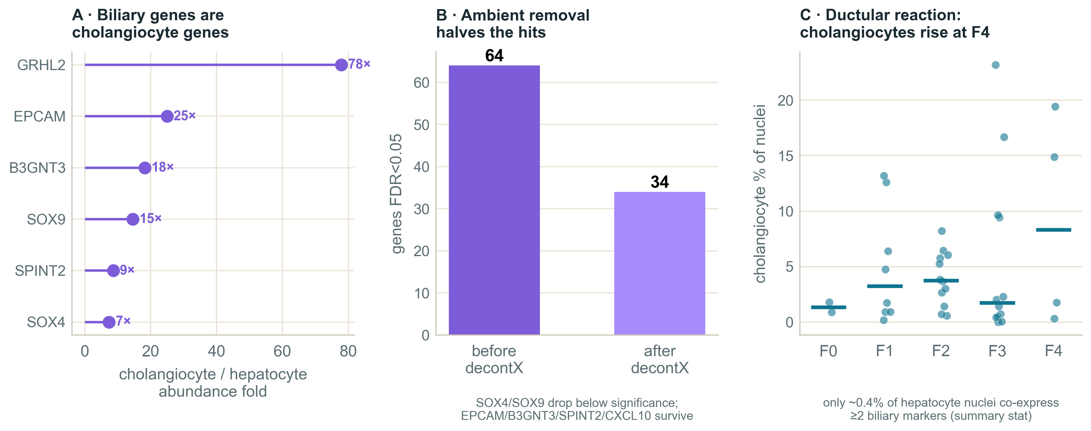
c
SOURCE
RESULTS
The biliary signal: compositional? a lead
What we see: biliary / ductular genes (EPCAM, SOX9, GRHL2, B3GNT3, SPINT2) rise at F4 — exactly where cirrhosis’s ductular reaction floods the tissue with cholangiocytes.
Figure. Source attribution — cross-lineage abundance, decontX ambient-RNA removal, and the F4 ductular reaction.
COMPOSITIONAL (the lead)
These are cholangiocyte genes. At F4 there are more cholangiocytes → more of their RNA in the ambient “soup” (plus the odd doublet) enters hepatocyte droplets → hepatocytes look biliary without transdifferentiating.
RARE PER CELL (read carefully)
Only ~0.4% of hepatocyte nuclei co-detect biliary markers at ≥2 UMI — not population-wide. But that is prevalence over ALL hepatocytes: it argues against MASS transdifferentiation, not against a rare sub-population (class imbalance).
OPEN (a residual survives)
decontX removes about half the hits (64 → 34), but EPCAM / SPINT2 / B3GNT3 survive decontamination — ambient can’t explain all of it, so a rare intrinsic state is not excluded.
Verdict: most consistent with composition / ambient (the ductular reaction) — a lead, not a closed verdict.
Computational Genomics 76553 · HUJI · MASLD snRNA-seq hackathon

Slide 16
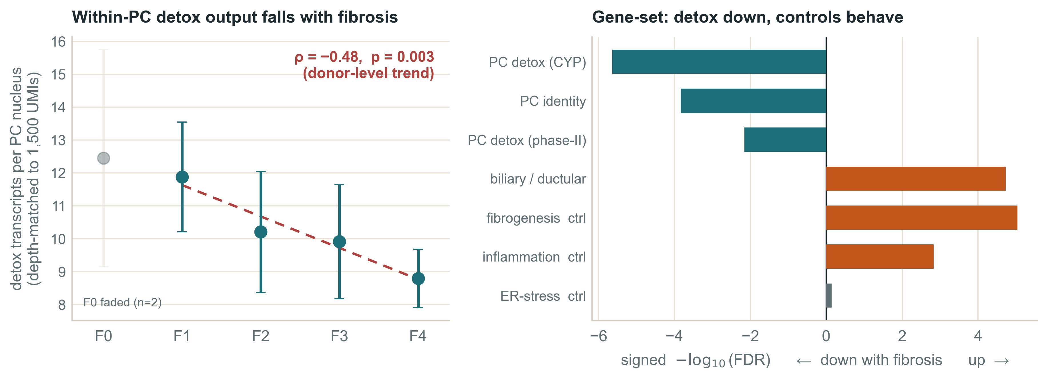
THE ONE REAL CHANGE
RESULTS
Pericentral detox dims — identity stays
Cells keep their class — but within pericentral nuclei, the detox program’s level falls with fibrosis
Figure 5. Left — within-PC detox output¹ (depth-matched transcripts per PC nucleus) across fibrosis. Right — gene-set programs²: PC detox / identity down, biliary + fibrogenesis up, validating controls behaved.
Like a radio: the genre held (cells keep identity); the volume dropped (the program dims). A relative decline (transcripts within a fixed budget), not proven absolute molecule loss; a donor-level trend; could partly reflect a shift among PC subzones. No single gene clears per-gene FDR — only the coordinated set + the per-cell trend.
¹ Within-PC detox output: depth-matched to 1,500 UMIs, donor-level Spearman (ρ=−0.48, p=0.003); measured on detox genes (CYP2E1, CYP1A2, ADH4…) disjoint from the GLUL/CYP3A4 identity anchors — so the anchor fraction stays flat while the module dims. ² Gene-set: camera — Wu & Smyth 2012; ROAST — Wu et al. 2010; GSEA — gseapy.
Computational Genomics 76553 · HUJI · MASLD snRNA-seq hackathon
11
Notes:
The one real biopsy-internal change. LEFT: within-PC detox output (detox transcripts per PC nucleus, depth-matched to 1,500 UMIs) falls from ~11.9 at F1 to ~8.8 at F4; donor-level Spearman rho -0.48, p=0.003. F0 (n=2) faded. RIGHT: gene-set test (camera) — PC detox (CYP) FDR 2e-6, PC identity 1.5e-4, phase-II 7e-3, all DOWN; biliary/ductular + fibrogenesis/inflammation controls UP; ER-stress flat (validating controls). CAREFUL FRAMING: this is a RELATIVE transcript decline within a fixed 1,500-UMI budget, not proven absolute molecule loss; it is a donor-level trend (not pseudoreplicated); it could partly reflect a shift among PC subzones rather than pure within-cell downregulation; no single detox gene clears per-gene FDR. Cells retain their pericentral/periportal identities — functional dimming of a zonated program, NOT de-zonation or transdifferentiation. This was our original within-PC metric (the one count hint), conservatively shelved as borderline, now confirmed by the coordinated set test + the full-trajectory trend, after ruling out a composition artifact (TMM, contaminant removal, the per-cell measure).

Slide 17
CONCLUSION
Zonal identity holds — the pericentral detox program dims
01
Cells keep their zonal genomic identity — no de-zonation signal
02
The one real change: the pericentral detox program dims
03
The dramatic trajectory possibly tracks acquisition, not disease
We correct one evidence leg —
the snRNA marker-correlation; the paper’s imaging and protein staining are untouched.
The biliary signal is a separate compositional lead.
Computational Genomics 76553 · HUJI · MASLD snRNA-seq hackathon
13
Notes:
Close on the methodological lesson: in single-cell disease atlases, acquisition matching can dominate apparent disease trajectories. Bottom line, narrow and honest: the snRNA-seq evidence for progressive de-zonation does not survive matched-source re-analysis — we correct one evidence leg, the marker-correlation; imaging/protein/organoid untouched; the biliary signal is most consistent with composition/ambient RNA, a rare intrinsic state not excluded.

Slide 18
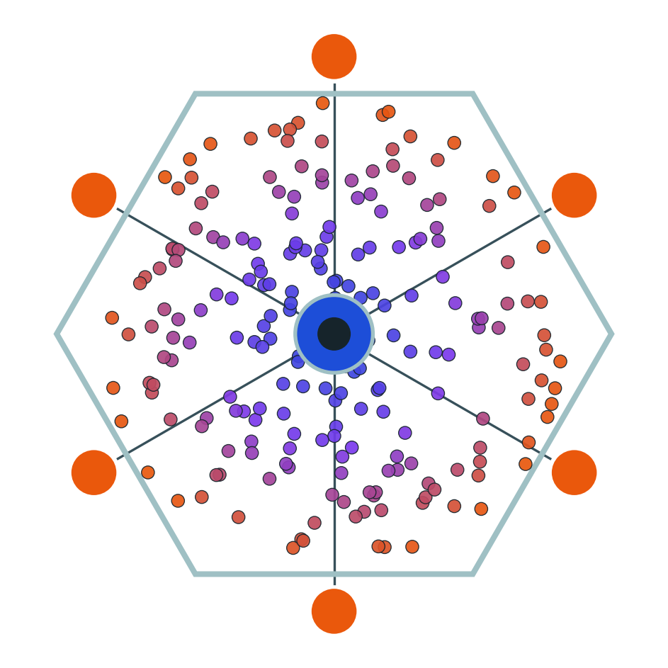
Thank you
now — QA: your questions
No hepatocytes lost their identity in the making of this talk.
Illuminati confirmed
Roee Tekoah · Shira Gelbstein · Computational Genomics 76553 · HUJI

Slide 19
QA · SCOPE
Are you overturning the paper? No
We re-tested only the snRNA-seq transcriptional zonation/plasticity evidence.
We did NOT test imaging, protein staining, organoids, or 3D architecture.
Claim: matched biopsy transcriptomes do not show progressive zonation loss.
We agree the strong signal is an end-stage phenomenon.

Slide 20
DONOR VARIANCE
QA
Why a flat result is readable despite huge donor spread
Within each fibrosis stage the per-donor pericentral-anchor fraction spans ~25–35 pp (SD ≈ 12 pp).
Could that scatter be hiding a real trend? No — four reasons:
1
The donor is the replicate — not the cell
2
The spread is the same at every stage
Inference is donor-level (F1–F4 = 8 / 12 / 12 / 4). A stage MEAN has standard error SE ≈ SD/√n ≈ 12/√10 ≈ 4 pp — we compare stage means (± 4 pp), not individual donors (± 12 pp).
Variance is homoscedastic — as wide at F1 as at F4. A real progression would shift the mean monotonically beyond ± 4 pp; it doesn’t. This is noise around a flat line, not a trend buried in noise.
3
We bound what is excluded (TOST)
4
Stable across marker sets & thresholds
Not merely “no trend found”: a shift > ± 19 pp between F1 and F4 is positively rejected at the donor level. Only a subtle drift (≤ 10 pp) remains possible — limited by F4’s n = 4.
The flat result holds on 6 marker sets (2–1,637 genes, incl. Paper 2’s own) and the full ≥1 / ≥2 / ≥3-UMI grid — no setting-dependent signal hiding in the variance.
Bottom line: large person-to-person variance ≠ an undetectable signal. With donor-level inference and an equivalence bound, a large progressive de-zonation is excluded (a subtle ≤10-pp drift is not).
Computational Genomics 76553 · HUJI · MASLD snRNA-seq hackathon

Slide 21
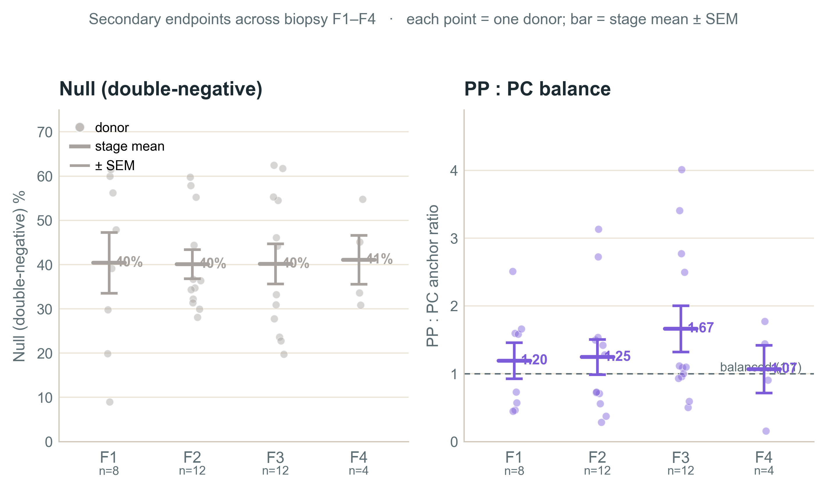
QA · SECONDARY ENDPOINTS
Null is flat; the PP : PC ratio shows no stage trend
Null (double-negative): ≈ 40 / 40 / 40 / 41% — no rise across stages.
PP : PC ratio: ≈ 1.20 / 1.25 / 1.67 / 1.07 — near the 1 : 1 line (F3 pulled by one high donor).
Same large person-to-person spread as the anchors, same absence of a stage trend.
Figure 7. Null (double-negative) fraction and the periportal : pericentral anchor ratio across biopsy F1–F4 (each point = one donor; bar = stage mean ± SEM).

Slide 22
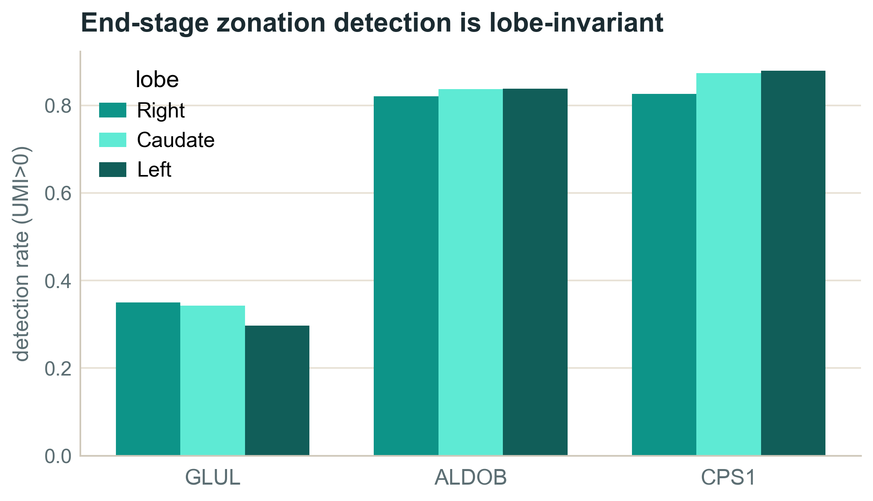
QA · LOBE
Right, caudate and left lobes all agree
Detection matches across all three lobes.
Lobe does not explain the signal; explant-vs-biopsy acquisition still does.
Figure 8. Zonation-marker detection across Right / Caudate / Left lobes in end-stage explants.

Slide 23
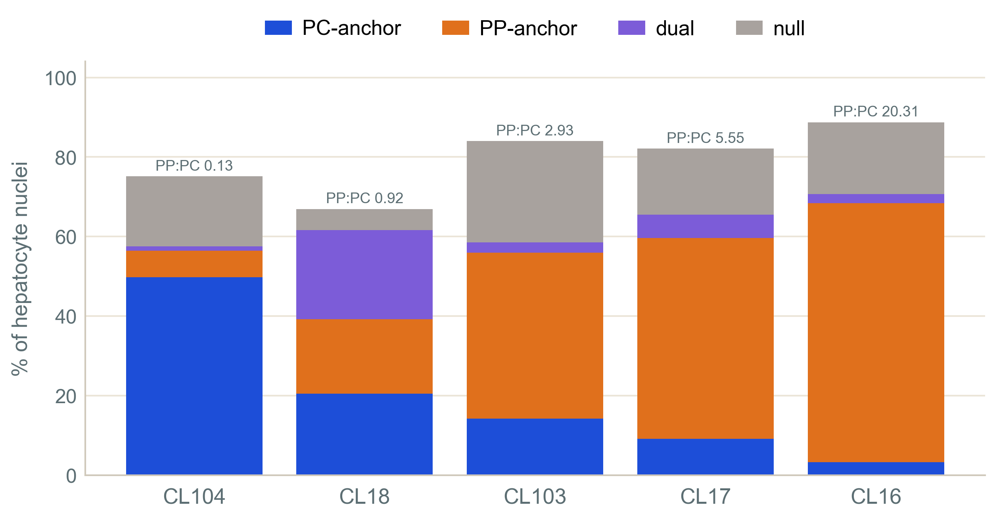
QA · END-STAGE
End-Stage Shenanigans: Five donors, five phenotypes
PC-anchor 3% → 50%; PP:PC 0.13 → 20.
Dramatic but NOT one program — pooling manufactures a uniform “collapse.”
Figure 9. Per-explant anchor fractions — end-stage is heterogeneous, not one coherent program.

Slide 24
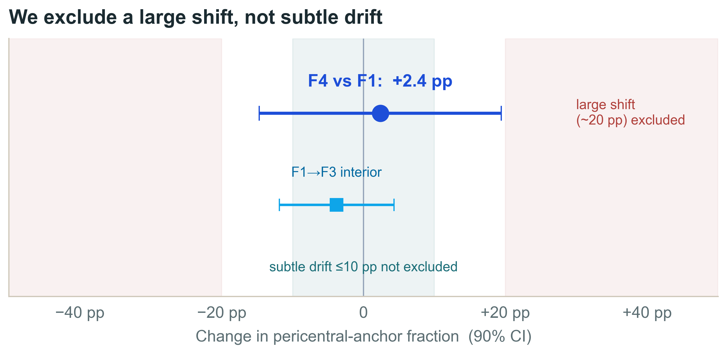
QA · ROBUSTNESS
Sensitivity grid + equivalence bound
Stable across every variant:
anchor genes, periportal rule, ALDOB in/out, CPS1-based, 1 vs 2 UMI.
No depletion · no dual rise · no turn-off — in all.
Bound (TOST): large shift (~19 pp) excluded; subtle drift ≤10 pp not (F4 n=4).
Figure 10. Equivalence bound on the F4-vs-F1 pericentral-anchor change.

Slide 25
QA · AUDIT DETAIL
Confounder battery — the numbers
Confounder | What we did (test · numbers) | Verdict
Tissue source | organ-cube / explant ends are not acquisition-matched to needle biopsy | excluded → biopsy-only F1–F4
Procurement stress | IEG+HSP across 6 lineages; hep 18× ≈ endothelial 18× (no zonation) | organ-wide handling, not zonation
Sequencing batch | run × source Cramér’s V = 0.84; run × F (biopsy) = 0.40 | ends confounded; biopsy estimable
Lobe (R / C / L) | marker detection across right / caudate / left lobes in explants | lobe-invariant
Sequencing depth | binomial down-thin to B = 1,000 / 1,500 / 3,000 UMIs | PC-share flat at every B (SD 0.006–0.010)
Ambient RNA (“soup”) | corr( ALB share , dual fraction ) across 38 donors = +0.04 | does not drive co-expression
Cholangiocyte mis-annotation | KRT19⁺ ≤ 0.001, EPCAM⁺ ≤ 0.003 in every anchor class | not contaminating cholangiocytes
Ploidy / complexity | nFeatures by stage: 2218 / 3063 / 3169 / 2641 / 1984 | non-monotone — does not track stage
Depth-match discard | 3.5–7.8 % dropped below B, uniformly lower-detection | depth-driven, not PC-biased
Clinical covariates | partial corr( detox , F | Age ) = −0.32; Age–F = +0.43 | demographics do not explain trends

Slide 26
QA · METHODS
Why raw counts, why pseudobulk
Raw counts: marker co-detection + ambient sensitivity need molecules, not SCT residuals.
Pseudobulk: cells from one donor are not independent — sum per donor, then edgeR (Squair 2021).
edgeR: filterByExpr → 21,022 genes; TMM; NB quasi-likelihood GLM, robust dispersion; common BCV 0.405.
Primary signal persists in DIRECTION with a run covariate and within a single run; significance attenuates with n (not a batch artifact).

Slide 27
QA · AMBIENT
Does decontX prove contamination? No
decontX models a native + ambient RNA mixture and subtracts the estimate.
Hits 64 → 34; SOX4/SOX9 drop below significance → supports an ambient contribution.
But it can remove true hybrid signal OR leave residual contamination.
Source attribution is a lead, not a closed verdict; CXCL10 is a separate candidate inflammatory signal.

Slide 28
QA · GENE-SET RESULT
Ten pre-specified sets — the detox program goes down
Gene set | Zone / program (identity) | n | Dir | camera FDR
xenobiotic_CYP | PC detox — phase-I (CYP) | 13 | ↓ | 2×10⁻⁶
detox_phase2 | PC detox — phase-II (UGT/GST/SULT) | 16 | ↓ | 7×10⁻³
pericentral_anchors | PC identity (Paper 2 landmarks) | 20 | ↓ | 1.5×10⁻⁴
periportal_anchors | PP identity (Paper 2 landmarks) | 20 | ↑ | 1.5×10⁻²
urea_cycle | PP program (nitrogen) | 9 | ↓ | 0.12 (ns)
bile_acid_lipid | mixed metabolism | 20 | – | 0.72 (ns)
cholangiocyte_ductular | biliary / bile-duct markers | 10 | ↑ | 1.9×10⁻⁵
CTRL_interferon | inflammation (+control) | 20 | ↑ | 1.5×10⁻³
CTRL_EMT | fibrogenesis / scar (+control) | 20 | ↑ | 9×10⁻⁶
CTRL_ER_stress | unfolded-protein resp. (−control) | 20 | – | 0.72 (ns)
Donor-level, biopsy F0–F4, limma::camera (GSEA agrees). Pre-specified, no fishing: PC/PP identity = Paper 2’s own landmark genes; CYP / detox / urea / bile = KEGG·HGNC cores; biliary = plasticity.txt + markers; controls = MSigDB Hallmark cores. The validating controls behaved (fibrogenesis & inflammation ↑, ER-stress flat) — proof the test detects real biology, not noise. The pericentral detox + identity programs fall; the see-saw (PP ↑) and biliary ↑ are why we adversarially controlled for composition (it survived).

Slide 29
QA · METHODS GLOSSARY
Gene-set testing, in one breath each
Pseudobulk — sum each donor’s hepatocyte counts into one profile per donor (donor = unit of inference).
CPM — each gene as a share of the donor’s total counts; simple, but compositional (a few surging genes shrink everyone else’s share).
TMM — the scaling factor is taken from the bulk of genes after trimming the extreme movers, so surging genes can’t set it → composition-robust.
Per-gene DGE — test each gene on its own for a fibrosis trend (edgeR); misses a weak shift shared by many genes.
Gene-set test — test a whole pre-specified set at once. camera = competitive (more shifted than the rest of the genome?; Wu & Smyth 2012); ROAST = self-contained (does the set move against zero?; Wu et al. 2010).
Within-PC detox output — detox transcripts per pericentral nucleus after equalizing read depth: per-cell, relative to the cell’s own output, immune to between-cell composition.
Adversarial check — redo with TMM, with ROAST, with the rising genes removed, and with the per-cell measure; all four agreed → the dimming is real.

Slide 30
QA · SCENARIO COVERAGE
Every de-zonation route, mapped to its signature
Mechanism | Signature | Biopsy F0→F4 (donor-median) | Verdict
Pericentral depletion | PC-anchor fraction ↓ | 36 / 19 / 23 / 22 / 21 % | flat → no depletion
Periportal depletion | PP-anchor fraction ↓ | 20 / 21 / 22 / 24 / 24 % | flat → no depletion
Dimming | within-PC level ↓ (magnitude) | 11.9 → 8.8 detox UMI/nuc (F1→F4); ρ = −0.48 | REAL — gene-set + within-PC confirm (CYP FDR 2e-6)
Co-expression | dual (≥2 UMI) fraction ↑ | ~0.0 / 0.2 / 0.4 / 0.2 / 0.2 % | ambient soup → no
Gradient compression | per-cell balance → middle | mild, non-monotone (peak F3) | gradient present
Turn-off | null (double-neg) fraction ↑ | 34 / 44 / 36 / 39 / 39 % | flat → no turn-off
Composition shift | PP : PC anchor ratio | 0.62 / 1.16 / 1.01 / 1.10 / 1.18 | ~flat → no shift
Induction | program level ↑ | flat in biopsy; rises only end-stage | explant-only
Each row is a distinct way zonation could fail, mapped to its signature on depth-normalized counts. The structure-redistribution routes (cells crossing boxes) are all flat — cells keep their identity. The one magnitude route, dimming, is REAL: the pericentral detox program quiets, confirmed by gene-set + within-PC testing.

Slide 31
QA · FULL CONCLUSIONS
Conclusions · limits · next steps
Conclusions
Limits
Next
Full healthy→end-stage trajectory is source-confounded.
In biopsy F1–F4 cells keep zonal identity — no de-zonation (large shift excluded).
Two real biopsy-internal signals: a compositional biliary signal (a lead), and a confirmed pericentral-detox dimming (gene-set + per-cell).
“PC-like program,” not lobular location — counts can’t see spatial position.
Imaging / protein / organoid evidence not re-analyzed.
F4 has only 4 biopsy donors.
Detox dimming is a RELATIVE decline (not proven absolute) and could partly reflect a shift among PC subzones; self-contained test clears only the CYP core.
Spatial / independent-biopsy validation of the detox-dimming gradient.
Leave-one-F4-donor-out DGE.
Quantitative contamination model for the biliary lead.
Functional readout of pericentral detox capacity.

