Slide 1
Spatial Degradation of Hepatocyte Zonation
Decoding the collapse of liver cell identity across the fatty-liver disease course
portal
central
Roee · Shira | Computational Genomics 76553 — Final Hackathon

Slide 2
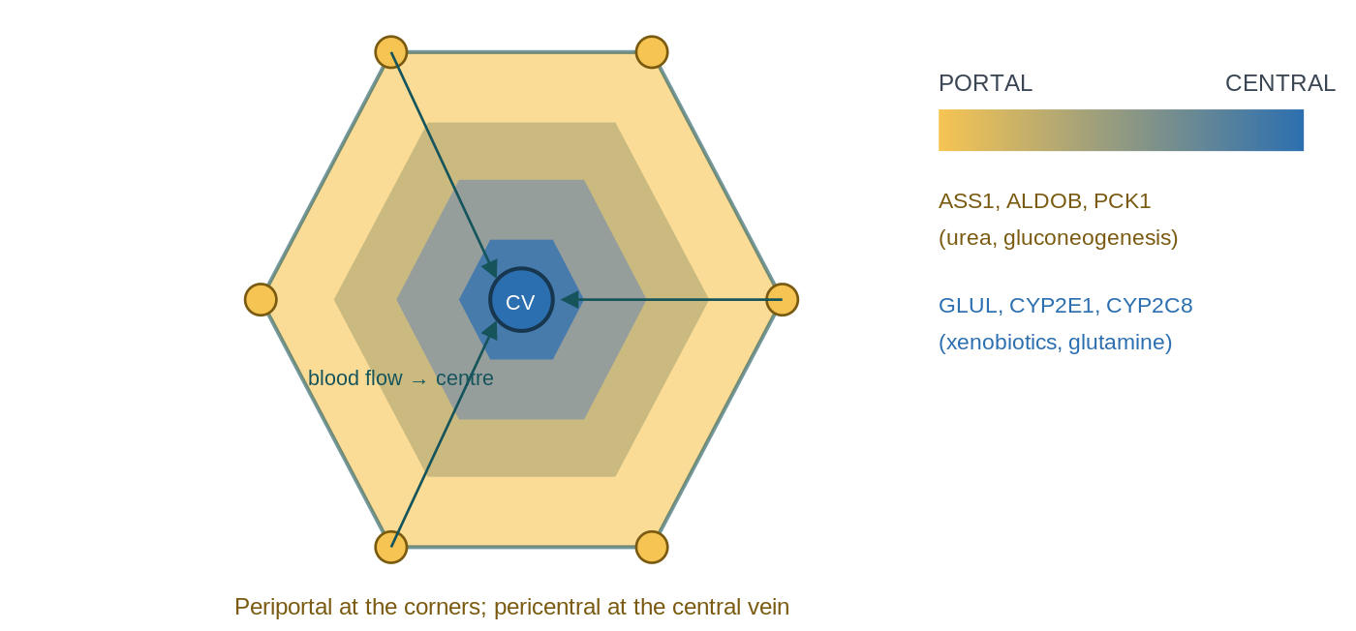
THE BIOLOGY
What the liver does — and the zonation gradient
The liver is a metabolic factory:
buffers blood sugar,
makes plasma proteins
produces bile acids
converts nitrogen waste to urea
detoxifies drugs.
Two epithelial cells:
hepatocytes (the bulk factory)
and cholangiocytes (bile-duct lining). Blood flows portal → central, so a cell's environment — and the genes it switches on — depends on where it sits:
• Periportal: urea cycle, gluconeogenesis (ASS1, PCK1). • Pericentral: drug metabolism, glutamine (CYP2E1, GLUL).
Zonation = this position-dependent gene gradient.
The hinge: position is encoded in expression, so it can be decoded back out.

Slide 3
WHAT WE MEASURE
Two ways identity breaks: de-zonation vs plasticity
Both look like 'a cell expressing two opposite things at once' — the difference is WHICH boundary is crossed.
De-zonation
Plasticity
Loses its POSITION on the portal ↔ central axis
Co-expresses opposite zonal programs (e.g. CYP2E1 + ASS1).
Signature: the pericentral / periportal zonation genes.
Loses its CELL-TYPE identity (hepatocyte → bile-duct).
Co-expresses hepatocyte + duct programs (e.g. ALB + KRT7).
Signature: KRT7, KRT19, SOX9 … (from Paper 1).
Analogy: a worker who forgets which station they man (de-zonation) is still a factory worker; one who forgets they work in the factory at all (plasticity) is something else. H3 asks whether these are the same cells — does losing your address predict losing your job?

Slide 4
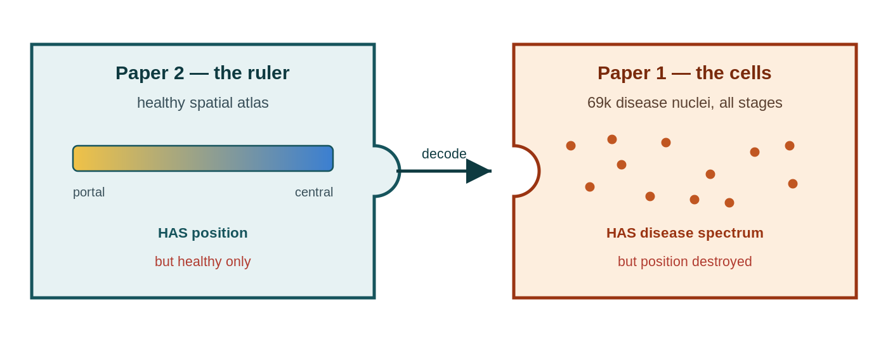
THE OPPORTUNITY
Two datasets, one gap
Paper 2 — the ruler
Paper 1 — the cells
Healthy human liver with spatial coordinates KEPT
→ a quantitative porto-central zone index.
But healthy only.
69k disease nuclei across all stages,
but snRNA-seq THREW AWAY position.
Our move: use the healthy ruler to assign each diseased cell a pseudo-zonal coordinate. Neither paper did this.

Slide 5
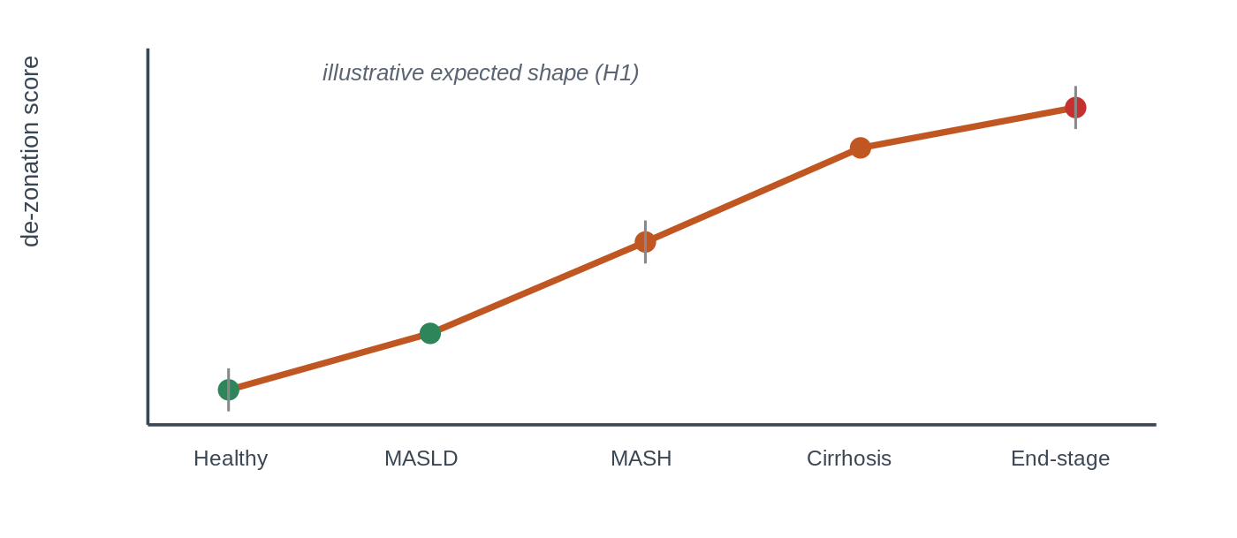
WHAT WE TEST
Research question & hypotheses
Q Using the healthy porto–central zonation ruler from Paper 2, can we assign a quantitative pseudo-zonation coordinate to every spatially-blind hepatocyte in Paper 1 — and so measure how, and how much, hepatocyte zonation degrades as MASLD advances from healthy to end-stage, and whether that degradation is linked to the transdifferentiation Paper 1 reports?
H1 — Erosion
H2 — Which programs
H3 — Plasticity link
A de-zonation score rises monotonically across stages (Healthy → end-stage).
Test: ordered trend on per-donor values.
Specific programs (e.g. pericentral CYP detox) lose their zonal pattern earliest.
Test: pseudobulk donor×zone DE + BH-FDR.
The most de-zonated hepatocytes are the ones drifting toward bile-duct identity.
Test: within-donor correlation.
Why it matters: drug dosing (pericentral CYP) · ammonia / encephalopathy (periportal urea) · finer-than-histology staging · cancer / de-differentiation link · a reusable decoder for the many spatially-blind disease atlases.
illustrative — the H1 collapse curve we're after

Slide 6
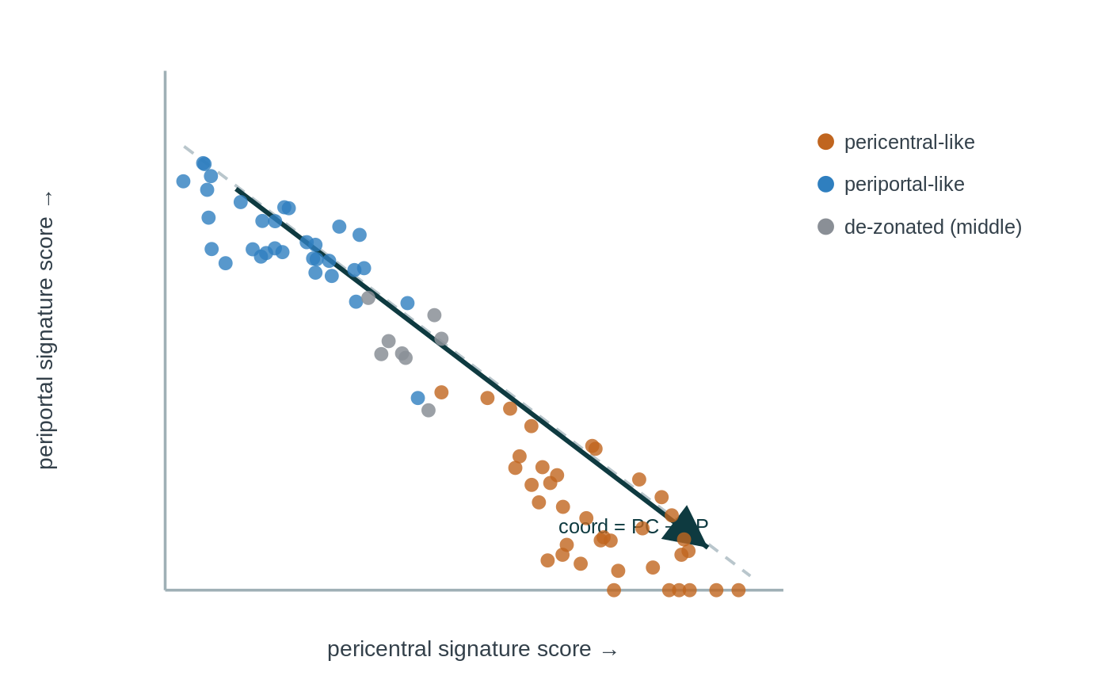
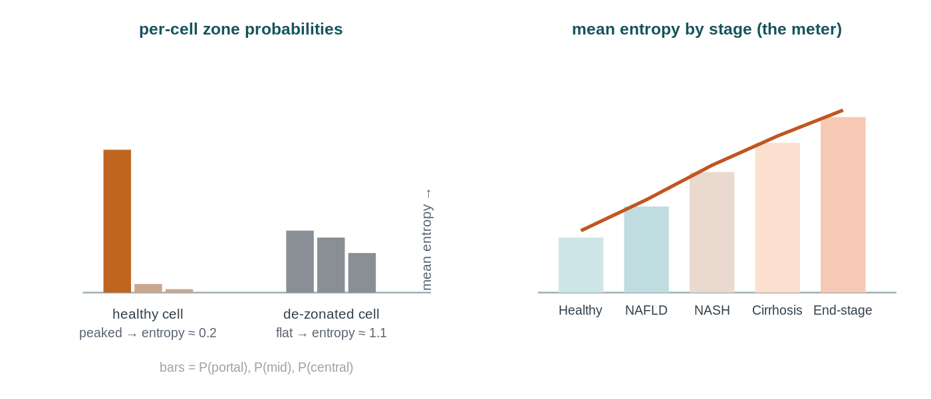
THE METHOD
How we decode position
1
Signatures
2
Coordinate
3
Classifier
4
Collapse
▶
▶
▶
pericentral & periportal gene sets — landmark & full, compared
score = mean_z(PC) − mean_z(PP) per cell
zone probabilities → entropy = confusion = de-zonation
one metric per donor, tested across stages

Slide 7
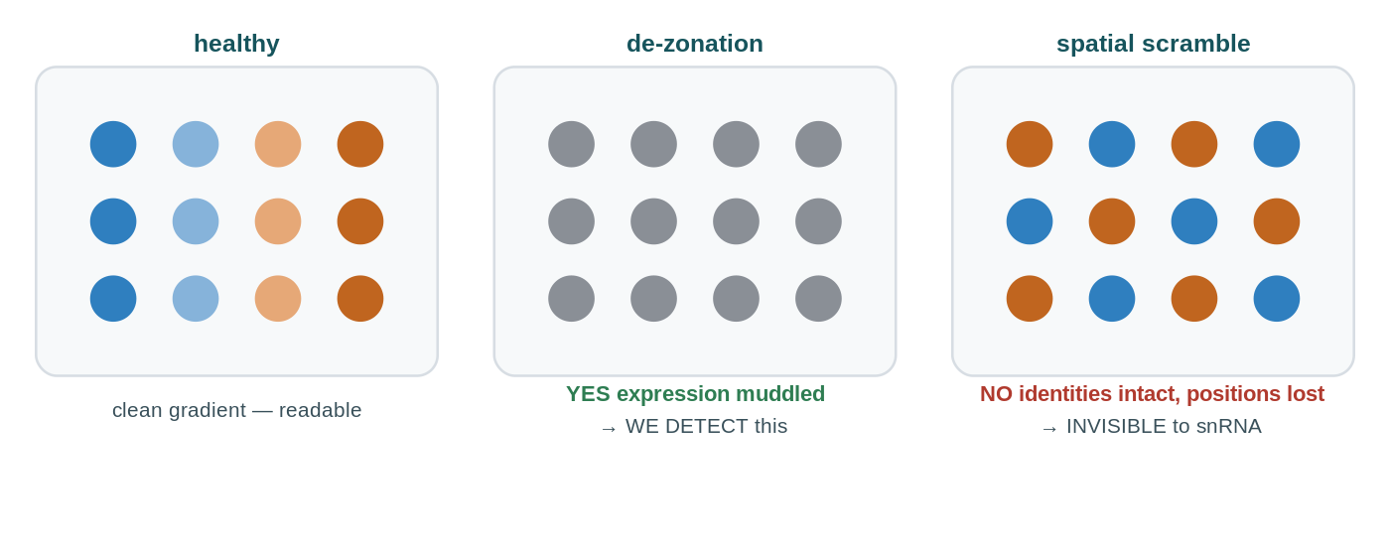
WHY IT HOLDS UP
Doing it honestly
Negative control. Shuffle the disease-stage labels and re-run: the collapse trend must VANISH. A 'signal' that survives shuffling was an artefact. (The positive control — recovering zonation in healthy liver — is the previous slide.)
What de-zonation is — and isn't
IS — loss of the expression program: pericentral–periportal mutual exclusivity weakens and the coordinate spread narrows.
ISN'T — physical spatial scrambling with intact expression: dissociated data couldn't see it, and it's very unlikely here.
Donor-level inference (no pseudoreplication) and held-out-gene / circularity guards underpin every test — details in backup.

Slide 8
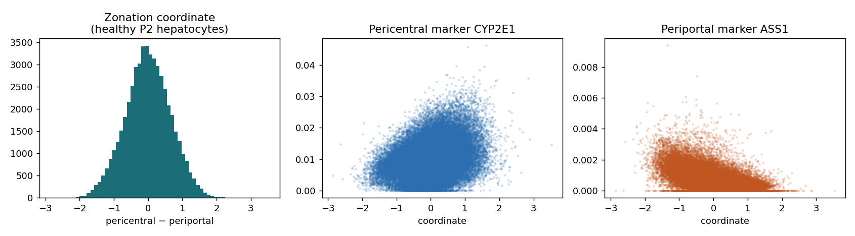
POSITIVE CONTROL
✓ DONE — REAL DATA
The ruler works on healthy liver
On real Paper 2 healthy hepatocytes the coordinate recovers zonation: pericentral CYP2E1 rises with it and periportal ASS1 falls.
A single broad central hump is exactly what a continuum looks like — the proof of zonation is the marker slopes, not two peaks. We validated before trusting it on disease.

Slide 9
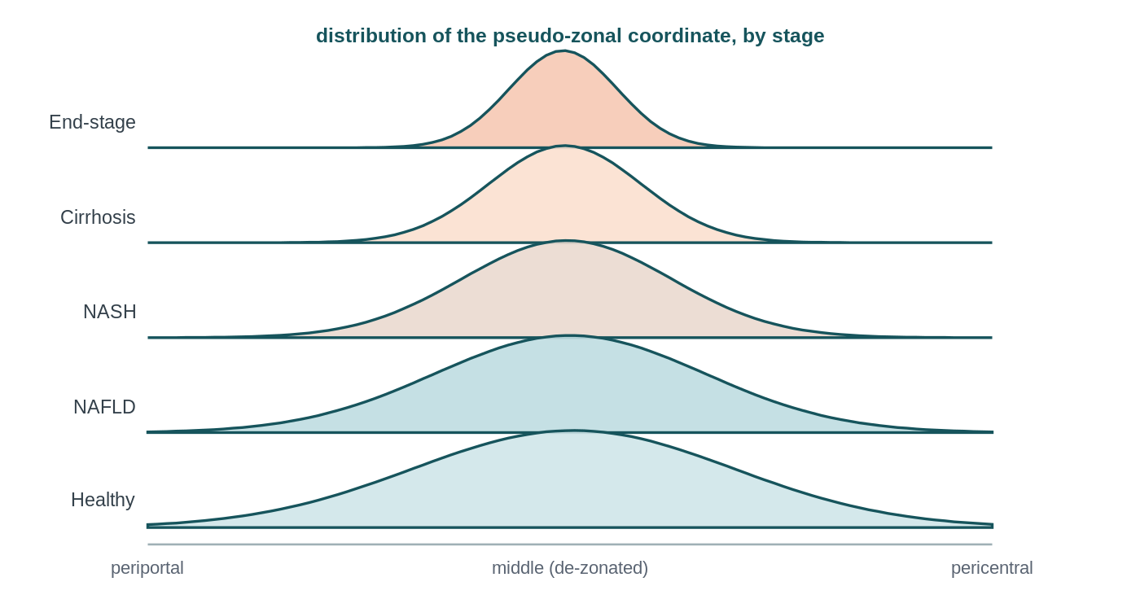
RESULT
TO FILL AFTER HACKATHON
H1 — Does zonation collapse across stages?
What to look for
Coordinate spread NARROWS and pericentral–periportal anti-correlation weakens toward 0 across stages.
We found: ___
[fill: ρ, donor-bootstrap 95% CI, permutation p]
plot_a6_collapse · pipeline.py:collapse
EXPECTED SHAPE — swap for real A6

Slide 10
RESULT
TO FILL AFTER HACKATHON
H2 — Which programs collapse, and where?
FIGURE GOES HERE Volcano per zone (portal / central): effect vs −log10 q plot_a7_volcano · signature genes flagged
What to look for
A coherent set of genes at q<0.05 — surviving EXCLUSION of the signature genes — concentrated in one zone first.
We found: ___
[fill: # genes q<0.05 per zone; name the 3–5 earliest-collapsing programs]
pipeline.py:de

Slide 11
RESULT
TO FILL AFTER HACKATHON
H3 — Are de-zonated cells the plastic ones?
FIGURE GOES HERE Stage-stratified scatter: de-zonation vs plasticity score plot_a8_plasticity · WITHIN donor/stage
What to look for
A positive within-donor link — not a pooled one (late disease trivially has more of both).
We found: ___
[fill: mean per-donor ρ; OLS dez coefficient controlling stage+donor]
pipeline.py:plasticity

Slide 12
WHAT WE CAN'T CLAIM
Limitations & honest scope
• Blind to pure spatial scrambling — if cells keep identity but move, dissociated data sees nothing. • Pseudo-zonal, not (x,y) — a 1-D reconstructed coordinate, never a true position. • Ruler-validity matters — disease may corrupt the marker genes; Step 5b checks whether the ruler still holds. • Associational — we measure collapse, not its cause.

Slide 13
Conclusions
TO FILL AFTER HACKATHON
H1 — [did zonation collapse, and how monotonically? ___]
H2 — [which programs eroded first, and in which zone? ___]
H3 — [did de-zonation track plasticity, within donors? ___]
One-line takeaway: a reference-decoder turns the many spatially-blind disease atlases into a quantitative readout of how liver identity disintegrates. [refine with results]

Slide 14
Thank you — questions?
Roee · Shira | Computational Genomics 76553 (backup slides follow)

Slide 15
BACKUP
TO FILL AFTER HACKATHON
Is the ruler still a ruler? (validity battery)
FIGURE GOES HERE Per-stage: internal coherence · cross-program anti-corr · split-half · program-off vs restriction-lost plot_a5b_ruler (Step 5b)

Slide 16
BACKUP
TO FILL AFTER HACKATHON
Classifier — held-out confusion matrix (Paper 2)
FIGURE GOES HERE Confusion matrix + held-out accuracy on Paper 2 before applying to Paper 1 Step 4b · calibrated multinomial logistic regression

Slide 17
BACKUP
Statistical rigor — the checklist
BH-FDR q<0.05, never raw p
Ordered trend test, not pairwise only
Donor-level resampling (never 69k cells as independent)
Pseudobulk donor×zone DE; H2 via coordinate×stage interaction on held-out genes
Positive + negative controls
Effect sizes beside p/q

Slide 18
BACKUP
OPTIONAL — IF IT RAN
Bonus — collapse vs inherited risk (Paper 3)
FIGURE GOES HERE Hypergeometric overlap: Step-7 collapse drivers vs Paper-3 risk-variant targets, expression-matched background step9_bonus_enrichment.py · report fold + BH q

Slide 19
BACKUP
Data & reproducibility
Raw → processed: Seurat .rds → counts.mtx; MATLAB .mat → paper2_train.npz. Pipeline reads only data/processed/. Repo: src/{prep,steps,plotting,tools}, signatures/{paper2_landmark,core,expanded,sensitivity}, results/. run_all.py reproduces every figure on a clean checkout. Signatures: baseline = EXACT Paper 2 landmark set (paper2_landmark); expanded from the ranked snRNA table; core = curated.

