Slide 1
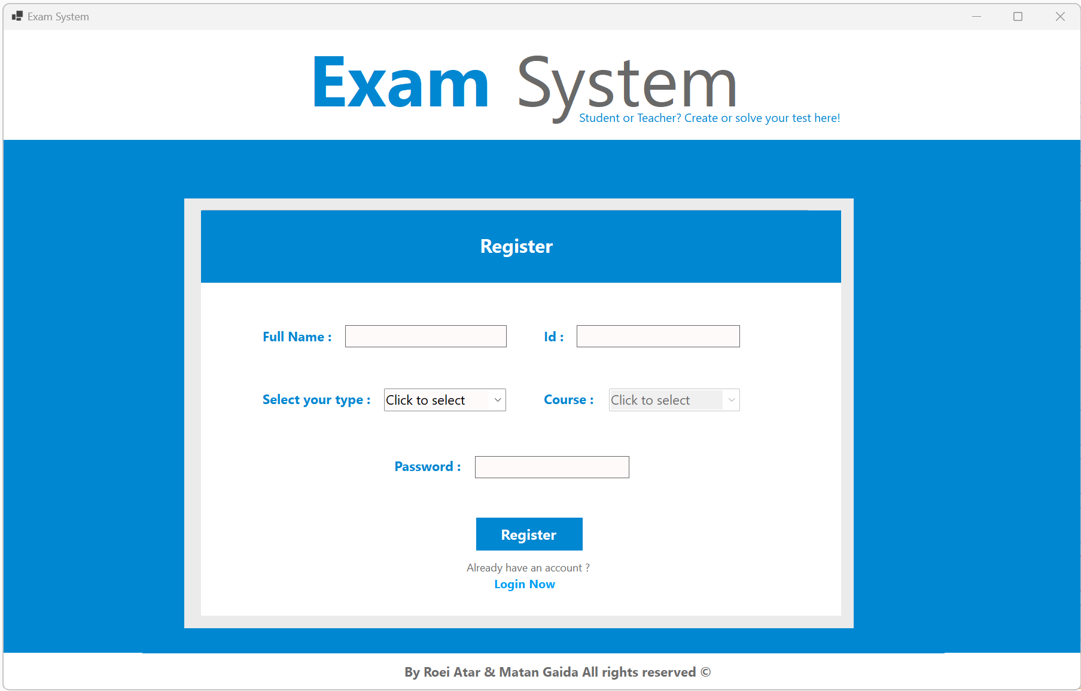
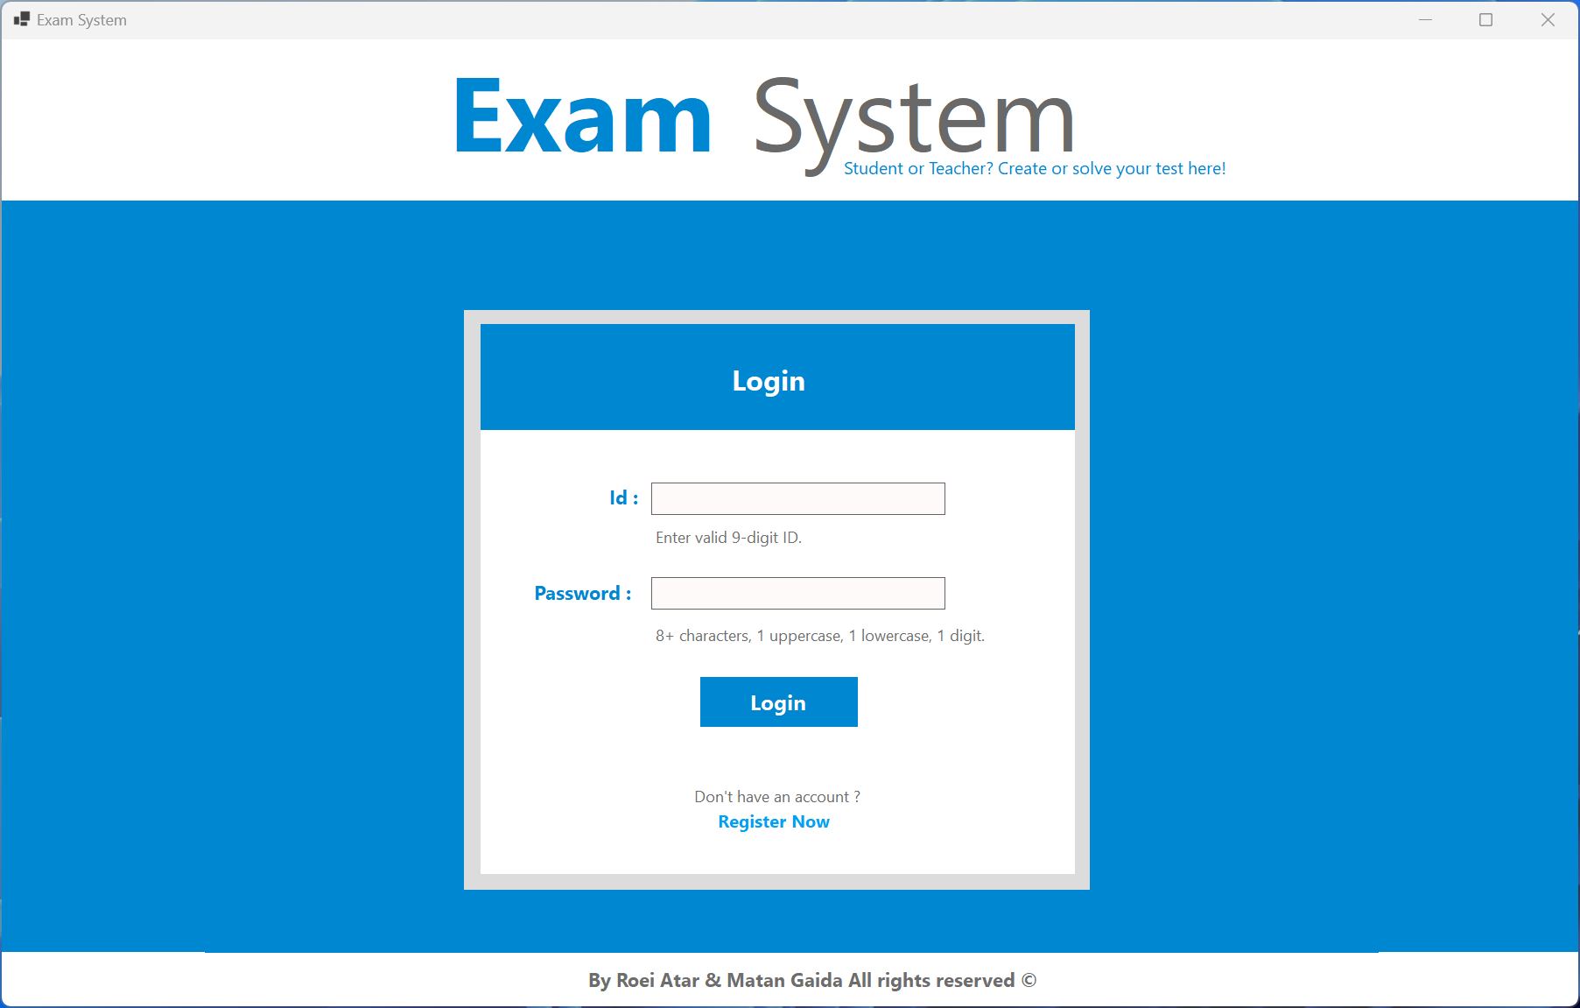
Exam System
By Roei Atar & Matan Gaida
All rights reserved ©

Slide 2
About
This project is about managing a test interface for both teachers and students.
For each of the users, the application provides different options with the help of different management screens.
The Teacher has the options of creating, saving, editing, updating and deleting tests within a database.
In addition, he has the option to see statistical data for the test he has chosen.
Student can search and solve an exam And see result of finished exams.

Slide 3
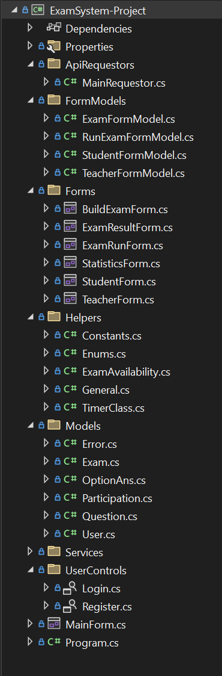
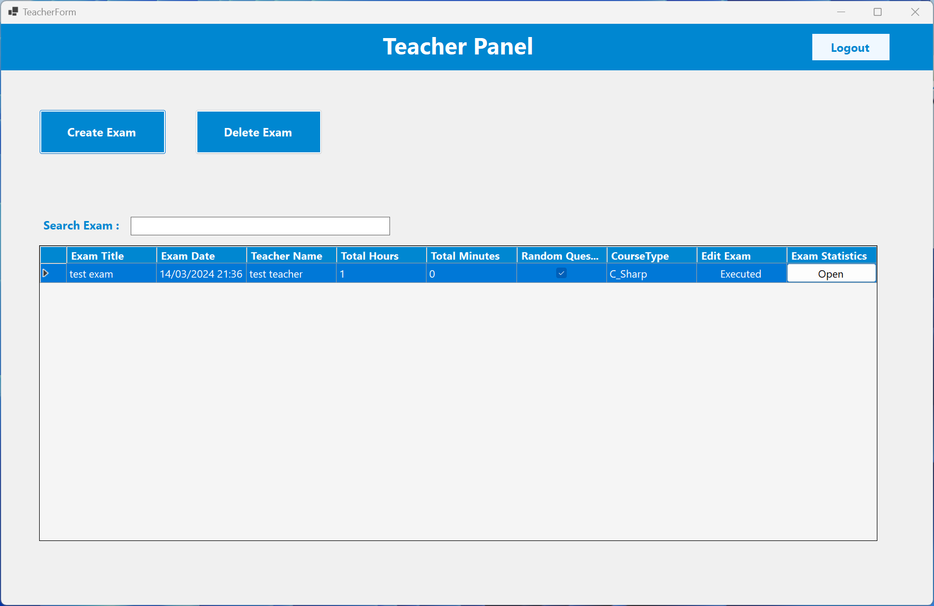
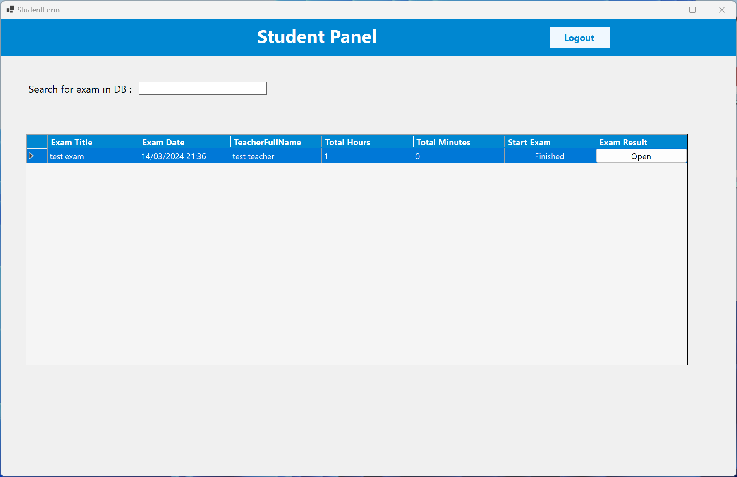
General structure
Client Side
Windows form application .NET framework 6.0
Forms :
BuildExamForm.cs
ExamResultForm.cs
ExamRunForm.cs
StatisticsForm.cs
StudentForm.cs
TeacherForm.cs
HttpRequestor :
MainRequestor.cs
Helpers :
Constants.cs
Enums.cs
ExamAvailability.cs
General.cs
TimerClass.cs
Models :
Error.cs
Exam.cs
OptionAns.cs
Participation.cs
Question.cs
User.cs
UserControls :
Login.cs
Register.cs
FormModels :
ExamFormModel.cs
RunExamFormModel.cs
StudentFormModel.cs
TeacherFormModel.cs

Slide 4
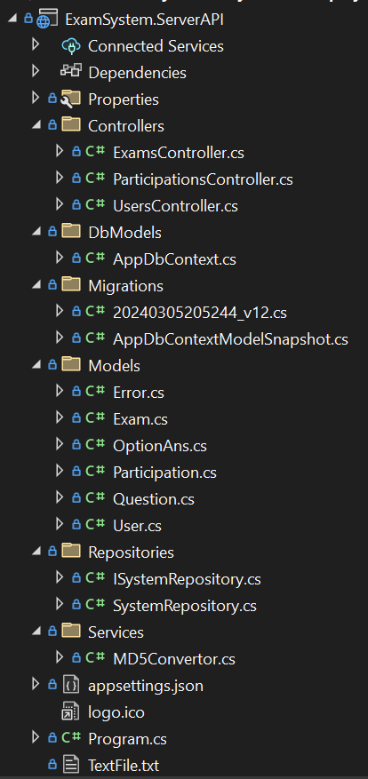
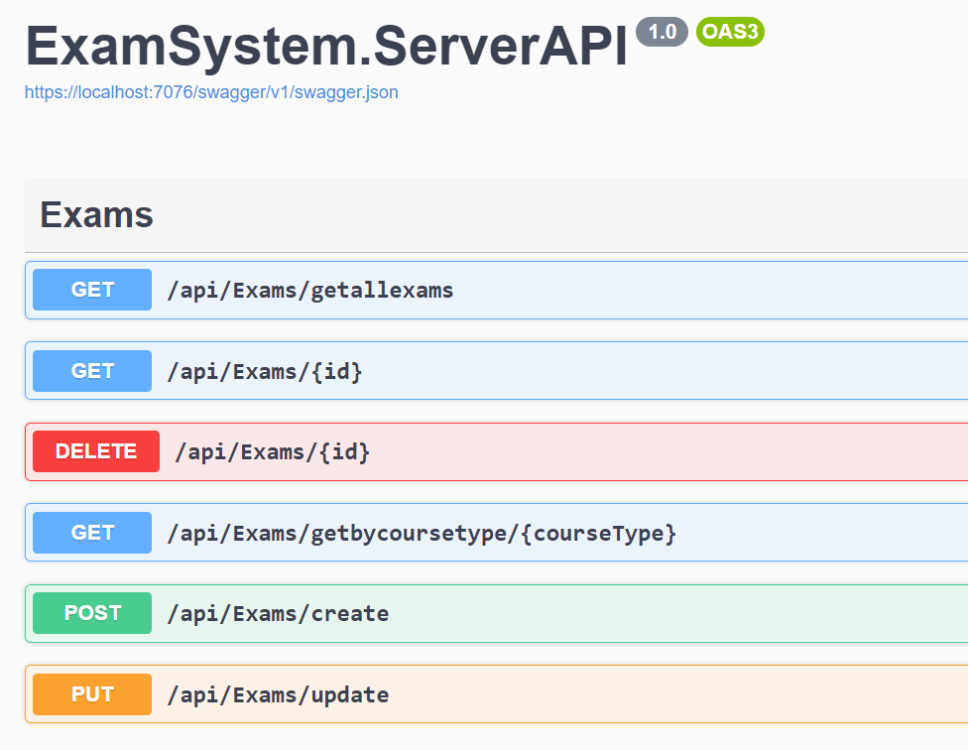
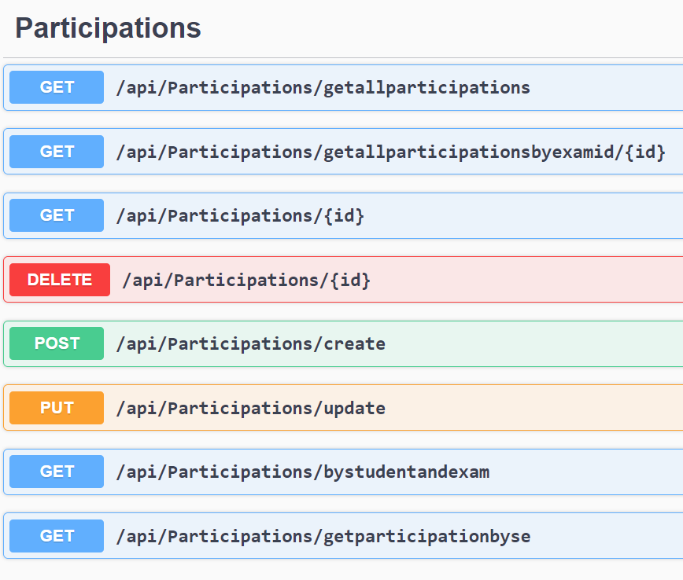
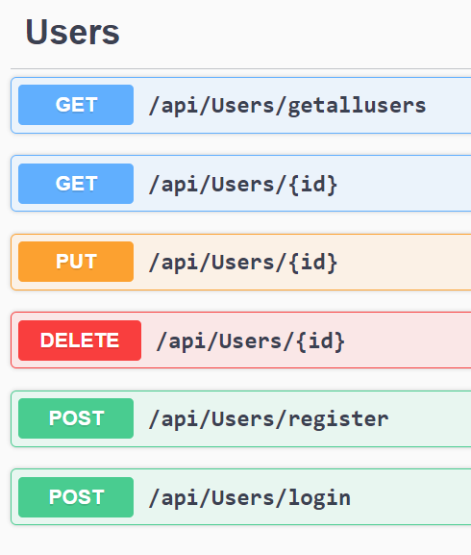
General structure
Server Side
ASP .NET WEB API SERVER
Models :
Error.cs
Exam.cs
OptionAns.cs
Participation.cs
Question.cs
User.cs
Repositories :
SystemRepository.cs
Interfaces :
ISystemRepository.cs
DbModels :
AppDbContext.cs
Services :
MD5Convertor.cs
Controllers :
ExamsController.cs
ParticipationsController.cs
UsersController.cs

Slide 5


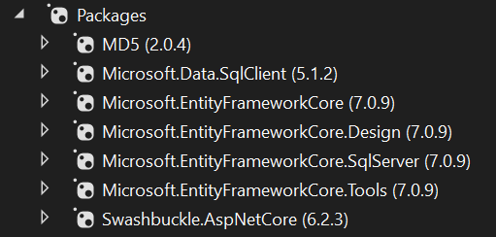
Frameworks & Nuget Technologies
ogies
Client :
For the client side we used the following Frameworks as required:
Server :
In the server side we used
all necessary NuGet packages for accessing and working with a database

Slide 6
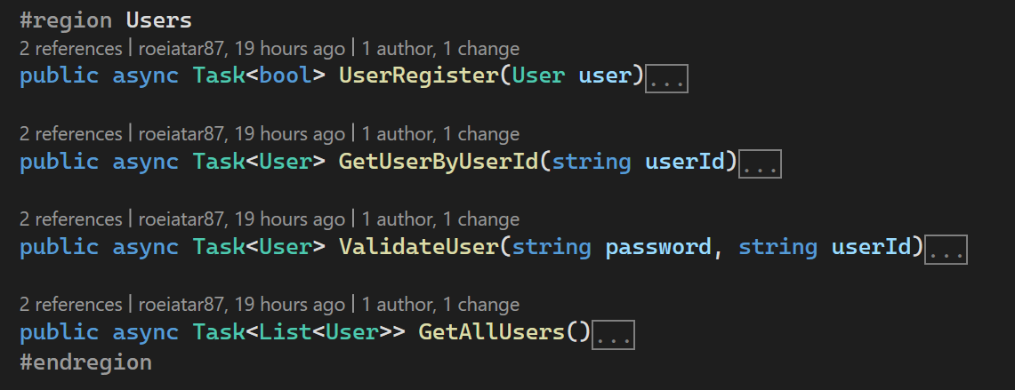
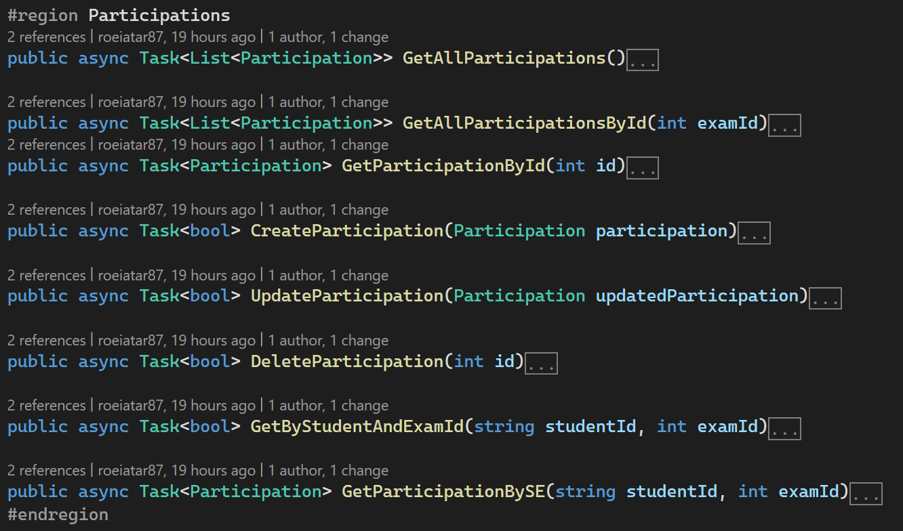
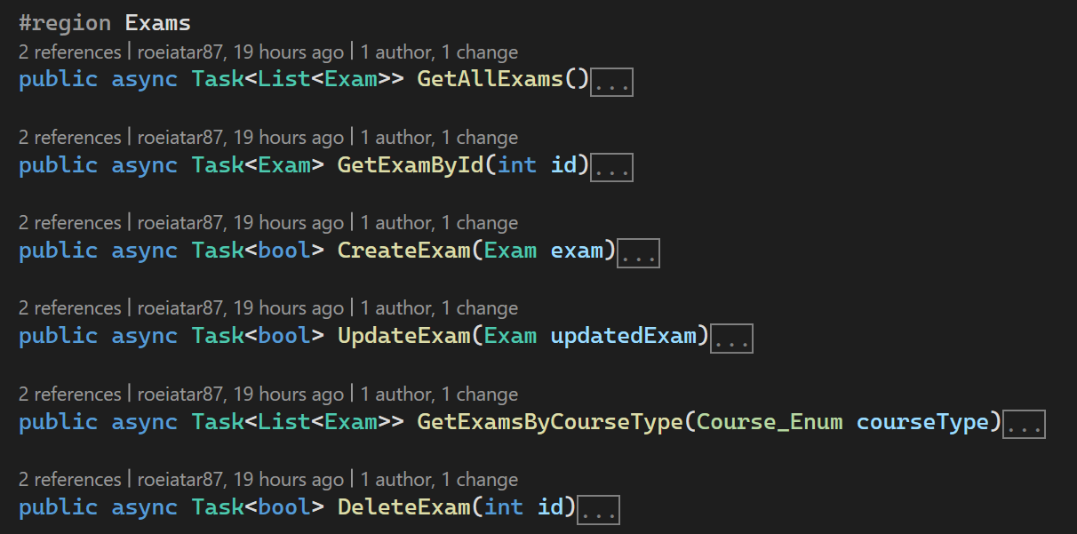
List of API functions for accessing server
Users
SystemRepository functions
Participations
Exams

Slide 7
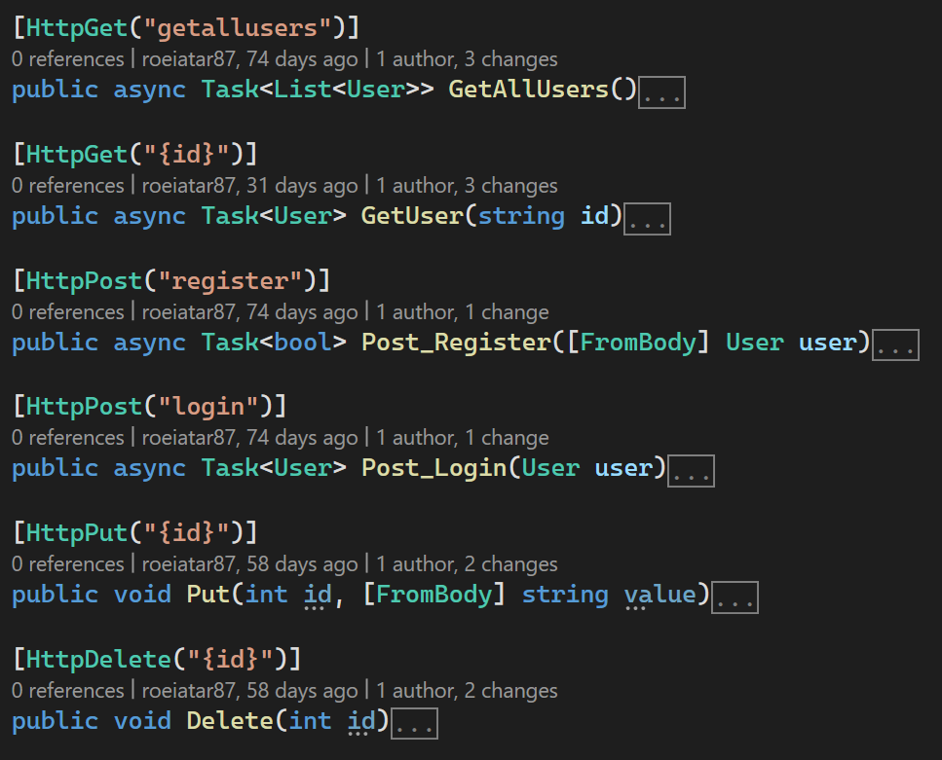
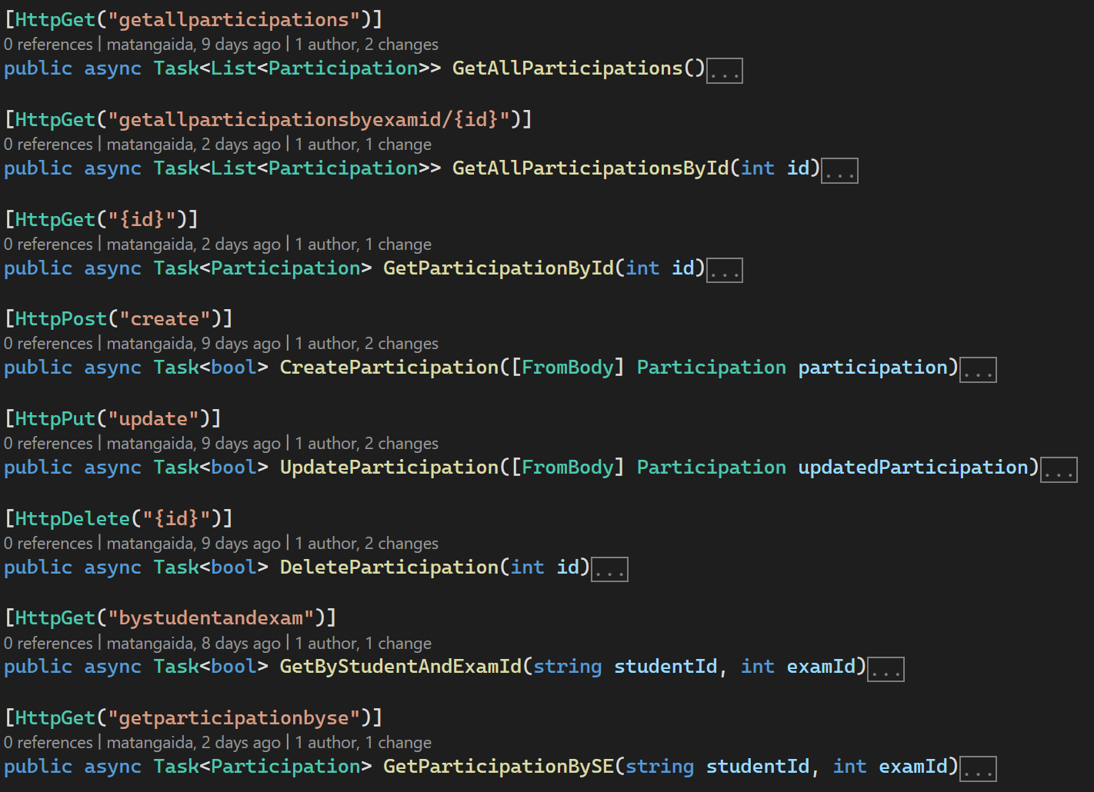
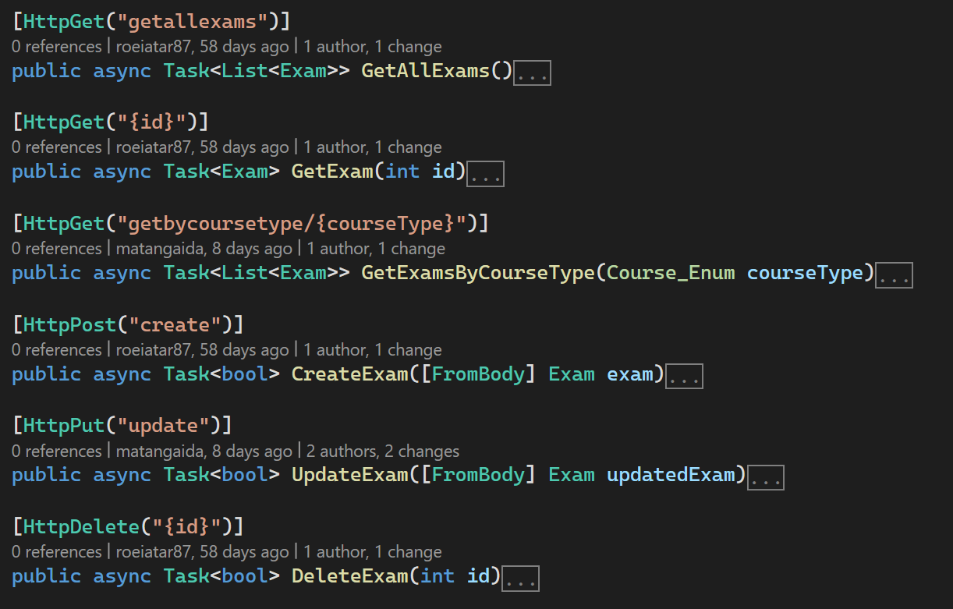
List of API functions for accessing server
Controllers functions
Users
Participations
Exams

Slide 8
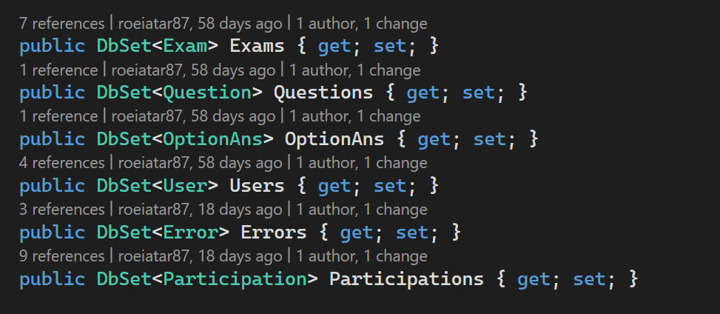
Tables definitions in the AppDbContext
In addition to these definitions, there is also the definition of the relationships between the tables:
one Exam has -many Questions.
one Question has - many Answers.
one Exam has - many Participations.
one Participation has – many Errors.

Slide 9
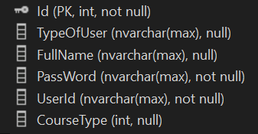
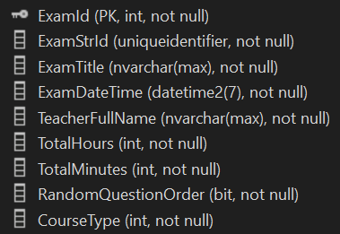
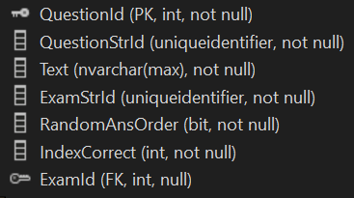
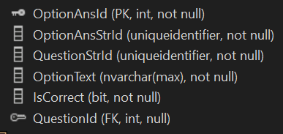
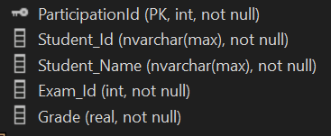
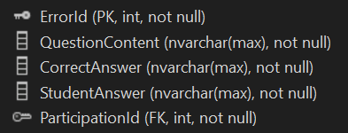
Users
Tables and columns in the database
Exams
Questions
OptionAns
Participations
Errors

Slide 10
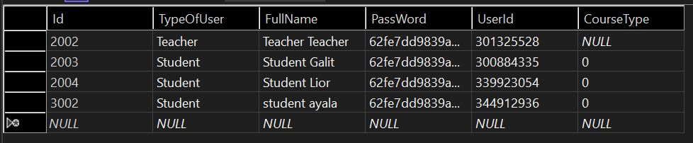
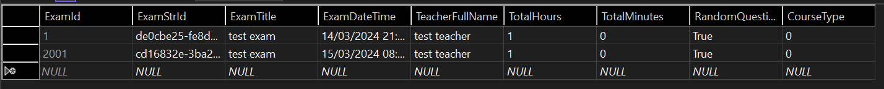
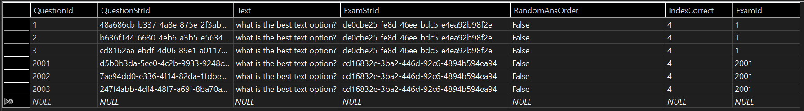
Tables and columns in the database - screenshots
Users
Exams
Questions

Slide 11
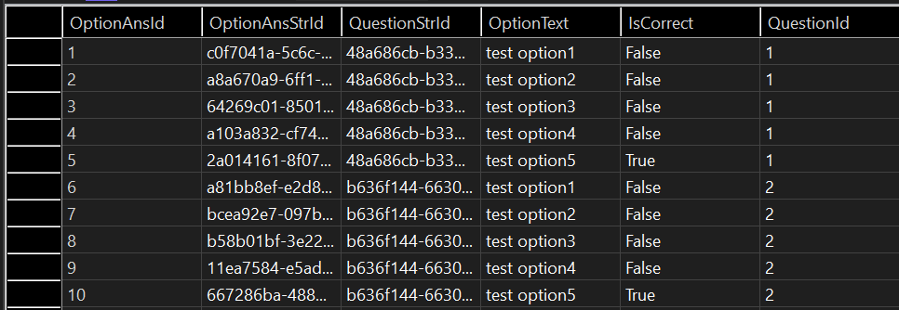
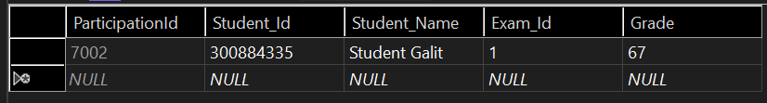
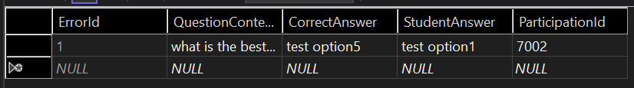
Tables and columns in the database - screenshots
OptionAns
Participations
Errors

Slide 12
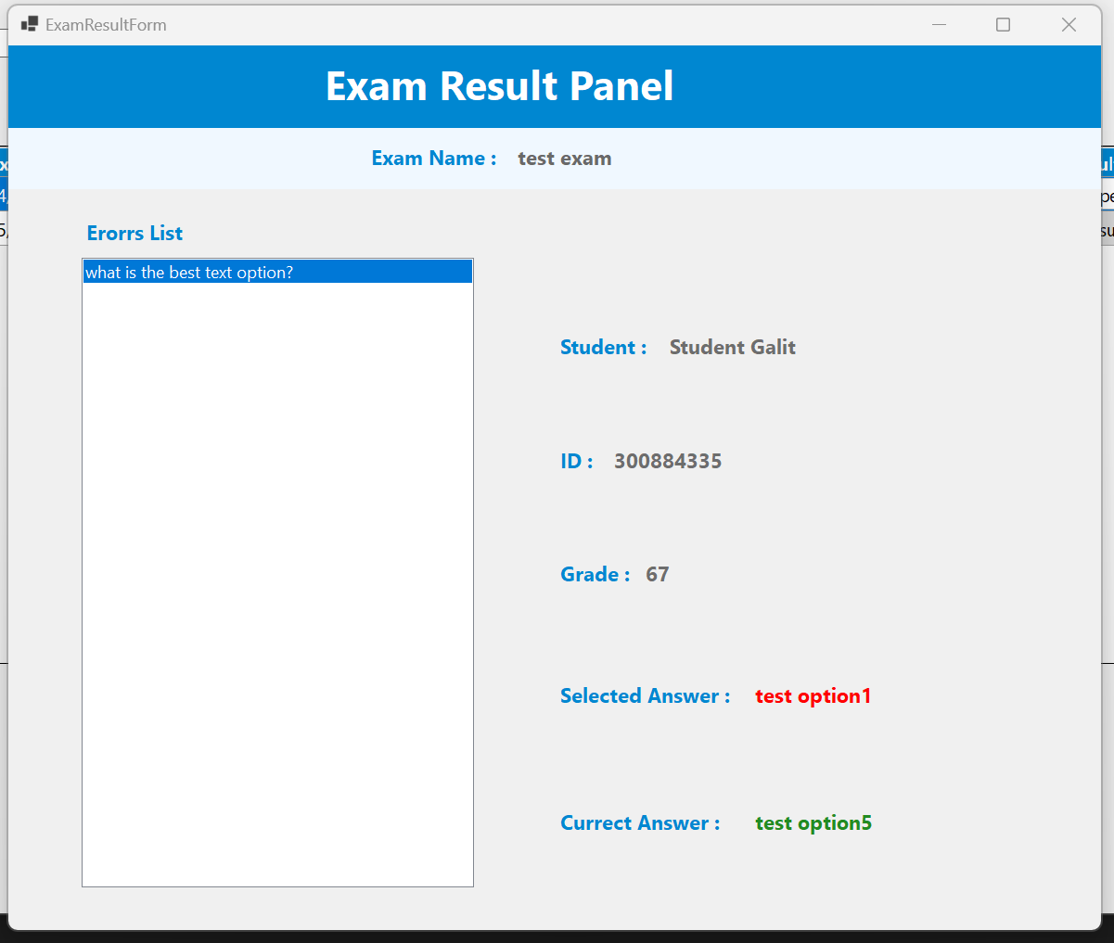
Windows screenshots - Student
Student Panel
Exam Result

Slide 13
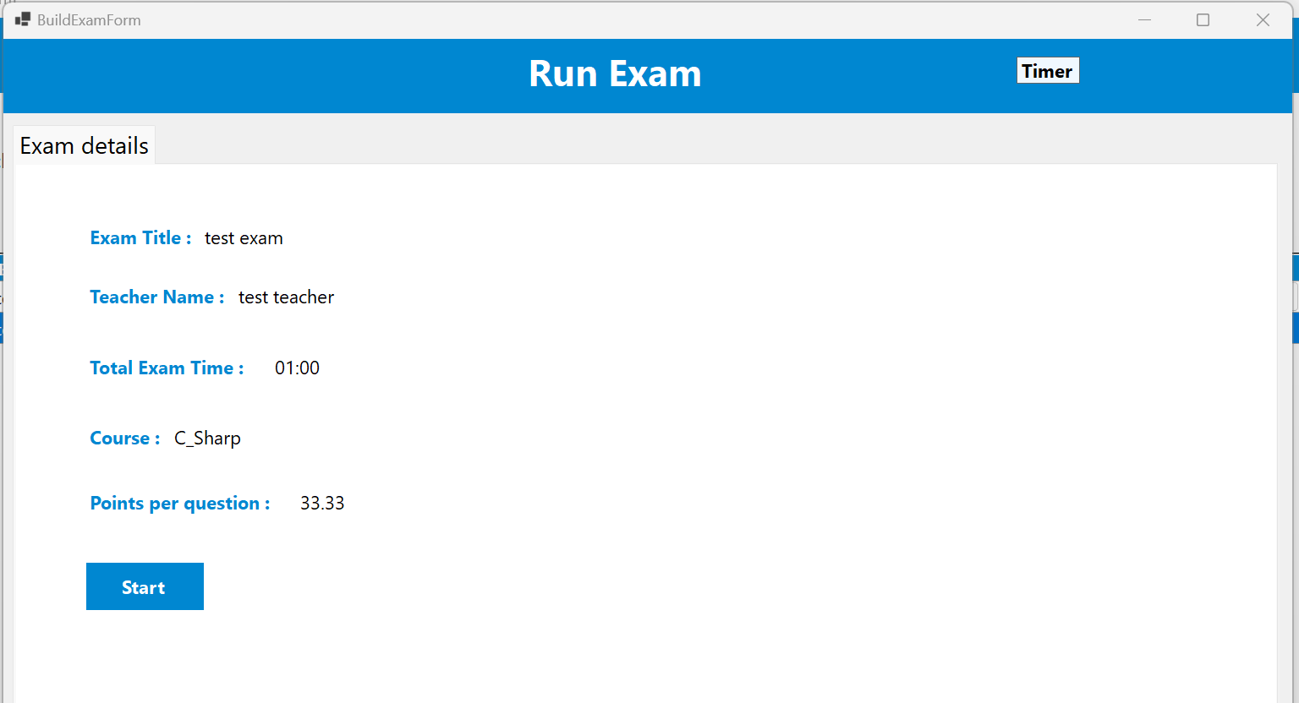
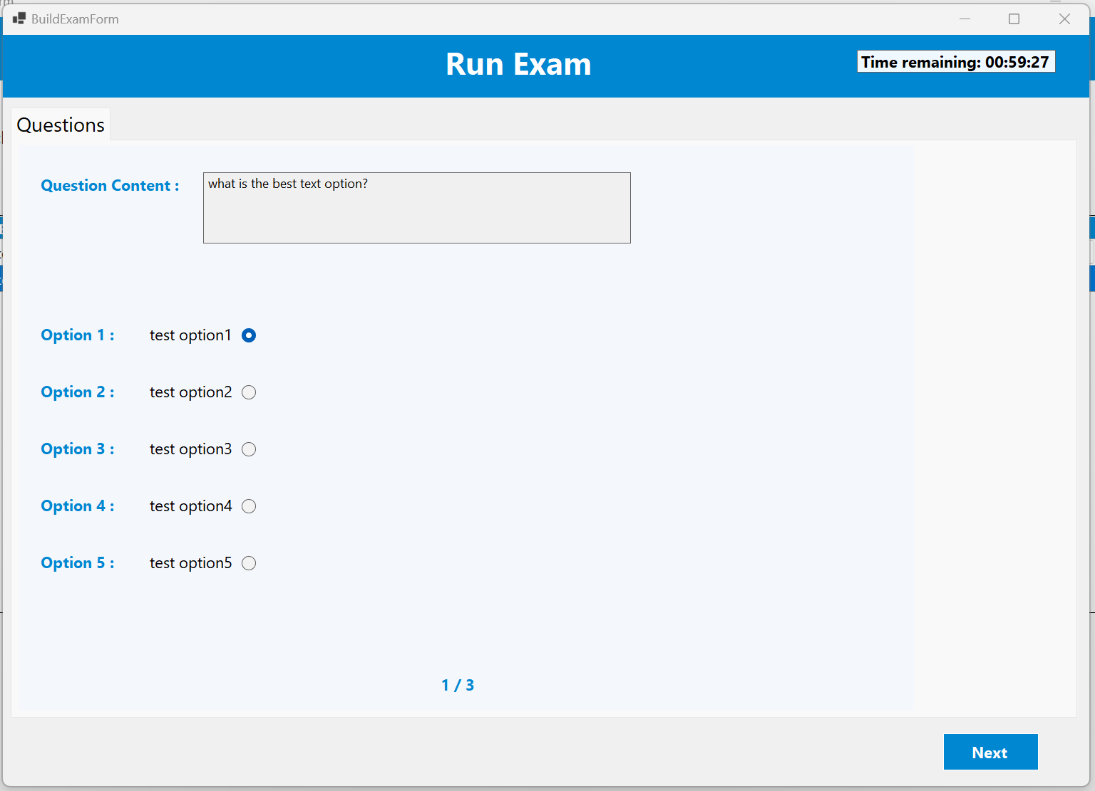
Windows screenshots - Student
Exam details
Questions

Slide 14
Windows screenshots - Teacher
Teacher Panel

Slide 15
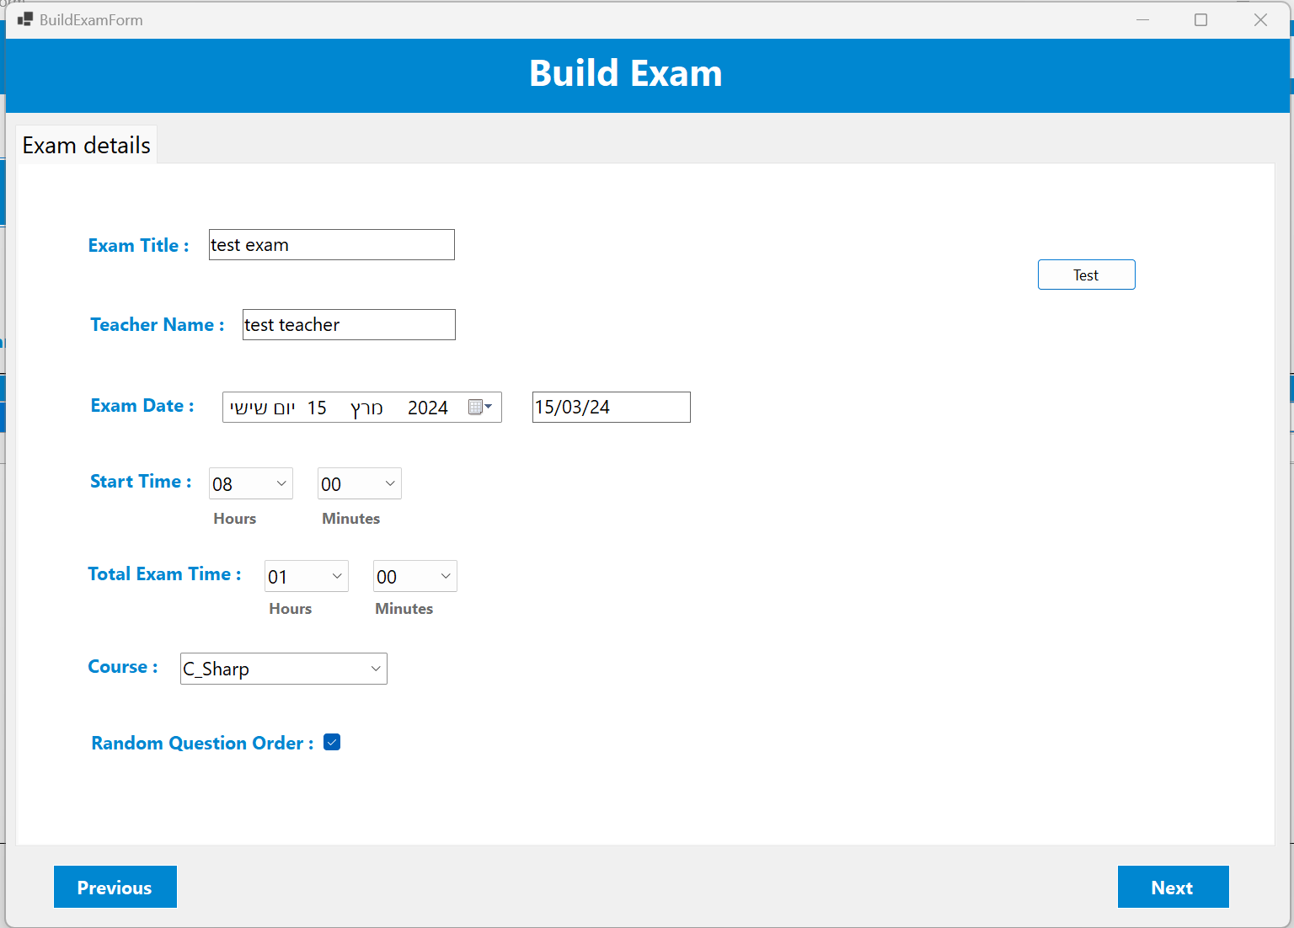
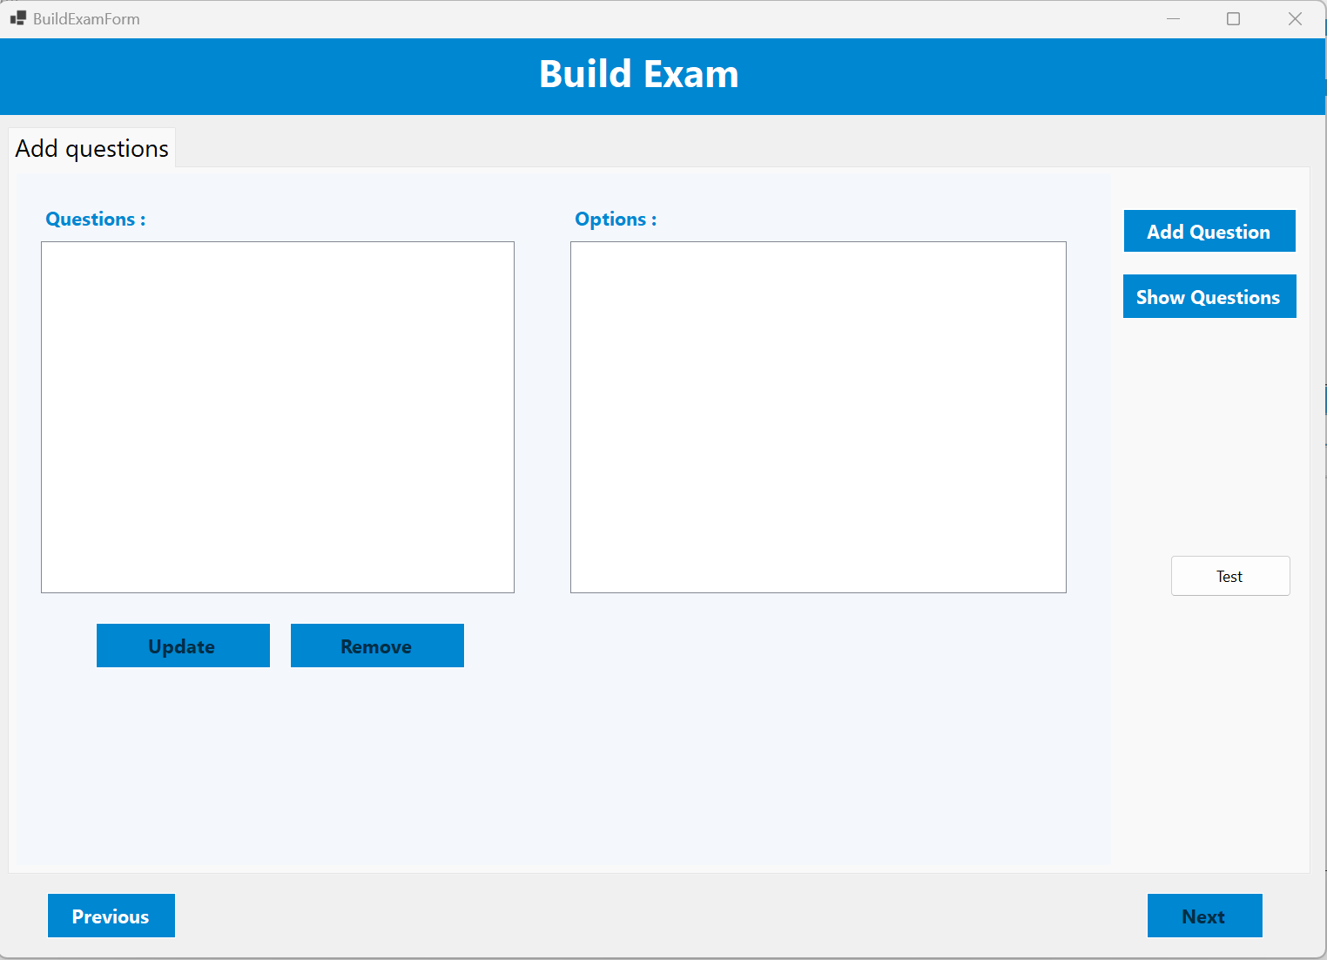
Windows screenshots - Teacher
Build Exam - details
Question list view

Slide 16
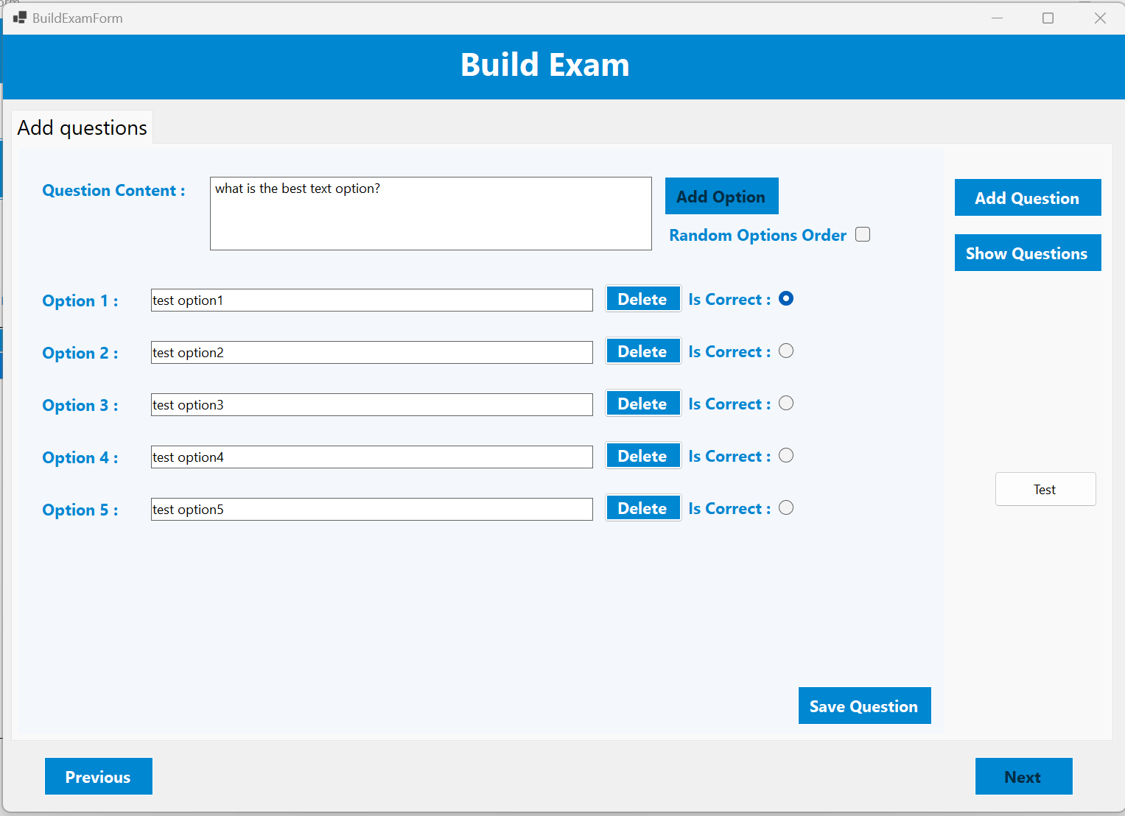
Windows screenshots - Teacher
Add Question

Slide 17
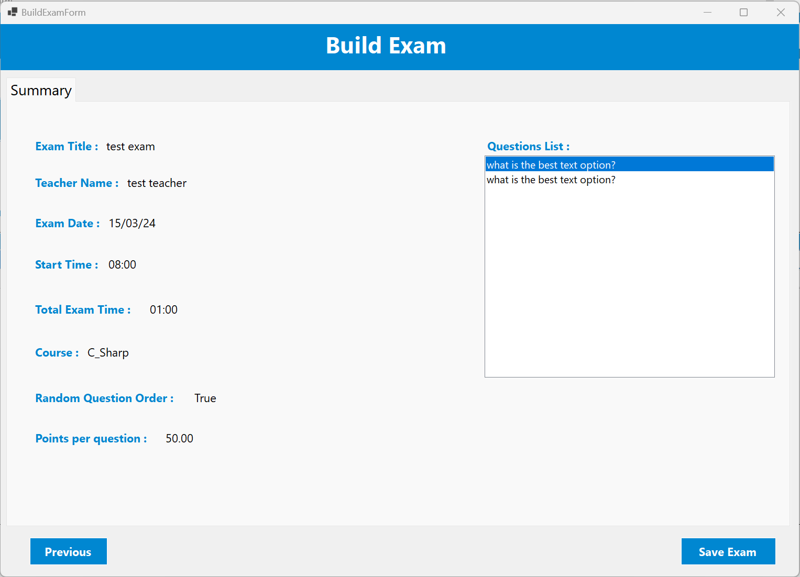
Windows screenshots - Teacher
Summery

Slide 18
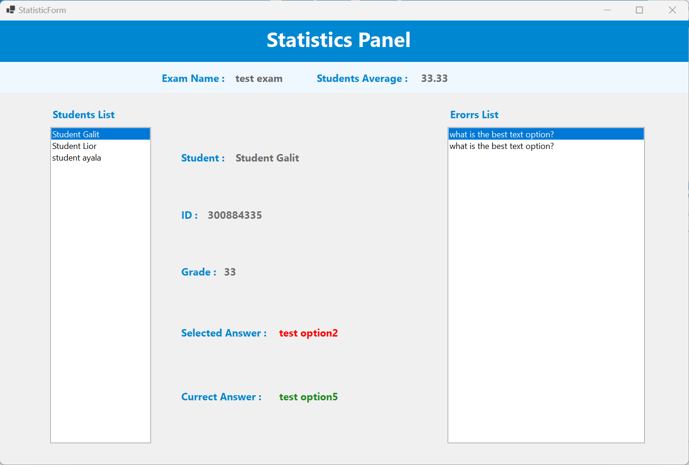
Windows screenshots - Teacher
Statistics Panel

Slide 19
Windows screenshots - Teacher
Statistics Panel

Slide 20
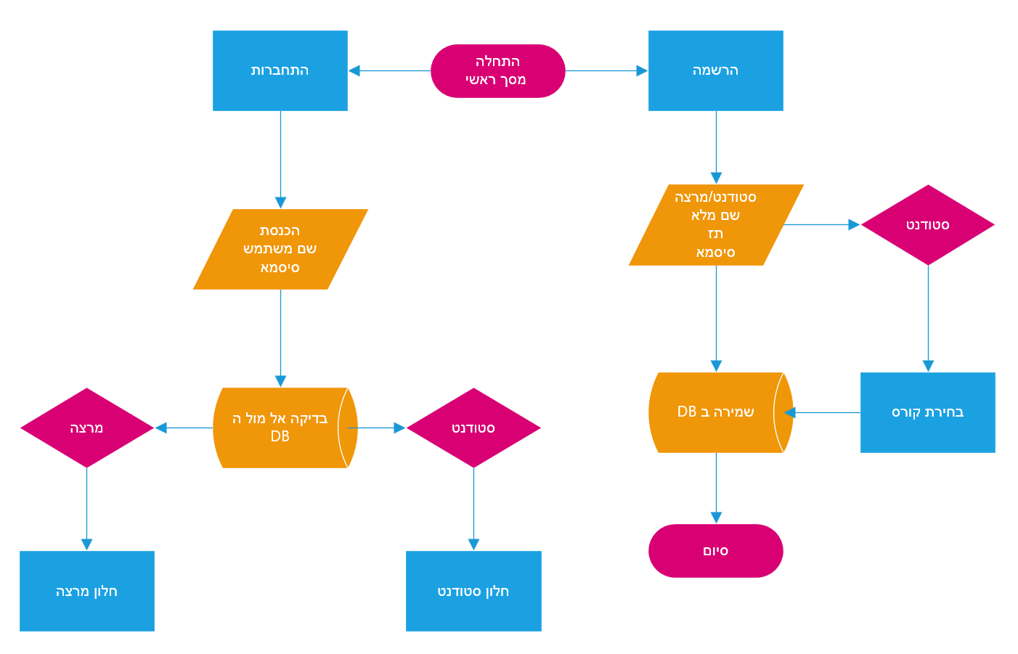
Main data flow

Slide 21
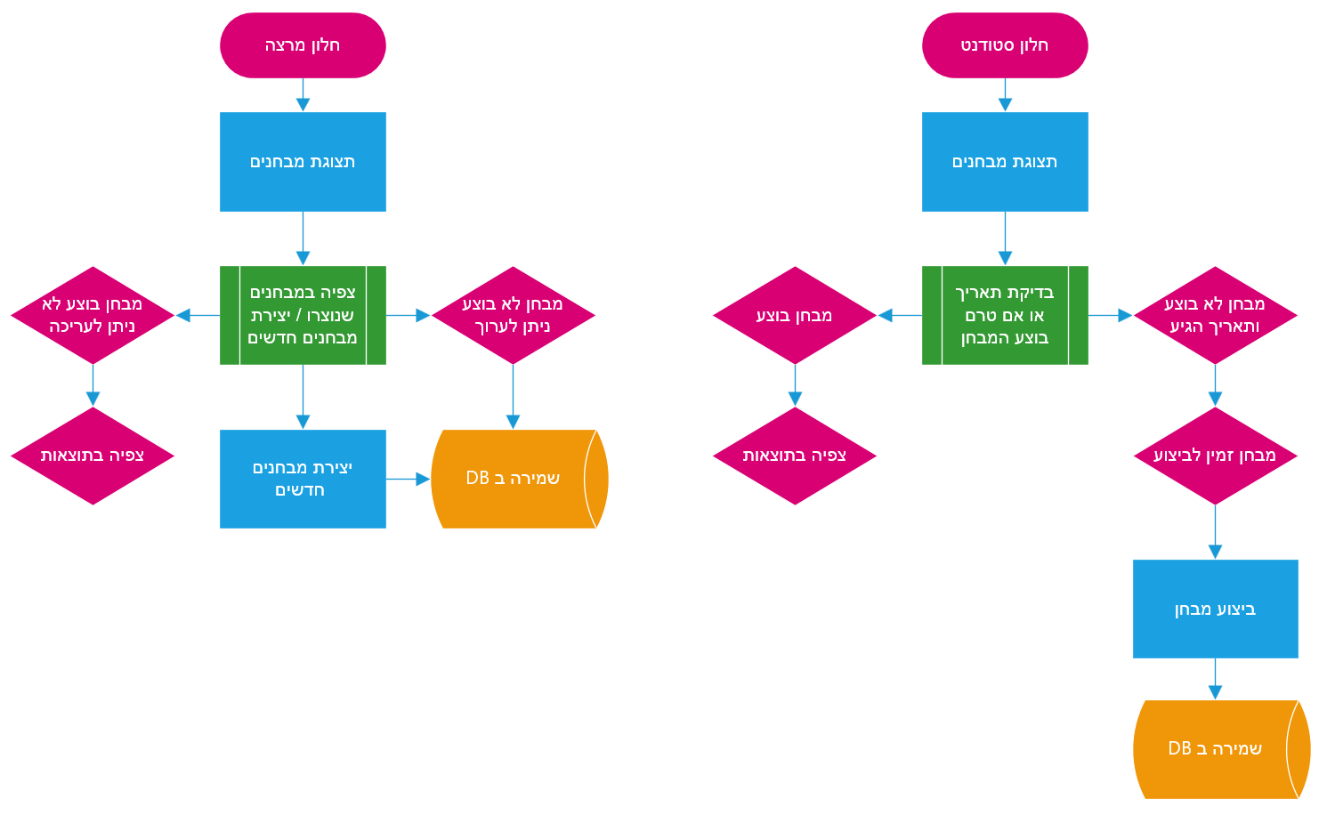
Student & Teacher data flow

Slide 22
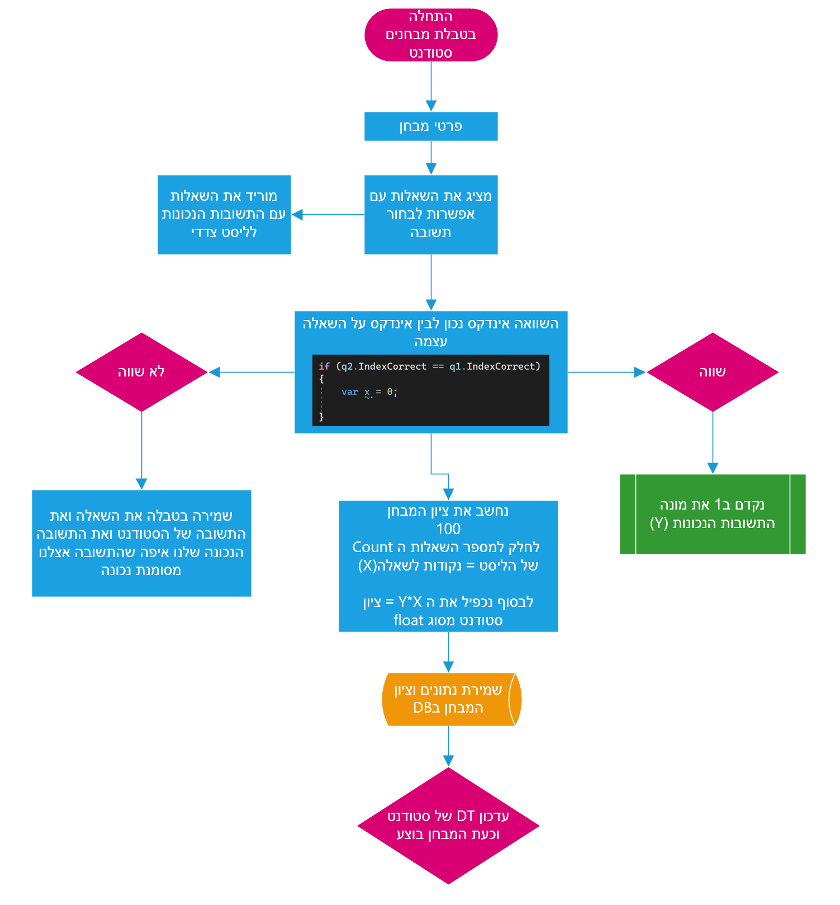
Run Exam data flow

Slide 23
THANK YOU
By Roei Atar & Matan Gaida
All rights reserved ©

