Slide 1


Real Health Kombucha
Raw · Vegan · Probiotic
Handcrafted in Madeira, made for your menu
A partnership proposal for restaurants · Roel & Nina
Notes:
Welcome. We're Roel and Nina, and we brew Real Health Kombucha here in Madeira. In the next 15 minutes: who we are, how we brew, our flavours, who already serves us, how ordering works, and what it earns you.

Slide 2
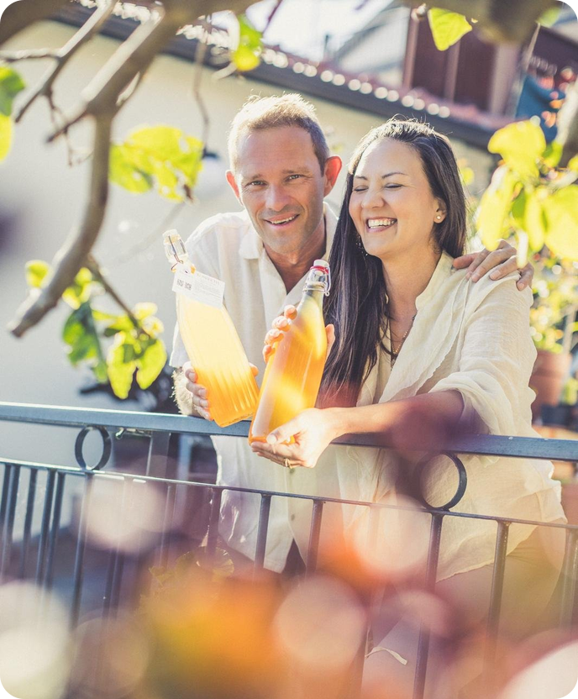



Meet Roel & Nina
We are a couple living in Ponta do Sol, Madeira, who believe that what you drink every day should make you feel good.
What started as a home experiment in our kitchen grew into a small-batch kombucha brewery. Every bottle is still brewed, flavoured and bottled by the two of us, and delivered personally.
Ponta do Sol, Madeira
Brewed locally on the island
Small batches, by hand
Brewed and bottled by Roel & Nina
Delivered personally
We bring it, and collect your empties
Notes:
DRAFT: adjust to your own story. Introduce yourselves: background, why Madeira, why health matters to you both.

Slide 3
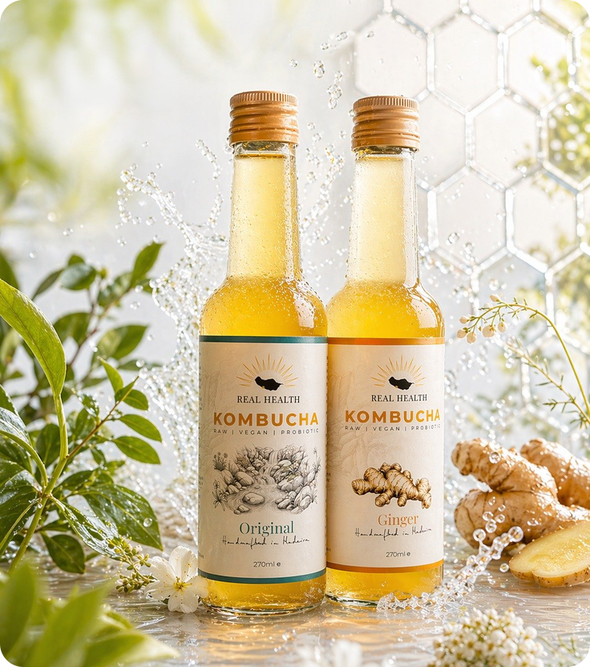



It all started with our water
We changed our drinking water
We installed a drinking-water filter at home, with a UMH Pure Gold fitted after the last filter stage: a gold-plated device with a rock crystal inside that energises and restructures the filtered water. No power, no magnets.
We tasted the difference
Softer, cleaner and fresher. Our tea, coffee and everything we made with it tasted better.
Then came kombucha
Kombucha is more than 95% water, so great water makes great kombucha. Friends kept asking for bottles, and Real Health Kombucha was born.
Notes:
DRAFT: rewrite in your own words. The facts used here come from the label spec: water filtered through activated carbon and structured with the UMH Pure Gold device (consciousspaces.com, fitted after the last filter stage; 24k gold-plated brass with a rock crystal, no power or magnets). Keep to the process description (no health claims about the structured water) to stay in line with EC Regulation 1924/2006.

Slide 4




From pure water to living drink
1 Pure water
2 Green tea brew
3 Fermentation
4 Flavour & bottle
Filtered drinking water, energised and structured by our UMH Pure Gold device.
Green tea (Camellia sinensis) steeped and sweetened with raw cane sugar.
The SCOBY culture ferments the tea in glass jars and eats most of the sugar.
Fresh juices, roots and herbs are added; a second fermentation makes it naturally sparkling.
Raw & unpasteurised
Live cultures
Naturally sparkling
Vegan
< 0.5% vol
Notes:
Walk through the four production steps. Mention fermentation time and batch size if you want to (check your Production tab in the app for real numbers).

Slide 5






A drink your guests feel good about
Live cultures
Raw and unpasteurised, full of the living bacteria and yeasts from fermentation.
Antioxidants
Green tea polyphenols, which research links to protection against cell damage.
Gut friendly
Studies associate fermented drinks with a more diverse gut flora.
Less sugar
Most of the sugar is consumed during fermentation. A lighter alternative to soft drinks.
Alcohol-free choice
Naturally below 0.5% vol, an adult drink for guests who skip alcohol.
Clean & vegan
Only water, tea, cane sugar, culture and real fruit, roots and herbs.
Based on published research on kombucha and fermented foods. Not a medical claim.
Notes:
Keep the wording soft ('research suggests', 'associated with'). EU rules (EC 1924/2006) don't allow health claims on the product itself, so don't print these on menus.

Slide 6







Seven flavours, all made with real ingredients
Pure green tea kombucha, bright and mellow
Warming with a zesty bite
Sunny, juicy and smooth
Crisp and thirst-quenching
Two sizes
1 L bottle · €8.00
+ €2 deposit, refunded on return
270 ml bottle · €3.50
+ €1 deposit, refunded on return
Fresh, aromatic island citrus
Golden, tangy and earthy
Grapefruit, lemon, mint, ginger, cinnamon
Notes:
Bring tasting samples of 2-3 flavours. Original, Ginger and Wild Orange are good starters for a first order.

Slide 7
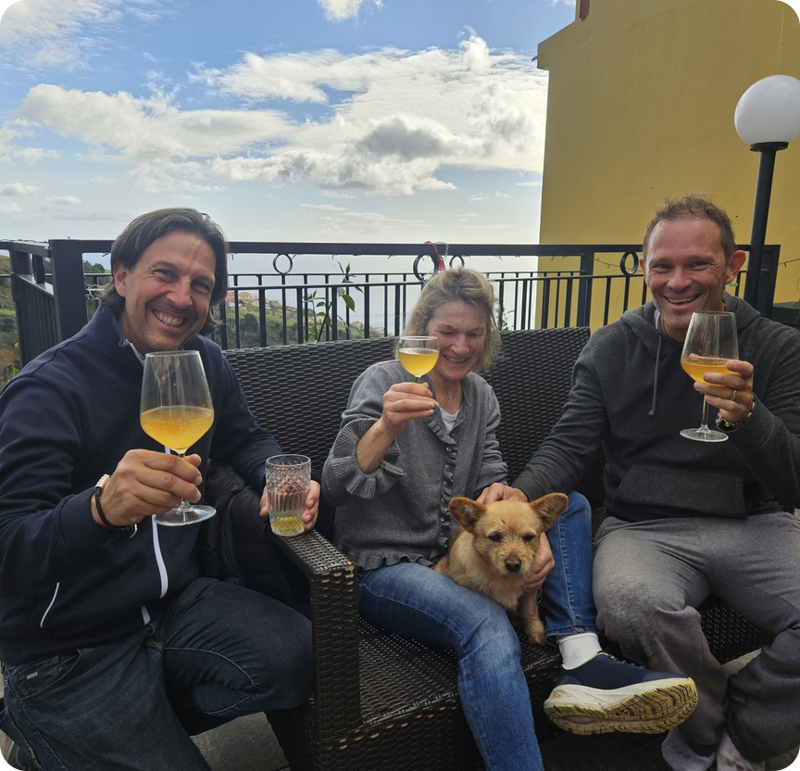

Already on the menu across Madeira
8 restaurants & cafés already serve Real Health Kombucha
Sun Spot
Palm Spot
Koa Spot
Vegan World
Casa Velha do Palheiro
Casa Velha Tea House
Balancal
Buddha & Sakura
Notes:
If possible, mention which flavours sell best at the venue you're pitching to, or a quote from one of these partners.

Slide 8

What guests say about us on Google
5.0
★★★★★
37 Google reviews, every one of them 5 stars
Some of the best kombucha I’ve had anywhere … First had it at the beach cafe … and then had to buy my own bottles.
Absolutely delicious, authentic and raw (by FAR the best kombucha we have ever had).
David W. ★★★★★
Hannah R. ★★★★★
Super refreshing, lightly fizzy, and incredibly delicious. You can immediately taste the superior quality.
Well-balanced, sweet, and surprisingly bubbly!
Most-loved flavours
Ginger
Wild Orange
Metabolic Boost
Julia C. ★★★★★
Theresa ★★★★★
I regularly get Metabolic Boost and Wild Orange ones but they’re all top notch. Perfect balance of sparkle too.
Best Kombucha not only on Madeira but all of Portugal, maybe even the world.
Stevie Z. ★★★★★
Annika F. ★★★★★
Notes:
Source: Google Maps reviews for Real Health Kombucha (5.0 stars, 37 reviews), read on 27 October 2026. Quotes are verbatim, shortened with '…'; reviewers shown by first name and last initial. David's review is the strongest point for restaurants: he discovered us at a beach café in Ponta do Sol and then became a direct customer.

Slide 9






Reordering takes 30 seconds in our app
One-tap reorder
Your last order is pre-filled; adjust and send.
Scan to sign up
New order
1 L Ginger
× 4
We're notified instantly
Every order reaches us by WhatsApp and email.
1 L Wild Orange
× 3
English or Portuguese
Your staff use whichever language they prefer.
270 ml Lime
× 12
270 ml Original
× 12
Order history
See what you ordered and when it was delivered.
Create your account
We activate it
Order anytime
Pre-filled with your last order
Send order
Recibos verdes
Download your monthly invoices straight from the app.
Works on any phone: add it to your home screen
Notes:
Demo the app live if possible: show the restaurant view, place a test order, and show the WhatsApp notification arriving.

Slide 10

By the glass, one 1 L bottle earns you up to €20
Glass | Glasses per bottle | Cost per glass | Menu price | Profit per glass | Margin | Profit per bottle
200 ml | 5 | €1.60 | €4.00 | €2.40 | 60% | €12.00
200 ml | 5 | €1.60 | €5.70 | €4.10 | 72% | €20.50
250 ml | 4 | €2.00 | €4.00 | €2.00 | 50% | €8.00
250 ml | 4 | €2.00 | €5.70 | €3.70 | 65% | €14.80
72%
margin at €5.70 per 200 ml glass
2.5×
your money back on every bottle
You pay €8.00 per 1 L bottle (+ €2 deposit, refunded on return). Margin = profit ÷ menu price. VAT not included.
Tip: serve it in 200 ml glasses over ice with a slice of fruit. It looks premium and gets you five glasses from every bottle.
Notes:
Cost per glass = €8 ÷ glasses per bottle. Margin = profit ÷ menu price. Menu prices are examples and include VAT, so the restaurant's net profit after VAT is somewhat lower.

Slide 11


Small bottles pay off from €5 on the menu
Menu price | Profit | Margin
€4.00 | €0.50 | 13%
€5.00 | €1.50 | 30%
€5.70 | €2.20 | 39%
You pay €3.50 per bottle
plus a €1 deposit that you get back when you return the empty.
Price it at €5.00–€5.70
At €4.00 there is only €0.50 left per bottle.
Notes:
The deposit is not a cost: it's refunded when the empty bottle comes back. Recommend €5.00-€5.70 as the menu price for the 270 ml bottle.

Slide 12



What a typical month could look like
Example order: 8 × 1 L bottles served in 200 ml glasses at €5.70, plus 24 × 270 ml bottles at €5.70
You spend
€148
8 × €8.00 + 24 × €3.50
Your guests spend
€365
40 glasses + 24 bottles at €5.70
Your extra profit
€217
every month, from one fridge shelf
The deposit (8 × €2 + 24 × €1 = €40) comes back to you when the empties are returned, so it's not included as a cost.
Notes:
Revenue: 8 bottles × 5 glasses × €5.70 = €228, plus 24 × €5.70 = €136.80, total €364.80. Cost: 8 × €8 + 24 × €3.50 = €148. Profit €216.80. Menu prices include VAT; adjust the example to the restaurant's size.

Slide 13
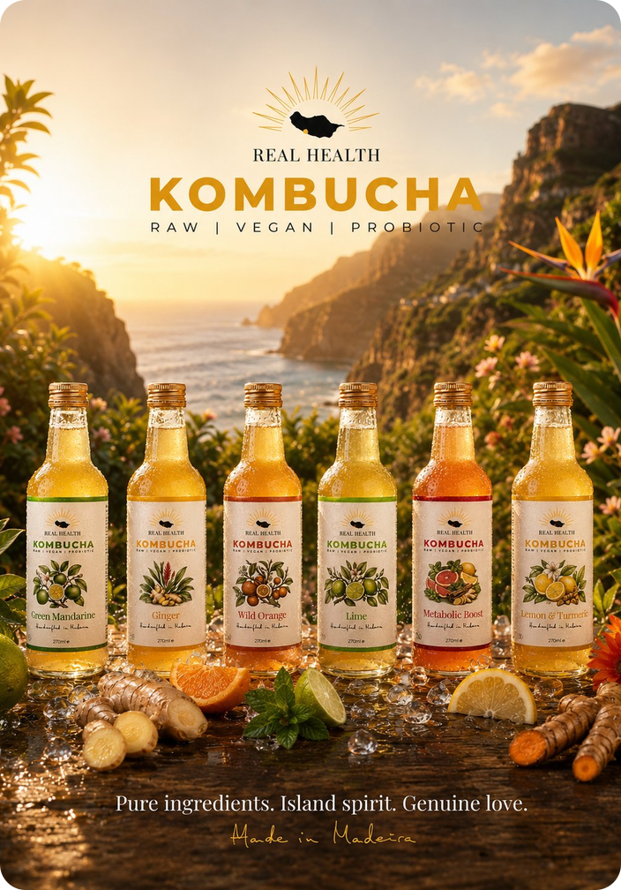





Let's put Real Health Kombucha on your menu
Personal delivery across the island
We collect your empties and refund the deposit
Easy reordering through our app
Table QR cards for reviews and bottle returns
Roel & Nina
realhealthkombucha.com
Ponta do Sol, Madeira
WhatsApp
Instagram
Notes:
Close by offering a tasting and a first trial order. Leave the app QR card and a price sheet behind.

