Slide 1
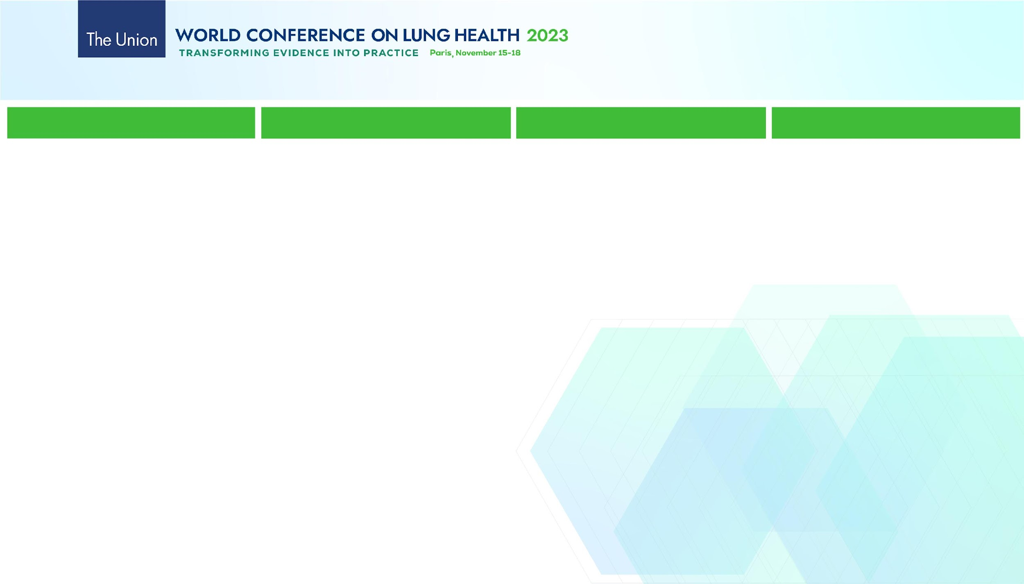
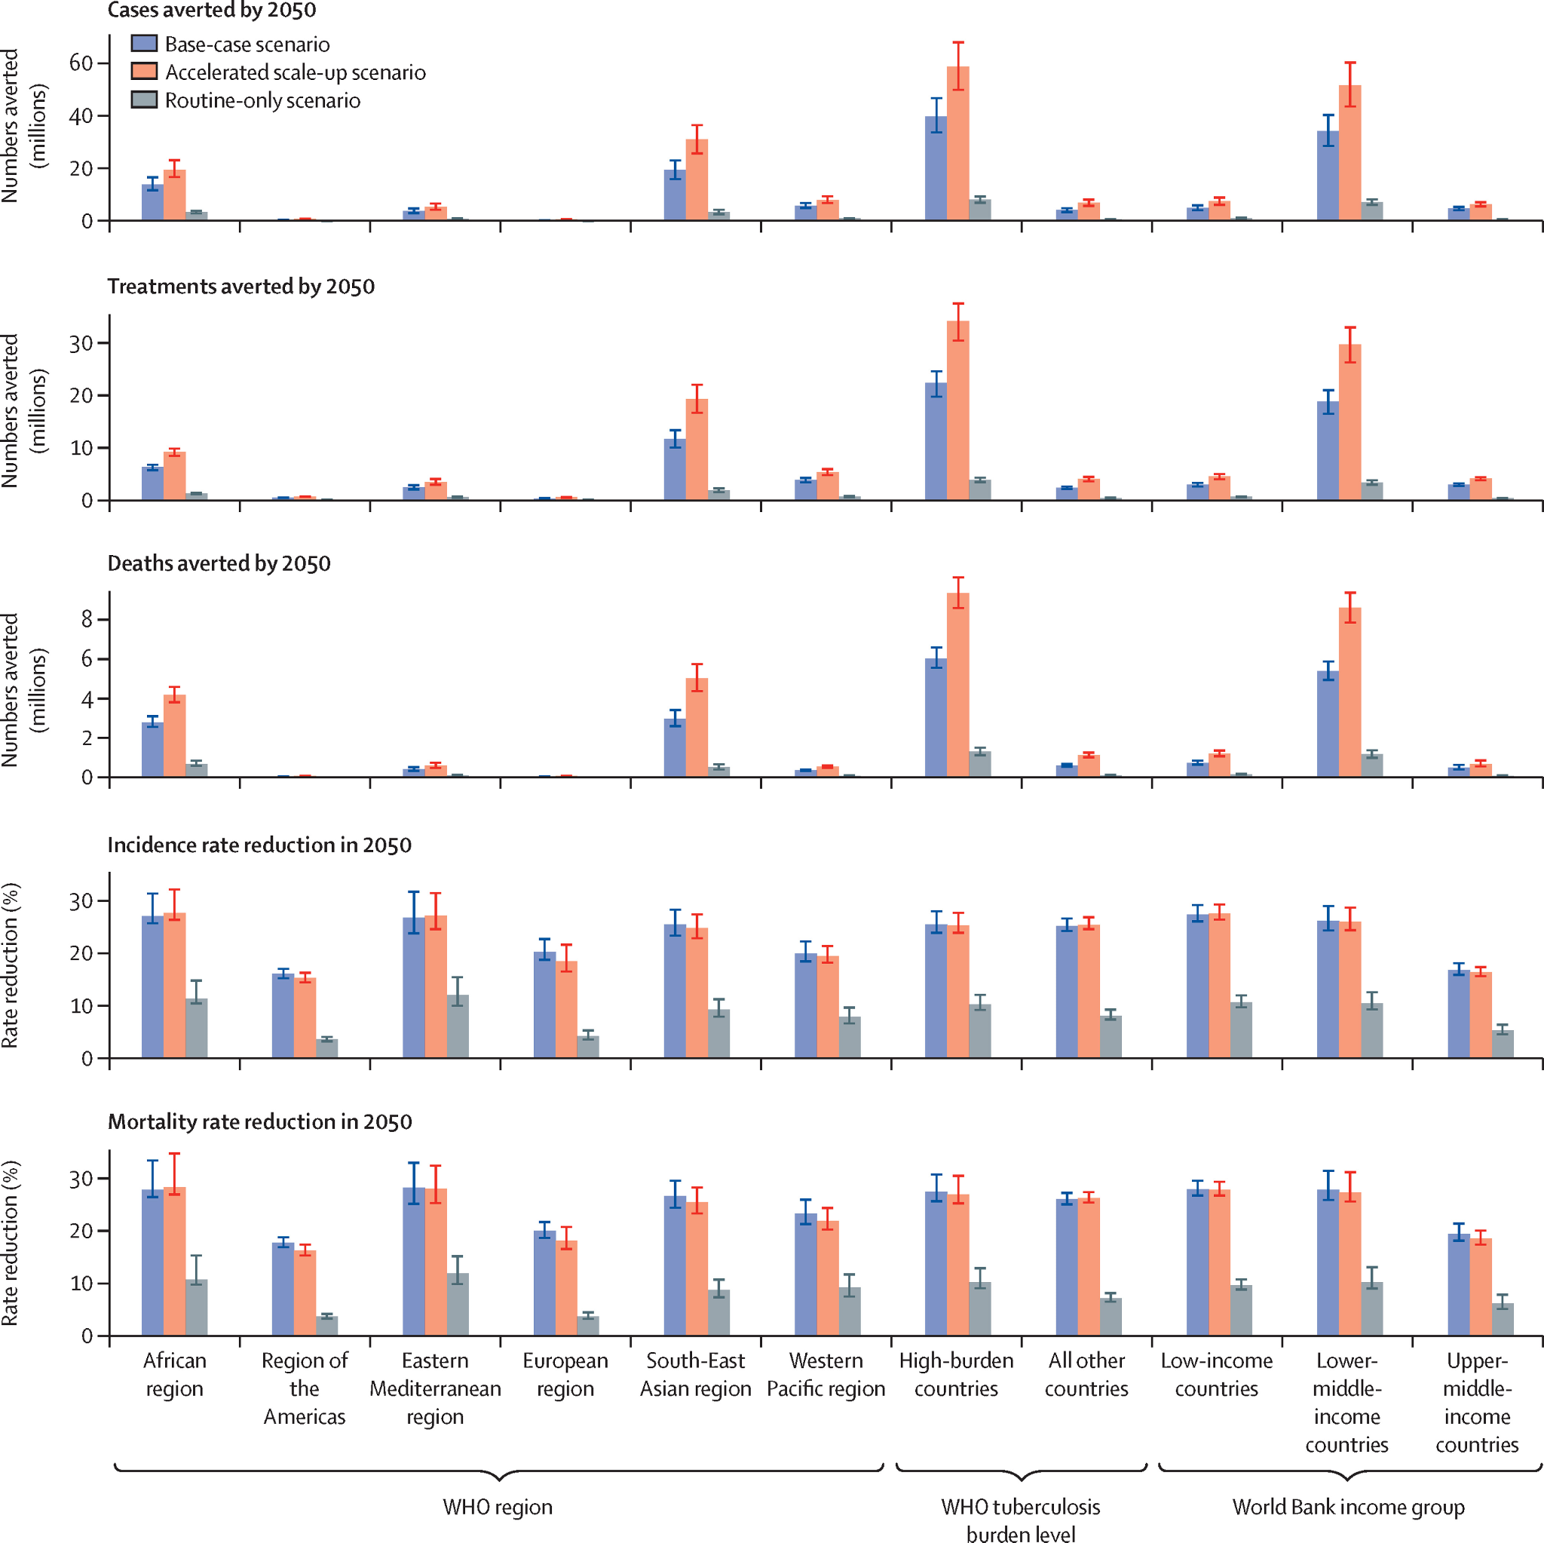
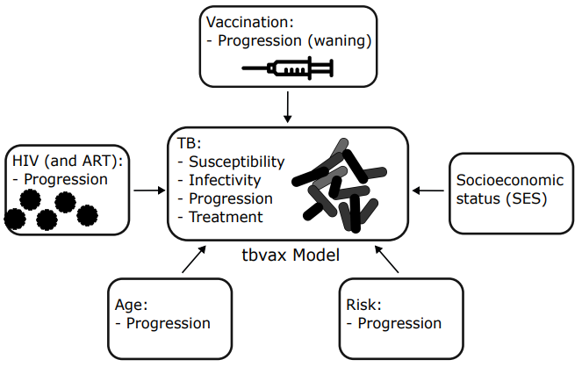


A new, versatile, and open source mathematical
modelling framework applied to estimating the
impact of novel TB vaccines
R. Bakker^{1,2}, R. Clark ¹, T. Sumner ¹ , P. Pelzer ², D. Jerene ², A. Gebhard ², R. White ¹
¹ London School of Hygiene and Tropical Medicine, London, UK.
² KNCV Tuberculosis Foundation, The Hague, Netherlands.
02474
Background
Design Method
Results
Conclusions
The impact of tuberculosis (TB) and interventions against the disease can be estimated using transmission models. Here we present a framework (tbvax) that was develop to project the health benefits and costs of different TB vaccination strategies. We highlight the model's utility by showcasing its use in estimating the health impacts of novel TB vaccines in low- and middle-income countries, referencing results from [1].
Tbvax model
The model was developed in R and uses a system of ordinary differential equations to represent the population, which is structured according to age, TB stage, HIV, RISK, socioeconomic (SES) and vaccination status. The user specifies the number of classes in each of these dimensions (e.g. by the stage of TB natural history) and the interdependencies between model parameters. Transmission is determined by the transmission probability per contact and the number of contacts per day between 5-year age groups specified by contact matrices. The R package deSolve was used for numerically solving the differential equations. Model calibration is quick and efficient using the new R package hmer [3].
Impact of new vaccine in LMICs
Tbvax was run in 105 LMICs (accounting for 93% global incidence). Vaccine scenarios were implemented as a base-case (routine vaccination of 9-year-olds and one-off vaccination of those aged 10 years and older, with country-specific introduction between 2028 and 2047, and 5-year scale-up to target coverage); accelerated scale-up (similar to base-case, but with all countries introducing vaccines in 2025, with instant scale-up) and routine-only (similar to the base-case, but with routine vaccination only).
Routine vaccination of those aged 9 years and a one-off vaccination of those aged ≥10 years would prevent 44 million TB cases and 5 million TB deaths before 2050 compared to no new vaccine introduction (Figure 3). Costs and cost-effectiveness of introducing this vaccine in LMICs were reported in [2].
We developed a new transmission model that was successfully applied to estimate the health impact, costs, and cost-effectiveness of novel TB vaccines. The model can be used to compare the impact of additional interventions, e.g. enhanced case finding vs. preventive treatment, and to
estimate the optimal mix of interventions for a given budget (i.e. allocative efficiency).
Figure 1. Schematic showing how a population is structured within tbvax.
Figure 3. Cumulative cases averted from vaccine introduction to 2050 by WHO region, tuberculosis burden level, and WB income group, expressed relative to a baseline scenario with no new vaccine. Three vaccination scenarios were compared: base-case, accelerated scale-up and routine-only scenario (each described in Design Method)
References
1. RA Clark et al. Lancet Global Health 2023; 11: e546–55
2. A Portnoy et al. Plos Medicine 2023; 20 (1), e1004155
3. D Scarponi et al. Epidemics 2023; 43, 100678
Figure 2. QR codes linking to: (LEFT) GitHub repository of scripts used in publications [1] and [2] and (RIGHT) a shiny app simulating TB interventions in South Africa.

