Slide 1

Introduction
Wonderful Wines of the world provided us with a dataset of 10,000 customers that have made purchases from the last 18 months. Our goal is to segment these customers into clusters on two levels using various data mining techniques.
First, there is the segmentation for representing the value of the customer. With features available such as age, money spent on purchases, and customer's annual income, we can obtain results like how much a particular age group of customers is spending.
Second, we have the segment for customer buying behavior. Here we have access to the types of wines that were purchased by the customer, in addition to their online purchasing percentage. With the insights found, we can see what kind of wines customers are interested in buying.
Finally, we'll combine these two segments and with the insights obtained, we can suggest important business applications from the derived knowledge.

Slide 2
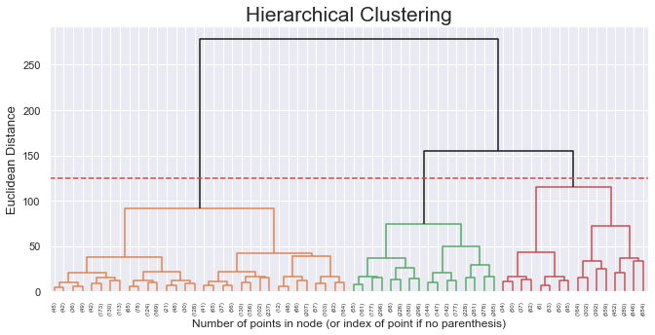
Hierarchical Clustering for Customer Value
Our strategy was to take a bottom-up approach to build the dendrogram
From there, we took the cluster labels, grouped them back into an unscaled data frame with the same features. Using bar plots, with the cluster as the x axis, and the feature on the y axis, we can draw some basic conclusions for customer value.

Slide 3
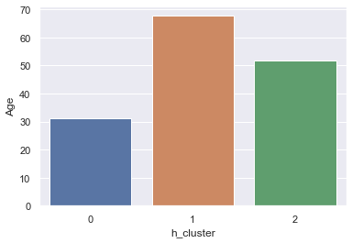
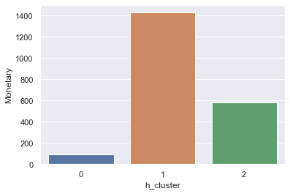
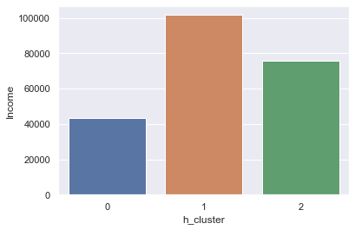
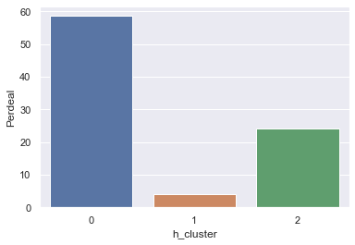
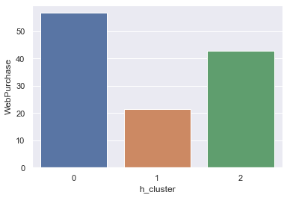
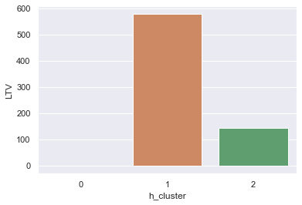
Bar plots to show findings for Customer value

Slide 4
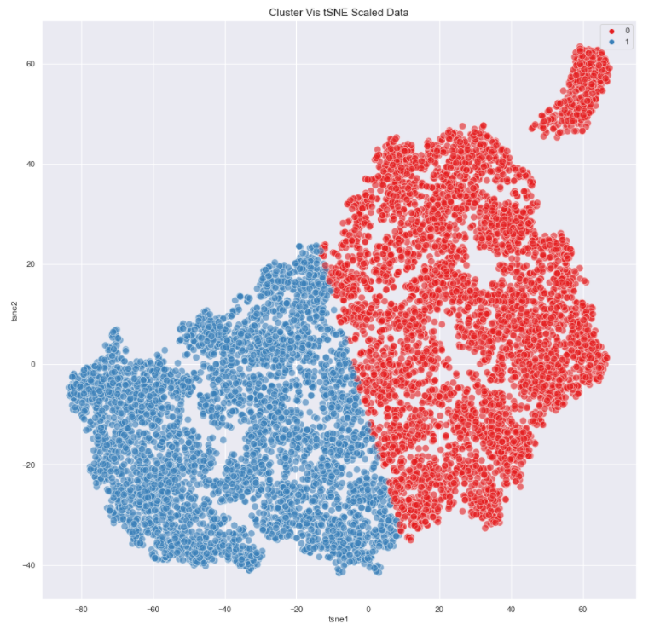
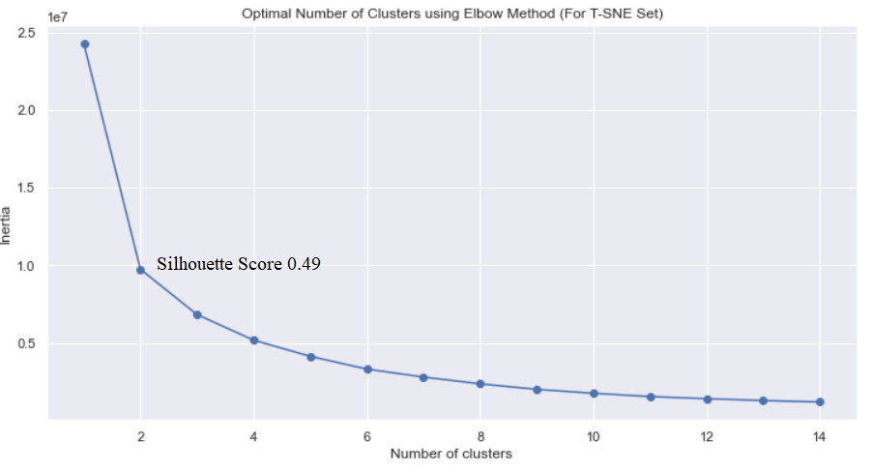
K-means Clustering
Final Clusters
Clusters | OG Dataset | PCA (5 PCA) | T-SNE
2 | 0.401 | 0.426 | 0.486
3 | 0.270 | 0.298 | 0.387
4 | 0.298 | 0.329 | 0.408
5 | 0.248 | 0.280 | 0.392

Slide 5
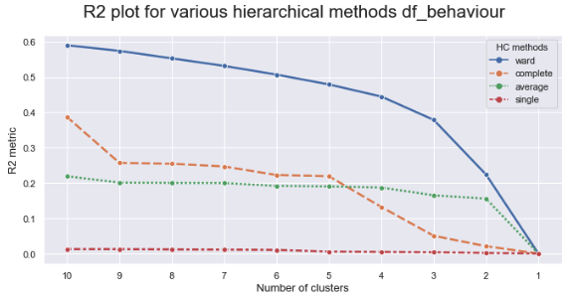
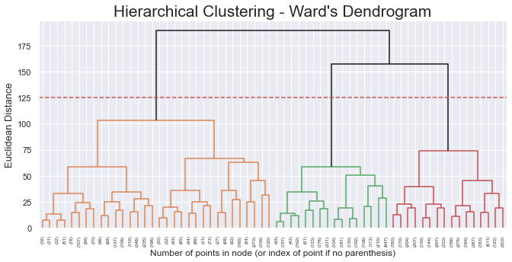
Buying Behavior Clustering
Features: All wine types + WebPurch + Perdeal
Hierarchical Clustering & Kmeans

Slide 6
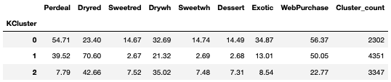
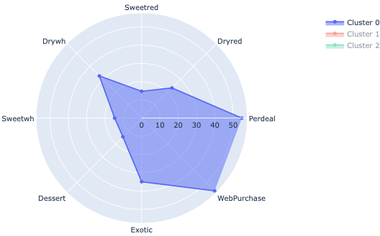
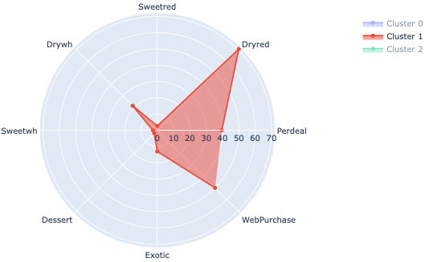
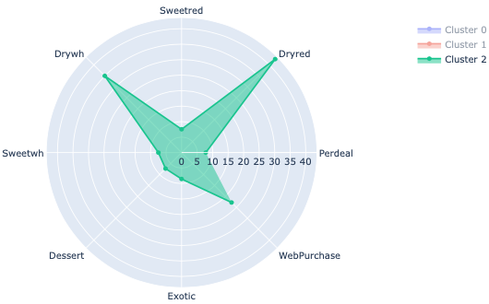
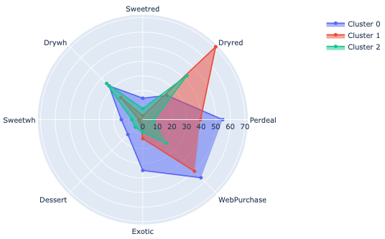
Results

Slide 7
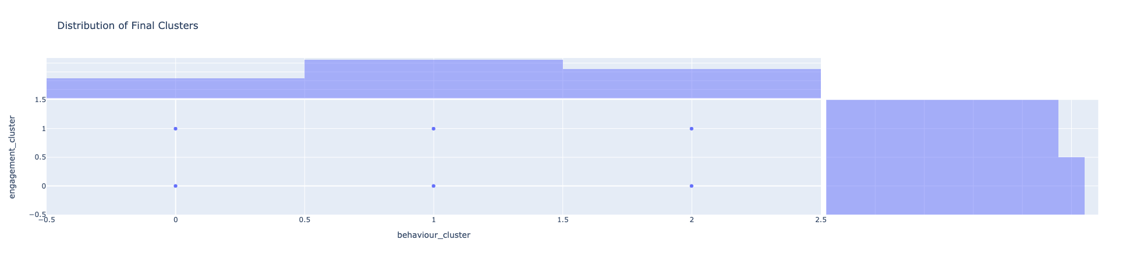
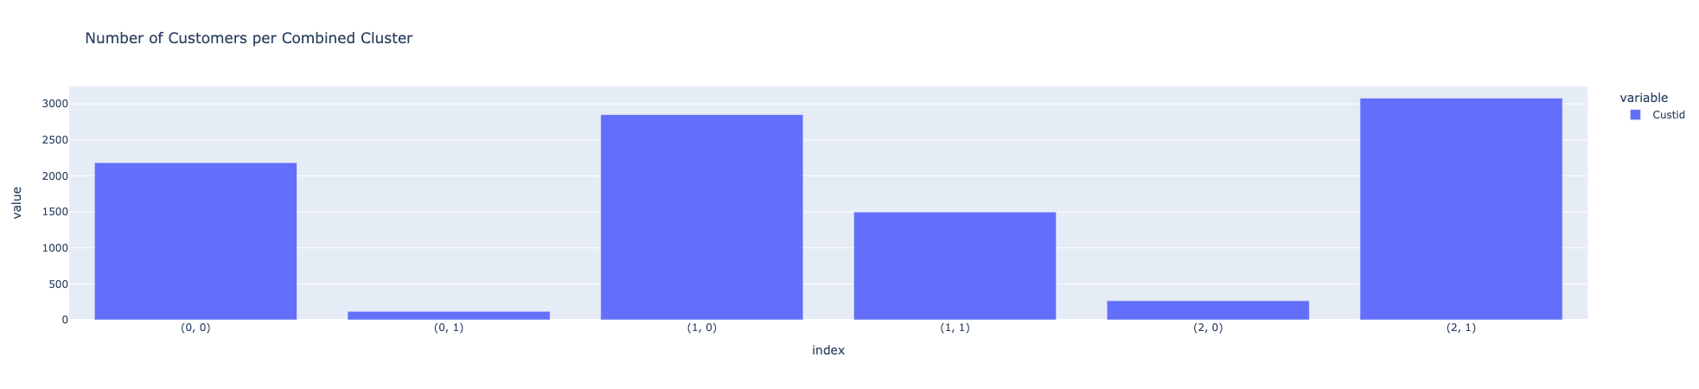
Engagement and Behavioral Combined Results
2302
4351
3347
4534
5466

Slide 8
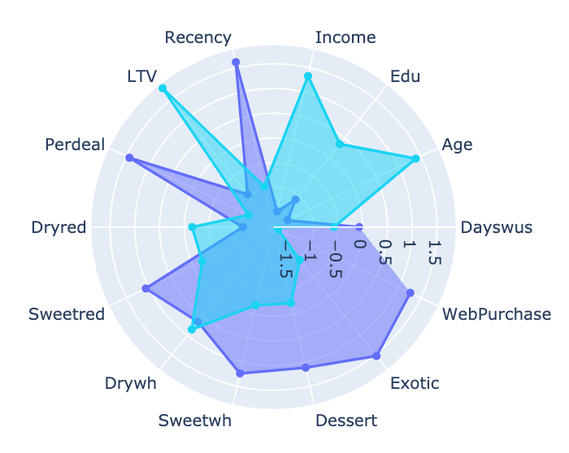
Marketing Use Case 1 (Segment Comparison)
Disparities in:
Demographics
Purchasing channel
Product tastes
Promotion Sensitivity
LTV and Recency

Slide 9
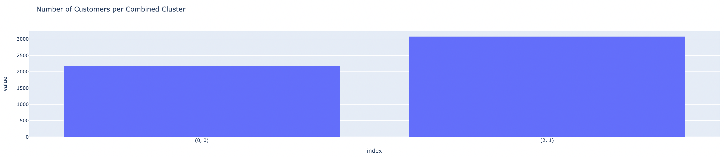
Marketing Use Case 1
Relevance
A large part of the customer base (52.65%) fall within these two clusters.

Slide 10
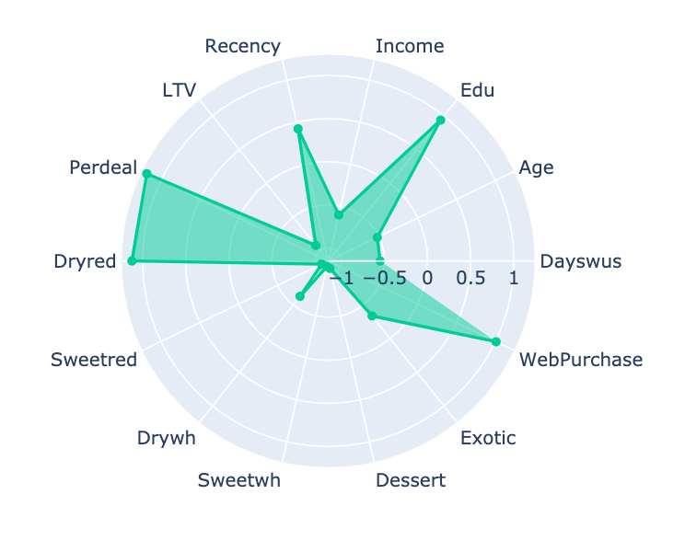
Marketing Use Case 2
Defining Characteristics:
Comparatively low LTV but compensate with high volume (28.5% of customers)
Extreme preference for Dryred
Very sensitive to promotions
Online shoppers
Possible strategy:
Google Ads for discounted dry red wine

