Slide 1


Hotel Cancelation prediction
Group AD
N
Haitham

Slide 2
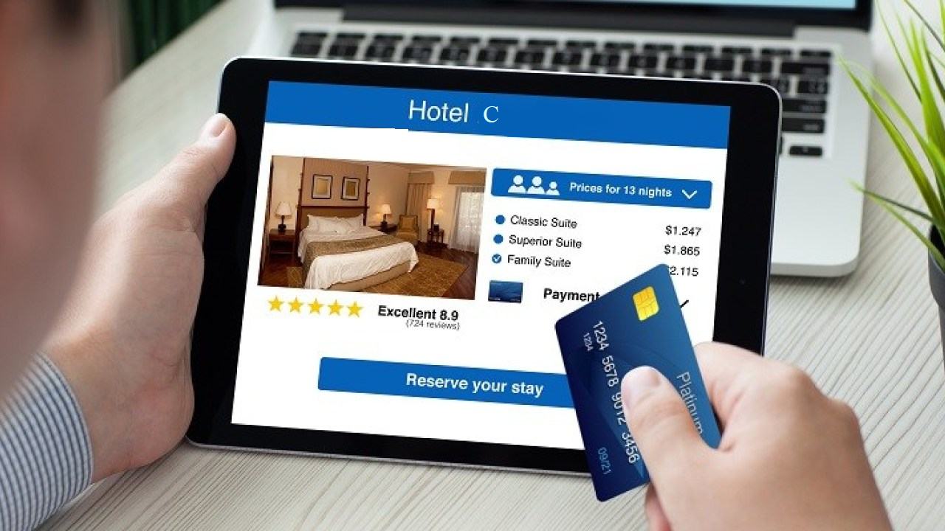
Background
Traditional travel industry has Changed to OTA's in the past Decade.
Hotel cancelations rose from 33% in 2014 to 40% in 2018.
Tourism industry, and specifically Hotel industry suffer from this trend.
Hotel C aims to reduce cancelations by 20%.

Slide 3

Data Exploration
Our Dataset contained 79.330 records, 31 features, 13 objects, 2 floats and 16 integers.
Outliers in ADR, and lead time
28 missing values .

Slide 4
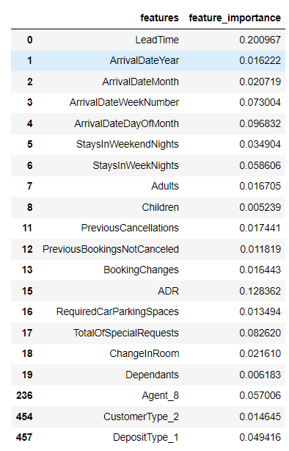
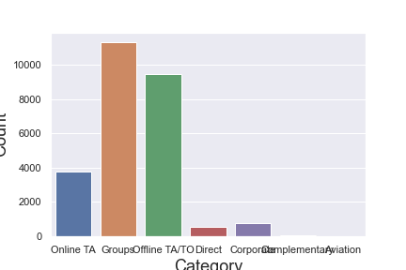
Feature Selection
Data Cleaning
25.902 values were duplicates, which accounts to 32% of the datasets record.
Duplicated Data

Slide 5

Modeling

Slide 6
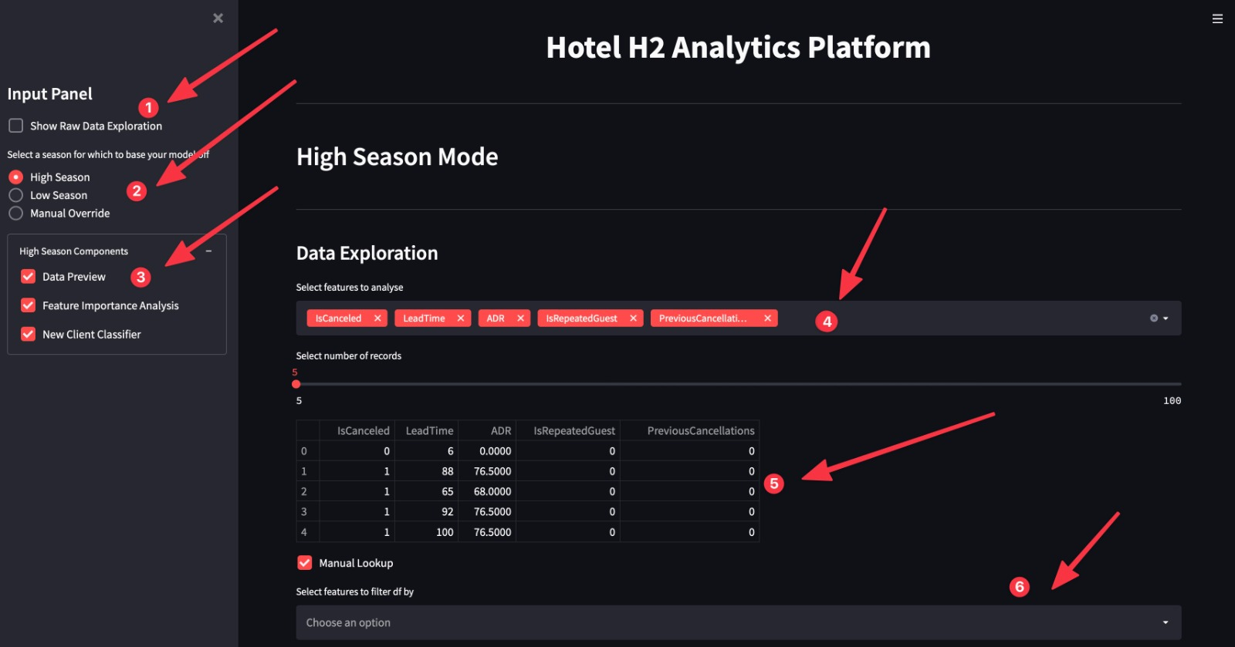
Online platform walkthrough1

Slide 7
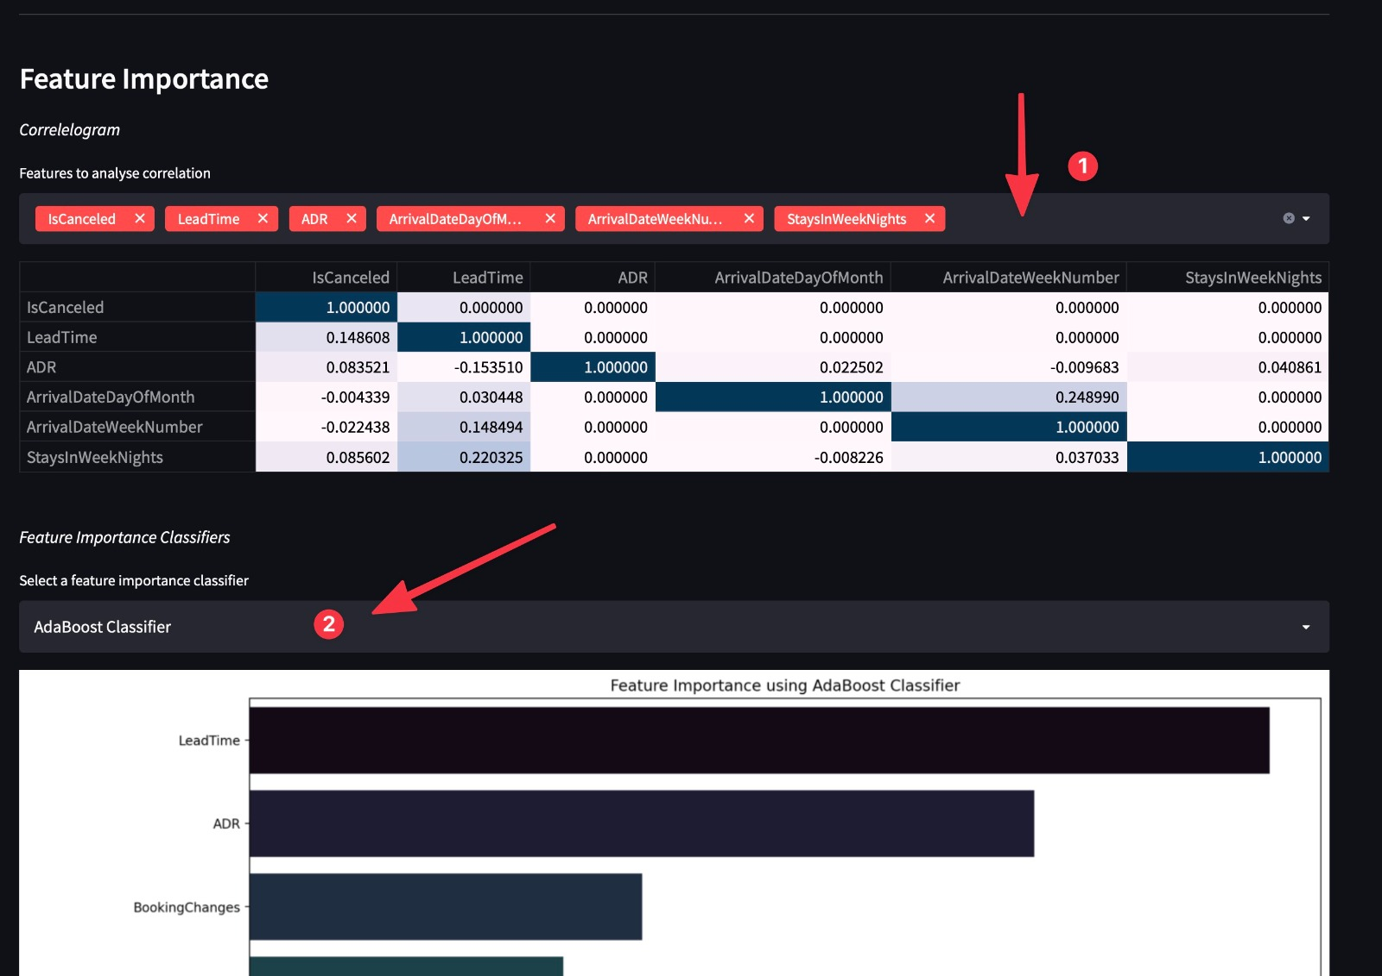
Online platform walkthrough2

Slide 8
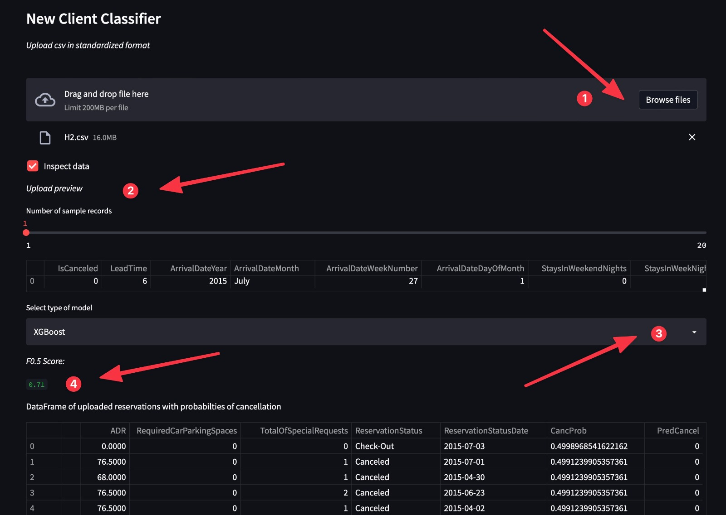
Online platform walkthrough3

Slide 9
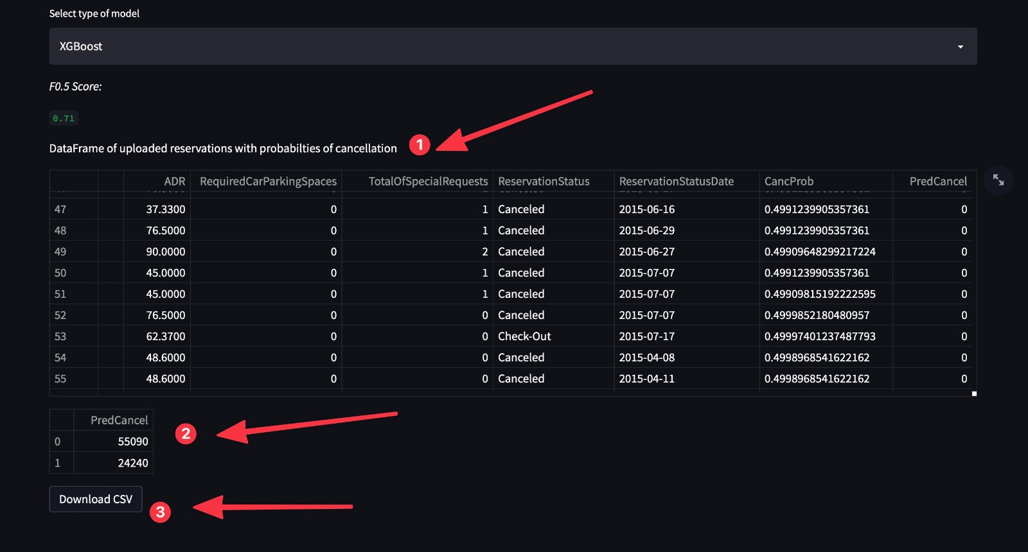
Online platform walkthrough4

Slide 10
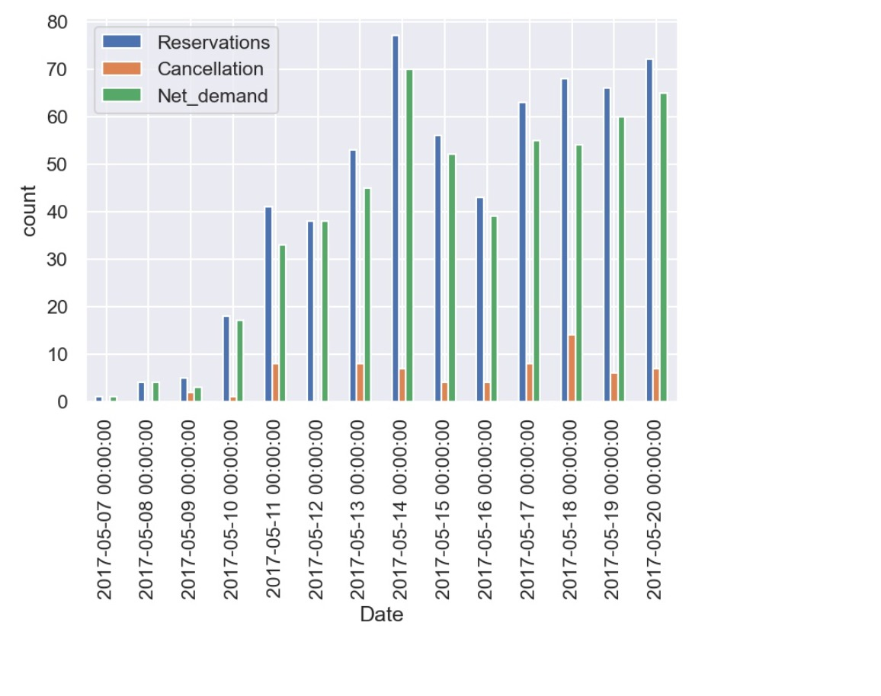
Visualization of Net Demand
Mangers are able to consult net demand per day as a downloadable off the platform.
Thresholds are altered on a per season basis if need be.
Allows managers to implement best business practices based on predicted cancellations.

