Slide 1
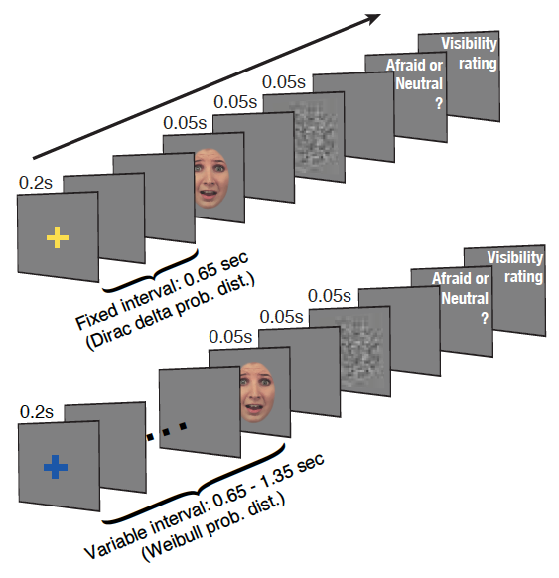
Neural bases of the temporal prediction of affective signals

Slide 2
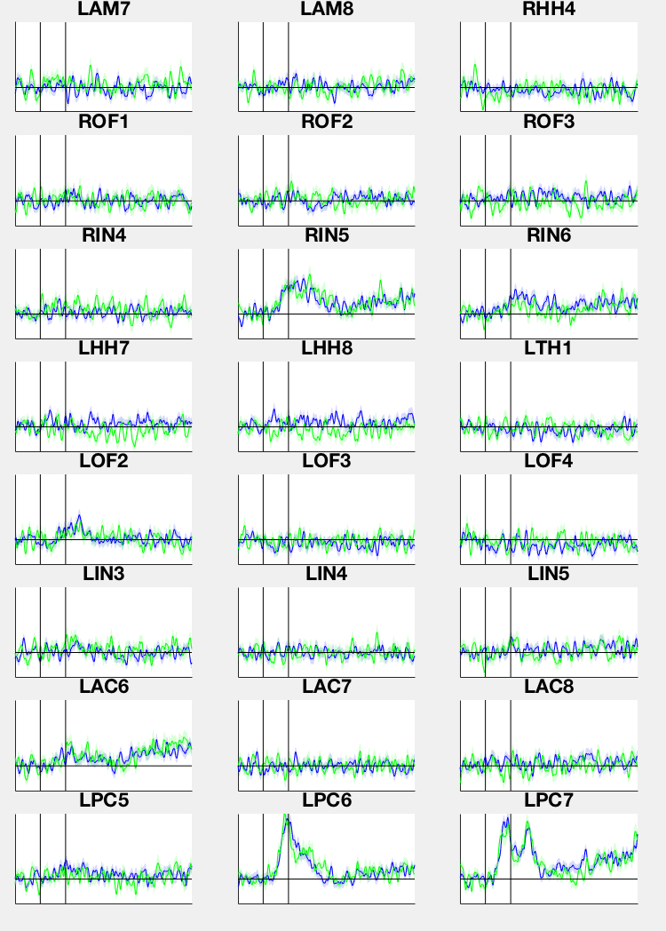
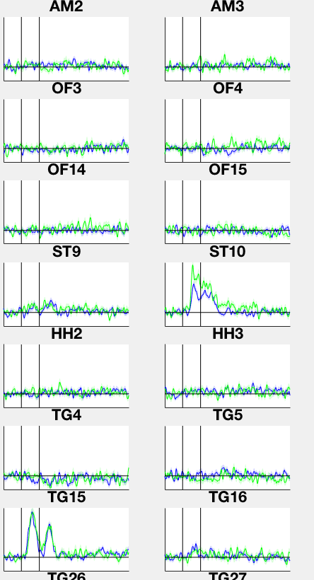
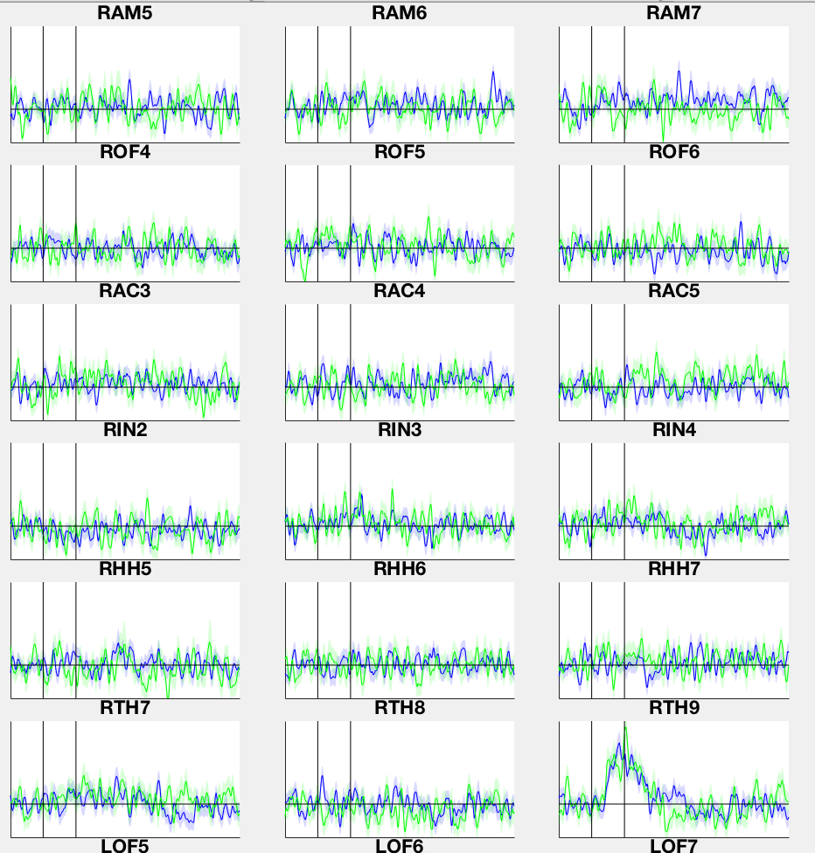
Cue Target Interval: pred > unpred PFC,MTL : HFA
IR35 CTI
Blue = pred
Green = unpred
IR38
IR39

Slide 3
Cue Target Interval: pred > unpred PFC <-> MTL : theta coupling/PAC Hipp <-> Amygdala : theta coupling/PAC
IR35: theta coupling between orbitofrontal, amygdala, insula, pred < unpred (mostly)
IR38: theta coupling orbitofrontal and amygdala, pred < unpred
IR39: theta coupling orbitofrontal and amygdala, pred <> unpred (very weak)
IR41: varied

Slide 4
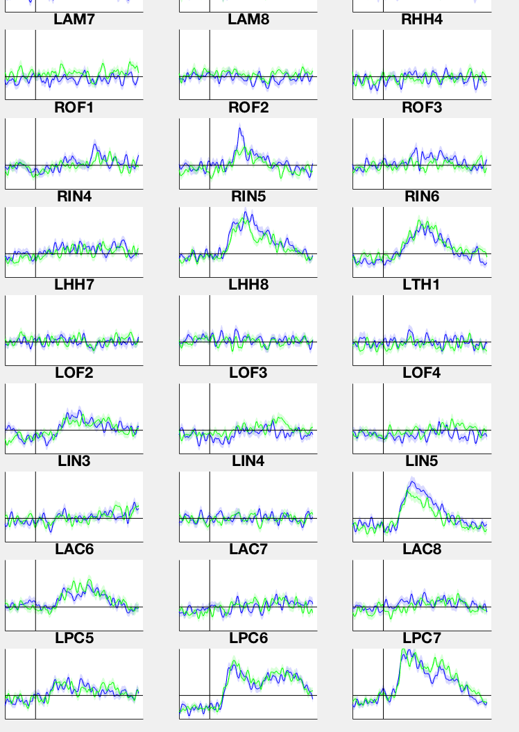
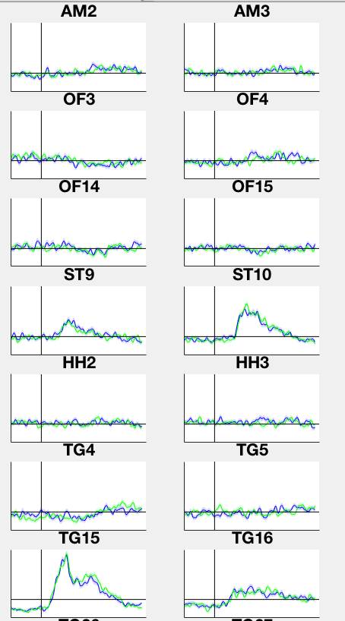
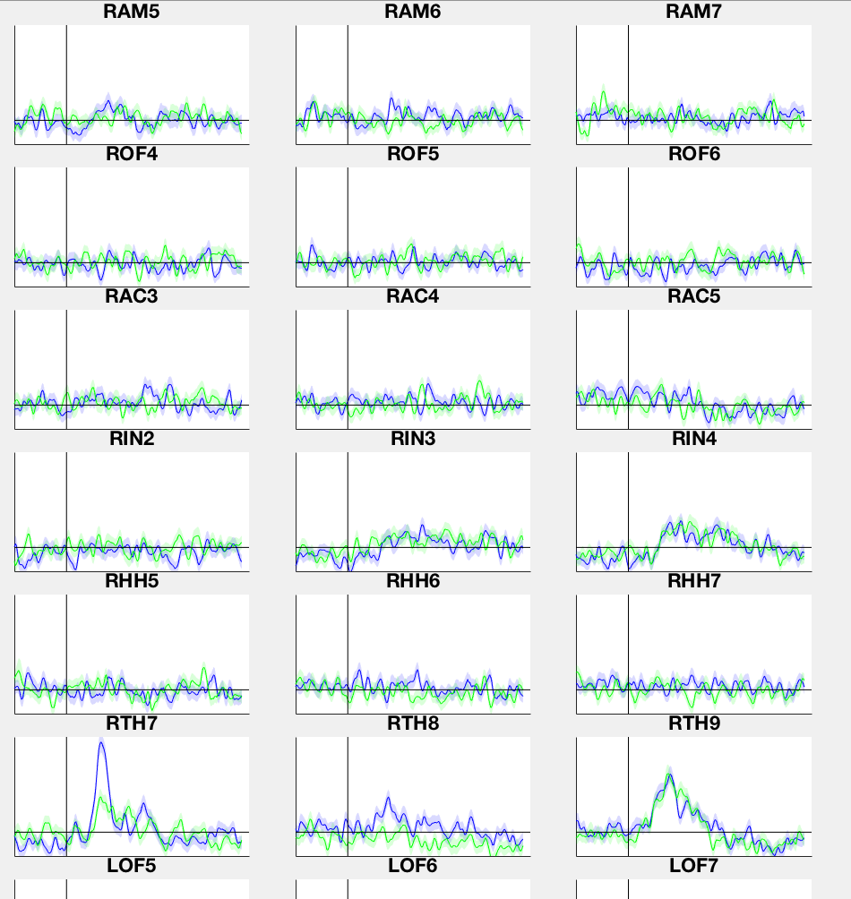
Post face: fearful > neutral PFC,MTL : HFA
IR35
Blue = fear
Green = neutral
IR38
IR39

Slide 5
Post face: fearful > neutral PFC <-> MTL : theta coupling/PAC
IR35: theta coupling orbitofrontal (o), amygdala (a), insula (i), fear < neut (o<->a), fear > neut (i <-> o/a)
IR38: theta coupling orbitofrontal (o) and amygdala (a), fear <> neut
IR39: theta coupling orbitofrontal, insula (i), fear < neut
IR41: varied

