Slide 1
Facility
Data
Own
User
id
name
type
status
unit
step
wardID
bedID
id
time
location_lng
location_lat
type
amount
facID
id
userID
wardID
bedID
id
name
email
passwd
role

Slide 2
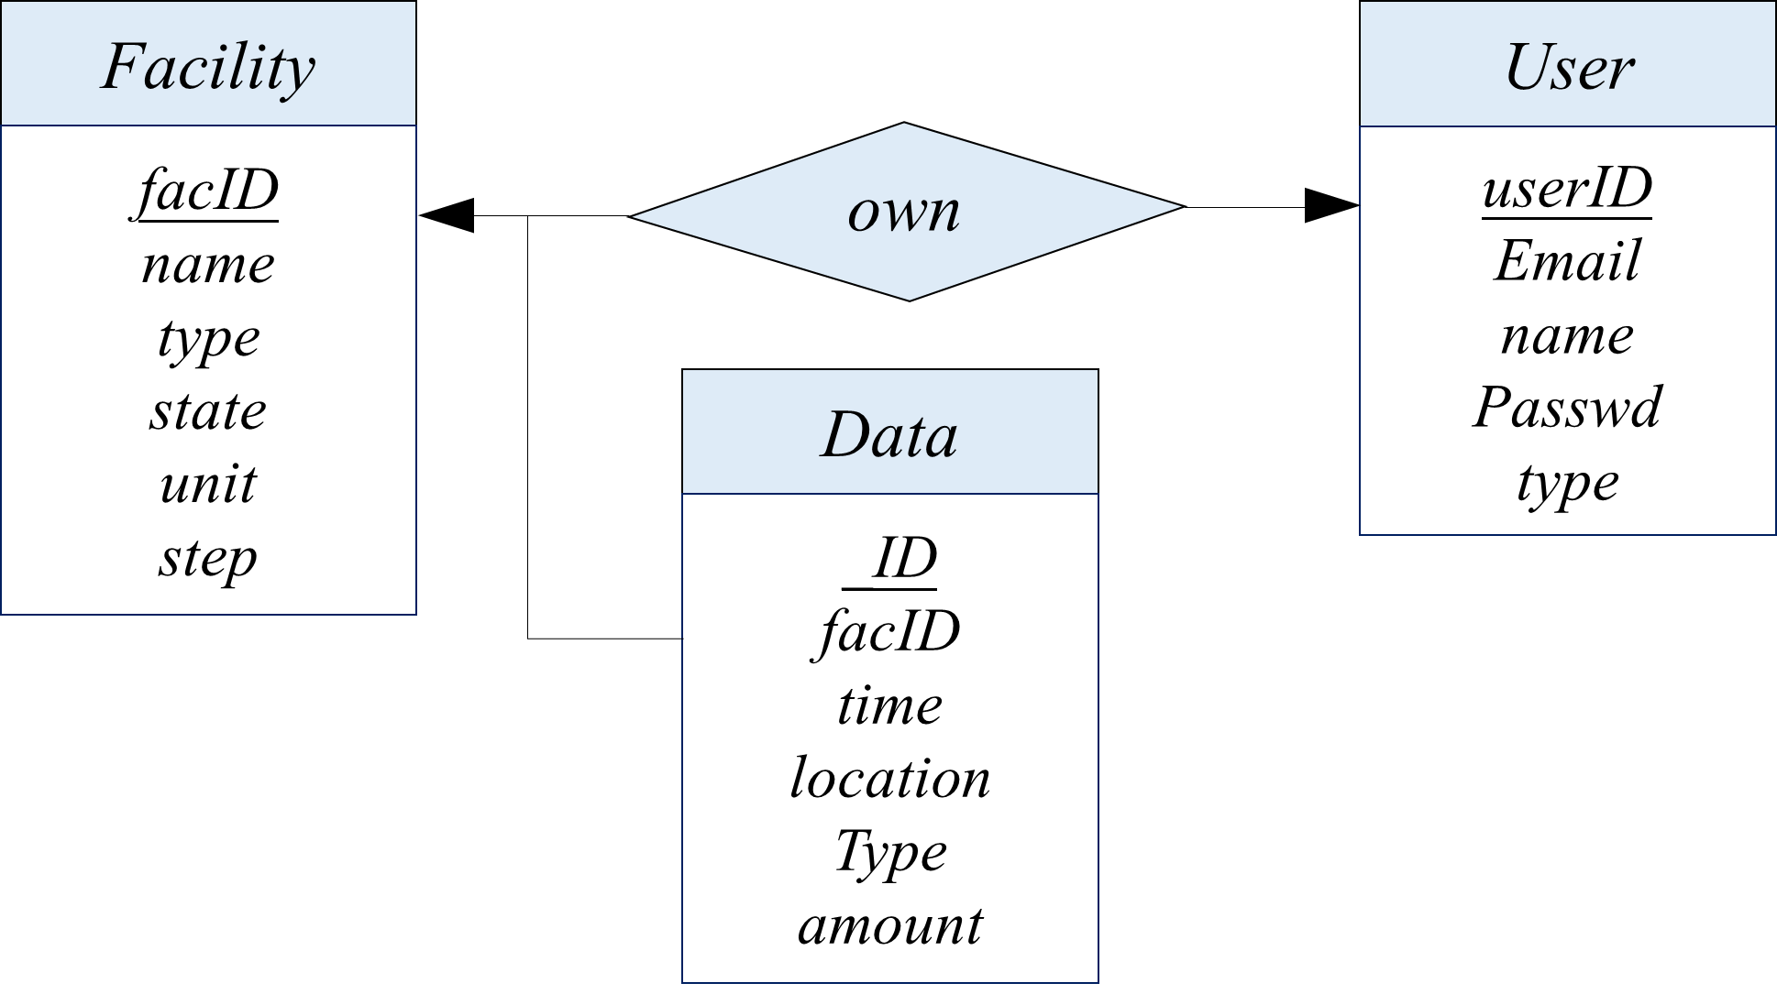

Slide 3
