Slide 1

Alteryx Migration Case Study
AI-assisted migration of Alteryx workflow logic to Qlik Sense
From Spaghetti to Scripts
Greg Roeper
USGREGROE@GMAIL.COM
www.linkedin.com/in/gregoryroeper

Slide 2
Alteryx Use Case – GSP Data & Reporting
SUMMARY
BENEFITS
Objective:
Enterprise-wide initiative focused on three pillars:
Cost Reduction: Consolidation of software licenses.
Data Security: Bolstering governance via centralized reporting.
Optimization: Transforming legacy technical debt.
Solution:
Migrate existing Alteryx workflows to Qlik Sense application in the enterprise reporting repository leveraging AI augmented Python tools.
Key Challenges:
Multiple sources: Data Lake, Google documents.
Complex calculation logic: Many branches following different filtering and editing paths to multiple outputs.
Inherited legacy workflows characterized by dense web-like connections, overlapping and confusing.
Quantitative Value
Creating a base set of Python tools to translate Alteryx native code to Qlik Sense native code reduce conversion time by 40%.
Qualitative Value
AI augmentation assured a coherent flow and improved error trapping during the code migration.
For the most part, these migrations were straightforward "lifts" because the workflows were uncomplicated. However, a number of these legacy processes were complex.

Slide 3
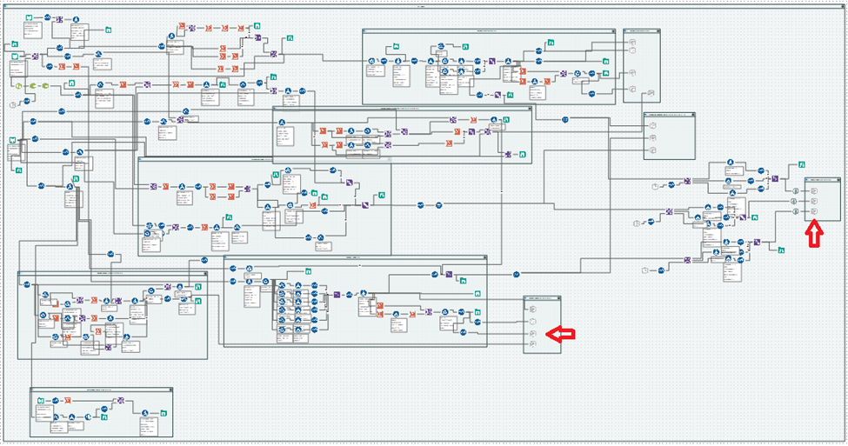
Use Case Example Screenshot
Data Inputs
4 Datalake SQL query inputs
4 Google sheet inputs
These inputs were scattered throughout the Workflow
Data Outputs
15 Google sheet outputs
The arrows indicate specific nodes used as examples in this document

Slide 4
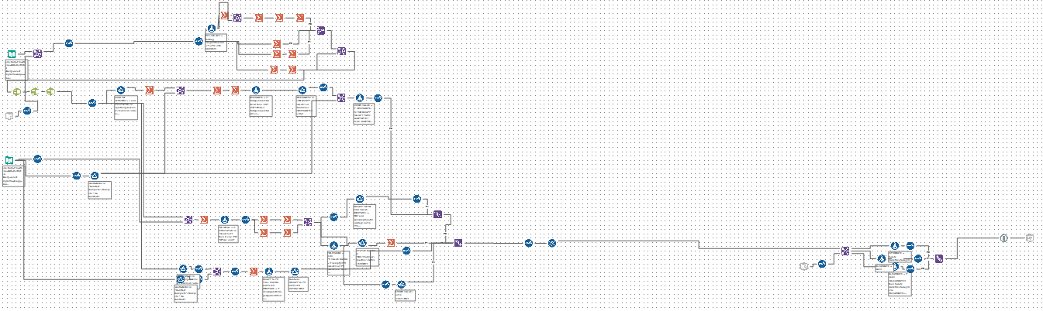
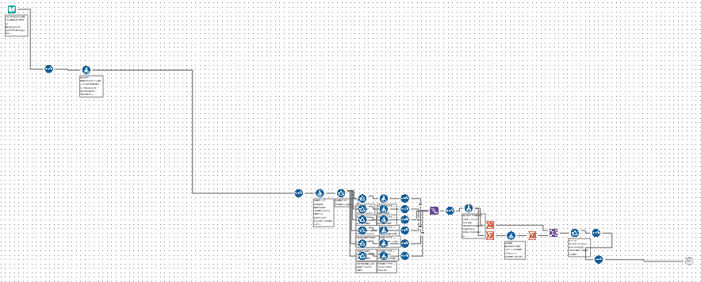
Phase 1: Untangling the Logic
To convert this into a clean Qlik Sense application, I first had to unravel the logic and separate the specific branches feeding each output. The first step was to develop a Python script that could isolate the paths for each individual output into its own separate Alteryx workflow .yxmd file by manipulating the underlying XML of the Alteryx source file. This allowed me to strip away the secondary clutter and reverse-engineer the core business logic of each branch without the visual "noise" of the original file.
Below are two of the resulting "clean" branches:

Slide 5
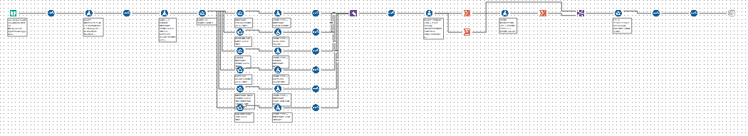
Phase 2: Visual Optimization
Once isolated, the workflows were still disorganized. I updated my Python script to programmatically rearrange the tool coordinates in the XML, enforcing a strict left-to-right flow pattern. This made the logic immediately more digestible.
Below are those same two branches with their new, optimized layouts:
Python script I wrote had the option to retain the original Tool ID numbers or replace them with new Tool ID numbers from left to right. For this workflow I kept the original IDs so that I could easily trace logic back to the master file and, if needed, to recombine branches within the final Qlik Sense load script.

Slide 6
Phase 3: Translating the Logic
The final phase involved translating Alteryx formulas and filters into Qlik Sense load script commands. To accomplish this, I created another Python utility that parsed the entire workflow, extracted the logic from Formula and Filter tools, and converted the syntax. The resulting translations were stored in a mapping spreadsheet for validation.
Example: Automated Logic Translation
Original Altreryx Formula:
if [contr_status] not in ('Contract Complete') then "OK" elseif
IsEmpty([link_contr])or [link_contr] in('http://not applicable','http://.','http://na','http://n/a','http://n.a','http://no link','http://xxx') then "CNTRCT-ERROR-01" elseif
not contains ([link_contr], "https://") then "CNTRCT-ERROR-09" elseif
[COUPA FLAG]in('yes') and Contains([link_contr],"corporate.sourcehost.com/contracts") then "OK" elseif
Contains([link_contr],"corporate.sourcehost.com/order_header") then "CNTRCT-ERROR-03" elseif
Contains([link_contr],"corporate.sourcehost.com/suppliers") then "CNTRCT-ERROR-05" elseif
[COUPA FLAG]in('yes') and (Contains([link_contr],"drive.google.com/file/") or contains([link_contr],"https://docs.google.com/document/")) then "OK" elseif
[COUPA FLAG]in('yes') and not Contains([link_contr],"corporate.sourcehost.com/contracts") then "CNTRCT-ERROR-02" elseif
[COUPA FLAG]in('no') and (Contains([link_contr],"corporate.sourcehost.com/contracts") or Contains([link_contr],"https://docs.google.com/document/")) then "OK" elseif
contains([link_contr],'drive.google.com/file/') then "OK" elseif
Contains([link_contr],"drive.google.com/drive/folder") then "CNTRCT-ERROR-07" elseif
Contains([link_contr],"https://corporatecorp.quickbase.com/db/bnskksae5") then "CNTRCT-ERROR-06" elseif
Not Contains([link_contr],"drive.google.com/file/") then "CNTRCT-ERROR-08" else
"ERROR CL" endif

Slide 7
Converted Qlik Sense Formula:
If( not Match([contr_status], 'Contract Complete'), 'OK',
If( IsNull([link_contr]) or Len(Trim([link_contr]))=0 or Match([link_contr],
'http://not applicable','http://.','http://na','http://n/a','http://n.a','http://no link','http://xxx'), 'CNTRCT-ERROR-01',
If( not WildMatch([link_contr], '*https://*'), 'CNTRCT-ERROR-09',
If( Match([COUPA FLAG], 'yes') and WildMatch([link_contr], '*corporate.sourcehost.com/contracts*'), 'OK',
If( WildMatch([link_contr], '*corporate.sourcehost.com/order_header*'), 'CNTRCT-ERROR-03',
If( WildMatch([link_contr], '*corporate.sourcehost.com/suppliers*'), 'CNTRCT-ERROR-05',
If( Match([COUPA FLAG], 'yes') and (WildMatch([link_contr], '*drive.google.com/file/*’)
or WildMatch([link_contr], '*https://docs.google.com/document/*')), 'OK',
If( Match([COUPA FLAG], 'yes') and not WildMatch([link_contr], '*corporate.sourcehost.com/contracts*'), 'CNTRCT-ERROR-02',
If( Match([COUPA FLAG], 'no') and (WildMatch([link_contr], '*corporate.sourcehost.com/contracts*’)
or WildMatch([link_contr], '*https://docs.google.com/document/*')), 'OK',
If( WildMatch([link_contr], '*drive.google.com/file/*'), 'OK',
If( WildMatch([link_contr], '*drive.google.com/drive/folder*'), 'CNTRCT-ERROR-07',
If( WildMatch([link_contr], '*https://corporatecorp.quickbase.com/db/bnskksae5*'), 'CNTRCT-ERROR-06',
If( not WildMatch([link_contr], '*drive.google.com/file/*'), 'CNTRCT-ERROR-08','ERROR CL'
)))))))))))))

Slide 8
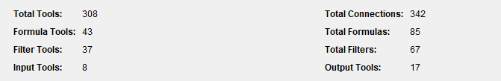
Technical Nuances
The most difficult aspect of these translations involved mapping functions that behave differently across platforms. For instance, Alteryx’s CONTAINS function is highly flexible, whereas the Qlik Sense equivalent, MATCH, uses a completely different format and strictness levels. By utilizing Python to automate the bulk of the "heavy lifting," I was able to focus my time on solving these complex syntax edge cases, ultimately delivering a secure and highly performant Qlik Sense environment.
Statistics for the workflow used in this demo:
.

Slide 9
CONCLUSION
The successful migration of these complex Alteryx workflows to Qlik Sense represents a significant milestone in our enterprise-wide modernization and cost-reduction initiatives. By moving beyond a simple "lift and shift" approach and instead engineering a programmatic migration path, we achieved several critical objectives:
Elimination of Technical Debt: Through Phase 1 and 2, the "spaghetti" logic that had accrued over years was untangled and visually optimized. This not only facilitated the migration but also provided stakeholders with a clear, documented understanding of business logic that was previously obscured.
Scalability via Automation: The development of custom Python utilities to manipulate underlying XML and translate formula syntax proved to be the project’s greatest force multiplier. By automating the most labor-intensive aspects of the conversion, we ensured consistency, minimized human error, and established a repeatable framework for future workflow deactivations.
Performance and Governance: The final Qlik Sense environment offers superior performance compared to the legacy disparate server model. Centralizing this logic within the Qlik Sense load script has significantly bolstered our data security posture and provided a single source of truth for global reporting.
Ultimately, this project demonstrated that even the most complex legacy processes can be transitioned efficiently when technical ingenuity is applied to the migration process itself. By leveraging Python to bridge the gap between Alteryx's visual nodes and Qlik's script-based architecture, we have delivered a high-performance, sustainable analytics ecosystem that will serve the organization for years to come.

