Slide 1

Ghidra
& Disassembly

Slide 2
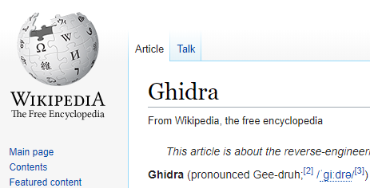
How To Pronounce Ghidra?
Hard G!
Notes:
Gh is an Italian digraph that denotes hard G sound.
Examples:
Pizza Margherita
Spaghetti

Slide 3
Agenda
Ghidra Setup (14:00)
Getting familiar with Ghidra (14:15)
Disassembly and Decompilation in Ghidra (14:40)
Exercise – writing a processor module (15:20)
Wrap Up (16:00)

Slide 4
Goal
Get familiar with Ghidra’s basics
Learn how disassemblers work

Slide 5
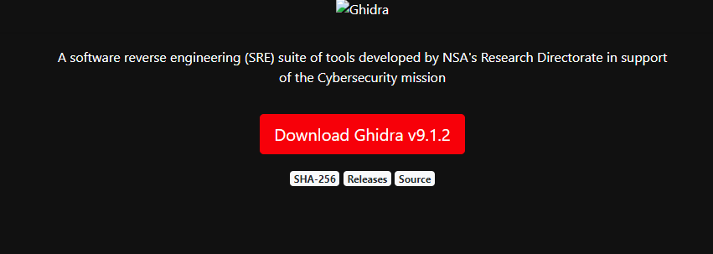
How do I Get Ghidra?
https://ghidra-sre.org/ - Blocked in Israel(?) (Error 403).
Can be accessed using a web proxy service like HMA.
Ghidra is open source!
It’s hosted on GitHub: https://github.com/NationalSecurityAgency/ghidra
Notes:
GitHub’s builds are different than the public releases that are available at Ghidra’s website.

Slide 6
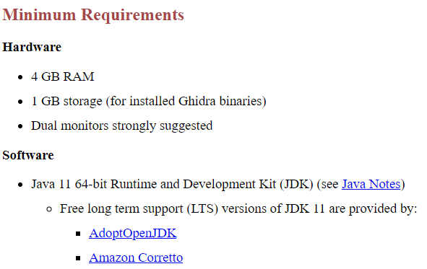
What Does Ghidra Require?

Slide 7
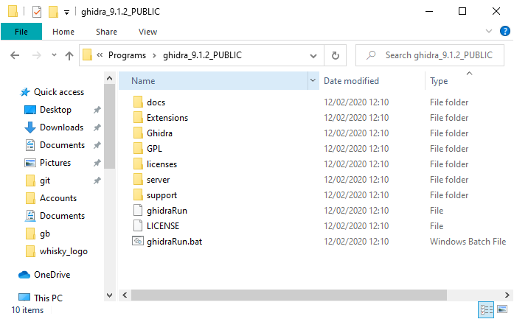
Navigating Ghidra
Documentation
Running on Linux/MacOS
Running on Windows

Slide 8
Documentation
Installation guide
Coding standards for Ghidra development
Cheat Sheet
SLEIGH & p-code reference
Ghidra Class
TOP SECRET
Notes:
Ghidra Class contains presentations for learning Ghidra.

Slide 9
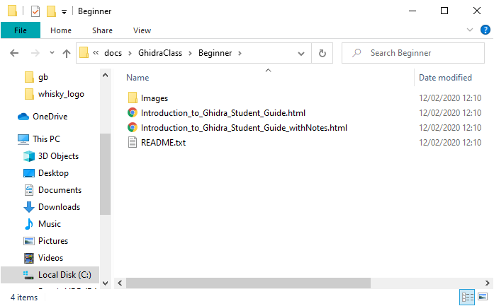
Let’s jump to the Ghidra Class!
Notes:
Just introduce “What is Ghidra?” (7)

Slide 10
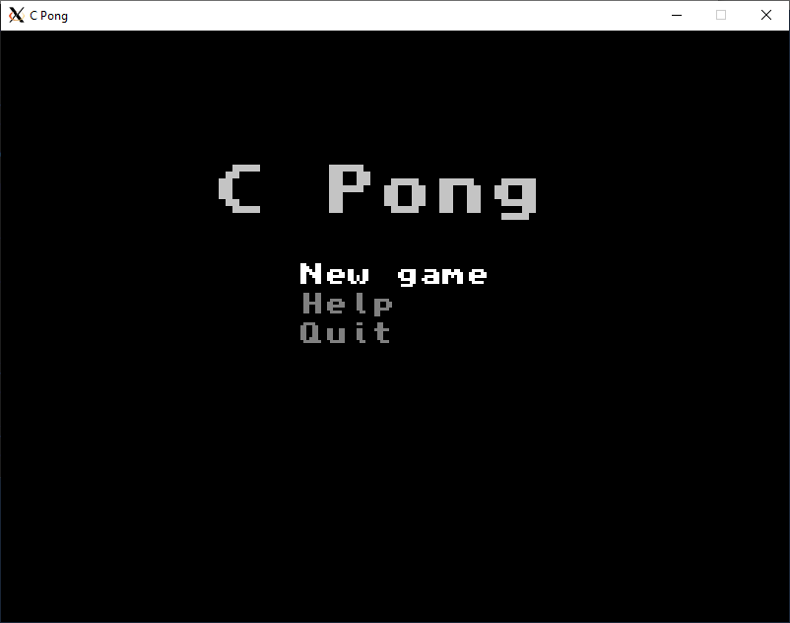
Example
cpong
https://github.com/makzyt4/cpong
Makefile, gcc, SDL2 library
Notes:
First run the game, then go through the presentation.

Slide 11
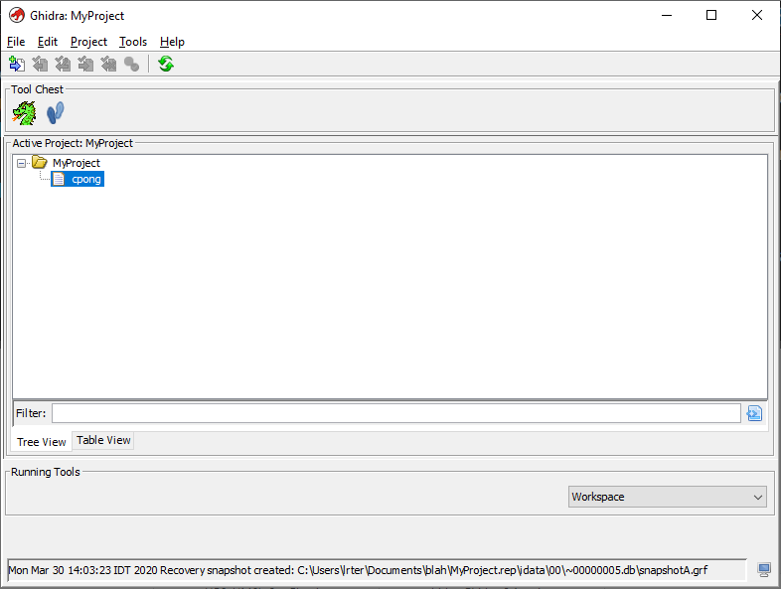
Project Manager
Notes:
Go through the different menus:
Help -> installed processors.
Tool Chest – Code Browser is what we’re here for.

Slide 12
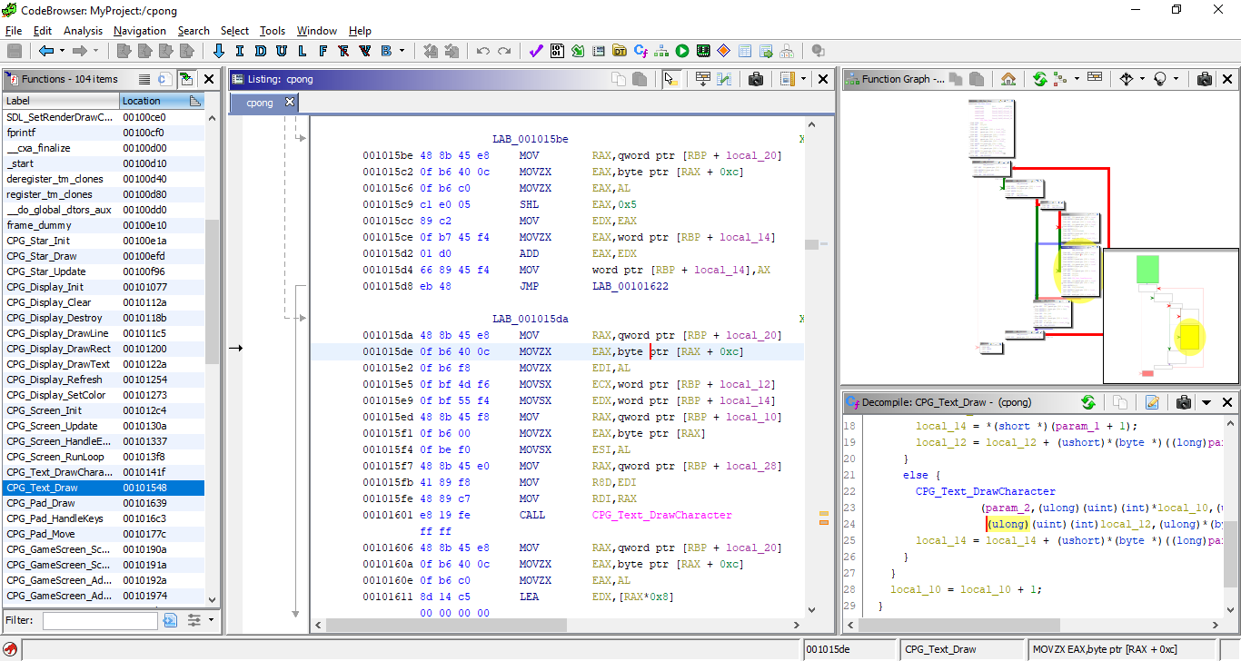
Code Browser
Notes:
Go through the different windows, focus on:
Navigation, commenting, labeling, highlighting.
Listing (also how to edit it)
Function Graph
Decompile
Symbol references
Bonus: Jython interpreter.

Slide 13
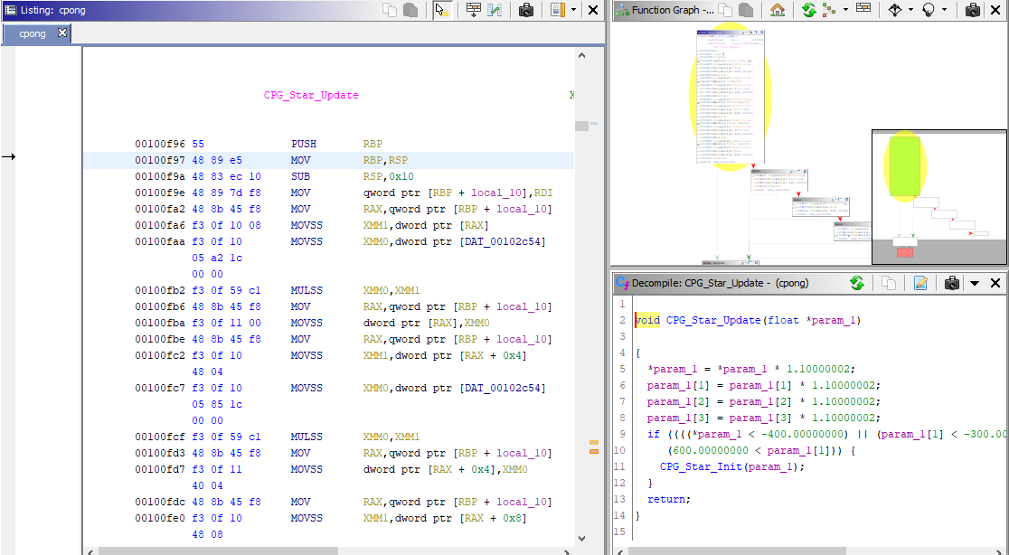
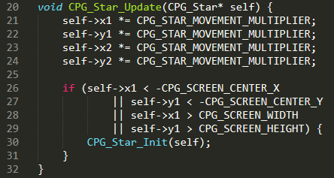
Example
Source vs Decompilation
Notes:
Source vs Decompilation

Slide 14

How Does Ghidra Do That?
Ghidra translates disassembly to P-Code and P-Code to C!
Notes:
What is P-Code?

Slide 15
P-Code
“P-code is a register transfer language designed for reverse engineering applications. The language is general enough to model the behavior of many different processors. By modeling in this way, the analysis of different processors is put into a common framework, facilitating the development of retargetable analysis algorithms and applications.”
From Ghidra’s documentation

Slide 16
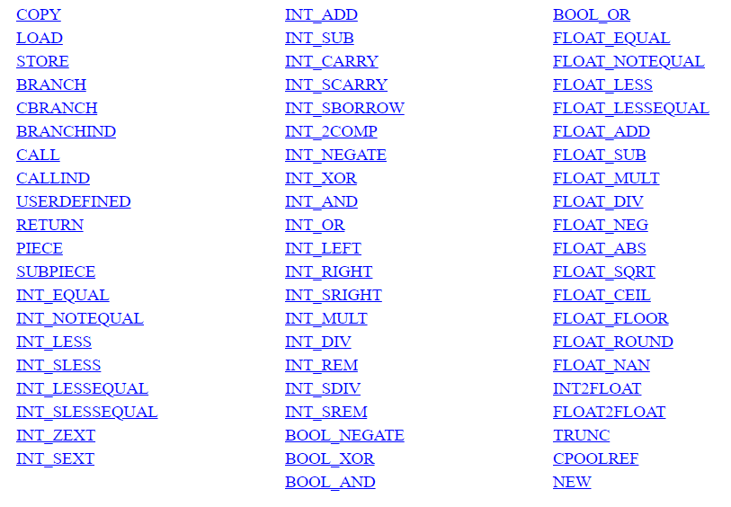
P-Code

Slide 17
How Does Ghidra Do That?
Ghidra translates disassembly to P-Code and P-Code to C!

Slide 18
How Does Ghidra Do That?
Ghidra translates disassembly to P-Code and P-Code to C!
Disassembler modules translates disassembly to P-Code
Every supported processor code can be translated to P-Code
Every supported processor code can be decompiled

Slide 19
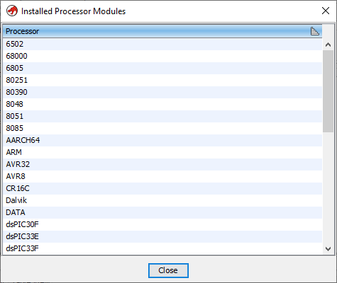
Processor Specification
Ghidra support many popular processors
Processor modules located under “Ghidra/Processor”
For the basic specification, the SLEIGH language is used

Slide 20
SLEIGH
“SLEIGH is a language for describing the instruction sets of general purpose microprocessors, in order to facilitate the reverse engineering of software written for them. SLEIGH was designed for the GHIDRA reverse engineering platform and is used to describe microprocessors with enough detail to facilitate two major components of GHIDRA, the disassembly and decompilation engines”
From SLEIGH’s documentation

Slide 21
SLEIGH
& Ghidra
Notes:
The real head slide.

Slide 22
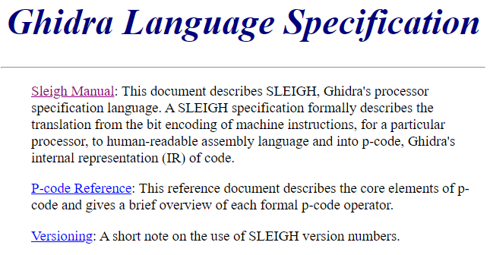
How Do I Learn SLEIGH?
A documentation is bundled with Ghidra

Slide 23
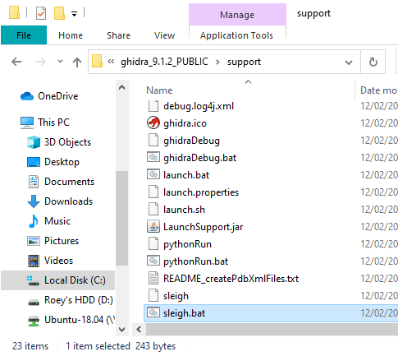
What Do I Need To Know First?
SLEIGH is not a programming language
SLEIGH is written to ‘.slaspec’ extended files
SLEIGH compiles to a nasty XML (‘.sla’)
The SLEIGH compiler comes bundled with Ghidra

Slide 24
TL;DR
A SLEIGH spec file is made of the following:
Endianness and Alignment definitions
Memory spaces definitions
Registers definitions
Tokens and Attachments definitions
Special P-Code definitions
Macros definitions
Constructors

Slide 25


Endianness and Alignment Definitions
Endianness – big or small
Alignment – whether instruction shall be aligned

Slide 26
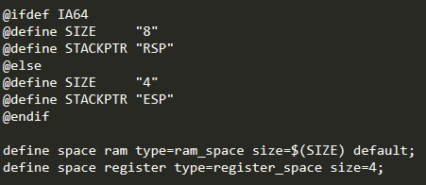
Memory Spaces Definitions
The RAM, ROM, Registers apaces are declared here

Slide 27
Registers Definitions
It is possible to define different registers on the same register spaces

Slide 28
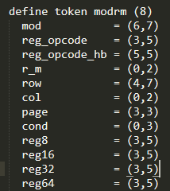
Tokens and Attachments Definitions
Tokens are the instruction building blocks
Attachment’s role is attaching a token to a register

Slide 29
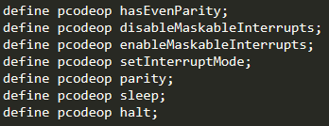
Special P-Code Definitions
Standard P-Code is a defined set and can’t cover the whole Instruction Set

Slide 30
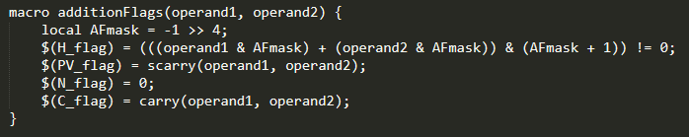
Macros Definitions
They behave like functions, but they are macros as SLEIGH is not a programming language

Slide 31
Constructors
Constructor is the heart of SLEIGH
They are used to construct instruction and auxiliary rules
table_header: display_section is bit_pattern [ disassembly_section ] { semantic_section }
Notes:
'table_header' is the table the constructor will be added to. When omitted, the table is the root table that houses the instructions. Usually non-root table are auxiliary to the root's content.
'display_section' is the what will be displayed when disassembling the instruction.
'bit_patten' is a patten that need to be matched to identify the instruction.
'disassembly_section' is a section made of instruction to be executed in disassembly time. It is usefull for calculating branches for example.
'semantic_section' is where a translation of the instruction into p-code would be added.

Slide 32
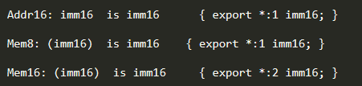

Constructors Example
Auxiliary constructors:
Instruction constructor:
Notes:
Open the Z80 SLEIGH spec and backtrace from the constructors to the tokens and the registers.

Slide 33

Constructors Example
Auxiliary constructors:
Instruction constructor:

Slide 34
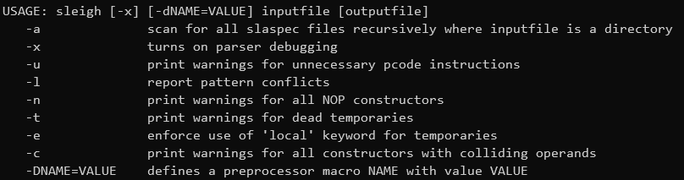
Compilation

Slide 35
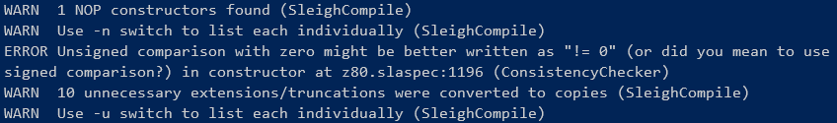
Compilation Example
Let’s Compile Z80 spec
Notes:
Live demonstration

Slide 36
Exercise
X86 is hard, lets go Z80, kinda…

Slide 37
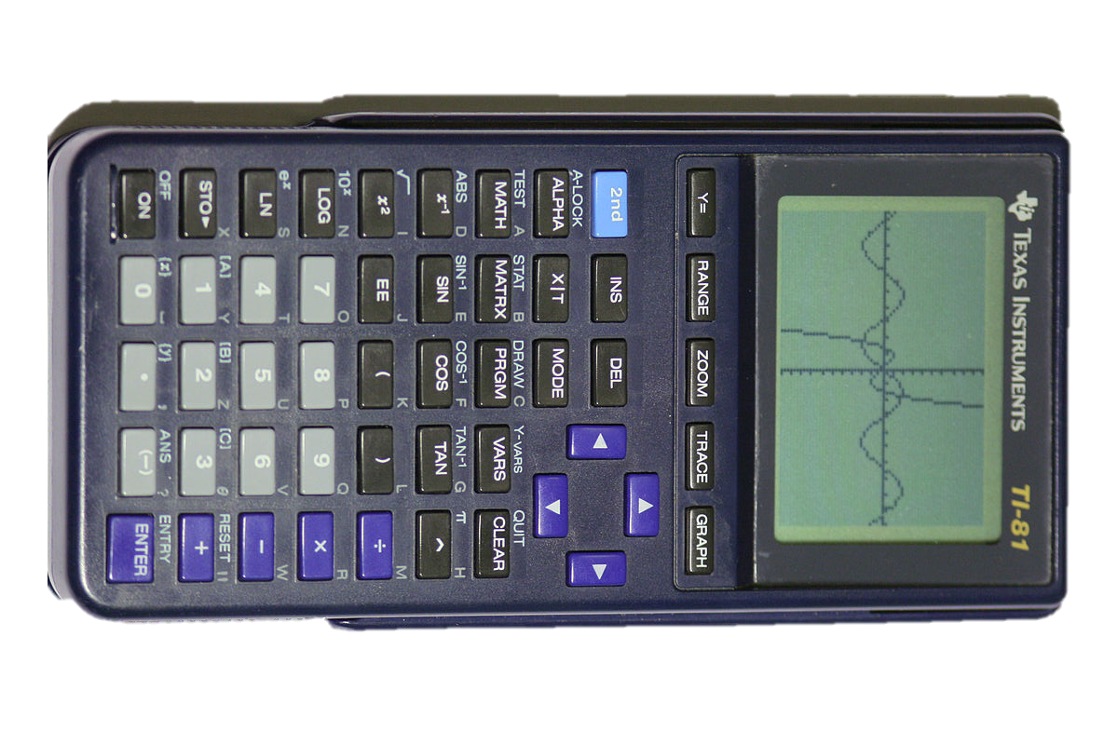
Z80
The Z80 is an 8-bit microprocessor launched in 1976
It was used back then for desktop computers and later for embedded systems, calculators and other handheld devices
Ghidra has a SLEIGH spec for the Z80

Slide 38
Game Boy
Game Boy is an 8-bit handheld game console released by Nintendo in 1989
It uses Sharp’s custom LR35902 microprocessor which is based on Z80
Ghidra doesn’t have Game Boy’s SLEIGH spec 😢 (IDA Pro does 😠)

Slide 39
Our Mission
The NSA intercepted a malicious payload in the presidential Game Boy of the White House
NSA refuses to use IDA Pro, they insist using Ghidra
Our mission is to write a SLEIGH spec for the Game Boy and reverse engineer the payload!

Slide 40
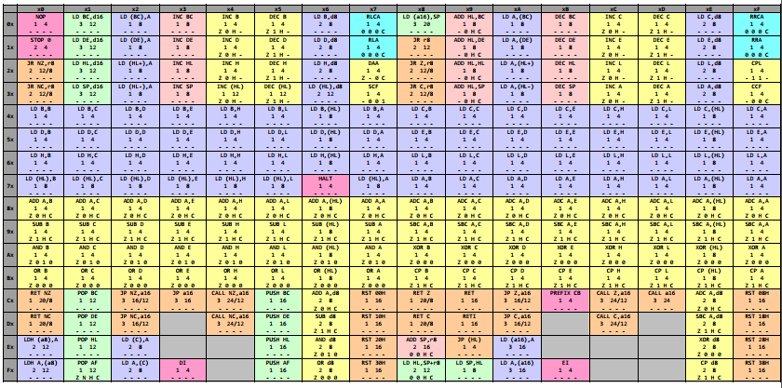
Exercise Details
We will not implement the whole SLEIGH spec, only a subset
The microprocessor’s documentation is provided.
Notes:
Go over the documentation

Slide 41
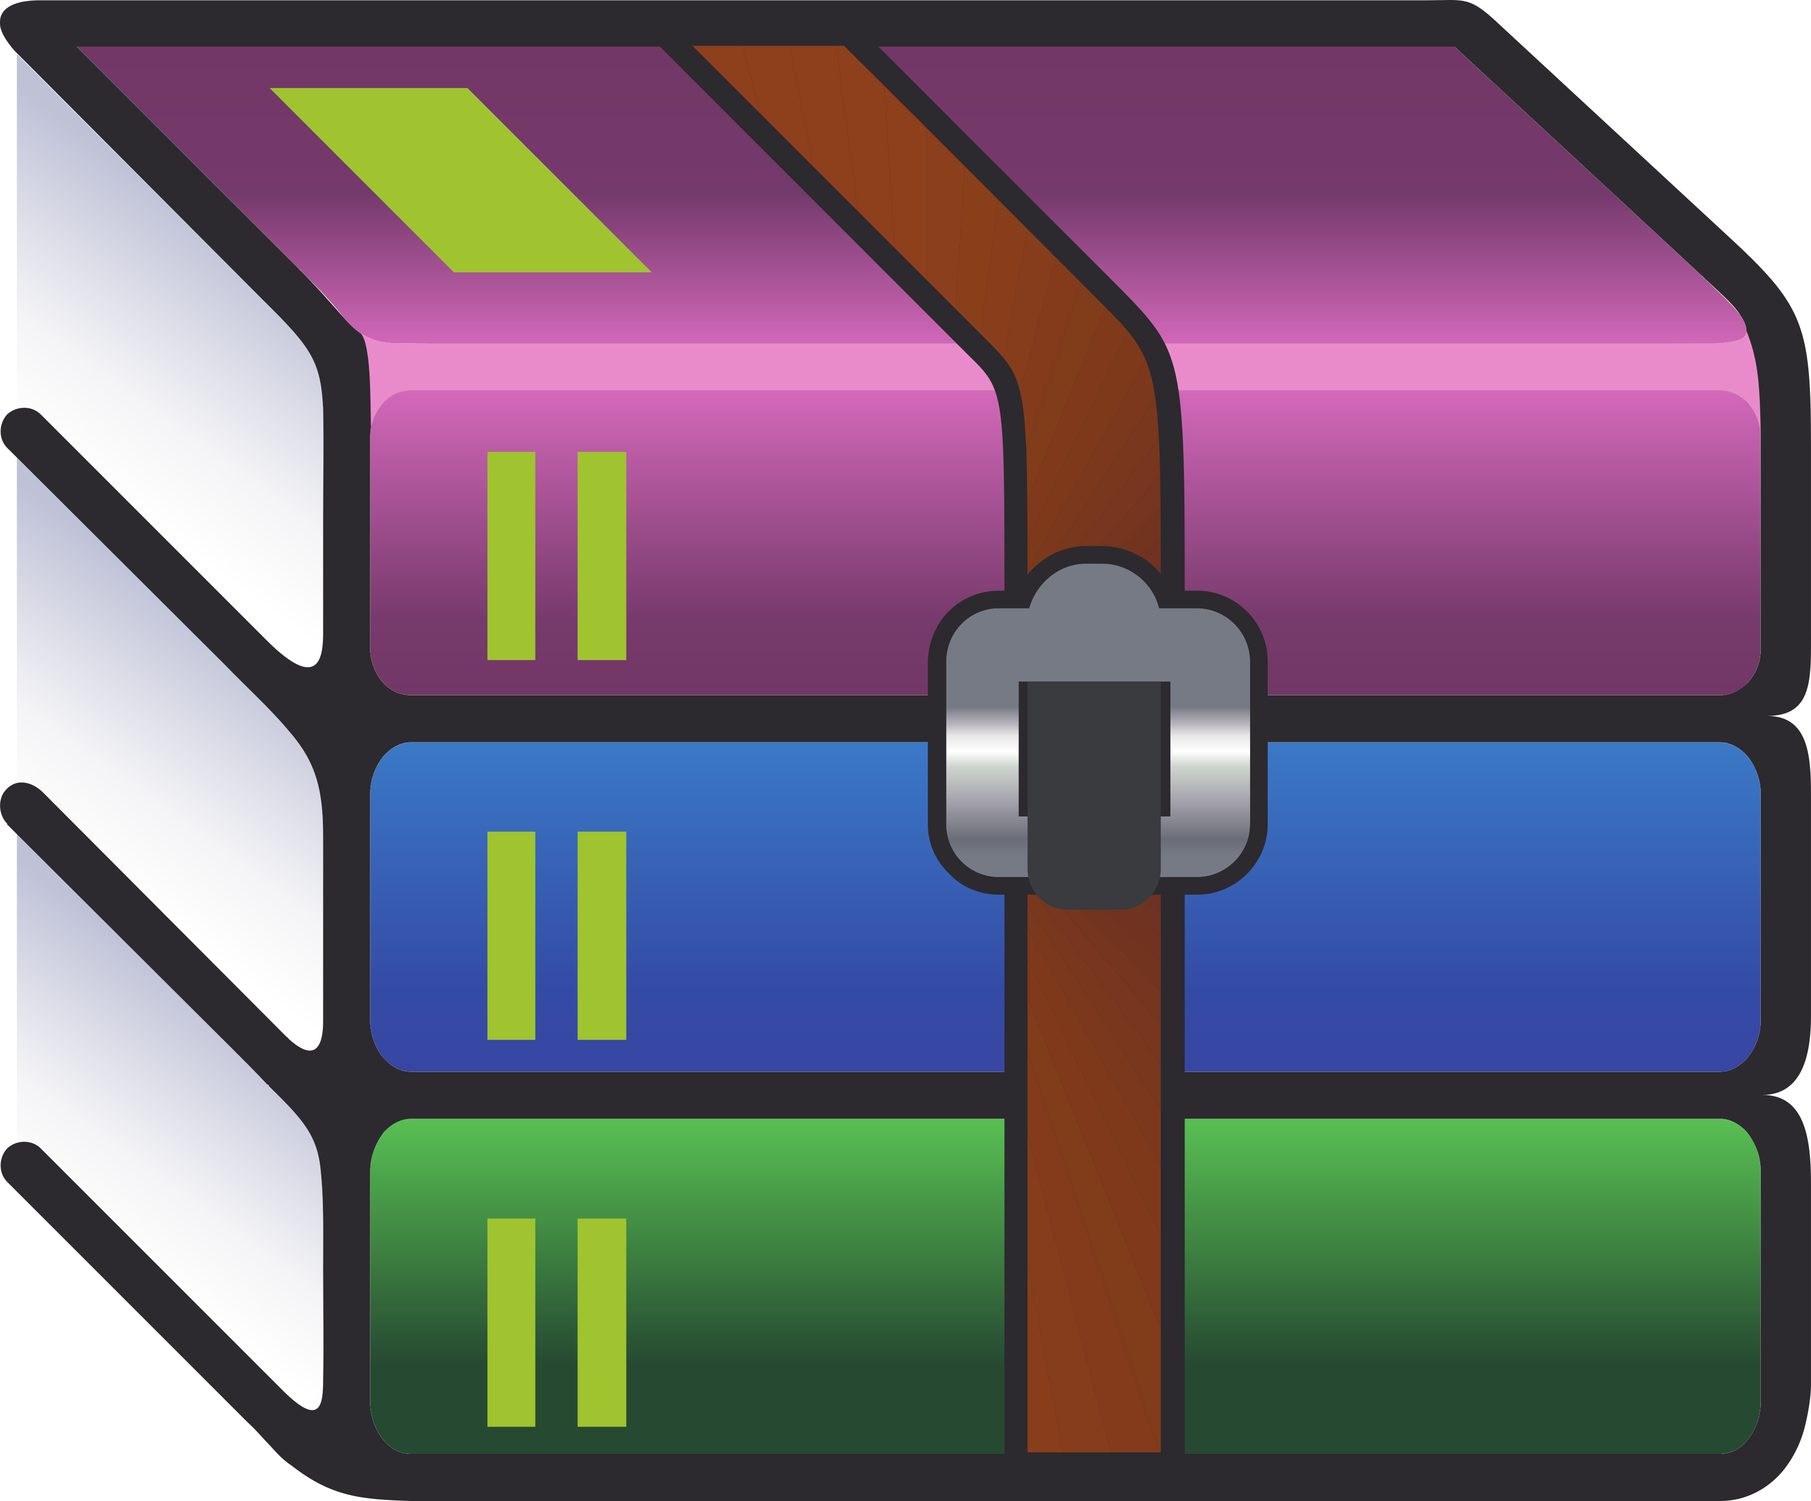
Exercise Resources
Solution is provided in the ‘solution’ directory
The malicious payload is ‘malicious.bin’
The SLEIGH spec template is given at ‘Ghidra\Processors\GB\data\languages\GB.slaspec’
The Game Boy documentation is provided as a PDF
x86 slaspec for reference (‘ia.sinc’)
Notes:
https://github.com/roey-e/ghidra-class

Slide 42
Steps
Complete the registers definitions.
Go over the binary’s HEX representation and list the used instructions using the documentation.
~SYNC~
Notes:
Time = 10 minutes

Slide 43
Steps
Write the instructions in the appropriate place in the ‘slaspec’.
Compile the ‘slaspec’ to ‘sla’.
~SYNC~
Notes:
Suggestion: compile after every instruction
Give the class 10 minutes, take control afterwards
Total time: 15 minutes

Slide 44
Steps
Copy the GB directory to Ghidra/Processor directory.
Disassemble the payload using Ghidra.
~SYNC~
Notes:
Give the class 10 minutes.
Total time = 15 minutes.

Slide 45
Wrap Up
Notes:
Talk about what we did
What is sleigh and what makes it cool (declarative, allows decompilation)
Raise the question: Can we use Sleigh for emulating any processor? (yes and no.)

Slide 46
Questions?

