Slide 1

Week 4 Mini-Project
Team 4
Maksim Akkonen, Mohamed Bakhiet, Robin Faure, Markus Jakonen

Slide 2

E-Rental Business Case
Company Overview
E-Rental is a regional micro-mobility rental company that provides environmentally friendly transportation solutions through a fleet of e-scooters, e-bikes, and kickboards.
The company operates a network of staffed rental stores and unmanned self-service rental stations across Finland, Sweden, Germany, and Switzerland, providing customers with convenient short-term access to e-scooters, e-bikes, and kickboards for commuting, tourism, and recreational use.
Following strong customer adoption and profitable operations during its first two years, E-Rental is preparing for expansion into several new European markets. As the business grows, management requires greater visibility into operational performance, customer behavior, asset utilization, and maintenance costs.

Slide 3
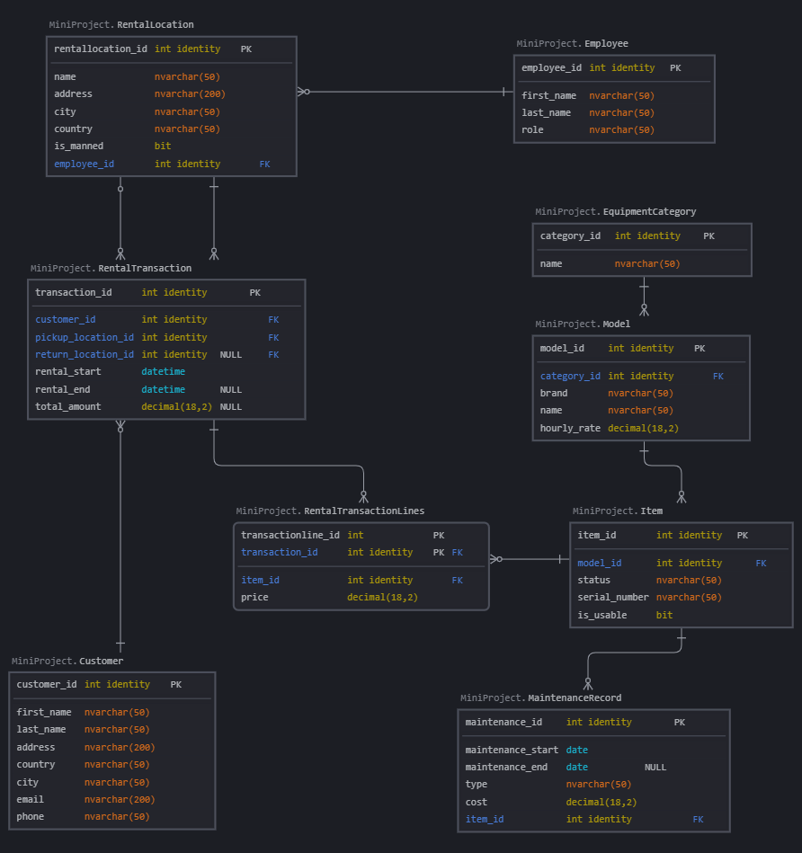

Operational Database Model
Relationship | Description
Employee → RentalLocation | One employee can be responsible for multiple rental locations. Each location references one employee.
Customer → RentalTransaction | One customer can have many rental transactions. Each transaction belongs to one customer.
RentalLocation → RentalTransaction.pickup_location_id | One location can be used as the pickup location for many transactions. Each transaction has one pickup location.
RentalLocation → RentalTransaction.return_location_id | One location can be used as the return location for many transactions. Return location is nullable for active rentals.
RentalTransaction → RentalTransactionLines | One transaction can contain many rented items. Each transaction line belongs to one transaction.
Item → RentalTransactionLines | One item can appear in many transaction lines across its lifecycle, but should not be rented in overlapping active rentals.
EquipmentCategory → Model | One category can contain many equipment models. Each model belongs to one category.
Model → Item | One model can have many physical items. Each item belongs to one model.
Item → MaintenanceRecord | One item can have many maintenance records. Each maintenance record belongs to one item.
The full documentation is on GitHub, in README.md files.

Slide 4
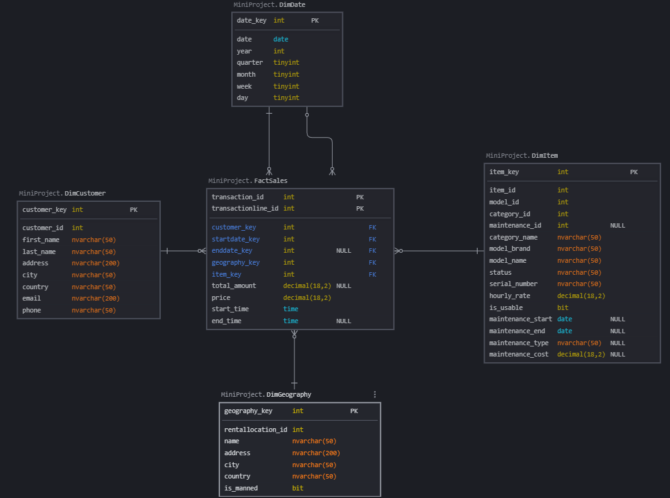
Data Warehouse Model
Fact Grain
One row in FactSales = one rental transaction line = one physical item rented in one rental transaction.
Implications:
A transaction with one rented item produces one fact row
A transaction with three rented items produces three fact rows
transaction_id can repeat in FactSales when a transaction contains multiple items
transactionline_id identifies the individual rented item line
Rented item quantity is not stored as a separate column. It is calculated by counting fact rows.
Line-level rental revenue is calculated from FactSales.price
Transaction-level totals must be handled carefully because total_amount is repeated on every line of a multi-item transaction
The full documentation is on GitHub, in README.md files.

Slide 5
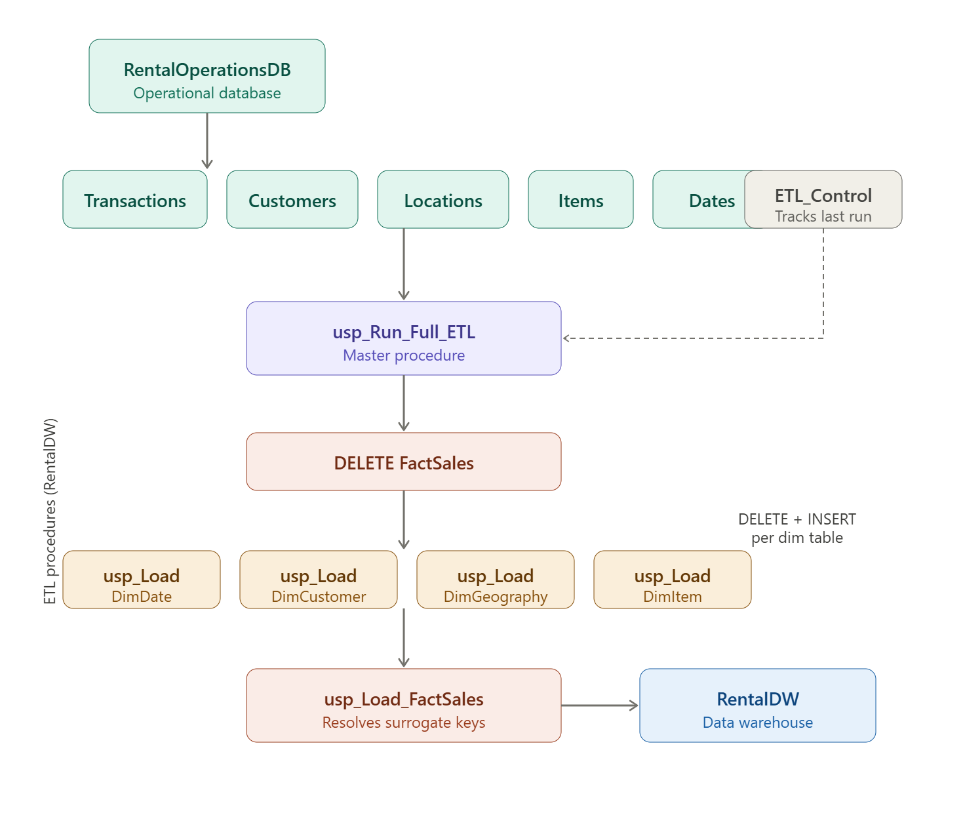
ETL Process Overview
The ETL process extracts data from the RentalOperationsDB, transforms it into a dimensional model, and loads it into the RentalDW for reporting and analysis.
Dimension tables are loaded first. Customer data is loaded into DimCustomer, location data into DimGeography, and equipment-related data from the Item, Model, EquipmentCategory, and MaintenanceRecord tables is combined into DimItem. The DimDate table is populated separately with calendar dates and time attributes.
After the dimensions are populated, the FactSales table is loaded using data from the dimension tables and RentalTransaction and RentalTransactionLines. During this process, business keys are matched to dimension surrogate keys, dates are converted into date keys, and measures such as rental price and total transaction amount are loaded into the fact table.
Finally, validation checks are performed to reconcile source and warehouse data, verify relationships, and ensure data quality and consistency.

Slide 6
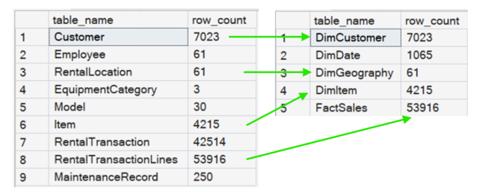
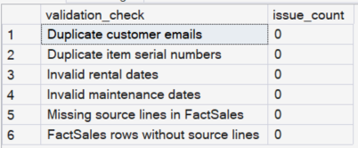
Validations
Row counts from ODB and DW
Summary for the most important checks

Slide 7
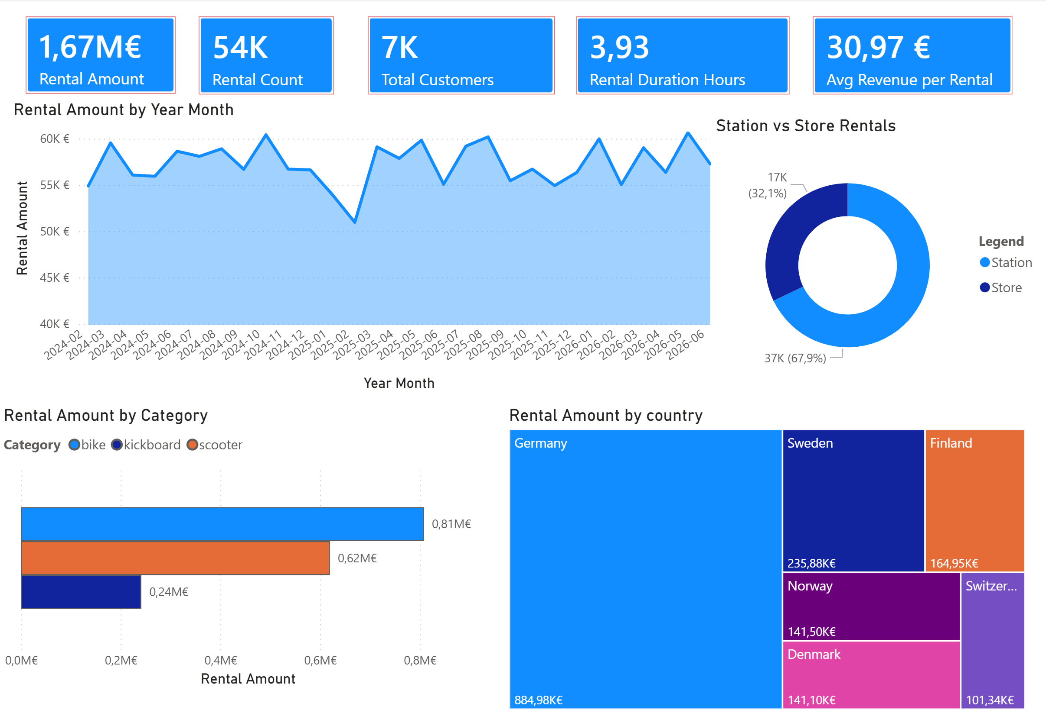

Slide 8
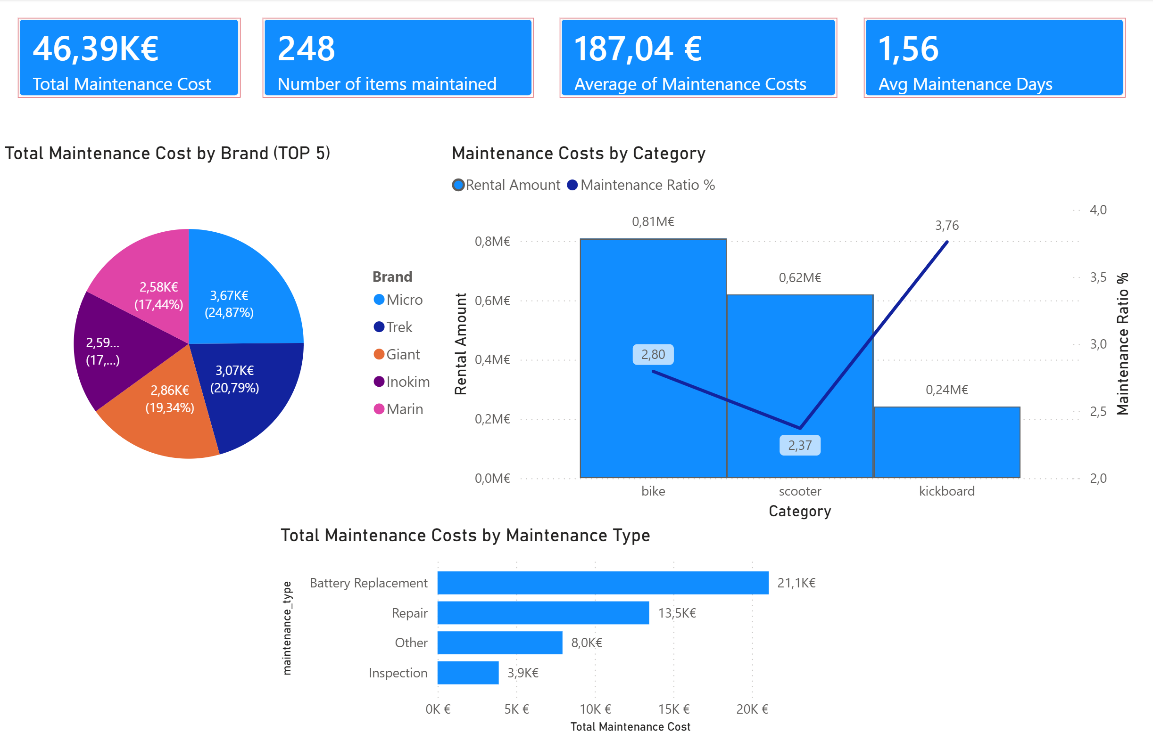

Slide 9
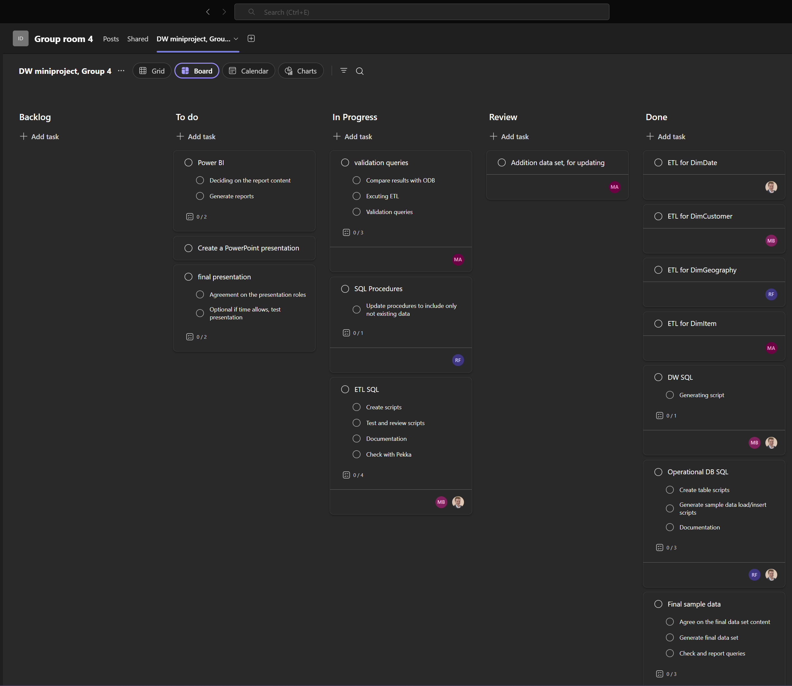
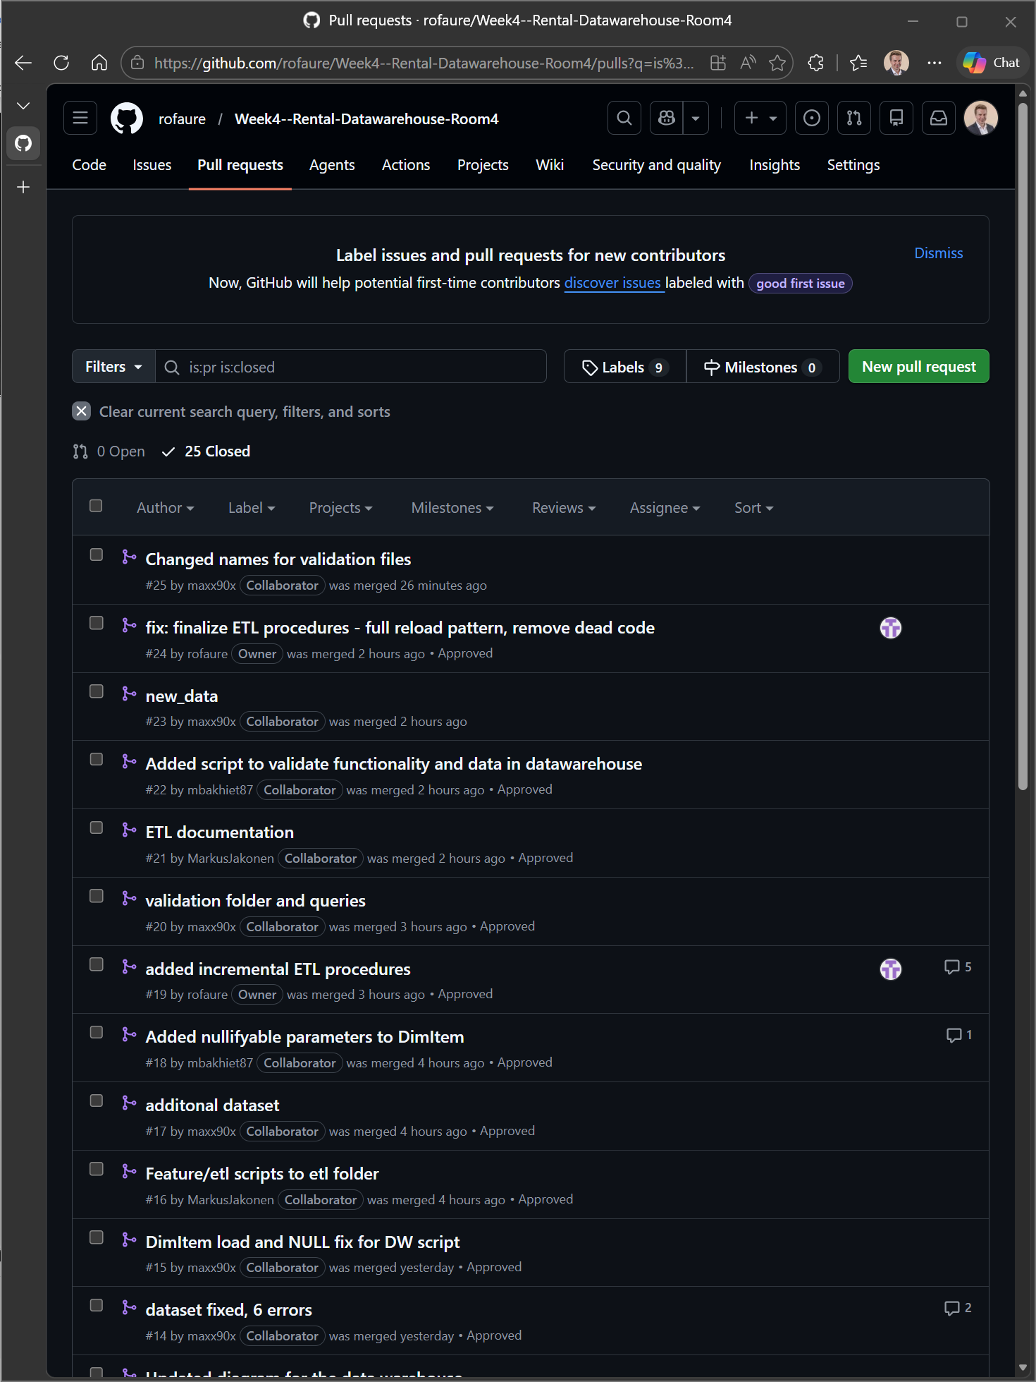
Scrum
Sprint planning: 2 sprints
Daily Scrum every morning
Scrum board for tracking
Product backlog
Sprint backlog
GitHub
All scripts, diagrams, test data and documentation
Branches created from main, merged back via pull requests
Way of Working
GitHub link

Slide 10
Future Improvements
Main Challenges During the Project
Building the ETL process to move data from the source database to the data warehouse.
Converting normalized source data into a dimensional model.
Combining data from multiple source tables.
Handling date and time transformations.
Loading dimension and fact tables correctly.
Validating data and checking for errors.
Comparing source data with warehouse data to ensure accuracy.
Planning for future incremental data loads.
Learning the importance of data quality and consistency.
In the future, the data warehouse could be expanded by adding a separate maintenance dimension table. This would provide more depth for maintenance analysis and allow the company to track historical changes using Type 2 SCD logic. For example, changes in maintenance type, maintenance cost, item condition, or usability status could be preserved over time instead of overwritten. This would improve long-term analysis of equipment reliability, maintenance trends, and asset lifecycle performance.
Notes:
Challenges:
The most challenging aspect of the project was the ETL development process. Transforming data from a highly normalized transactional database into a business-friendly dimensional model required extensive planning, mapping, and testing. Special attention was given to joining data from multiple source tables, creating dimension and fact records, handling date and time transformations, and ensuring that the warehouse accurately reflected the source system.
Additional effort was spent on data validation, source-to-target reconciliation, and designing a strategy for future incremental loads. These challenges provided practical experience in real-world ETL workflows and highlighted the importance of data quality, consistency, and maintainability in data warehouse solutions.

Slide 11

Live demo
Team 4

