Slide 1



Development of a QDA Algorithm for Fault Detection in Boeing 737 Aircraft.
by Rofeeq Shittu A (U21CS1046)
Supervised by:
Prof. PO Achimugu
Air Force Institute of Technology, Kaduna.
July, 2025

Slide 2

The Boeing 737: A Critical Need for Advanced Detection
The Boeing 737 has been a cornerstone of global aviation since 1967, but recent incidents, particularly with the MAX series, have highlighted critical needs for improved fault detection. Traditional methods are often reactive and struggle to identify subtle, evolving system anomalies.
This project aims to develop a Quadratic Discriminant Analysis (QDA) algorithm for enhanced fault detection to have high accuracy, with a strong focus on engine safety and proactive maintenance.
2

Slide 3
AIM AND OBJECTIVES OF THE STUDY
This research aims to develop a QDA algorithm for robust fault detection in Boeing 737 aircraft, leveraging NASA's CMAPSS FD001 and synthetic datasets.
1
Data Collection & Preprocessing: Identify fault-indicative features from CMAPSS FD001.
2
Model Development: Implement a QDA fault detection model.
3
Performance Evaluation: Validate practical applicability against aviation standards.
3

Slide 4
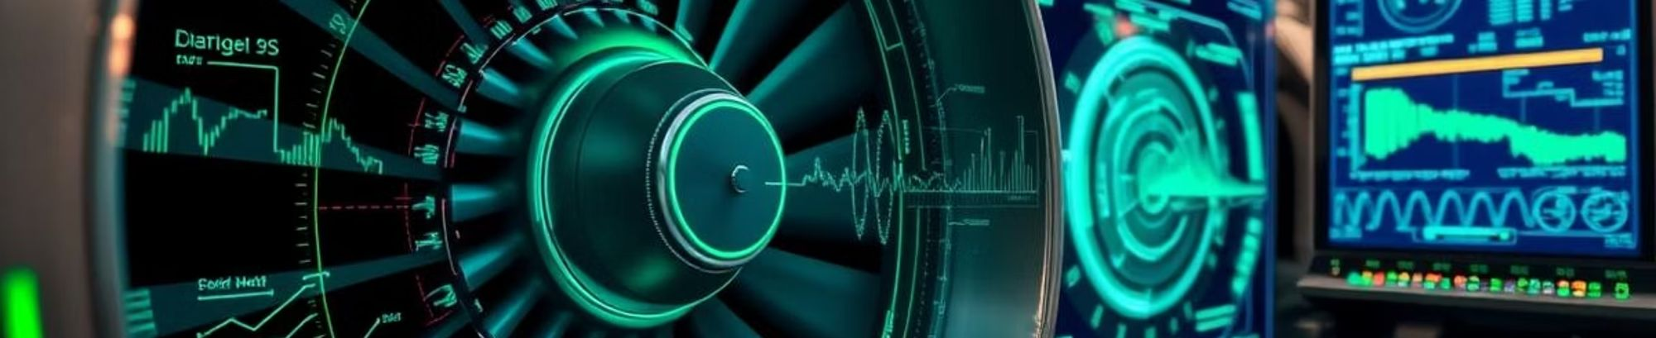
Leveraging Machine Learning for Aviation Safety
Machine learning offers significant potential to revolutionize aviation fault detection. While prior research, such as that by Xia et al. (though since retracted), achieved up to 93% accuracy, a critical gap remains in comprehensive multi-phase and multi-sensor coverage.
This study directly addresses these limitations, building upon existing research to provide a more robust and comprehensive fault detection solution specifically for the Boeing 737.
[...improving on Xia et al, 2025 research]
4

Slide 5

Methodology: A Structured Research Approach
Data Processing
Data Acquisition
Implementing robust preprocessing, including outlier removal and normalization
Utilising CMAPSS FD001 for comprehensive coverage.
Performance Evaluation
QDA Model Training
Evaluating against FAA standards, focusing on accuracy, recall, and robustness.
Training the QDA algorithm to detect subtle fault signatures efficiently.
5

Slide 6

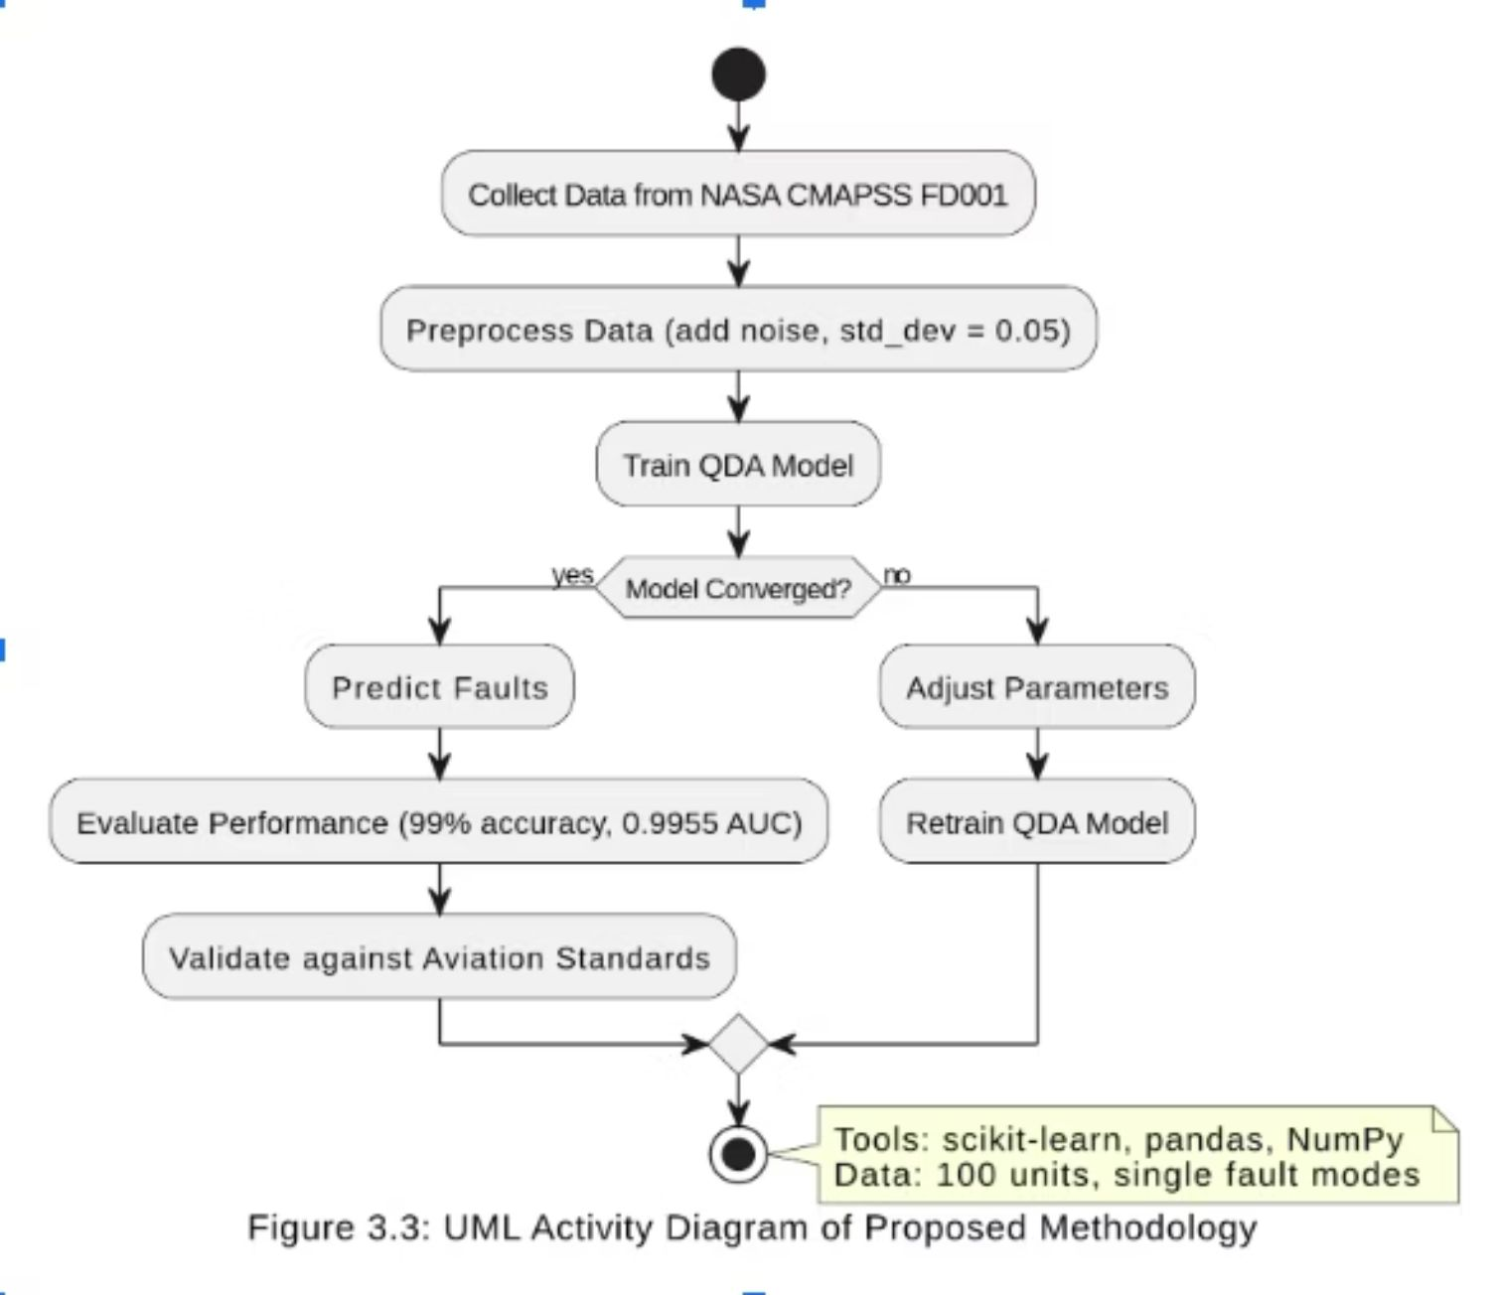



Data Collection and Preprocessing
CMAPSS FD001 dataset: 20,631 cycles, 21 sensor readings (e.g., T30).
Data cleaning: <1% missing data, outliers removed.
SMOTE for class balancing.
17 key features (e.g., T30, P30) selected for fault correlation.
6

Slide 7
Results: Exceeding FAA Standards
Validation Accuracy
Validation AUC
Test Accuracy
Test Recall
Test AUC
False Negatives
False Positives
94.36%
98.90%
99.00%
94.00%
0.9955
6
152
The QDA algorithm demonstrated exceptional performance, achieving 99% accuracy and a 0.9955 AUC on the test set. These results significantly exceed the FAA's minimum 90% accuracy threshold, indicating robust generalisation and effective fault detection capabilities.
7

Slide 8
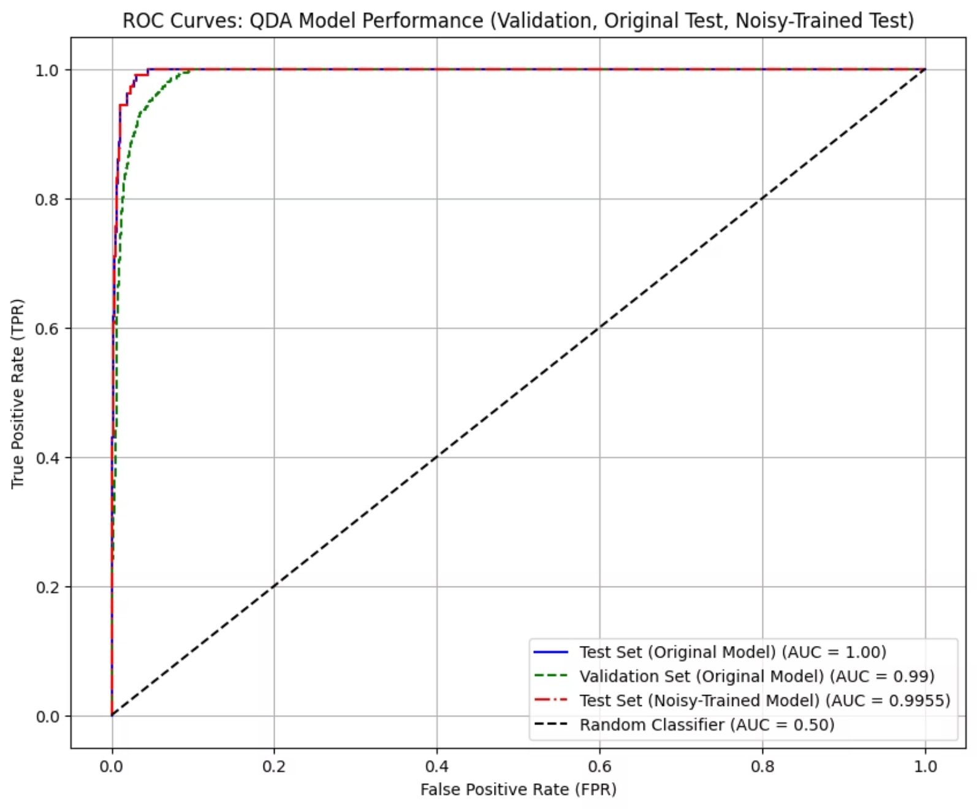
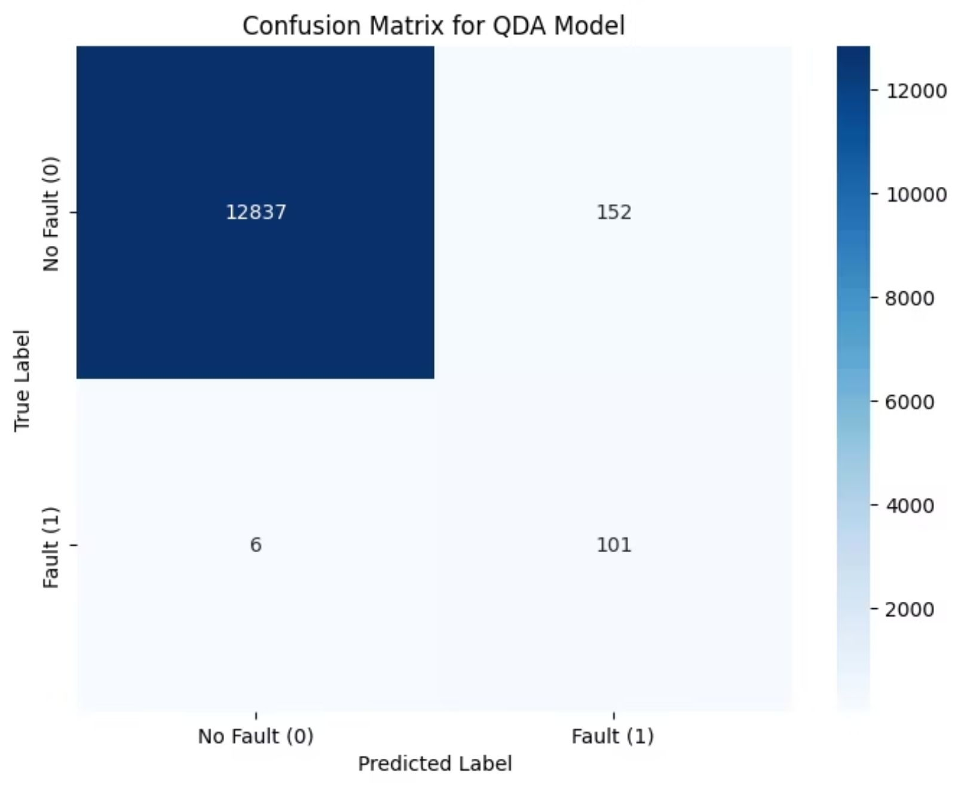
Visualizing Model Effectiveness
The ROC Curve clearly shows a 0.9955 AUC on the test set, confirming the model's excellent discriminative power.
The Confusion Matrix details 12,837 true negatives and 101 true positives, further validating the algorithm's precision. Key features like T30 and P30 are highlighted for their significant contribution to fault detection.
8

Slide 9
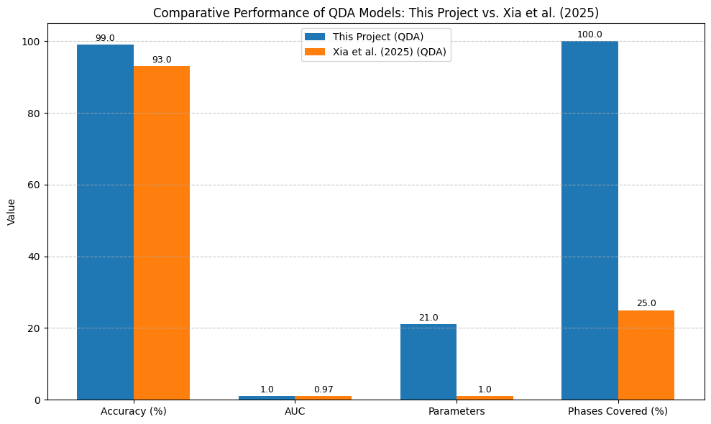
Benchmark/Comparison Chart
My dataset: 21 parameter (8 used) &
Xia et al: 1 – Baroaltitide (Altitude-rltd FD)
All fight phases (taxi to landing) VS only takeoff & accent phase (25%)
This bar plot compares my QDA model with Xia et al.’s 2025 study. My work achieves 99% accuracy and 0.9955 AUC, using 21 parameters across 100% of flight phases, versus their 93% accuracy, 0.97 AUC, and single-parameter, 25% phase coverage. This highlights my improvements in scope and performance.
9

Slide 10

Strengths, Limitations, and Refinements
Key Strengths
High recall (94%) significantly reduces missed faults and robust performance against noise.
Identified Limitations
A precision of 40% and 6 false negatives suggest areas for improvement.
SMOTE's Impact
SMOTE significantly improved specificity, leading to a reduction in false positives.
Future Direction
Further threshold tuning is recommended to enhance precision while maintaining high recall.
10

Slide 11
Impact/Contribution & Future Prospects
Enhanced Safety
Reduced Maintenance Costs
The 94% recall achieved significantly reduces the risk of in-flight failures.
Drastically cuts maintenance costs by minimising 152 false positives compared to the pre-SMOTE 4852. This proactive approach supports efficient maintenance scheduling.
Future Integration
Safer Aviation Future
Holds substantial potential for real-time integration with Flight Data Recorders (FDRs).
Ultimately, this research enhances the safety and operational efficiency of Boeing 737 aircraft, contributing to a safer future for aviation.
11

Slide 12





Conclusion
Achieved 99% accuracy, 0.9955 AUC objectives.
Meets FAA standards, ensures safety.
(Study >) Proactive approach for Boeing 737 maintenance.
Contributes to aviation safety technology.
Successful project outcome demonstrated.
12

Slide 13




Recommendations and Q&A
Tune thresholds to boost precision.
Optimize SMOTE for >95% recall.
Validate with real-world FDR data.
Expore real-time QDA variants.
Questions?
13

Slide 14
Thank You for Your Attention!

