Slide 1
Quick sort algorithm
BY:
Rofida Akram Soliman

Slide 2
purpose
Quicksort is a sorting algorithm designed to efficiently sort arrays or lists. Its main purpose is to rearrange the elements of an array in ascending or descending order using divide and conquer technique

Slide 3
Table of content
01
How it works
02
Structure
The code
03
analysis

Slide 4
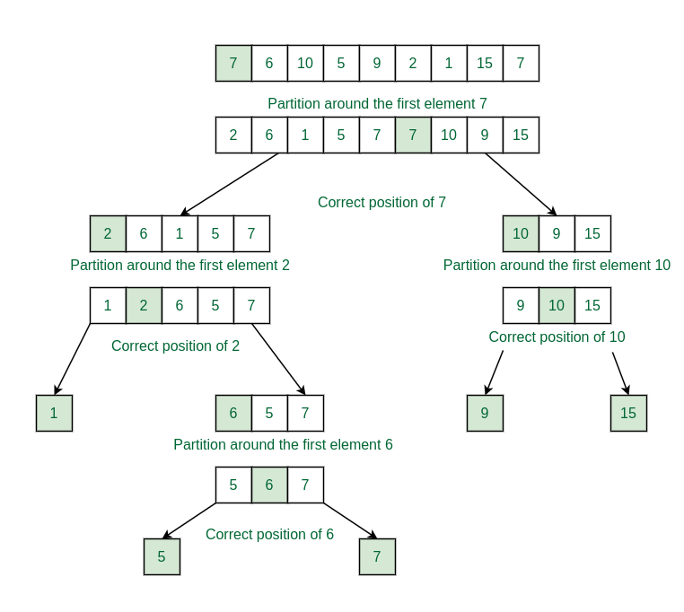
How it works

Slide 5
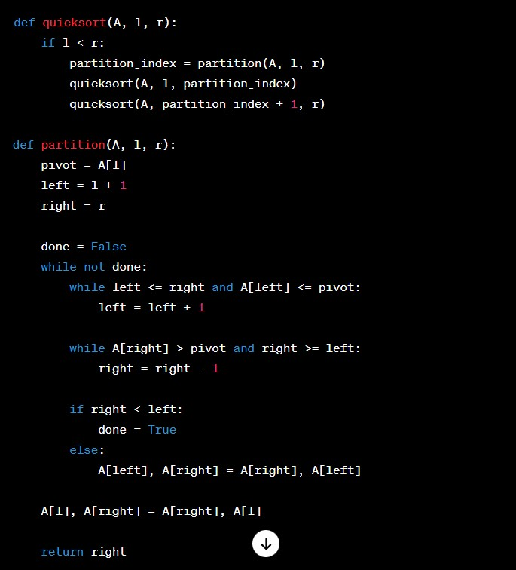
The code

Slide 6
Quick sort analysis

Slide 7
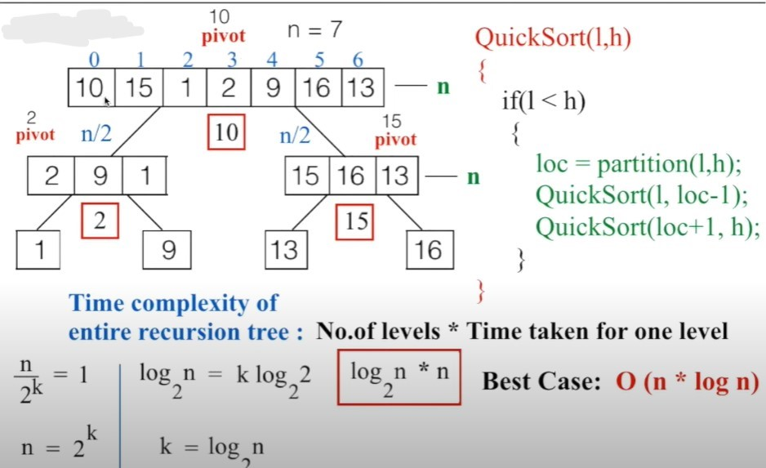

Slide 8
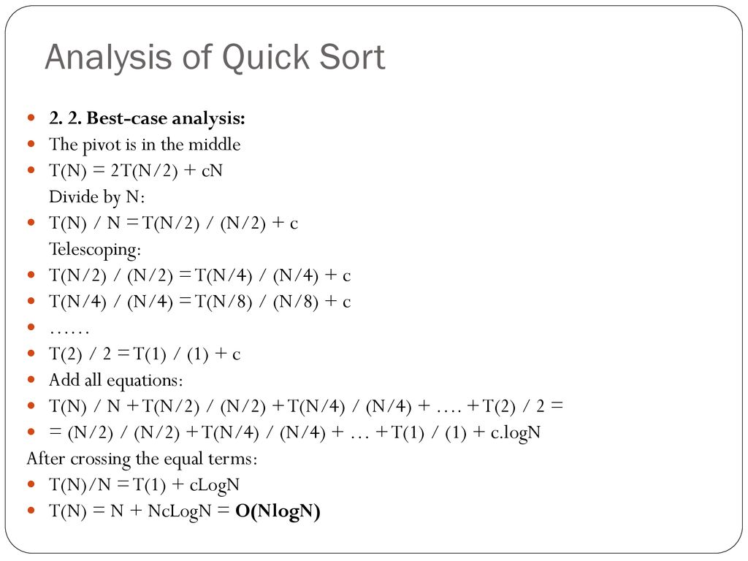

Slide 9
Thank
you🖤

