Slide 1

burning revenge
vs

Slide 2
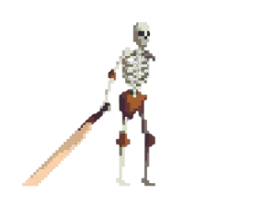
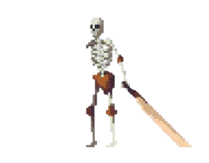
The LOre
Our main hero is a necromancer who decided to reject his power and begin a
Normal life, unlike his brother, who was also a necromancer and become even
More evil.
He had lived quiet and calmly until his Brother
became old. All necromancers Must take
the soul of young necromancer and absorb their
life energy not to die.
So he stole our main`s hero kids(3) and
Our hero is trying to bring them back
And stop his evil brother.

Slide 3

Main mechanics
Main hero
Shooting – our main hero will get the shotgun at the start of the game (about it later)
Dash – our main hero is a mage in the past, so he has the special ability (he is Invulnerable while using)
Jump – jump
Death – become dead
Default mob
Chasing our hero on some distance
Sprinting
Hits with big blade
Death – fall to piecies

Slide 4

Main mechanics
First kid (miniboss 1)
Jumping at our main hero and hit him with a dugger
(while close) teleport behind him and also hit
Becoming dead
Second Kid(miniboss 2)
Throw cursed cubes (yeah he Is cool)
Becoming dead (not cool)
Necromancer
Flying – without wings
Shooting laser – not random( aim to our hero)
Spawning default mobs – I don`t know where he is hiding them
Becoming dead

Slide 5
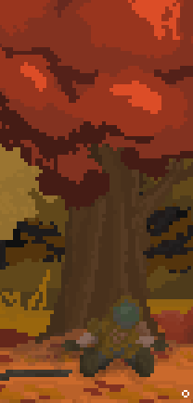
Easter eggs
So, our main hero gets the shotgun from the corpse of the doom

Slide 6
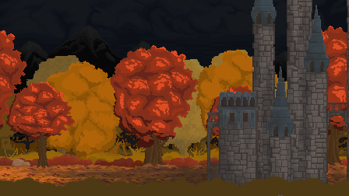
Easter eggs
The castle from the game “heroes of might and magic III”

Slide 7
It must be said
Pixel design (Textures are drawn by ourselves)

