Slide 1
Your Transformer is
Secretly Linear
Razzhigaev, Mikhalchuk, Goncharova, Gerasimenko, Oseledets, Dimitrov, Kuznetsov
Findings of ACL 2024 · published August 2024 · arXiv:2405.12250
Dvir Musari — 216687566
Idan Rosen — 330841131
Roi Khouri — 330909037
Code: <YOUR GITHUB LINK>
Video: <UNLISTED YOUTUBE LINK>
Original code: github.com/AIRI-Institute/LLM-Microscope
Deep Learning (83882) · Bar-Ilan University · Prof. Tom Tirer
Notes:
Introduce the group and the paper. Say in one sentence what the paper claims: the transformation between consecutive layers of a decoder is almost perfectly linear.

Slide 2
MOTIVATION
What does one transformer layer actually do?
A modern decoder stacks 12 to 80 identical blocks: multi-head attention and a non-linear MLP.
The usual assumption is that every block performs a rich non-linear computation that the model cannot do without.
But nobody actually measured how non-linear a single block is.
This is not only an interpretability question — if a block is close to linear, we can delete it or replace it with a matrix and make the model smaller and faster.
0.99
linearity score between
consecutive decoder layers
The paper reports ~0.99 - we measured 0.970
2
Notes:
Set up the question. Emphasise that the surprise is how simple the answer turns out to be.

Slide 3
BACKGROUND · LECTURE 8
Background: the residual stream
h(i+1) = h(i) + Attention( LayerNorm( h(i) ) )
h(i+2) = h(i+1) + MLP( LayerNorm( h(i+1) ) )
residual stream
+
+
+
block i
block i+1
block i+2
each block writes a SMALL update back onto the stream
A block never replaces its input — it only ADDS to it. "Layer i is linear" means: there is ONE matrix A, shared by all tokens, with h(i+1) ≈ h(i)·A.
If such an A exists, the block adds no expressive power that a plain linear layer could not add.
3
Notes:
Connect to the transformer lecture. The residual connection is the structural fact the whole paper is built on.

Slide 4
METHOD
How the paper measures linearity
linearity score = 1 − min over A of ‖ X̃ A − Ỹ ‖²_F
X and Y are the token embeddings of two consecutive layers, both centred and normalised by their Frobenius norm.
This is Procrustes similarity, except the minimum runs over ALL linear maps A, not only orthogonal ones.
Normalising makes the score comparable across depth — embedding norms grow a lot with depth.
The score is in [0, 1]. 1 means a perfect linear relation.
The inner minimisation is plain least squares, so A* = (X̃ᵀX̃)⁻¹ X̃ᵀỸ — closed form, no training needed.
4
Notes:
Explain that no optimisation is needed — this is why the whole analysis is cheap to reproduce.

Slide 5
THE PAPER'S RESULTS
What the paper found
1
2
3
Analysis
Pruning & distillation
Regularization
The main stream scores ~0.99 at almost every depth, in GPT-2, OPT, LLaMA and BLOOM. Remove the residual component and the score collapses.
The most linear layers can be deleted with a small perplexity cost. Replacing them with a linear map plus distillation recovers most of the gap.
A cosine term during pretraining makes layers less linear — and improves SuperGLUE and TinyStories scores for small models.
We reproduce (1) and (2) in full. We do not reproduce (3) — pretraining a 150M model from scratch does not fit on a laptop GPU.
5
Notes:
Keep this slide short — the assignment asks for a brief review of the paper's results so there is time for our own experiments.

Slide 6
OUR EXPERIMENTS
Our setup: the same question on a laptop GPU
 | The paper | Our reproduction
Decoders | GPT-2 XL, OPT 2.7B, Llama2-7B, BLOOM | GPT-2, GPT-2-medium, OPT-125M, Pythia-160M
Encoders | not tested | BERT-base, RoBERTa-base (our extension)
Data | internal corpora, TinyStories, SuperGLUE | WikiText-2 (raw)
Distillation | layer-wise MSE training | closed-form least squares affine fit
Hardware | multi-GPU cluster | one RTX 3050 Ti laptop — 4 GB VRAM
Why small models are still a fair test: the claim is about the architecture, not about one checkpoint — so we test four different families instead of one big model.
6
Notes:
Be honest about the compute limit and explain why the reproduction is still meaningful.

Slide 7
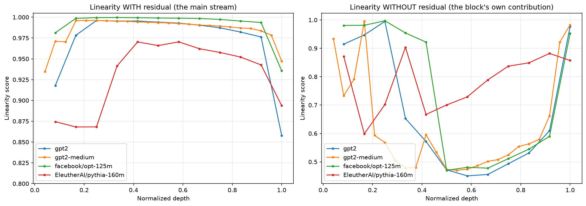
RESULT · REPRODUCES FIGURE 1
Experiment 1 — linearity profiles of four decoders
Model | with res. | w/o res.
gpt2 (12L) | 0.9720 | 0.6724
gpt2-medium (24L) | 0.9854 | 0.6211
opt-125m (12L) | 0.9914 | 0.7384
pythia-160m (12L) | 0.9306 | 0.7821
mean | 0.970 | 0.704
Reproduced. Removing the residual costs 0.27 - the block is not linear, the residual connection around it is.
Three independent codebases land in the same band. Least linear layers: the last (0.8775) and the first (0.9447), exactly as the paper reports.
7
Notes:
Say whether we reproduced the 0.99, and point out that the first and last layers are the least linear.

Slide 8
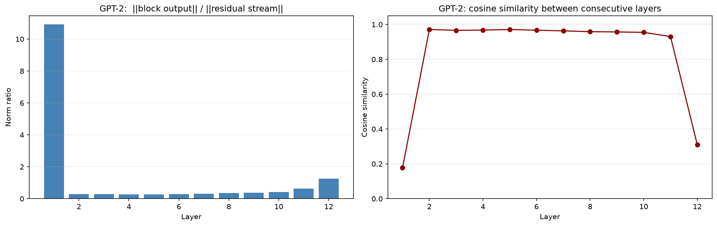
RESULT · REPRODUCES FIGURE 3
Experiment 2 — why is it so linear?
Each block adds a contribution whose norm is small compared with the residual stream it is added to. So h(i+1) ≈ h(i) — and the identity map is trivially linear.
Interior layers 2-11
norm ratio 0.347
cosine 0.961
Each block adds a third of the stream's norm and barely rotates it. That is the mechanism.
Two layers must be excluded: layer 1 (ratio 10.9 - hidden_states[0] is the raw embedding) and layer 12 (includes the final LayerNorm, cosine 0.31). The raw mean of 1.30 is meaningless.
8
Notes:
This is the slide that shows we understood the paper and did not just repeat the abstract.

Slide 9
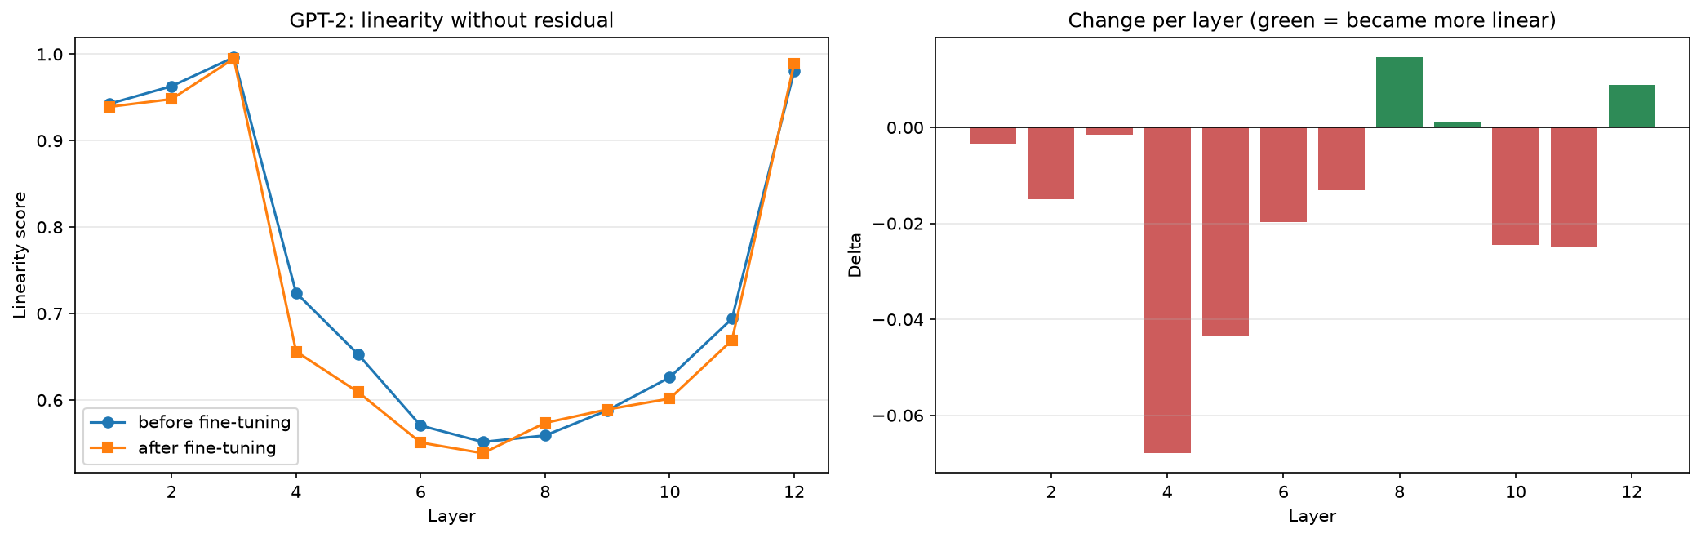
RESULT · WE DO NOT REPRODUCE TABLE 1
Experiment 3 - fine-tuning made layers LESS linear
The paper reports that fine-tuning increases linearity - every entry of its Table 1 is positive. We ran this twice, and the two runs disagree in a way that is more informative than either alone.
Run | Task | val. acc | majority | learned? | mean delta
1 | BoolQ | 0.6175 | 0.622 | NO | +0.1106
2 | SST-2 | 0.9002 | 0.5092 | YES | -0.0157
The paper's direction appeared only when the model FAILED.
Run 1's final loss, 0.6511, is the entropy of the class prior (0.663) - it learned P(y) and nothing else. A collapsed representation is trivially linear.
So: never report a linearity delta without the task accuracy beside it.
9
Notes:
Explain why this is counter-intuitive: we expect fine-tuning to add task-specific structure, yet the layers become simpler.

Slide 10
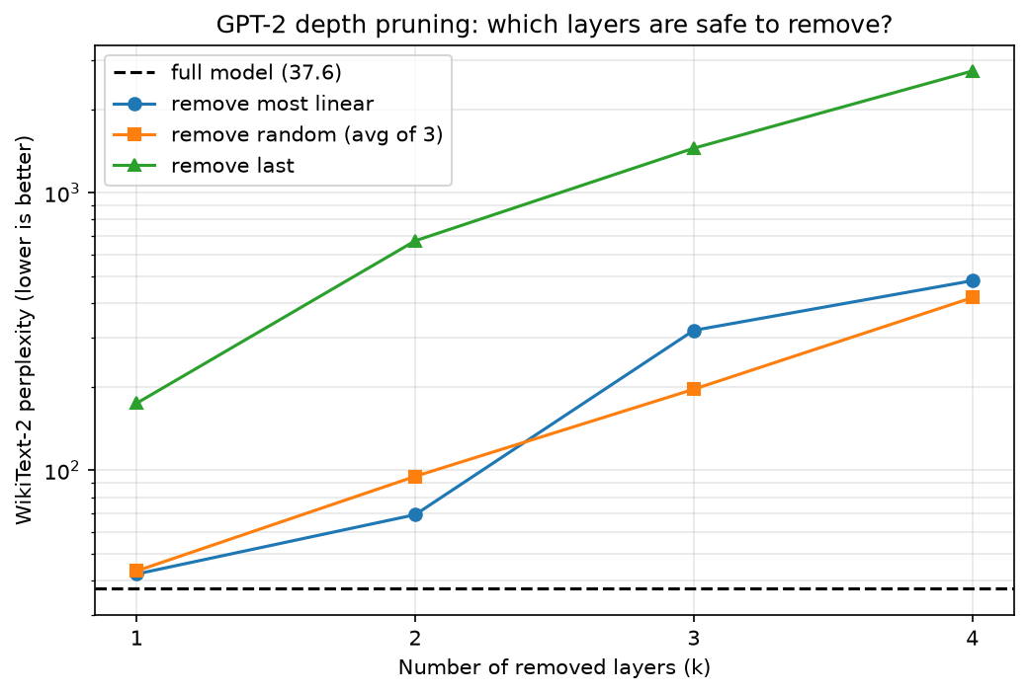
RESULT · REPRODUCES FIGURES 6-8
Experiment 4 — pruning the most linear layers
If a layer is almost a linear map, deleting it should cost little. We rank GPT-2's layers by linearity and compare three deletion strategies by WikiText-2 perplexity. Full model: 37.57.
k | most linear | random | last k
1 | 42.2 | 43.3 | 174.3
2 | 69.1 | 95.0 | 671.1
3 | 319.1 | 195.8 | 1447.2
4 | 482.0 | 418.8 | 2746.5
Wins at k=1,2 - then loses to random.
GPT-2's four most linear layers are 2, 3, 4, 5 - adjacent. Deleting a contiguous block removes a whole stage of computation; random deletions spread the damage. Greedy top-k ignores that layers interact.
10
Notes:
Mention that our models are small, so they have less redundancy to give away than a 1.3B model.

Slide 11
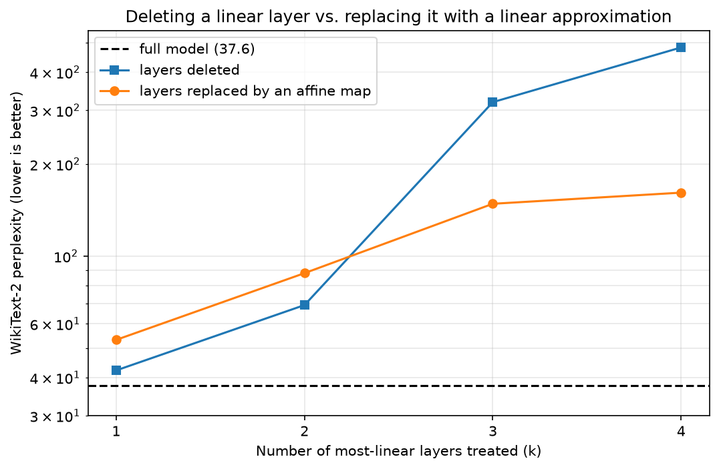
RESULT · OUR CHEAP DISTILLATION
Experiment 5 — replace the layer instead of deleting it
The paper trains the replacement with a distillation loss. But when the target is linear, that objective IS a least-squares problem - so we solve it in closed form. Seconds instead of hours.
k | deleted | affine map | fit R2
1 | 42.2 | 53.2 | 0.997
2 | 69.1 | 87.9 | 0.997
3 | 319.1 | 148.3 | 0.997
4 | 482.0 | 161.3 | 0.996
The curves cross - and that makes sense.
For small k the network absorbs a missing layer, so an imperfect approximation only adds error. At k=4, where deletion is catastrophic, the linear map cuts perplexity from 482 to 161 - three times better, exactly where the technique is needed.
11
Notes:
This is our own simplification of the paper's method — say clearly that it is closed form and why that is possible.

Slide 12
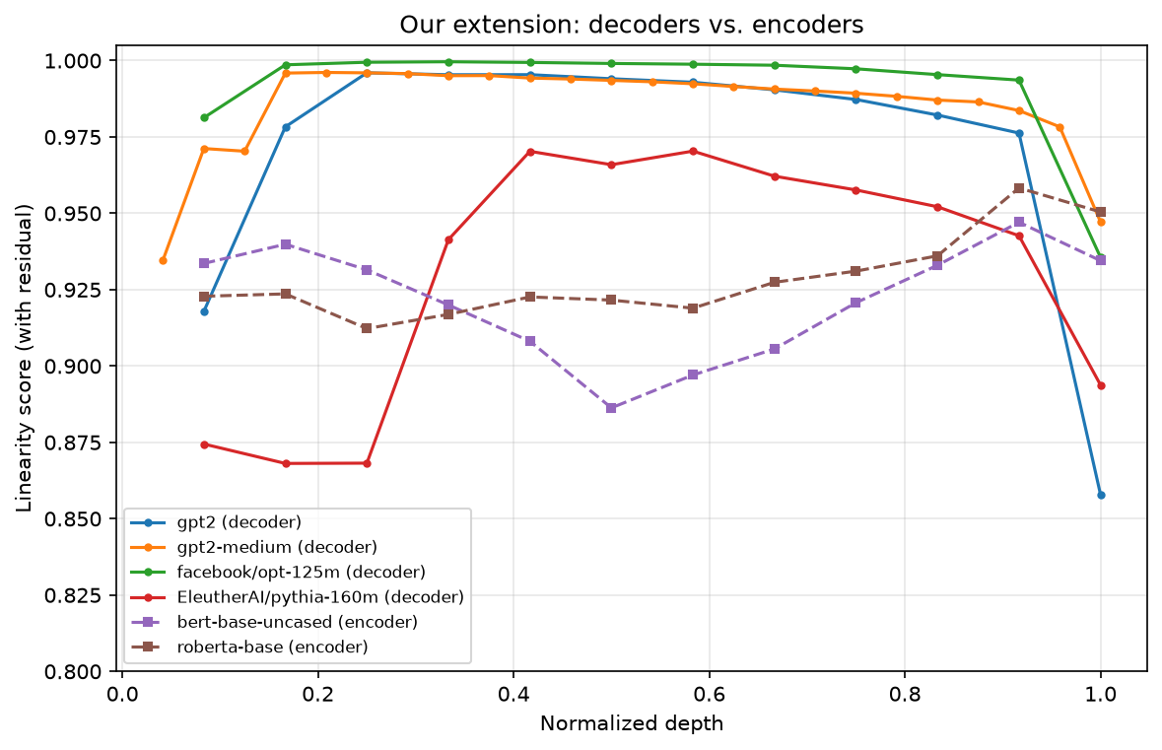
BEYOND THE PAPER
Our extension — are encoders secretly linear too?
"Our analysis predominantly focuses on transformer decoders, thus the generalizability of our findings to encoder-only or encoder-decoder architectures may be limited." — the paper's Limitations section
The title says "transformer", but every experiment in the paper is about decoders.
Yet the explanation they give — a small block output added to a large residual stream — is not specific to decoders at all. BERT and RoBERTa have exactly the same structure.
So we ran the identical measurement on BERT-base and RoBERTa-base and plotted them next to the decoders.
Yes - BERT 0.9214, RoBERTa 0.9285. Far above the 0.094 floor, so the effect is real in encoders too; but below every decoder except Pythia, so it is weaker.
12
Notes:
Explain why we picked this experiment: it tests a limitation the authors themselves admit, and it is cheap enough for our hardware.

Slide 13
DISCUSSION
What our results say about the paper
Limitations we can now argue from data
Challenges we hit
The metric is generous TWICE. Most of a block is already linear - Q, K, V, output and both MLP layers are matrix multiplications. Only softmax and GELU are not, and everything linear is absorbed into A for free.
The score is an R-squared, so it is inflated by ~d/n - and the paper never reports n.
The Table 1 result is not robust: we got its sign only from a fine-tune that failed.
Greedy top-k pruning is the wrong rule: the most linear layers are adjacent.
A fine-tune that looked like it worked: +0.1106, matching the paper - until we compared 0.6175 against the 0.622 majority baseline.
A learning-rate search too small to be a search: 38 optimizer steps, every candidate at chance.
float16 cannot resolve a score of 0.97 - the least squares had to move to float64 on the CPU.
free_memory(model) freed nothing: del on a parameter drops the function's local name, not the caller's reference.
torch.cuda.is_available() was False - Windows pip installs a CPU-only torch that raises no error.
13
Notes:
The assignment explicitly rewards discussing limitations and challenges — spend real time on this slide.

Slide 14
Conclusions
Decoders really are almost linear between consecutive layers - mean 0.970 across four families, falling to 0.704 once the residual is subtracted.
The mechanism holds: each interior block adds 0.35 of the stream's norm at a cosine of 0.96, so the next state is mostly the previous one.
Pruning works for one or two layers and then fails - the most linear layers are adjacent, and a closed-form affine replacement rescues it (482 to 161 at k=4).
We did NOT reproduce Table 1. A real fine-tune gave -0.0157; only a failed one gave +0.1106. A linearity delta is uninterpretable without task accuracy beside it.
Encoders are secretly linear too (BERT 0.9214, RoBERTa 0.9285) - so this belongs to residual networks, not to decoders.
Thank you · Questions?
Notes:
Fill the blanks from results.json once the notebook has been run end to end.

Slide 15
APPENDIX
Appendix A — the linearity score, step by step
1. Take the token embeddings of two consecutive layers: X, Y of shape (n tokens × d).
2. Centre both matrices by subtracting the mean over tokens.
3. Divide each by its Frobenius norm — this makes the score scale-invariant.
4. Solve the least squares problem A* = (X̃ᵀX̃ + εI)⁻¹ X̃ᵀỸ in float64.
5. score = 1 − ‖X̃A* − Ỹ‖²_F.
Sanity checks we ran: an exact linear map gives 1.000, an independent random matrix gives ≈0.02, and ReLU on top of a linear map gives ≈0.74.
Notes:
Use this slide only if someone asks how the metric is computed.

Slide 16
APPENDIX · OUR CONTROL
Appendix B - does the score depend on how much text you measure?
The linearity score is an R-squared, so fitting d parameters to n samples explains ~d/n of the variance by chance. We confirmed the law, then re-ran the two GPT-2 models at 3x the tokens to check that our depth reading was not an artifact of it.
n | d | measured on random data | d / n
2048 | 768 | 0.3748 | 0.3750
8192 | 768 | 0.0936 | 0.0938
8192 | 1024 | 0.1249 | 0.1250
24576 | 768 | 0.0313 | 0.0312
24576 | 1024 | 0.0417 | 0.0417
Model | n=8192 | n=24576
gpt2 | 0.9720 | 0.9671
gpt2-medium | 0.9854 | 0.9809
gap | 0.0134 | 0.0138
The gap does not move. Had it been a floor artifact it should have shrunk by ~0.021, so the difference between the two models is real and the depth reading survives.
A caveat the paper does not discuss: any linearity score should be reported together with the n it was measured on.
16
Notes:
Backup numbers for questions.

