Slide 1
all documents
true relevant
assessed & relevant
retrieved by any contestant
missing assessments but no impact on ranking

Slide 2
all documents
true relevant
retrieved by any contestant
assessed & relevant
missing assessments impact relative ranking

Slide 3
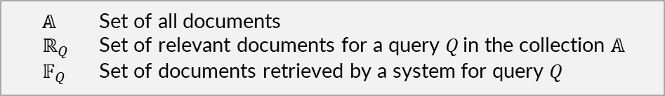
$𝔸$ Set of all documents
$ℝ_{Q}$ Set of relevant documents for a query $Q$ in the collection $𝔸$
$𝔽_{Q}$ Set of documents retrieved by a system for query $Q$

Slide 4
$$\begin{matrix}p=\frac{\left|𝔽_{Q}∩ℝ_{Q}\right|}{\left|𝔽_{Q}\right|} & r=\frac{\left|𝔽_{Q}∩ℝ_{Q}\right|}{\left|ℝ_{Q}\right|} & f=\frac{\left|𝔽_{Q}∖ℝ_{Q}\right|}{\left|{𝔸∖ℝ}_{Q}\right|}\end{matrix}$$

Slide 5


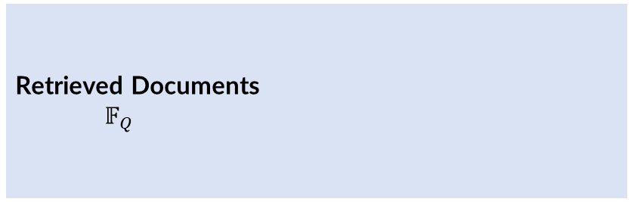

Collection of Documents
$$𝔸$$
Relevant
Documents
$ℝ_{Q}$
Retrieved Documents
$𝔽_{Q}$
Relevant,
Retrieved
$$𝔽_{Q}∩ℝ_{Q}$$

Slide 6
Precision: $p=\frac{\left|𝔽_{Q}∩ℝ_{Q}\right|}{\left|𝔽_{Q}\right|}$ Recall: $r=\frac{\left|𝔽_{Q}∩ℝ_{Q}\right|}{\left|ℝ_{Q}\right|}$ Fallout: $f=\frac{\left|𝔽_{Q}∖ℝ_{Q}\right|}{\left|{𝔸∖ℝ}_{Q}\right|}$

Slide 7
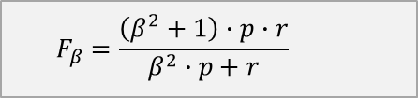
$$F_{β}=\frac{\left(β^{2}+1\right)∙p∙r}{β^{2}∙p+r}$$

Slide 8
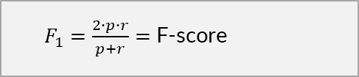
$F_{1}=\frac{2∙p∙r}{p+r}=$F-score

Slide 9


🔍 Search Method A
🔍 Search Method B
$p=\frac{7}{14}=50\%$ $r=\frac{7}{20}=35\%$ $F_{1}=\frac{2∙\frac{7}{14}∙\frac{7}{20}}{\frac{7}{14}+\frac{7}{20}}=0.41$
$p=\frac{4}{6}=67\%$ $r=\frac{4}{20}=20\%$ $F_{1}=\frac{2∙\frac{4}{6}∙\frac{4}{20}}{\frac{4}{6}+\frac{4}{20}}=0.31$
relevant document
non-relevant document

Slide 10
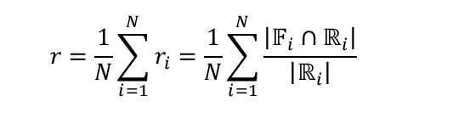
$$r=\frac{1}{N}\sum_{i=1}^{N}{r_{i}}=\frac{1}{N}\sum_{i=1}^{N}{\frac{\left|𝔽_{i}∩ℝ_{i}\right|}{\left|ℝ_{i}\right|}}$$
$$p=\frac{1}{N}\sum_{i=1}^{N}{p_{i}}=\frac{1}{N}\sum_{i=1}^{N}{\frac{\left|𝔽_{i}∩ℝ_{i}\right|}{\left|𝔽_{i}\right|}}$$

Slide 11
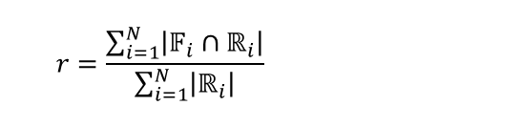
$$p=\frac{\sum_{i=1}^{N}{\left|𝔽_{i}∩ℝ_{i}\right|}}{\sum_{i=1}^{N}{\left|𝔽_{i}\right|}}$$
$$r=\frac{\sum_{i=1}^{N}{\left|𝔽_{i}∩ℝ_{i}\right|}}{\sum_{i=1}^{N}{\left|ℝ_{i}\right|}}$$

Slide 12
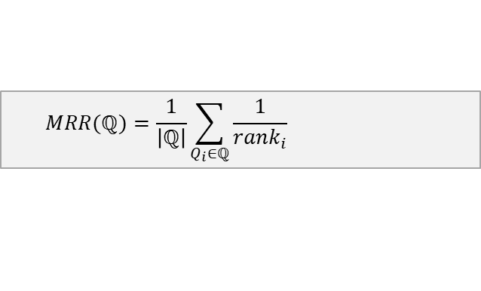
$$MRR(ℚ)=\frac{1}{\left|ℚ\right|}\sum_{Q_{i}∈ℚ}{\frac{1}{{rank}_{i}}}$$

Slide 13









🔍 Search Method A
$$RR_{1}=\frac{1}{2}=0.5$$
$$Q_{1}$$
$$RR_{2}=\frac{1}{4}=0.25$$
$$Q_{2}$$
$$RR_{3}=\frac{1}{1}=1$$
$$Q_{3}$$
$$RR_{4}=\frac{1}{5}=0.2$$
$$Q_{4}$$
①
①
①
①
②
②
②
②
③
③
③
③
$$MRR_{A}(ℚ)=0.49$$
④
④
④
④
⑤
⑤
⑤
⑤

Slide 14





























$$Q_{1}$$
①
$$p_{1}=100\%$$
$$r_{1}=20\%$$
Precision-Recall-Curve
②
$$p_{2}=100\%$$
$$r_{2}=40\%$$
③
$$p_{3}=67\%$$
$$r_{3}=40\%$$
④
$$p_{4}=75\%$$
$$r_{4}=60\%$$
⑤
$$p_{5}=60\%$$
$$r_{5}=60\%$$
⑥
$$p_{6}=67\%$$
$$r_{6}=80\%$$
⑦
$$p_{7}=57\%$$
$$r_{7}=80\%$$
ranking
⑧
$$p_{8}=50\%$$
$$r_{8}=80\%$$
⑨
$$p_{9}=44\%$$
$$r_{9}=80\%$$
Interpolated
⑩
$$p_{10}=40\%$$
$$r_{10}=80\%$$
⑪
$$p_{11}=36\%$$
$$r_{11}=80\%$$
⑫
$$p_{12}=33\%$$
$$r_{12}=80\%$$
⑬
$$p_{13}=38\%$$
$$r_{13}=100\%$$
⑭
$$p_{14}=36\%$$
$$r_{14}=100\%$$

Slide 15



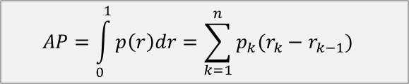
fact- checker
$$AP=\int_{0}^{1}{p\left(r\right)dr}=\sum_{k=1}^{n}{p_{k}(r_{k}−r_{k−1})}$$
System Efficiency
R-precision
$$MAP\left(ℚ\right)=\frac{1}{\left|ℚ\right|}\sum_{Q_{i}∈ℚ}{AP\left(Q_{i}\right)}$$
Precision
$$AP$$
patent lawyer
Recall
$$r_{t}$$

Slide 16
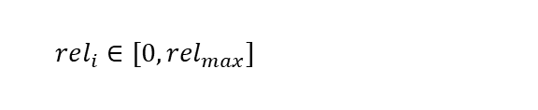
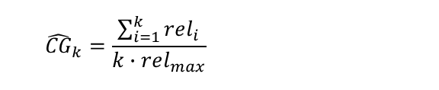
$$CG_{k}=\sum_{i=1}^{k}{rel_{i}}$$
$${\hat{CG}}_{k}=\frac{\sum_{i=1}^{k}{rel_{i}}}{k∙rel_{max}}$$
$$rel_{i}∈[0, {rel}_{max}]$$

Slide 17
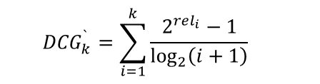
$$DCG_{k}=\sum_{i=1}^{k}{\frac{rel_{i}}{\log_{2}\left(i+1\right)}}$$
$${DCG}_{k}^{`}=\sum_{i=1}^{k}{\frac{2^{rel_{i}}−1}{\log_{2}\left(i+1\right)}}$$
variant:

Slide 18

$$nDCG_{k}=\frac{DCG_{k}}{IDCG_{k}}$$
$$IDCG_{k}=\max{DCG_{k}}$$
with: (over all possible rankings of documents)

Slide 19
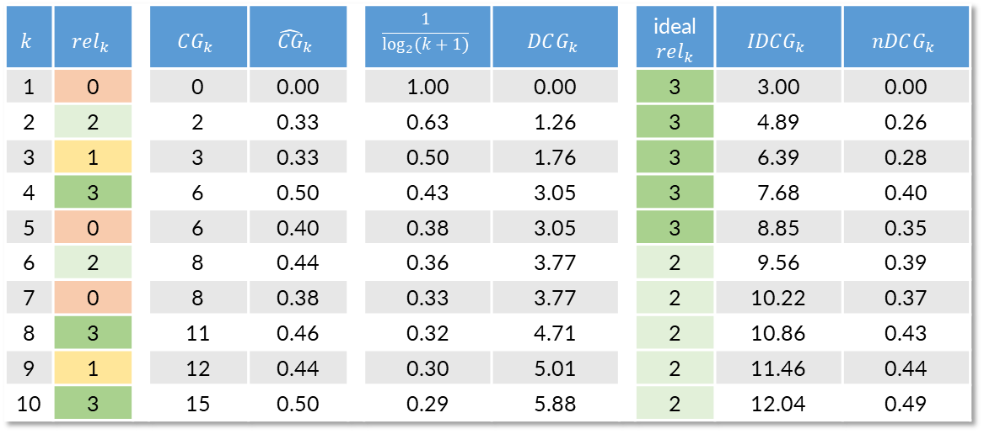
$$k$$ | $$rel_{k}$$ |  | $$CG_{k}$$ | $${\hat{CG}}_{k}$$ |  | $$\frac{1}{\log_{2}{(k+1)}}$$ | $$DCG_{k}$$ |  | ideal $rel_{k}$ | $$IDCG_{k}$$ | $$nDCG_{k}$$
1 | 0 |  | 0 | 0.00 |  | 1.00 | 0.00 |  | 3 | 3.00 | 0.00
2 | 2 |  | 2 | 0.33 |  | 0.63 | 1.26 |  | 3 | 4.89 | 0.26
3 | 1 |  | 3 | 0.33 |  | 0.50 | 1.76 |  | 3 | 6.39 | 0.28
4 | 3 |  | 6 | 0.50 |  | 0.43 | 3.05 |  | 3 | 7.68 | 0.40
5 | 0 |  | 6 | 0.40 |  | 0.38 | 3.05 |  | 3 | 8.85 | 0.35
6 | 2 |  | 8 | 0.44 |  | 0.36 | 3.77 |  | 2 | 9.56 | 0.39
7 | 0 |  | 8 | 0.38 |  | 0.33 | 3.77 |  | 2 | 10.22 | 0.37
8 | 3 |  | 11 | 0.46 |  | 0.32 | 4.71 |  | 2 | 10.86 | 0.43
9 | 1 |  | 12 | 0.44 |  | 0.30 | 5.01 |  | 2 | 11.46 | 0.44
10 | 3 |  | 15 | 0.50 |  | 0.29 | 5.88 |  | 2 | 12.04 | 0.49

Slide 20
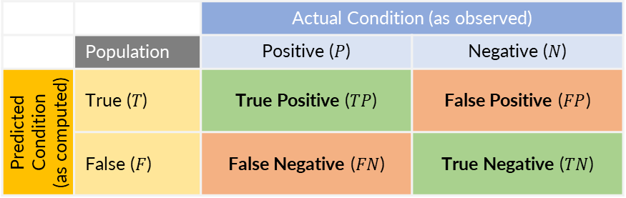
 |  | Actual Condition (as observed)
 | Population | Positive ($P$) | Negative ($N$)
Predicted Condition (as computed) | True ($T$) | True Positive ($TP$) | False Positive ($FP$)
 | False ($F$) | False Negative ($FN$) | True Negative ($TN$)
There is also “confusion” regarding the placement of actual values in the confusion matrix. Earlier papers display the confusion matrix with actual values in the columns (like here on the left side), while more recent publications and popular software packages use the transformed notation, placing the actual values as rows. This does not change the interpretation of the confusion matrix but makes it difficult to read the table if it appears in the unfamiliar form.

Slide 21
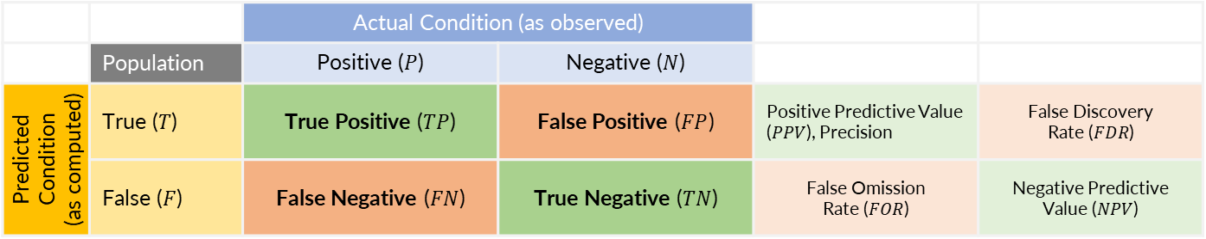
 |  | Actual Condition (as observed)
 | Population | Positive ($P$) | Negative ($N$)
Predicted Condition (as computed) | True ($T$) | True Positive ($TP$) | False Positive ($FP$) | Positive Predictive Value ($PPV$), Precision | False Discovery Rate ($FDR$)
 | False ($F$) | False Negative ($FN$) | True Negative ($TN$) | False Omission Rate ($FOR$) | Negative Predictive Value ($NPV$)

Slide 22
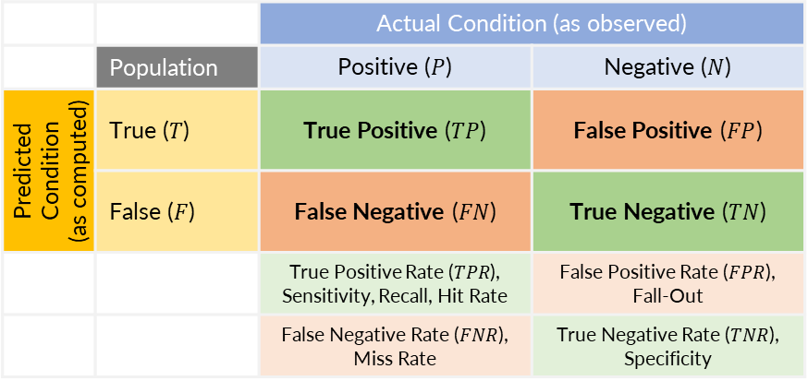
 |  | Actual Condition (as observed)
 | Population | Positive ($P$) | Negative ($N$)
Predicted Condition (as computed) | True ($T$) | True Positive ($TP$) | False Positive ($FP$)
 | False ($F$) | False Negative ($FN$) | True Negative ($TN$)
 |  | True Positive Rate ($TPR$), Sensitivity, Recall, Hit Rate | False Positive Rate ($FPR$), Fall-Out
 |  | False Negative Rate ($FNR$), Miss Rate | True Negative Rate ($TNR$), Specificity

Slide 23
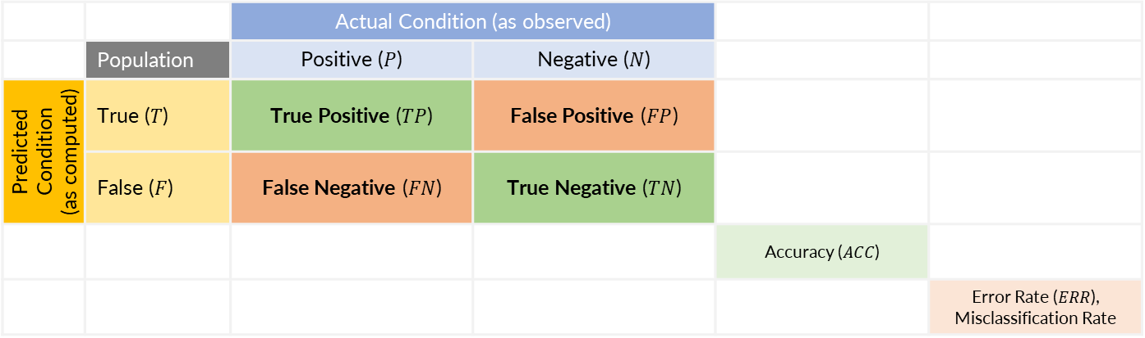
 |  | Actual Condition (as observed)
 | Population | Positive ($P$) | Negative ($N$)
Predicted Condition (as computed) | True ($T$) | True Positive ($TP$) | False Positive ($FP$)
 | False ($F$) | False Negative ($FN$) | True Negative ($TN$)
 |  |  |  | Accuracy ($ACC$)
 |  |  |  |  | Error Rate ($ERR$), Misclassification Rate

Slide 24
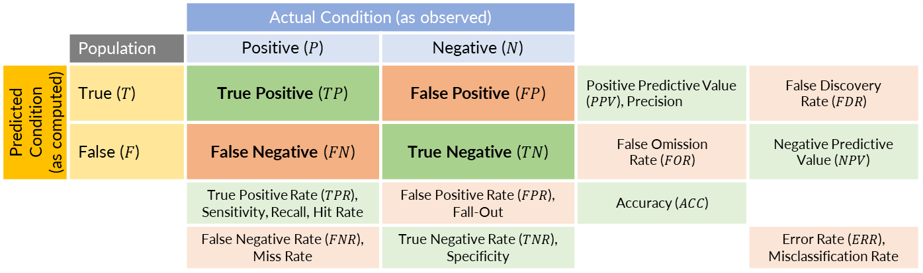
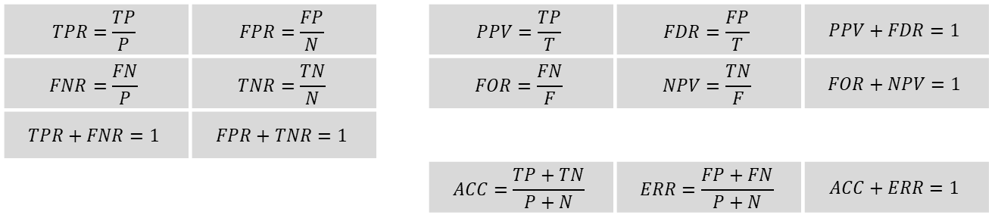
 |  | Actual Condition (as observed)
 | Population | Positive ($P$) | Negative ($N$)
Predicted Condition (as computed) | True ($T$) | True Positive ($TP$) | False Positive ($FP$) | Positive Predictive Value ($PPV$), Precision | False Discovery Rate ($FDR$)
 | False ($F$) | False Negative ($FN$) | True Negative ($TN$) | False Omission Rate ($FOR$) | Negative Predictive Value ($NPV$)
 |  | True Positive Rate ($TPR$), Sensitivity, Recall, Hit Rate | False Positive Rate ($FPR$), Fall-Out | Accuracy ($ACC$)
 |  | False Negative Rate ($FNR$), Miss Rate | True Negative Rate ($TNR$), Specificity |  | Error Rate ($ERR$), Misclassification Rate
$$TPR=\frac{TP}{P}$$ | $$FPR=\frac{FP}{N}$$ |  | $$PPV=\frac{TP}{T}$$ | $$FDR=\frac{FP}{T}$$ | $$PPV+FDR=1$$
$$FNR=\frac{FN}{P}$$ | $$TNR=\frac{TN}{N}$$ |  | $$FOR=\frac{FN}{F}$$ | $$NPV=\frac{TN}{F}$$ | $$FOR+NPV=1$$
$$TPR+FNR=1$$ | $$FPR+TNR=1$$
 |  |  | $$ACC=\frac{TP+TN}{P+N}$$ | $$ERR=\frac{FP+FN}{P+N}$$ | $$ACC+ERR=1$$

Slide 25
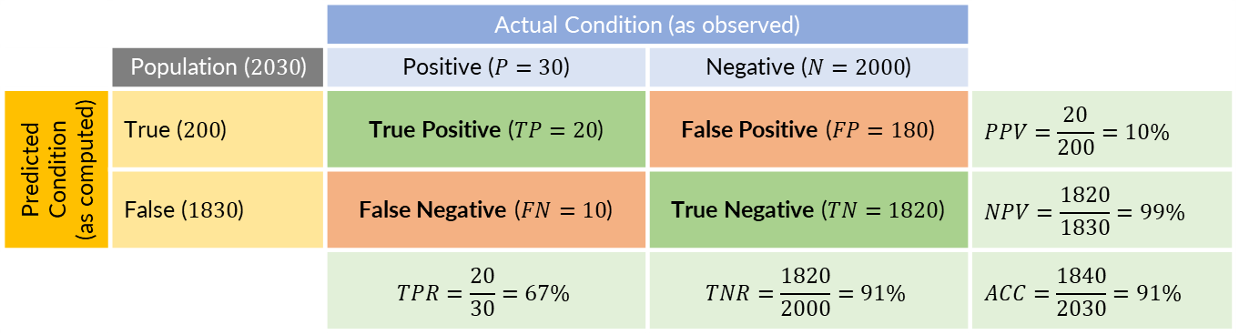
 |  | Actual Condition (as observed)
 | Population ($2030$) | Positive ($P=30$) | Negative ($N=2000$)
Predicted Condition (as computed) | True ($200$) | True Positive ($TP=20$) | False Positive ($FP=180$) | $$PPV=\frac{20}{200}=10\%$$
 | False ($1830$) | False Negative ($FN=10$) | True Negative ($TN=1820$) | $$NPV=\frac{1820}{1830}=99\%$$
 |  | $$TPR=\frac{20}{30}=67\%$$ | $$TNR=\frac{1820}{2000}=91\%$$ | $$ACC=\frac{1840}{2030}=91\%$$

Slide 26

 |  | Actual Condition (as observed)
 | Pop. ($100,000$) | Positive ($P=700$) | Negative ($N=99,300$)
Predicted Condition (as computed) | True ($5,560$) | True Positive ($TP=595$) | False Positive ($FP=4,965$) | $$PPV=\frac{20}{200}=11\%$$
 | False ($94,440$) | False Negative ($FN=105$) | True Negative ($TN=94,335$) | $$NPV=\frac{1820}{1830}=99\%$$
 |  | $$TPR=\frac{20}{30}=85\%$$ | $$TNR=\frac{1820}{2000}=95\%$$ | $$ACC=\frac{1840}{2030}=95\%$$

Slide 27
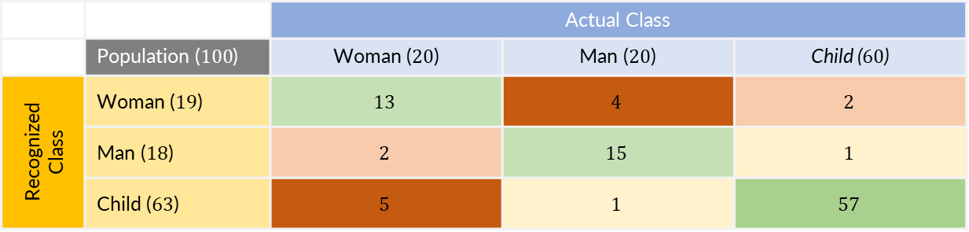
 |  | Actual Class
 | Population ($100$) | Woman ($20$) | Man ($20$) | Child ($60$)
Recognized Class | Woman ($19$) | $$13$$ | $$4$$ | $$2$$
 | Man ($18$) | $$2$$ | $$15$$ | $$1$$
 | Child ($63$) | $$5$$ | $$1$$ | $$57$$

Slide 28
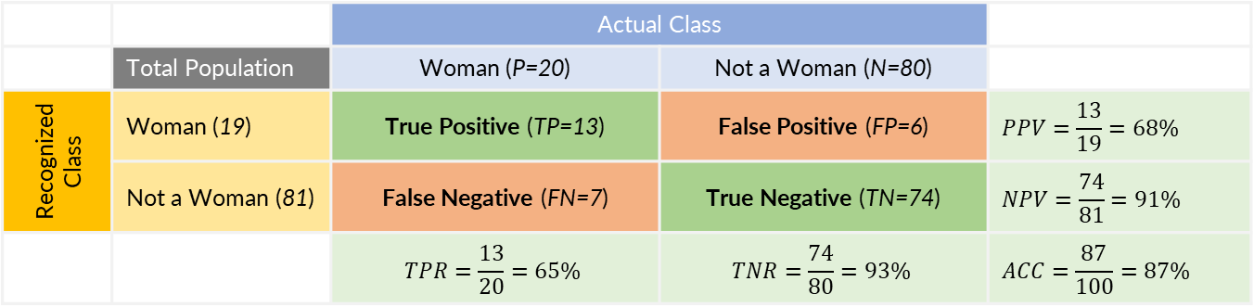
 |  | Actual Class
 | Total Population | Woman (P=20) | Not a Woman (N=80)
Recognized Class | Woman (19) | True Positive (TP=13) | False Positive (FP=6) | $$PPV=\frac{13}{19}=68\%$$
 | Not a Woman (81) | False Negative (FN=7) | True Negative (TN=74) | $$NPV=\frac{74}{81}=91\%$$
 |  | $$TPR=\frac{13}{20}=65\%$$ | $$TNR=\frac{74}{80}=93\%$$ | $$ACC=\frac{87}{100}=87\%$$
precision
sensitivity
specificity

Slide 29

 |  | Actual Class
 | Total Population | Child (P=60) | Not a Child (N=40)
Recognized Class | Child (63) | True Positive (TP=57) | False Positive (FP=6) | $$PPV=\frac{57}{63}=90\%$$
 | Not a Child (37) | False Negative (FN=3) | True Negative (TN=34) | $$NPV=\frac{34}{37}=92\%$$
 |  | $$TPR=\frac{57}{60}=95\%$$ | $$TNR=\frac{34}{40}=85\%$$ | $$ACC=\frac{91}{100}=91\%$$
precision
sensitivity
specificity

Slide 30
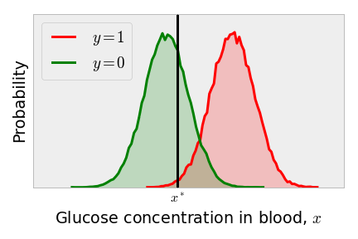
disease
healthy
Notes:
Question (basic): What is the output of many binary classification algorithms?
Solution: Prediction score, not direct class assignment, threshold
Question (basic): What are the two curves that represent the distribution of concentration in the example given?
Solution: Green for healthy people, red for those with diabetes, overlap
Question (intermediate): What is the purpose of choosing a threshold in binary classification algorithms?
Solution: To classify scores as healthy or sick, to minimize false negatives and false positives
Question (intermediate): What are the true negative rate (TNR) and false positive rate (FPR) used to determine in binary classification algorithms?
Solution: Specificity, the integral of the distribution over scores
Question (intermediate): What is the Receiver Operating Characteristic curve (ROC curve) used for in binary classification algorithms?
Solution: Visualize the performance of a binary classifier, plot true positive rate and false positive rate
Question (advanced): How is the threshold for each row determined in the generation of the ROC curve?
Solution: The threshold is set to the score value in that row, items above the threshold are classified as "positives"
Question (advanced): How is the interpretation of the ROC-curve used to evaluate the performance of binary classification methods?
Solution: To determine the effectiveness of ruling out diseases, construct new methods to improve outcomes, assess sensitivity and specificity
Question (advanced): What is the optimal threshold in binary classification algorithms based on specific performance goals?
Solution: Threshold that maximizes accuracy, closest to the ideal point in the upper left corner, sum of sensitivity and specificity
Question (advanced): What is the area under the ROC curve (AUC) used to measure in binary classification algorithms?
Solution: How well a method can distinguish between positive and negative predictions, reflect the method's performance
Question (advanced): How does the prevalence of cases impact the outcome in binary classification algorithms?
Solution: Affects the number of true negatives and true positives, determines the effectiveness of ruling out or ruling in diseases based on the method's sensitivity and specificity

Slide 31
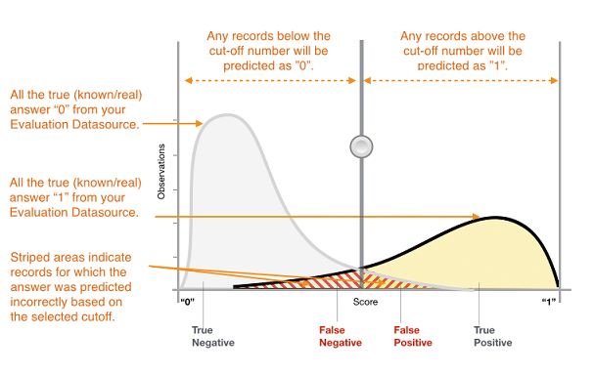
source: https://docs.aws.amazon.com/machine-learning/latest/dg/binary-classification.html

Slide 32
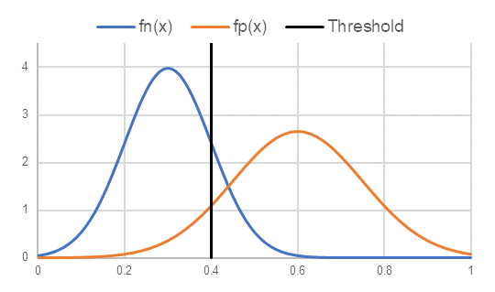

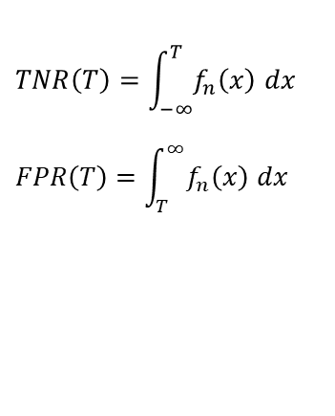
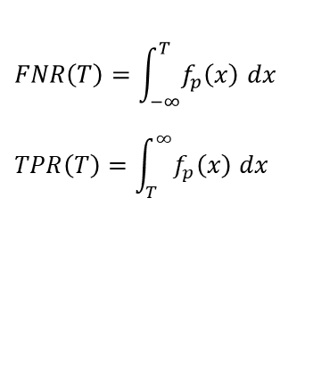

$$TNR\left(T\right)=\int_{−∞}^{T}{f_{n}\left(x\right) dx}$$
$$FPR\left(T\right)=\int_{T}^{∞}{f_{n}\left(x\right) dx}$$
$$f_{n}(x)$$
TNR
FPR
specificity
$$FNR\left(T\right)=\int_{−∞}^{T}{f_{p}\left(x\right) dx}$$
$$TPR\left(T\right)=\int_{T}^{∞}{f_{p}\left(x\right) dx}$$
$$f_{p}(x)$$
TPR
FNR
sensitivity

Slide 33
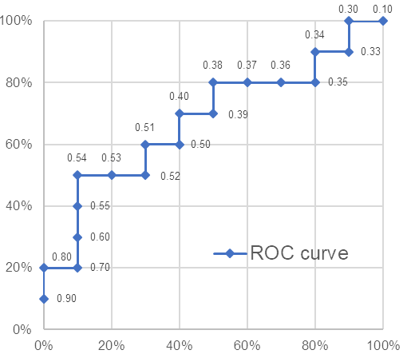


sensitivity
1-specificity
Ideal point with maximum sensitivity and specificity
Class | Score |  | TP | FP | FN | TN |  | TPR | FPR | ACC
P | 0.90 |  | 1 | 0 | 9 | 10 |  | 10% | 0% | 55%
P | 0.80 |  | 2 | 0 | 8 | 10 |  | 20% | 0% | 60%
N | 0.70 |  | 2 | 1 | 8 | 9 |  | 20% | 10% | 55%
P | 0.60 |  | 3 | 1 | 7 | 9 |  | 30% | 10% | 60%
P | 0.55 |  | 4 | 1 | 6 | 9 |  | 40% | 10% | 65%
P | 0.54 |  | 5 | 1 | 5 | 9 |  | 50% | 10% | 70%
N | 0.53 |  | 5 | 2 | 5 | 8 |  | 50% | 20% | 65%
N | 0.52 |  | 5 | 3 | 5 | 7 |  | 50% | 30% | 60%
P | 0.51 |  | 6 | 3 | 4 | 7 |  | 60% | 30% | 65%
N | 0.50 |  | 6 | 4 | 4 | 6 |  | 60% | 40% | 60%
P | 0.40 |  | 7 | 4 | 3 | 6 |  | 70% | 40% | 65%
N | 0.39 |  | 7 | 5 | 3 | 5 |  | 70% | 50% | 60%
P | 0.38 |  | 8 | 5 | 2 | 5 |  | 80% | 50% | 65%
N | 0.37 |  | 8 | 6 | 2 | 4 |  | 80% | 60% | 60%
N | 0.36 |  | 8 | 7 | 2 | 3 |  | 80% | 70% | 55%
N | 0.35 |  | 8 | 8 | 2 | 2 |  | 80% | 80% | 50%
P | 0.34 |  | 9 | 8 | 1 | 2 |  | 90% | 80% | 55%
N | 0.33 |  | 9 | 9 | 1 | 1 |  | 90% | 90% | 50%
P | 0.30 |  | 10 | 9 | 0 | 1 |  | 100% | 90% | 55%
N | 0.10 |  | 10 | 10 | 0 | 0 |  | 100% | 100% | 50%
$TPR$ (sensitivity)
Threshold (T) for this point
$FPR$ (1-specificity)

Slide 34
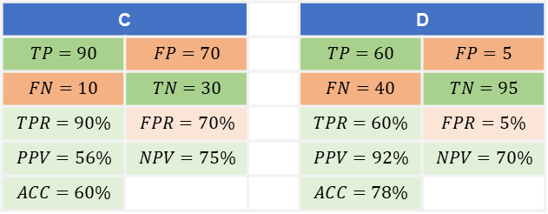


A |  |  | B
$$TP=95$$ | $$FP=30$$ |  | $$TP=40$$ | $$FP=80$$
$$FN=5$$ | $$TN=70$$ |  | $$FN=60$$ | $$TN=20$$
$$TPR=95\%$$ | $$FPR=30\%$$ |  | $$TPR=40\%$$ | $$FPR=80\%$$
$$PPV=76\%$$ | $$NPV=93\%$$ |  | $$PPV=33\%$$ | $$NPV=25\%$$
$$ACC=83\%$$ |  |  | $$ACC=30\%$$
High specificity → ability to “rule in” (pos. prediction) if PPV is high
High sensitivity → ability to “rule out” (neg, prediction) if NPV is high
B’
C |  |  | D
$$TP=90$$ | $$FP=70$$ |  | $$TP=60$$ | $$FP=5$$
$$FN=10$$ | $$TN=30$$ |  | $$FN=40$$ | $$TN=95$$
$$TPR=90\%$$ | $$FPR=70\%$$ |  | $$TPR=60\%$$ | $$FPR=5\%$$
$$PPV=56\%$$ | $$NPV=75\%$$ |  | $$PPV=92\%$$ | $$NPV=70\%$$
$$ACC=60\%$$ |  |  | $$ACC=78\%$$
$TPR$ (sensitivity)
better
worse
$FPR$ (1-specificity)

Slide 35


sensitivity
1-specificity
Ideal point with maximum sensitivity and specificity
Class | Score |  | TP | FP | FN | TN |  | TPR | FPR | ACC
P | 0.90 |  | 1 | 0 | 9 | 10 |  | 10% | 0% | 55%
P | 0.80 |  | 2 | 0 | 8 | 10 |  | 20% | 0% | 60%
N | 0.70 |  | 2 | 1 | 8 | 9 |  | 20% | 10% | 55%
P | 0.60 |  | 3 | 1 | 7 | 9 |  | 30% | 10% | 60%
P | 0.55 |  | 4 | 1 | 6 | 9 |  | 40% | 10% | 65%
P | 0.54 |  | 5 | 1 | 5 | 9 |  | 50% | 10% | 70%
N | 0.53 |  | 5 | 2 | 5 | 8 |  | 50% | 20% | 65%
N | 0.52 |  | 5 | 3 | 5 | 7 |  | 50% | 30% | 60%
P | 0.51 |  | 6 | 3 | 4 | 7 |  | 60% | 30% | 65%
N | 0.50 |  | 6 | 4 | 4 | 6 |  | 60% | 40% | 60%
P | 0.40 |  | 7 | 4 | 3 | 6 |  | 70% | 40% | 65%
N | 0.39 |  | 7 | 5 | 3 | 5 |  | 70% | 50% | 60%
P | 0.38 |  | 8 | 5 | 2 | 5 |  | 80% | 50% | 65%
N | 0.37 |  | 8 | 6 | 2 | 4 |  | 80% | 60% | 60%
N | 0.36 |  | 8 | 7 | 2 | 3 |  | 80% | 70% | 55%
N | 0.35 |  | 8 | 8 | 2 | 2 |  | 80% | 80% | 50%
P | 0.34 |  | 9 | 8 | 1 | 2 |  | 90% | 80% | 55%
N | 0.33 |  | 9 | 9 | 1 | 1 |  | 90% | 90% | 50%
P | 0.30 |  | 10 | 9 | 0 | 1 |  | 100% | 90% | 55%
N | 0.10 |  | 10 | 10 | 0 | 0 |  | 100% | 100% | 50%
$TPR$ (sensitivity)
Threshold (T) for this point
$FPR$ (1-specificity)

