Slide 1
CS6461 – Computer Architecture
Spring 2018
Morris Lancaster - Lecturer
Adapted from Professor Stephen Kaisler’s Notes
Lecture 11
Multiprocessor Computing: Memory
  Some slides from material by Krste Asanovic (MIT/UCB)

Slide 2
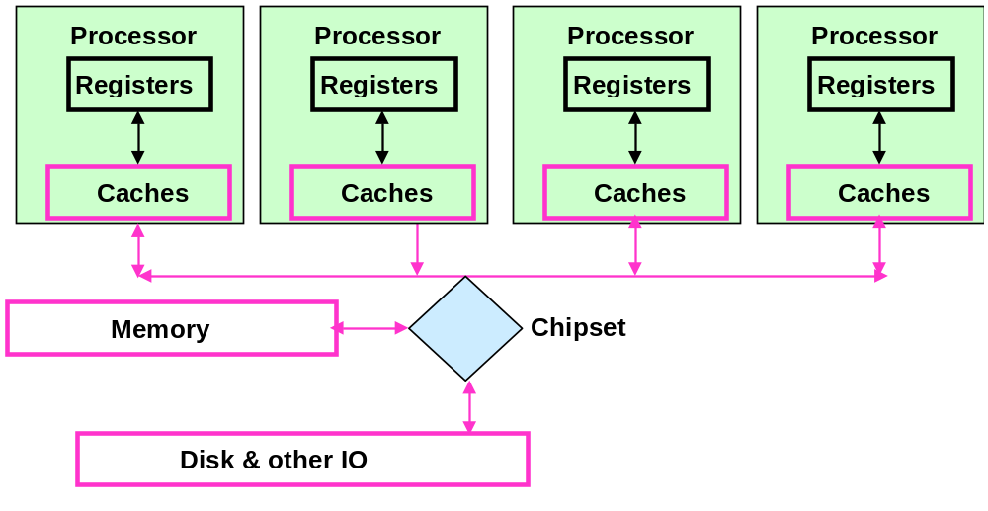
Multiprocessor Memory Architecture – Critical Problem
Introduce multiple processors in a shared memory architecture
  Each has its own cache
CS61 Computer Architecture
CS61 Computer Architecture
11-<number>

Slide 3
Shared Memory Architecture
All processors share the same memory and execute a single copy of the operating system.
Several (two or more) processors share the same address space
Communication is implicit, e.g., read and write can occur to same memory locations, so processors must deconflict among themselves
Synchronization can occur at both hardware and software level
  However, synchronization at hardware level does not preclude deadlock or errors occurring at the software level.
CS61 Computer Architecture
CS61 Computer Architecture
11-<number>

Slide 4
CACHE COHERENCE
Shared Memory Architectures give rise to the problem of Cache Coherency.
  If one processor reads data from memory before another processor, which has updated its cache, but NOT written the cache back to memory, it will get inconsistent results.
  If this occurs in a program which is running across multiple processors, e.g., a multitasking or multithreading program, significant program errors can result.
  Caches used to reduce data access latency; need to be kept coherent
  Latencies due to getting value from remote location impact performance
  Getting remote value is two-part operation
    Get value
    Get permissions to use value
CS61 Computer Architecture
CS61 Computer Architecture
11-<number>

Slide 5
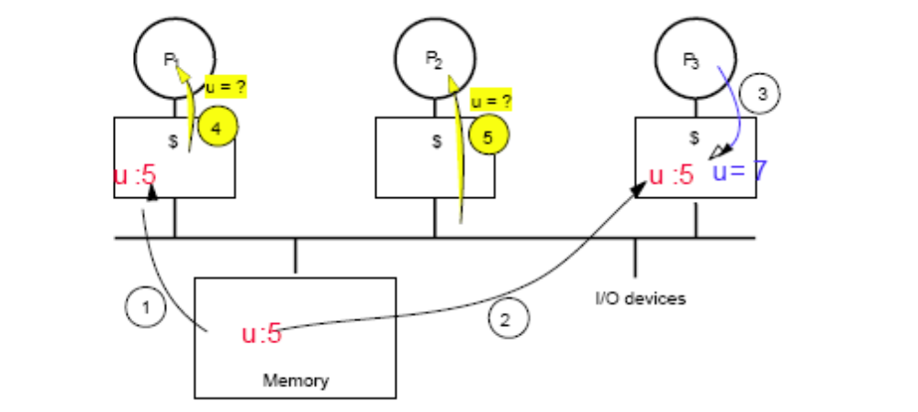
Consider this example …
After event 3, the processors P1 and P2 will see different values for u.
With write back cache, the value depends on which memory writes back when
This is an unacceptable result, but it is frequent!
CS61 Computer Architecture
CS61 Computer Architecture
11-<number>

Slide 6
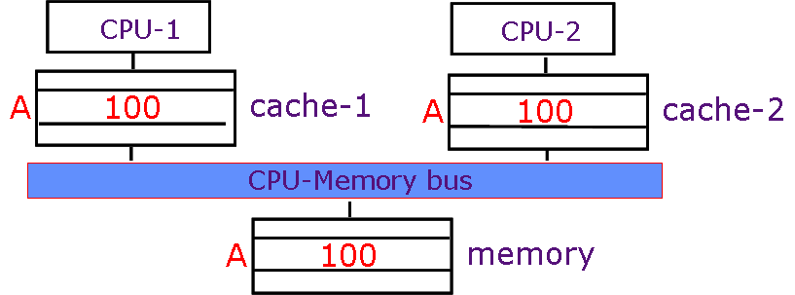
Cache Coherency Problem
Suppose CPU-1 updates A to 300.
  write-back: memory and cache-2 have stale values
  write-through: cache-2 has a stale value
CS61 Computer Architecture
CS61 Computer Architecture
11-<number>

Slide 7
Coherency
Coherency means the following:
  Any read must always return the most recent write
  Very difficult to implement; must choose between tradeoffs
  A better strategy is: Any write must be eventually seen by a read
  All writes are seen in their proper order, e.g., serialization
  A write by any processor invalidates all copies of the same cache block in every other processor’s cache
CS61 Computer Architecture
CS61 Computer Architecture
11-<number>

Slide 8
Defining Coherency
1. Preserve Program Order: Read by processor P to location X that follows a write by P to X, with no writes of X by another processor occurring between the write and the read by P, always returns the value written by P
2. Coherent view of memory: Read by a processor to location X that follows a write by another processor to X returns the written value if the read and write are sufficiently separated in time and no other writes to X occur between the two accesses
3. Write serialization: 2 writes to same location by any 2 processors are seen in the same order by all processors
- If not, a processor could keep value 1 since saw as last write
- For example, if the values 1 and then 2 are written to a location, processors can never read the value of the location as 2 and then later read it as 1
A write does not complete (and allow the next write to occur) until all processors have seen the effect of that write
CS61 Computer Architecture
CS61 Computer Architecture
11-<number>

Slide 9
What is the Problem?
A scheme where every CPU knows who has a copy of its cached data is far too complex.
So, each CPU (cache system) ‘snoops’ (i.e. watches continually) for write activity concerned with data addresses which it has cached.
This assumes a bus structure which is ‘global’, i.e., all communication can be seen by all.
However, this scheme is not scalable because of bus limitations!!
A more scalable solution: ‘directory based’ coherence schemes

Slide 10
Coherency Misses
True sharing misses arise from the communication of data through the cache coherence mechanism
  Invalidates due to 1st write to shared block
  Reads by another CPU of modified block in different cache
  Miss would still occur if block size were 1 word
False sharing misses when a block is invalidated because some word in the block, other than the one being read, is written into
  Invalidation does not cause a new value to be communicated, but only causes an extra cache miss
  Block is shared, but no word in block is actually shared
  ⇒ miss would not occur if block size were 1 word
CS61 Computer Architecture
11-<number>

Slide 11
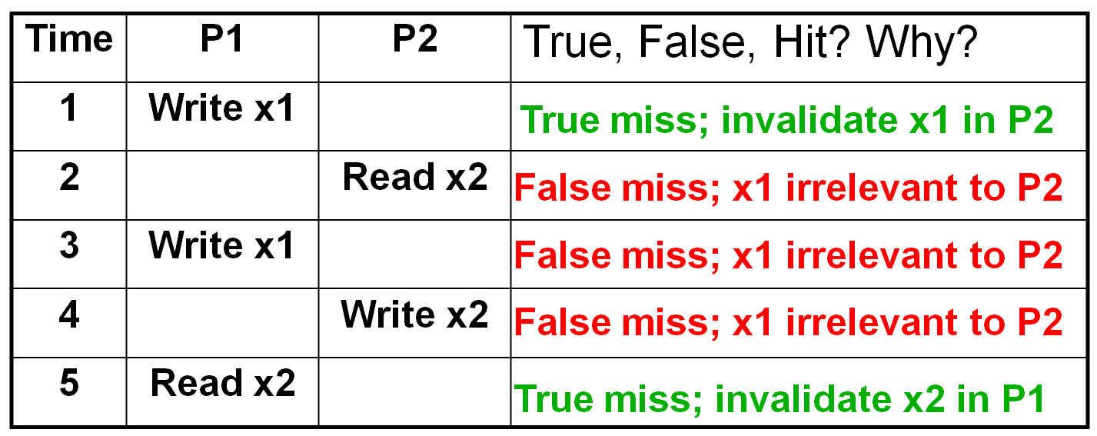
Example: True v. False Sharing v. Hit?
Assume x1 and x2 are in the same cache block.
Let P1 and P2 both read x1 and x2 before.
CS61 Computer Architecture
11-<number>

Slide 12
Resolving the Problem
There are two mechanisms to resolve this problem
Write Back: Data is written from a modified cache only when necessary, e.g., when either:
  Cache line must be replaced because of a more recent access, or
  A read against the cache line is detected
  Doesn’t tie up memory bandwidth
  Need synchronization among processor caches in order to avoid coherency problems
CS61 Computer Architecture
CS61 Computer Architecture
11-<number>

Slide 13
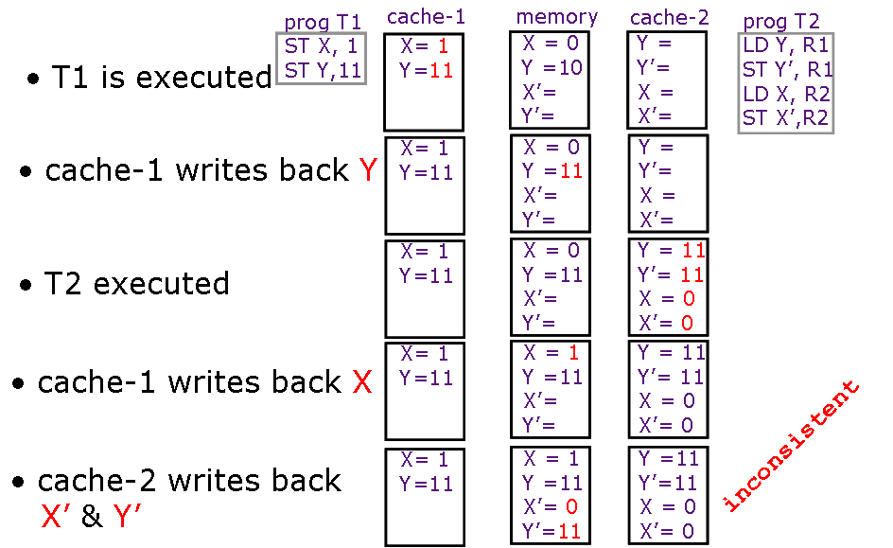
Write Back Protocol
(instructions: LD Y, R1 means R1 <- c(Y); ST X,1 means X <- 1)
Why? Because all of T2 is executed before cache-1 has updated X!
CS61 Computer Architecture
CS61 Computer Architecture
11-<number>

Slide 14
Write Through Protocol
Write Through: Data is written to memory immediately upon writing to the cache:
  Uses memory bandwidth
  Ensures that data is always current in memory
Write-through caches don’t preserve sequential consistency either
CS61 Computer Architecture
CS61 Computer Architecture
11-<number>

Slide 15
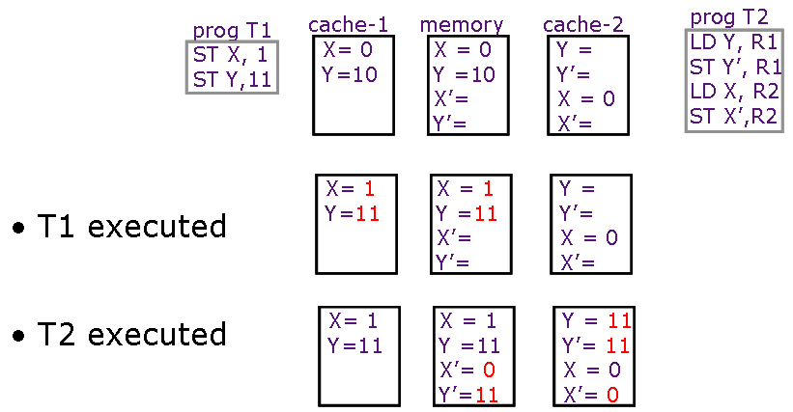
Write Through Protocol
(instructions: LD Y, R1 means R1 <- c(Y); ST X,1 means X <- 1)
So, X and Y are updated in memory.
But, T2 executing concurrently can still read X before cache update!
Why? Again T2 is fully executed before cache-1 updates memory!
Write-Through is not immediate!
CS61 Computer Architecture
CS61 Computer Architecture
11-<number>

Slide 16
Defining Write Consistency
Let’s assume
1. A write does not complete (and allow the next write to occur) until all processors have seen the effect of that write
2. The processor does not change the order of any write with respect to any other memory access
=> If a processor writes location A followed by location B, any processor that sees the new value of B must also see the new value of A
These restrictions allow the processor to reorder reads, but forces the processor to finish writes in program order
CS61 Computer Architecture
CS61 Computer Architecture
11-<number>

Slide 17
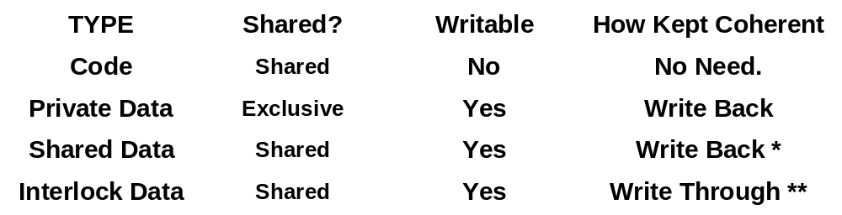
Ensuring Consistency
Now, there are different kinds of data in cache, so we need to determine what mechanism must be applied to ensure coherency
* Write Back gives good performance
** Write Through may cause severe memory performance degradation
CS61 Computer Architecture
CS61 Computer Architecture
11-<number>

Slide 18
Cache Coherent System
A Cache Coherent System Must:
  Provide a set of states, state transition diagram, and actions
  Manage coherence protocol: Determine when to invoke coherence protocol
    Find info about state of block in other caches to determine
    whether need to communicate with other cached copies
    (b) Locate the other copies
    (c) Communicate with those copies (invalidate/update)
  is done the same way on all systems
  state of the line is maintained in the cache
  protocol is invoked if an “access fault” occurs on the line
Different approaches distinguished by (a) to (c)
CS61 Computer Architecture
CS61 Computer Architecture
11-<number>

Slide 19
Bus-based Coherence
All of (a), (b), (c) done through broadcast on bus
  faulting processor sends out a “search”
  others respond to the search probe and take necessary action
Could do it in scalable network too
  broadcast to all processors, and let them respond
Conceptually simple, but broadcast doesn’t scale with p
  on bus, bandwidth doesn’t scale
  on scalable network, every fault leads to at least p network transactions
Scalable coherence:
  can have same cache states and state transition diagram
  different mechanisms to manage protocol
CS61 Computer Architecture
CS61 Computer Architecture
11-<number>

Slide 20
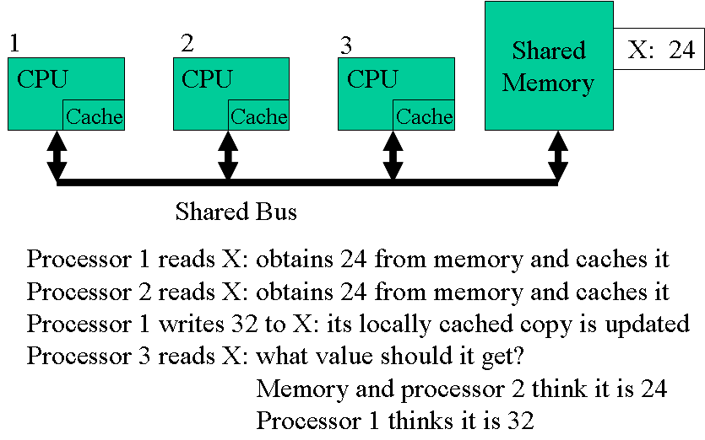
Bus-based Coherence
CS61 Computer Architecture
CS61 Computer Architecture
11-<number>

Slide 21

Snooping Solution (Snoopy Cache)
Send all requests for data to all processors
Processors snoop the cache to see if they have a copy and respond accordingly
  Snoop every address placed on the bus
Either get exclusive access before write via write invalidate or update all copies on write
Requires broadcast, since caching information is at processors
Works well with bus (natural broadcast medium)
Dominates for small scale machines (most of the market)
CS61 Computer Architecture
CS61 Computer Architecture
11-<number>

Slide 22
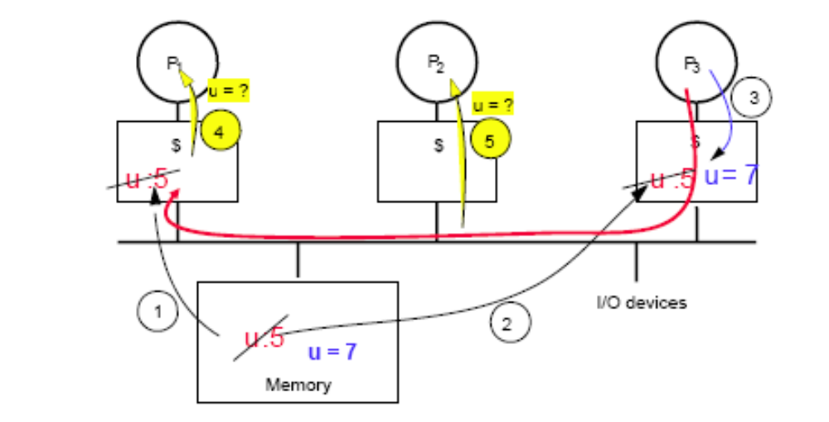
Write Through Invalidate
CS61 Computer Architecture
CS61 Computer Architecture
11-<number>

Slide 23
Bus Snooping
Proc1
Proc2
ProcN
Snoop
DCache
Snoop
DCache
Snoop
DCache
Single Bus
Memory
I/O
Cache controllers monitor shared bus traffic with duplicate address tag hardware (so they don’t interfere with processor’s access to the cache)
Only need to do for DCache since ICache cannot be modified by program
CS61 Computer Architecture
CS61 Computer Architecture
11-<number>

Slide 24
How does the Snoopy Protocol work?
Each block of memory is in one state:
  Clean in all caches and up-to-date in memory (Shared)
  OR Dirty in exactly one cache (Exclusive)
  OR Not in any caches
Each cache block is in one state:
  Shared : block can be read
  OR Exclusive : cache has only copy, its writeable, and dirty
  OR Invalid : block contains no data
Write Invalidate
  CPU wanting to write to an address, grabs a bus cycle and sends a ‘write invalidate’ message
  All snooping caches invalidate their copy of appropriate cache line
  CPU writes to its cached copy (assume for now that it also writes through to memory)
  Any shared read in other CPUs will now miss in cache and re-fetch new data.
Write Update
  CPU wanting to write grabs bus cycle &broadcasts new data as it updates its own copy
  All snooping caches update their copy
Note that in both schemes, problem of simultaneous writes is taken care of by bus arbitration - only one CPU can use the bus at any one time.
CS61 Computer Architecture
CS61 Computer Architecture
11-<number>

Slide 25
Update or Invalidate?
Update looks the simplest, most obvious and fastest, but:-
  Invalidate scheme is usually implemented with write-back caches and in that case:
    Multiple writes to same word (no intervening read) need only one invalidate message but would require an update for each
    Writes to same block in (usual) multi-word cache block require only one invalidate but would require multiple updates.
Due to both spatial and temporal locality, these cases occur often.
Bus bandwidth is a precious commodity in shared memory multi-processors
Experience has shown that invalidate protocols use significantly less bandwidth.

Slide 26
Directory-Based Schemes
Snoopy schemes do not scale because they rely on broadcast
Directory-Based Scheme:
  Keep track of what is being shared in one centralized place
Distributed memory => distributed directory for scalability (avoids bottlenecks)
Send point-to-point requests to processors via network
Scales better than Bus Snooping
Actually existed BEFORE Snooping-based schemes
All modern microprocessors use write invalidate
CS61 Computer Architecture
CS61 Computer Architecture
11-<number>

Slide 27
Directory-Based Cache States
For each cache line, there are 4 possible states:
  C-invalid (= Nothing): The accessed data is not resident in the cache.
  C-shared (= Sh): The accessed data is resident in the cache, and possibly also cached at other sites. The data in memory is valid.
  C-modified (= Ex): The accessed data is exclusively resident in this cache, and has been modified. Memory does not have the most up-to-date data.
  C-transient (= Pending): The accessed data is in a transient state (for example, the site has just issued a protocol request, but has not received the corresponding protocol reply).
CS61 Computer Architecture
11-<number>

Slide 28
Home Directory Cache States
For each memory block, there are 4 possible states:
  R(dir): The memory block is shared by the sites specified in dir (dir is a set of sites). The data in memory is valid in this state. If dir is empty (i.e., dir = ε), the memory block is not cached by any site.
  W(id): The memory block is exclusively cached at site id, and has been modified at that site. Memory does not have the most up-to-date data.
  TR(dir): The memory block is in a transient state waiting for the acknowledgements to the invalidation requests that the home site has issued.
  TW(id): The memory block is in a transient state waiting for a block exclusively cached at site id (i.e., in C-modified state) to make the memory block at the home site up-to-date.
CS61 Computer Architecture
11-<number>

Slide 29
Directory-Based Schemes
In addition to cache state, we must track which processors have data when in the shared state (usually bit vector, 1 if processor has copy)
Keep it simple(r):
  Writes to non-exclusive data => write miss
  Processor blocks until access completes
  Assume messages received and acted upon in order sent
CS61 Computer Architecture
CS61 Computer Architecture
11-<number>

Slide 30
Directory Implementation
Directories have different meanings (& therefore uses) to different processors
  home node: where the memory location of an address resides (and cached data may be there too) (static)
  local node: where the request initiated (relative)
  remote node: alternate location for the data if this processor has requested it (dynamic)
In satisfying a memory request:
  messages sent between the different nodes in point-to-point communication
  messages get explicit replies
Some simplifying assumptions for using the protocol
  processor blocks until the access is complete
  messages processed in the order received
CS61 Computer Architecture
CS61 Computer Architecture
11-<number>

Slide 31
Basic Operation of Directory
With each cache-block in memory:
  k presence-bits for k processors, 1 dirty-bit
Read from main memory by processor i:
  If dirty-bit OFF then
    { read from main memory;
    turn p[i] ON; }
  If dirty-bit ON then
    { recall line from dirty proc (cache state to shared);
    update memory;
    turn dirty-bit OFF;
    turn p[i] ON;
    supply recalled data to i;}
Write to main memory by processor i:
  If dirty-bit OFF then
    { supply data to i;
    send invalidations to all caches that have the block;
    turn dirty-bit ON;
    turn p[i] ON; ... }
CS61 Computer Architecture
CS61 Computer Architecture
11-<number>

Slide 32
Examples of Directory Protocol Messages
Message type Source Destination Msg Content
Read miss Local cache Home directory P, A
– Processor P reads data at address A; make P a read sharer and request data
Write miss Local cache Home directory P, A
– Processor P has a write miss at address A; make P the exclusive owner and request data
Invalidate Home Remote caches A
directory
– Invalidate a shared copy at address A
Fetch Home directory Remote cache A
– Fetch the block at address A and send it to its home directory; change state of A in the remote cache to shared
Fetch/Invalidate Remote cache A
Home directory
– Fetch the block at address A and send it to its home directory; invalidate block in the cache
Data value reply Home directory Local cache Data
– Return a data value from the home memory (read miss response)
Data write back Remote cache Home directory A, Data
– Write back a data value for address A (invalidate response)
CS61 Computer Architecture
CS61 Computer Architecture
11-<number>

Slide 33
Directory-Based Coherency - 1
Multiple copies are not a problem when reading
Processor must have exclusive access to write a word
  What happens if two processors try to write to the same shared data word in the same clock cycle?
  The bus arbiter decides which processor gets the bus first (and this will be the processor with the first exclusive access).
  Then the second processor will get exclusive access.
  Thus, bus arbitration forces sequential behavior.
This sequential consistency is the most conservative of the memory consistency models.
  With it, the result of any execution is the same as if the accesses of each processor were kept in order and the accesses among different processors were interleaved.
All other processors sharing that data must be informed of writes
CS61 Computer Architecture
CS61 Computer Architecture
11-<number>

Slide 34
Directory-Based Coherency - 2
Ensuring that all other processors sharing data are informed of writes can be handled two ways
Write-update (write-broadcast) – writing processor broadcasts new data over the bus, all copies are updated
  All writes go to the bus → higher bus traffic
  Since new values appear in caches sooner, can reduce latency
  Bus is locked until all writes complete
Write-invalidate – writing processor issues invalidation signal on bus
  cache snoops check to see if they have a copy of the data
  if so, they invalidate their cache block containing the word (this allows multiple readers but only one writer)
Uses the bus only on the first write → lower bus traffic, so better use of bus bandwidth
CS61 Computer Architecture
CS61 Computer Architecture
11-<number>

Slide 35
Issues
Scaling of memory and directory bandwidth
  Can not have main memory or directory memory centralized
  Need a distributed memory and directory structure
Directory memory requirements do not scale well
  Number of presence bits grows with number of PEs
  Many ways to get around this problem
    limited pointer schemes of many flavors

Slide 36
CC-NUMA Configuration
Node consists of processor, memory and I/O:
  Each processor has own L1 and L2 cache (maybe L3?)
  S processor has fast access to its local memory & slower access to “remote” memory located at other processors
  Each node has own main memory
  Nodes connected by some networking facility
Each processor sees single addressable memory space
Memory request order by a processor:
  L1 cache (local to processor)
  L2 cache (local to processor)
  Main memory (local to node)
  Remote memory
    Delivered to requesting (local to processor) cache
Automatic and transparent
CS61 Computer Architecture
CS61 Computer Architecture
11-<number>

Slide 37
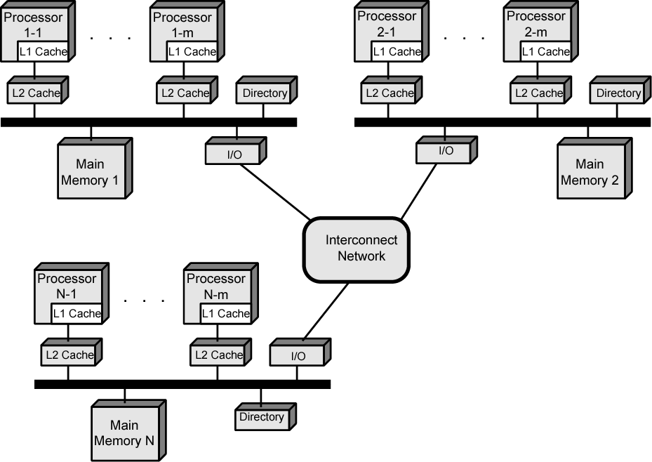
CC-NUMA Configuration
Note: Centralized directory per bus
Each node maintains directory of location of portions of memory and cache status
CS61 Computer Architecture
CS61 Computer Architecture
11-<number>

Slide 38
CC-NUMA Configuration
So, node 2 processor 3 (P2-3) requests location 798 in memory of node 1
  P2-3 issues read request on snoopy bus of node 2
  Directory on node 2 recognises location is on node 1
  Node 2 directory requests node 1’s directory to get value of location 798
  Node 1 directory requests contents of 798
  Node 1 memory puts data on (node 1 local) bus
  Node 1 directory gets data from (node 1 local) bus
  Data transferred to node 2’s directory
  Node 2 directory puts data on (node 2 local) bus
  Data picked up, put in P2-3’s cache and delivered to processor
CS61 Computer Architecture
CS61 Computer Architecture
11-<number>

Slide 39
CC-NUMA Configuration
Cache Coherence:
  Node 1 directory keeps note that node 2 has copy of data
  If data modified in cache, this is broadcast to other nodes
  Local directories monitor and purge local cache if necessary
  Local directory monitors changes to local data in remote caches and marks memory invalid until write-back
  Local directory forces write-back if memory location requested by another processor
CS61 Computer Architecture
CS61 Computer Architecture
11-<number>

Slide 40
Some Problems - I
A cache block contains more than one word.
Cache-coherence is performed at the block level, not the word level.
Suppose P1 writes word₁ and P2 writes word_{k} (k <n) where both words have the same block address.
What can happen?
CS61 Computer Architecture
11-<number>

Slide 41
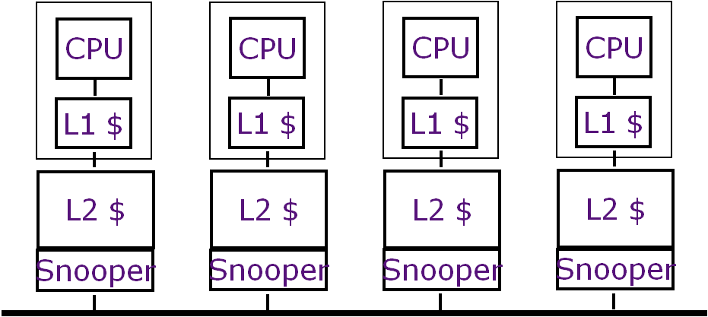
Some Problems - II
Processors: small L1 cache, larger L2 cache (both on processor chip)
Properties:
  Entries in L1 must be in L2
  Invalidation in L2 implies invalidation in L1
Snooping on L2 does not affect CPU-L1 bandwidth
Can a problem occur? Consider concurrent CPU write to L1 as a snooping occurs on L2 for the same word
CS61 Computer Architecture
11-<number>

Slide 42
Additional Material
CS61 Computer Architecture
CS61 Computer Architecture
11-<number>

Slide 43
Snooping Protocol: State Diagram
CPU read hit
CPU read miss
Shared
(read/only)
Invalid
Place read op
on bus
CPU read miss
Write back block
CPU Write
Place write
op on bus
Place read op on bus
CPU write
Place write op on bus
CPU read hit
Exclusive
(read/write)
CPU write miss
Write back cache block
Place write op on bus
CPU write hit
CS61 Computer Architecture
CS61 Computer Architecture
11-<number>

Slide 44
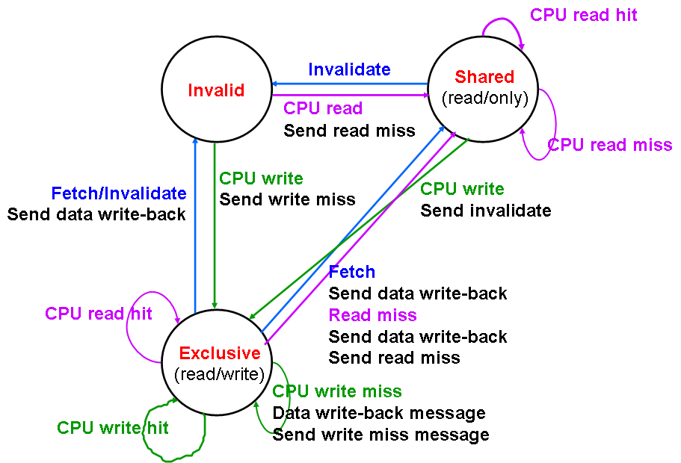
Directory Protocol: CPU State Diagram
CS61 Computer Architecture
CS61 Computer Architecture
11-<number>

Slide 45
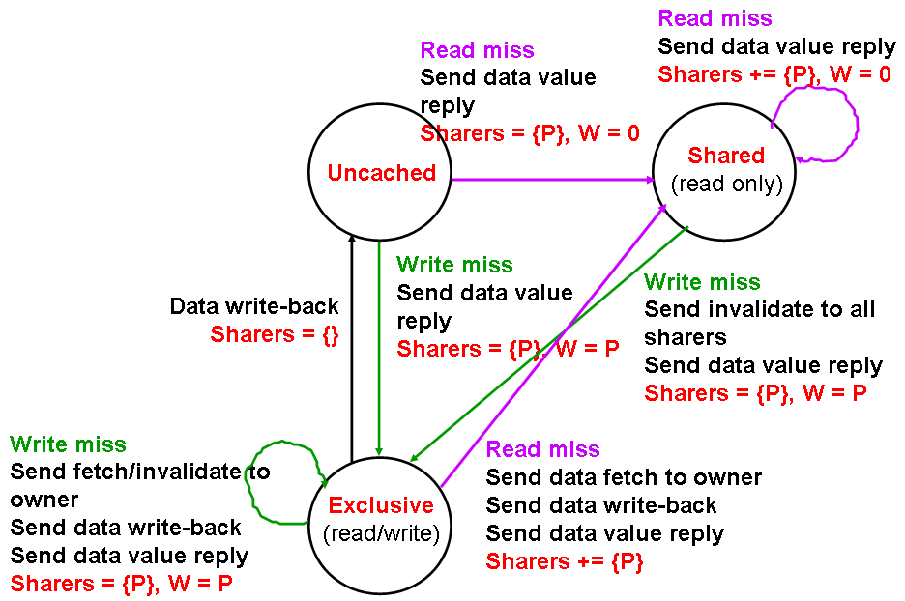
Directory Protocol: Memory Block State Diagram
CS61 Computer Architecture
CS61 Computer Architecture
11-<number>

Slide 46
MESI Cache Coherency Protocol
Another write-invalidate protocol that is used in the Pentium 4 (and many other micro’s) is MESI with four states:
  Modified – same
  Exclusive – only one copy of the shared data is allowed to be cached; memory has an up-to-date copy
    Since there is only one copy of the block, write hits don’t need to send invalidate signal
  Shared – multiple copies of the shared data may be cached (i.e., data permitted to be cached with more than one processor); memory has an up-to-date copy
  Invalid – same
CS61 Computer Architecture
CS61 Computer Architecture
11-<number>

Slide 47
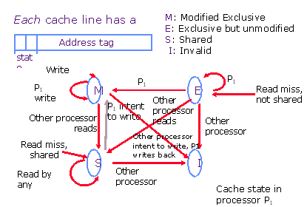
MESI Cache Coherency Protocol
CS61 Computer Architecture
CS61 Computer Architecture
11-<number>

Slide 48
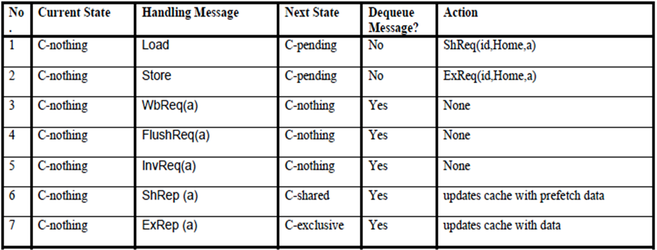
Directory-Based Cache Transitions - I
CS61 Computer Architecture
11-<number>

Slide 49
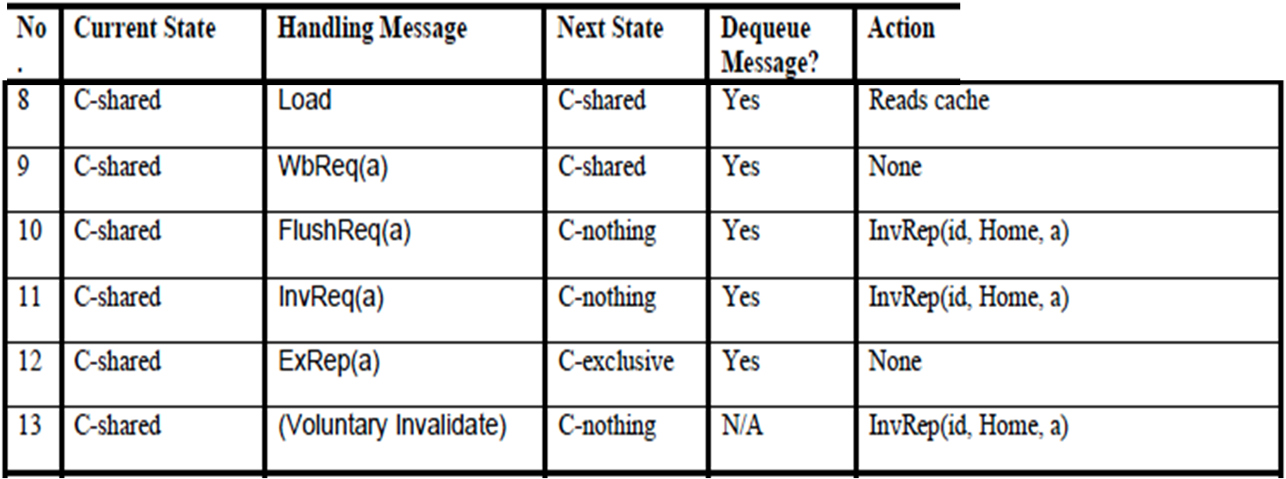
Directory-Based Cache Transitions - II
CS61 Computer Architecture
11-<number>

Slide 50
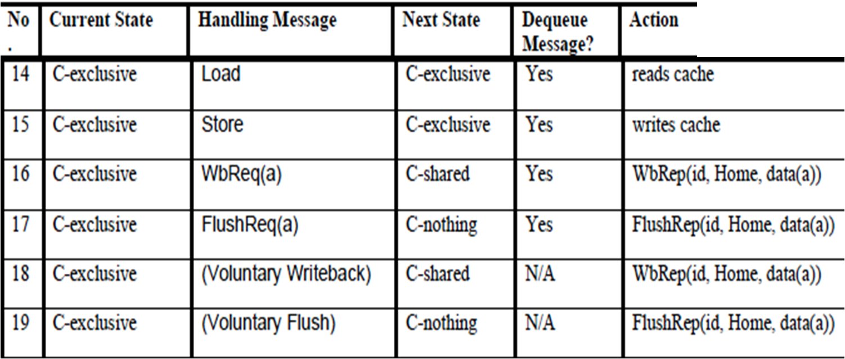
Directory-Based Cache Transitions - III
CS61 Computer Architecture
11-<number>

Slide 51
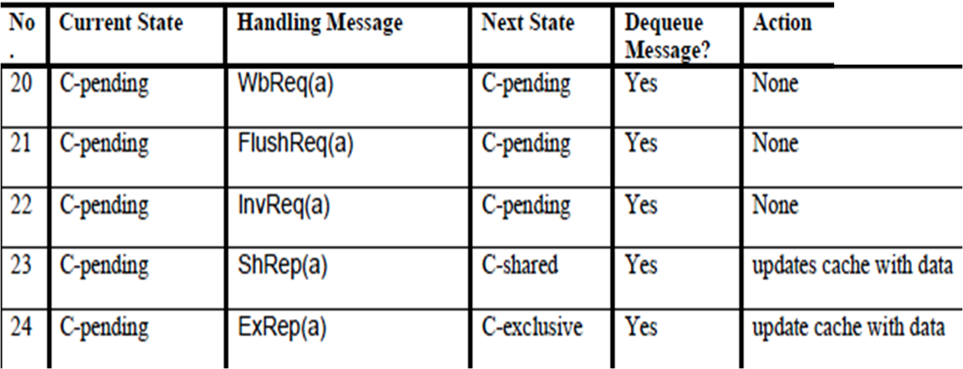
Directory-Based Cache Transitions - IV
CS61 Computer Architecture
11-<number>

