Slide 1
CS6461 – Computer Architecture
Morris Lancaster
Adapted from Professor Stephen Kaisler’s Notes
Lecture 3 - Instruction Set Architecture

Slide 2
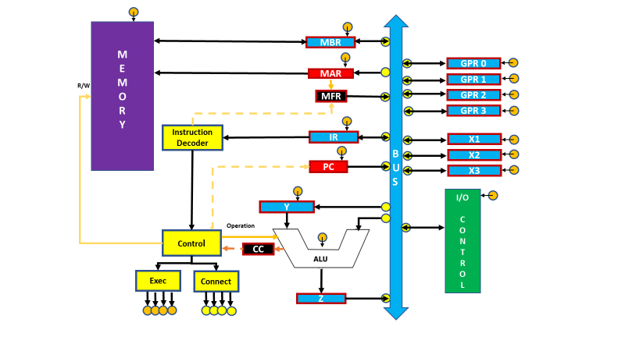
Project Status and Information
CS61 Computer Architecture - Lecture 3

Slide 3
Instruction Set Architecture (ISA)
The ISA is that portion of the machine visible to the assembly level programmer or to the compiler writer.
  Is (recently) not the “real” machine!
  An interface between hardware and low-level software
  Standardizes instructions and bit patterns representing them; follows specified design principles
  The machine description that a hardware designer must understand to design a correct implementation of the computer.
Advantage: Different implementations of the same instruction set (IBM System/360)
Disadvantage: desire for compatibility prevents trying out new ideas
Q?: Is binary compatibility really important??
CS61 Computer Architecture - Lecture 3

Slide 4
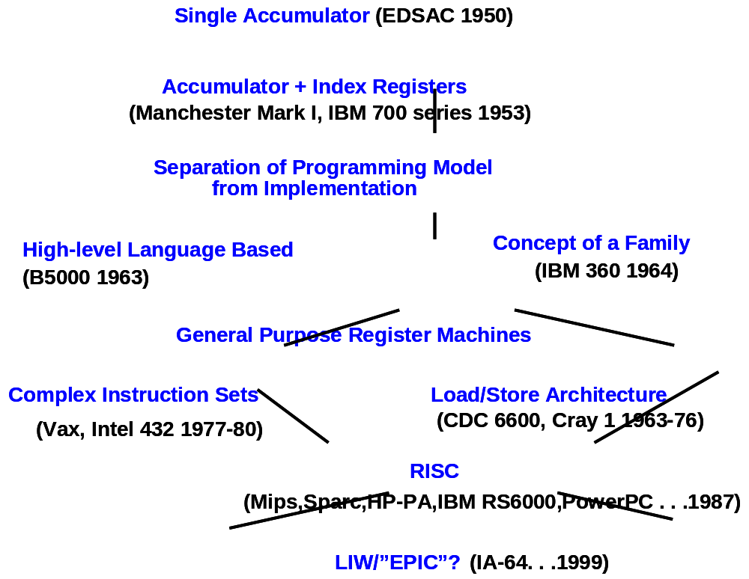
Evolution of ISAs
CS61 Computer Architecture - Lecture 3

Slide 5
Why is ISA Design important?
The instruction set architecture is one of the most important design issues that a CPU designer must get right from the start.
  Features like caches, pipelining, superscalar implementation, etc., can all be grafted on to a CPU design long after the original design is obsolete (ex: Intel x86 architecture)
  However, it is very difficult to change the instructions a CPU executes once the CPU is in production and people are writing software that uses those instructions.
  Therefore, one must carefully choose the instructions for a CPU.
You might be tempted to take the "kitchen sink" approach to instruction set design and include as many instructions as you can dream up in your instruction set. This approach fails for several reasons
CS61 Computer Architecture - Lecture 3

Slide 6
Nasty Reality #1: Silicon Real Estate
The first problem with "putting it all on the chip" is that each feature requires some number of transistors on the CPU's silicon die.
  CPU designers work with a "silicon budget" and are given a finite number of transistors to work with.
  This means that there aren't enough transistors to support "putting all the features" on a CPU.
  The original 8086 processor, for example, had a transistor budget of less than 30,000 transistors.
  The Pentium III processor had a budget of over eight million transistors.
CS61 Computer Architecture - Lecture 3

Slide 7
Nasty Reality #2: Cost
Although it is possible to use millions of transistors on a CPU today, the more transistors you use the more expensive the CPU.
The more instructions that you have (CISC), the more complex the circuitry and, consequently, the more transistors you need.
CS61 Computer Architecture - Lecture 3

Slide 8
Nasty Reality #3: Expandability
One problem with the "kitchen sink" approach is that it's very difficult to anticipate all the features people will want.
  For example, Intel's MMX and SIMD instruction enhancements were added to make multimedia programming more practical on the Pentium processor.
  Back in 1978, very few people could have possibly anticipated the need for these instructions.
When designing a CPU using the "kitchen sink" approach, it is often common to discover that programs almost never use some of the available instructions.
Unless very few programs use the instruction (and you're willing to let them break) or you can automatically simulate the instruction in software, removing instructions is a very difficult thing to do.
CS61 Computer Architecture - Lecture 3

Slide 9
Nasty Reality #4: Legacy Support
Often it is the case that an instruction the CPU designer feels is important turns out to be less useful than anticipated.
  For example, the LOOP instruction on the 80x86 CPU sees very little use in modern high-performance programs.
  The 80x86 ENTER instruction is another good example.
  This is almost the opposite of expandability – retaining apparently not useful instructions
Unfortunately, you cannot easily remove instructions in later versions of a processor because this will break some existing programs that use those instructions.
Generally, once you add an instruction you have to support it forever in the instruction set.
CS61 Computer Architecture - Lecture 3

Slide 10
Nasty Reality #5: Complexity
The popularity of a new processor is easily measured by how much software people write for that processor.
  Most CPU designs die a quick death because no one writes software specific to that CPU.
  Therefore, a CPU designer must consider the assembly programmers and compiler writers who will be using the chip upon introduction.
While a "kitchen sink" approach might seem to appeal to such programmers, the truth is no one wants to learn an overly complex system.
If your CPU does everything under the sun, this might appeal to someone who is already familiar with the CPU.
However, pity the poor soul who doesn't know the chip and has to learn it all at once.
CS61 Computer Architecture - Lecture 3

Slide 11
Basic Instruction Design Goals
In a typical Von Neumann architecture CPU, the computer encodes CPU instructions as numeric values and stores these numeric values in memory.
  The encoding of these instructions is one of the major tasks in instruction set design and requires very careful thought.
To encode an instruction we must pick a unique numeric opcode value for each instruction.
  With an n-bit number, there are 2n different possible opcodes, so to encode m instructions you will need an opcode that is at least log2(m) bits long.
With 128 instructions (27), you need a 7-line to 128-line decoder to decide which instruction you have.
CS61 Computer Architecture - Lecture 3

Slide 12
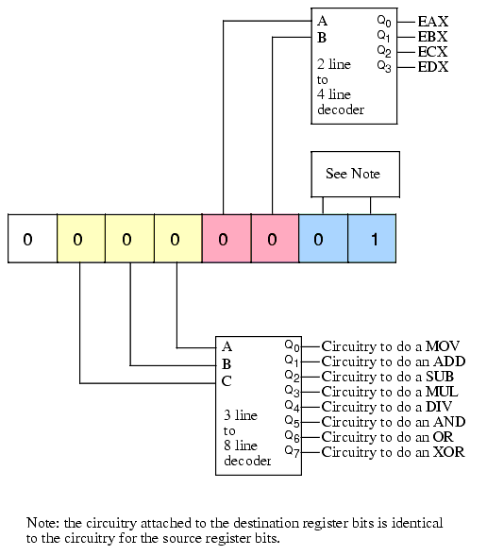
8-Instruction Decoder
CS61 Computer Architecture - Lecture 3

Slide 13
What Must an Instruction Specify?
Which operation to perform
Where to find the operands (registers, memory, immediate, stack, other)
Where to store the result (registers, memory, immediate, stack, other)
Location of next instruction (either implicitly or explicitly)
CS61 Computer Architecture - Lecture 3

Slide 14
Interpreting Memory Addresses
Objects may have byte or word addresses – an address refers to the number of bytes or words counted from the beginning of memory.
  Little Endian – puts the byte whose address is xx00 at the least significant position in the word.
  Big Endian – puts the byte whose address is xx00 at the most significant position in the word.
  Alignment – data must be aligned on a boundary equal to its size. Misalignment typically results in an alignment fault (hardware trap) that must be handled by the Operating System.
It is common for most machines today to do byte addressing since we want to often manipulate
objects of byte size, such as characters.
CS61 Computer Architecture - Lecture 3

Slide 15
Types of Instructions
Transfer of control: jumps, calls,
Arithmetic/Logical – add, subtract, multiply, divide, sqrt, log, sin, cos, ….; also, Boolean comparisons
Load/Store: load a value from memory or store a value to memory
Stack instructions: push/pop
System: traps, I/O, halt, no-operation, …
Floating Point Arithmetic
Decimal
String operations
Multimedia operations: Intel’s MMX and Sun’s VIS
CS61 Computer Architecture - Lecture 3

Slide 16
Computer Architectures (from Instruction Perspective)
Accumulator (acc):
1 address add A acc = acc + memory[A]
1+x address addx A acc = acc + memory[A + x]
Stack:
0 address add tos = tos + next
(tos = top of stack)
General Purpose Register:
2 address add A B EA(A) = EA(A) + EA(B)
3 address add A B C EA(A) = EA(B) + EA(C)
Load/Store: Mem3 = Mem1 + Mem2
0 Memory load R1, Mem1
load R2, Mem2
add R1, R2
store R1, Mem3
1 Memory load R1, Mem1
add R1, Mem2
store R1, Mem3
CS61 Computer Architecture - Lecture 3

Slide 17
Addressing Architectures
Motorola 6800 / Intel 8080/8085 (1970s)
  1-address architecture: ADDA <addr>
  (A) = (A) + (addr)
Intel x86 (1980s)
  2-address architecture: ADD EAX, EBX
  (A) = (A) + (B)
MIPS (1990s)
  3-address architecture: ADD $2, $3, $4
  ($2) = ($3) + ($4)

Slide 18
Adding C = B + A
Stack | Accumulator | Register (Register-memory) | Register (load-store)
Push A | Load A | Load R1, A | Load R1, A
Push B | Add B | Add R1, B | Load R2, B
Add | Store C | Store C, R1 | Add R3, R1, R2
Pop C |  |  | Store C, R3
CS61 Computer Architecture - Lecture 3

Slide 19
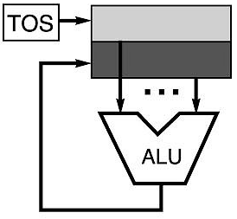
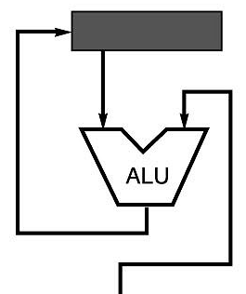
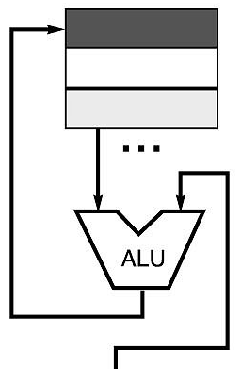
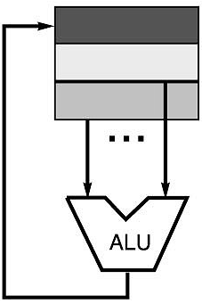
Graphic View
memory
memory
acc = acc + mem[C]
R1 = R1 + mem[C]
R3 = R1 + R2
Registers are the class that won out.
The more registers on the CPU, the better, except that studies of
early RISC machines found that 32 registers was more than enough.
Today, that is debatable given the video and gaming environments.
CS61 Computer Architecture - Lecture 3

Slide 20
Stack Architecture
Need Top of Stack register, Stack Limit register,
Pros
  Good code density (implicit operand addressing→ top of stack)
  Low hardware requirements
  Easy to write a simple compiler for stack architectures
Cons
  Stack becomes the bottleneck
  Little ability for parallelism or pipelining
  Data is not always at the top of stack when needed, so additional instructions are needed
  Difficult to write an optimizing compiler for stack architectures (Good PhD topic!!)
CS61 Computer Architecture - Lecture 3

Slide 21
Accumulator Architectures
One or more accumulators (masquerade as GPRs)
Pros
  Very low hardware requirements
  Easy to design and understand
Cons
  Accumulator becomes the bottleneck
  Little ability for parallelism or pipelining
  High memory traffic
CS61 Computer Architecture - Lecture 3

Slide 22
Memory-Memory Architectures
Operands fetched directly from memory into internal registers
Pros
  Requires fewer instructions (especially if 3 operands)
  Easy to write compilers for (especially if 3 operands)
Cons
  Very high memory traffic (especially if 3 operands)
  Variable number of clocks per instruction (especially if 2 operands) and indexing and indirect access and …
  With two operands, more data movements are required
CS61 Computer Architecture - Lecture 3

Slide 23
Register-Memory Architectures
Operands fetched from register and memory
Pros
  Some data can be accessed without loading first
  Instruction format easy to encode
  Good code density
Cons
  Operands are not equivalent (poor orthogonality)
  Variable number of clocks per instruction (w/ indexing and indirect access and …)
  May limit number of registers
CS61 Computer Architecture - Lecture 3

Slide 24
Load-Store/Register-Register Architectures
Operands fetched only from registers which are pre-loaded
Pros
  Simple, fixed length instruction encoding
  Instructions take similar number of cycles
  Relatively easy to pipeline
Cons
  Higher instruction count
  Not all instructions need three operands
  Dependent on good compiler
CS61 Computer Architecture - Lecture 3

Slide 25
Addressing Modes
To get to the data, we must have a way of addressing the data. This is the Address Mode. Data can be in several places:
  in the instruction
  in a register
  in main memory
For main memory, we need to generate an absolute address, e.g., the address that is sent out over the memory bus (from the MDR)
CS61 Computer Architecture - Lecture 3

Slide 26
DEC VAX Addressing Modes
Studies by [Clark and Emer] indicate that modes 1-4 account for 93% of all operands on the VAX
Address Mode | Example | Action
Register direct Ri | Add R4, R3 | R4 < R4 + R3
Immediate (literal) #n | Add R4, #3 | R4 < R4 + 3
Displacement M[Ri + #n] | Add R4, 100(R1) | R4 < R4 + M[100 + R1]
Register indirect M[Ri] | Add R4, (R1) | R4 < R4 + M[R1]
Indexed M[Ri + Rj] | Add R4, (R1 + R2) | R4 < R4 + M[R1 + R2]
Direct (absolute) M[#n] | Add R4, (1000) | R4 < R4 + M[1000]
Memory Indirect M[M[Ri] ] | Add R4, @(R3) | R4 < R4 + M[M[R3]]
Autoincrement M[Ri++] | Add R4, (R2)+ | R4 < R4 + M[R2] R2 <- R2 + d
Autodecrement M[Ri - -] | Add R4, (R2) | R4 < R4 + M[R2] R2 <- R2 - d
Scaled M[Ri + Rj*d + #n] | Add R4, 100(R2)[R3] | R4 < R4 + M[100 + R2 + R3*d]
CS61 Computer Architecture - Lecture 3

Slide 27
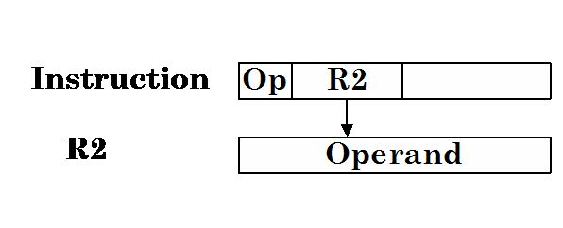
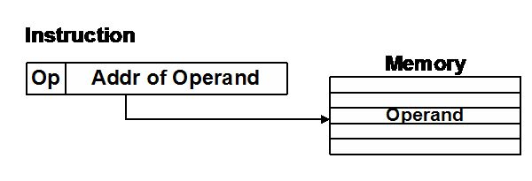
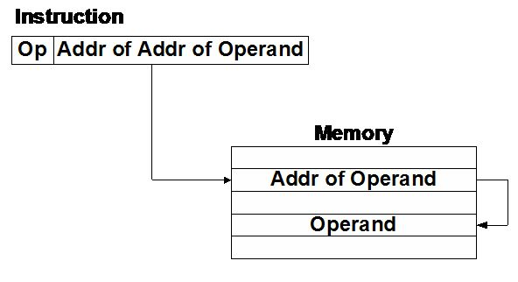
Addressing Examples - I
Register Direct Addressing: The Register contains the operand
Direct Addressing to Main Memory: Instruction contains the Main Memory Address
Indirect Addressing To Main Memory: Instruction contains an address in main memory whose contents are the address of the operand
CS61 Computer Architecture - Lecture 3

Slide 28
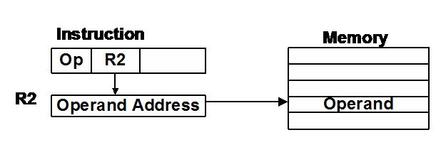
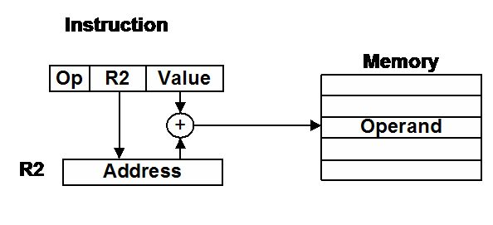
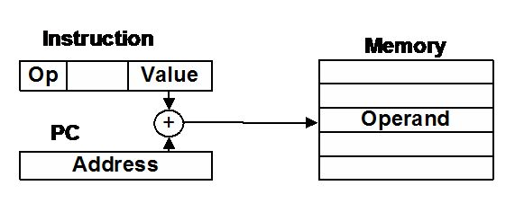
Addressing Examples - II
Register Indirect Addressing: The register contains the address of a main memory location which contains the address of the operand
The contents of the register specify a base address which is added to the displacement value in the instruction to provide the effective main memory address.
Relative Addressing: The displacement value in the instruction is added to the contents of the PC to generate the effective main memory address.
CS61 Computer Architecture - Lecture 3

Slide 29
Control Instructions: Issues and Tradeoffs - I
Compare and branch
+ no extra compare, no state passed between instructions
-- requires ALU op, restricts code scheduling opportunities
Implicitly set condition codes ­ Z, N, V, C
+ can be set ``for free'' as a result of an arithmetic/logical operation
-- constrains code reordering, extra state to save/restore
Explicitly set condition codes
+ can be set ``for free'', decouples branch/fetch from pipeline
-- extra state to save/restore
Condition in general ­purpose register
+ no special state but uses up a register
-- branch condition separate from branch logic in pipeline
CS61 Computer Architecture - Lecture 3

Slide 30
Control Instructions: Issues and Tradeoffs - II
Some data for MIPS
80% branches use immediate data
> 80% of those values are zero
50% branches use == 0 or != 0
Compromise in MIPS
branch==0, branch<>0
compare instructions for all other compares, such as LT, LTE, GT, GTE
Link Return Address:
implicit register ­- many recent architectures use this
+ fast, simple
-- software must save register before next call, whether interrupts or not
explicit register
+ may avoid saving register, but is a good ideas to do so
-- register must be specified
processor stack
+ recursion direct
-- complex instructions
CS61 Computer Architecture - Lecture 3

Slide 31
Control Instructions: Issues and Tradeoffs - III
Save or restore state:
What state?
  function calls: registers
  system calls: registers, flags, PC, PSW, etc
Hardware need not save registers
  Caller can save registers in use
  Callee saves registers it will use
Hardware register save
  IBM STM, VAX CALLS
  Faster?
Many recent architectures do no register saving
  Or do implicit register saving with register windows (SPARC)
CS61 Computer Architecture - Lecture 3

Slide 32
What comes first? The compiler or the ISA?
Depends on who you ask.
Early computers were programmable only in machine or assembly language; compilers came later –
  like FORTAN I and MAD and LISP and COBOL and BASIC and ALGOL and … (Jean Sammet in History of Programming Languages listed over 700 of them!)
AT&T, in designing the their WE chips, closely examined how the C compiler generated instructions and designed an ISA to efficiently support that compiler
Similarly, for the Intel iAPX 432 and Ada 83.
CS61 Computer Architecture - Lecture 3

Slide 33
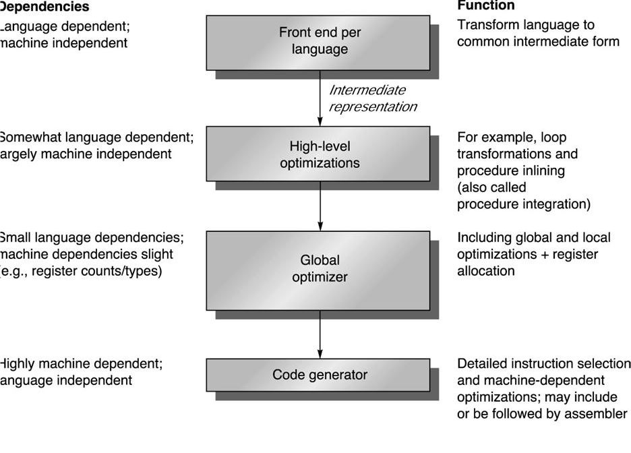
Compiler Structure
CS61 Computer Architecture - Lecture 3

Slide 34
Compilation Steps
Parsing ­­> intermediate representation
Jump Optimization
Loop Optimizations
Register Allocation
Code Generation ­­> assembly code
Common Sub­Expression
Procedure in-lining
Constant Propagation
Strength Reduction
Pipeline Scheduling
CS61 Computer Architecture - Lecture 3

Slide 35
What do Compiler Writers Want?
Characteristics of ISA:
  regularity
  orthogonality
  composability
Compilers perform a giant case analysis
  too many choices make it hard
Orthogonal instruction sets
  operation, addressing mode, data type
One solution or all possible solutions
  2 branch conditions ­ eq, lt
  or all six ­ eq, ne, lt, gt, le, ge
  not 3 or 4
Let the compiler put the instructions together to make more complex sequences.
CS61 Computer Architecture - Lecture 3

Slide 36
Designing ISAs to Improve Compilation
Provide enough general purpose registers to ease register allocation ( more than 16).
Provide regular instruction sets by keeping the operations, data types, and addressing modes orthogonal.
Provide primitive constructs rather than trying to map to a high-level language.
Simplify trade-off among alternatives.
Allow compilers to help make the common case fast.
CS61 Computer Architecture - Lecture 3

Slide 37
ISA Metrics
Orthogonality
  No special registers, few special cases, all operand modes available with any data type or instruction type
Completeness
  Support for a wide range of operations and target applications
Regularity
  No overloading for the meanings of instruction fields
Streamlined Design
  Resource needs easily determined. Simplify tradeoffs.
Ease of compilation (programming?), Ease of implementation, Scalability
CS61 Computer Architecture - Lecture 3

Slide 38
Summary of ISA Design Space
Five Primary Dimensions
  Number of explicit operands ( 0, 1, 2, 3 )
  Operand Storage Where besides memory?
  Effective Address How is memory location specified?
  Type & Size of Operands byte, int, float, vector, . . .
  How is it specified?
  Operations add, sub, mul, . . .
  How is it specifed?
Other Aspects
  Successor How is it specified?
  Conditions How are they determined?
  Encodings Fixed or variable? Wide?
  Parallelism
CS61 Computer Architecture - Lecture 3

Slide 39
Looking at ISAs
1. Amdahl, Blaauw, and Brooks, “Architecture of the IBM System/360.” IBM Journal of Research and Development, 8(2):87-101, April 1964
2. Lonergan and King, “Design of the B 5000 system.” Datamation, vol. 7, no. 5, pp. 28-32, May, 1961
3. Patterson and Ditzel, “The case for the reduced instruction set computer.” Computer Architecture News, October 1980
4. Clark and Strecker, “Comments on ‘the case for the reduced instruction set computer’," Computer Architecture News, October 1980.
CS61 Computer Architecture - Lecture 3

Slide 40
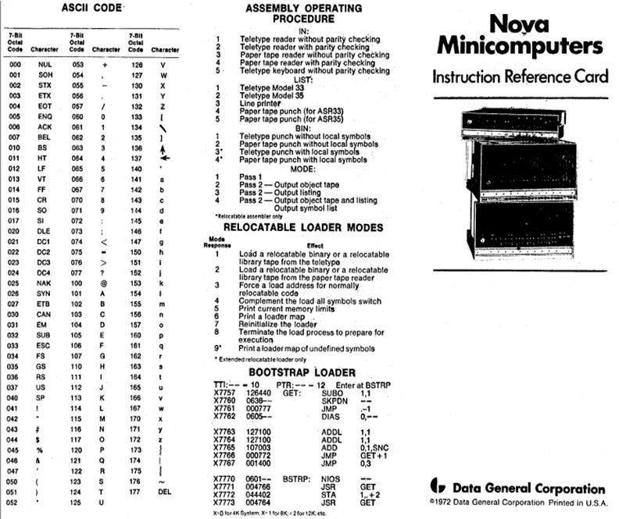
DG Nova ISA
CS61 Computer Architecture - Lecture 3

Slide 41
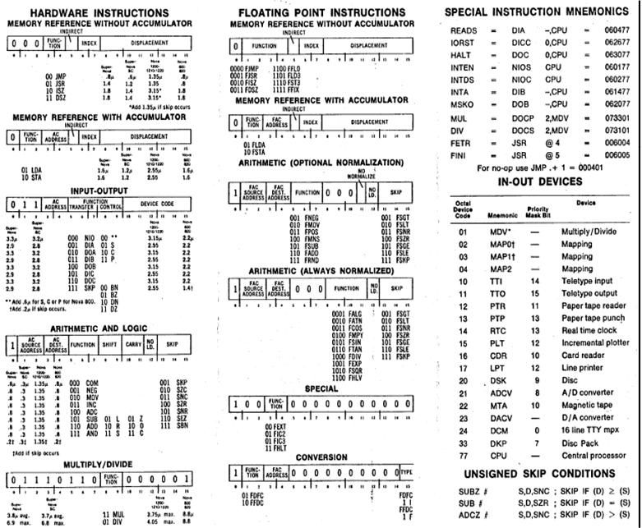
DG Nova ISA
CS61 Computer Architecture - Lecture 3

