Slide 1
CS6461 – Computer Architecture
Morris Lancaster
Adapted from Professor Stephen Kaisler’s Slides
Lecture 6 – I/O Systems

Slide 2
I/O System Design
A typical program does three basic activities: input, computation, and output.
Most I/O devices interface to the CPU in a fashion quite similar to memory.
  Many devices appear to the CPU as though they were memory devices.
  To output data to the outside world, the CPU simply stores data into a "memory" location and the data magically appears on some connectors external to the computer.
Similarly, to input data from some external device, the CPU simply transfers data from a "memory" location into the CPU
  this "memory" location holds the value found on the pins of some external connector.
An output port is a device that looks like a memory cell to the computer but contains connections to the outside world.
  An I/O port typically uses a latch rather than a flip-flop to implement the memory cell.
  When the CPU writes to the address associated with the latch, the latch device captures the data and makes it available on a set of wires external to the CPU and memory system.
CSCI 6461 – Computer Architecture

Slide 3
I/O Types
There are three basic forms of input and output that a typical computer system will use:
  I/O-mapped I/O uses special instructions to transfer data between the computer system and the outside world.
  Memory-mapped I/O uses special memory locations in the normal address space of the CPU to communicate with real-world devices
  Direct Memory Access (DMA) is a special form of memory-mapped I/O where the peripheral device reads and writes data in memory without going through the CPU.
CSCI 6461 – Computer Architecture

Slide 4
Memory-Mapped I/O
A memory-mapped peripheral device is connected to the CPU's address and data lines exactly like memory:
  whenever the CPU reads or writes the address associated with the peripheral device, the CPU transfers data to or from the device.
  a certain portion of the processor's address space is mapped to the device, and communications occur by reading and writing directly to/from those memory areas.
  Memory-mapped I/O is suitable for devices which must move large quantities of data quickly, such as graphics cards.
  Memory-mapped I/O can be used either instead of or more often in combination with traditional registers. For example, graphics cards still use registers for control information such as setting the video mode.
  A potential problem exists with memory-mapped I/O, if a process is allowed to write directly to the address space used by a memory-mapped I/O device.
CSCI 6461 – Computer Architecture

Slide 5
Memory-Mapped I/O: Advantages
Principle Advantage: the CPU can use any instruction that accesses memory to transfer data between the CPU and a memory-mapped I/O device.
  PDP-11 had no I/O instructions
  I/O registers in devices were mapped to memory locations
  The MOV instruction is the one most commonly used to send and receive data from a memory-mapped I/O device, but any instruction that reads or writes data in memory is also legal.
  For example, if you have an I/O port that is read/write, you can use the ADD instruction to read the port, add data to the value read, and then write data back to the port.
CSCI 6461 – Computer Architecture

Slide 6
Memory-Mapped I/O: Disadvantages
Principle Disadvantage: they consume addresses in the memory map.
  Generally, the minimum amount of space you can allocate to a peripheral (or block of related peripherals) is a four kilobyte page.
  A few independent peripherals can wind up consuming a fair amount of the physical address space.
  A typical PC has only a couple dozen such devices, so this isn't much of a problem.
  However, some devices, like video cards, consume a large chunk of the address space (e.g., some video cards have 32 megabytes of on-board memory that they map into the memory address space).
CSCI 6461 – Computer Architecture

Slide 7
I/O Mapped IO
I/O-mapped input/output uses special instructions to access I/O ports. (sounds redundant, doesn’t it?)
Many CPUs do not provide this type of I/O, although the 80x86 does.
  The Intel 80x86 family uses the IN and OUT instructions to provide I/O-mapped input/output capabilities.
  The 80x86 IN and OUT instructions behave somewhat like the MOV instruction except they transmit their data to and from a special I/O address space that is distinct from the memory address space.
  The IN and OUT instructions use the following syntax (where al is a register):
    in( port, al ); // ... or AX or EAX, port is a constant in the range
    out( al, port ); // 0..255.
    in( dx, al ); // Or AX or EAX.
    out( al, dx ); etc…
CSCI 6461 – Computer Architecture

Slide 8
Intel 80x86
The 80x86 family uses a separate address bus for I/O transfers.
  This bus is only 16-bits wide, so the 80x86 can access a maximum of 65,536 different bytes in the I/O space.
  The first two instructions encode the port address as an eight-bit constant, so they're actually limited to accessing only the first 256 I/O addresses in this address space.
  This makes the instruction shorter (two bytes instead of three).
Unfortunately, most of the interesting peripheral devices are at addresses above 255, so the first pair of instructions above are only useful for accessing certain on-board peripherals in a PC system.
CSCI 6461 – Computer Architecture

Slide 9
Intel 80x86
To access I/O ports at addresses beyond 255 you must use the latter two forms of the IN and OUT instructions above.
  These forms require that you load the 16-bit I/O address into the DX register and use DX as a pointer to the specified I/O address.
  For example, to write a byte to the I/O address $378, you would use an instruction sequence like the following:
    mov( $378, dx );
    out( al, dx );
CSCI 6461 – Computer Architecture

Slide 10
I/O Mapped IO
Principle Advantage: peripheral devices mapped to this area do not consume space in the memory address space.
This allows you to fully expand the memory address space with RAM or other memory.
On the other hand, you cannot use arbitrary memory instructions to access peripherals in the I/O address space
You can only use the IN and OUT instructions.
CSCI 6461 – Computer Architecture

Slide 11
I/O Mapped IO
Principle Disadvantage: it is quite small.
  Although most peripheral devices only use a couple of I/O addresses (and most use fewer than 16-bit I/O addresses), a few devices, like video display cards, can occupy millions of different I/O locations (e.g., three bytes for each pixel on the screen).
As noted earlier, some video display cards have 32 MBytes of dual-ported RAM on board.
Clearly we cannot easily map this many locations into the 64K I/O address space.
CSCI 6461 – Computer Architecture

Slide 12
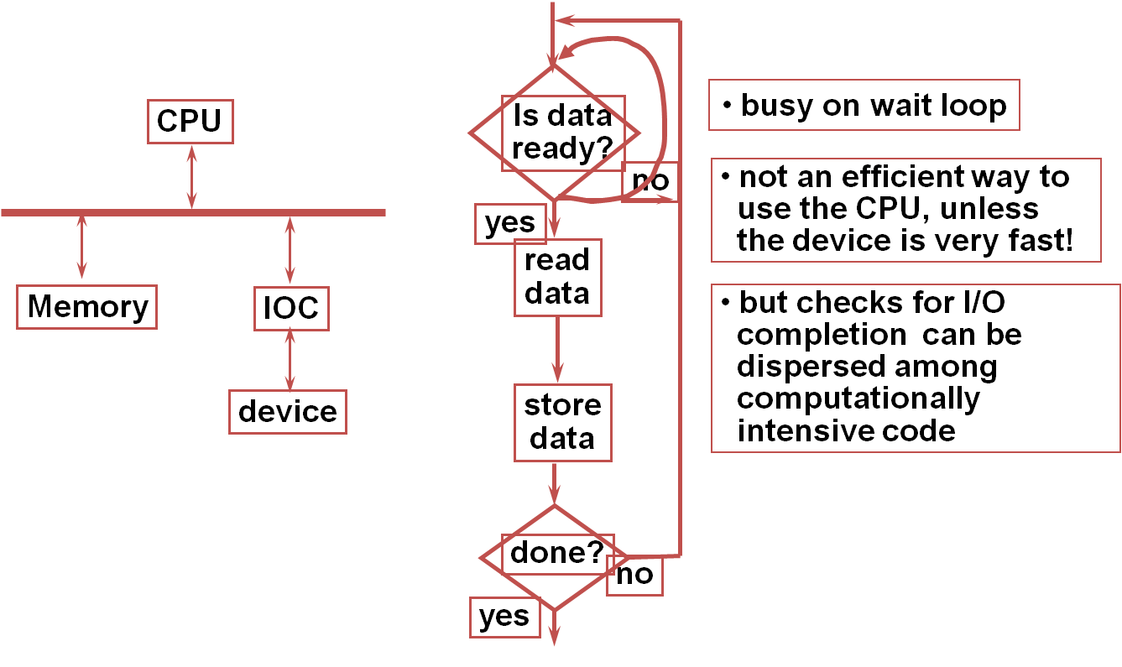
I/O Mapped IO
Polling
CSCI 6461 – Computer Architecture

Slide 13
Direct Memory Access - I
For very high-speed I/O devices the CPU may be too slow when processing this data a byte (or word or double word) at a time.
Such devices generally have an interface to the CPU/Memory bus so they can directly read and write memory.
This is known as direct memory access since the peripheral device accesses memory directly, without using the CPU as an intermediary.
This often allows the I/O operation to proceed in parallel with other CPU operations, thereby increasing the overall speed of the system.
Note, however, that the CPU and DMA device cannot both use the address and data busses at the same time. (in most machines).
CSCI 6461 – Computer Architecture

Slide 14
Direct Memory Access - II
Concurrent processing only occurs if:
  the CPU has a cache
  is executing code, and
  accessing data found in the cache (so the bus is free).
Even if the CPU must halt and wait for the DMA operation to complete, the I/O is still much faster since many of the bus operations during I/O or memory-mapped I/O consist of instruction fetches or I/O port accesses which are not present during DMA operations.
CSCI 6461 – Computer Architecture

Slide 15
Direct Memory Access - III
A typical DMA controller consists of a pair of counters and other circuitry that interfaces with memory and the peripheral device.
  One of the counters serves as an address register. This counter supplies an address on the address bus for each transfer.
  The second counter specifies the number of transfers to complete. Each time the peripheral device wants to transfer data to or from memory, it sends a signal to the DMA controller.
The DMA controller places the value of the address counter on the address bus.
At the same time, the peripheral device places data on the data bus (if this is an input operation) or reads data from the data bus (if this is an output operation).
After a successful data transfer, the DMA controller increments its address register and decrements the transfer counter.
This process repeats until the transfer counter decrements to zero.
CSCI 6461 – Computer Architecture

Slide 16

How Does DMA Work?
CSCI 6461 – Computer Architecture

Slide 17
Interrupt-Driven System
Interrupts allow devices to notify the CPU when they have data to transfer or when an operation is complete, allowing the CPU to perform other duties when no I/O transfers need its immediate attention.
The CPU has an interrupt-request line that is sensed after every instruction.
A device's controller raises an interrupt by asserting a signal on the interrupt request line.
The CPU then performs a state save, and transfers control to the interrupt handler routine at a fixed address in memory.
  The CPU catches the interrupt and dispatches the interrupt handler.
The interrupt handler determines the cause of the interrupt, performs the necessary processing, performs a state restore, and executes a return from interrupt instruction to return control to the CPU.
  The interrupt handler clears the interrupt by servicing the device.
  Note that the state restored does not need to be the same state as the one that was saved when the interrupt went off.
CSCI 6461 – Computer Architecture

Slide 18
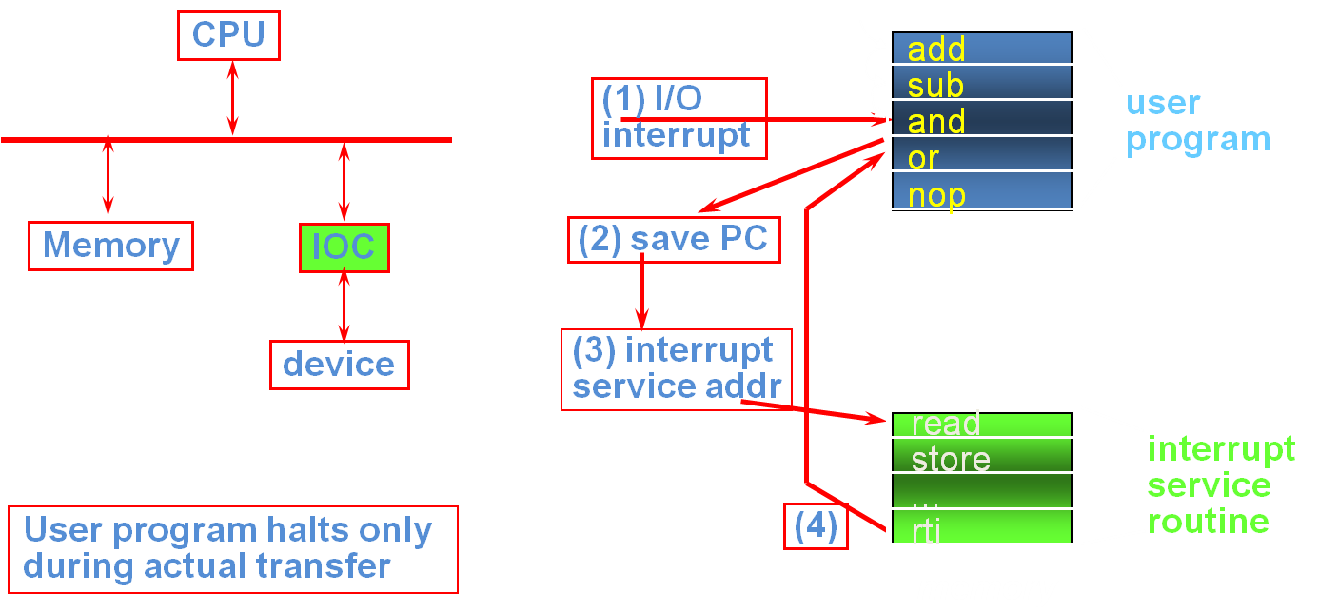
Interrupt-Driven System
CSCI 6461 – Computer Architecture

Slide 19
Interrupts vs. Traps
I/O devices and the CPU can execute concurrently.
  Each device controller is in charge of a particular device type.
  Each device controller has a local buffer.
  CPU moves data from/to main memory to/from local buffers
  I/O is from the device to local buffer of controller.
  Device controller informs CPU that it has finished its operation by causing an interrupt.
Determines which type of interrupt has occurred:
  polling
  vectored interrupt system
Separate segments of code determine what action should be taken for each type of interrupt
A trap is a software-generated interrupt cause by:
  A user program error (e.g. division by zero)
  A user request for a service by the OS
CSCI 6461 – Computer Architecture

Slide 20
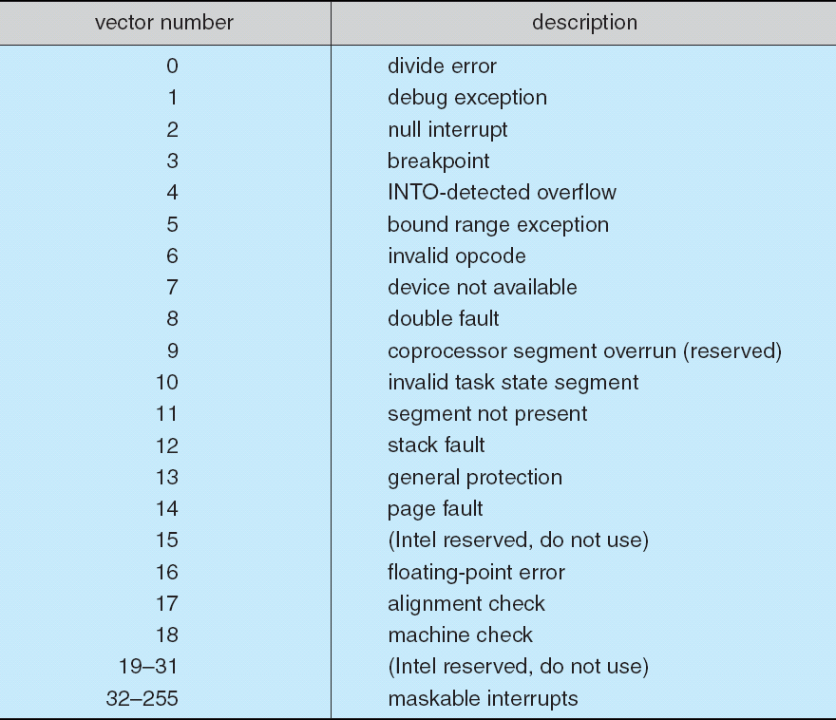
Some Types of Intel Interrupts
CSCI 6461 – Computer Architecture

Slide 21
I/O Processors
Separate microprocessor-based system that handles all I/O operations
CPU send I/O request to IOP
IOP converts this into a set of instructions specific to the device to be accessed.
IOP sends instructions to the device controller which retrieves or stores the data
Device controller reads data or stores data in the specified memory locations.
IOP interrupts CPU when done.
CSCI 6461 – Computer Architecture

Slide 22
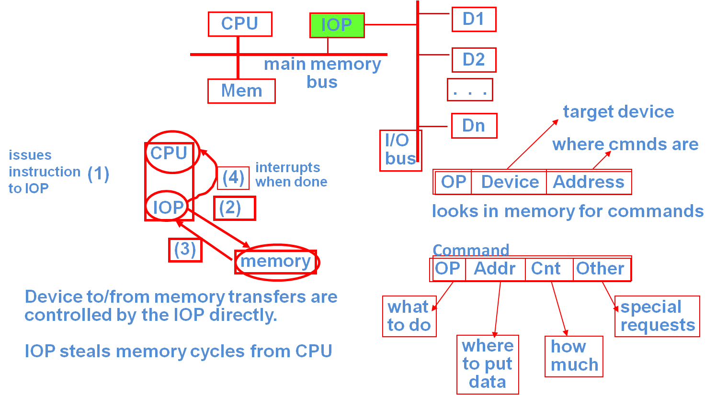
I/O Processors
CSCI 6461 – Computer Architecture

Slide 23

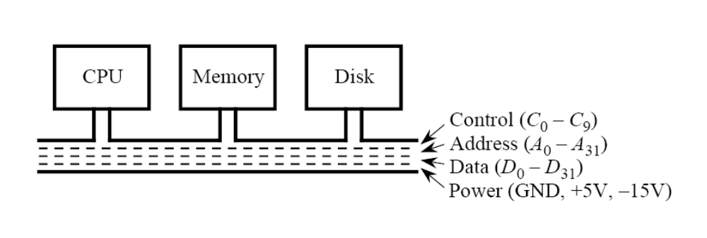
Another (Sort Of) Axiom: It’s Also About the Buses!!
Types of Buses:
  processor-memory buses: short and high speed
  I/O buses : long and have many devices connected to them
  backplane buses: allow processors, memory, and I/O devices to coexist on single bus
Old Style: All On One Bus)
CSCI 6461 – Computer Architecture

Slide 24
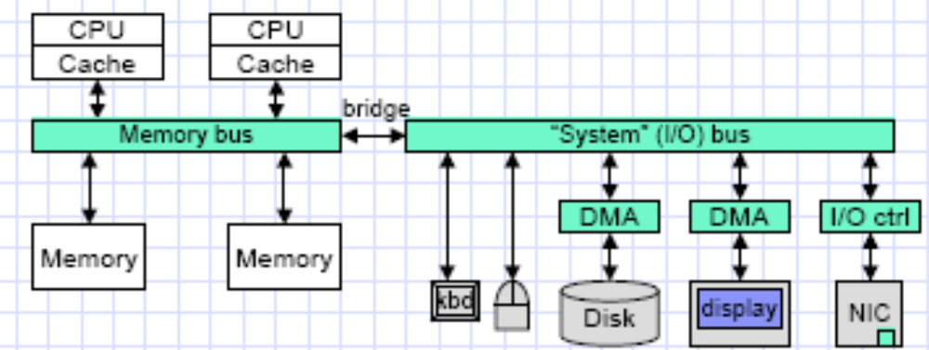
Modern Computer System
Note: Most modern systems now have two busses: a CPU-Memory bus and a Memory-High Speed Peripheral Devices bus.
CSCI 6461 – Computer Architecture

Slide 25
Bus Issues
A bus is a set of control lines and a set of data lines
  control lines indicate what type of info is contained on the data lines
A bus transaction: two parts
  send address and command
  receive or send the data
I/O - in perspective of the processor
  input- data from device to memory where processor can read it
  output - data to a device from memory where processor wrote it
A bus creates a communication bottleneck
  Limited by physical factors: length of bus, number of devices
  Lots of devices increases propagation delays
But, it supports versatility since new devices can be added easily
CSCI 6461 – Computer Architecture

Slide 26
Synchronous/Asynchronous Buses
Synchronous - clock in control lines
  can be implemented easily in finite state machine
  every device on bus must run at the same clock rate
  because of clock skew, either short and fast, or long and slow
  processor/memory usually synchronous
Asynchronous- not clocked
  can accommodate wide variety of devices
  handshaking protocol: read-request data-ready, acknowledge
  handshaking slow, so can use synchronizer
  asynchronous scales better with technology changes and can support a wider variety of device response speeds, but increased overhead
CSCI 6461 – Computer Architecture

Slide 27
A (Historical) Survey of Buses - I
ISA: Industry Standard Architecture
  Old technology – ran at 8 MHz, 16 bits transfer
  42.4 Mbits/s maximum transfer rate
  Rare today, replaced by EISA
MCA: Micro-Channel Architecture
  IBM’s attempt to compete with the ISA and seize the standard
  32-bits transfer
  Automatically configured cards (Plug-n-Play)
  Not compatible with ISA
EISA: Extended Industry Standard Architecture
  32 bits transfer
  8.33 MHz cycle
  Backward compatible with ISA
CSCI 6461 – Computer Architecture

Slide 28
A (Historical) Survey of Buses - II
VESA: Video Electronic Standards Association
  32-bit bus
  Found mostly on Intel 80486 machines
  Relied on the 486 processor to function
  So, people started switching to the PCI bus
PCI: Peripheral Component Interconnect
  Up to 33 MHz and 960 Mbits/s transfer rate
  16-bit architecture
  Synchronous or Asynchronous
  Plug-n-Play became reality
  Ran (at that time) at half of system bus – 66 MHz
PCI-X: PCI Extended
  Ran at 133 MHz
  64-bit transfer w/ maximum throughput of 1 GBits/s
  Developed for Fibre Channel, Gigabit Ethernet, and Ultra3 SCSI
CSCI 6461 – Computer Architecture

Slide 29
A (Historical) Survey of Buses - III
AGP: Accelerated Graphics Port
  A high speed – 133 MHz – PCI port
  Used for high-speed 3D Graphics processors
  Dedicated to a single device
IDE: Integrated Drive Electronics
  Good performance at cheap cost
  Mostly used for high-speed hard disks
  Other names: ATA, ATAPI, EIDE, ….
SCSI: Small Computer Systems Interface
  Mostly used for slower speed peripherals, but include hard disks
  Speed varied: 80 - 640 Mbits/s
  Later updated to Fast SCSI, Ultra SCSI, etc..
CSCI 6461 – Computer Architecture

Slide 30
A (Historical) Survey of Buses - IV
USB: Universal Serial Bus
  Hot plug-n-play
  Standard connectivity for many personal computer systems today
  Up to 127 devices chained together
  Up to 480 Mbits/s (Version 2.0)
Firewire (IEEE 1394):
  Developed by Apple
  400 Mbits/s transfer rate
  Hot plug-n-play
Other types of ports: IBM Parallel Port, Game Ports, etc.
CSCI 6461 – Computer Architecture

Slide 31
SCSI
A set of standards for physically connecting and transferring data between computers and peripheral devices.
SCSI is an intelligent, peripheral, buffered, peer to peer interface.
Every device attaches to the SCSI bus in a similar manner by hiding the complexity of the physical format.
SCSI standard defines command sets for specific peripheral device types.
Must have at least one host, but may have more; up to 16 devices per bus in later versions.
See http://www.scsita.org/terms-and-terminology.html
CSCI 6461 – Computer Architecture

Slide 32
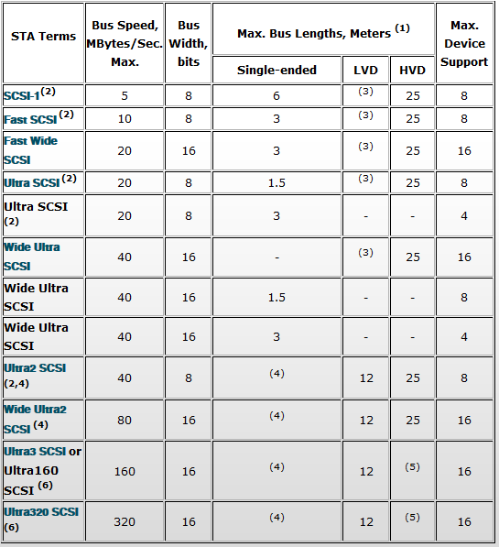
SCSI Bus Comparison
http://www.scsita.org/terms-and-terminology.html
CSCI 6461 – Computer Architecture

Slide 33
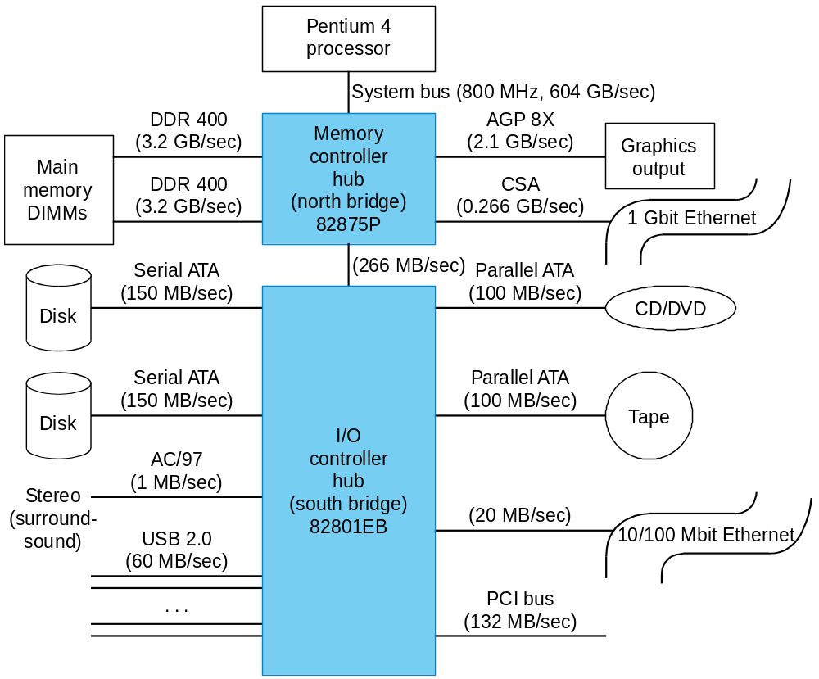
How Do Buses Fit In?
CSCI 6461 – Computer Architecture

Slide 34
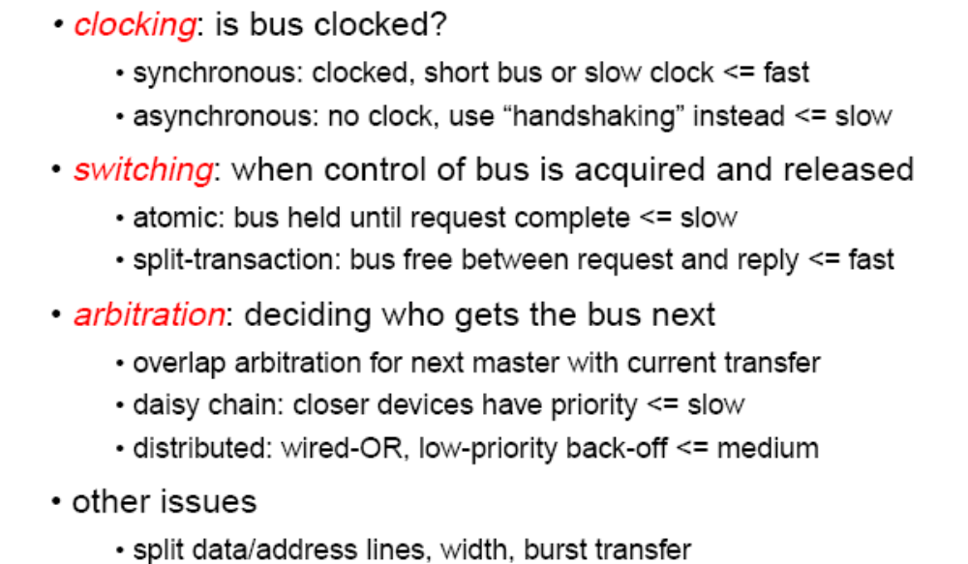
Bus Issues
CSCI 6461 – Computer Architecture

Slide 35
Who Cares About I/O?
Well:
  CPU Performance increased 50% - 100% per year, now slowing to 25-50% or less
  Memory Performance increasing slowly, but slower than CPU speed by order of magnitude
  I/O Performance limited by mechanical delays (< 5% per year performance increase – IOs per second or MBs per second)
Amdahl’s Law: System speed-up is limited by the slowest part!
  10% I/O & 10x CPU ◊ 5x Performance (lose 50%)
  10% I/O & 100x CPU ◊ 10x Performance (lose 90%)
So, 100% speed-up in CPU performance buys you little if you can’t get the data on and off the disk much faster or to and from CPU much faster.
CSCI 6461 – Computer Architecture

Slide 36
So, who cares? WE DO!!
I/O bottleneck:
  Diminishing fraction of time in CPU
  Diminishing value of faster CPUs
I/O Design is an important, but neglected topic in computer architecture and even more neglected in the study of the design and operation of operating systems.
CSCI 6461 – Computer Architecture

Slide 37
I/O Systems
The I/O system is shared by multiple programs using the processor
I/O systems often use interrupts to communicate information about i/o operations - interrupts cause transfer to OS mode
Low level control of an I/O device is complex:
  it requires managing a set of concurrent events
  the requirements for the correct device control are often very detailed
OS guarantees I/O rights/security (disk read/write access)
OS provides abstractions for accessing devices
OS handles interrupts
OS makes I/O fair
OS needs ability to command I/O devices
Device must be able to tell OS when I/O device is done or error
CSCI 6461 – Computer Architecture

Slide 38
(Sort of) Axiom: It’s all about the disks!!
We want fast disk accesses: fast swaps for virtual memory, fast file reads, fast file writes
Magnetic Disks:
  Floppy disks (8 in, 5.25 in, 3.5 in)
  Hard disks (various sizes)
  Rotating platter coated with magnetic surface and moveable read/write head to access the disk
  Some disks are beginning to feature one read/write head per track (Note: Magnetic drums used to have this feature)
In a magnetic disk, storage is non volatile (unless you experience a head crash!!)
CSCI 6461 – Computer Architecture

Slide 39
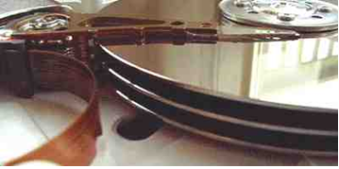
What’s a Hard Disk?
Hard disk platter is metal or glass
  can be larger because it is rigid
  has higher density because it can be controlled more precisely
  hard disk has higher data rate because it spins faster
Hard disks
  Collection of platters (1-15) each of which has two recordable disk surfaces
  Stack is rotated at 3600-5400- 7200 RPM usually, but high performance disks faster
  Diameter between 1-8 inches (used to be 24 inches)
  Each disk surface has concentric circles - called tracks
    1000-5000 tracks per surface
  Track divided into sectors that contain data
    64-200 sectors per track
  Disk heads move together
  Cylinder - all the tracks under the heads at a given point on all surfaces
CSCI 6461 – Computer Architecture

Slide 40
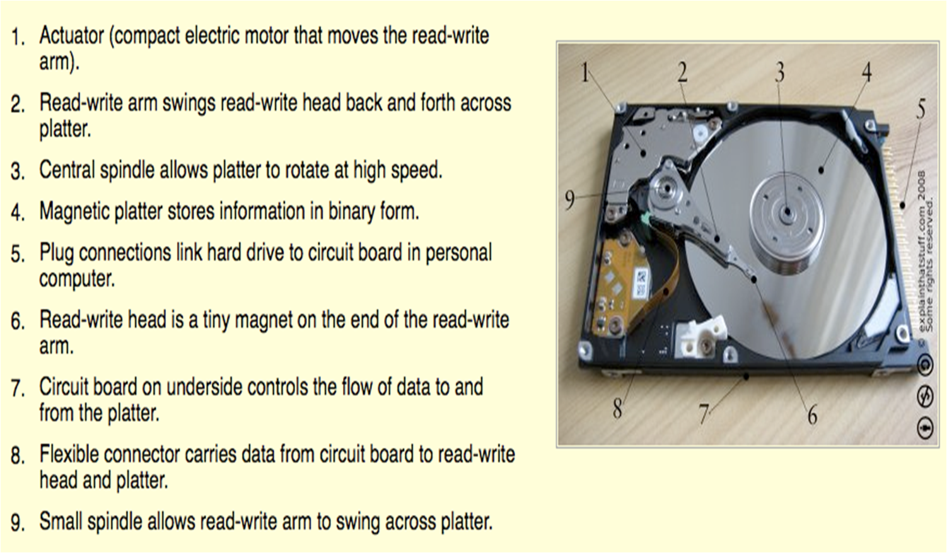
Hard Disks
CSCI 6461 – Computer Architecture

Slide 41
Hard Disks: Timing
seek - position head over proper track
  seek time (min, max, avg)
rotational delay/latency - after head reached correct track, time to wait for the desired sector to rotate under the read/write head
  average wait is half way around disk ~8.3ms
  smaller diameter can spin at higher rates with less power consumption
transfer time - time to transfer a block of bits (sector) - function of sector size (2-15 MB/sec)
disk controller - handles control of disk and transfer between disk and memory
controller time - overhead because of disk controller
CSCI 6461 – Computer Architecture

Slide 42
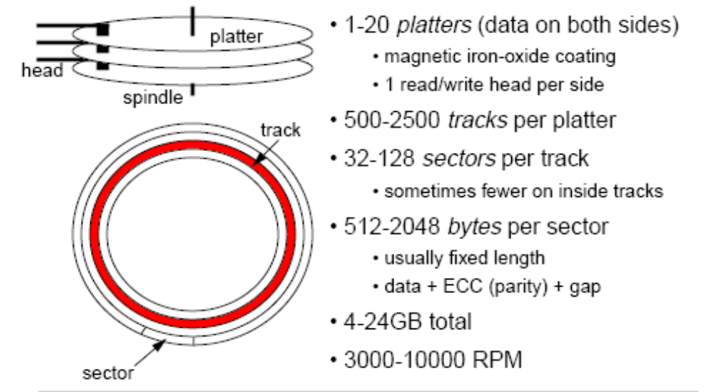
Hard Disk Parameters
Note: This is old data, but to give you an idea
CSCI 6461 – Computer Architecture

Slide 43
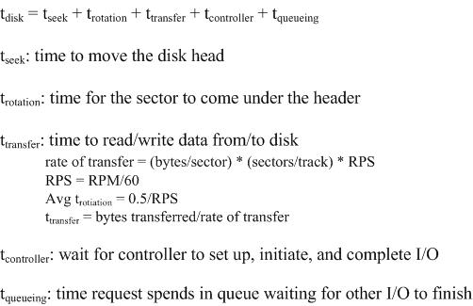
Hard Disk Performance
CSCI 6461 – Computer Architecture

Slide 44
Hard Disk Performance: Example
So, assume:
  3600 RPM ➔ 60 RPS
  Avg seek time ~ 9 msecs
  100 sectors/track; 512 bytes/sector
  t_{controller} + t_{queuing} ~ 1 msec
So, what is the average time to read one sector?
  Rate of transfer = 100 sectors/trk * 512 bytes/sector * 60 RPS => 2.4 MBytes/s
  t_{transfer} = 512 bytes/2.4 Mbytes/s = 0.2 msecs
  t_{rotation} = 0.5/ 60 RPS – 8.3 msecs
  t_{disk} = 9 msecs + 8.3 msecs + 0.3 msecs + 1 msec = 18.5 msecs
So, the time to transfer is the smallest component of the I/O time!!
Note: t_{queuing} gets longer the more requests are issued against the disk
CSCI 6461 – Computer Architecture

Slide 45
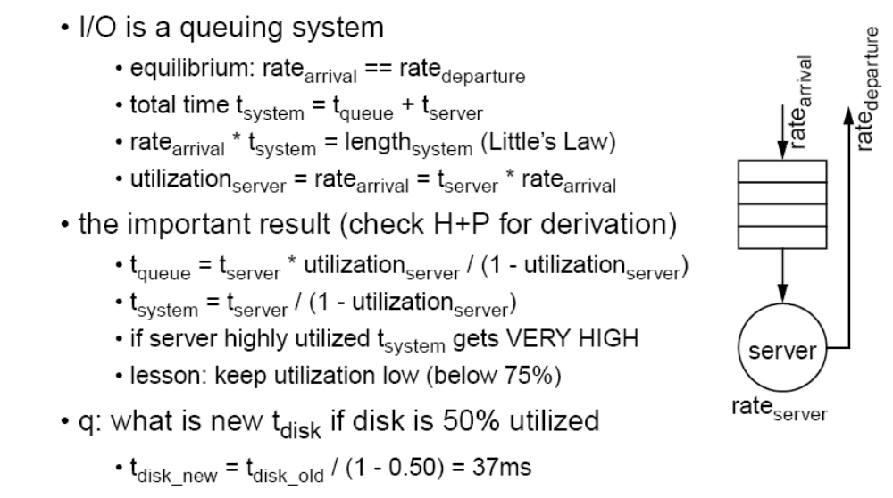
I/O System: Queuing
CSCI 6461 – Computer Architecture

Slide 46
Design Based on Anticipated Workload
Data mining + supercomputing
  Large files, sequential reads
  Raw data transfer rate is most important
Transaction processing
  Large files, but many small requests and random access
  I/Os per second is most important
Timesharing File Systems
  Small files, sequential access – usually
  I/Os per second is most important
CSCI 6461 – Computer Architecture

Slide 47
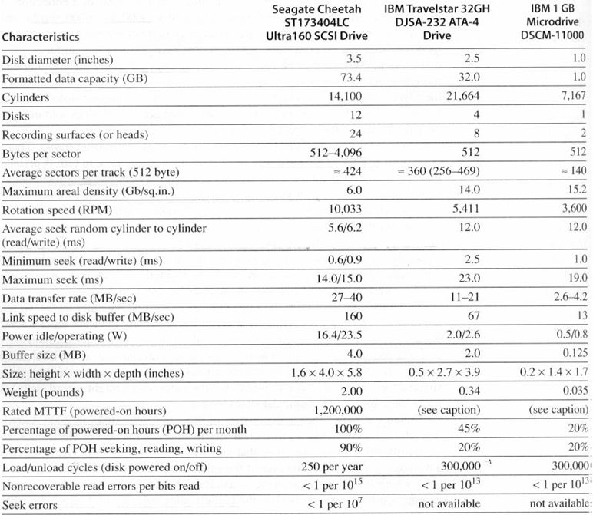
Hard Disks: Examples (circa 2000)
CSCI 6461 – Computer Architecture

Slide 48
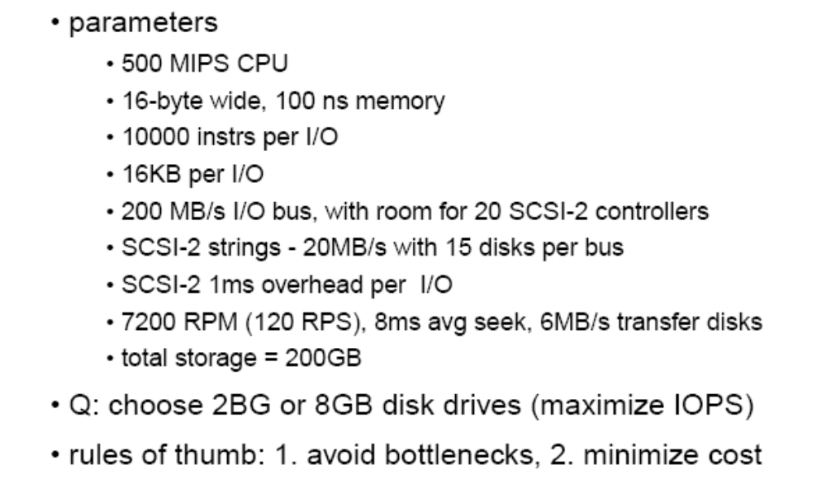
I/O Design (H&P Example – 3rd Ed.)
CSCI 6461 – Computer Architecture

Slide 49
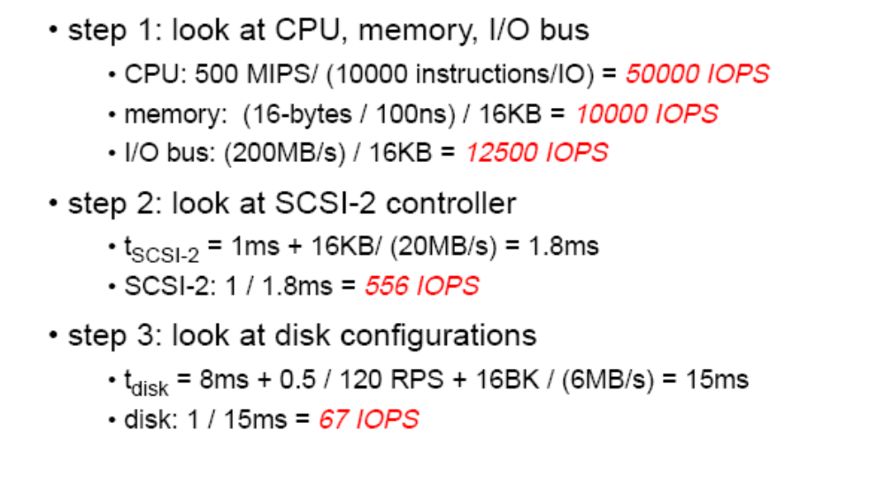
I/O Design - I
CSCI 6461 – Computer Architecture

Slide 50
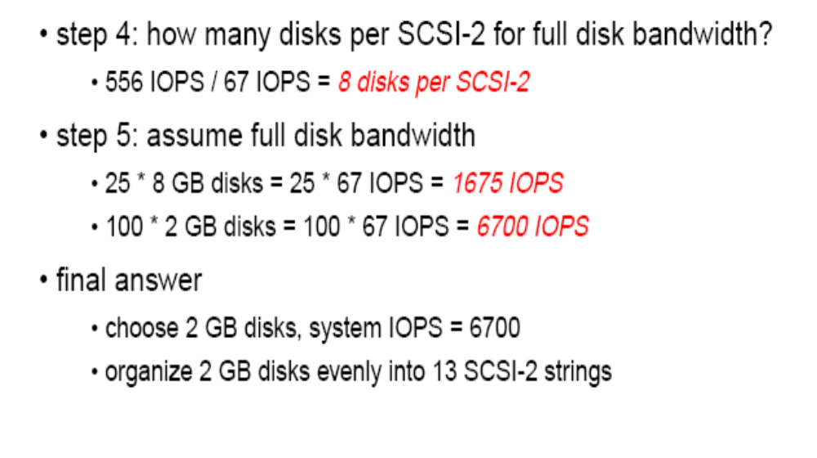
I/O Design - II
CSCI 6461 – Computer Architecture

