Slide 1
CS6461 – Computer Architecture
Adapted from Professor Stephen Kaisler’s slides
Lecture 7 – Improving Performance

Slide 2
Axiom: It’s All About Performance!!
System Performance:
Overlap - I/O vs CPU
  Time_{Workload} = (Time_{CPU} + Time_{I/O}) - Time_{Overlap}
But, we are concerned with computer architecture here….
CS61 Computer Architecture
CS61 Computer Architecture
7-<number>
7-<number>

Slide 3
Computation Time
Computation Time (CPU) is a product of three factors:
  Number of instructions executed = Instruction Count (IC): remember this is not the code (program) size
  Average number of clock cycles per instruction (CPI): if CPI varies for different instructions, a weighted average is needed
  Clock period (τ)
  So, we have:
  CPU time = IC * CPI * τ
CPU time = #instructions * (#cycles/instruction) * #seconds/cycle
  Ex: 900M instructions * (1.8 cycles)/instruction * 10 ns/cycle = 16.2 secs
CS61 Computer Architecture
CS61 Computer Architecture
7-<number>
7-<number>

Slide 4
Instruction Level Parallelism (ILP)
The principle that there are many instructions in code that don’t depend on each other.
Thus, it is possible to execute those instructions in parallel or to rearrange the order of their execution.
Assumes multiple functional units
ILP Issues:
Building compilers to analyze the code and generate alternative sequences of instructions
Building smart hardware that dynamically schedules instruction execution at run-time
CS61 Computer Architecture
CS61 Computer Architecture
7-<number>
7-<number>

Slide 5
Terminology
Basic Block - That set of instructions between entry points and between branches.
  A basic block has only one entry and one exit.
  Typically, this is about 6 instructions long.
Loop Level Parallelism - the parallelism that exists within a loop.
  Such parallelism can cross loop iterations.
Loop Unrolling - Either the compiler or the hardware is able to exploit the parallelism inherent in the loop.
CS61 Computer Architecture
CS61 Computer Architecture
7-<number>
7-<number>

Slide 6
Software Loop Unrolling
(due to M. Geiger, UMass - Dartmouth)
Add a scalar to a vector
for (I = 1000; I > 0; I =I – 1)
{
x [I] = x[I] + s;
}
Consider the following delays due to architectural elements:
Instruction Instruction Latency
producing result using result in cycles
FP ALU op Another FP ALU op 3
FP ALU op Store double 2
Load double FP ALU op 1
Load double Store double 1
Integer op Integer op 1
CS61 Computer Architecture
CS61 Computer Architecture
7-<number>
7-<number>

Slide 7
Translate to MIPS Code
Loop:
L.D F0,0(R1) ;F0=vector element
ADD.D F4,F0,F2 ;add scalar from F2
S.D 0(R1),F4 ;store result
DSUBUI R1,R1, 8 ;decrement pointer 8 bytes
BNEZ R1,Loop ;branch R1 != zero
Assume doublewords = 8 bytes
R1 contains the vector base address
Instruction format:
<opcode> <destination> <operand1> <operand2>
x.D =>s double word instruction
CS61 Computer Architecture
CS61 Computer Architecture
7-<number>
7-<number>

Slide 8
Where are the stalls?
Loop:
1 L.D F0,0(R1) ;F0=vector element
2 stall ; cannot execute next instruction because F0 is destination above
3 ADD.D F4,F0,F2 ;add scalar in F2
4 stall
5 stall
6 S.D 0(R1),F4 ;store result
DSUBUI R1,R1, 8 ;decrement pointer 8 bytes
stall ;assumes can’t forward branch
BNEZ R1,Loop ;branch R1 != zero
A stall is where two instructions cannot be executed concurrently because of hazards or conflicts.
Instruction Instruction Latency in
producing result using result clock cycles
FP ALU op Another FP ALU op 3
FP ALU op Store double 2
Load double FP ALU op 1
So, it takes 9 clock cycles per iteration including the stalls.
CS61 Computer Architecture
CS61 Computer Architecture
7-<number>
7-<number>

Slide 9
Rewrite Code to Minimize Stalls
Loop:
1 L.D F0,0(R1)
2 DSUBUI R1,R1, 8
3 ADD.D F4,F0,F2
4 stall
5 stall
S.D 8(R1),F4 ;altered offset when ; move DSUBUI
BNEZ R1,Loop
Swapped the DSUBUI and the S.D by changing the
address of the S.D
So, 7 clock cycles per iteration: 3 for execution, 4 for loop overhead.
CS61 Computer Architecture
CS61 Computer Architecture
7-<number>
7-<number>

Slide 10
Can we make it any faster? (unravel loop by 4)
Loop:
L.D F0,0(R1) ; One Cycle Stall
3 ADD.D F4,F0,F2 ; Two Cycle Stall
6 S.D 0(R1),F4 ;drop DSUBUI & BNEZ
7 L.D F6,-8(R1)
9 ADD.D F8,F6,F2
12 S.D -8(R1),F8 ;drop DSUBUI & BNEZ
13 L.D F10,-16(R1)
15 ADD.D F12,F10,F2
18 S.D -16(R1),F12 ;drop DSUBUI & BNEZ
19 L.D F14,-24(R1)
21 ADD.D F16,F14,F2
24 S.D -24(R1),F16
25 DADDUI R1,R1,#-32 ;alter to 4*8
BNEZ R1,LOOP
Note: DSUBUI -> DADDU w/ negative immediate op
So, this takes 27 clock cycles or about 6.75/Iteration
(if F1 is multiple of 4)
CS61 Computer Architecture
CS61 Computer Architecture
7-<number>
7-<number>

Slide 11
An Unrolled Loop That Minimizes Stalls:
1 Loop: L.D F0,0(R1) ; Note the trick here
2 L.D F6,-8(R1) ; Set up target addresses first
3 L.D F10,-16(R1)
4 L.D F14,-24(R1)
5 ADD.D F4,F0,F2 ; do four additions
6 ADD.D F8,F6,F2 ; need multiple adders for concurrency
7 ADD.D F12,F10,F2
8 ADD.D F16,F14,F2
9 S.D 0(R1),F4
10 S.D -8(R1),F8
11 S.D -16(R1),F12
12 DSUBUI R1,R1,#32
13 S.D 8(R1),F16 ; 8-32 = -24
14 BNEZ R1,LOOP
Takes 14 clock cycles or 3.5/iteration
CS61 Computer Architecture
CS61 Computer Architecture
7-<number>
7-<number>

Slide 12
Unrolling Issues
What is the minimum number of times that we should unroll a loop?
We may not know the upper bound of the loop until run-time?
Q: Can we determine a maximum upper bound from the code?
Q: Should the unrolling be an even number (mod 2 = 0?) or an odd number (mod 2 = 1?) or, perhaps, even a small prime?
Q: Compiler is written for the macro language. Does not know the specific architecture or idiosyncrasies of the microprocessor. Hazards depend on the pipeline!
Q: How do we discover name dependencies for memory accesses? Easy to do for registers because they have fixed names, so we just rename them.
CS61 Computer Architecture
CS61 Computer Architecture
7-<number>
7-<number>

Slide 13
Three Ways To Improve Performance
Reduce clock cycle time
  Technology, implementation
Reduce number of instructions
  Improve instruction set
  Improve compiler
Reduce cycles/Instruction
  Improve implementation
But, this is very dependent on the compiler:
  How many instructions are independent within a block?
CS61 Computer Architecture
CS61 Computer Architecture
7-<number>
7-<number>

Slide 14
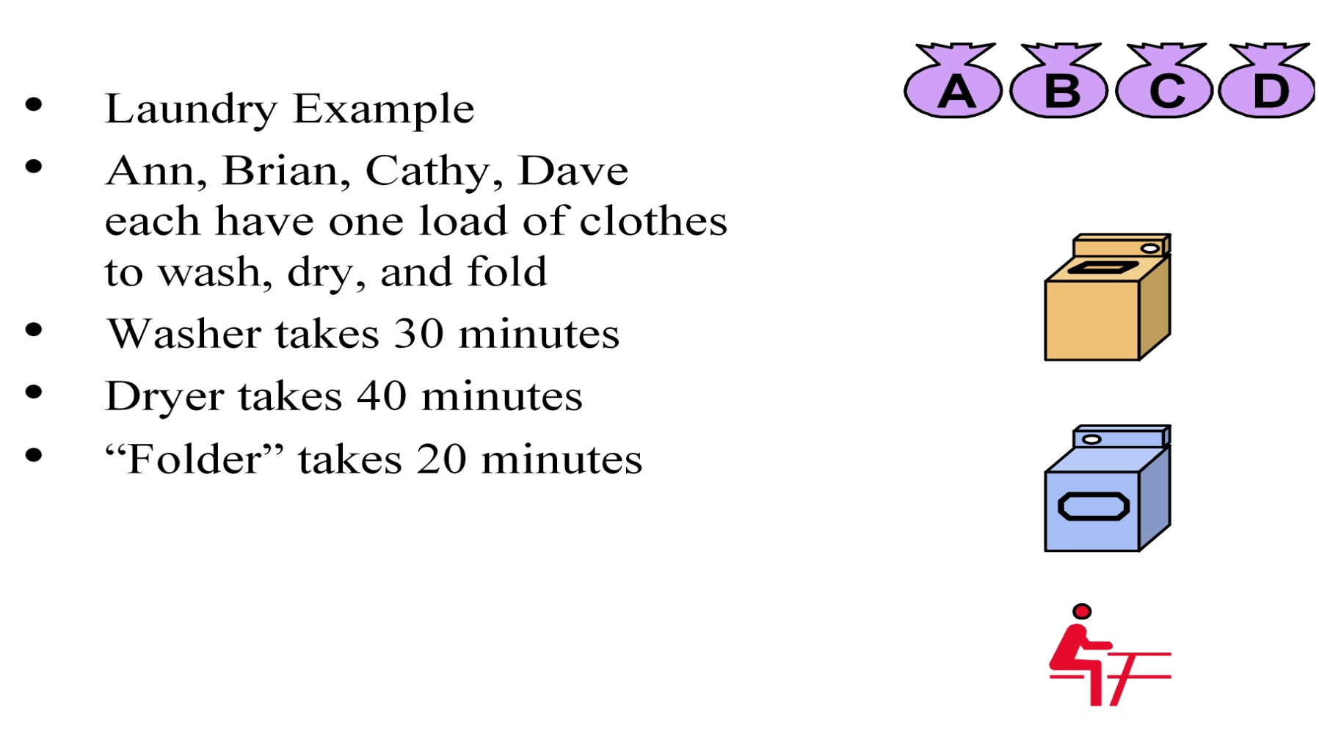
Pipelining – The Laundry Example
(from Prof. Narahari’s Lectures)
CS61 Computer Architecture
CS61 Computer Architecture
7-<number>
7-<number>

Slide 15
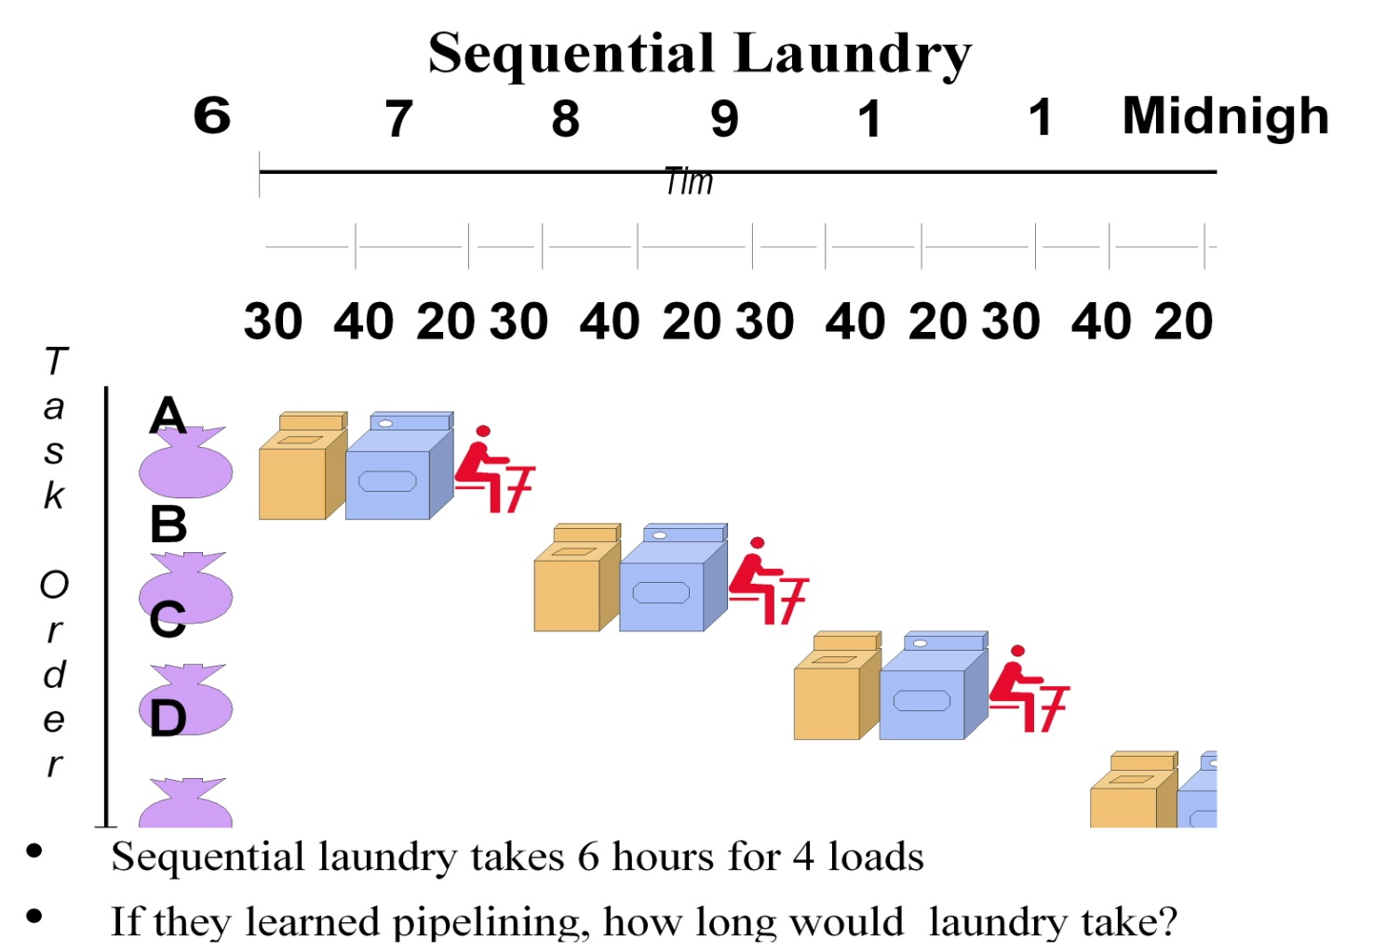
Sequential Laundry
So, a pipeline is a mechanism for breaking a task into multiple subtasks – each separate from the other – and performing the subtasks of multiple jobs concurrently.
CS61 Computer Architecture
CS61 Computer Architecture
7-<number>
7-<number>

Slide 16
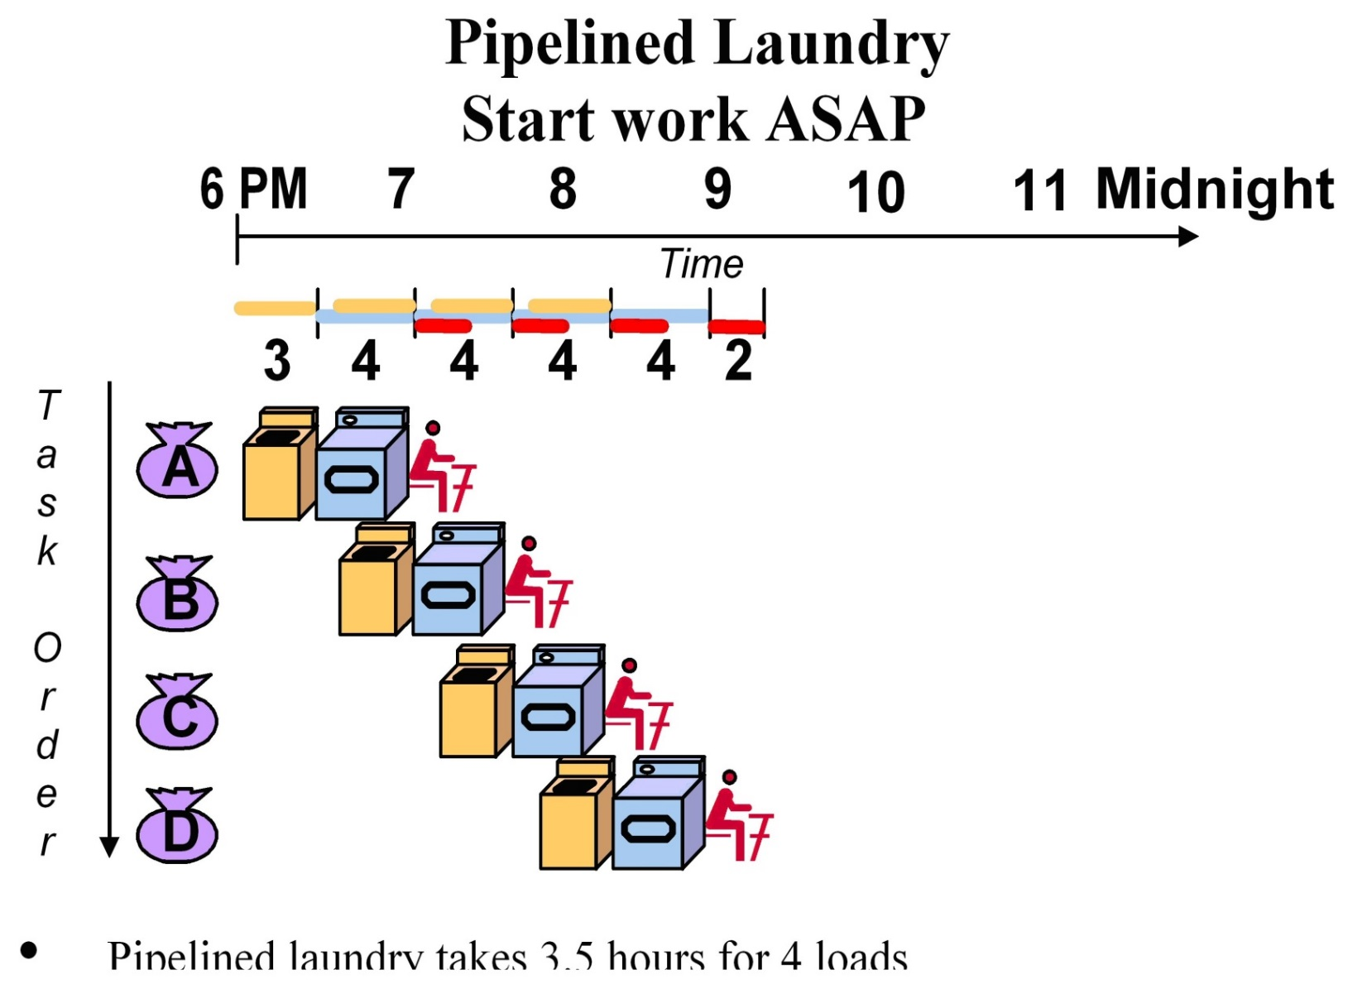
Pipelined Laundry
CS61 Computer Architecture
CS61 Computer Architecture
7-<number>
7-<number>

Slide 17
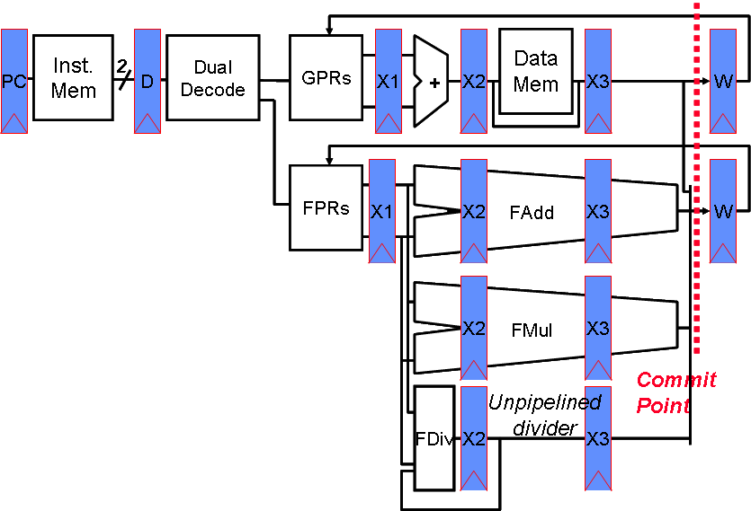
Relevance to CPUs
Fetch two instructions per cycle; issue both simultaneously if one is integer/memory and other is floating point
Inexpensive way of increasing throughput, examples include Alpha 21064 (1992) & MIPS R5000 series (1996)
CS61 Computer Architecture
CS61 Computer Architecture
7-<number>
7-<number>

Slide 18
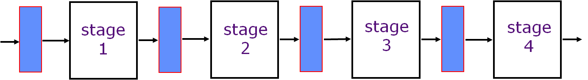
Ideal Pipeline
All objects go through the same stages
No sharing of resources between any two stages
Propagation delay through all pipeline stages is equal
The scheduling of an object entering the pipeline is not affected by the objects in other stages
But, instructions depend on each other!
CS61 Computer Architecture
7-<number>

Slide 19
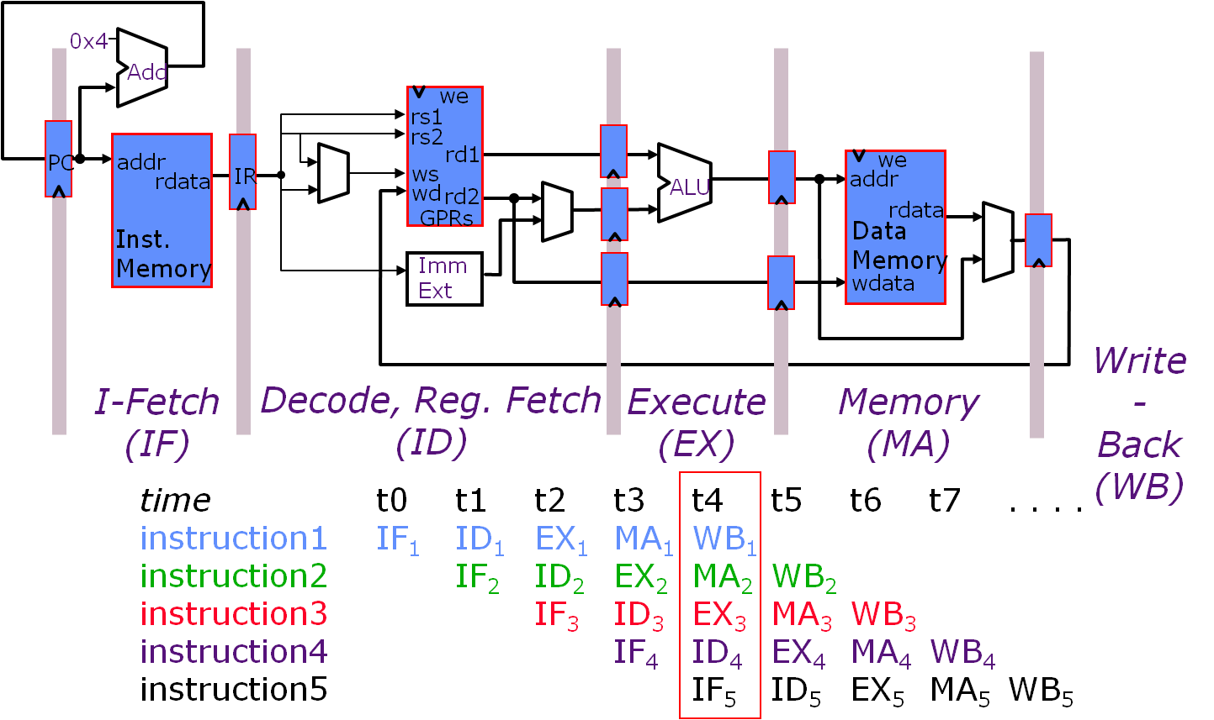
Example: 5-Stage Pipeline
CS61 Computer Architecture
7-<number>

Slide 20
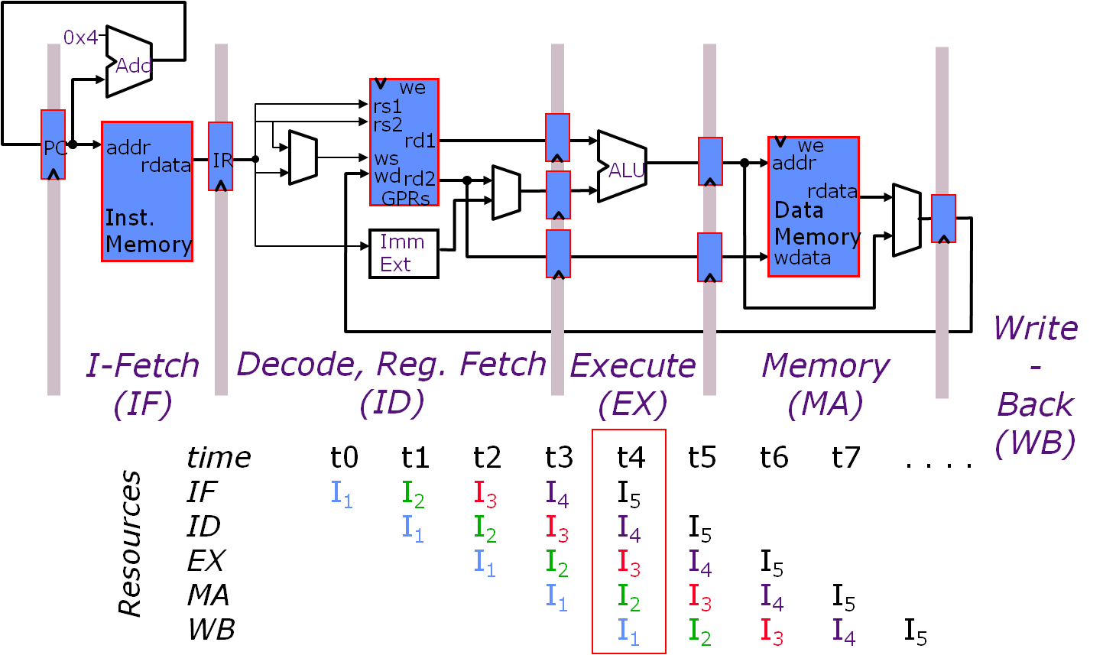
Ex: 5-Stage Pipeline – Resource Usage
CS61 Computer Architecture
7-<number>

Slide 21
Pipeline Speedup
Speedup and Efficiency of Pipeline: clock cycle = t
  Frequency f = 1/t
A k-stage pipeline processes n tasks in k + (n-1) clock cycles
  k cycles for the first task
  n-1 cycles for the remaining n-1 tasks
Total time to process n tasks: T_{k} = [k + (n-1)]t
For the non-pipelined processor: T₁ = n * k * t
Speedup Factor:
  S_{k} = T₁/T_{k} = nkt/[k + (n-1)]t = nk/(k + (n-1))
Efficiency of a k-stages pipeline:
  E_{k} = S_{k}/k = n/(k + (n-1))
Pipeline Throughput:
  H_{k} = n/[k + (n-1)]t = nf/(k + (n-1))
  (the number of tasks being performed per unit time)
Assume the latch delay between stages is d:
So, t = max {t_{m}} + d
CS61 Computer Architecture
CS61 Computer Architecture
7-<number>
7-<number>

Slide 22
Pipeline Speedup Example
A task has 4 subtasks with time:
  t1=60, t2=50, t3=90, and t4=80 ns (nanoseconds)
Latch delay = 10 ns
Pipeline cycle: t = 90+10 = 100 ns
For non-pipelined execution: T_{k} = 60+50+90+80 = 280 ns
Speedup for above case is: 280/100 = 2.8 !!
Pipeline Time for 1000 tasks = 1000 + 4-1= 1003*100 ns
Sequential time = 1000*280 ns
Throughput = 1000/1003 = 0.99
What is the problem here ?
  Lose a little performance due to shifting work through stages
Lesson: Look at the overall performance;
not at the individual tasks!
CS61 Computer Architecture
CS61 Computer Architecture
7-<number>
7-<number>

Slide 23
Pipelining Issues
Pipeline rate limited by slowest pipeline stage
Multiple tasks operating simultaneously
Potential speedup = Number of stages
  But, unbalanced lengths of pipe stages reduces speedup
  But, time to “fill” pipeline and time to “drain” it reduces speedup
Limits to size of n
  clock skew with long pipeline
  inter-stage communication dominates
  length of basic block 4-7 instructions
    sequence of code with 1 entry, 1 exit point
  bigger in much floating-point code
Limits to simple division of work
  some operations take longer than others, e.g., FP divide
ISA difficulties
  variable-format instructions: harder to separate stages
  multiple addressing modes: harder to do all options in parallel
CS61 Computer Architecture
CS61 Computer Architecture
7-<number>
7-<number>

Slide 24
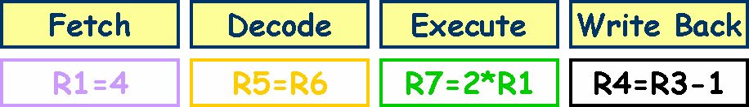
The Problem
Constant flow of instructions possible
Limitations due to data dependencies & control dependencies
In what pipeline stage does the processor fetch the next instruction?
If that instruction is a conditional branch, when does the processor know whether the conditional branch is taken (execute code at the target address) or not taken (execute the sequential code)?
What is the difference in cycles between them?
CS61 Computer Architecture
CS61 Computer Architecture
7-<number>
7-<number>

Slide 25
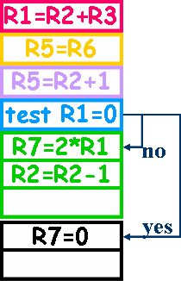
Conditionals
Dependencies:
  How to decide what to do?, e.g., which instruction to fetch to execute next.
If you guess wrong, then several cycles wasted as you flush the pipeline and reload it
See Handling Stalls:
  1 + Pipeline Stall CPI impacts the Speedup
  The 1st five techniques involve hardware design while the last five involve compiler technology.
  We will leave the last five for a course on compiler technology and code optimization.
Execution Sequence
CS61 Computer Architecture
CS61 Computer Architecture
7-<number>
7-<number>

Slide 26
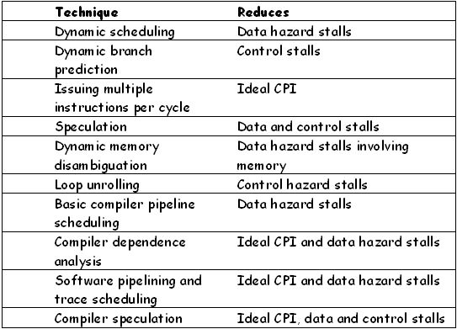
How to Handle Stalls?
CS61 Computer Architecture
CS61 Computer Architecture
7-<number>
7-<number>

Slide 27
Limits to Pipelining
Hazards prevent next instruction from executing during its designated clock cycle
  Structural hazards: HW cannot support this combination of instructions (single person to fold and put clothes away)
    Structural conflicts at the write-back stage due to variable latencies of different functional units
    An instruction in the pipeline may need a resource being used by another instruction in the pipeline
    Example: One Memory Port, no banking
  Data hazards: Instruction depends on result of prior instruction still in the pipeline (missing sock)
  Control hazards: Caused by delay between the fetching of instructions and decisions about changes in control flow (branches and jumps)
    Dependence may be for the next instruction’s address
CS61 Computer Architecture
CS61 Computer Architecture
7-<number>
7-<number>

Slide 28
Resolving Structural Hazards
Structural hazards occurs when two instruction need same hardware resource at same time
  Can resolve in hardware by stalling newer instruction till older instruction finished with resource
A structural hazard can always be avoided by adding more hardware to design
  E.g., if two instructions both need a port to memory at same time, could avoid hazard by adding second port to memory
CS61 Computer Architecture
7-<number>

Slide 29
Data Hazards - I
Data hazards due to register operands can be determined at the decode stage.
But, data hazards due to memory operands can be determined only after computing the effective address
  store M[r1 + disp1] ← r2
  load r3 ← M[r4 + disp2]
Does (r1 + disp1) = (r4 + disp2) ?
CS61 Computer Architecture
CS61 Computer Architecture
7-<number>
7-<number>

Slide 30
Data Hazards - II
Consider executing a sequence of
r_{k} ← r_{i} op r_{j}
type of instructions
Data-dependence
      r₃ ← r₁ op r₂ Read-after-Write
      r₅ ← r₃ op r₄ (RAW) hazard
Anti-dependence
      r₃ ← r₁ op r₂ Write-after-Read
      r₁ ← r₄ op r₅ (WAR) hazard
Output-dependence
      r₃ ← r₁ op r₂ Write-after-Write
      r₃ ← r₆ op r₇ (WAW) hazard
CS61 Computer Architecture
CS61 Computer Architecture
7-<number>
7-<number>

Slide 31
Data Hazards: Example
I₁ DIVD f6, f6, f4
I₂ LD f2, 45(r3)
I₃ MULTD f0, f2, f4
I₄ DIVD f8, f6, f2
I₅ SUBD f10, f0, f6
I₆ ADDD f6, f8, f2
RAW Hazards
WAR Hazards
WAW Hazards
CS61 Computer Architecture
CS61 Computer Architecture
7-<number>
7-<number>

Slide 32
Resolving Data Hazards
Strategy 1:
Wait for the result to be available by freezing earlier pipeline stages è interlocks
Strategy 2:
Route data as soon as possible after it is calculated to the earlier pipeline stage → bypass
Strategy 3:
Speculate on the dependence. Two cases:
Guessed correctly ➔ do nothing
Guessed incorrectly ➔ kill and restart
CS61 Computer Architecture
7-<number>

Slide 33
Why Hazards?
Out-of-order write hazards due to variable latencies of different functional units
Solution: Rename the registers!!
I: sub r1, r4, r3
J: add r5, r2, r3 ; so, use R5 to store result
K: mul r6, r1, r7
But, the compiler generated R1. So, hardware must handle the bookkeeping of using R1
Compiler generates code as apparently sequential since it does not know what environment it will run on.
CS61 Computer Architecture
CS61 Computer Architecture
7-<number>
7-<number>

Slide 34
Problem
Now, suppose instruction i is about to be issued and a predecessor instruction j is in the instruction pipeline
How do we detect and store potential hazard information?
Note that hazards in machine code are based on register usage
Keep track of results in registers and their usage
CS61 Computer Architecture
CS61 Computer Architecture
7-<number>
7-<number>

Slide 35
Simplifying …
No WAR hazard
no need to keep src1 and src2
The Issue stage does not dispatch an instruction in case of a WAW hazard
a register name can occur at most once in the dest column
WP[reg#] : a bit-vector to record the registers for which writes are pending
These bits are set to true by the Issue stage and set to false by the WB stage
Each pipeline stage in the FU's must carry the dest field
and a flag to indicate if it is valid “the (we, ws) pair”
CS61 Computer Architecture
CS61 Computer Architecture
7-<number>
7-<number>

Slide 36
Pipelining Multicycle Operations
Assume five-stage pipeline
Third stage (execution) has two functional units E1 and E2
  Instruction goes through either E1 or E2, but not both
  E1 and E2 are not pipelined
  Stage delay of E1 = 2 cycles
  Stage delay of E2 = 4 cycles
  No buffering on inputs of E1 and E2
Stage delay of other stages = 1 cycle
Consider an instruction sequence of five instructions
  Instructions 1, 3, 5 need E1
  Instructions 2, 4 need E2
CS61 Computer Architecture
CS61 Computer Architecture
7-<number>
7-<number>

Slide 37
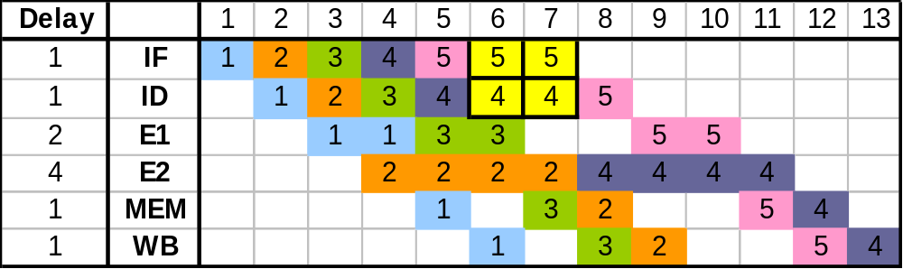
Space-Time Diagram: Multicycle Operations
Out-of-order completion
  3 finishes before 2, and 5 finishes before 4
Instructions may be delayed after entering the pipeline because of structural hazards
  Instructions 2 and 4 both want to use E2 unit at same time
  Instruction 4 stalls in ID unit
  This causes instruction 5 to stall in IF unit
CS61 Computer Architecture
CS61 Computer Architecture
7-<number>
7-<number>

Slide 38
Floating-Point Operations in MIPS
IF
ID
EX
Out-of-order
completion; has
ramifications for
exceptions
WAW hazards
possible; WAR
hazards not
possible
M1
M2
M3
M4
M5
M6
M7
A1
A2
A3
A4
Longer operation
latency implies
more frequent
stalls for RAW
hazards
MEM
DIV (25)
Structural hazard:
instructions have
varying running
times
Structural hazard:
not fully pipelined
WB
CS61 Computer Architecture
CS61 Computer Architecture
7-<number>
7-<number>

Slide 39
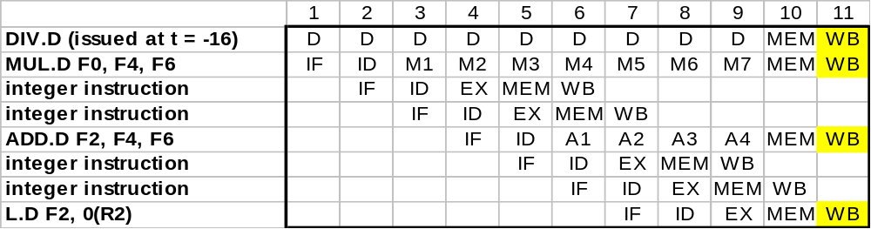
Structural Hazard on WB Unit
This is worst-case scenario: max steady-state number of write ports is 1
  Don’t replicate resources; detect and serialize access as needed
Early resolution
  Track use of WB in ID stage (using shift register), stall instructions there
    reservation register
  Simplifies pipeline control; all stalls occur in ID
    adds shift register and write-conflict logic
Late resolution
  Stall instructions at entry to MEM or WB stage
  Complicates pipeline control (two stall locations)
CS61 Computer Architecture
CS61 Computer Architecture
7-<number>
7-<number>

Slide 40
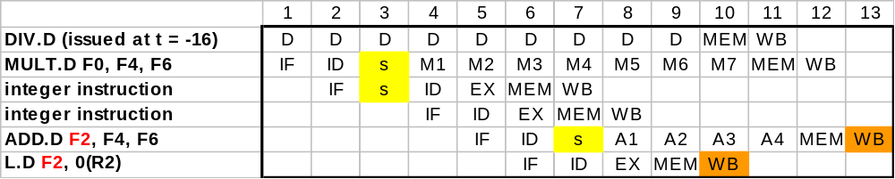
WAW Hazards
WAW hazard arises only when no instruction between ADD.D and L.D uses result computed by ADD.D
  Adding an instruction like “ADD.D F8,F2,F4” before L.D would stall pipeline enough for RAW hazard to avoid WAW hazard
  Can happen through a branch/trap (example in H&P-5^{th)}, Section A.9)
  Rare situation, but must still handle correctly
Hazard resolution
  Delay the issue of L.D until ADD.D enters MEM
  Cancel write of ADD.D
CS61 Computer Architecture
CS61 Computer Architecture
7-<number>
7-<number>

Slide 41
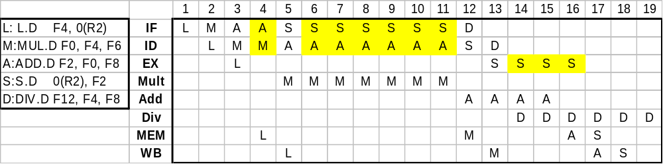
RAW Hazards
Longer delays of FP operations increases number of stalls in response to RAW hazards
Two methods for reducing stalls
  Compiler could have moved instruction D between instructions M and A, which would allow D to complete earlier; or hardware could detect this possibility and issue instruction D out of order
  ID stage is a bottleneck because instructions wait there for their operands to be available; could add buffers (reservation stations) to functional units and let instructions await their operands there
CS61 Computer Architecture
CS61 Computer Architecture
7-<number>
7-<number>

Slide 42
Responsibilities of Instruction Dispatch (all stalls in ID)
Three sets of checks
  Structural hazards
    Check for availability of FP unit
    Ensure WB unit will be available when needed
  RAW hazards
    Stall current instruction until its source registers are not listed as pending registers in a pipeline register that will not be available when current instruction needs the result
  WAW hazards
    If any instruction in adder, divider, or multiplier has same register destination as current instruction, stall current instruction
Hazards between FP and integer instructions
  Integer and FP instructions use disjoint sets of registers, except for FP-integer register moves
  FP load-stores can conflict with integer load-stores in MEM stage
CS61 Computer Architecture
CS61 Computer Architecture
7-<number>
7-<number>

Slide 43
Scoreboarding
Busy[FU#] : a bit-vector to indicate FU’s availability.
(FU = Int, Add, Mult, Div)
  These bits are hardwired to FU's.
WP[reg#] : a bit-vector to record the registers for which writes are pending.
  These bits are set to true by the Issue stage and set to false by the WB stage
Issue checks the instruction (opcode dest src1 src2)
against the scoreboard (Busy & WP) to dispatch
    FU available?
    RAW?
    WAR?
    WAW?
Busy[FU#]
WP[src1] or WP[src2]
cannot arise
WP[dest]
CS61 Computer Architecture
CS61 Computer Architecture
7-<number>
7-<number>

Slide 44
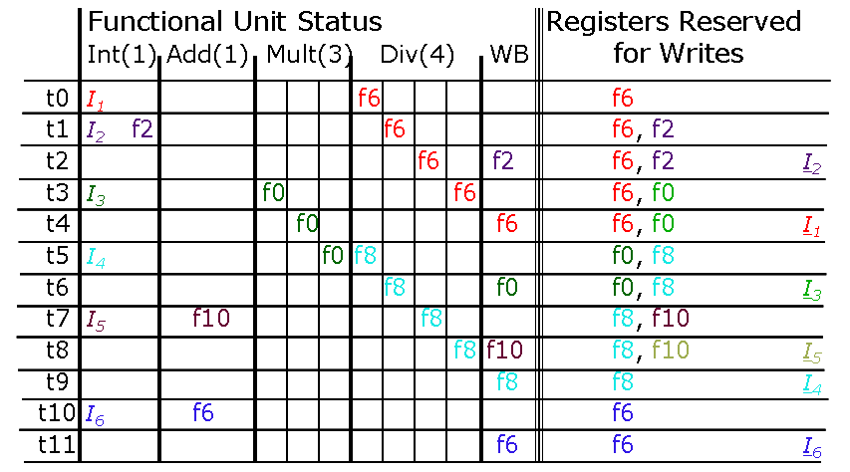
Scoreboard Dynamics
I₁ DIVD f6, f6, f4
I₂ LD f2, 45(r3)
I₃ MULTD f0, f2, f4
I₄ DIVD f8, f6, f2
I₅ SUBD f10, f0, f6
I₆ ADDD f6, f8, f2
CS61 Computer Architecture
CS61 Computer Architecture
7-<number>
7-<number>

Slide 45
Example: CDC 6600
Designed by Seymour Cray, 1963
A fast pipelined machine with 60-bit words, 128 Kword main memory capacity, 32 banks
Ten functional units (parallel, unpipelined)
  Floating Point: adder, 2 multipliers, divider
  Integer: adder, 2 incrementers, ...
Hardwired control (no microcoding)
  8-deep instruction stack
Scoreboard for dynamic scheduling of instructions
Ten Peripheral Processors for Input/Output
A fast multi-threaded 12-bit integer ALU
Very fast clock, 10 MHz (FP add in 4 clocks)
CS61 Computer Architecture
CS61 Computer Architecture
7-<number>
7-<number>

Slide 46
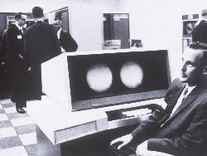

CDC 6600
CS61 Computer Architecture
CS61 Computer Architecture
7-<number>
7-<number>

Slide 47
About the CDC 6600
Thomas Watson Jr., IBM CEO, August 1963:
  “Last week, Control Data ... announced the 6600 system. I understand that in the laboratory developing the system there are only 34 people including the janitor. Of these, 14 are engineers and 4 are programmers... Contrasting this modest effort with our vast development activities, I fail to understand why we have lost our industry leadership position by letting someone else offer the world's most powerful computer.”
To which Cray replied:
  “It seems like Mr. Watson has answered his own question.”
CS61 Computer Architecture
CS61 Computer Architecture
7-<number>
7-<number>

Slide 48
CDC 6600: A Load/Store Architecture
(A ‘RISC’ processor before RISC)
Separate instructions to manipulate three types of registers:
  8 60-bit data registers (X0-X7)
  8 18-bit Address registers (A0-A7)
  8 18-bit Index Registers (B0-B7)
All arithmetic and logical operations were register-to-register operations.
Only load and store instructions access memory
6
3
3
3
opcode i j k Ri ← (Rj) op (Rk)
6
3
3
18
opcode i j disp Ri ← M[(Rj) + disp]
Touching address registers A1 to A5 initiates a load while
A6 or A7 initiates a store
        - very useful for vector operations
CS61 Computer Architecture
CS61 Computer Architecture
7-<number>
7-<number>

Slide 49
CDC 6600 Datapath
Operand Regs
8 x 60-bit
operand
10 Functional
Units
result
Central
Memory
128K words,
32 banks,
1μs cycle
IR
Address Regs Index Regs
8 x 18-bit 8 x 18-bit
Inst. Stack
8 x 60-bit
operand
addr
result
addr
CS61 Computer Architecture
CS61 Computer Architecture
7-<number>
7-<number>

Slide 50
CDC 6600: High Performance ISA
Use of three-address, register-register ALU instructions simplifies pipelined implementation
  No implicit dependencies between inputs and outputs
Decoupling setting of address register (Ar) from retrieving value from data register (Xr) simplifies providing multiple outstanding memory accesses
  Software can schedule load of address register before use of value
  Can interleave independent instructions in between
CDC6600 has multiple parallel but unpipelined functional units
  E.g., 2 separate multipliers
Follow-on machine CDC7600 used pipelined functional units
  Foreshadows later RISC designs
CS61 Computer Architecture
CS61 Computer Architecture
7-<number>
7-<number>

Slide 51
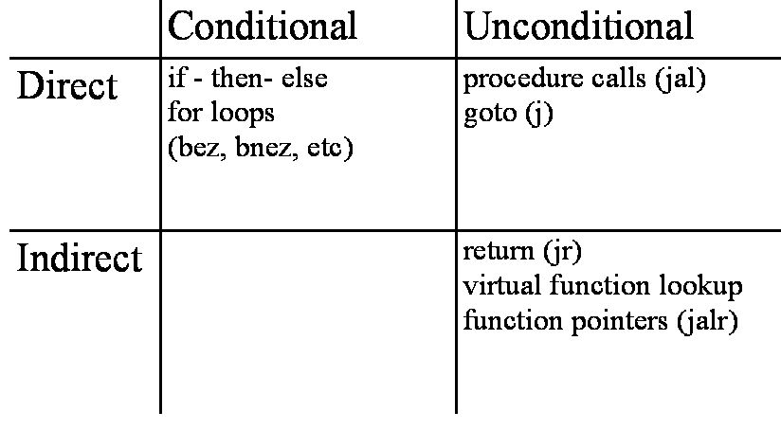
Branch Prediction
"The trouble with programmers is that you can never tell what a programmer is doing until its too late."
  What are Branches?
    Instructions which can alter the flow of instruction execution in a program
CS61 Computer Architecture
CS61 Computer Architecture
7-<number>
7-<number>

Slide 52
Control Flow Graphs
A representation, using graph notation, of all paths that might be traversed through a program during its execution.
Nodes represent basic blocks of code, which are sequences of instructions with no incoming or outgoing branches
  A basic block, i.e. a straight-line piece of code without any jumps or jump targets; jump targets start a block, and jumps end a block.
  Node X is dependent on node y if the computation in y determines whether or not x is executed.
  Basic blocks must be stored in consecutive locations in memory.
  - To map a CFG to a set of linear consecutive memory locations, additional unconditional branches need to be added.
Edges represent transfer of control from one basic block to another
CS61 Computer Architecture
CS61 Computer Architecture
7-<number>
7-<number>

Slide 53
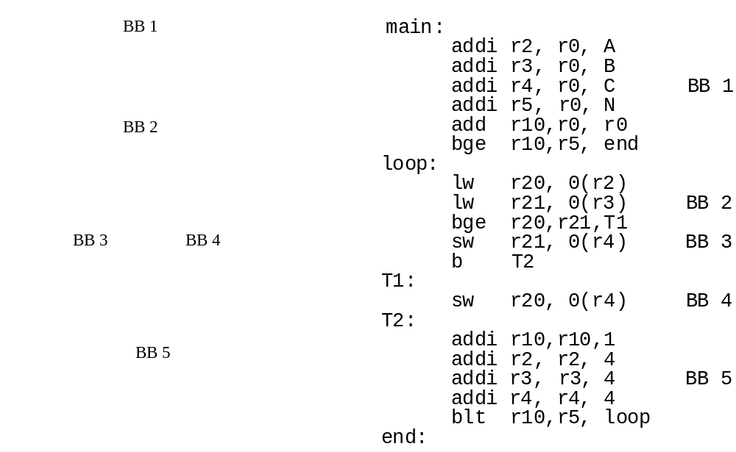
Control Flow Graph: Example
CS61 Computer Architecture
CS61 Computer Architecture
7-<number>
7-<number>

Slide 54
Effect of Branches
For unconditional branches
  Subsequent instruction cannot be fetched until target address determined
For conditional branches
  Machine must wait for resolution of branch condition
  And if branch taken then wait till target address computed
Branch instruction executed by the branch functional unit
When a branch occurs two parts needed:
  Branch target address (BTA) has to be computed
  Branch condition resolution – take it or not
Addressing modes will affect BTA delay
  For PC relative, BTA can be generated during Fetch stage for 1 cycle penalty
  For Register indirect, BTA generated after decode stage (to access register) = 2 cycle penalty
  For register indirect with offset = 3 cycle penalty
CS61 Computer Architecture
CS61 Computer Architecture
7-<number>
7-<number>

Slide 55
Branch Penalties
UltraSPARC-III instruction fetch pipeline stages
(in-order issue, 4-way superscalar, 750MHz, 2000)
A
PC Generation/Mux
P
Instruction Fetch Stage 1
Branch Target Address Known
F
Instruction Fetch Stage 2
B
Branch Address Calc/Begin Decode
I
Complete Decode
J
Steer Instructions to Functional units
Branch Direction &
Jump Register Target Known
R
Register File Read
E
Integer Execute
Remainder of execute pipeline
(+ another 6 stages)
CS61 Computer Architecture
CS61 Computer Architecture
7-<number>
7-<number>

Slide 56
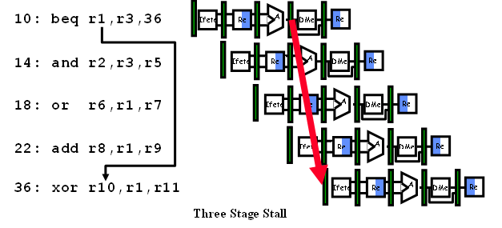
Effect of Branches: Stalls
If prefetched instructions at addresses 14, 18, 22 and branch is taken, pipeline must be flushed
Means no productive work is done until the pipeline is reloaded.
CS61 Computer Architecture
CS61 Computer Architecture
7-<number>
7-<number>

Slide 57
Branch Prediction
Increases the number of instructions available for the scheduler to issue.
  Increases instruction level parallelism (ILP)
Allows useful work to be completed while waiting for the branch to resolve
Prediction has become essential for getting good performance out of scalar instruction streams
Predicting the outcome of a branch
  Taken/Not Taken
  Direction of the branch
So we get two choices:
  Predict Taken, assuming by and large that branches tend to be taken
  BTFNT: Backward Taken; Forward Not Taken
CS61 Computer Architecture
CS61 Computer Architecture
7-<number>
7-<number>

Slide 58
Why Does Prediction Work?
Branches are frequent - 15-25%
Regularities:
  Underlying algorithm has regularities (probably impossible to write a truly pseudo-random algorithm)
  Data that is being operated on has regularities.
  Instruction sequence has redundancies that are artifacts of way that humans/compilers think about problems.
Today’s pipelines are deeper and wider
  Higher performance penalty for stalling
  Misprediction Penalty = issue width * resolution delay cycles
  (how long to flush pipeline)
  But, lots of cycles can be wasted
CS61 Computer Architecture
CS61 Computer Architecture
7-<number>
7-<number>

Slide 59
Branch Prediction Strategies
Static
  Decided before runtime; accuracy usually about 75%; anywhere from 41% to 91%
    Always-Not Taken; Always-Taken
    Backwards Taken, Forward Not Taken (BTFNT)
    Profile-driven prediction
Dynamic
  the ability of the hardware to make an educated guess about which way a branch will go - will the branch be taken or not – at the time the instruction is executed.
  Prediction decisions may change during the execution of the program
  The hardware looks for clues based on the instructions, or it can use past history, if it has it
  Accuracy tends towards 95% or better, depending on approach
Q: Is dynamic prediction better than static prediction?
  Considerable debate on whether this is true
  Probably several good Ph.D. theses in this area yet to be researched and written
CS61 Computer Architecture
CS61 Computer Architecture
7-<number>
7-<number>

Slide 60
When we predict a branch, what happens?
On mispredict:
  No speculative state may commit (see speculative execution later)
    Squash instructions in the pipeline
    Must not allow stores in the pipeline to occur
    Cannot allow stores which would not have happened to commit
    Need to handle exceptions appropriately
Example: a misprediction rate of 10% on a 4-issue, 5-stage pipeline means that ~23% of the issue slots will be wasted
  With 5% misprediction, about 13% of the issue slots will be wasted
CS61 Computer Architecture
CS61 Computer Architecture
7-<number>
7-<number>

Slide 61
How Do We Do Branch Prediction?
Well, we need the address at the same time as the prediction
Use a Branch History Table (BHT) [also known as a Branch Target Buffer (BTB)] with a 1-bit scheme
The BTB is a fully associative cache
A BHT/BTB contains information about what a branch did the last time it was executed
The PC of the branch is sent to the BTB. If an entry is found, it returns the predicted PC
If the branch is taken, execution continues at predicted PC
CS61 Computer Architecture
CS61 Computer Architecture
7-<number>
7-<number>

Slide 62
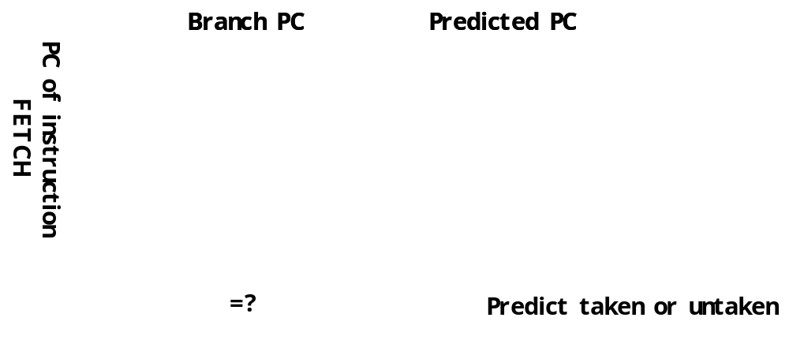
Branch Prediction
CS61 Computer Architecture
CS61 Computer Architecture
7-<number>
7-<number>

Slide 63
Branch Prediction
Entries are the branch instruction PC value and the predicted PC value, also a 1-bit flag saying whether the branch was taken or not.
Many branches occur within loops, so if we can predict correctly some large percentage of time, we have improved overall performance of that block of code
Large number of studies have shown average time through a loop is 9 iterations before loop exit taken and misprediction occurs
So, a 1-bit BHT mispredicts twice!
  End of loop case when it exits instead of looping
  On next execution of loop, first time through it will predict exit instead of looping
Performance = f(accuracy, cost of misprediction)
CS61 Computer Architecture
CS61 Computer Architecture
7-<number>
7-<number>

Slide 64
End of Loop Example
Loop LD R1,100(R2) ; Load R1 from c(R2)+100
MUL R6,R6,R1 ; R6 <- c(R6) * R1
SUBI R2,R2,#4 ; R2 <- c(R2) - 4
BNEZ R2,Loop ; if c(R2) /= 0, go to LOOP
Next time through it predicts end of loop, which is misprediction.
CS61 Computer Architecture
CS61 Computer Architecture
7-<number>
7-<number>

Slide 65
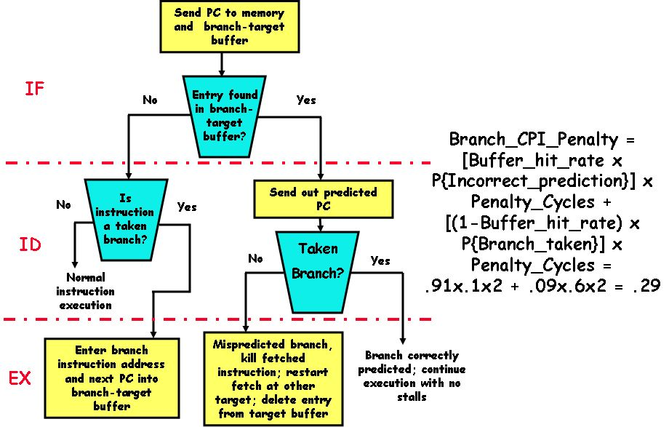
The Algorithm
From Patterson, Katz, and Culler at University of California-Berkeley
CS61 Computer Architecture
CS61 Computer Architecture
7-<number>
7-<number>

Slide 66
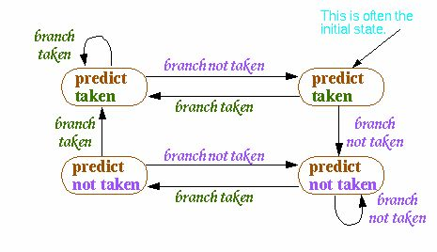
Q: How about using a 2-bit scheme?
Use two bits to represent two successive predictions that were taken or not.
Change prediction only if you get a misprediction twice
CS61 Computer Architecture
CS61 Computer Architecture
7-<number>
7-<number>

Slide 67
2-bit Scheme
Algorithm: have to be wrong twice before the prediction is changed
Works well when branches predominantly go in one direction
Why? A second check is made to make sure that a short & temporary change of direction does not change the prediction away from the dominant direction
What pattern is bad for two-bit branch prediction? (Exercise for students)
  <<Trace through a couple of branches to see what happens>>
Example w/ two branches:
i=100; x=30; y=50;
While (i > 0) do /* Branch 1 */
{
If (x > y) then /* Branch 2 */
{then part} /* no changes to xylem in this code */
else {else part}
i= i-1;
}
CS61 Computer Architecture
CS61 Computer Architecture
7-<number>
7-<number>

Slide 68
So, do we notice when branch predictions fail??
OK, I have argued that microprocessors are plenty fast – more so than we can write good code for in most cases
Conditional branches still comprise about 20% of instructions
What is the probability that a branch is taken?
Given:
  20% of branches are unconditional branches
  conditional branches, 66% branch forward & are evenly split between taken & not taken
  the rest branch backwards & are almost always taken
CS61 Computer Architecture
CS61 Computer Architecture
7-<number>
7-<number>

Slide 69
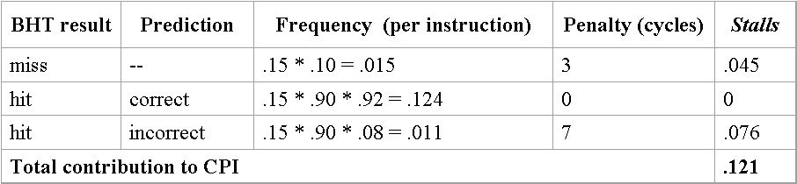
CPI Effects
What is the contribution to CPI of conditional branch stalls, given:
  15% branch frequency
  a BHT for conditional branches only with a
    10% miss rate
    3-cycle miss penalty
    92% prediction accuracy
    7 cycle misprediction penalty
  base CPI is 1
CS61 Computer Architecture
CS61 Computer Architecture
7-<number>
7-<number>

Slide 70
Why Are Predictions Important?
pipelines deeper
branch not resolved until more cycles from fetching
therefore the misprediction penalty greater
  cycle times smaller: more emphasis on throughput (performance)
  more functionality between fetch & execute
multiple instruction issue (superscalars & VLIW)
branch occurs almost every cycle
  flushing & refetching more instructions
object-oriented programming
more indirect branches which harder to predict
dual of Amdahl’s Law
other forms of pipeline stalling are being addressed so the portion of CPI due to branch delays is relatively larger
All this means that the potential stalling due to branches is greater
Best Bet: Do static and dynamic branch prediction together.
Build smarter compilers!!
Use dynamic prediction – either 2-bit or some correlation algorithm (we did not discuss)
CS61 Computer Architecture
CS61 Computer Architecture
7-<number>
7-<number>

Slide 71
Finally
Q: How many branches in a program are responsible for the top N% of all the branches taken?
  Is this an interesting number?
  Where are these branches located in the program?
  How much distance (e.g., # of instructions) between branches?
  These are all interesting questions that could be the topic of an interesting Ph.D. thesis
What can we do??
  Avoid branch prediction by turning branches into conditionally executed instructions
    if (x) then A = B op C else NOP
    This transformation is called “if-conversion”
    If false, then neither store result nor cause exception
  Expanded ISA of Alpha, MIPS, PowerPC, SPARC have conditional move; PA-RISC can annul any following instruction
  Drawbacks to conditional instructions
    Still takes a clock even if “annulled”
    Stall if condition evaluated late
    Complex conditions reduce effectiveness; condition becomes known late in pipeline
CS61 Computer Architecture
CS61 Computer Architecture
7-<number>
7-<number>

