Slide 1
CSCI 6461: Computer Architecture
Branch Prediction
Instructor: M. Lancaster
Corresponding to Hennessey and Patterson
Fifth Edition
Section 3.3 and Part of Section 3.9

Slide 2
Reducing Branch Costs
The frequency of branches and jumps demands that we also attack stalls arising from control dependencies
As we are able to add parallel and multiple parallel units, branching becomes a constraining factor
On an n-issue processor, branches will arrive n times faster
September 2012

Slide 3
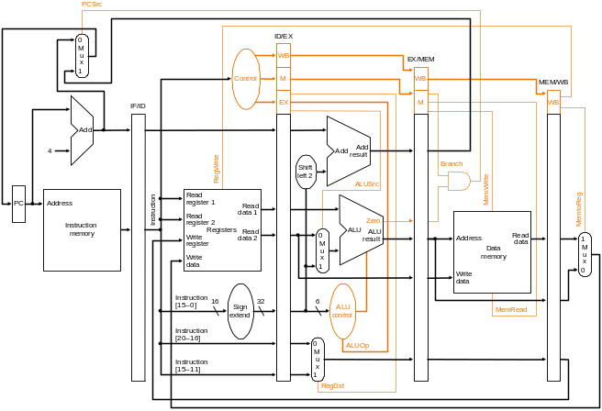
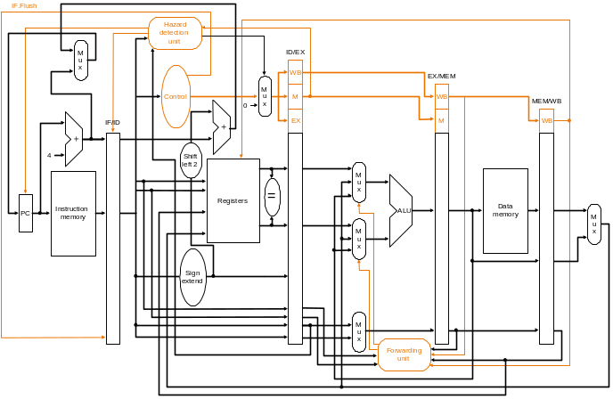
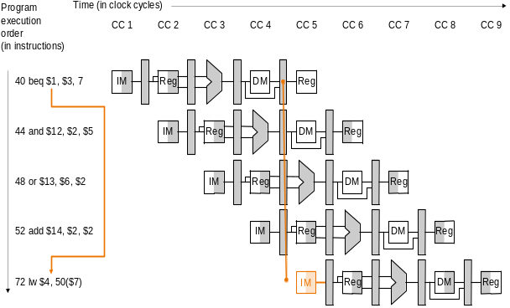
Review of a Branching Optimization
Branch destination and test known at end of third cycle of execution
Branch destination and test known at end of second cycle of execution
September 2012
Instruction Level Parallelism

Slide 4
Dynamic Branch Prediction
Branch prediction buffer
  Simplest scheme
  A small memory indexed by the lower portion of the address of the branch instruction
    Includes a bit that says whether the branch was taken recently or not
    No other tags
    Useful only to reduce the branch delay when it its longer than the time to compute the possible target PCs
    Since we only use low order bits, some other branch instruction could have set the tag
  The prediction is a hint that is assumed to be correct, if it turns out wrong, the prediction bit is inverted and stored back
September 2012

Slide 5
Dynamic Branch Prediction
Branch prediction buffer is a cache
The 1 bit scheme has a shortcoming
  Even if a branch is almost always taken, we will usually predict incorrectly twice, rather than once, when it is not taken
    Consider a loop branch that is taken nine times in a row then not taken. What is the prediction accuracy for this branch, assuming the prediction bit for this branch remains in the prediction buffer
      Mispredict on the the first and last predictions, as the loop branch was not taken on the first one as is set to 0. Then on the last loop it will not be taken and the prediction will be wrong again.
      Down to 80% accuracy here
September 2012

Slide 6
Dynamic Branch Prediction
To remedy this situation, 2 bit branch prediction schemes are often used. A prediction must miss twice before it is changed.
A specialization of a more general scheme that has a n-bit saturating counter for each entry in the prediction buffer. With n bits,we can take on the values 0 to 2^{n}-1. When the counter is >= ½ of its max value, branch is predicted as taken
Count is incremented on a taken branch and decremented on a not taken one
2 bits work almost as well as larger numbers
September 2012

Slide 7
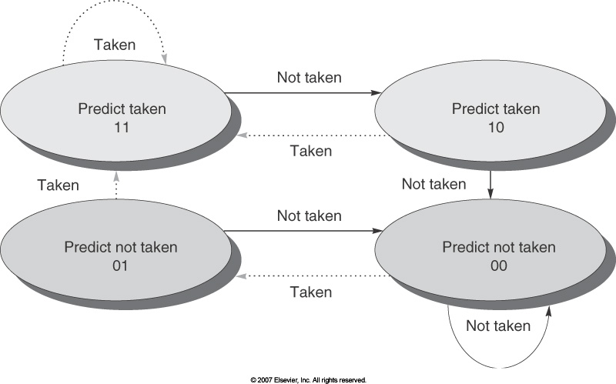
The States in a 2 Bit Prediction Scheme
September 2012

Slide 8
Branch Prediction Buffer
Implemented via a small special cache accessed with the instruction address during the IF pipe stage, or as a pair of bits attached to each block in the instruction cache and fetched with each instruction.
If the instruction is a branch and if predicted as taken, fetching begins from the target as soon as the PC is known. Otherwise sequential fetching and executing continue. If prediction is wrong the prediction bits are changed as in the state diagram.
September 2012

Slide 9
Branch Prediction Buffer
Useful for many pipelines
In our five stage pipeline the pipeline finds out whether the branch is taken and what the target of the branch is at roughly the same time as the branch predictor information would have been use (the end of the second stage of the execution of the branch).
Therefore, this scheme does not help for our pipeline
Next figure shows performance of 2-bit prediction for a given benchmark (between 1-18% mispredictions)
September 2012

Slide 10
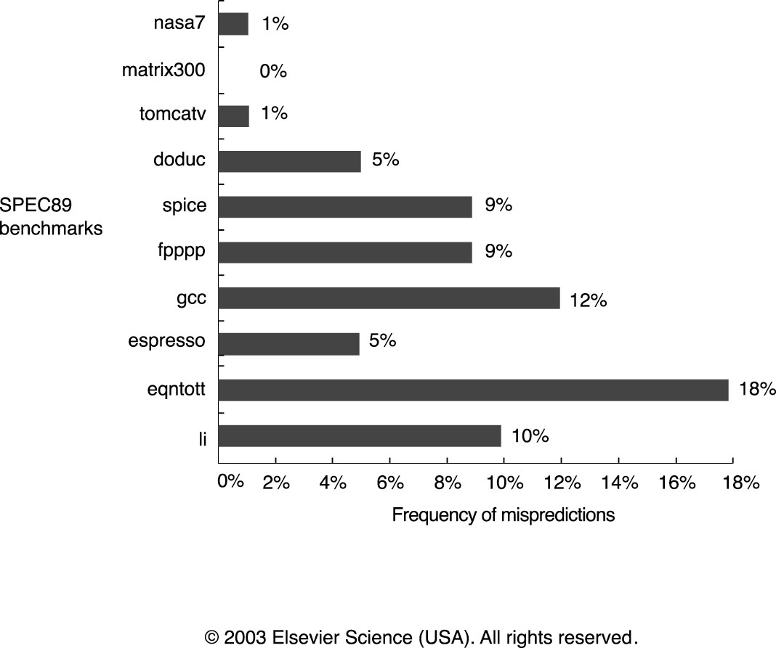
Prediction accuracy of a 4096 entry 2-bit prediction buffer
September 2012

Slide 11
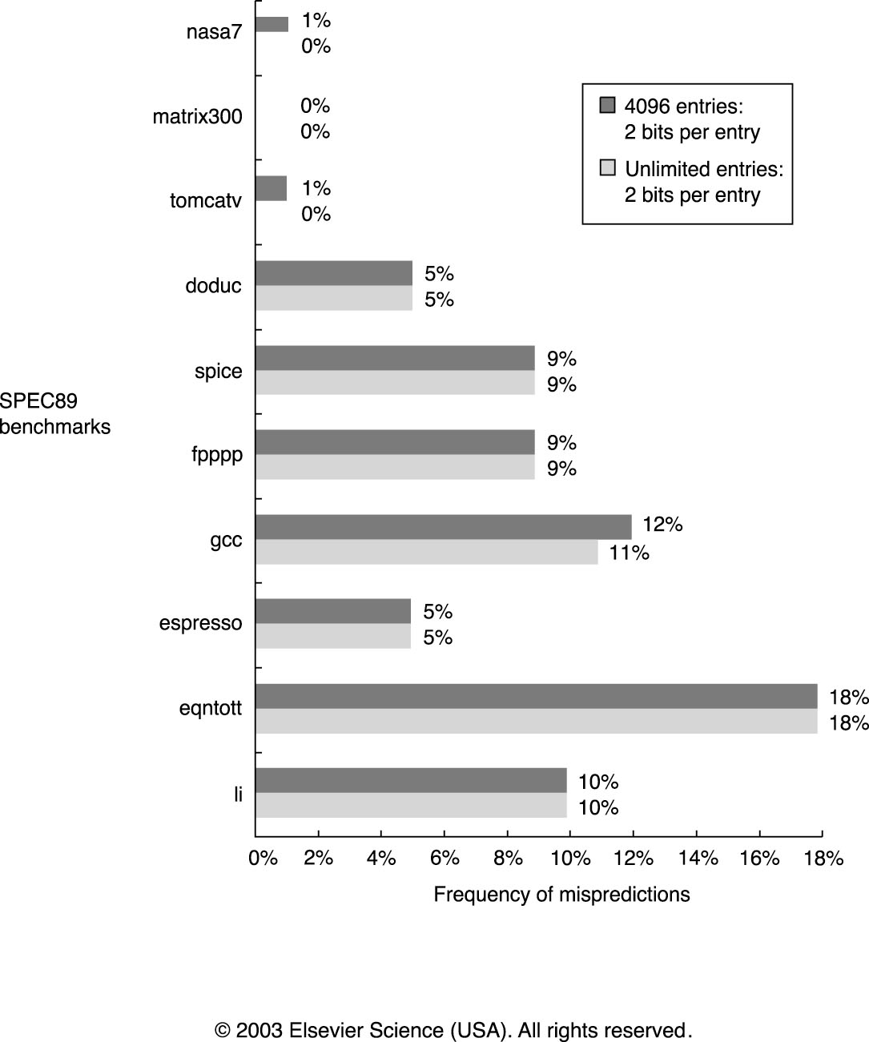
Increasing the size of the buffer does not help much
September 2012

Slide 12
Correlating Branch Predictors
Branch predictions for integer programs are less accurate
These 2 bit schemes use only recent behavior of a single branch to predict the future behavior of that branch
Look at other branches rather that just the branch we are trying to predict
  if (aa==2)
  aa=0;
  if (bb==2)
  bb=0;
  if (aa!=bb){
September 2012

Slide 13
Correlating Branch Predictors
MIPS Code
    DSUBUI R3,R1,#2
    BNEZ R3,L1 ;branch b1(aa!=2)
    DADD R1,R0,R0 ;aa=0
    L1: DSUBUI R3,R2,#2
    BNEZ R3,L2 ;branch b2 (bb!=2)
    DADD R2,R0,R0 ;bb=0
    L2: DSUBU R3,R1,R2
    BEQZ R3,L3 ;branch b3(aa==bb)
  Branch b3 is correlated with branches b1 and b2 – if branches b1 and b2 are both not taken then b3 will be taken since they are equal
September 2012

Slide 14
Correlating Branch Predictors
Branch predictors that use the behavior of other branches to make a prediction are called correlating predictors or two level predictors.
September 2012

Slide 15
Correlating Branch Predictors
Look at the branches with d = 0,1, and 2
if (d==0)
d=1;
if (d==1)
BNEZ R1,L1 ;branch b1 (d!=0)
DADDIU R1,R0,#1 ;d==0, set d=1
L1: DADDIU R3,R1,#-1
BNEZ R3,L2 ;branch b2 (d!=1)
L2;
September 2012

Slide 16
Correlating Branch Predictors
Initial value of d | d==0? | b1 | Value of d before b2 | d==1? | b2
0 | Yes | Not taken | 1 | Yes | Not taken
1 | No | Taken | 1 | Yes | Not taken
2 | No | Taken | 2 | No | Taken
Possible Execution Sequences
If b1 is not taken then b2 will not be taken
A 1 bit predictor initialized does not have the capability to take advantage of this
September 2012

Slide 17
Correlating Branch Predictors
To develop a branch predictor that uses correlation, let every branch have two prediction bits, one prediction assuming the last branch executed was not taken and another prediction bit that is used the the last branch executed was taken.
The last branch executed is usually not the same instruction as the branch being predicted, although this can occur.
September 2012

Slide 18
1-Bit Correlation Prediction
Prediction Bits | Prediction if last branch not taken | Prediction if last branch taken
NT/NT | NT | NT
NT/T | NT | T
T/NT | T | NT
T/T | T | T
This is a 1,1 predictor since it uses the behavior of the last branch to choose from among a pair of 1-bit branch predictors
An (m,n) predictor uses the last m branches to choose from 2^{m} branch predictors, each of which is an n bit predictor for a single branch
September 2012

Slide 19
(m,n) Predictors
Can yield higher prediction rates than the 2 bit scheme and requires only a small amount of additional hardware We can record the global history of the most recent m branches in an m bit shift register, where each bit records whether the branch was taken or not taken
The branch prediction buffer can be indexed by using a concatenation of the low order bits from the branch address with the m bit global history. That is the address indexes a row in the prediction buffer and the global buffer chooses among them.
September 2012

Slide 20
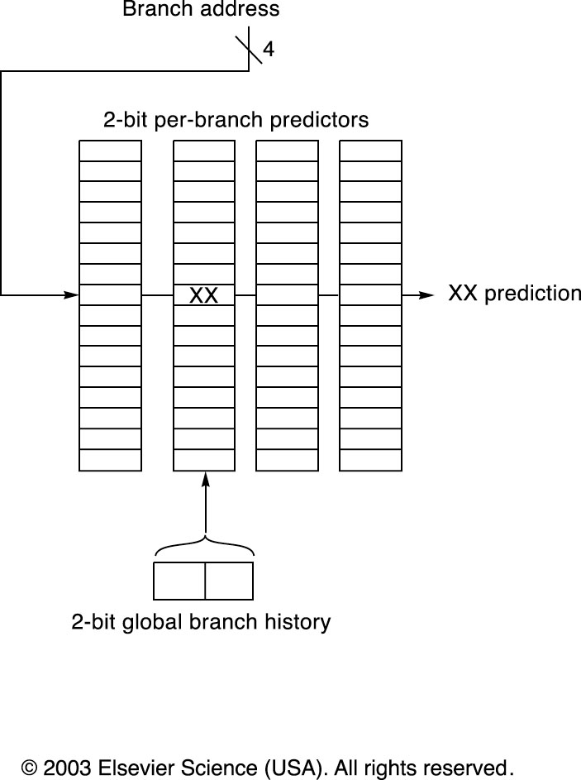
Fig 14
September 2012

Slide 21
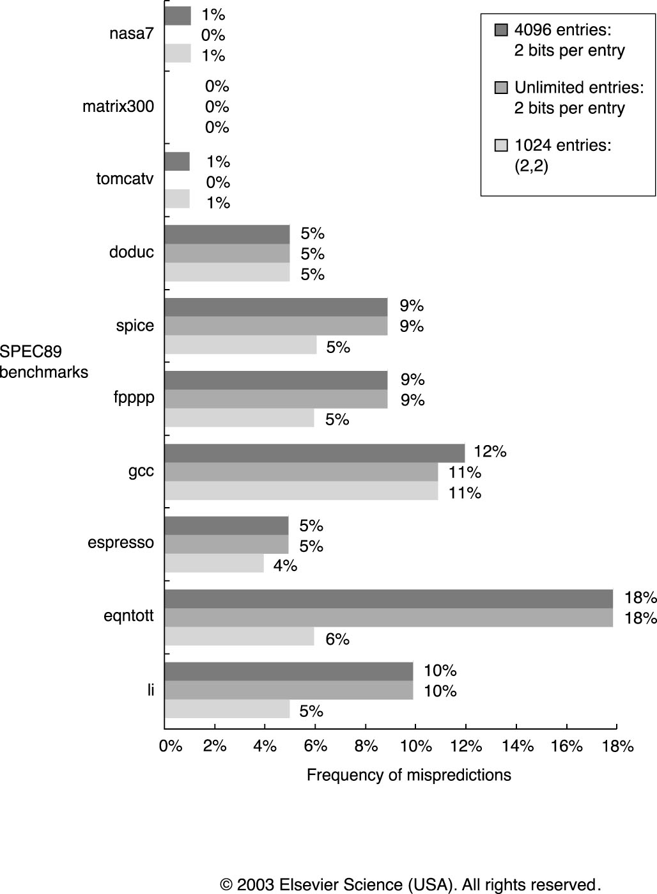
Comparison of Predictors – First is non-correlating for 4096 entries, followed by a non-correlating 2 bit predictor with unlimited entries and finally a 2 bit predictor with 2 bits of global history and 1024 entries
September 2012

Slide 22
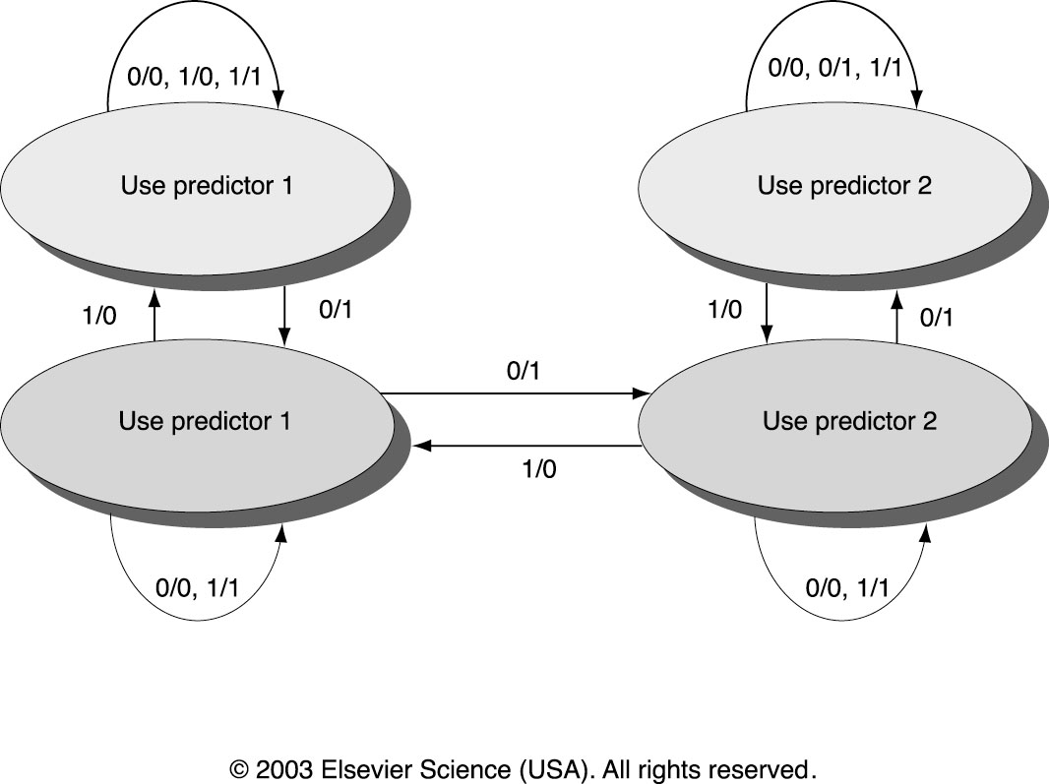
Tournament Predictor for the Alpha 21264
September 2012

Slide 23
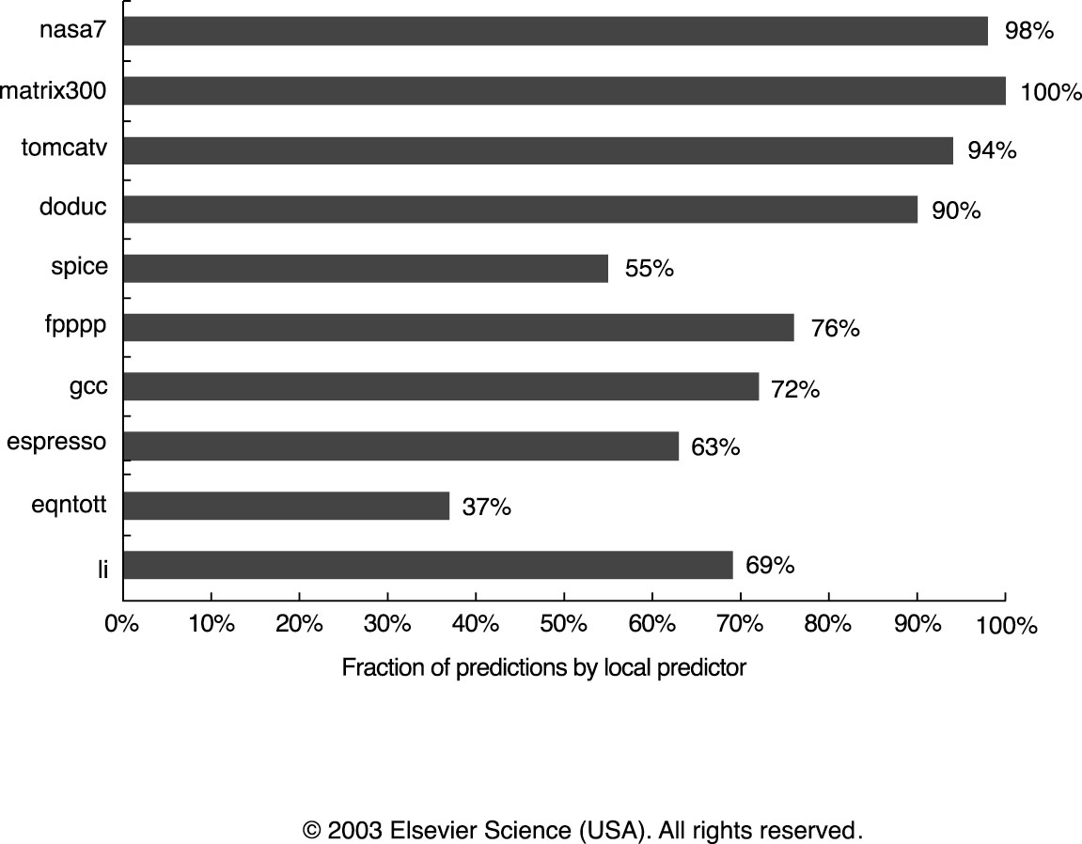
Fraction of Predictions Coming from the Local Predictor for a Tournament Predictor using SPEC89 Benchmarks
September 2012

Slide 24
Branch Target Buffers
(Advanced Technique for Instruction Delivery)
Reduce penalty in our 5 stage pipeline
  Determine next instruction address to fetch by the end of IF
    We must know whether an instruction (not yet decoded) is a branch and, if so what the next PC should be
    If at the end of IF we know the instruction is a branch and we know what the next PC should be, we have zero penalty
  A branch prediction cache that stores the predicted address for the next instruction after a branch is called a branch target buffer or branch target cache
  For the classic 5 stage pipeline, a branch prediction buffer is accessed during the ID cycle. At the end of ID we know the branch target address (computed in ID), the fall through address (computed during IF), and the prediction
September 2012

Slide 25
Branch Target Buffers
Reduce penalty in our 5 stage pipeline (continued)
  Thus by the end of ID we know enough to fetch the next predicted instruction.
  For a branch target buffer, we access the buffer during the IF stage using the instruction address of the fetched instruction (a possible branch) to index the buffer
  If we get a hit, then we know the predicted instruction address at the end of the IF cycle, which is one cycle earlier than for the branch prediction buffer
  This address is predicted and will be sent out before decoding the instruction. It must be known whether the fetched instruction is predicted as a taken branch
September 2012

Slide 26
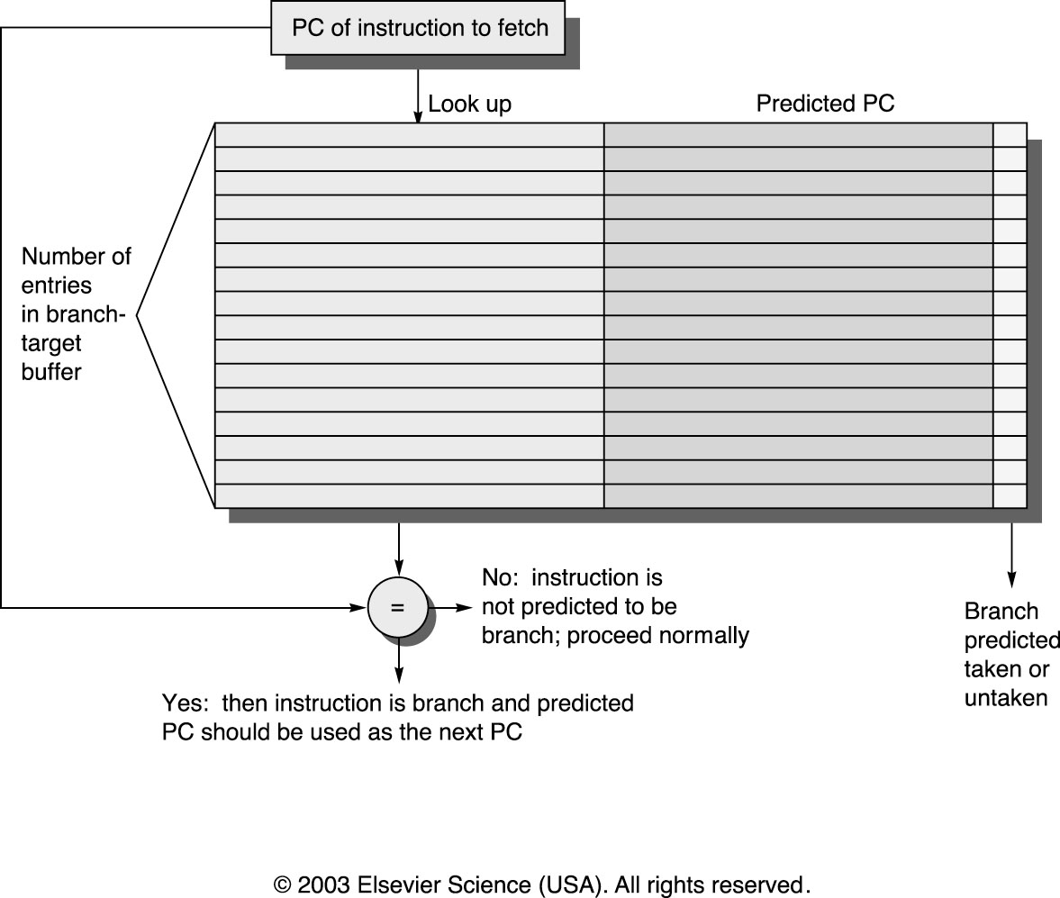
Fig 3.21 A Branch Target Buffer – The PC of the instruction being fetched is matched against a set of instruction addresses stored in the first column; which represent the addresses of known branches. If the PC matches one of these entries, then the instruction being fetched is a taken branch, and the second field, predicted PC, contains the prediction for the next PC after the branch. Fetching immediately begins at that address.
September 2012

Slide 27
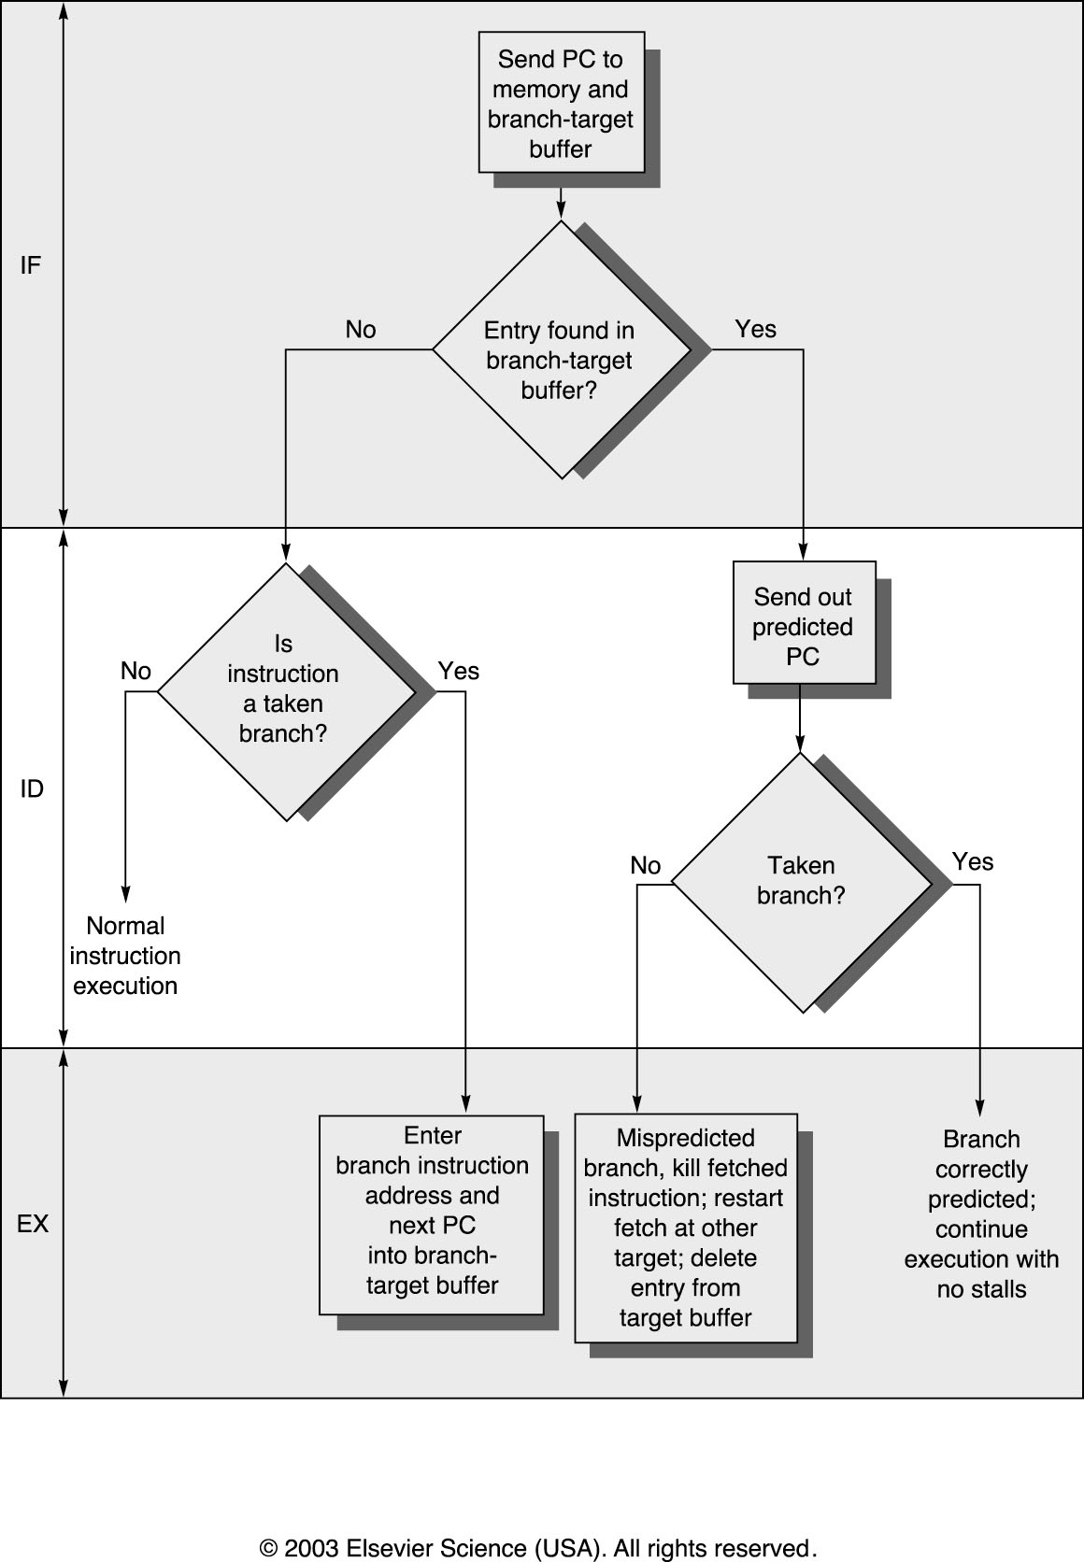
Fig 3.22 Steps Involve In Handling an Instruction with a Branch Target Buffer
September 2012

